Slide 1
Induction Evening
Welcome to Moon Class!
Mrs Reeve
Notes:
What a day looks like in September
Daily routines
Things we need them to have when they come e.g. wellies, waterproof coats
Contact with them and with us (on the gate, emails, phone calls)
Leaving them at the gate, self-regulation
Home visits and Nursery visits are so important and useful for settling and creating a big picture of the children
Characteristics of effective learning of how children learn underpin everything!!!
Classroom tour – Star tour with more general information then Moon tour characteristics with outdoor tour too

Slide 2
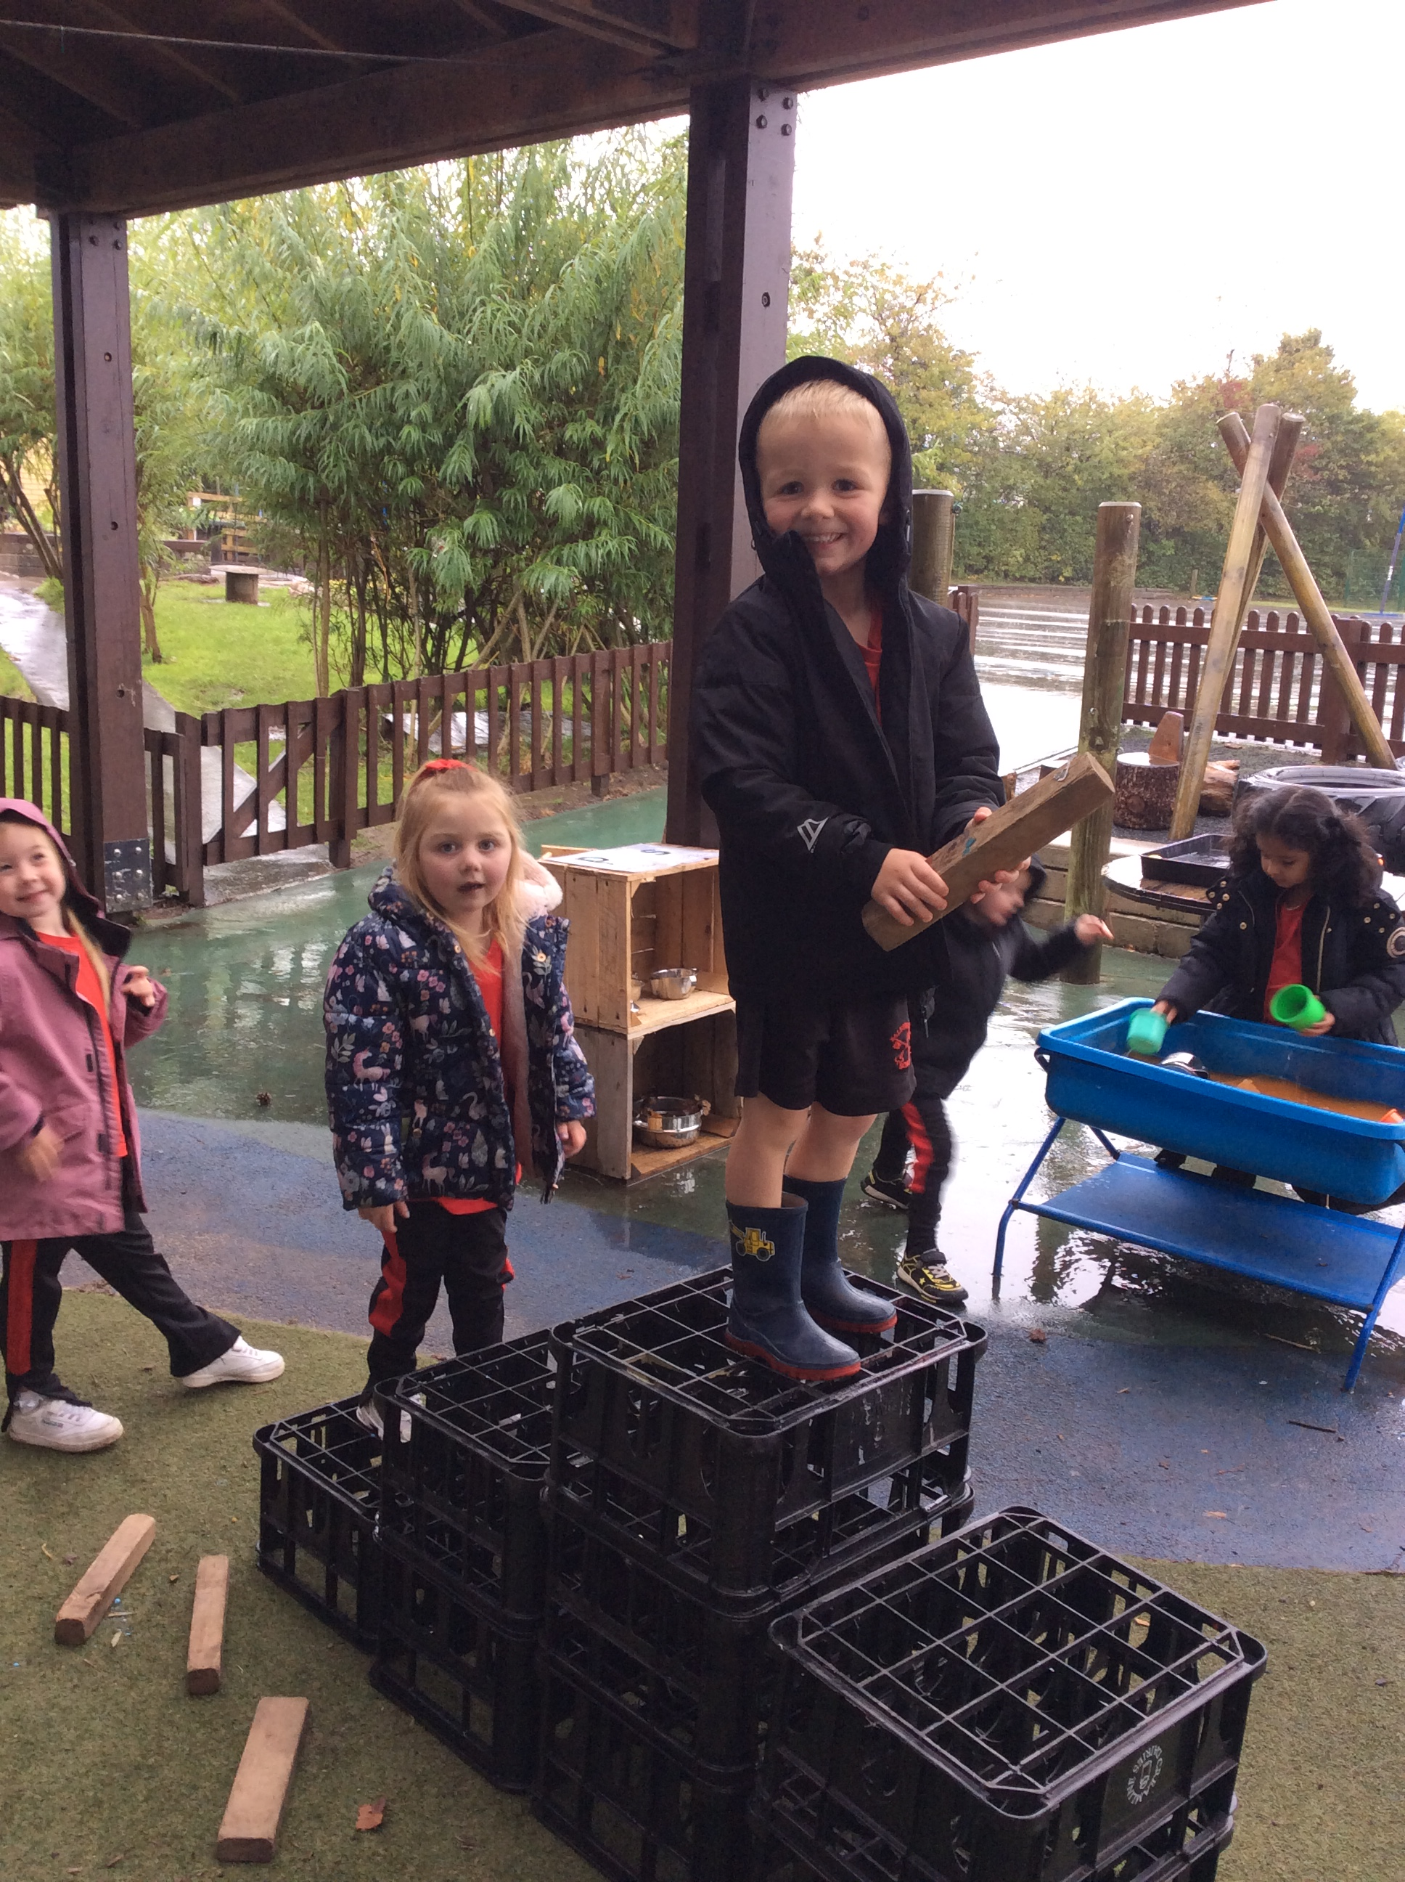
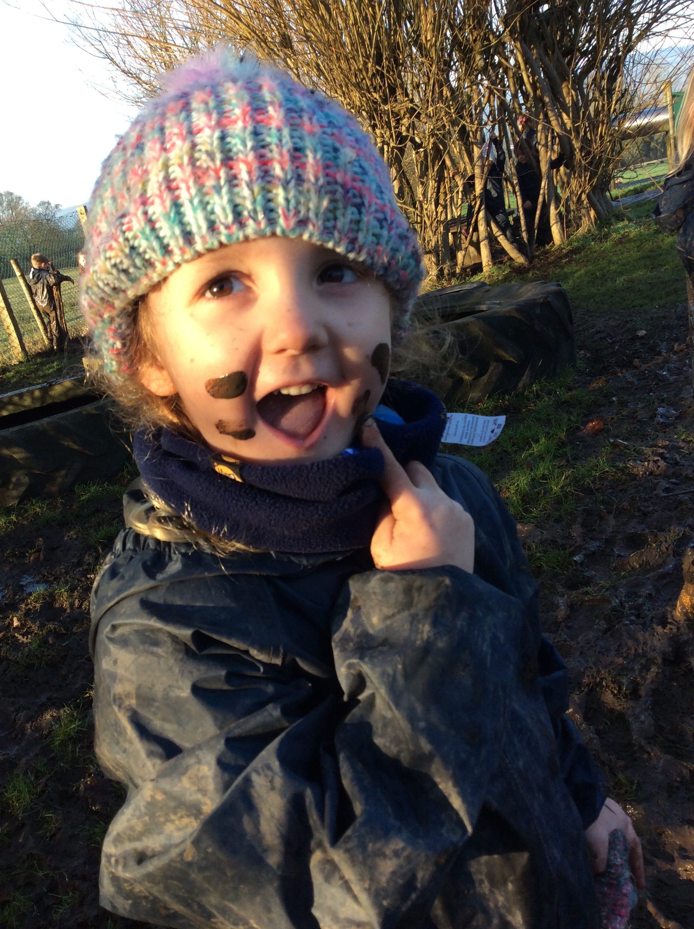
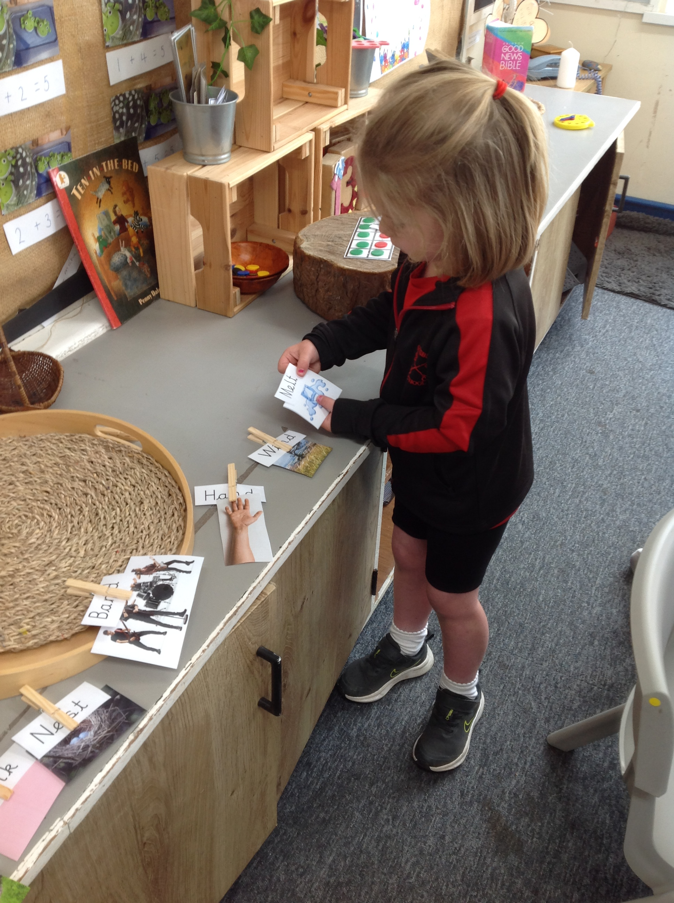
Daily Routines
Work as a close unit with Star Class
Miss Cummins takes Reception children for Forest School
Teaching Assistants support across both classes
All Reception children (Moon and Star) will have access to the same provision, units of work & learning opportunities
After initial teaching input has been delivered, children can mix across both classrooms and outdoors with all Reception children and the Year 1 children from Moon class

Slide 3
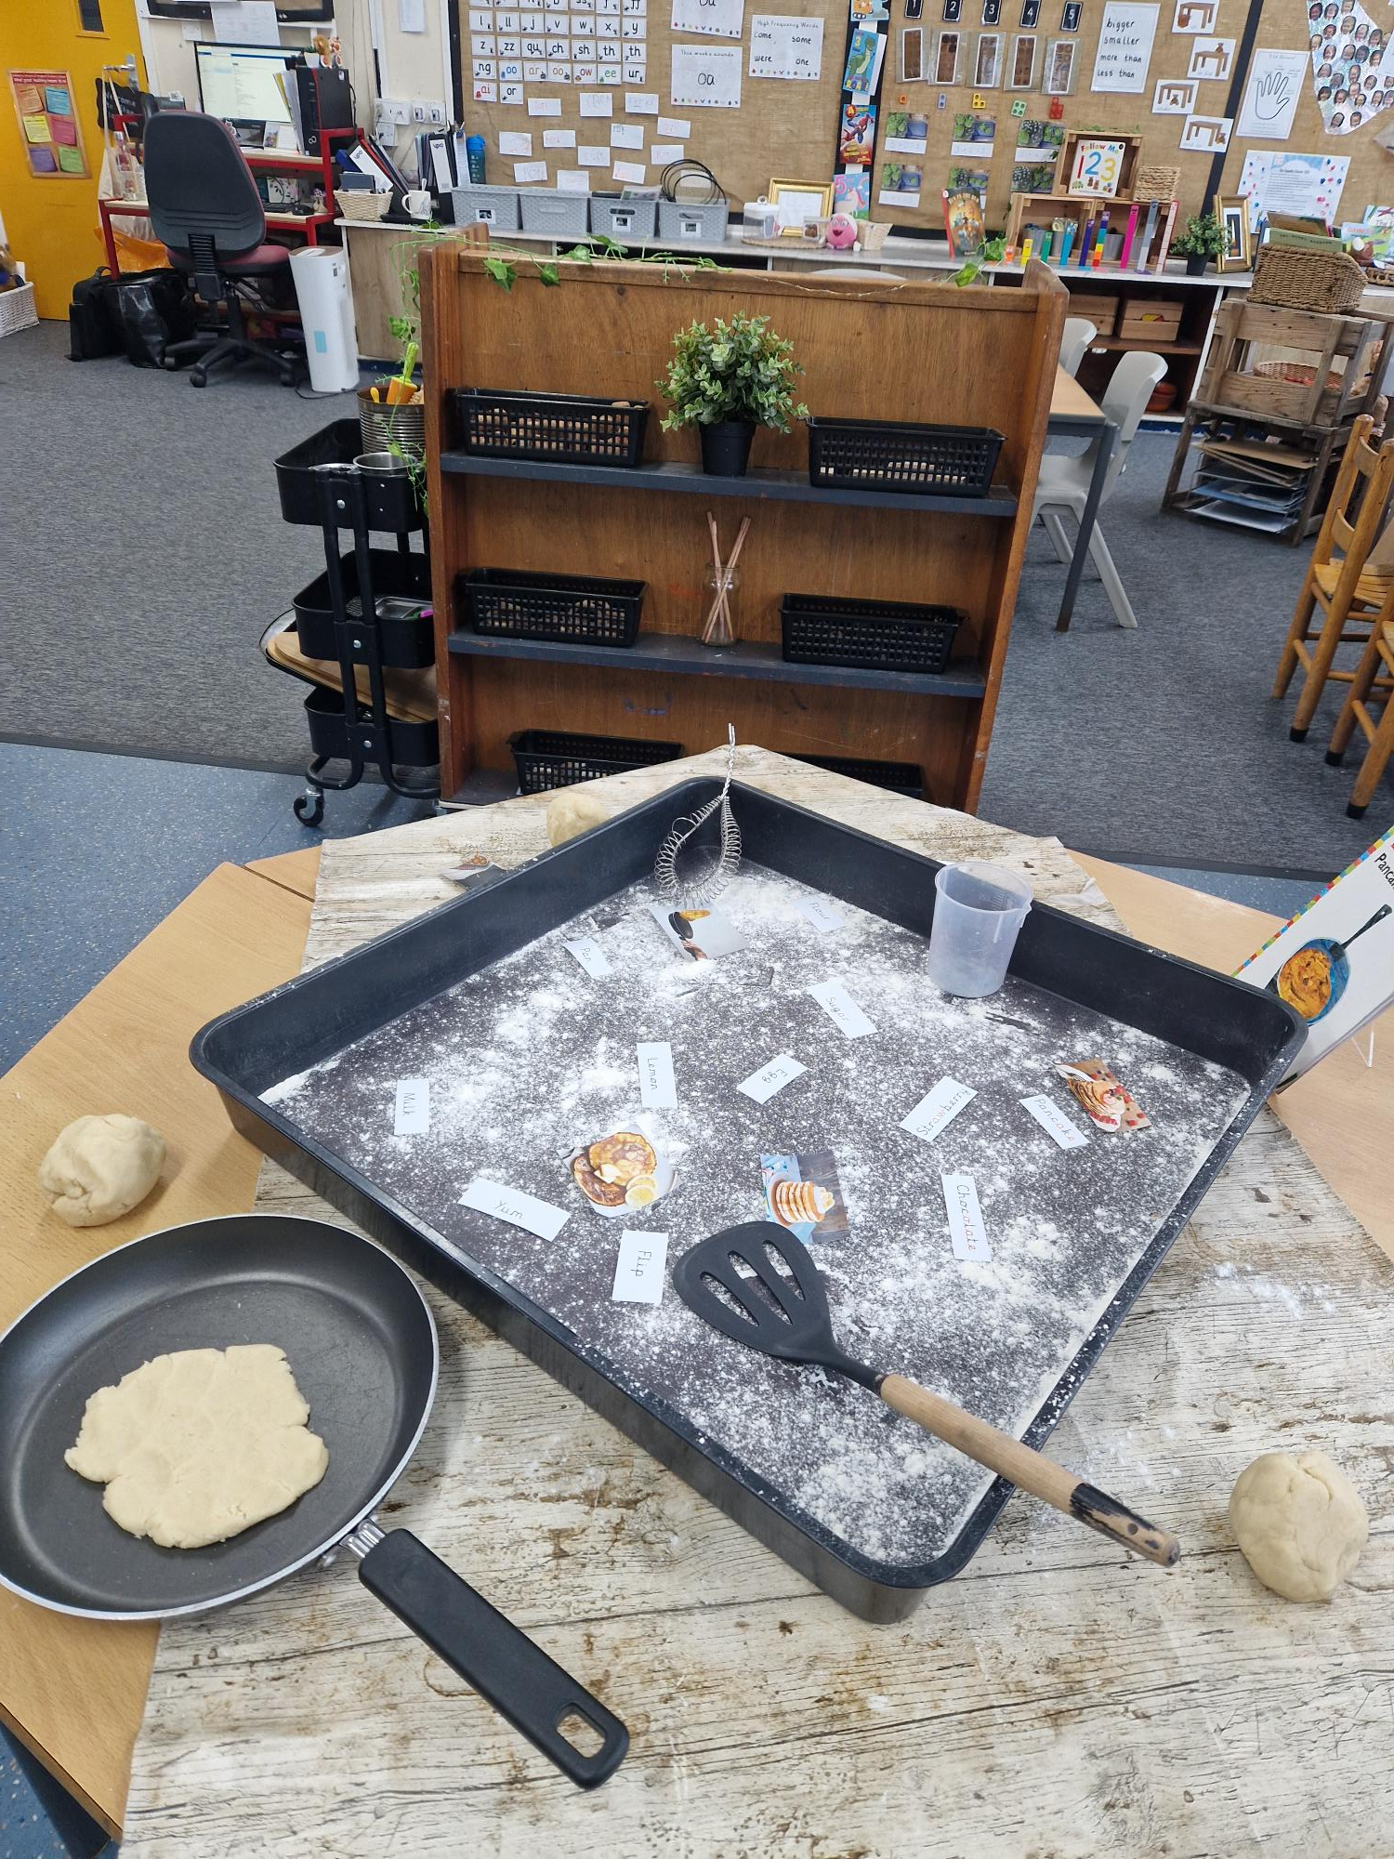
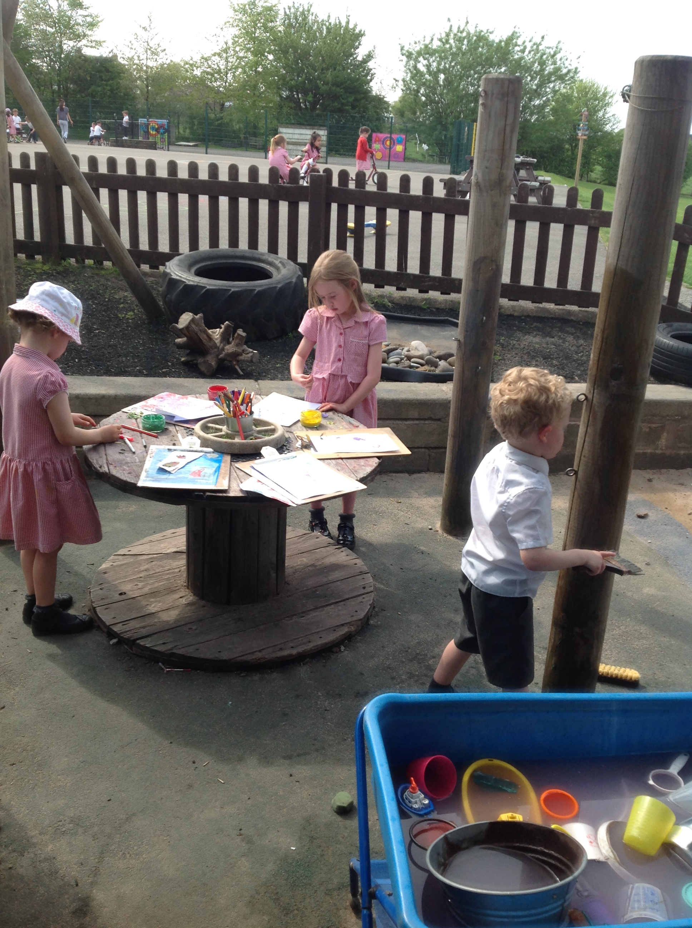
What a morning looks like
Please refer to the letter received for start dates and times
Drop off at the main gate
Children are supported to put their belongings away and
get busy in the classroom
Register and welcome gathering
Worship (to join after a few weeks)
Daily phonics lesson
Access provision, learning through play, with adult-led activities teaching Maths and English

Slide 4
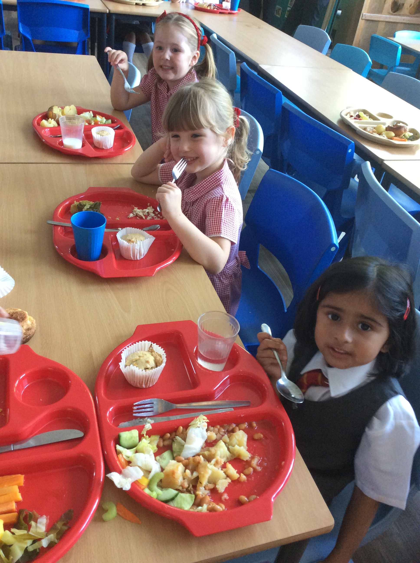
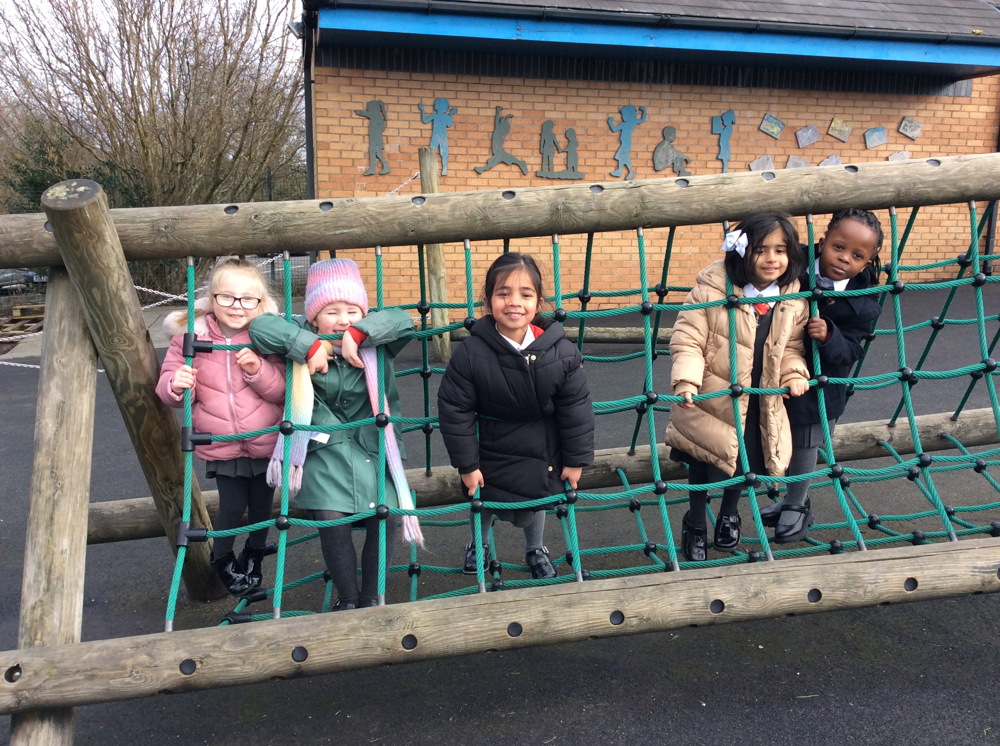
Lunch time
Singing, story or news time whilst getting ready for lunch
Lunch in the hall (family style sittings)
Outside to play
Lunchtimes supported by Teaching Assistants
Peer massage every day after lunch
Notes:
Drop off at the gate
Registration task
Register
Worship after a few weeks
Phonics
Provision with guided adult inputs in Maths or English
Singing or Story
Lunch
Play outside
Peer massage
Provision
Outdoor explorers or jubilee garden
Story
Home time

Slide 5
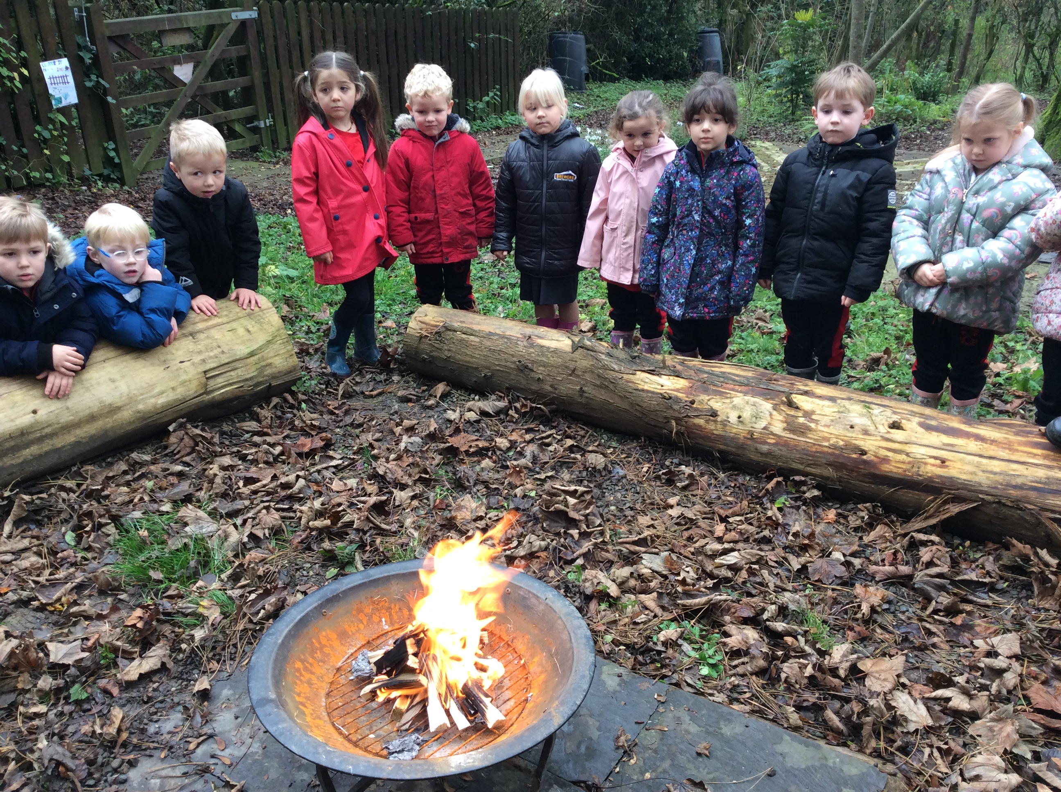
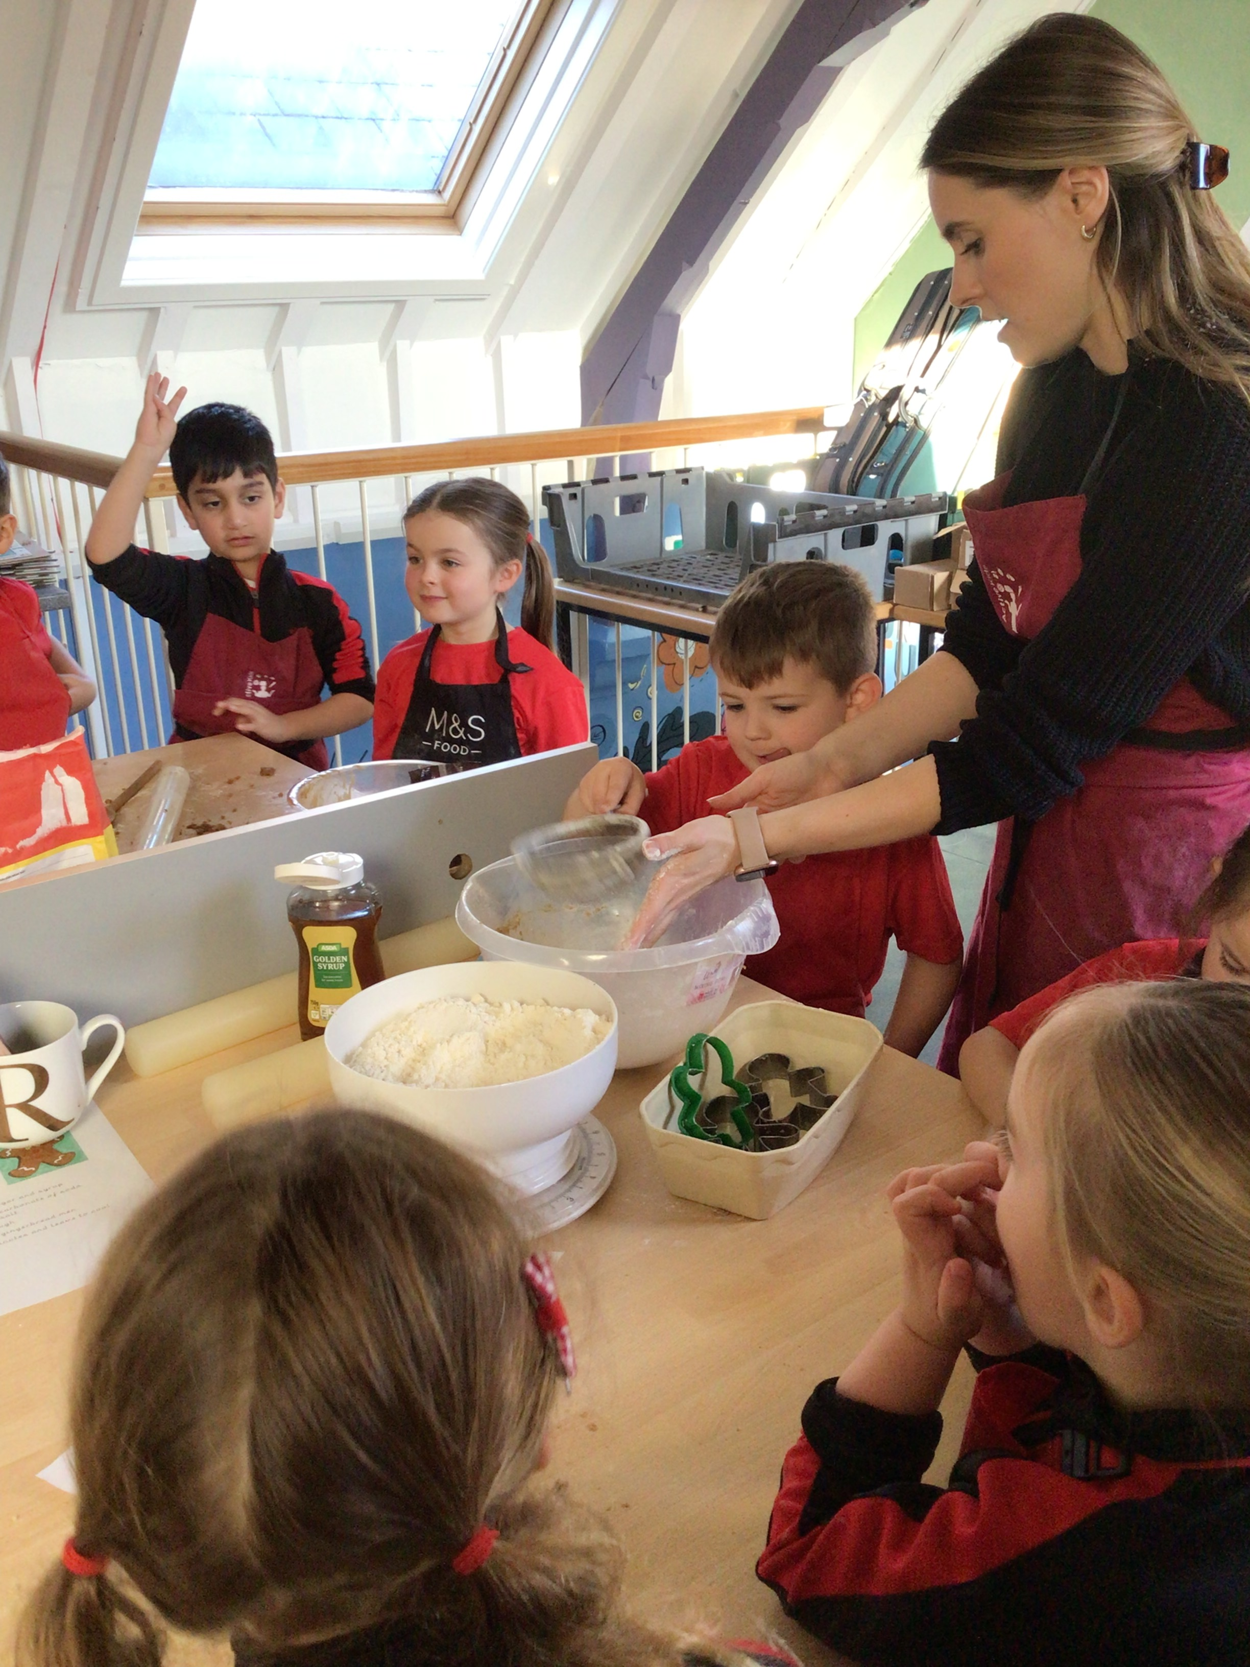
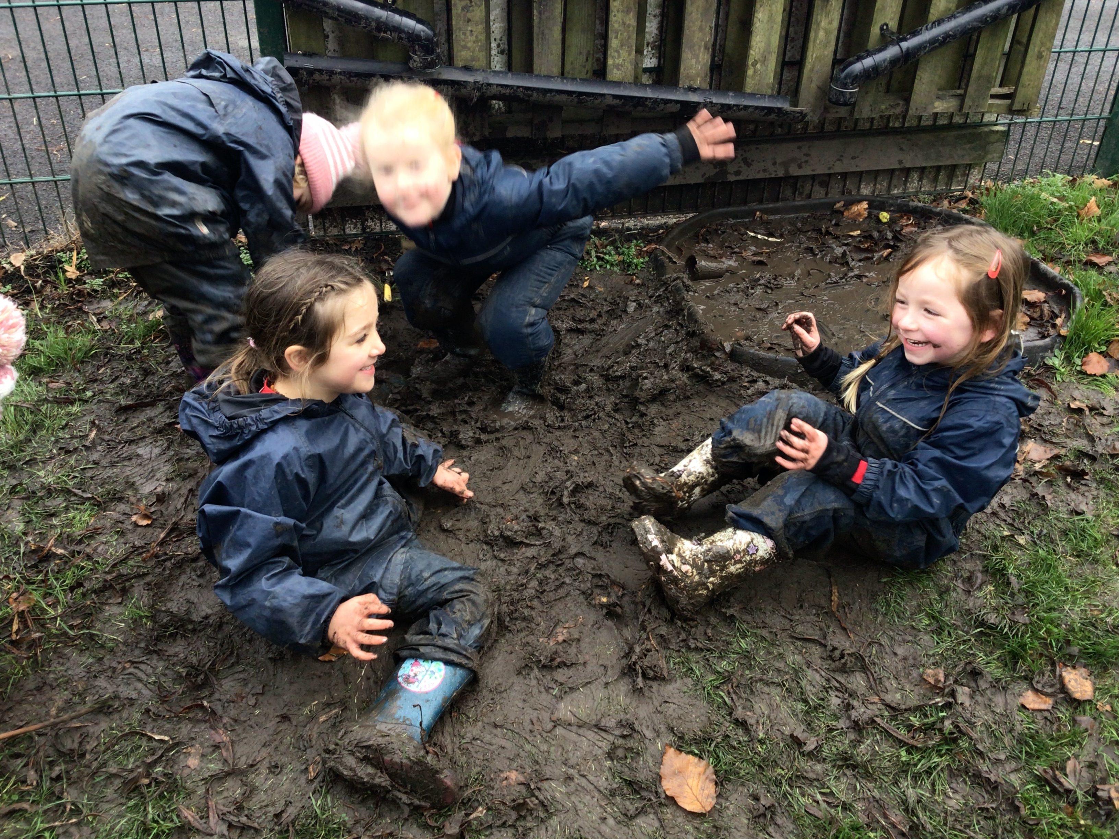
What an afternoon looks like
Adult-led inputs covering wider curriculum learning areas
Provision across both classrooms and outdoor area shared with Nursery
Forest school
Visits to the Jubilee Garden
PE
Notes:
Drop off at the gate
Registration task
Register
Worship after a few weeks
Phonics
Provision with guided adult inputs in Maths or English
Singing or Story
Lunch
Play outside
Peer massage
Provision
Outdoor explorers or jubilee garden
Story
Home time

Slide 6
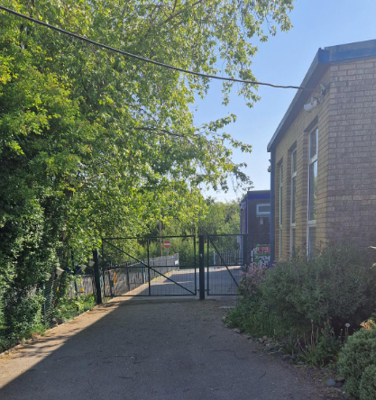
End of the day
Children are supported to get ready for home time and find their belongings
Share a story and say our school prayer every day before home time
Home time collection from gate at 3.30pm (3.15pm for the
first 2 weeks)
Please come forward to collect your child- come through gate and
we cannot release children into the carpark
Notes:
Drop off at the gate
Registration task
Register
Worship after a few weeks
Phonics
Provision with guided adult inputs in Maths or English
Singing or Story
Lunch
Play outside
Peer massage
Provision
Outdoor explorers or jubilee garden
Story
Home time

Slide 7
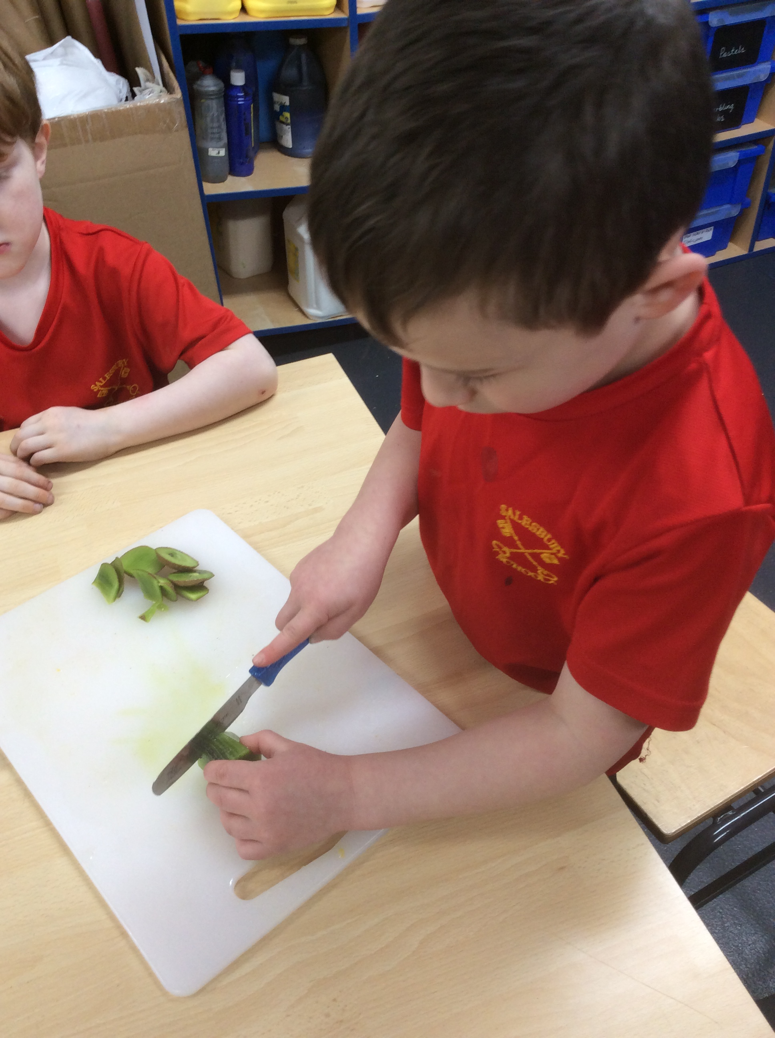
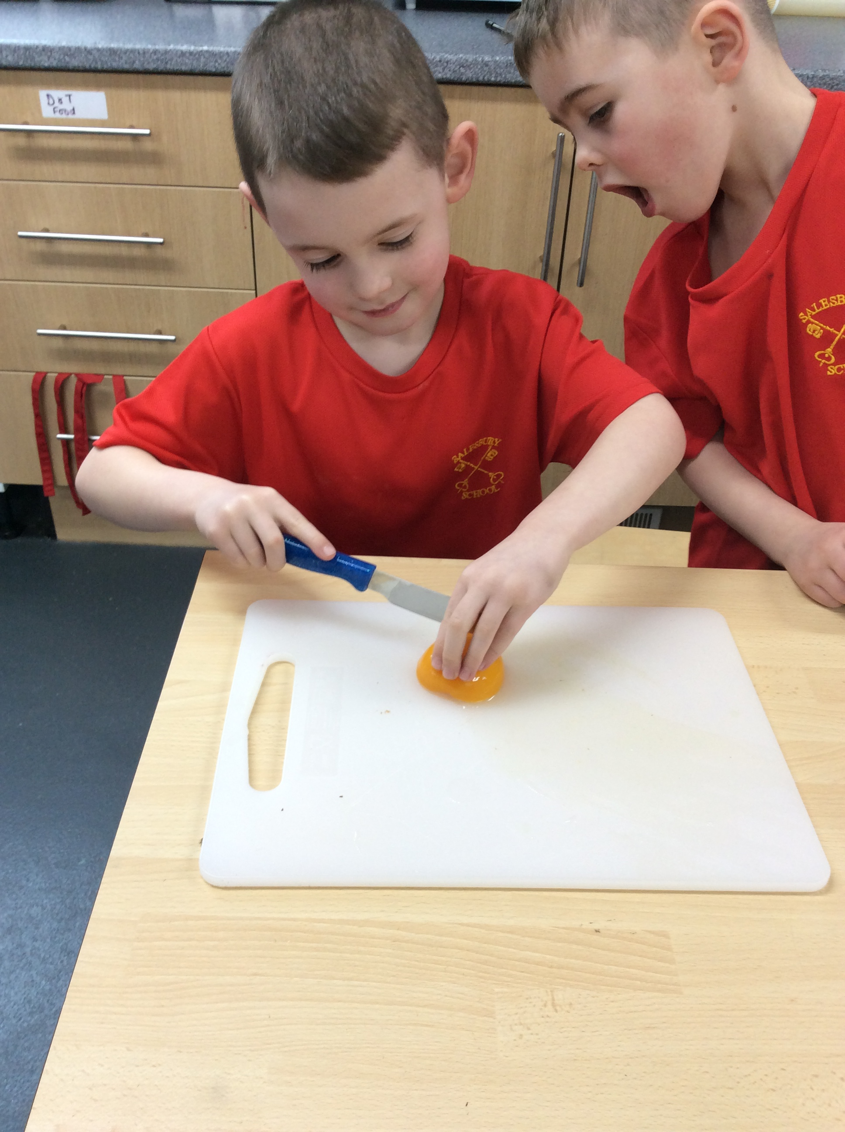
Snack
Structured snack time every day (fruit and vegetables)
Please see the leaflet about milk in your induction pack
We encourage children to help prepare snack

Slide 8
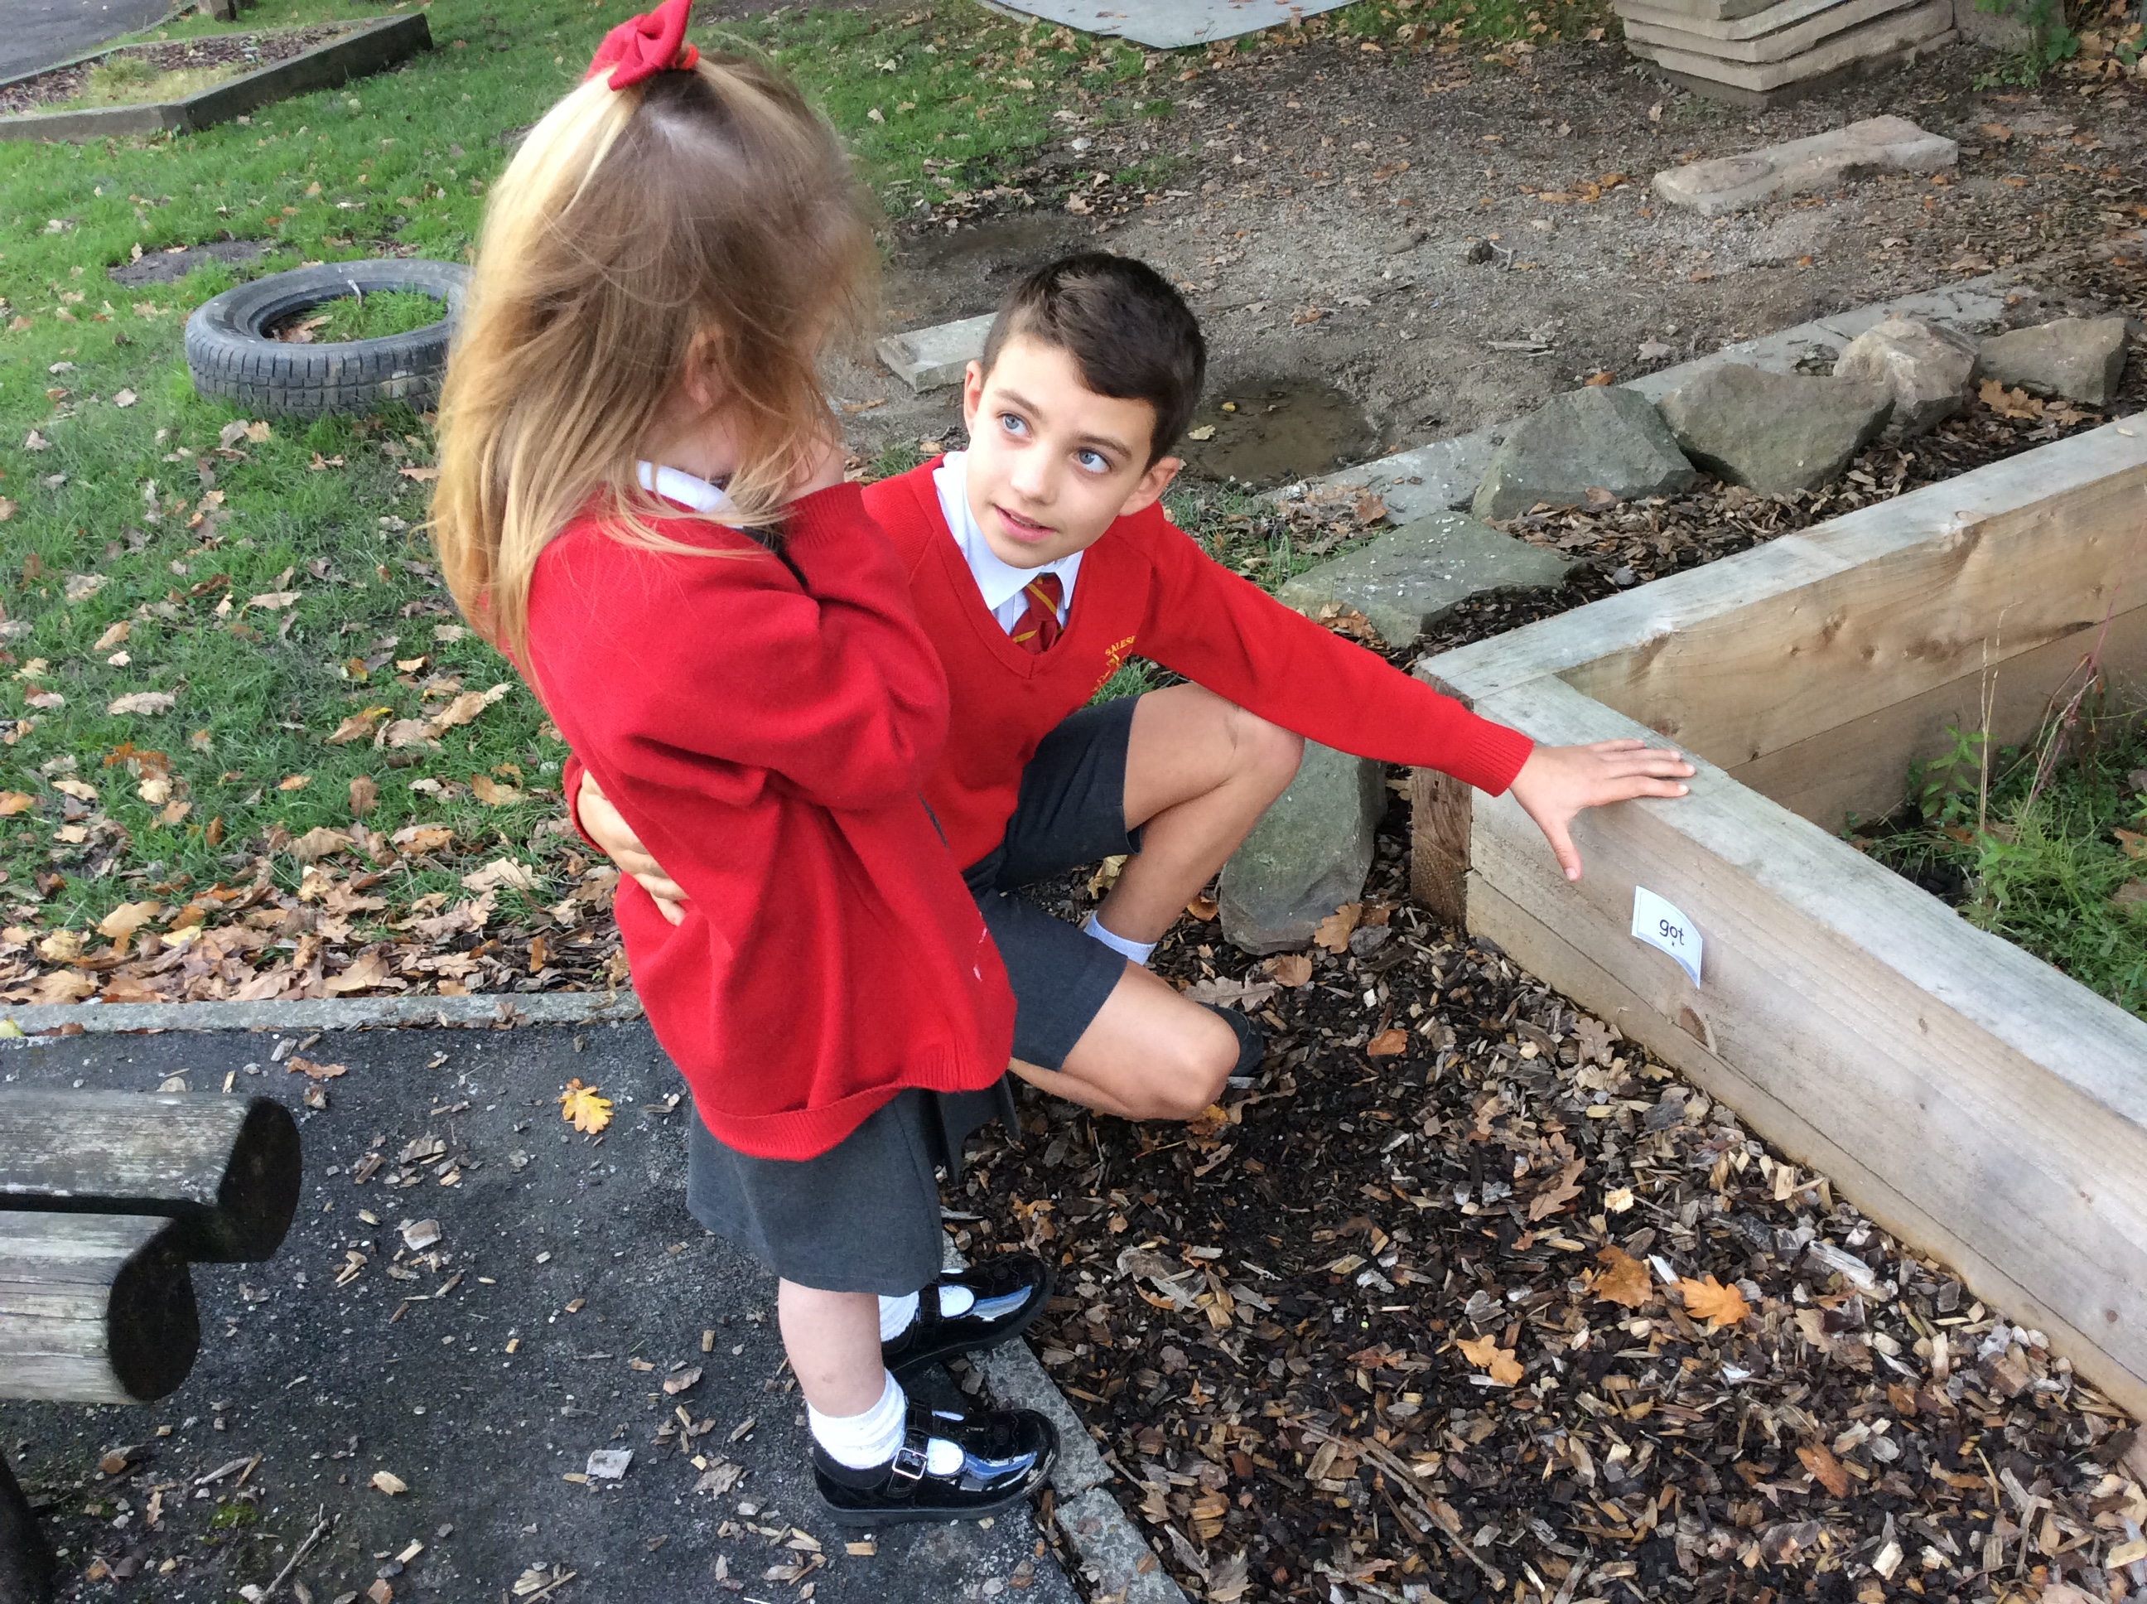
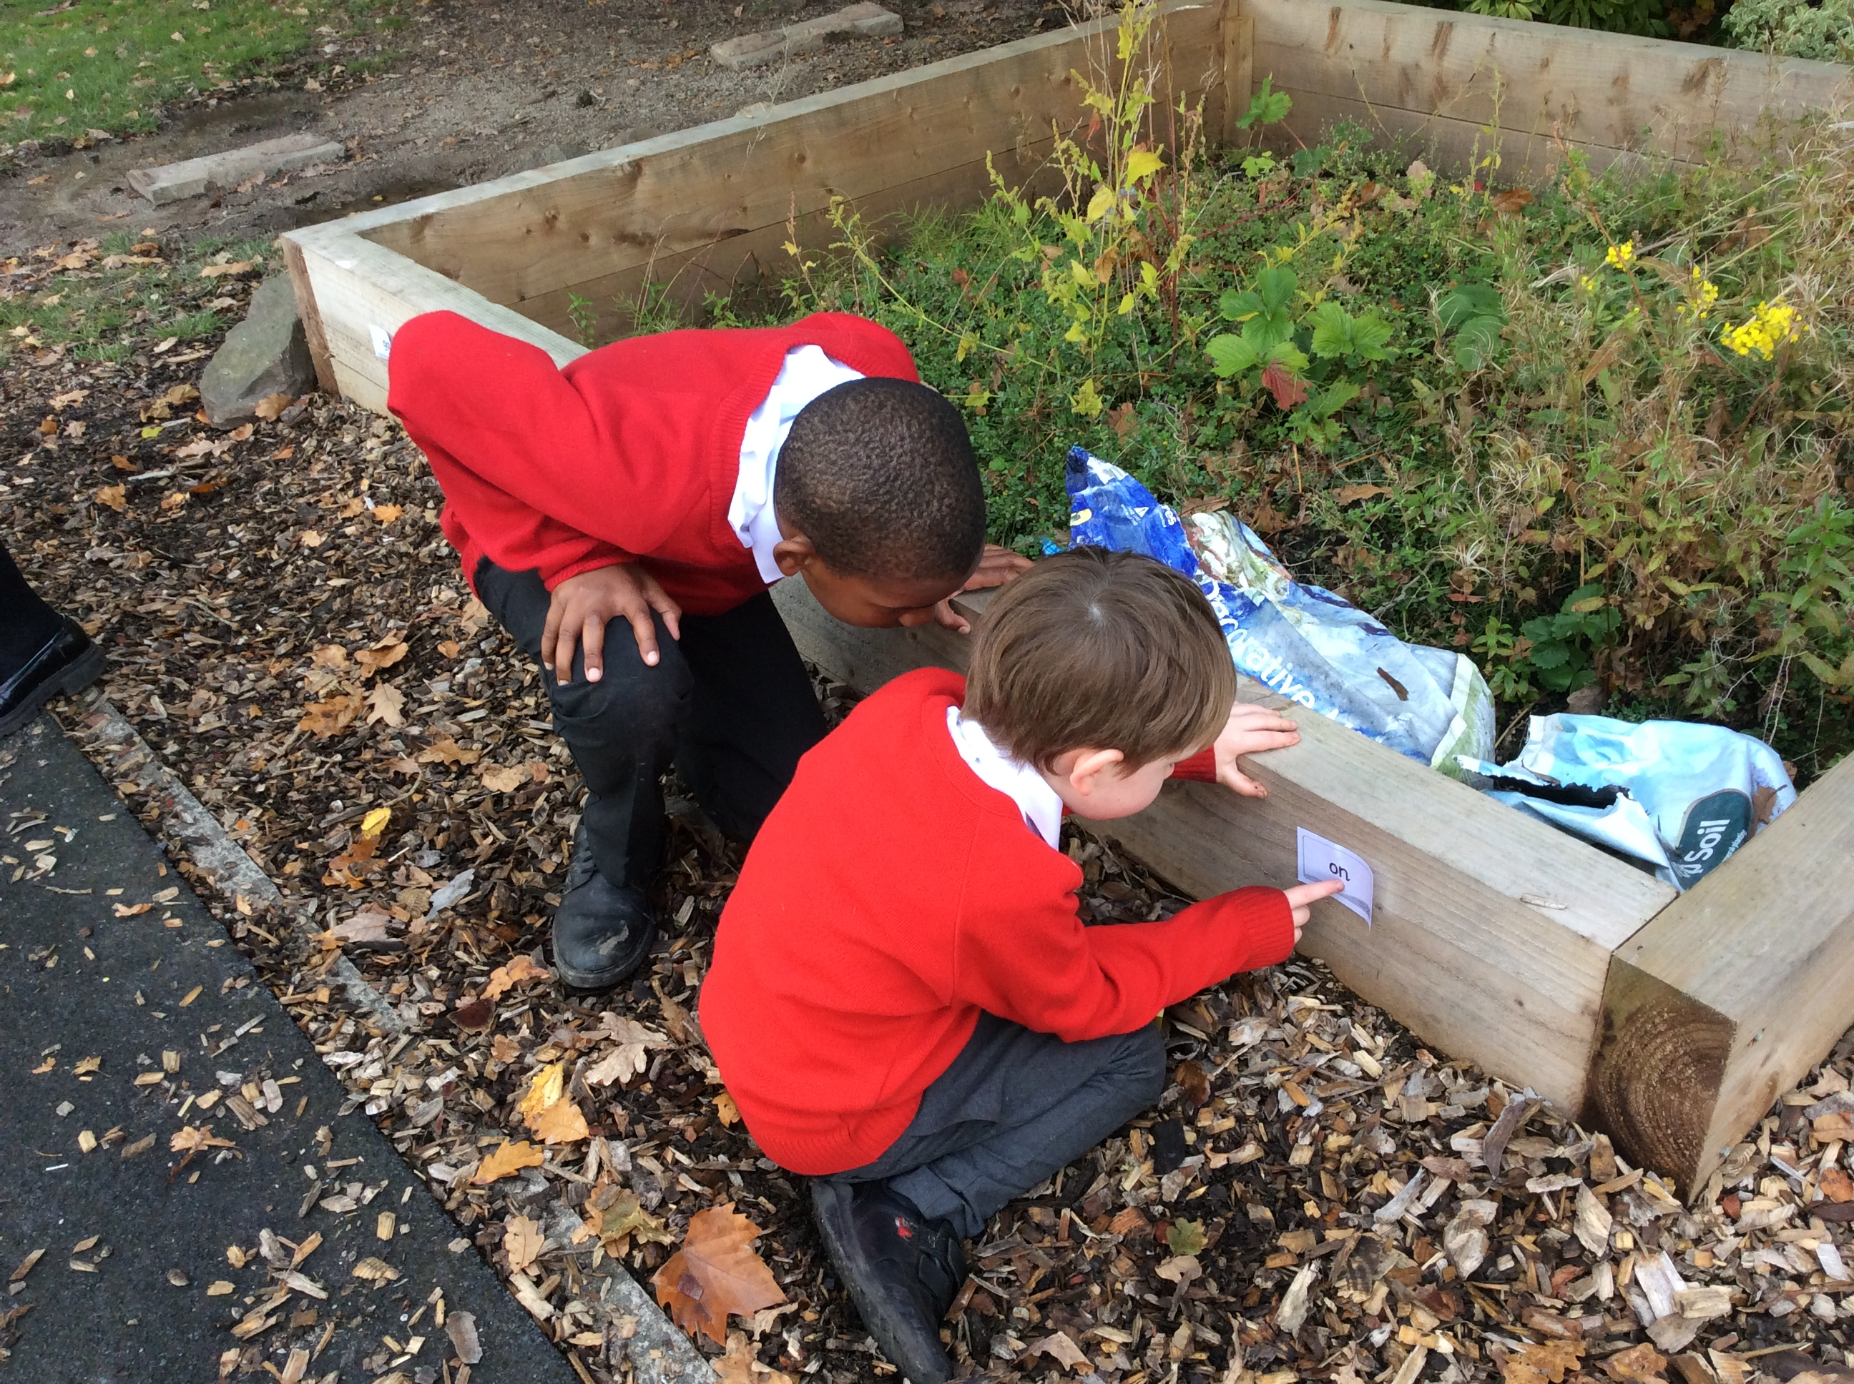
Buddies
Support during transition and in their Reception year
Teddy Bears Picnic
Weekly buddies sessions throughout the year
Notes:
Drop off at the gate
Registration task
Register
Worship after a few weeks
Phonics
Provision with guided adult inputs in Maths or English
Singing or Story
Lunch
Play outside
Peer massage
Provision
Outdoor explorers or jubilee garden
Story
Home time

Slide 9
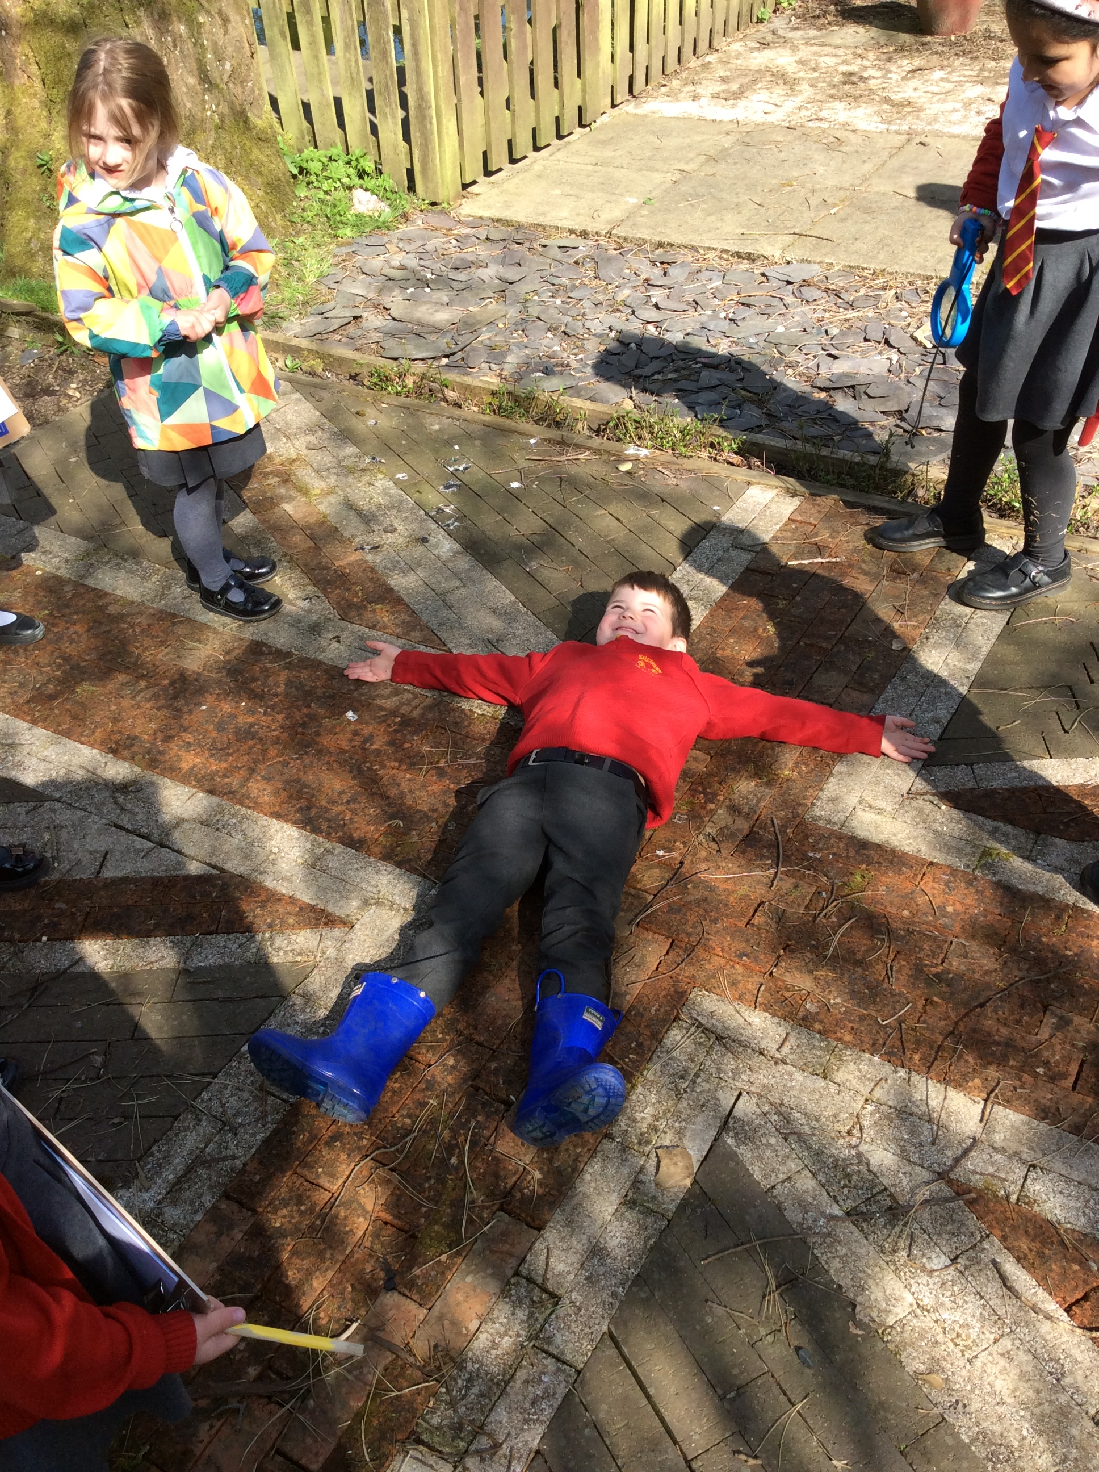
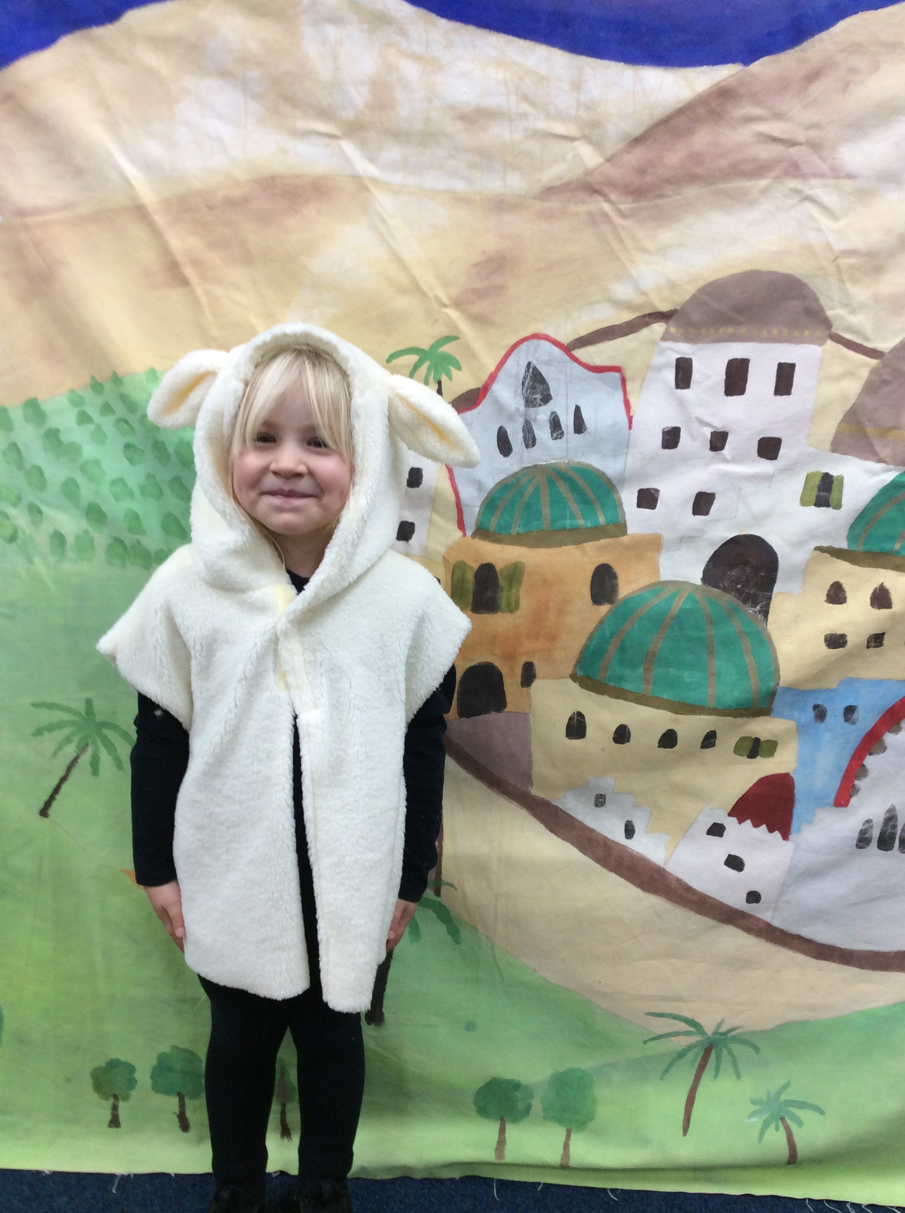
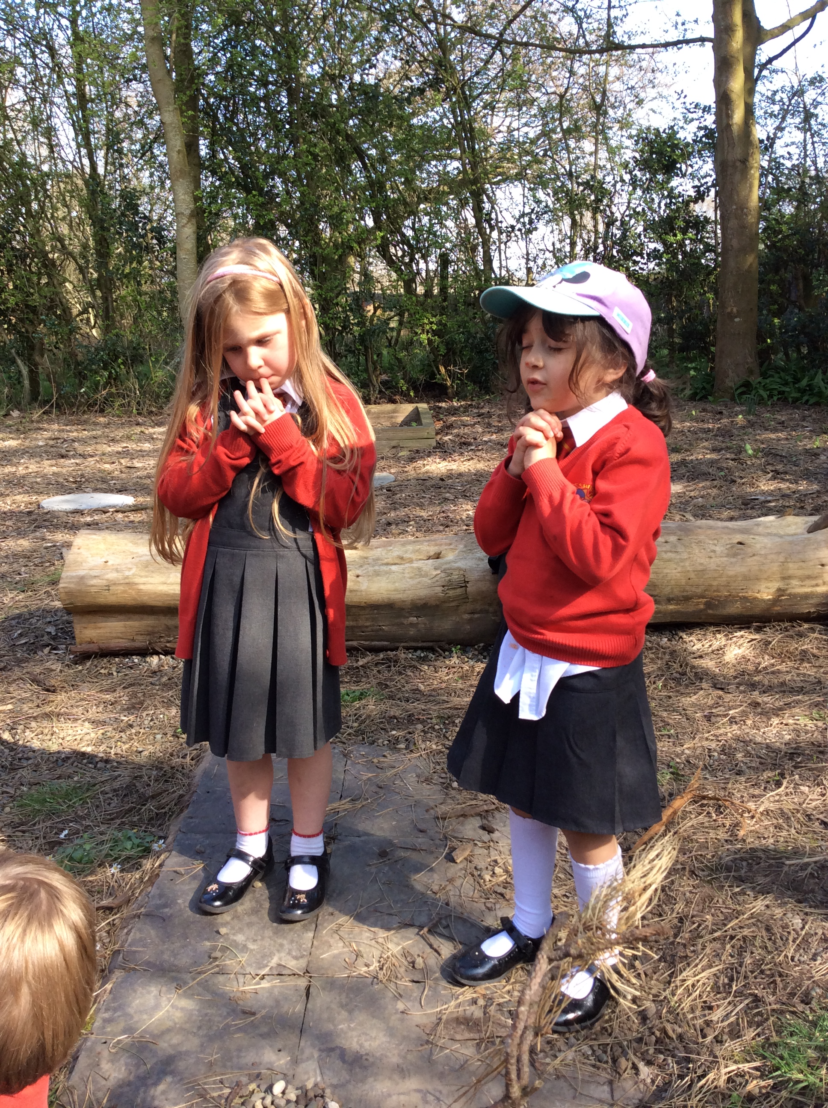
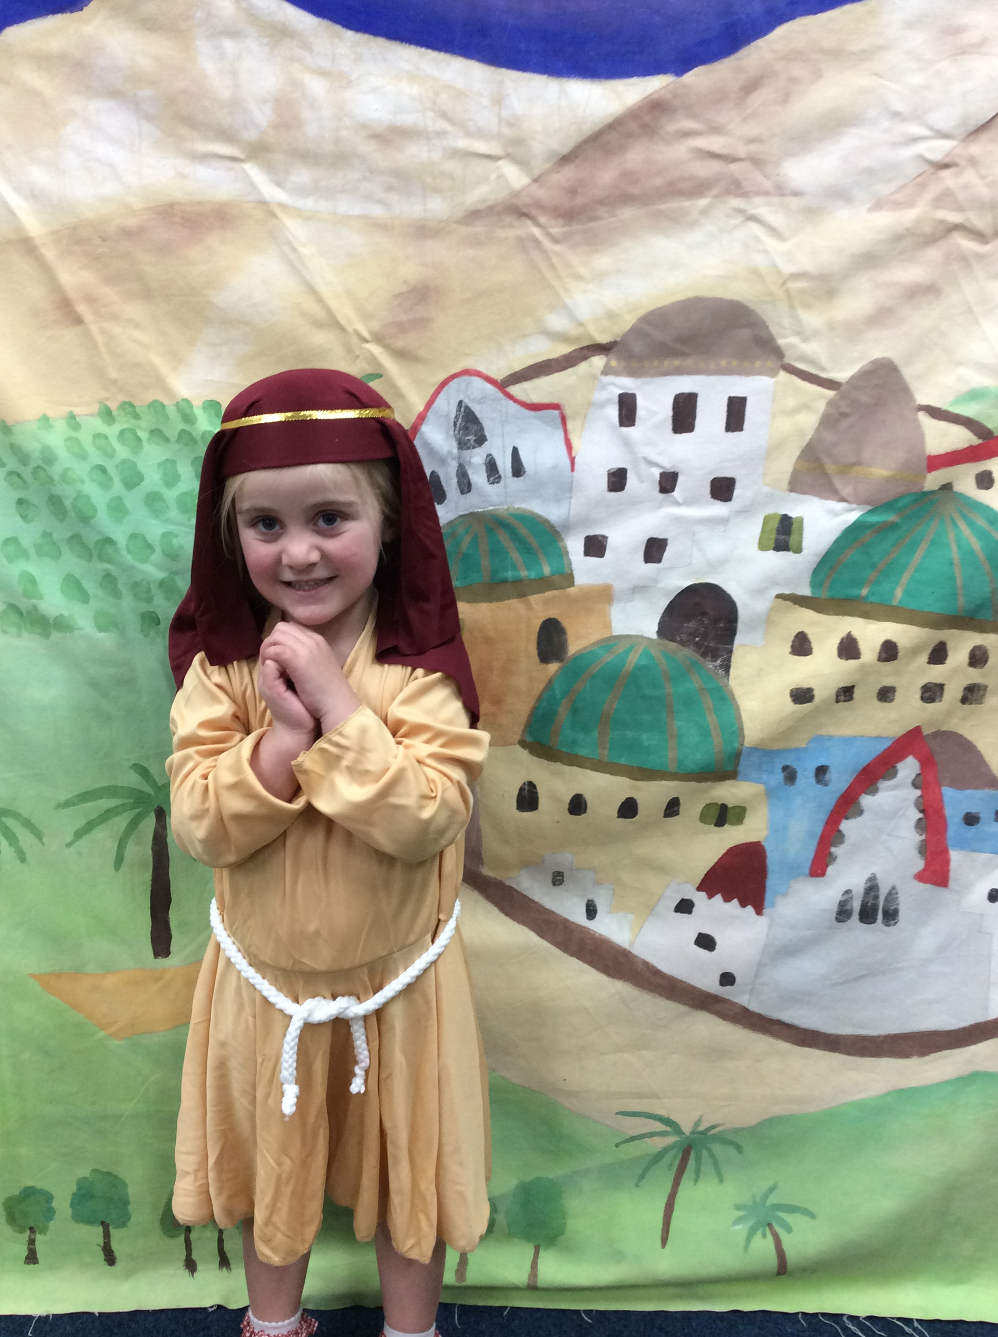
Church and School together
Worship as a whole school weekly in Church
Nativity performed in Church
Special services (Harvest, Christmas, Easter, end of year)
Daily prayers (end of day and before lunch)
Reflection areas in each classroom

Slide 10
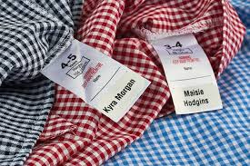
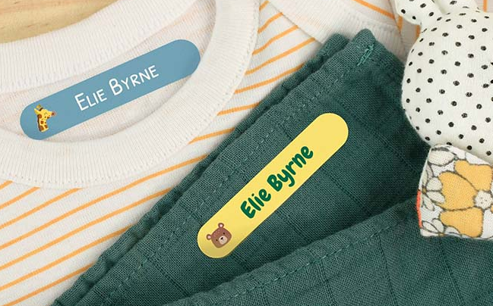
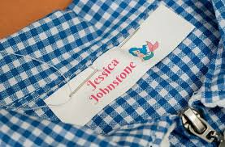
What children need
Waterproof coat every day
Wellies to be kept in school
Slippers with a hard sole to be kept in school
Named water bottle
Spare clothes in case of accidents & forest school
Please put names in EVERYTHING!

Slide 11
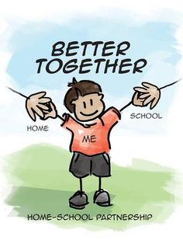
Communication
On the gate
Emails
Phone calls
Facebook Page
School Website
Termly report
Termly parent’s evening
Learning Together- more details to follow in the Autumn Term
reeve@salesbury.lancs.sch.uk cummins@salesbury.lancs.sch.uk

Slide 12
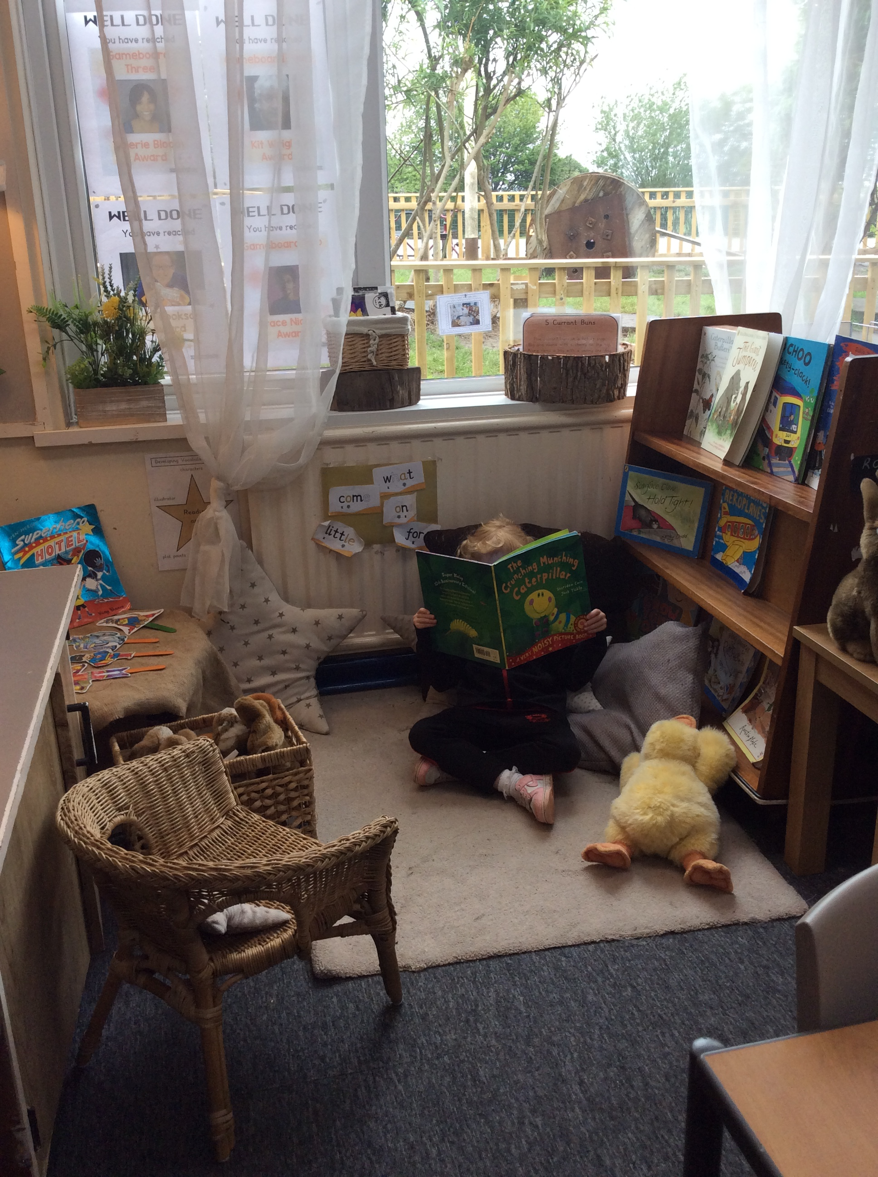
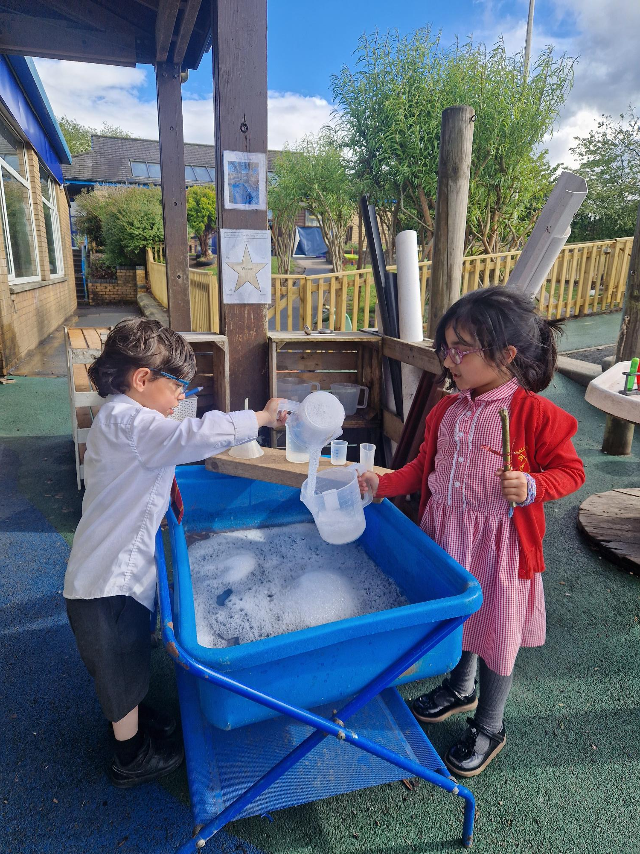
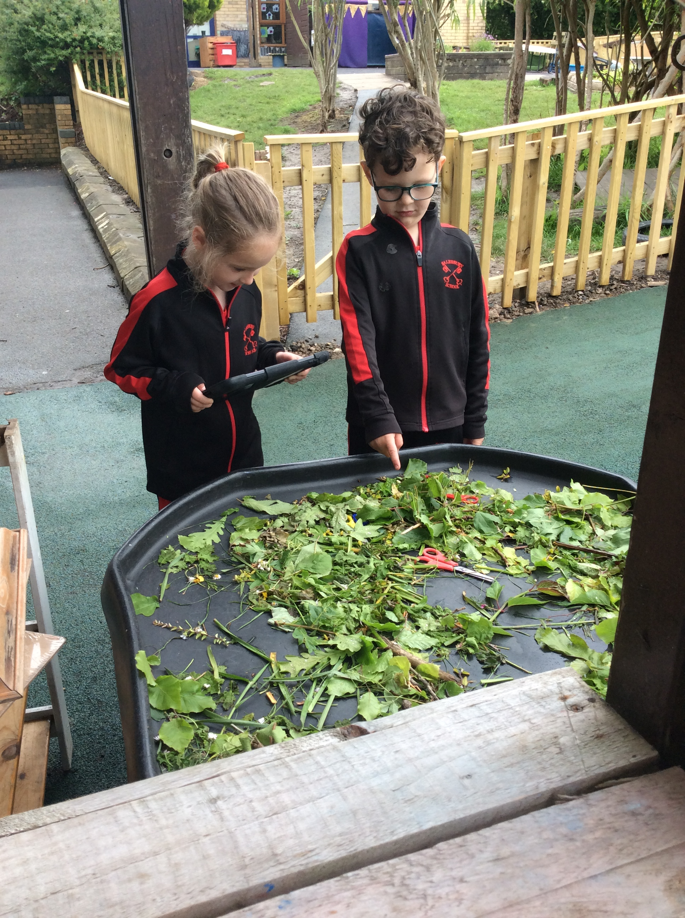
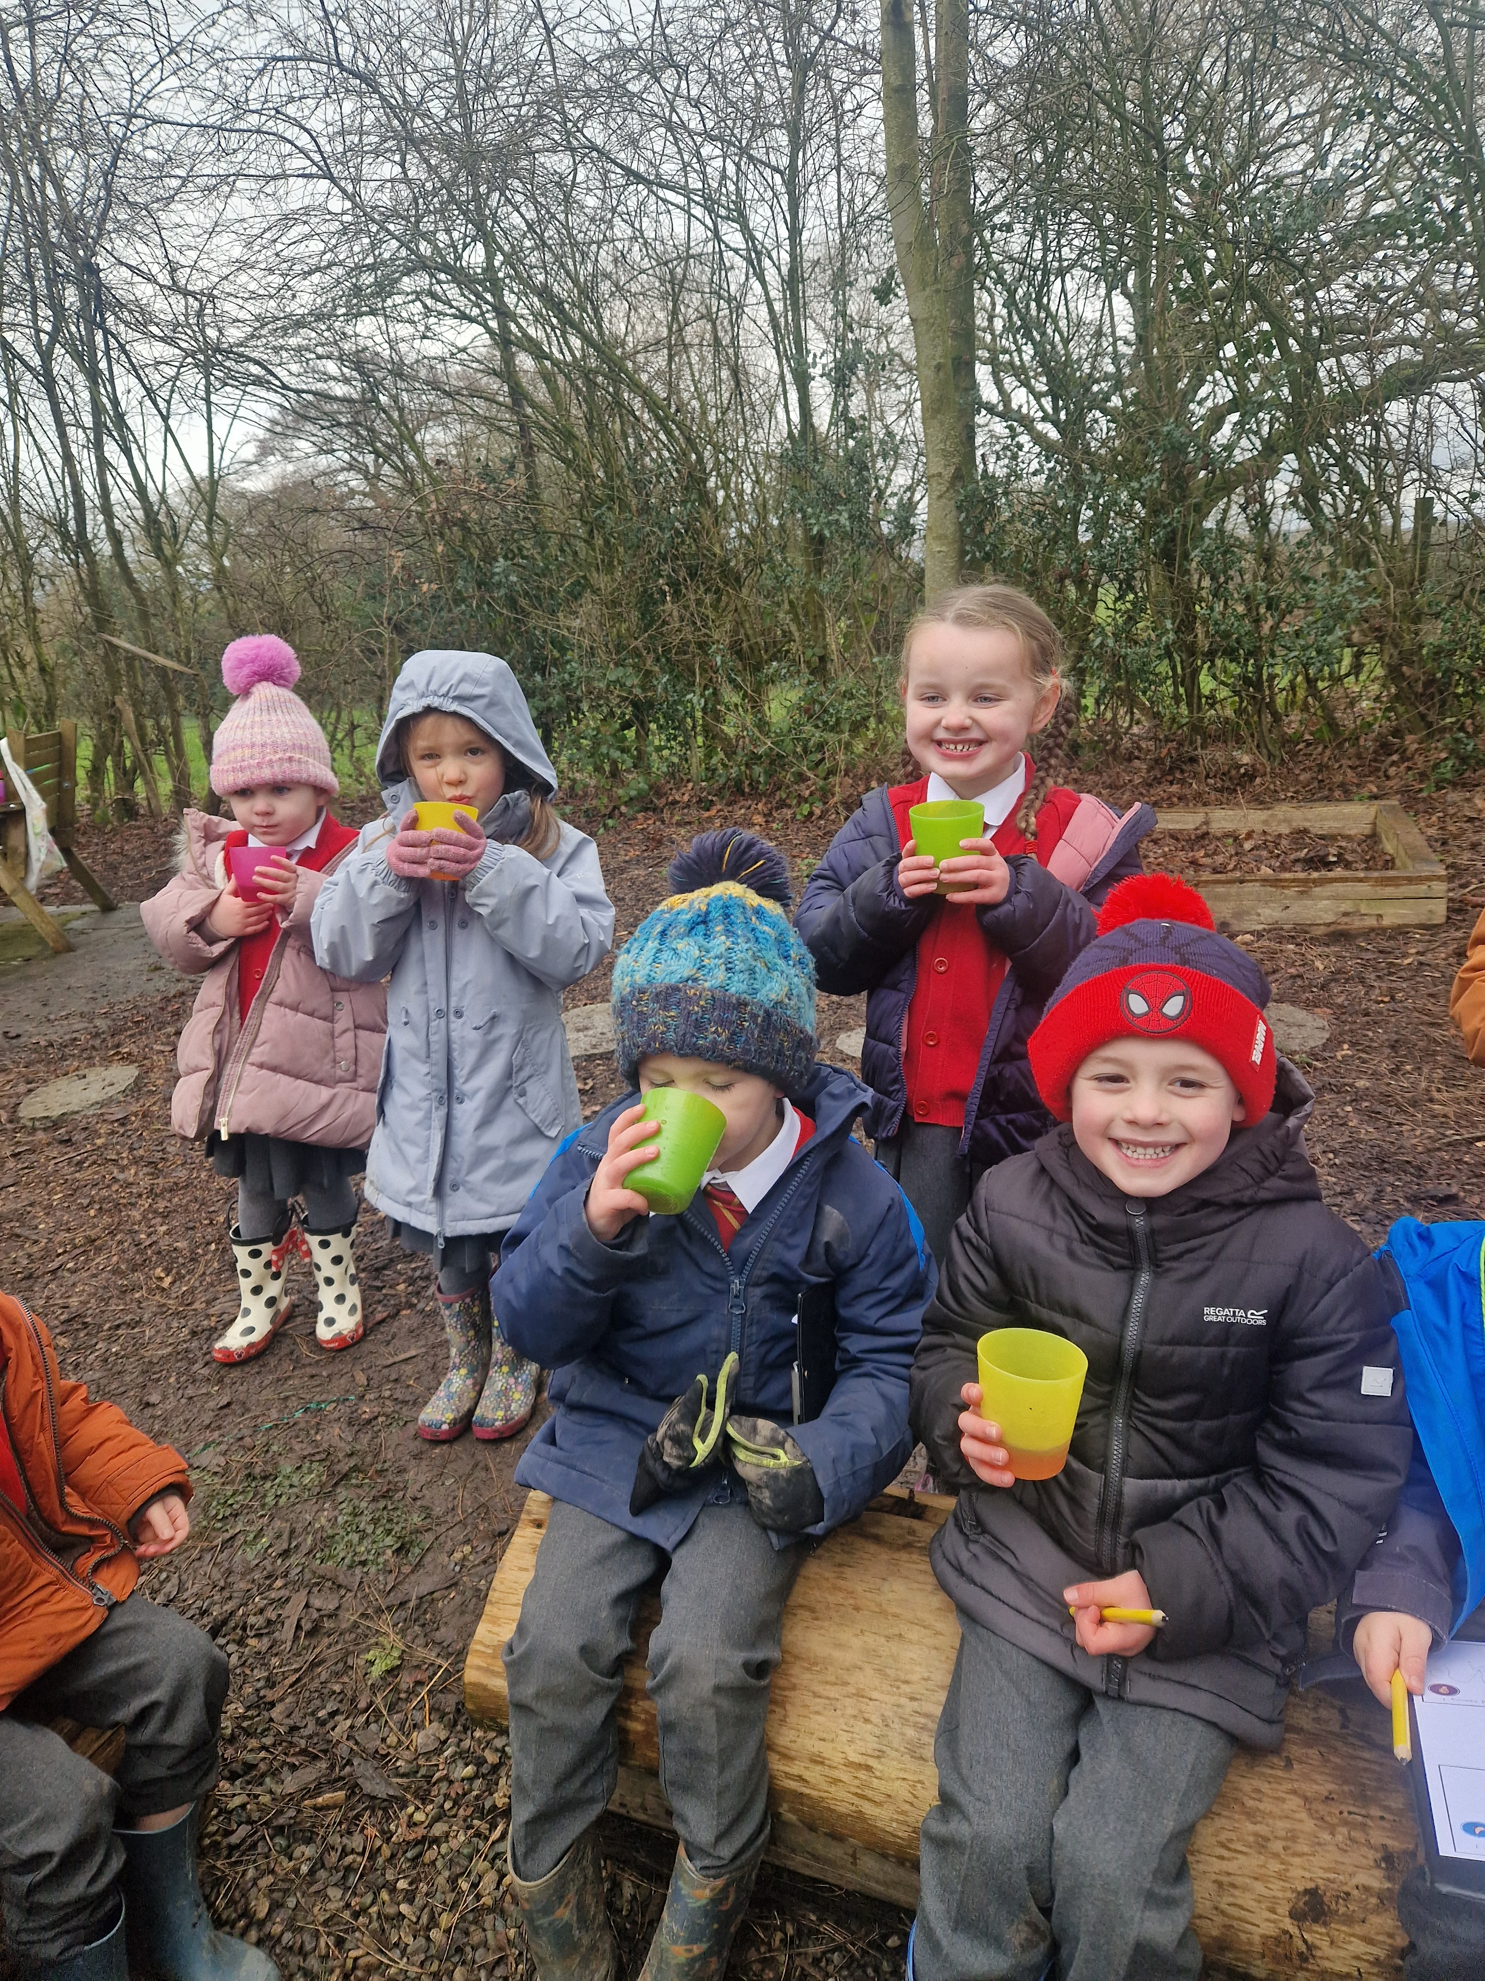
Our Environment
Star Class
Moon Class
Shared outdoor area
Mixed outdoor provision with nursery
Hall for PE lessons
Jubilee Garden
Field & Playground

