Slide 1
Induction Evening
Welcome to Star Class!
Miss Cummins
Notes:
What a day looks like in September
Daily routines
Things we need them to have when they come e.g. wellies, waterproof coats
Contact with them and with us (on the gate, emails, phone calls)
Leaving them at the gate, self-regulation
Home visits and Nursery visits are so important and useful for settling and creating a big picture of the children
Characteristics of effective learning of how children learn underpin everything!!!
Classroom tour – Star tour with more general information then Moon tour characteristics with outdoor tour too

Slide 2
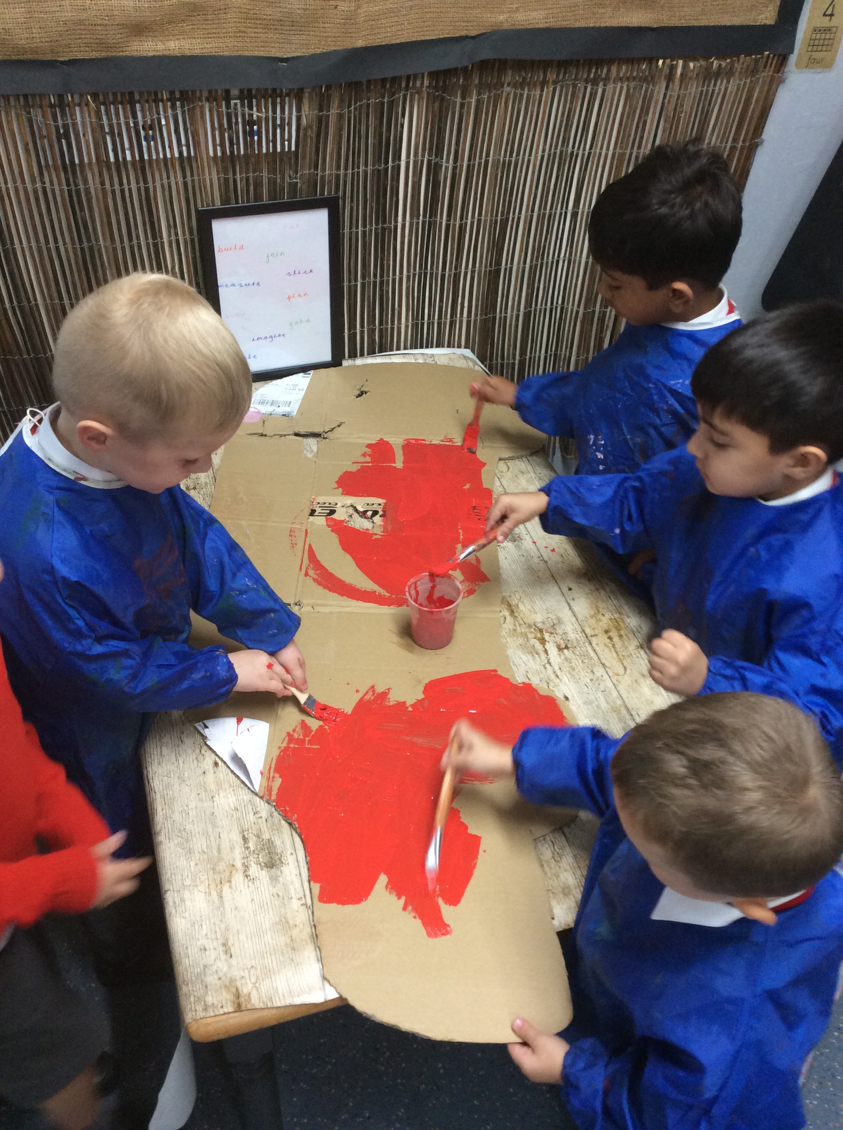
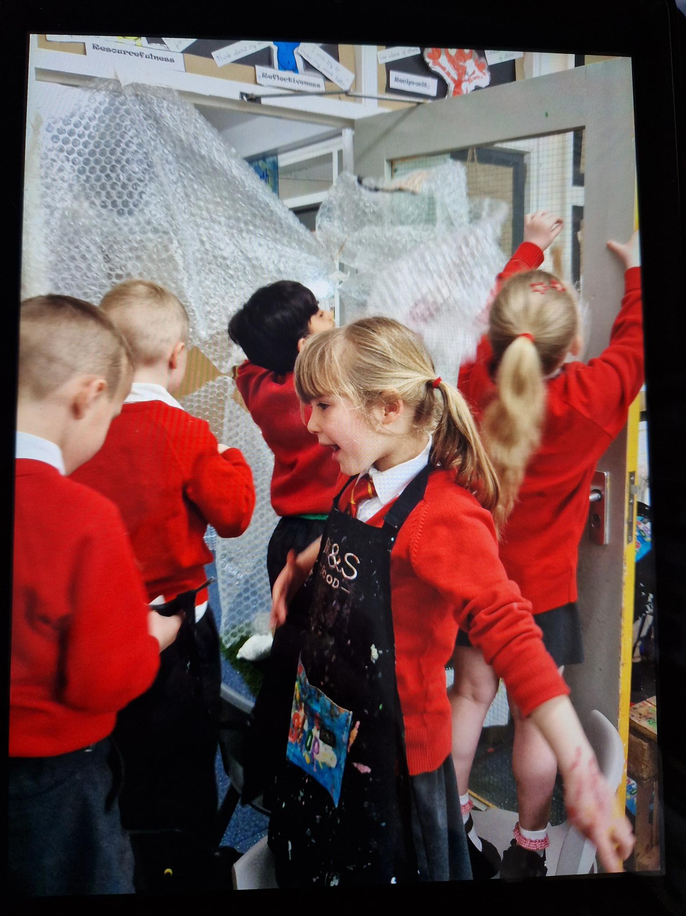
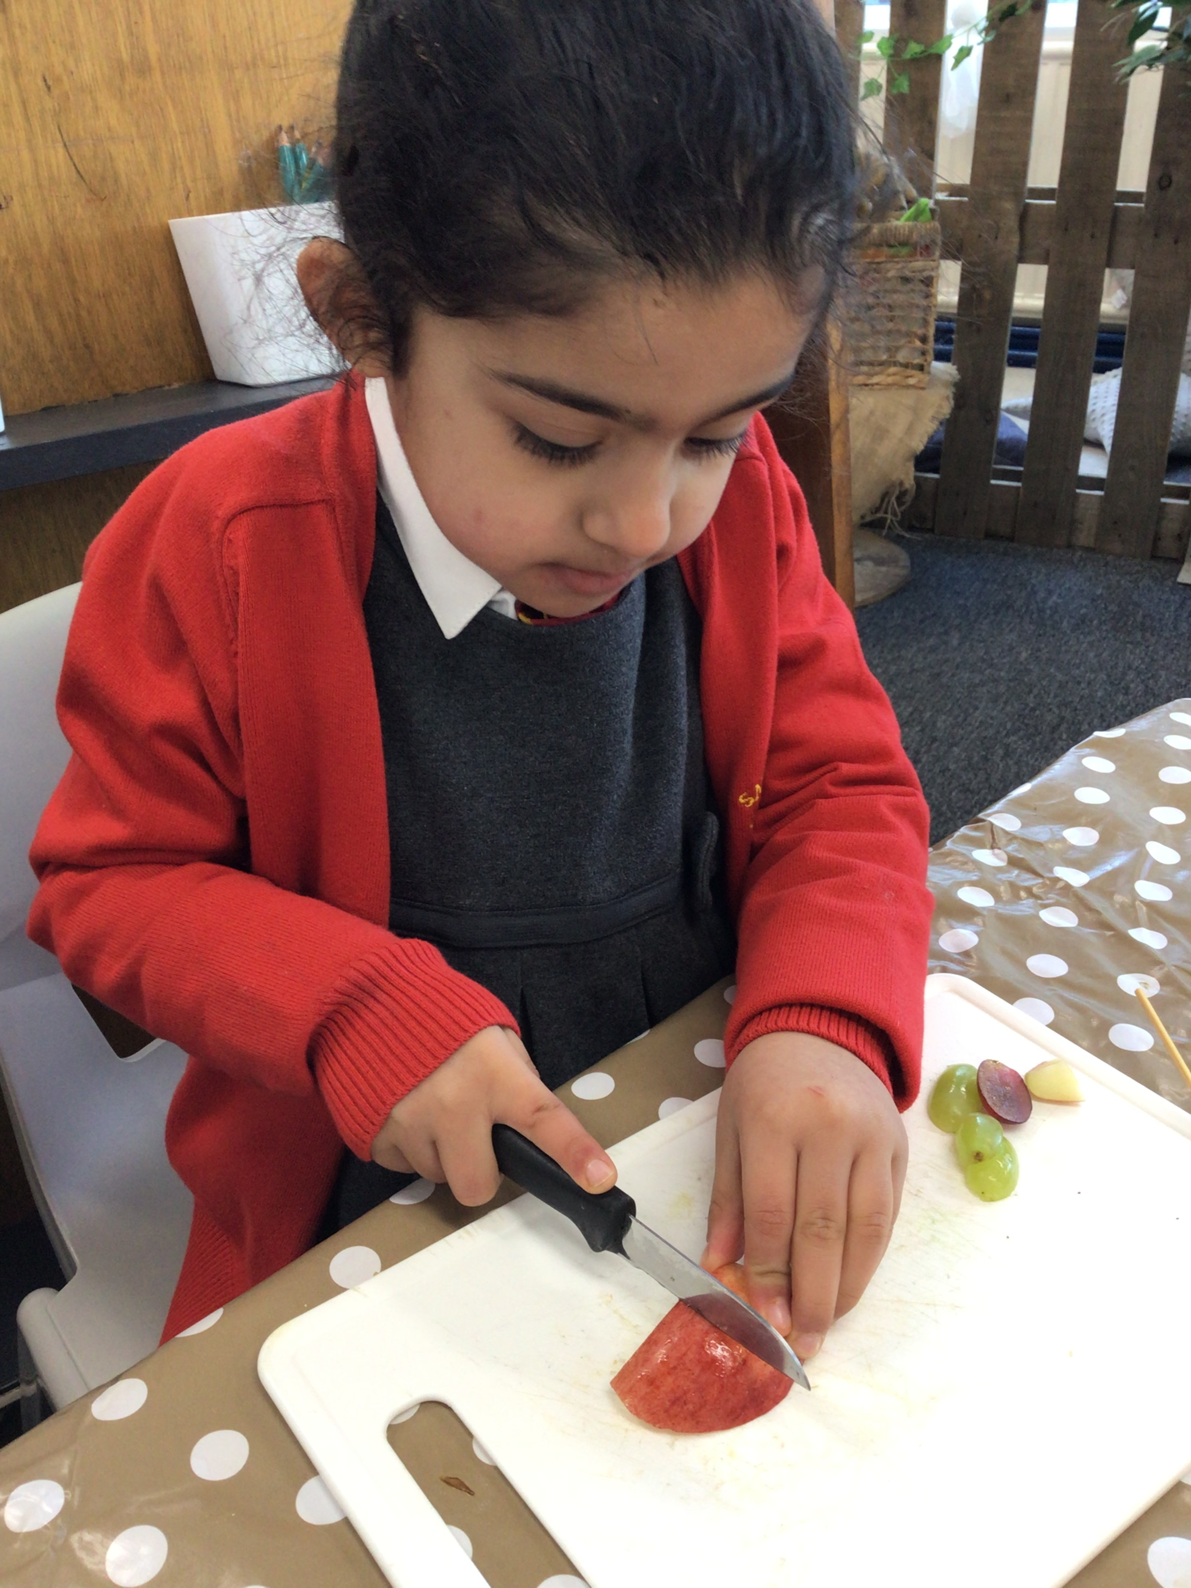
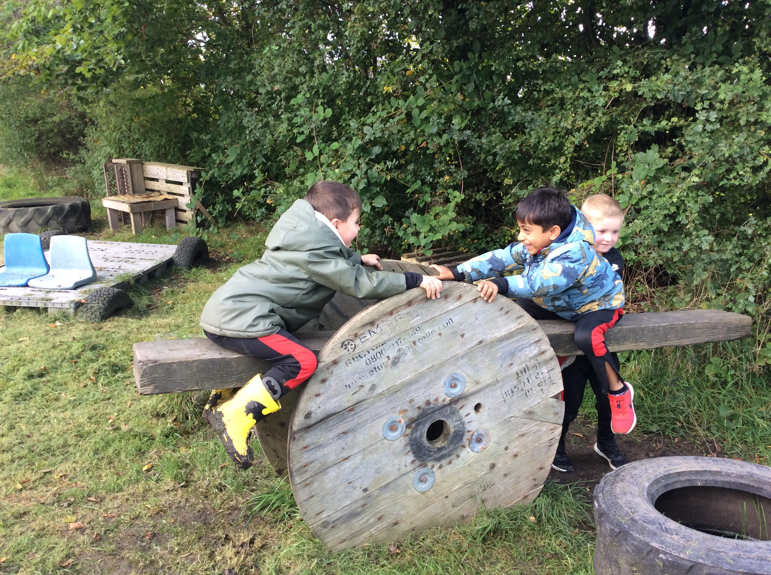
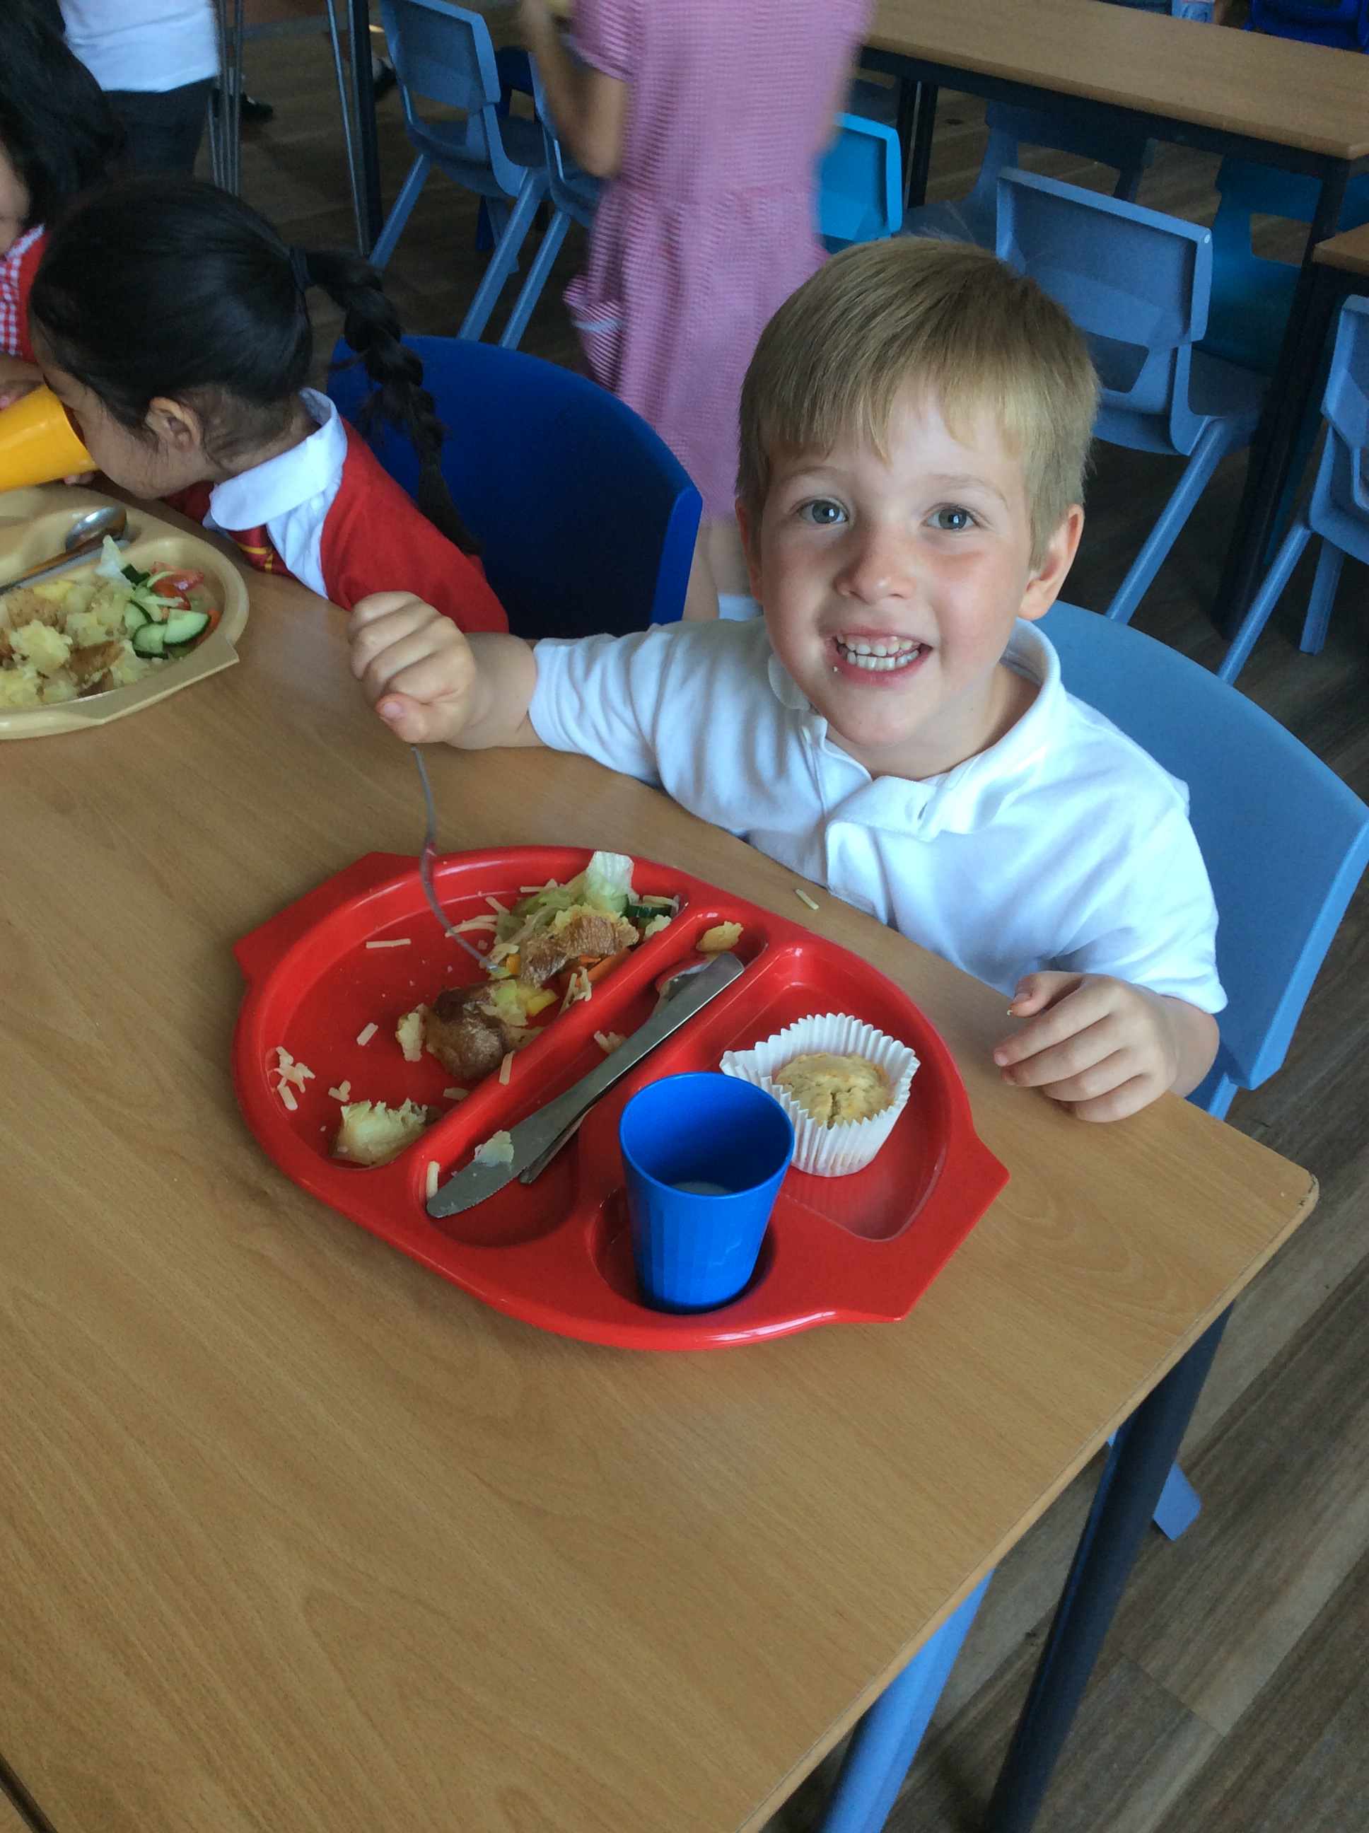
Starting School
The first half-term is all about giving children the opportunity to settle, get used to school routines, make new friends and for us to get to know them and their families!

Slide 3
Smooth Transition to Reception
Welcome Programme
Coffee Afternoon
Afternoon visit
Induction Evening
Lunch Visit
Morning visit
Teddy Bears Picnic
Nursery & Home Visits
Staggered start in September
Nursery and Reception shared outdoor provision

Slide 4
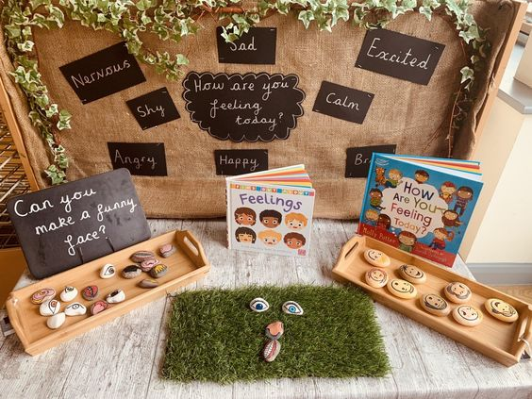
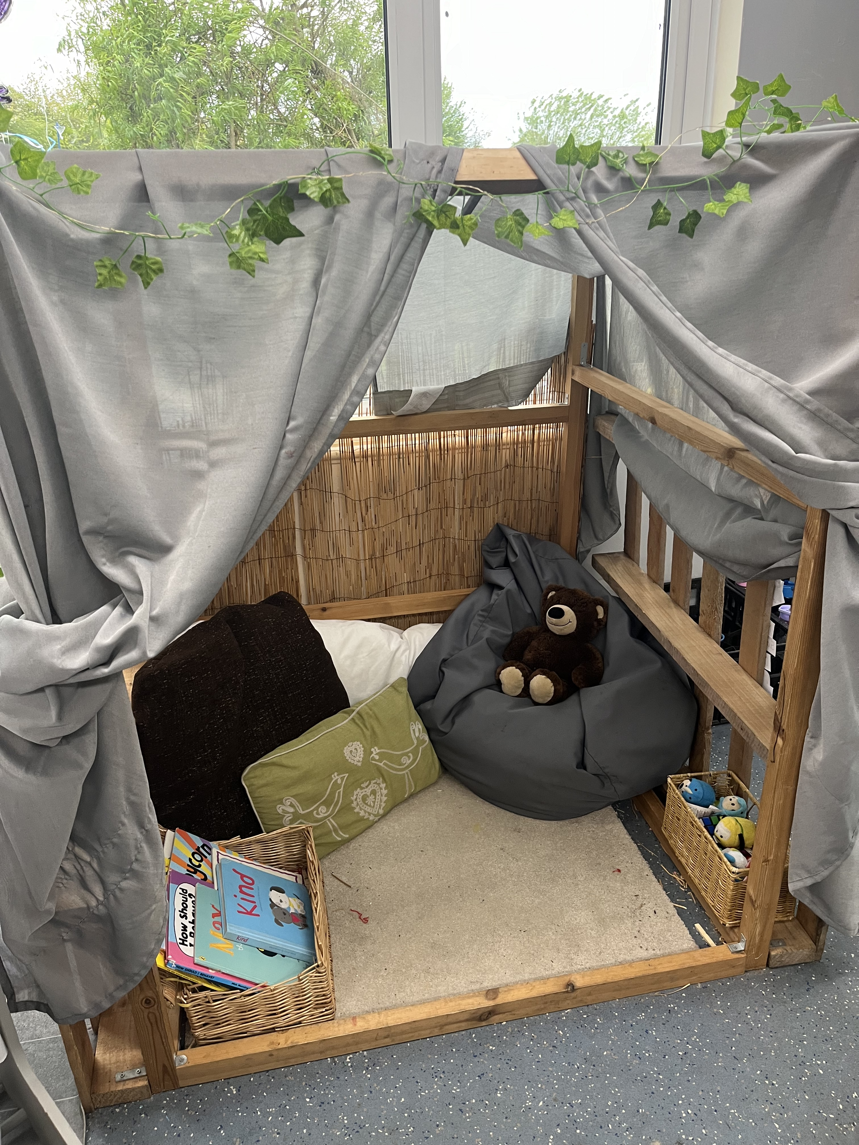
Nurture
Smooth transition through Welcome Programme
Home and Nursery visits
Greeting at the gate in the morning
Emotional check in
Peer massage
Calm corners
Buddy system
Familiar adults working across the unit

Slide 5

Learning and behaviour
Salesbury Way
Lead Learner each week
Spotlight system to recognise and celebrate
High 5
Mission in Action tickets for Hot Chocolate
Team points
Use of choice cards

Slide 6
Learning in Reception
Early Years Foundation Stage is made up of 7 areas of learning and development
3 prime areas
Personal, Social and Emotional Development
4 specific areas
Literacy
Physical Development
Communication and Language
Maths
Understanding the World
Expressive Arts and Design

Slide 7
3 Prime Areas
Personal, Social and Emotional Development
Self-regulation, managing self & building relationships
Communication and Language
Listening, attention and understanding & speaking
Physical Development
Gross motor skills & fine motor skills

Slide 8
4 Specific Areas
Literacy
Comprehension, word reading & writing
Understanding the World
Past and present, the natural world & people, culture and communities
Expressive Arts and Design
Creating with materials & being imaginative and expressive
Maths
Number & numerical patterns

Slide 9
Curriculum areas taught in School
Phonics – Monster Phonics
Guided Reading
English – The Write Stuff
Maths – Mastery Number Programme
Religious Education
Physical Education
Curriculum (Geography, History or Science focus)
Learning 4 Life
Art
Music
Design & Technology
Computing
Forest School

Slide 10
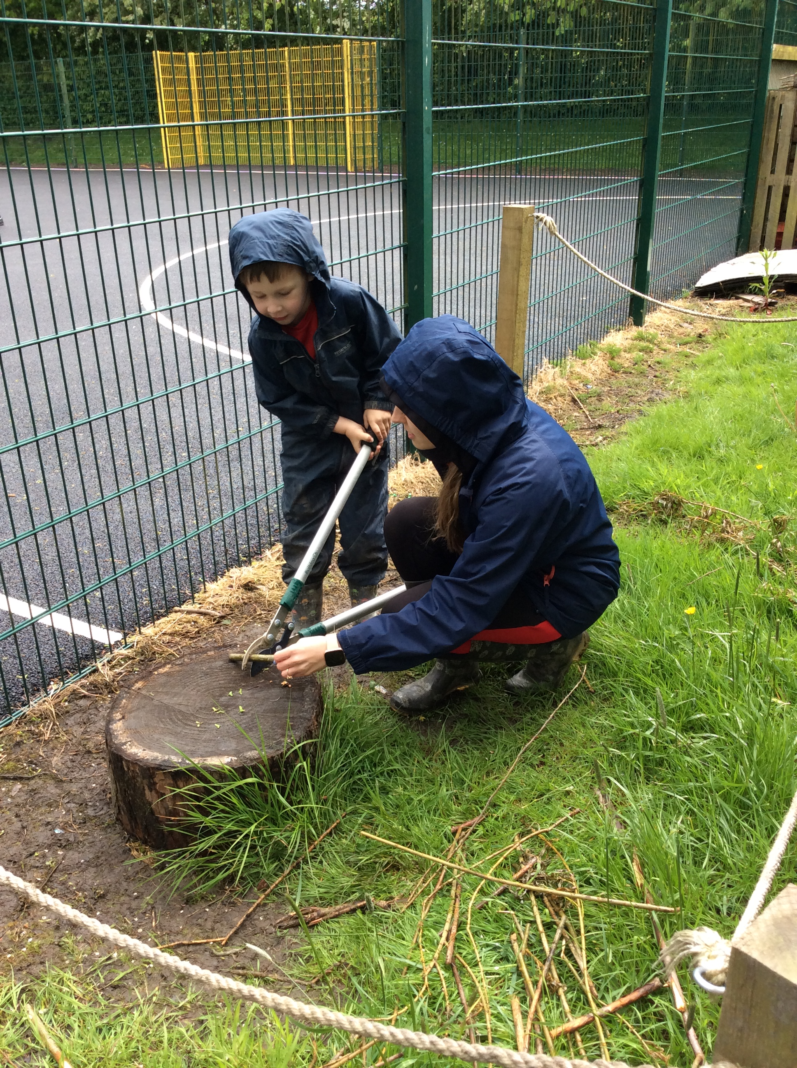
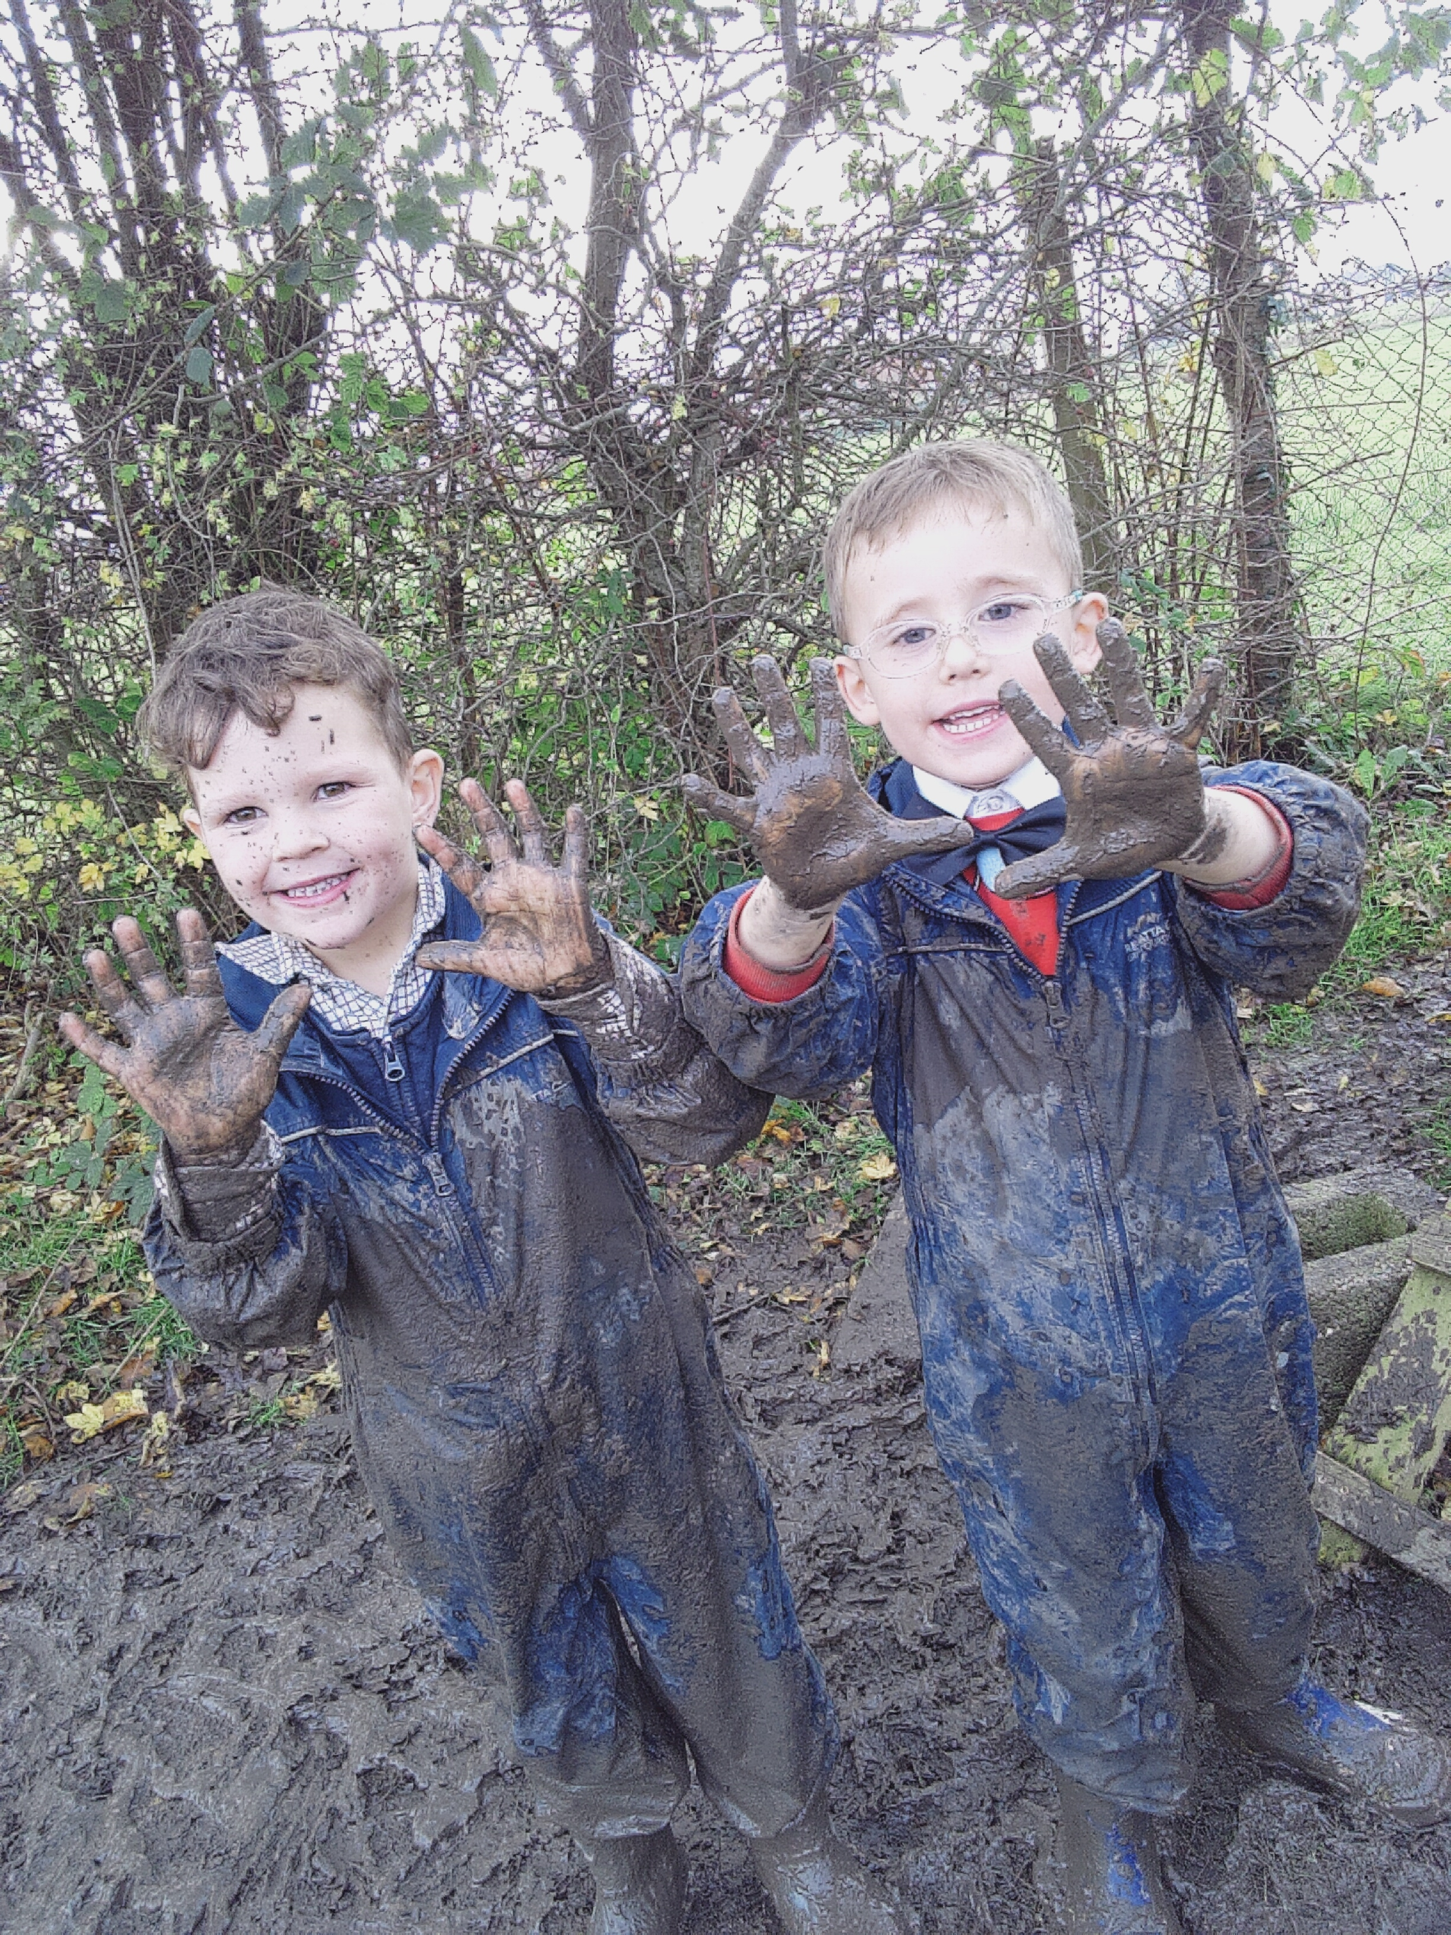
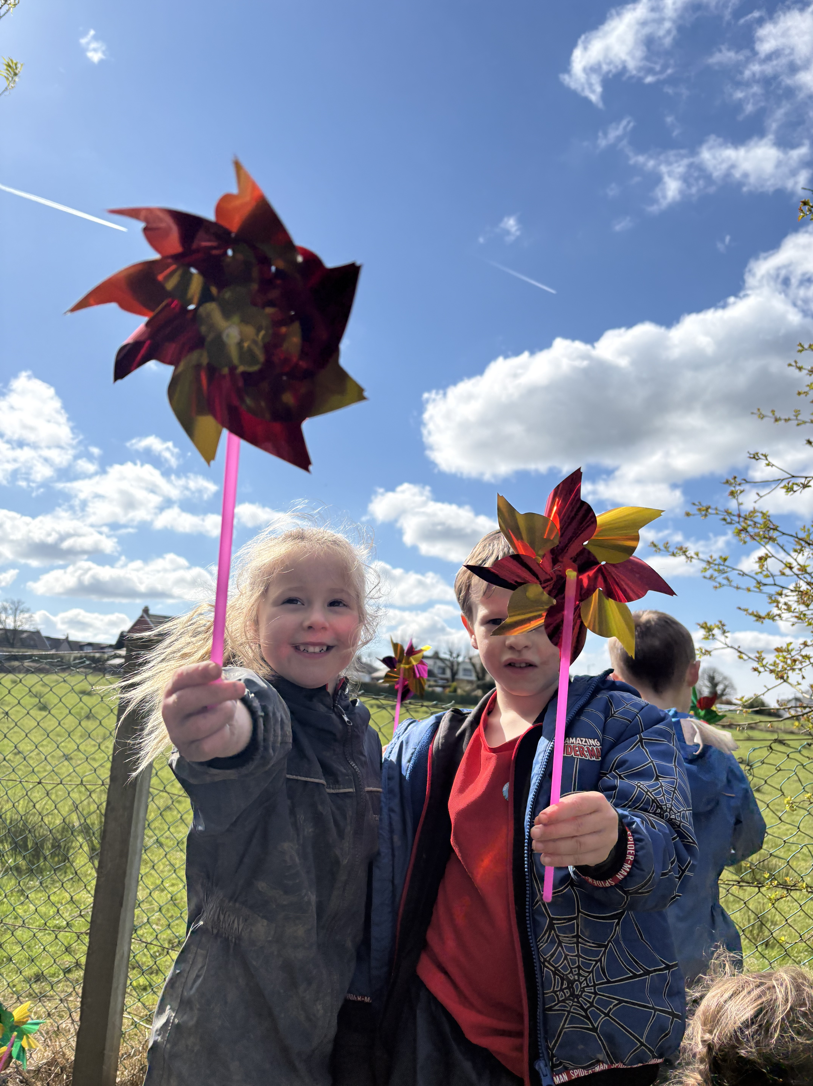
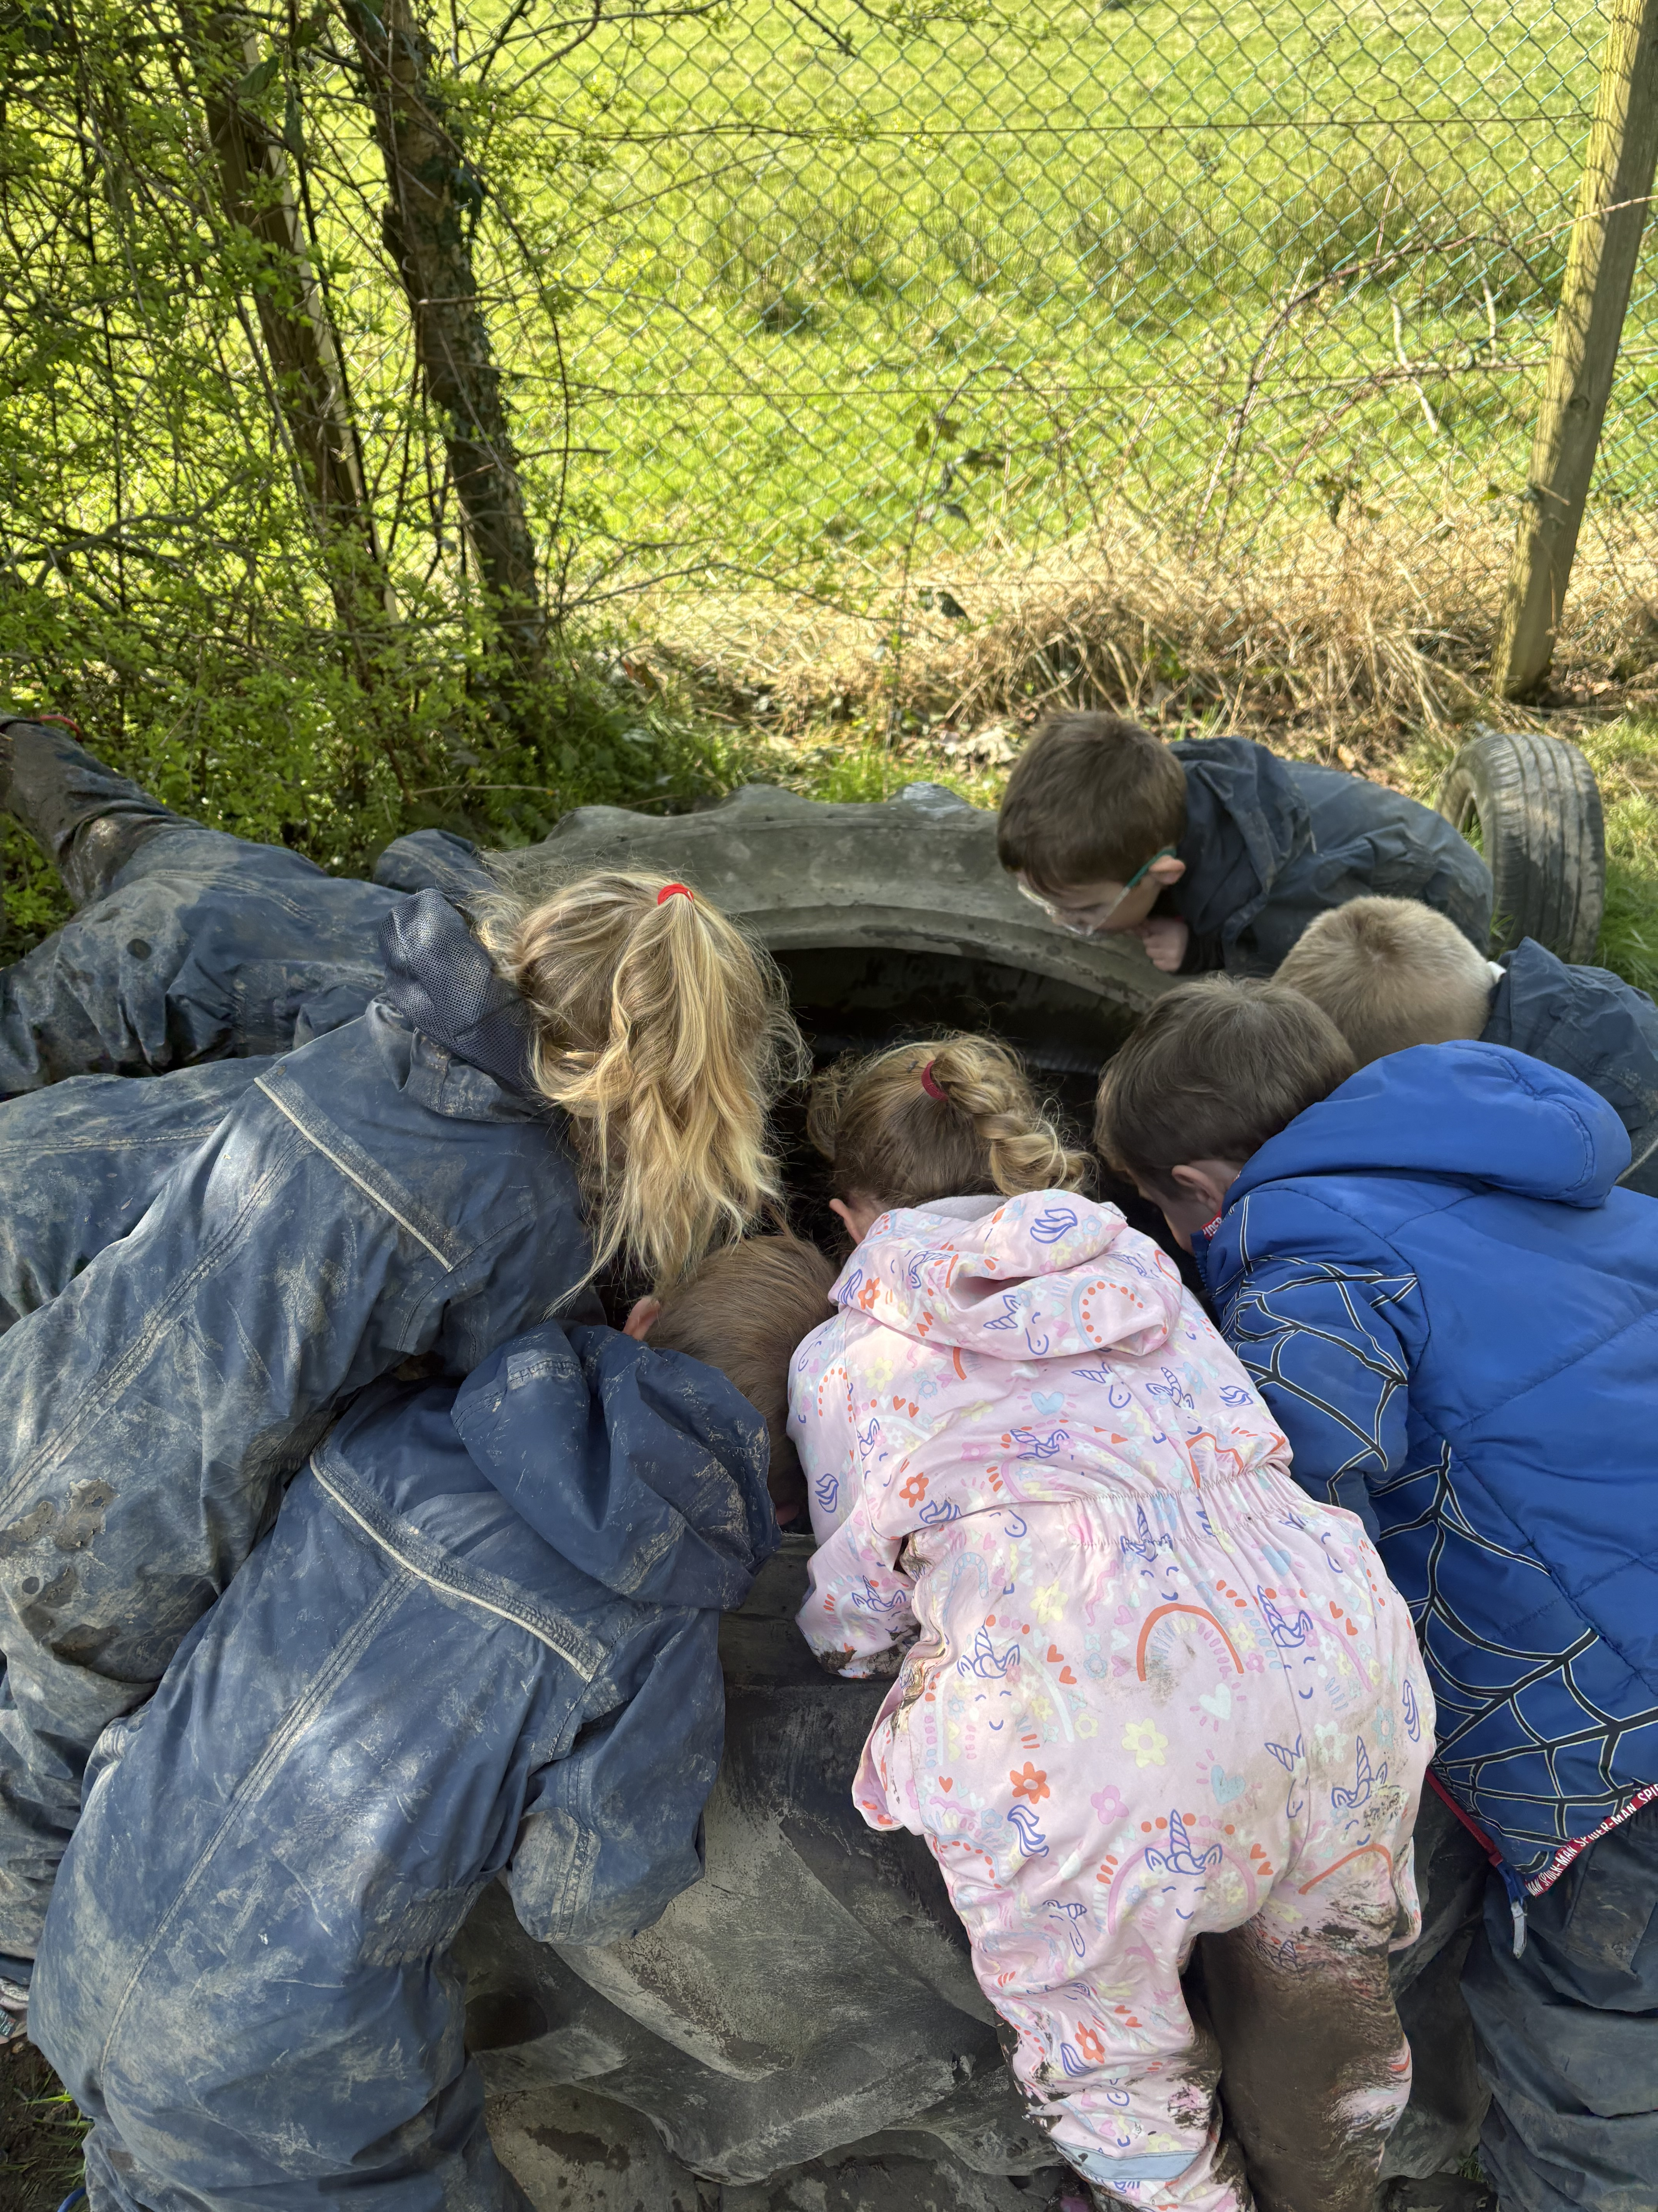
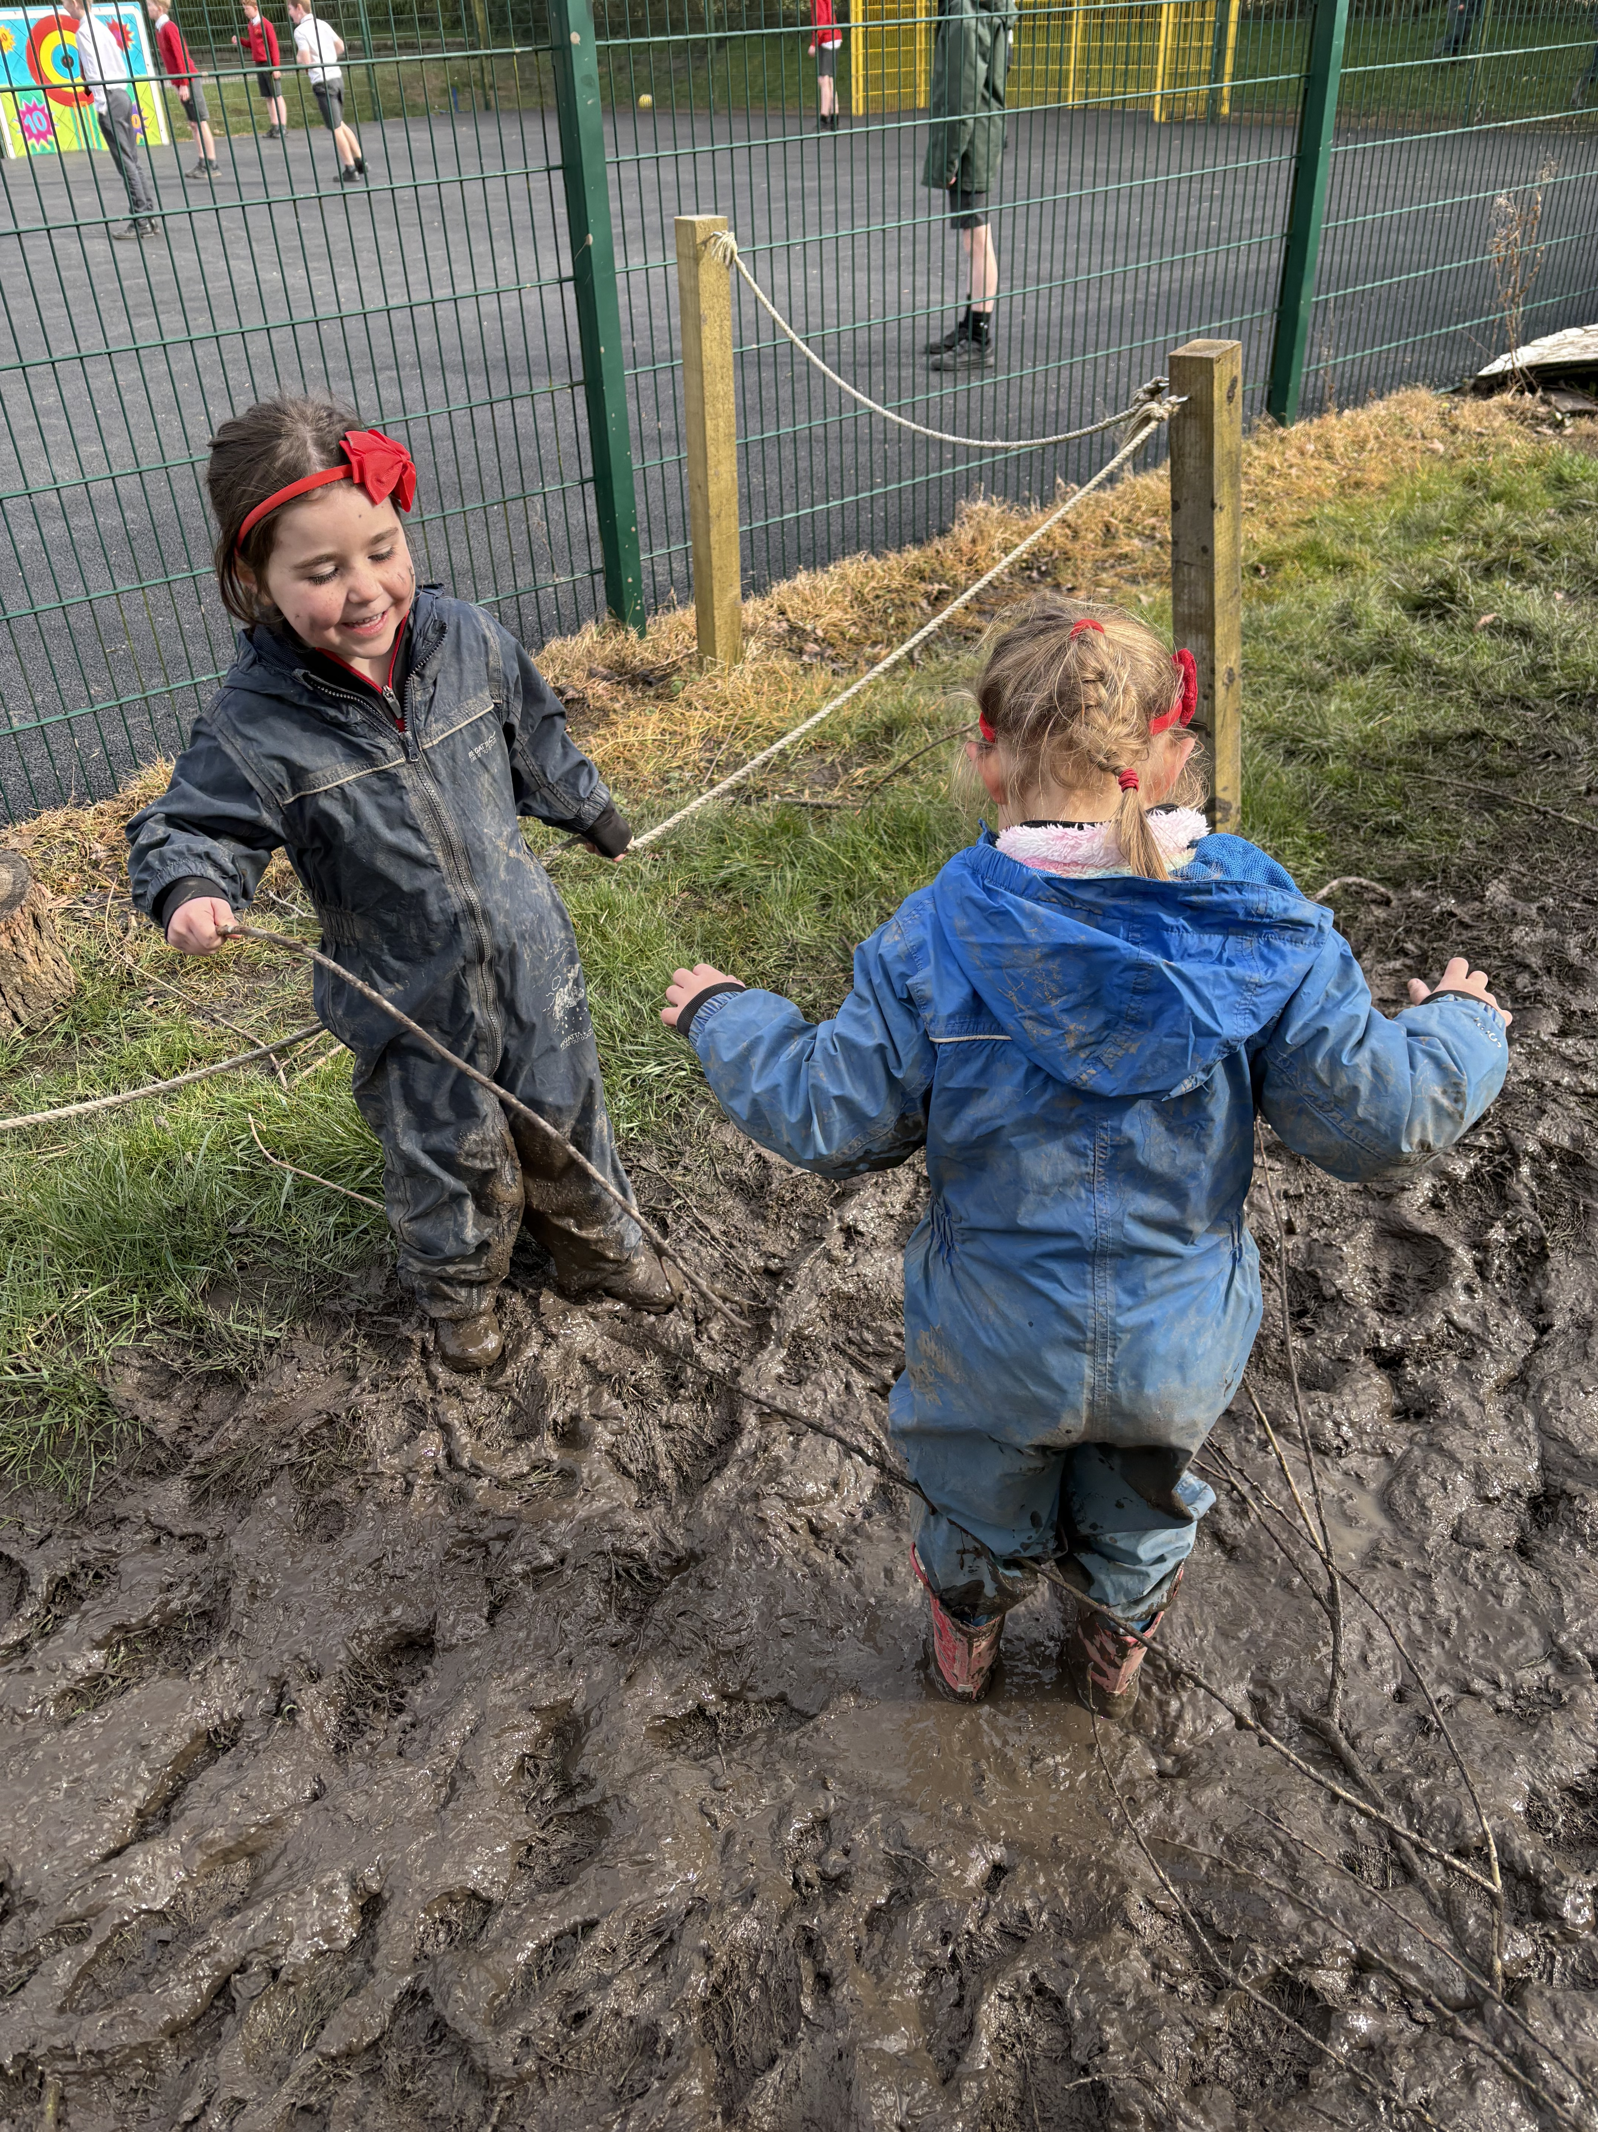
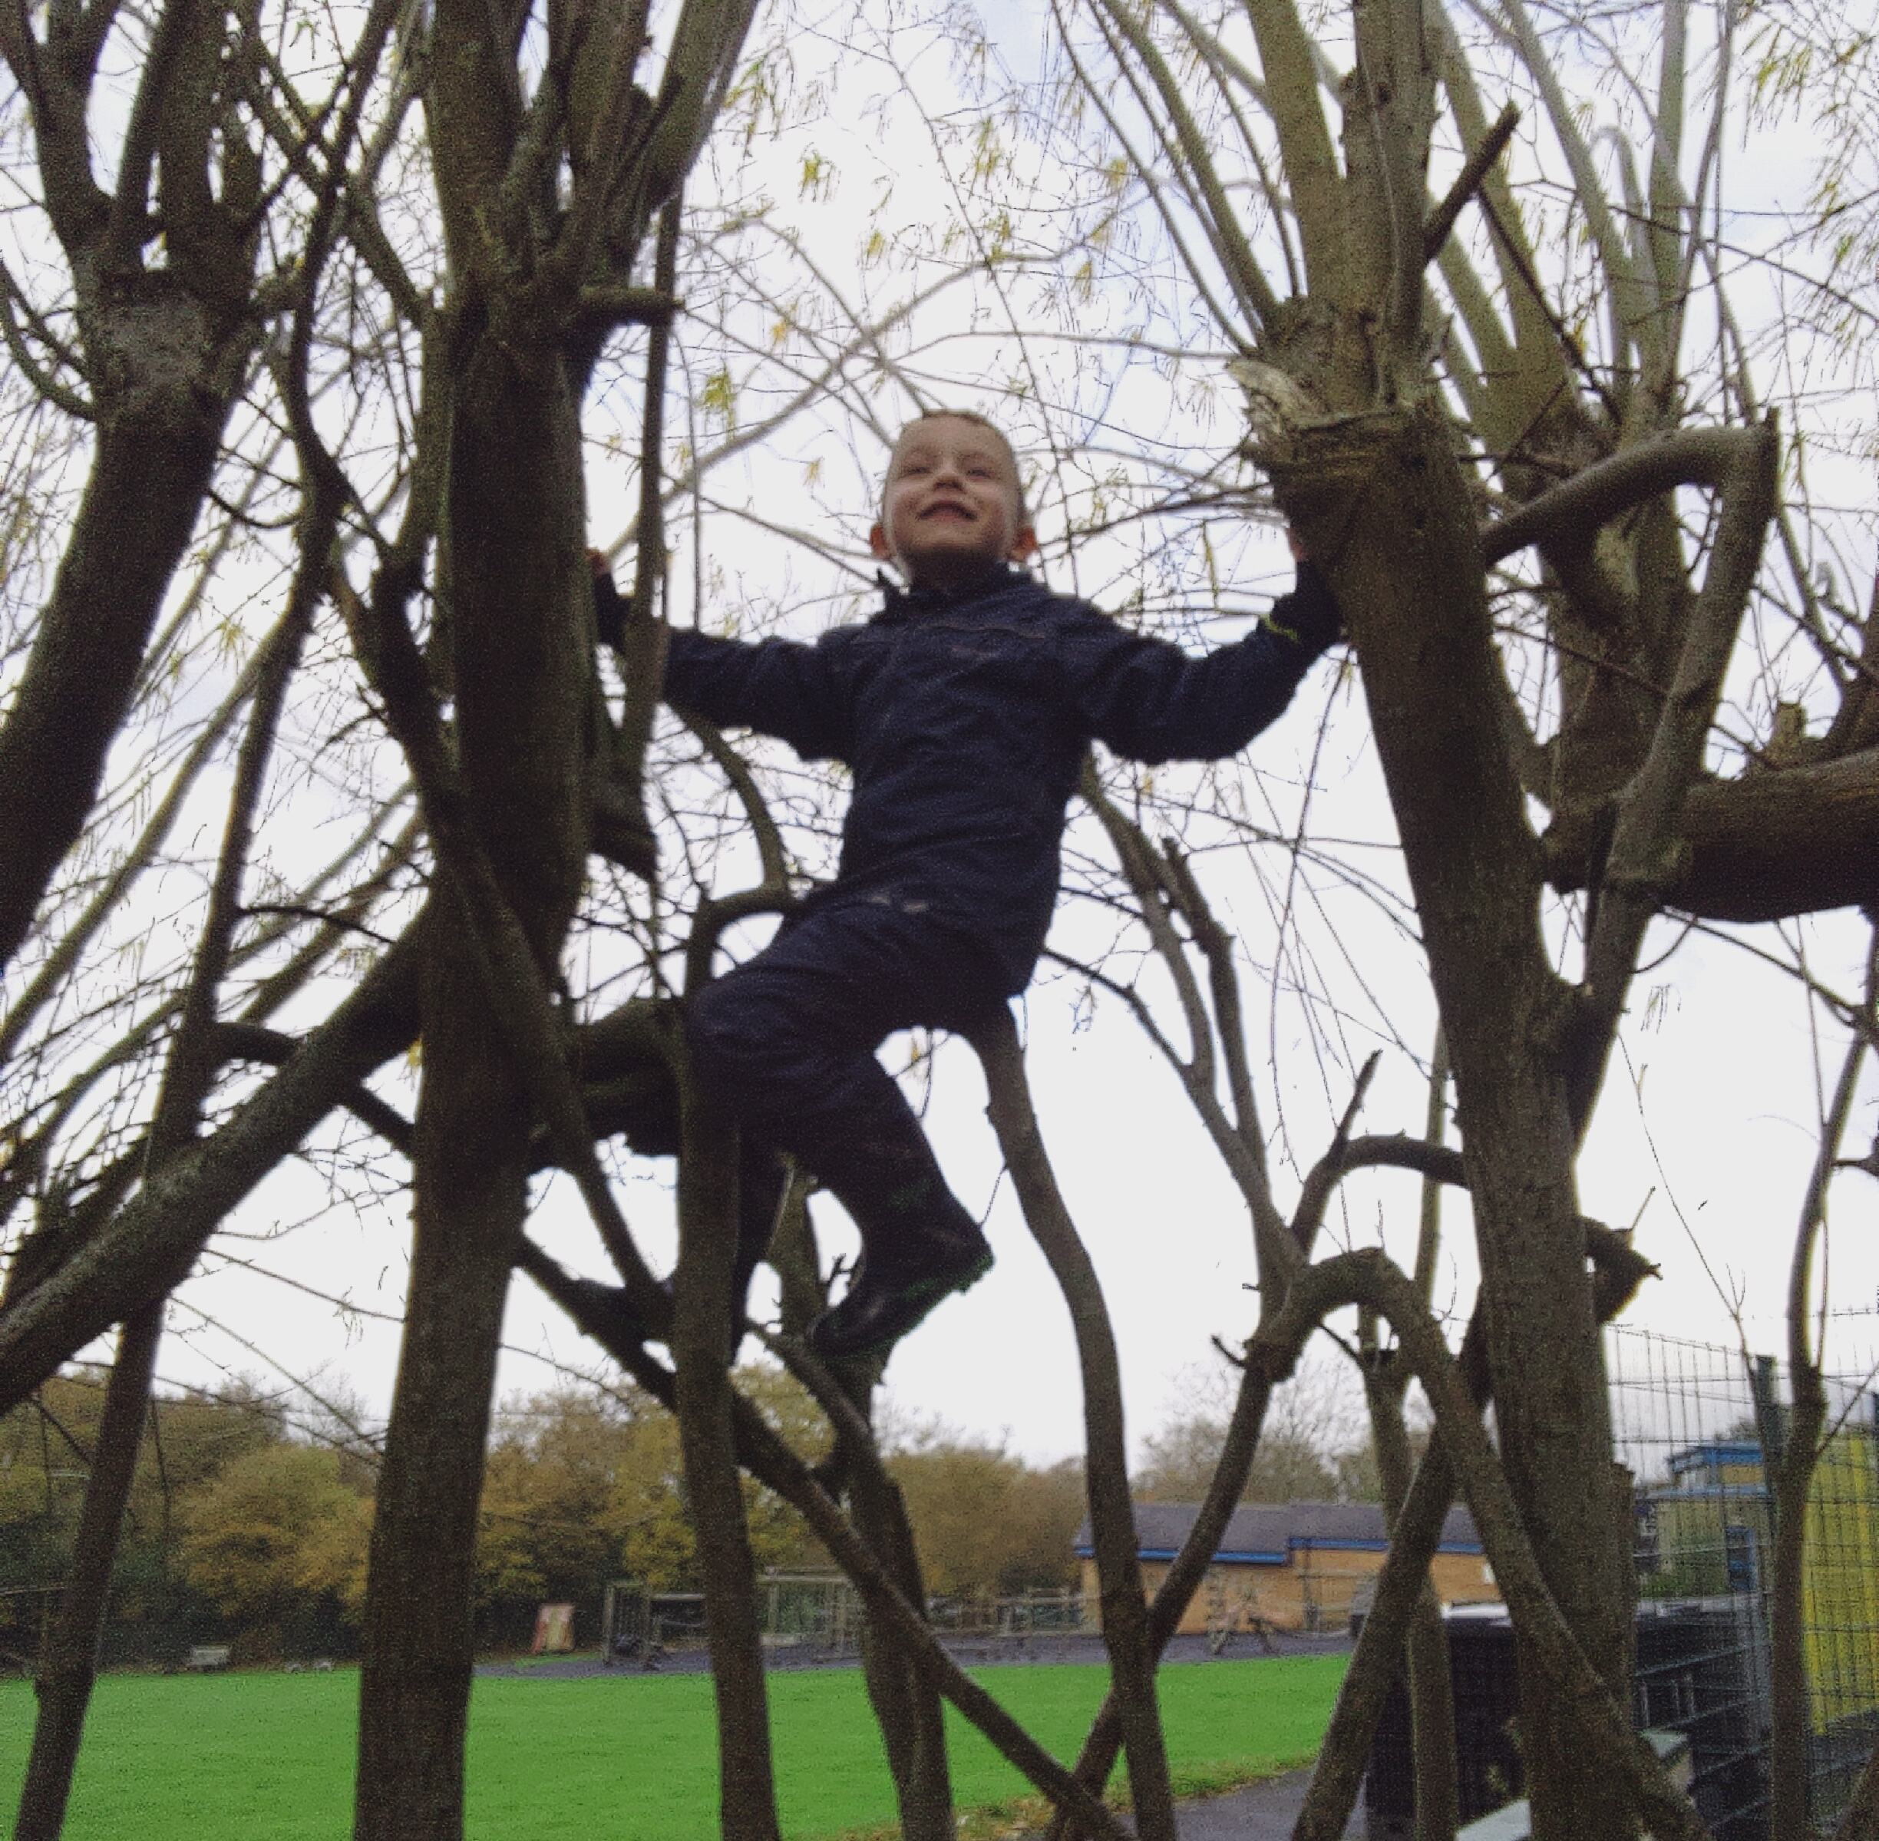
Forest School
2 hour sessions
Using hand tools, risky play, fire pit, den building
Whatever the weather!

Slide 11
How do children learn?
Characteristics of Effective Learning
Active Learning
Creative and Critical Thinking
Playing and Exploring
ENGAGEMENT
Finding out and exploring
Playing with what they know
Being willing to ‘have a go’
MOTIVATION
Keep trying
Being involved and concentrating
Enjoying achieving what they set out to do
THINKING
Making links
Working with ideas
Having their own ideas

Slide 12
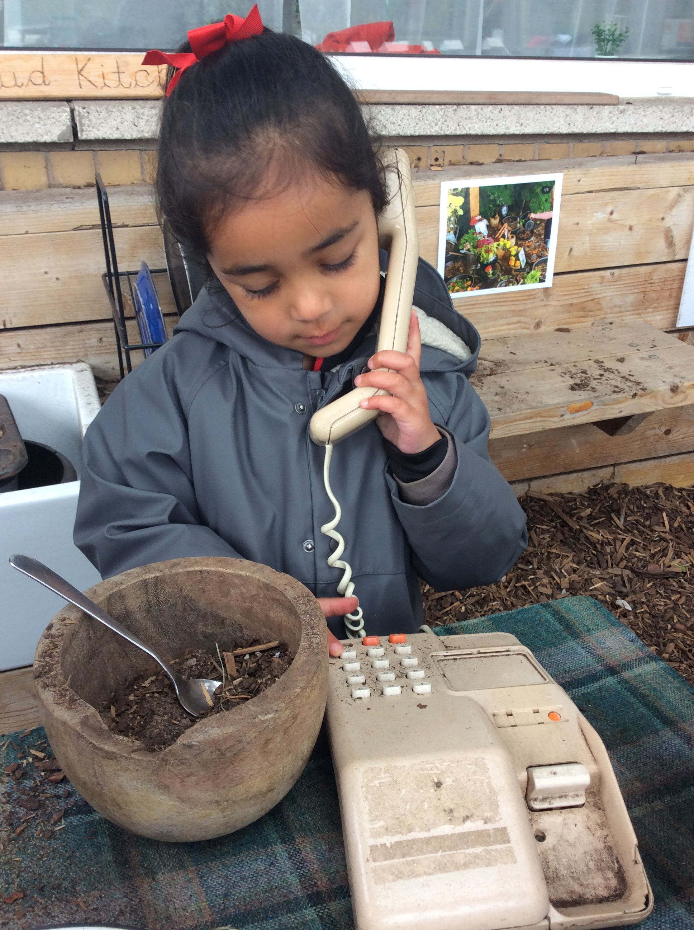
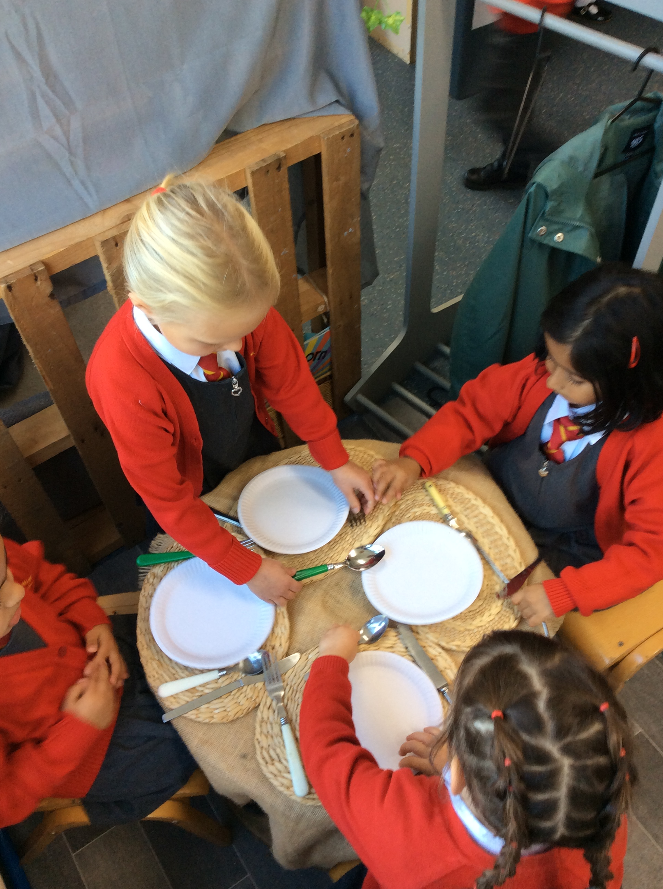
Learning through play!
Play is essential for children’s development, building their confidence as they learn to explore, relate to others, set their own goals and solve problems.
Children learn by leading their own play, and by taking part in play which is guided by adults both indoors and outdoors.

Slide 13
Being ‘school ready’
Can I eat independently using a knife and fork?
Have I practised getting myself dressed in my school uniform?
Can I fasten my shoes and zip up my coat?
Do I have a good bedtime routine so I get enough sleep?
Can I use the toilet independently?
Can I express my needs and ask for help?

Slide 14
How can you help your child to be ready for school?
Encouraging independence
Talking positively about starting school
Gross motor skills e.g. climbing, swinging, balancing
Playing games, taking turns and sharing
Opportunities to use their imagination
Share stories together
Singing songs and rhymes
Recognising their name
Playing and Exploring
Creating and Critical Thinking
Active Learning

Slide 15


Useful Information
https://foundationyears.org.uk/files/2021/09/What-to-expect-in-the-EYFS-complete-FINAL-16.09-compressed.pdf
https://www.sirenfilms.co.uk/library/the-characteristics-of-effective-learning-an-overview/

Slide 16
Thank you!
Any questions?
cummins@salesbury.lancs.sch.uk

