Slide 1
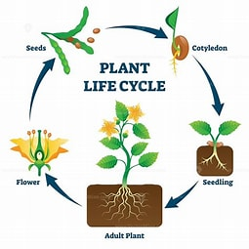







Salesbury Super 6 Knowledge Organiser for
Learning Focus: All Things Bright and Beautiful: Science
Key knowledge to learn
The parts of a plant – petal, leaf, stem, root, stigma, style, anther, ovule, ovary, sepal, filament.
A lifecycle shows the changes to a plant over it’s lifetime. A lifecycle is the different stages of life for a living thing. It has 4 main stages – germination, growing/flowering, pollination, fertilisation, seed dispersal.
Germination is when the seed begins to grow.
Pollination occurs when pollen is transferred to the stigma usually by an insect.
The plant needs to move or transport the seeds away from the parent plant so that they don't all try to grow in the same place. There are lots of different ways that seeds can be dispersed.
Plants are producers, which make their own food using light from the sun. Consumers are animals that eat plants or animals. If an animal is eaten by another animal it is prey, whereas the animal that eats it is called a predator.
Vocabulary
lifecycle | The different stages of life for a living thing.
pollination | occurs when pollen from the anther is transferred to the stigma, often by an insect
dispersal | Transporting the seeds away from the parent plant, so that they don’t all grow in the same place.
germination | When the seed starts to grow.
fertilisation | Fertilisation happens when the pollen travels from the stigma down the style to the ovary.
food chain | The order of events in an ecosystem, where one living thing gets eaten by another. Think prey and predator.
You can find out more by:- What is the life cycle of a plant? - BBC Bitesize The lifecycle of a plant - BBC Bitesize Life cycle of a plant | Science & Nature | National Geographic Kids (natgeokids.com) Biology of Plants: Introduction (mbgnet.net)

