Slide 1
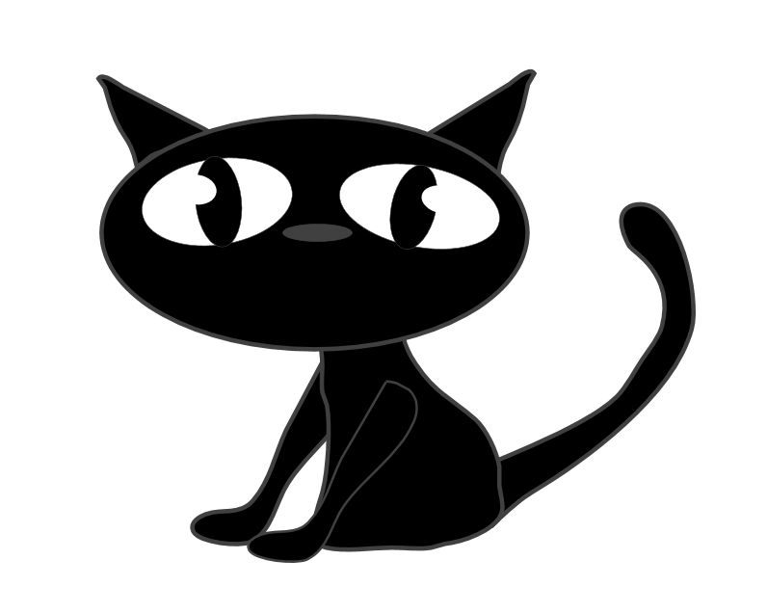
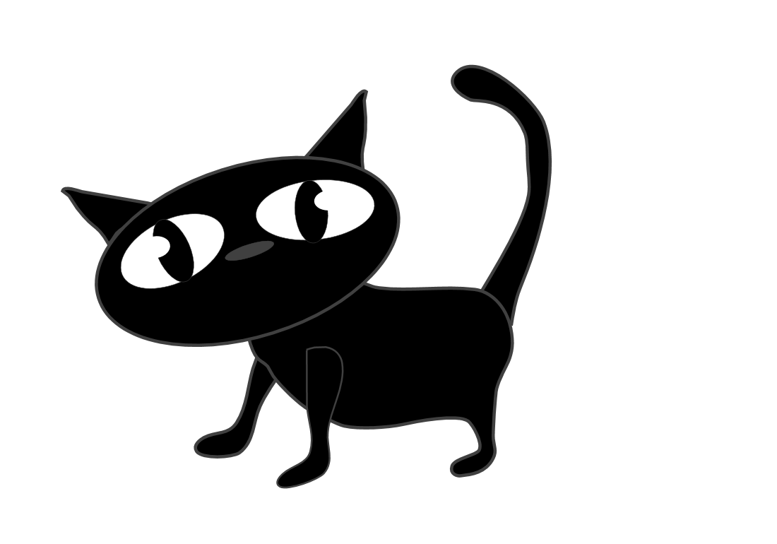
Year 2
WE 24th April

Slide 2

Mr

Slide 3
Mrs

Slide 4
who

Slide 5
eye

Slide 6
he’s

Slide 7
we’re

Slide 8
can’t

Slide 9
didn’t

Slide 10
couldn’t

Slide 11
stopped

Slide 12
jumped

