Slide 1

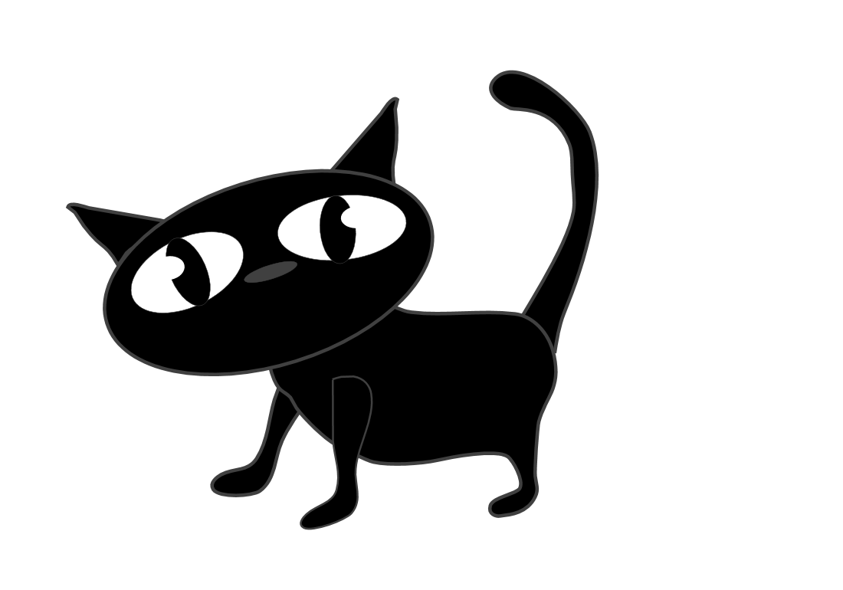
Year 2
WE 15th May

Slide 2

any

Slide 3
many

Slide 4
these

Slide 5
small

Slide 6
bear

Slide 7
boat

Slide 8
home

Slide 9
clothes

