Slide 1

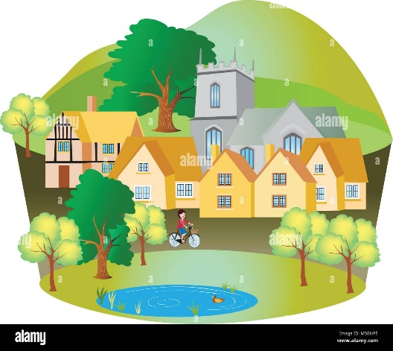
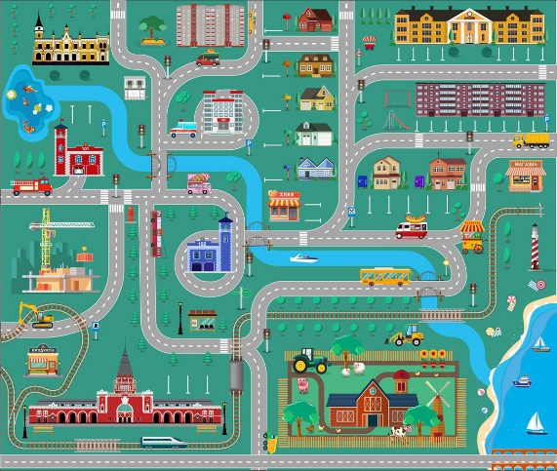
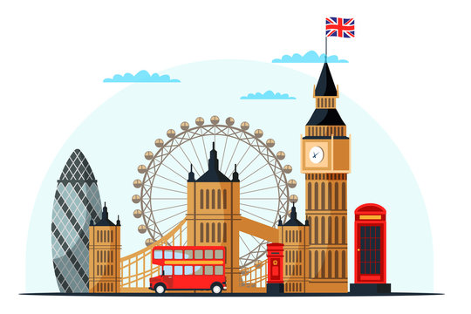
Salesbury Knowledge Organiser for EYFS
Learning Focus Spring 2 2026: Team GB
Key knowledge to learn
To understand the main purpose of maps and how to retrieve information from them.
To know that people live in different locations and these differ in size.
To know that countryside, villages, towns, beaches and cities often have common physical and human features which help to identify them.
To know that we choose a mode of transport depending on the journey we are making.
Vocabulary
beach | a place by the sea or ocean where there is sand or pebbles.
village | is a small place where people live, with a few houses and buildings.
town | a place where many people live, with houses, shops, places of worship and schools.
city | a very big place where many people live, with lots of buildings, shops, and roads.
countryside | land outside towns and cities, with fields, farms, and small villages.
You can find out more by:- BBC Two - William Whiskerson, Island, Farm, City, William Whiskerson - transport, travel and landmarks of London KS1 Geography: Life on the Isles of Scilly - BBC Teach KS1 Geography: Mountains and electricity - BBC Teach

