Slide 1

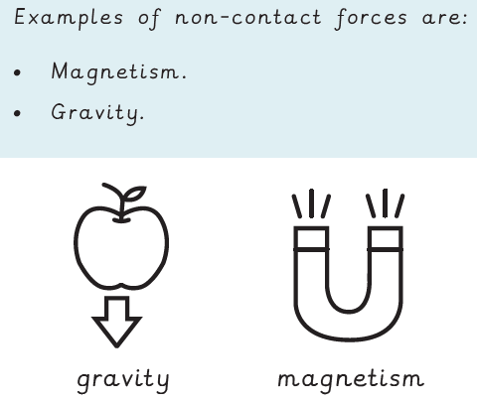







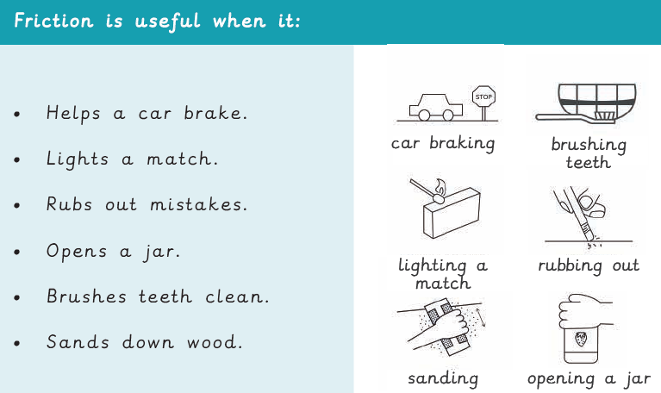
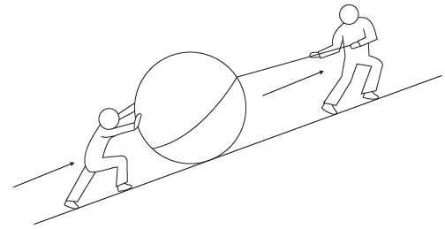
Salesbury Super 6 Knowledge Organiser for Science
Learning Focus: Spring into Action! Forces and Magnets
Key knowledge to learn
Friction To investigate motion on different surfaces.
What is a force? To describe the effects of contact lenses.
Pushes, Pulls and Twists To recognise the effects and uses of forces
Magnets To describe the effects of magnets.
Properties of Magnets To compare the properties of different types of magnets.
Uses of Magnets To explain the uses of magnets.
Vocabulary
Force | A force is a push, a pull or a twist.
Contact Force | Contact forces are caused by contact between two surfaces.
Non-contact Force | Non-contact forces can act at a distance.
Friction | Friction is a contact force that acts between surfaces that are sliding over one another.
Magnetism | Magnetism is the non-contact force that comes from a magnet.
Magnets | Magnets have a north pole and a south pole.
Electromagnets | Electromagnets are magnets that be turned on and off using electricity.
You can find out more by:- Friction https://www.bbc.co.uk/teach/class-clips-video/articles/zbncdnb https://www.bbc.co.uk/teach/class-clips-video/articles/z6vb47h Magnets https://www.bbc.co.uk/bitesize/articles/zhj9r2p Forces https://www.bbc.co.uk/bitesize/articles/zywcrdm

