Slide 1
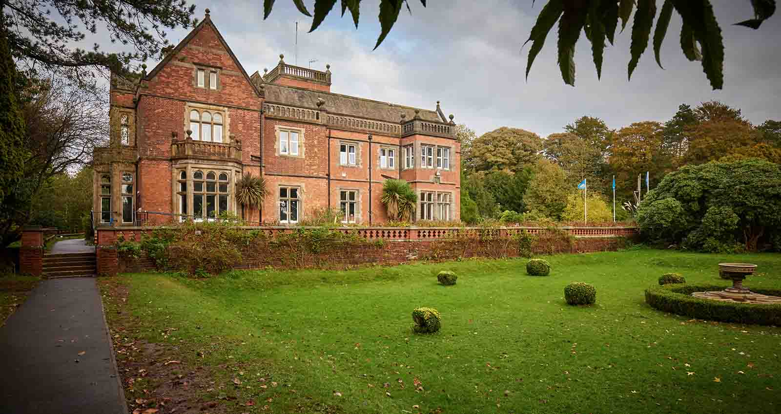
PGL 2026

Slide 2
Winmarleigh Hall, Lancashire
PGL Winmarleigh Hall
Church Lane
Winmarleigh
Preston
PR3 0LA

Slide 3
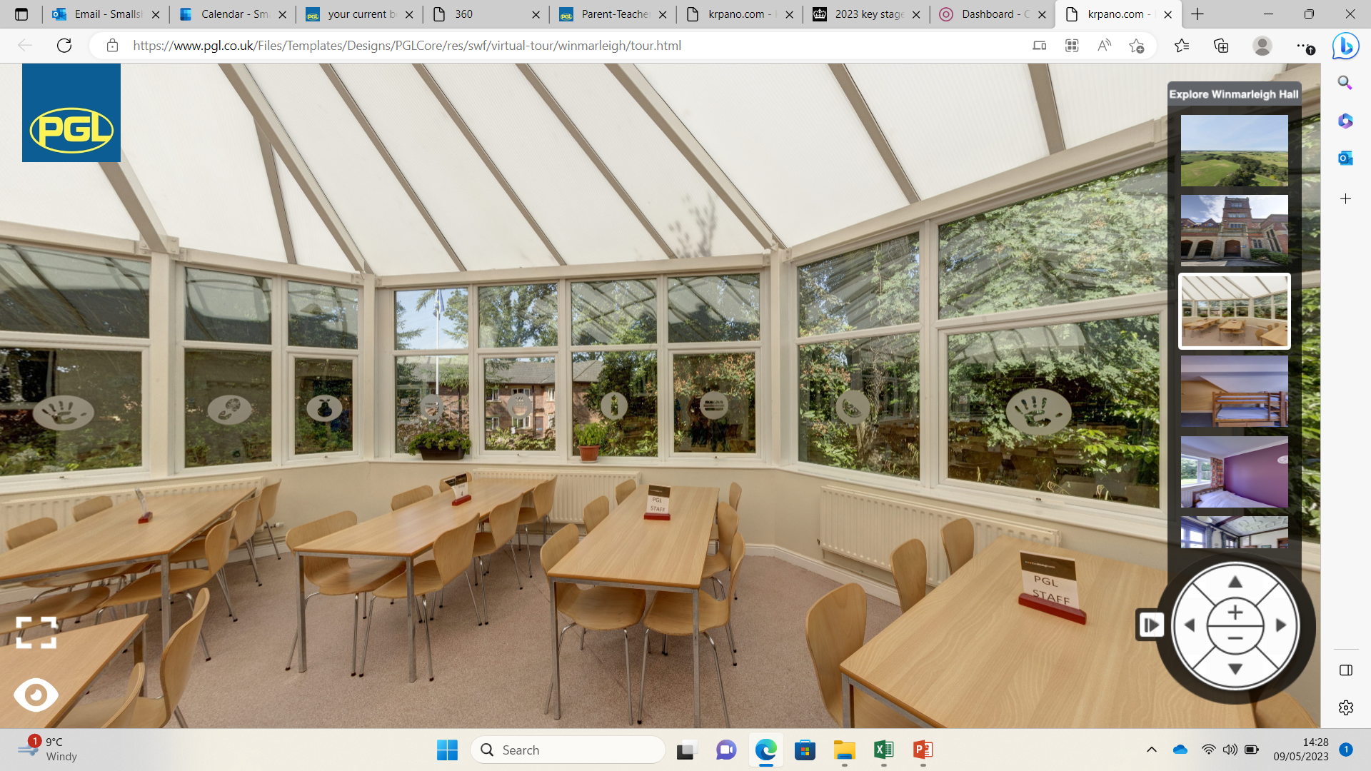
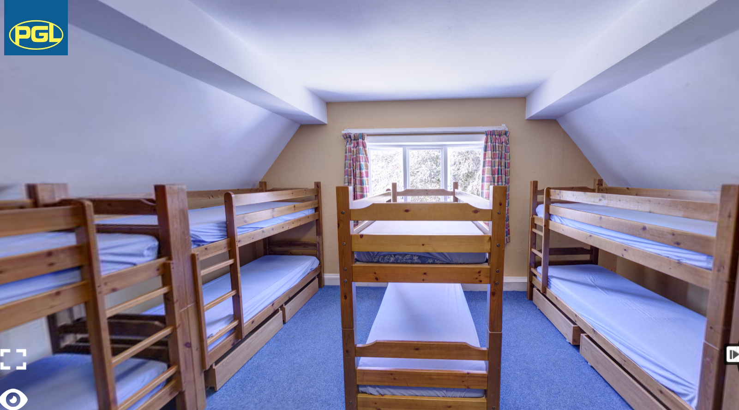

Slide 4
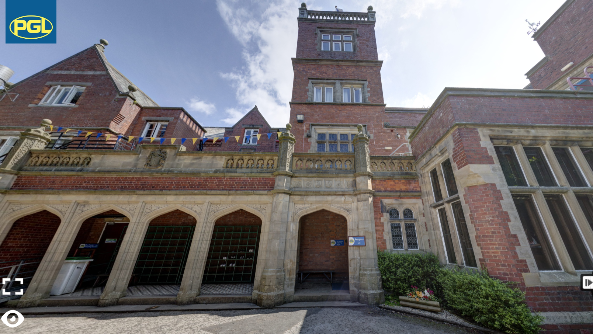

Slide 5
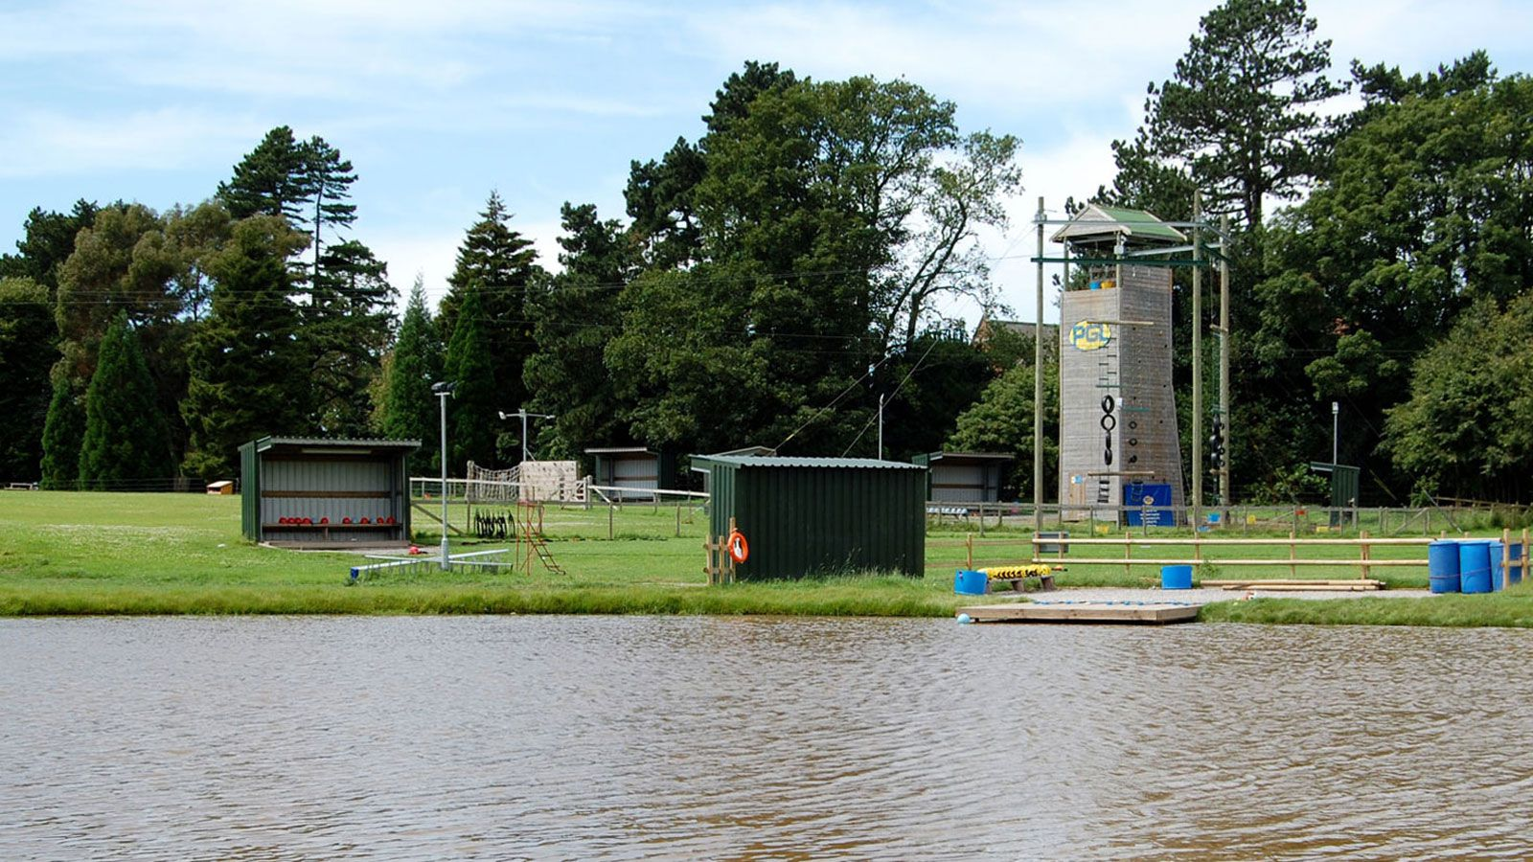

Slide 6
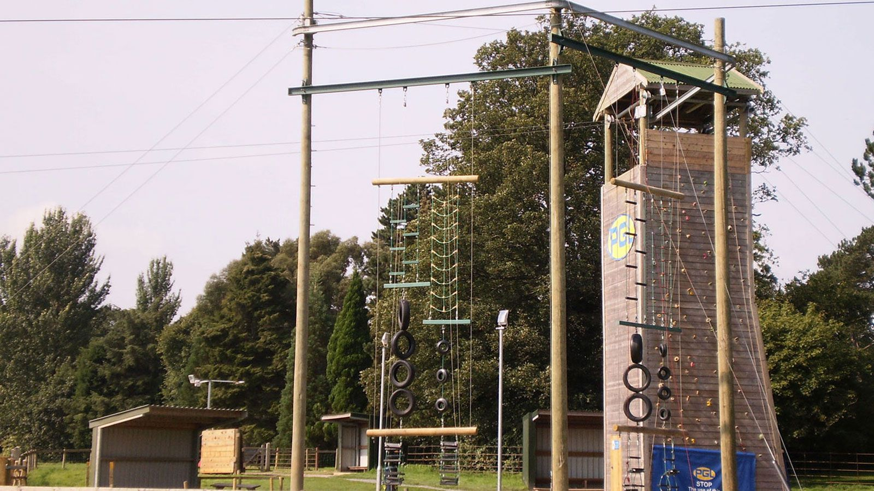

Slide 7
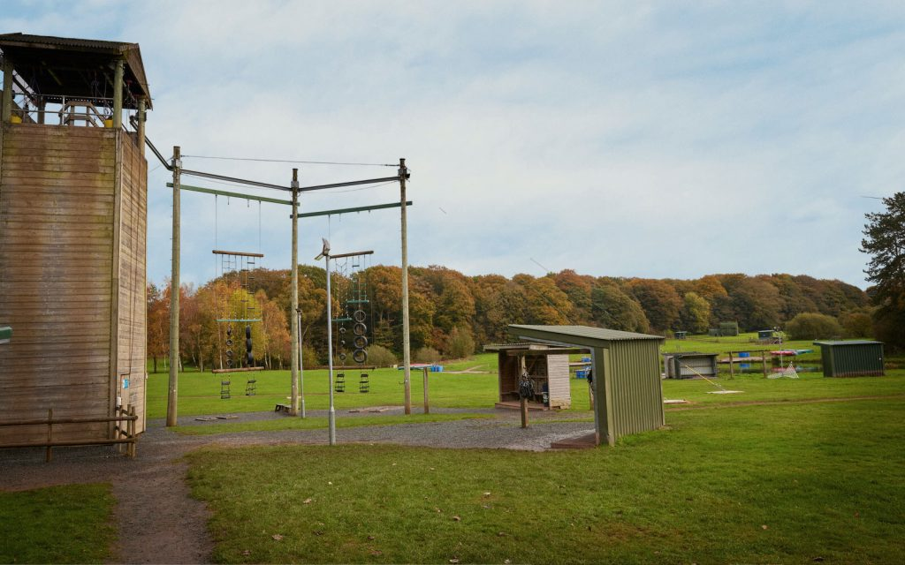

Slide 8
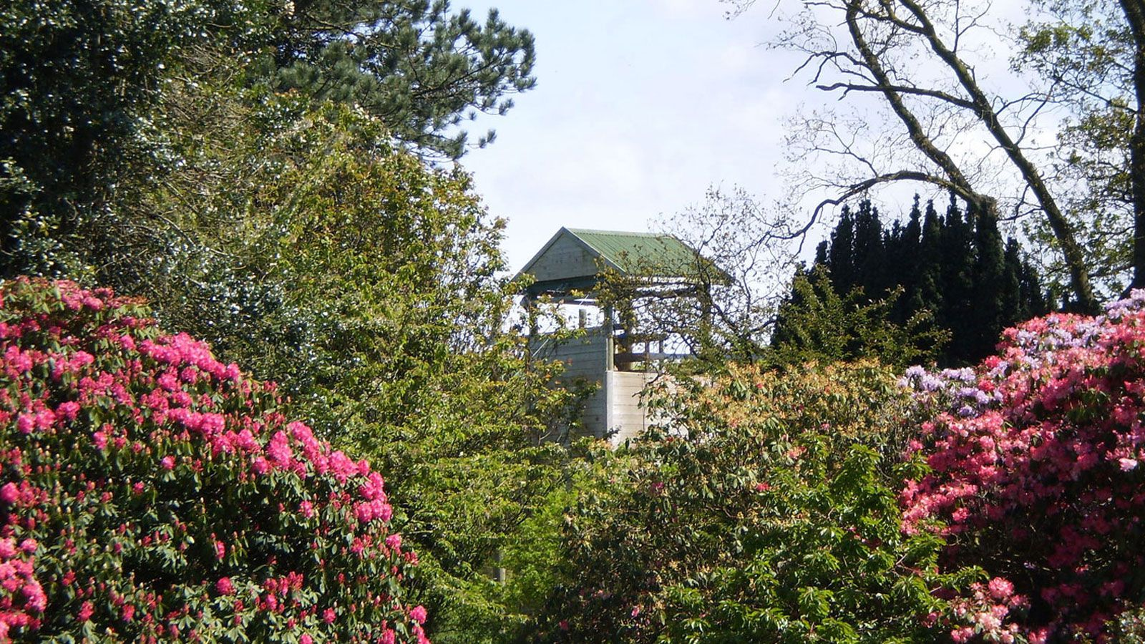

Slide 9
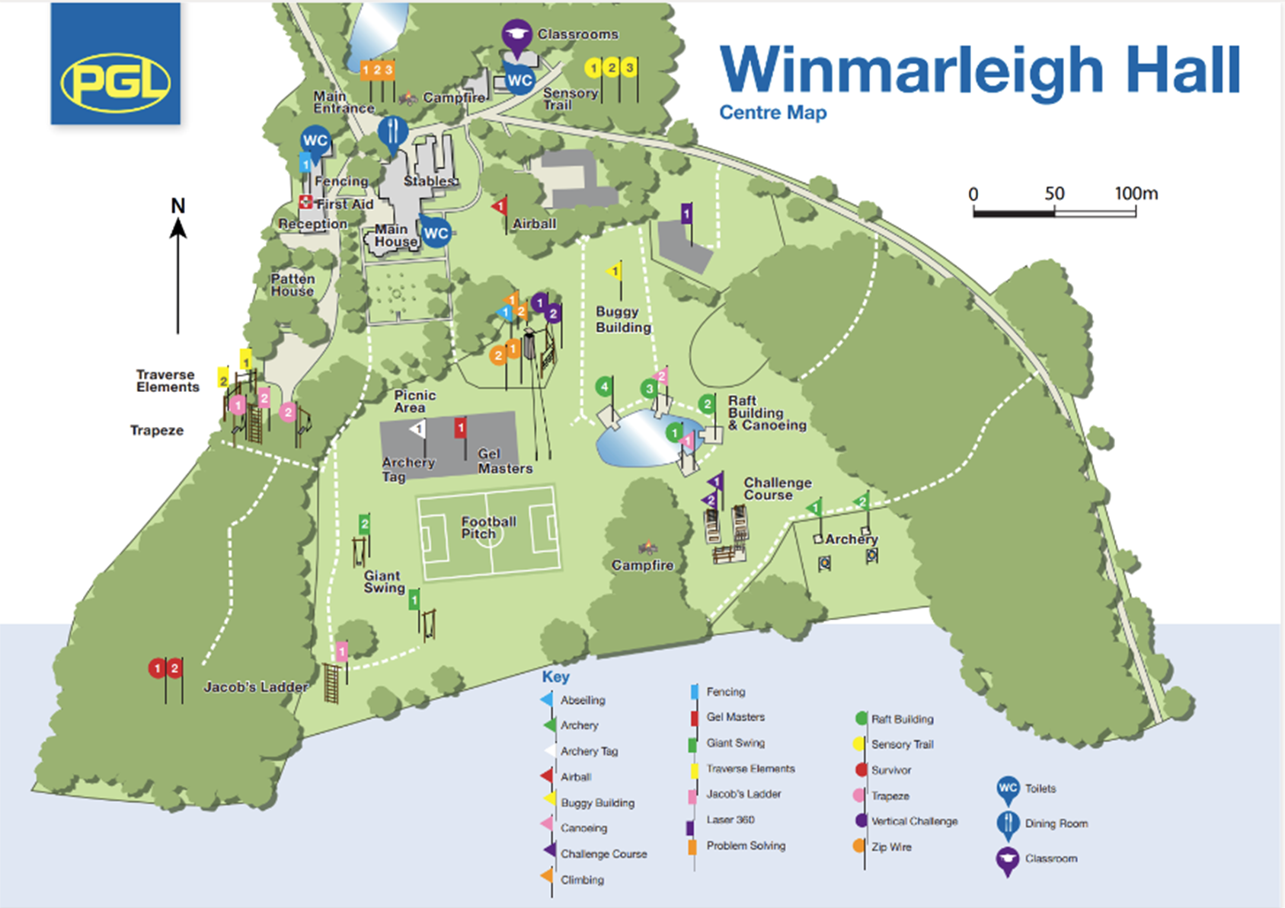

Slide 10
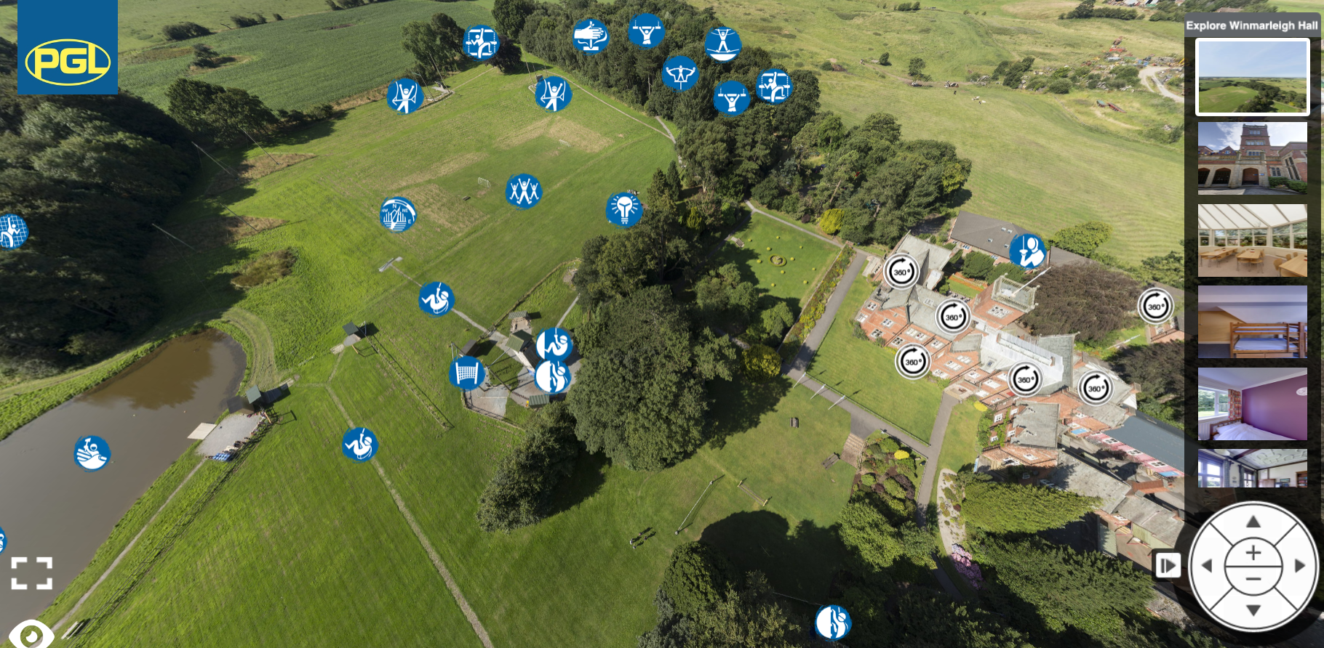
Tour of the site krpano.com - HDR-winmarleigh staff-lounge (pgl.co.uk)

Slide 11
Why PGL?
Great for personal development & confidence building
Increases motivation & appetite for learning

Slide 12
PGL Safety
The UK’s largest provider of outdoor education for young people
Over 55 years’ experience
Fully risk assessed
LOtC Quality Badge holder
Founding member of BAPA
ABTA bonded

Slide 13
Staff & Safety
4 staff members from school and 2 volunteers
Secure key pad doors
PGL staff present within the grounds of the centre
School rules apply
No technology of any sort including smart watches

Slide 14
Dates & Key Information
Monday 8th June – Friday 12th June
Arrive at school at 8:45am and we aim to leave at 11:15am – Hoodies
Expect to return at 2:30pm Friday
Updates to be posted on Facebook and with the School office
No sweets please – children can buy from the shop at PGL

Slide 15
Monday
Arrive at school at 8:45am
Packed lunch for children with plenty to keep them going throughout the day. Children who have a school packed lunch may wish to bring additional snacks.
Leave 11:15am
Arrive at PGL at from 12:15pm
Lunch, 2 activities, play games, tour, unpack and Tea
Evening activity

Slide 16
Typical Day
07:00 - School staff wake up the group
07:30 - Breakfast & free time
09:00- 1st activity session
10:30 - Break
10:40 – 2nd activity session
12:10 - Hot or cold lunch & free time
14:00 – 3rd activity session
15:30 - Break
15:40 – 4th activity session
17:30 – 19:30 - Two course evening meal & supervised free time
19:30 – 20:30 - Evening entertainment
21:00 – 22:00 – Settle Down/Bedtime
21:00 – 23:00 PGL staff on active night duty.
23:00 – 06:00 Senior PGL staff member on call, on site.

Slide 17
Rooms
Students will be in rooms of up to 6, 8 or 10 students
All rooms have en-suite bathrooms
The boys and girls are in separate rooms
Staff are on the same floors with the children in the accommodation block
PGL also have their own security team on site 24 hours a day

Slide 18
Food
Three meals a day
The first meal they will have is upon our arrival on the Monday evening. Snacks will be needed.
The last meal students will have is lunch on the Friday before we leave the centre.
Dietary needs – form/email
The PGL breakfast - hot options, cereals, toast, yoghurts, pastries & more!
Lighter tastier lunches - a pit-stop to prepare for a busy afternoon. Refuel with fresh sandwiches, soups, pasta or salads.
Delicious 'kids favourites' evening meals - crowd pleasing classics such as fish & chips, roast dinners and bangers & mash.

Slide 19
Kit List
Sleeping Bag
Blanket (if cold - hopefully not in June!)
Pillow
Wash bag
2 towels
Pyjamas (plus sweater/tracksuit in cold weather)
Changes of underwear
At least 3 long sleeved T-Shirts or fleeces
At least 3 pairs of old trousers (2 for activities, 1 for evenings)
Tracksuit (at least 2 pairs of bottoms).
Shorts (in warm weather) length!
Sports T-shirts (bring lots)
Thick and thin socks (2 pairs per day)
2/3 pairs of trainers (one for water activity that will not be used again, during the week)
A waterproof jacket

Slide 20
Waterproof over-trousers
Several strong clear plastic bags (for wet or spare clothes)
Plastic, named bottle for water
Sun hat and sun cream
Swim wear
Insect Repellent Stick
Lip balm
(Optional) Disposable Camera (Please make sure your child knows exactly how to use it and plan how many photos to take each day.
Don’t forget to name them – they all look similar!)
Please limit luggage to one case/bag per child plus one small back pack only. Cases with wheels are preferable if you have them.

Slide 21
Spending Money
Pocket money – £15.00 in a named, sealed envelope. If this can be in coins, it is better for the shop.
Please bring it by Friday 22nd May!

Slide 22
Please do not bring…
Smart watches
Mobile phones, tablets, iPads or iPods
Aerosol containers
Hairdryers
Jewellery
Anything valuable

Slide 23
Medicines
Medical form gives permission for staff to administer the medicine during the trip
Travel sickness tablets for the return journey to school will also need to be named on the form.
Hayfever medication

Slide 24
Activities
The activities shown offer individual as well as team challenges
Activities are designed to encourage new skills and develop existing ones
Specific activities can be requested (though not guaranteed) and the programme is discussed on arrival at the centre

Slide 25
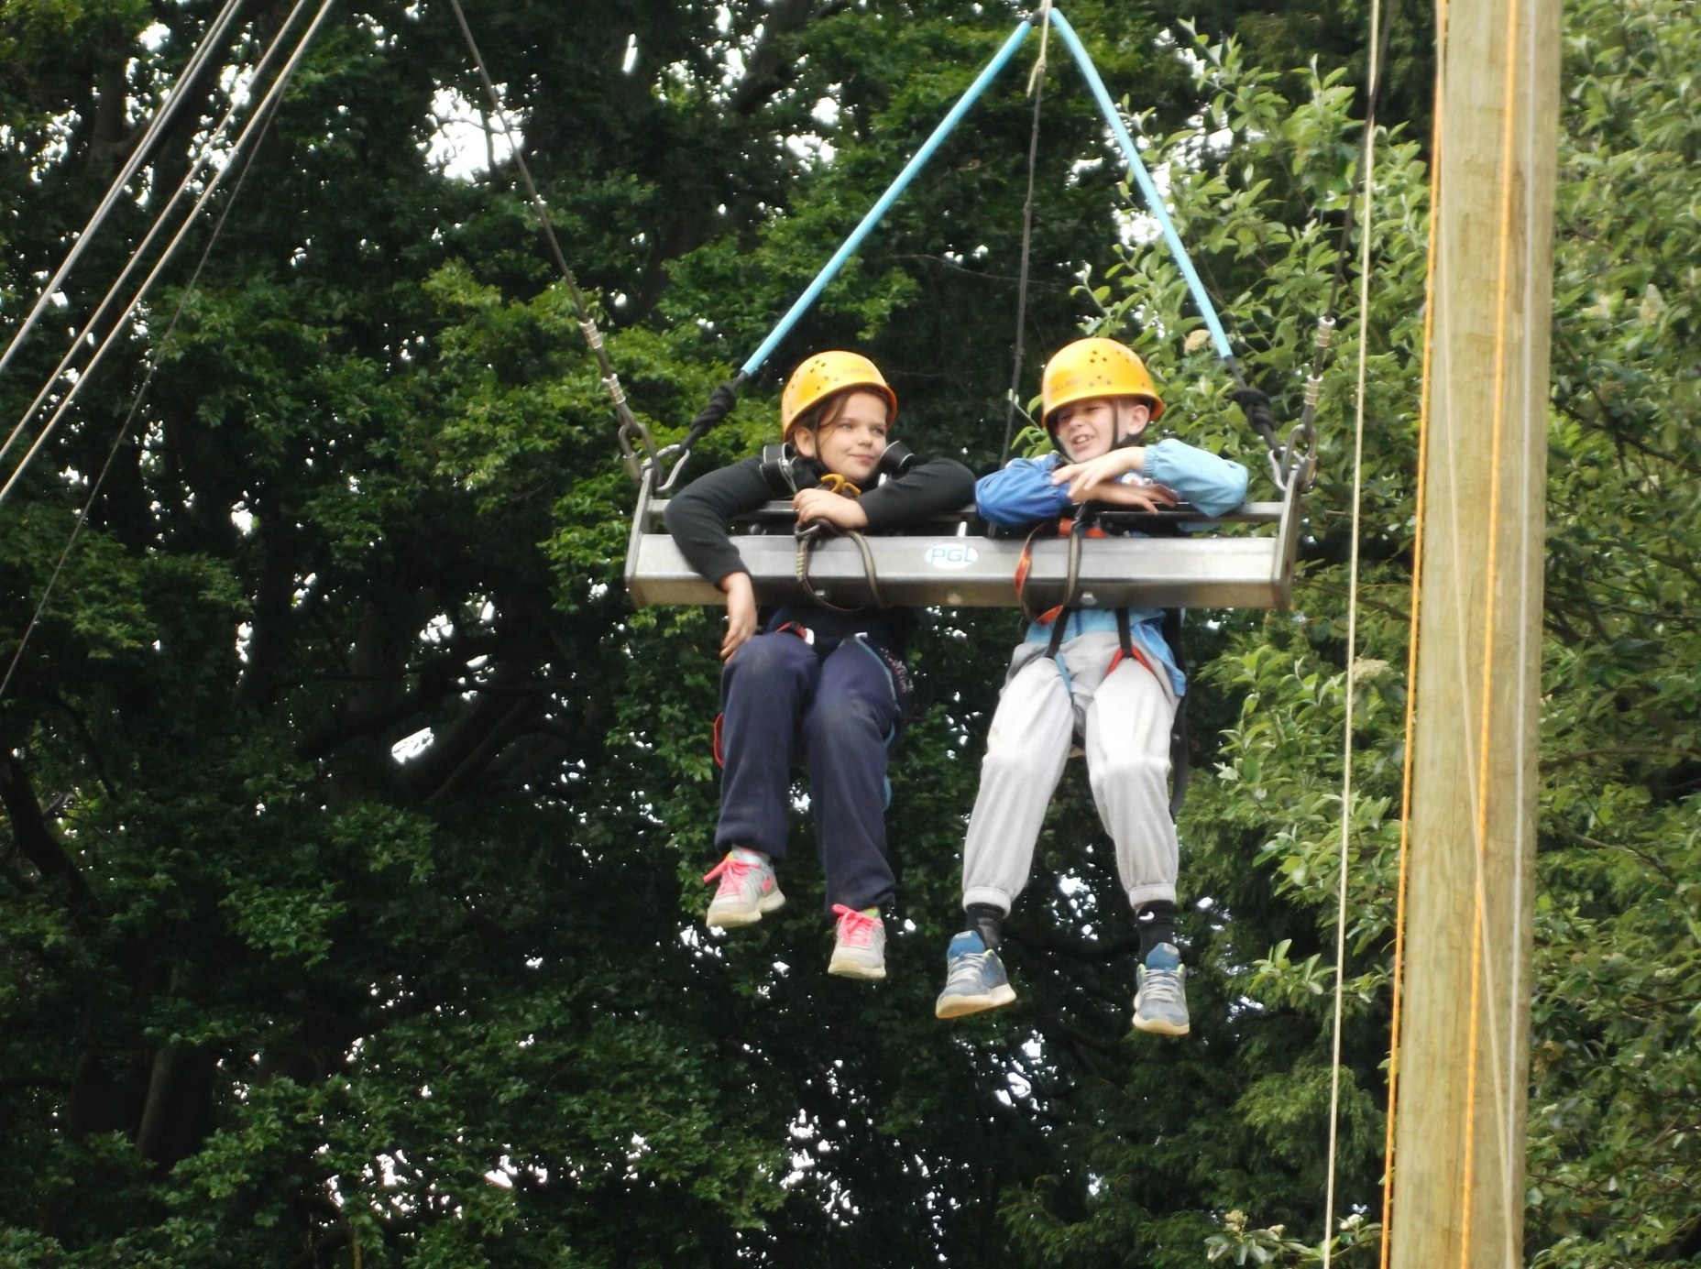
Giant Swing

Slide 26
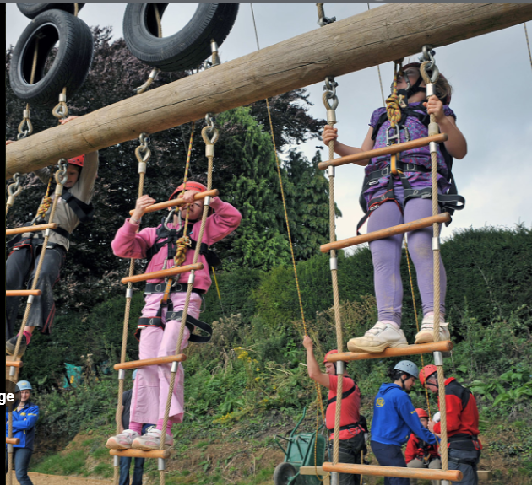
Vertical Challenge

Slide 27
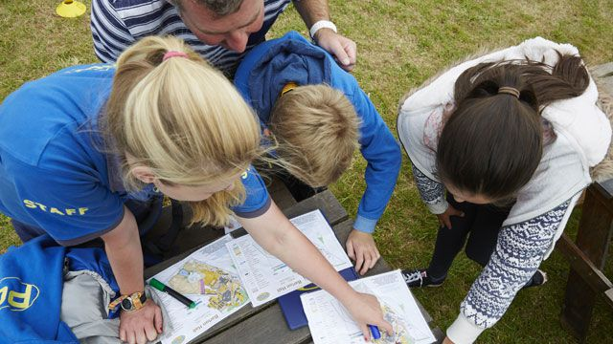
Orienteering

Slide 28
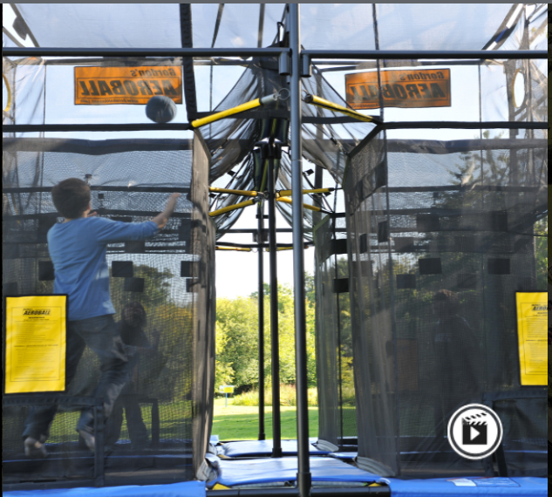
Aeroball

Slide 29
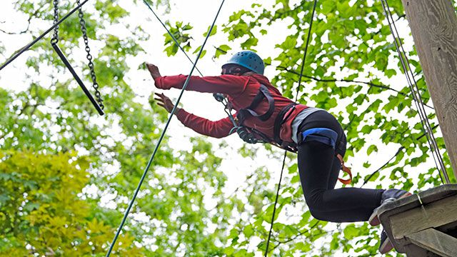
Trapeze

Slide 30
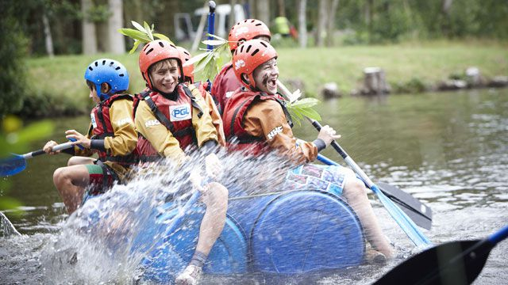
Raft Building

Slide 31
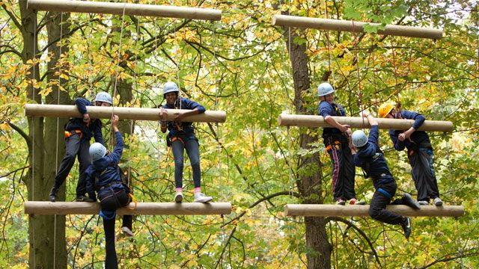
Jacob’s Ladder

Slide 32
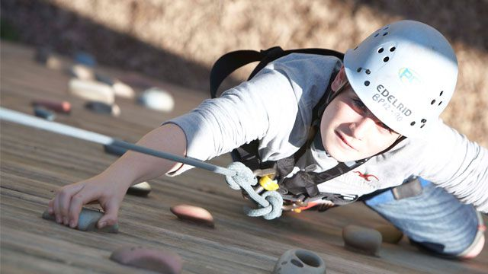
Climbing

Slide 33
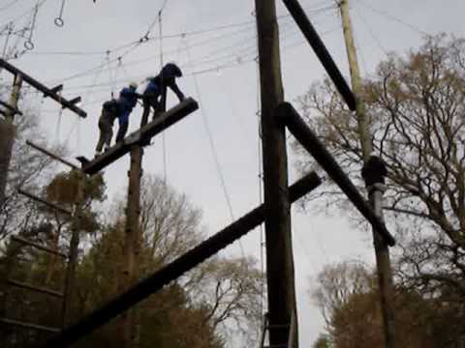
Traverse

Slide 34
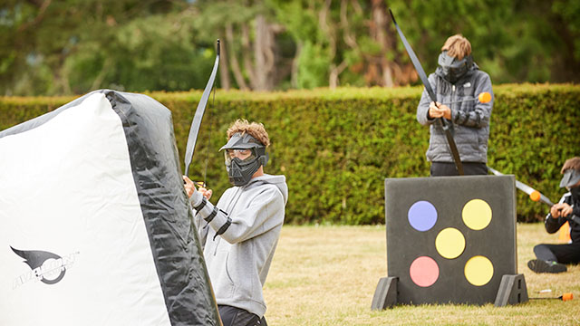
Archery Tag

Slide 35
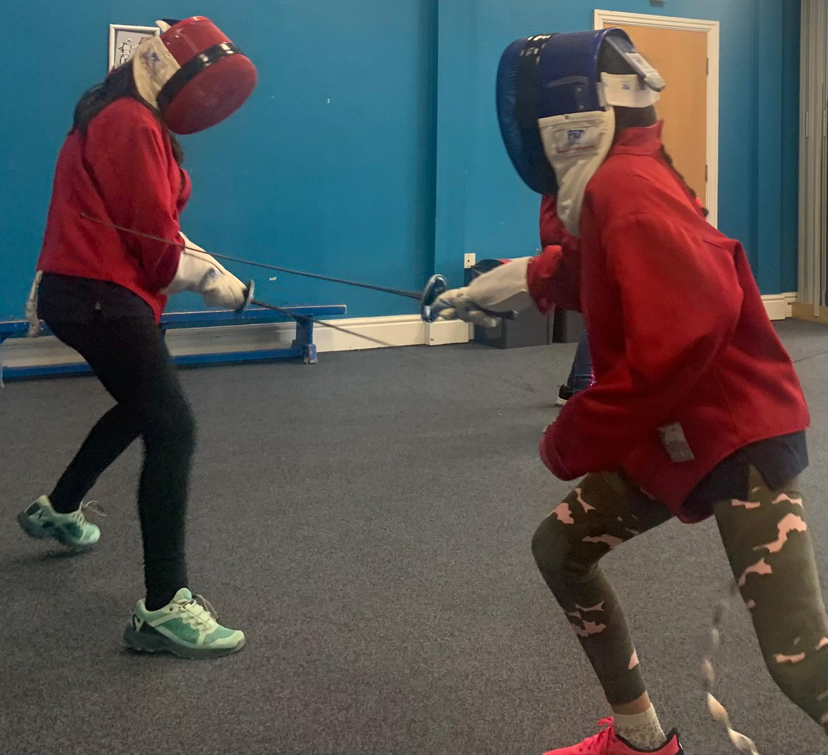
Fencing

Slide 36
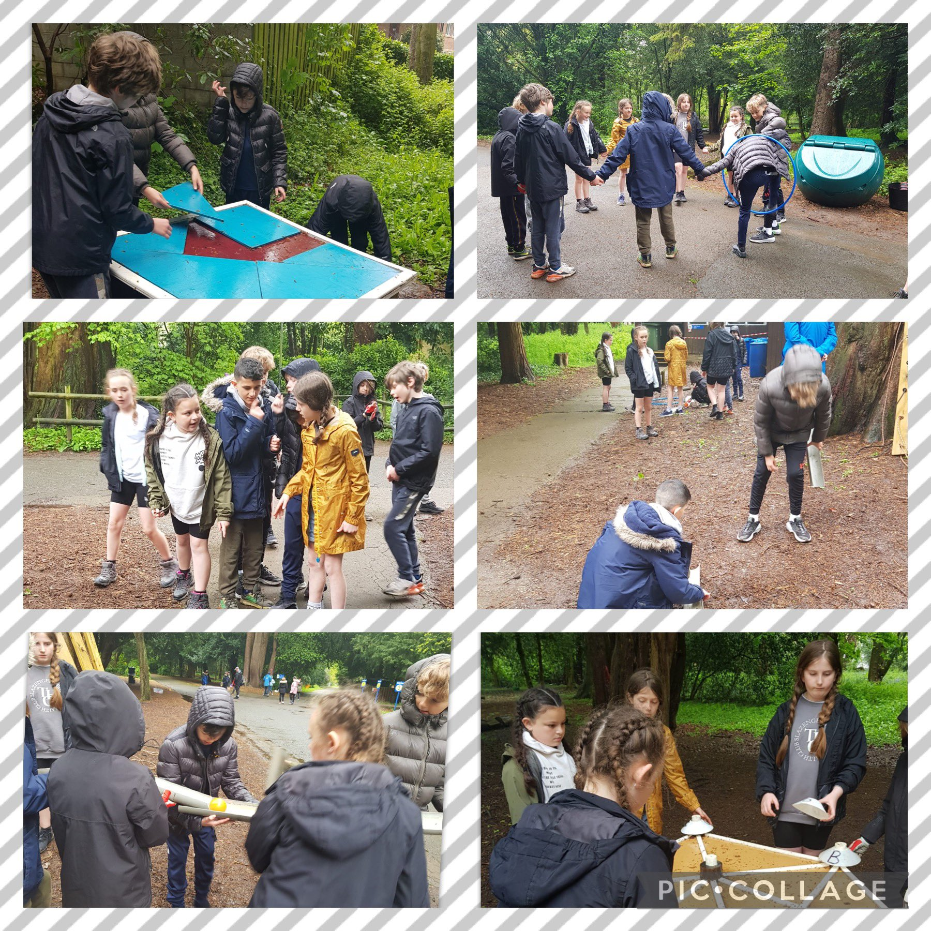
Problem Solving

Slide 37
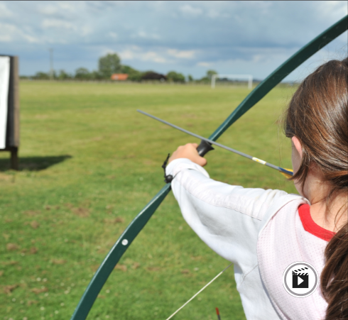
Archery

Slide 38
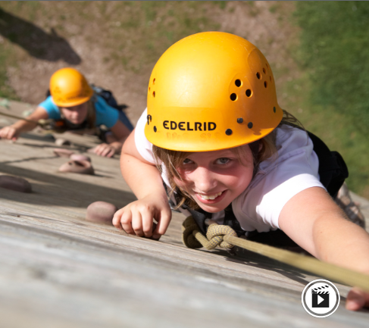
Abseiling

Slide 39
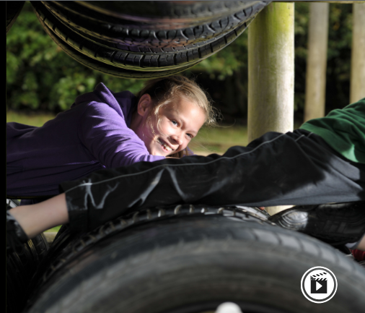
Challenge Course

Slide 40
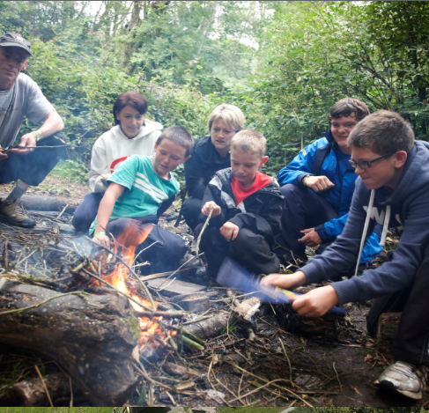
Survivor

Slide 41
If a child becomes unwell…
We will contact home and our base contact
Child would need to be collected and we would make arrangements with you

Slide 42
Finally…
360 (pgl.co.uk)
If you need to contact us regarding anything confidential then please email Mrs Smallshaw, or speak to us tonight.
THANK YOU ☺

