Slide 1
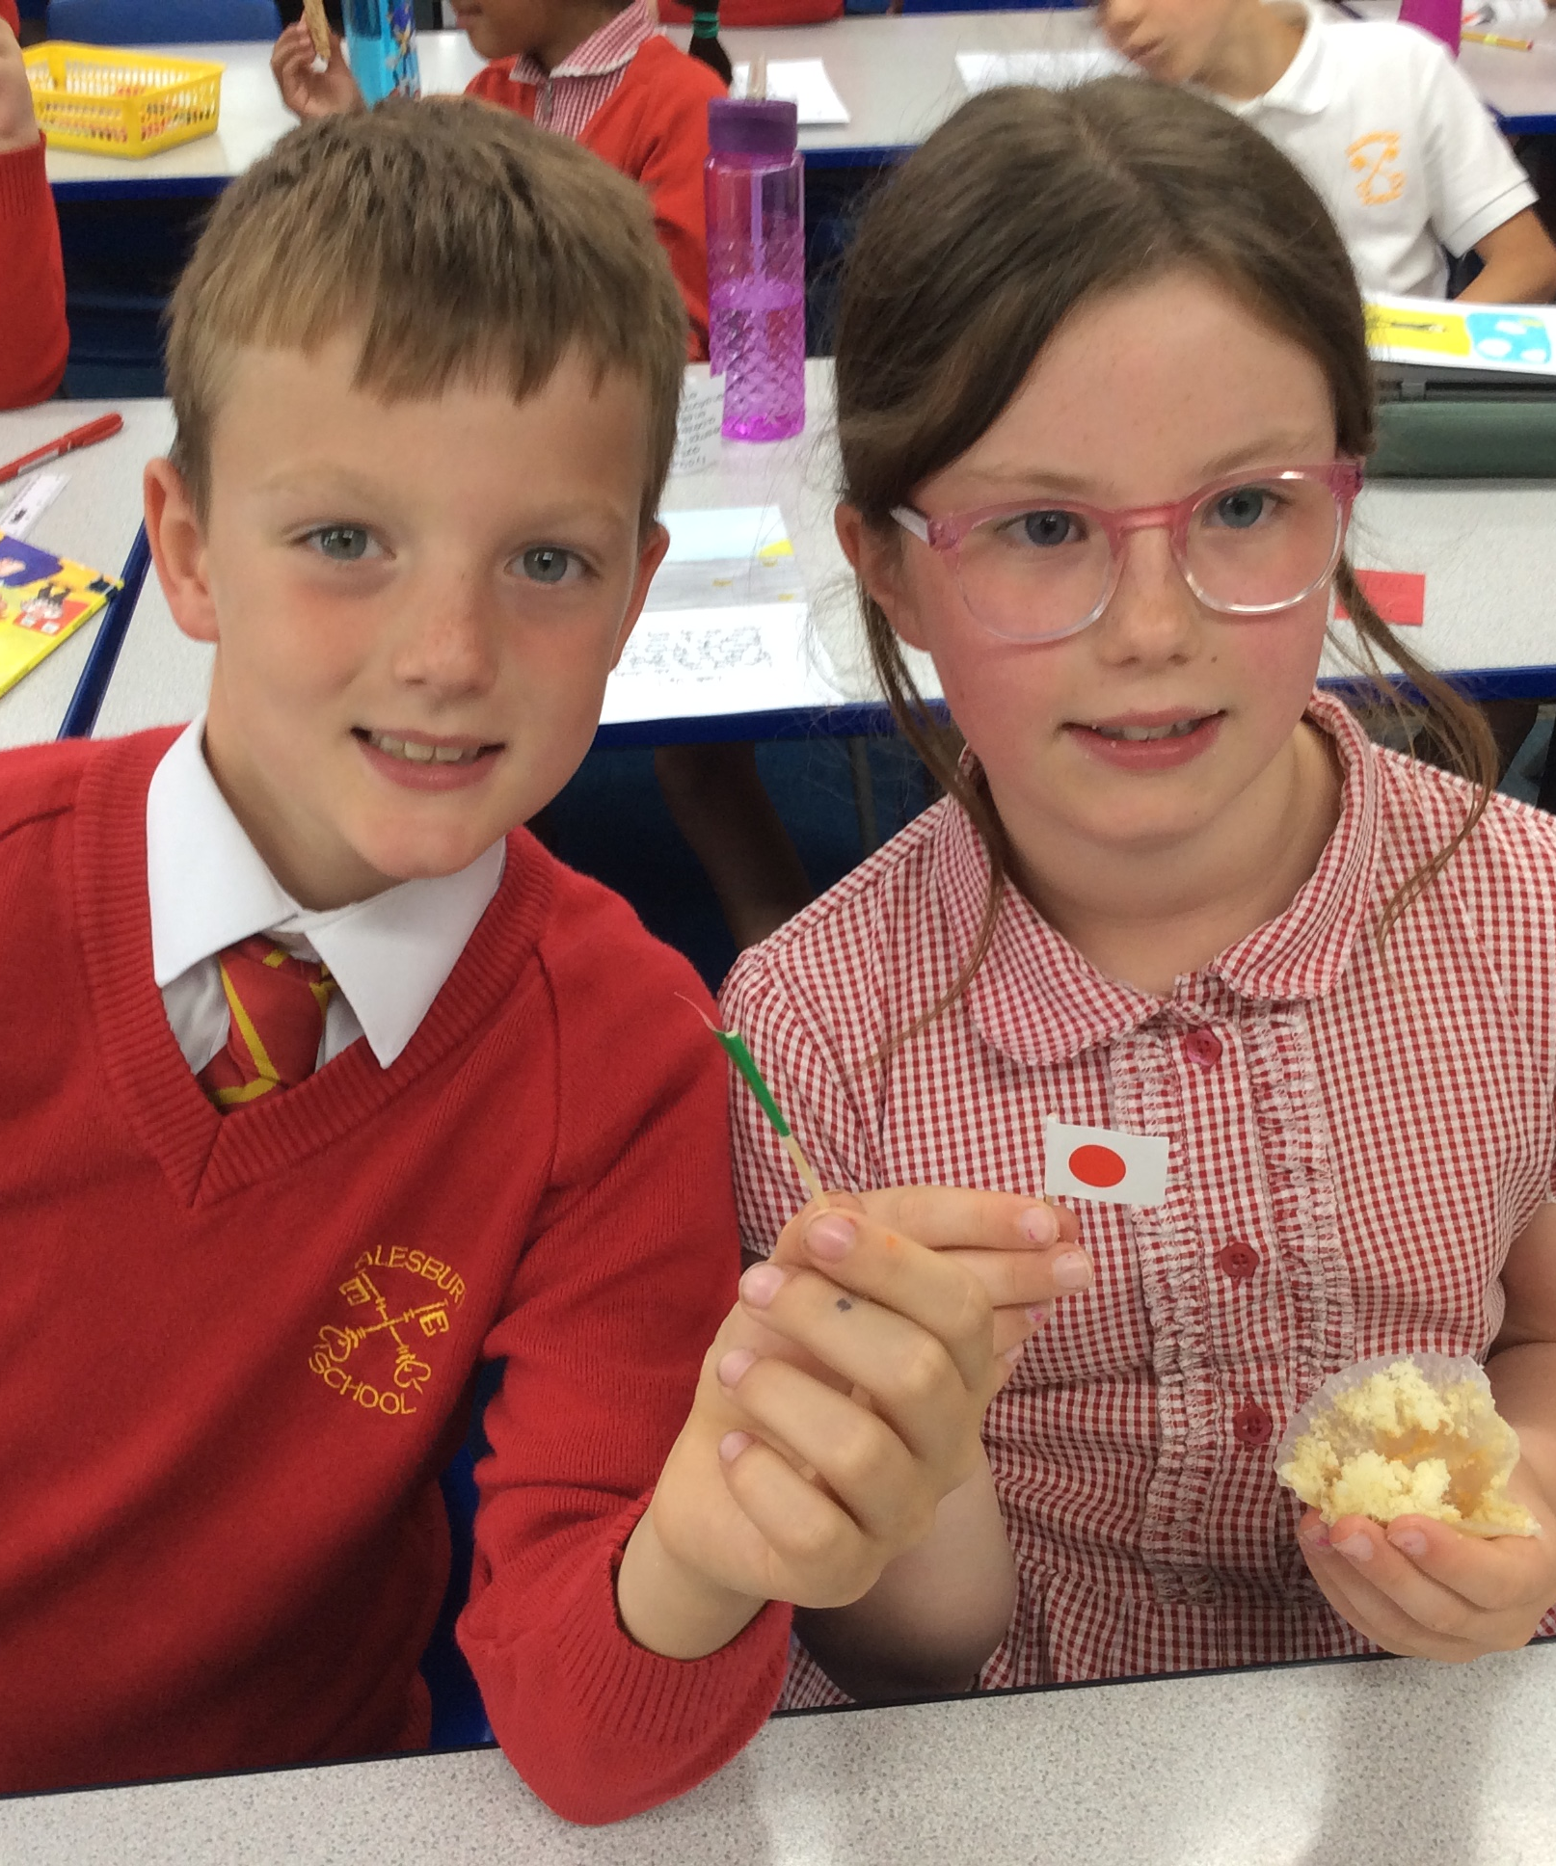
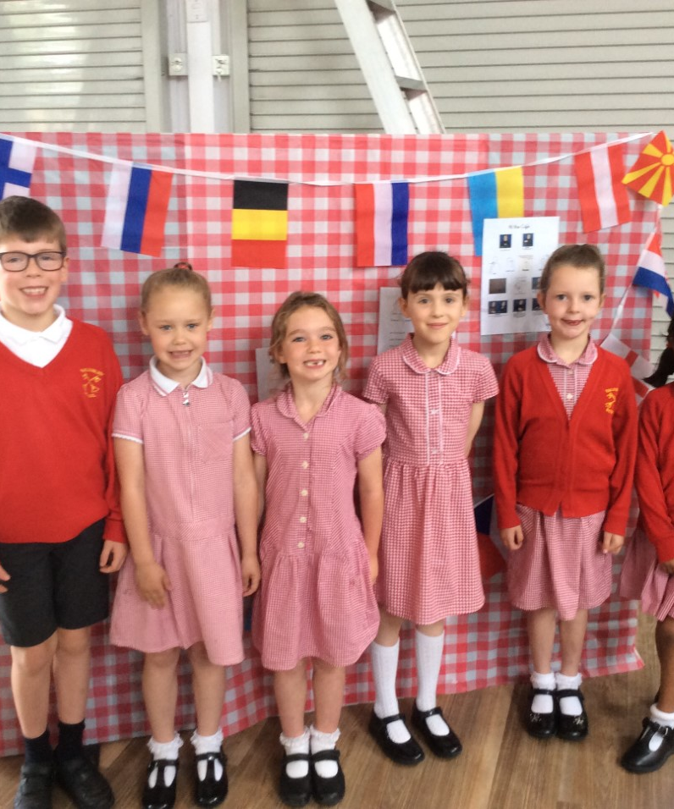
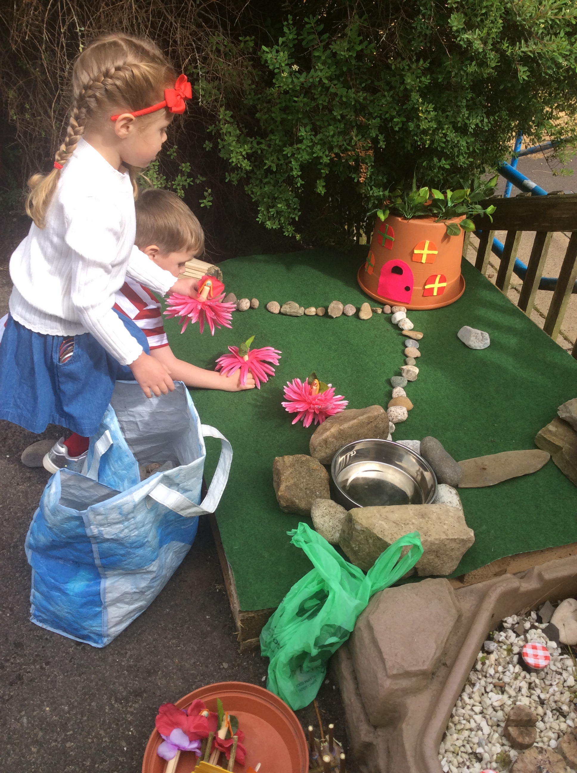
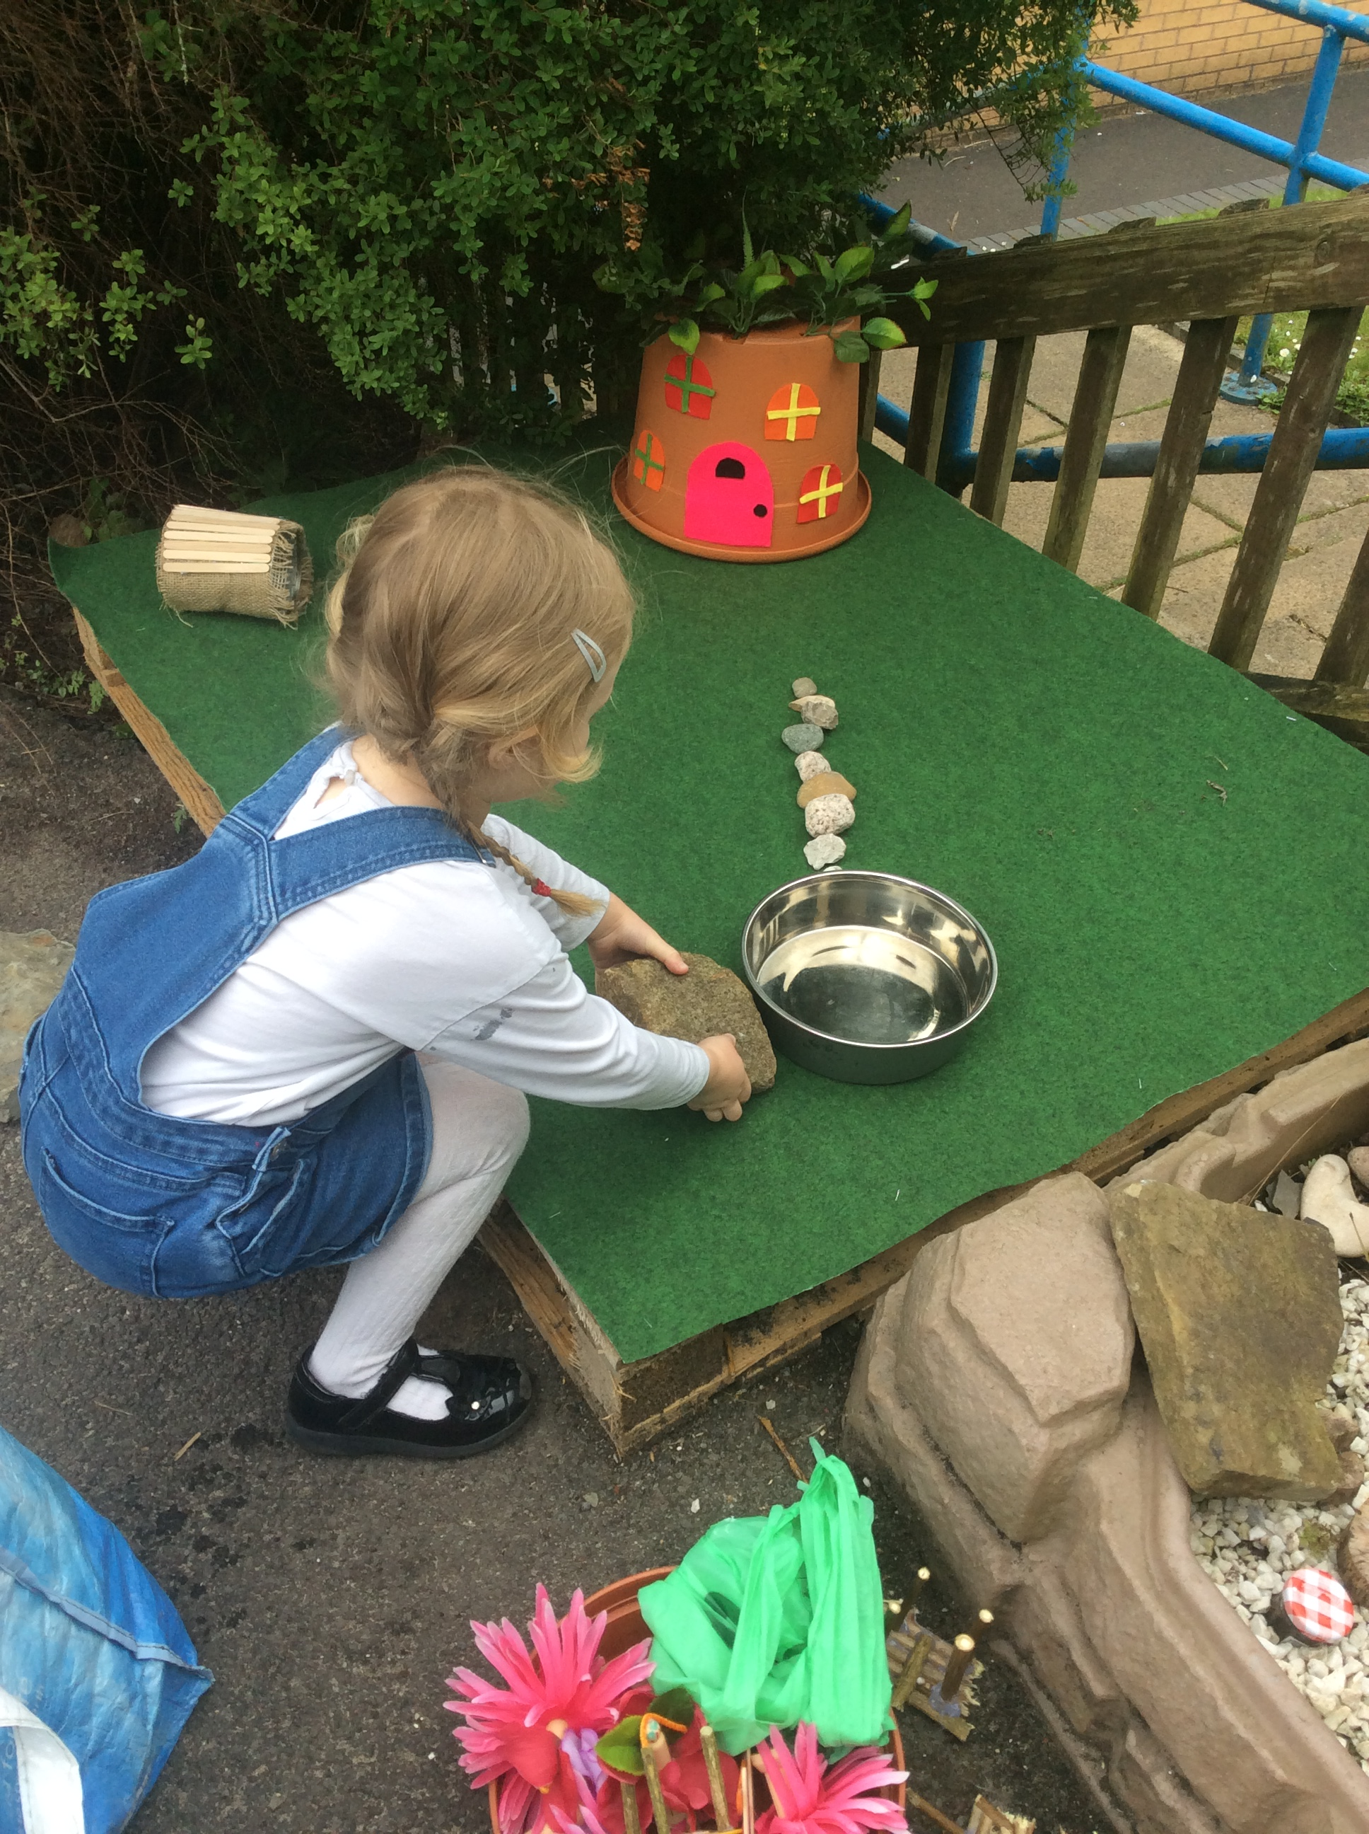
MEET THE
2025
TEACHER
Notes:
Emphasise start of relationship between you, children and parents
Few slides to provide information followed by an informal opportunity to chat afterwards

Slide 2
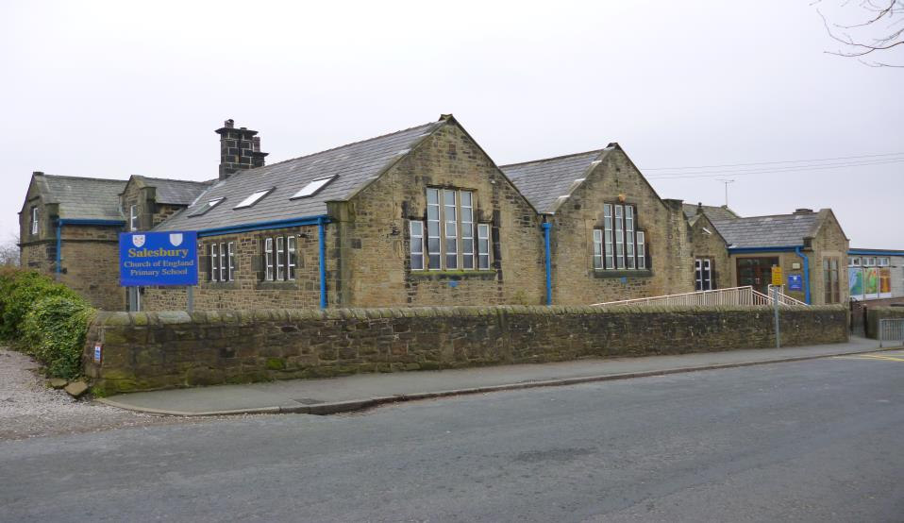
Aims of the Evening…
To provide an informal opportunity to meet each other, introduce the new school year and answer any initial queries you may have

Slide 3
If you have any queries
Teachers who work in our class
Miss. Healey & Mrs. Tyson
Teaching Assistants
Mrs. Melling
tyson@salesbury.lancs.sch.uk
healey@salesbury.lancs.sch.uk
Notes:
Introduce – you are first point of contact for queries, concerns

Slide 4

Curriculum
Strong, bespoke approach to teaching the National curriculum – strong, meaningful links across the curriculum where these can be made, use of visits, outdoor learning, visitors and experts
Mathematics and English taught daily discretely and interwoven across curriculum
Teaching children how to become more independent, successful learners, nurturing a growth mindset in all our children
Give children ownership of their learning – many opportunities for challenge, independence
All children access some some small group work or individual work across the year
Use assessment as a tool to see where children are, to find out what their gaps and next steps are and to inform future learning
Notes:
Curriculum designed to provide many exciting opportunities to develop skills and knowledge in each subject area
Explain that children will be praised/rewarded for effort and attitude to learning – talk about Growth Mindset – importance of effort and challenge
Distribute Knowledge Organisers or make arrangements to send out next week – explain how they can use these at home – little quizzes, games

Slide 5

Knowledge Organiser
Knowledge Organisers will be sent out periodically through the year
These set out the minimum knowledge and vocabulary children must learn within our theme for the half-term
This knowledge will be enhanced by much greater learning in class and many rich learning experiences
Please help your children learn the facts and vocabulary – make it fun!
Knowledge Organisers will be added to the class page of the website so we can keep remembering and recalling learning from earlier in the year.
Notes:
Suggest a couple of activities they could do to help children learn

Slide 6
Our Curriculum Unit this term
Our main subject focus is History delving deep into Chronology of Clothes and Fashion
Science: Rocks and Soil
Novel: The Lion, the Witch and the Wardrobe by C. S. Lewis
Poem: A Fashion Journey Through Time by Lily Brightwood
Notes:
Engage parents with what we will be teaching this term, topics, class novels, poems, planned visits and visitors, useful websites, books children may wish to access to support learning – e.g. class novel/poems
Could mention any possible trips/visitors

Slide 7

Ongoing Assessments
Progress is tracked for every individual child on a termly basis in mathematics, reading and writing. This helps us to monitor progress throughout the year and adapt teaching and support where needed.
Most children are taught within the year group expectations for the year group, children will be assessed at three different points in the school year against the following criteria: entering, developing, secure in meeting year group expectations. Children are not expected to be secure in the year group expectations until the end of year but are expected to make progress within the expectations throughout the year.
Children who are not ready for year group expectations will be supported to make progress towards these, children who demonstrate a strong secure understanding of expectations will be challenged through problem solving, deepening understanding, applying knowledge learned and creative learning opportunities
Support programmes are used to support small groups of children throughout the school as and when needed
You will be given a termly report including a summary of their learning attitudes and assessments prior to Parents Evening, these help you prepare for Parents Evening and formulate any questions you do have
Notes:
We will ensure that
Children are making good progress from their starting point
Children are working towards year group expectations as far as we possibly can, where children are working below due to cognitive difficulties individual and group plans will be put in place

Slide 8

Reading
Whole Class Reading taught each day
Reading at home – invaluable, please sign the diary each time you hear your child read
Reading Gameboard
Individual and small group support
Class Novel
Reading area within our classroom
Library Service
Daily Phonics lesson for EYFS and Key Stage 1
Reading across the curriculum
Parent volunteer helpers are welcome – we ask parents to volunteer at drop off time at 8.45 – 9.15am to listen to individuals read. Please let the school office know, if interested. DBS Clearance will be required but can be arranged by the school
Notes:
Explain all the different ways children read in school, make clear that home reading books are not school reading books but there to help children practice.
Stress the impact of daily reading aloud at home can make

Slide 9
Reading Gameboard
Research shows regular home reading, especially reading aloud, really does make a difference.
Gameboard to encourage regular reading. Please initial each day your child reads at home, when they reach a footprint, it is your turn to read to them. We will have a visual in class to see how children are progressing. This is something all children can do – practice!
Notes:
Talk through reading award scheme – parents initial each day they hear their child reads, when they reach a picture on the game board, it is children’s night off and parents to read to them. Children to collect their certificate at the end of each board, before collecting next one.
Regular home reading is so crucial – plea for support!

Slide 10
The benefits of reading as children grow
0–2 years
Bonding and building relationships
Speech and language
Foundational thinking
3–4 years
School readiness
Wellbeing and resilience
Emergent literacy
Thinking, memory and creativity
5–8 years
General knowledge and attainment
Wellbeing, resilience and attainment
Language and literacy
Thinking, memory, attention and creativity
Reading fluency
9+ years
General knowledge and attainment
Wellbeing, empathy and emotional intelligence
Language and literacy
Thinking, memory and creativity
Reading fluency
Notes:
Discuss benefits of reading aloud – for meaning, expression, fluency and comprehension – no matter the age

Slide 12
Year 4 Multiplication Tables Check (MTC)
By the end of Year 4, the children are expected to learn their times tables up to 12.
In Summer Term the children in Year 4 will sit the Government MTC test.
This is completed electronically.
The test consists of 25 questions, with a timer of 6 seconds to answer each question.
Results are published and shared with parents in the end of term, Summer Term Reports.

Slide 13

Wellbeing
Emotions Check-In
Five to Thrive
Wells of Wellbeing
Movement within lessons
Visual timetable
Clear routines and expectations
Notes:
Discuss daily routines which support wellbeing – all great for mental health!

Slide 14

Homework
In year 3 and 4 there will be a homework grid for each half term with different activities on that the children can complete.
Sent home electronically, on the school website and the children will be given a copy to take home.
If needed, an extra task will be given which will most likely focus on Mathematics or English (for example, extra comprehensions etc.)
There will be a weekly spelling sheet that will given out on a Friday and needs to be handed in by the following Thursday
Notes:
Discuss timings/types of homework
Expectations re presentation etc
How this will be sent home
Include details of web based

Slide 15
Spelling
Using the Spelling Shed scheme to teach spelling across the school.
Each week teachers will teach a new pattern with a homework sheet being given out on a Friday, due in by the following Thursday.
Spelling tests will take place each Friday. Children will have some sentences dictated to them by their teacher. These sentences will include some of the words children have practised that week. In addition, the sentences will also include words that have spelling patterns in from previous weeks and some of the year group words that children also need to practise and learn.
Encourage children to learn their spellings and their pattern each week, play the games on the Spelling Shed and complete their weekly homework task.

Slide 16

Behaviour
High expectations of behaviour
Recognition Board
Individual incidents dealt with separately
Choice Card System
Encourage children to reflect on their behaviour, take ownership and plan for their own improvements
High 5 is our celebration of good behaviour shown during the week
Consequences may include loss of privileges
Mission in Action tickets given for ‘above and beyond’ winners go and have Hot Chocolate
House Points
Importance of school and home working together – please raise any concerns directly with me, where possible
Notes:
Encourage parents to work supportively with school, to ask you directly if any queries, to support school with any consequences

Slide 17
P.E.
P.E. is on Tuesday and Wednesday
Children may wear the school tracksuit on these days or come in uniform and change for the lesson. We ask that children do not wear their own leggings, sports tops etc
All children must participate in PE as part of the curriculum
Earrings or other jewellery cannot be worn
Sports Coaches
Swimming
Notes:
Add class information

Slide 18
Health and Safety
Please ensure long hair is tied back at all times. Please keep hair accessories simple and in school colours
Simple stud earring can be worn in Key Stage 2 but should not be worn at all on PE days
Only prescribed medicine to be administered in school, a signed form must be completed which is available from the school office
Please attend to head-lice immediately
Online Safety – please follow age-appropriate guidelines at all times – safeguarding!
We do practice both fire drills and lockdown procedures – both of these will be practiced very quickly in the next couple of weeks. We do pre-warn children for the first drill.
Please update us if somebody different is collecting your child from school

Slide 19
Drinks & Snacks
Children are encouraged to have a bottle of water in school each day and take regular sips to keep hydrated. We do encourage children to have the school water bottle – this is neat and fits well on the school desks
Infant children access the fruit and vegetable daily scheme
Milk can be purchased for all children from the term they are five via CoolMilk, up to this point it is provided free of charge. Please see school office for further information.
Key Stage 2 children may bring in a healthy snack – no biscuits, crisps or chocolate. Fruit or Vegetables are ideal
Notes:
Discourage novelty bottles/Stanley cups – emphasise it is about sipping to avoid dehydration
Really emphasise KS2 snack and follow up carefully

Slide 20
School Uniform
High standards throughout the year
Children need a coat as we go outside throughout the year
Please keep hair accessories very simple and in school colours or black/white (no decorative accessories)
Black school shoes. Trainers can be worn on PE days only
Name labels – please label absolutely everything and keep topping up during the year
Notes:
Keeping extravagant accessories for evenings and weekends
Labour labelling of clothing

Slide 21
SRE in Year
Part of our PSHE and Science curriculum
Summer Term
Taught by the teacher
If you have any further questions about it, further information will be provided nearer to the time.
Notes:
Please add any timings of SRE programme for your year group, further information will be provided nearer the time

Slide 22
Friends of Salesbury School
First meeting is on Tuesday, 9th September 6.00pm– meetings are very informal but give opportunities to chat about the extras we can provide for our children. Some are fundraising events; others are more social events!
Notes:
Really welcome parents to come along and give it a try!

Slide 23
Class Facebook Page
Invitation to all parents to be part of our class Facebook group
We encourage interaction.
We share lots of our learning on this page in addition to little reminders
Notes:
Talk through access, permissions and purpose

Slide 24
Attendance
Regular attendance and punctuality matters!
Learning starts straight away – we have a very full timetable
Obviously, if children are poorly they cannot attend and we understand this but do encourage children to get in good habits
Please telephone the school office as early as possible if children are not attending and use the absence line
Children who have had vomiting or diarrhoea must stay off school for 24 hours to limit the opportunity to spread this
We are not allowed to authorise holidays during term-time unless there are particularly exceptional circumstances. Please remember penalty notices are now in place
Notes:
Change to guidance – absent from school 24 hours after vomiting/diarrhoea
All requests for leave during term time must be completed on an application form available from school office.
Ensure Penalty Notices are mentioned – the money does not come to school!!

Slide 25
Questions/Concerns
Please do get in contact if you have any questions or concerns throughout the year
Regular feedback through the year
Termly Report
Parents Evening - November, April
End of year report
End of Year consultation evening
Notes:
Add email address etc.
Set your stall out for a positive year, encourage support and working together
Thank everyone for taking the time to come!

