Slide 1
Computing
Maze Explorers!

Slide 2
Your challenge!
Your challenge is to complete the game, to get to Granny’s house or the gingerbread mans house!
Please watch the video on the next slide and follow the steps to complete your work.

Slide 3
New learning
Knowledge
To know how to make your character move.
Skill
Use the direction keys in 2Go to move forwards, backwards, left and right.
Undo your last move.
Move your character back to the starting point.

Slide 4
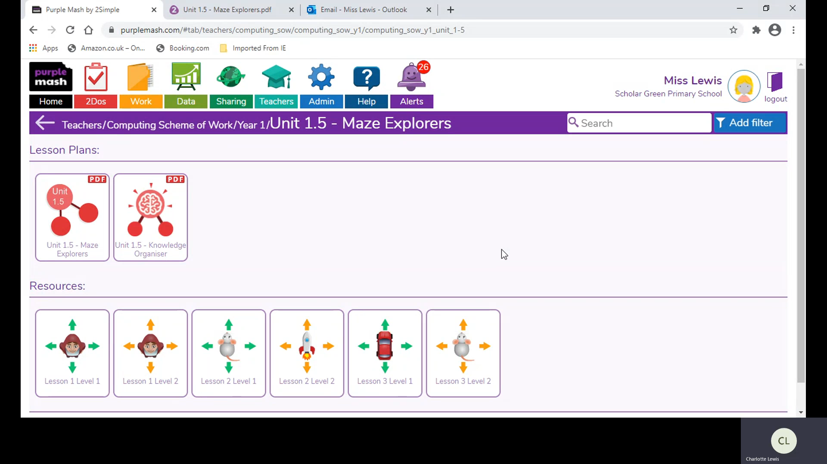
Instructions

Slide 5
Saving instructions
Challenge 1 – save your work as your name.
Share to ‘YR1 Maze Explorers Spring 1 20/21’
Challenge 2 – save your work as your name.
Share to ‘YR1 Maze Explorers Spring 1 20/21’

