Slide 1
Zippy’s friends
W.C 18.1.20

Slide 2
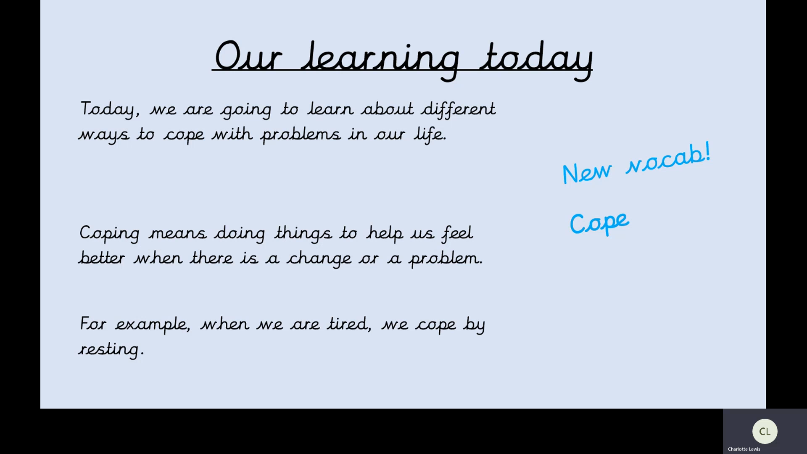
Video for parents

Slide 3
Our learning today
Today, we are going to learn about different ways to cope with problems in our life.
Coping means doing things to help us feel better when there is a change or a problem.
For example, when we are tired, we cope by resting.
New vocab!
Cope

Slide 4
Read through the story to see different ways to cope with a problem.

Slide 5
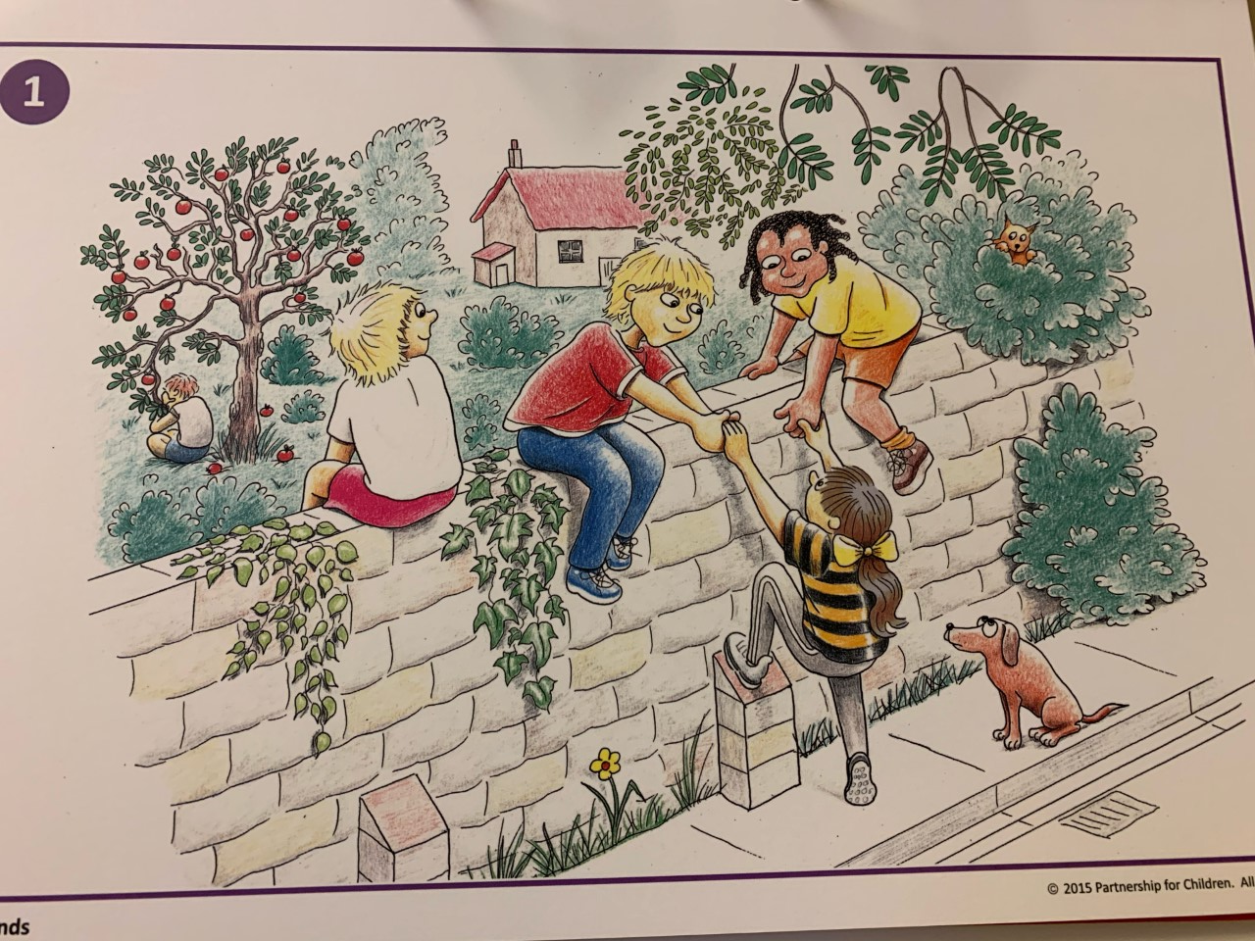
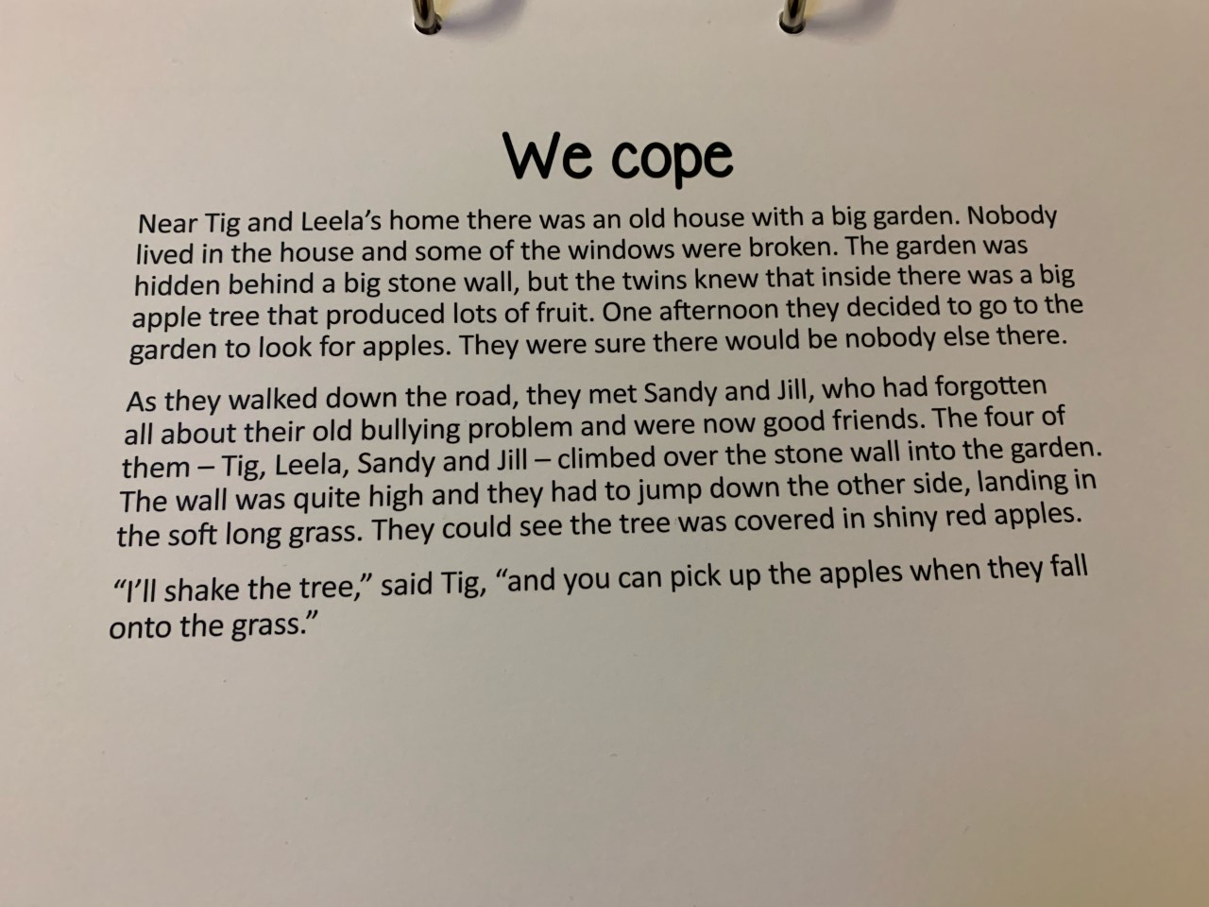
Story 6
We Cope

Slide 6
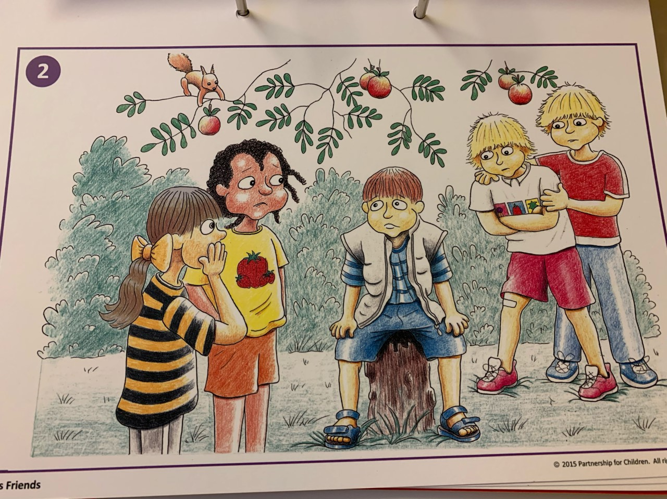
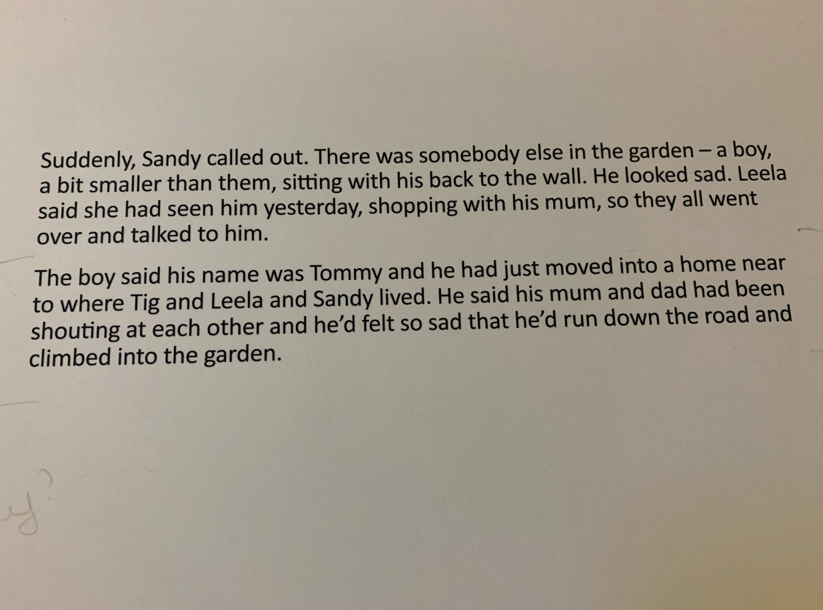

Slide 7
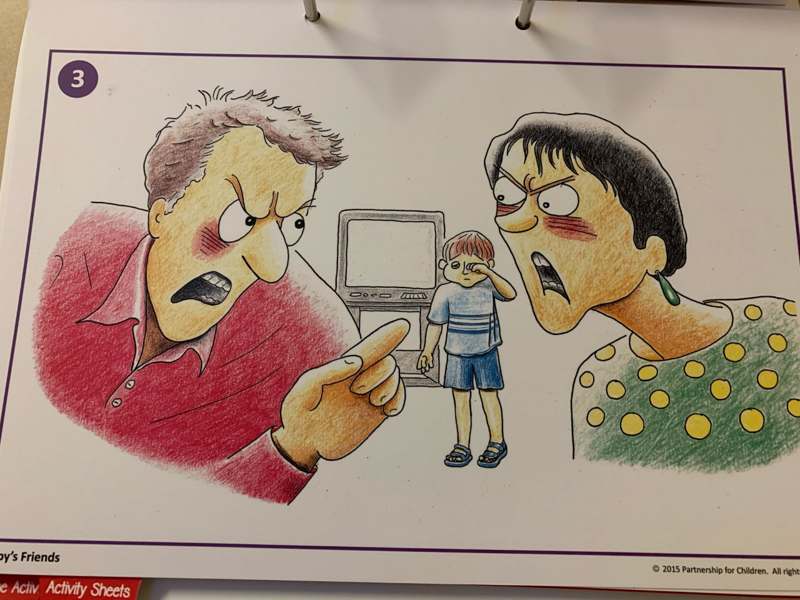
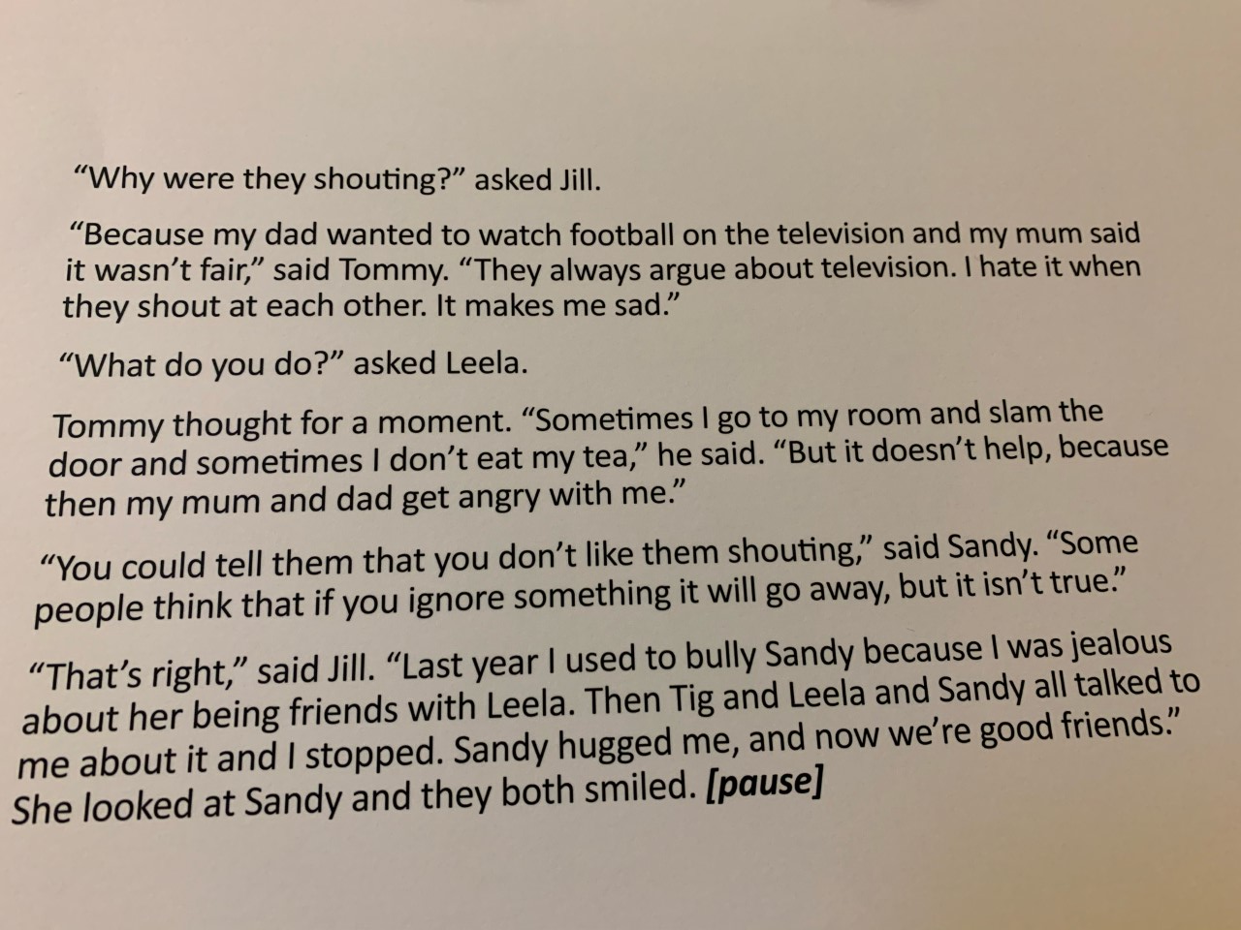

Slide 8
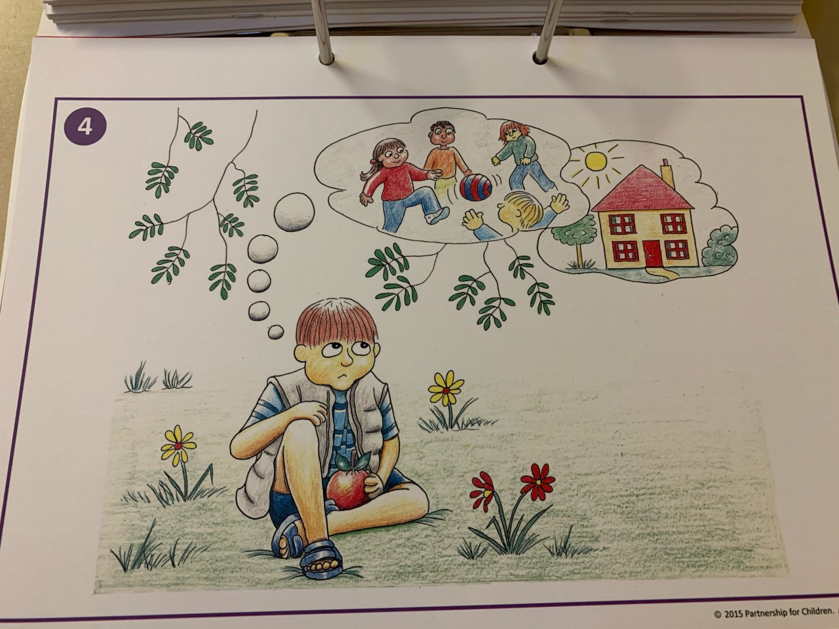
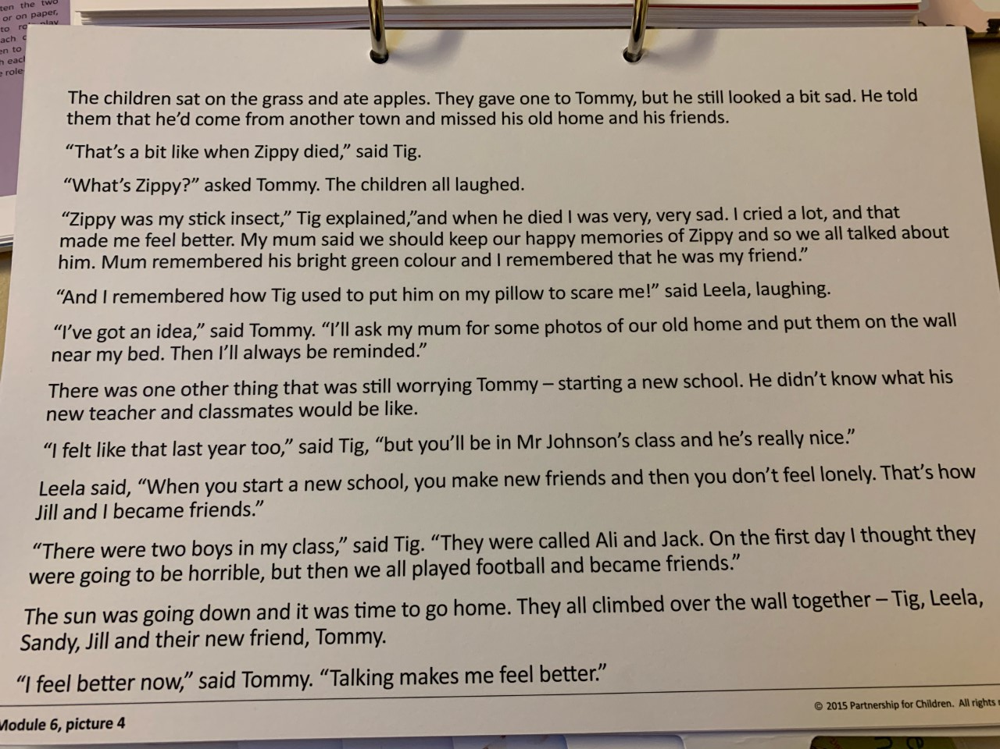

Slide 9
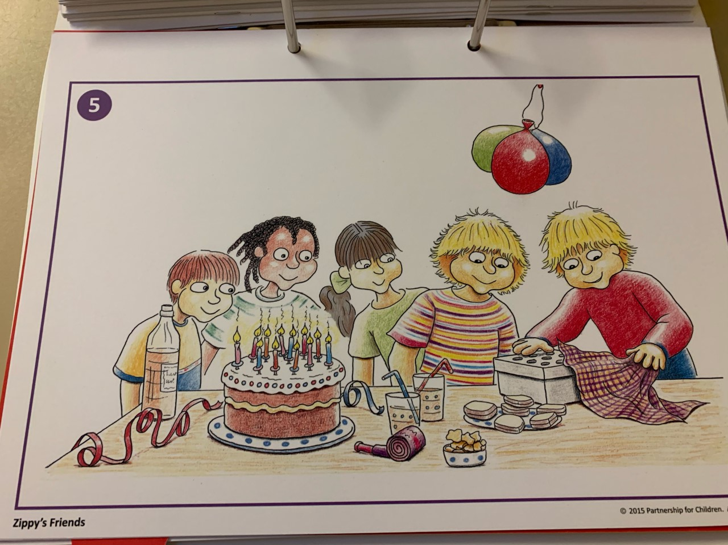
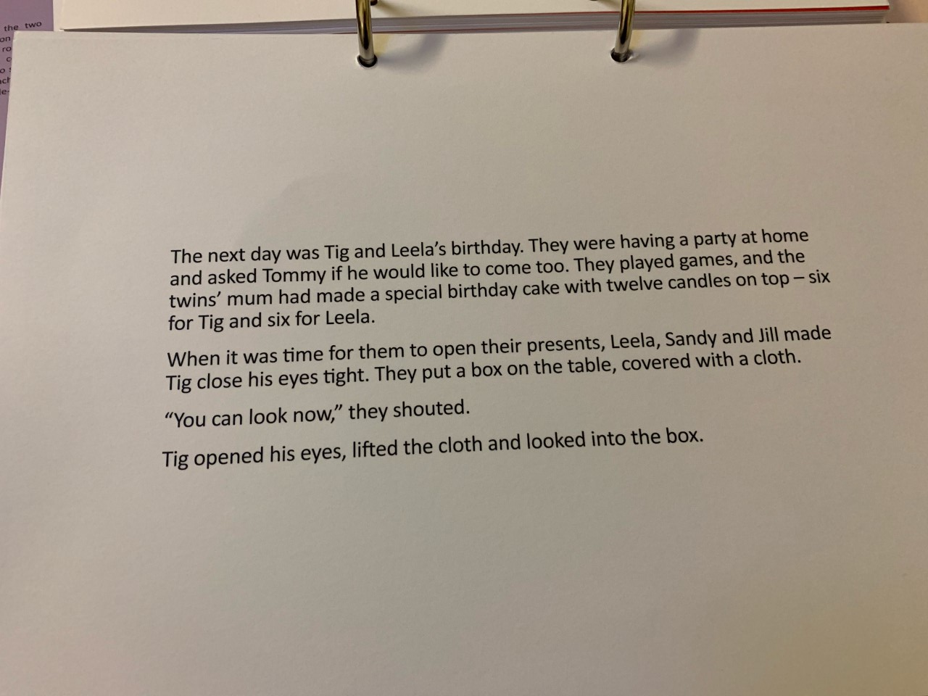

Slide 10
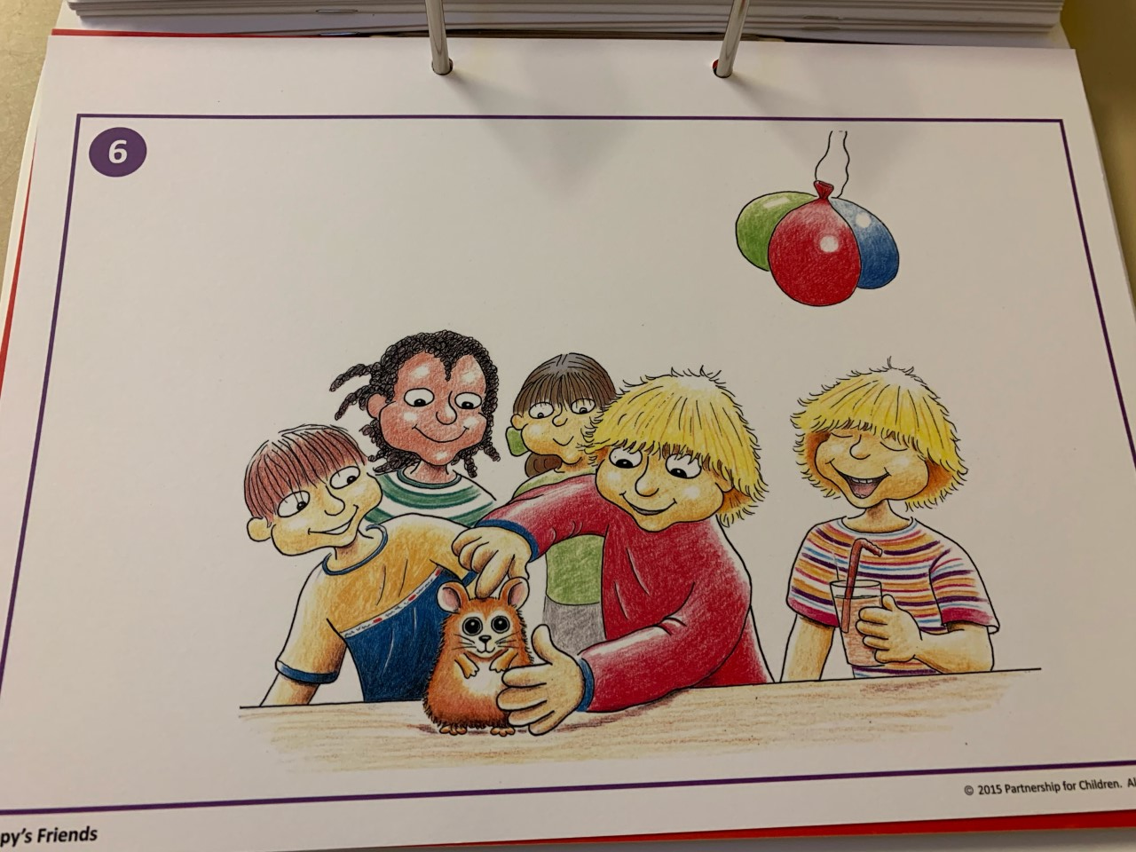
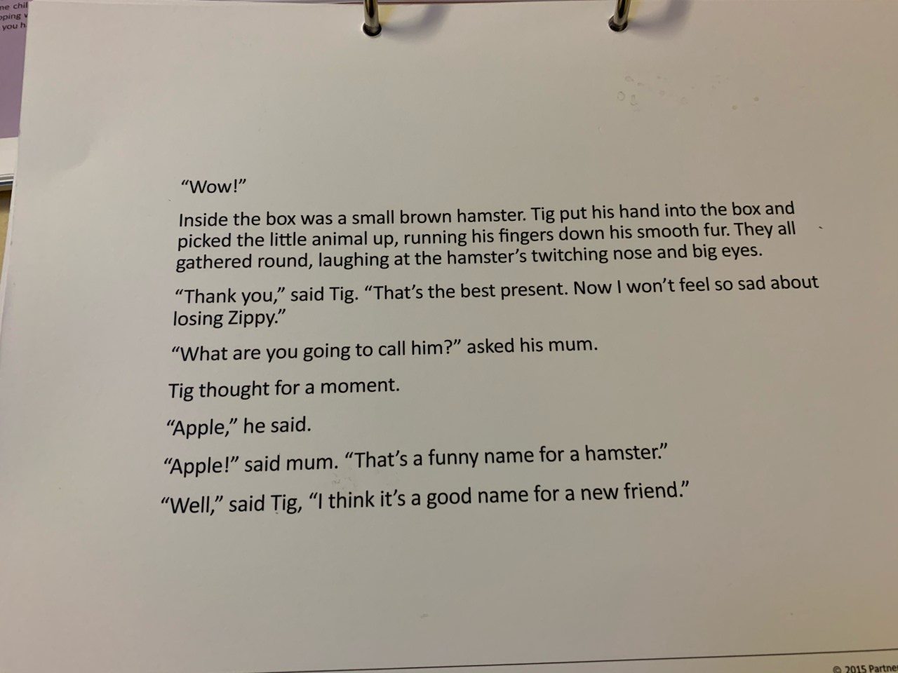

Slide 11
Sometimes we can change a situation, like when Sandy was being bullied by Jill.
Sometimes, we cannot change a situation, like when Tommy moved to a new town.
Can you think of a situation which you couldn’t change?
For example, if we are having an argument, seeing the other persons side may help to solve the problem.

Slide 12
Task
Your task today is to draw a picture of how you could cope with a situation you can or cannot change. You can draw your picture on a plain piece of paper, labelled with the date and titled ‘We Cope’.

Slide 13
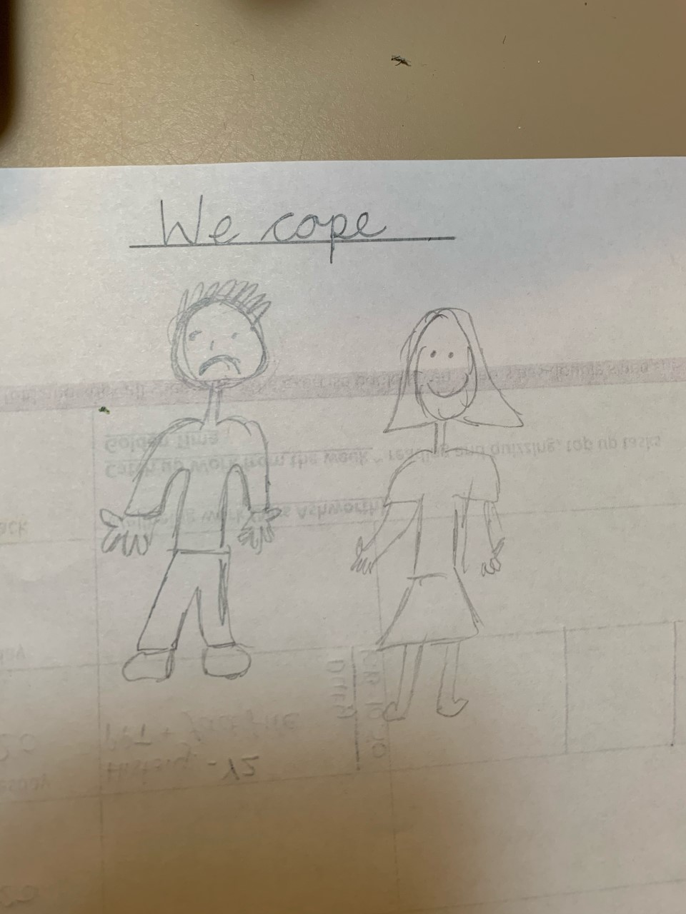
Example
If you feel sad, you could cope by telling a trusted adult. A teacher, a friend or someone at home.
This could help make you feel better.

