Slide 1
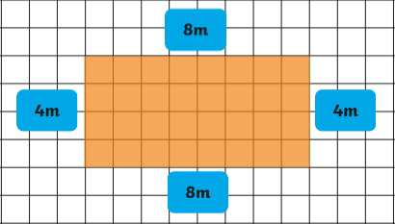
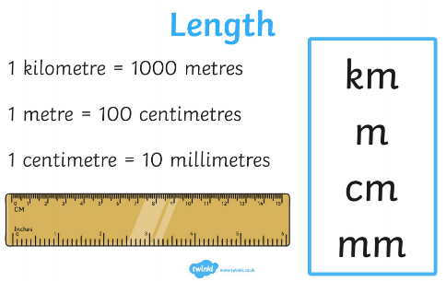
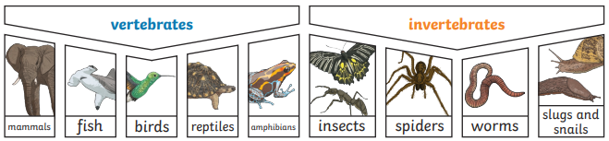
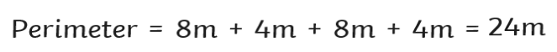
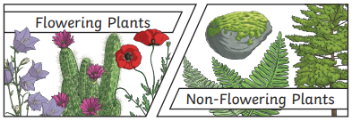
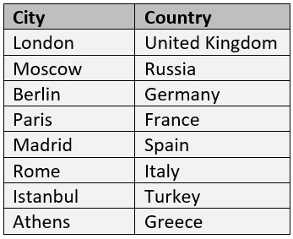
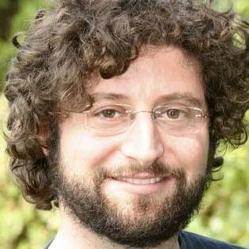
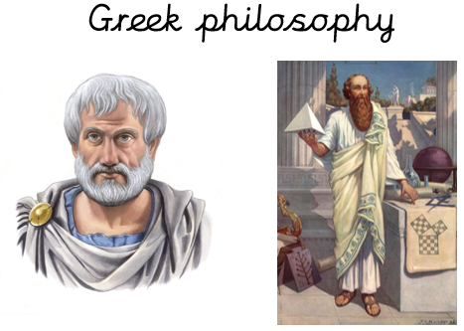
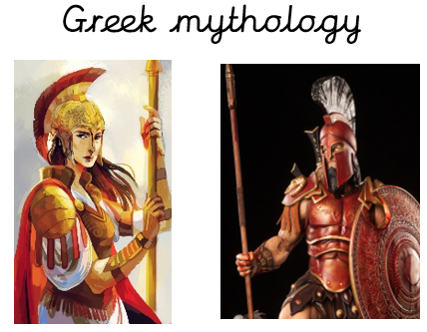
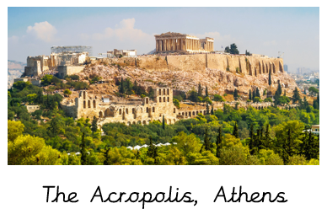



Year 4 Spring 1 Knowledge Organiser
Science
Living things and their habitats
Maths – Measurement (perimeter and equivalent lengths)
Geography
Major cities in Europe
Vocabulary Dozen
Mythology
Philosophy
Chronology
Acropolis
Environment
Classification
Habitat
Nutrition
Major city
Measurement
Kilometre
Perimeter
Andy Stanton is our new
author of the term.
He is best known for his
‘Mr Gum’ book series.
History – Ancient Greece
Life Skill
To help prepare
a simple meal.

