Slide 1
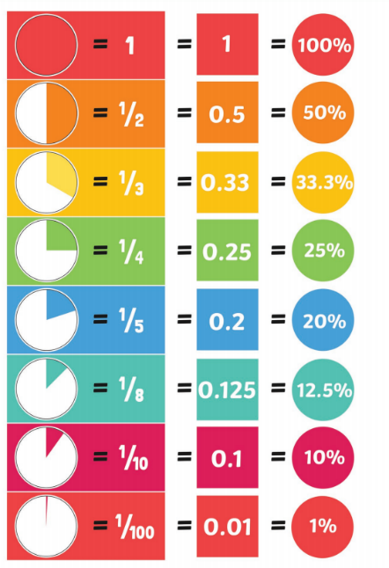
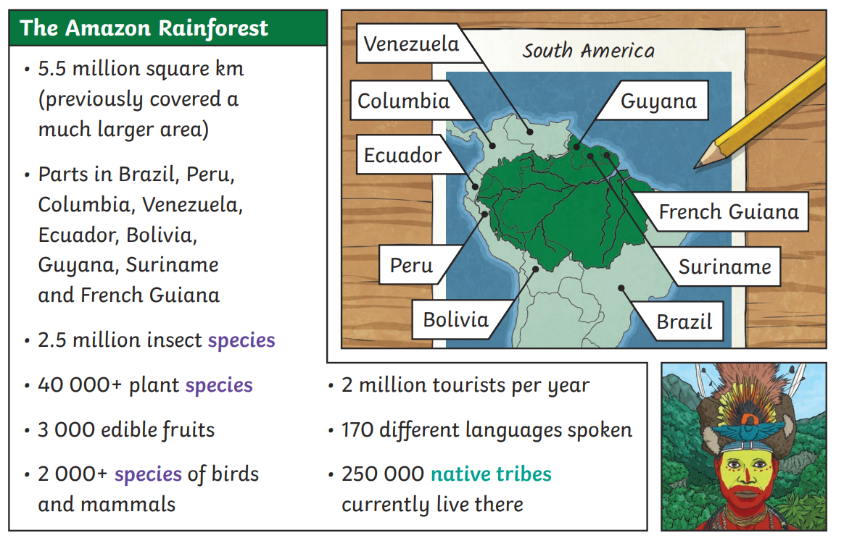
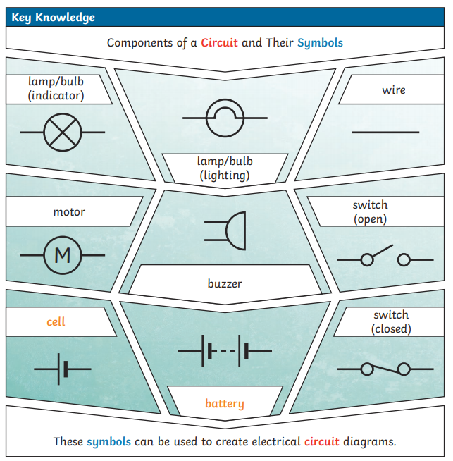
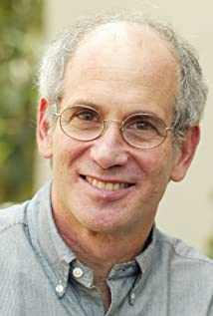
Year 6 Spring 1 Knowledge Organiser
Vocabulary Dozen
equivalent
biome
economy
trade links
vegetation
voltage
current
resistance
Holocaust
social
cultural
political
A biome is a natural area of plants and animals. The world is divided into lots of different biomes and they are all different depending on their climate.
Some biomes: Tropical Rainforest, Temperate Forest, Desert, Tundra, Taiga (Boreal Forest), Grassland, Savanna, Ice and Desert.
Life Skill: organising own bag and being responsible for packing their own equipment in preparation for high school.
During World War Two, Jewish people were persecuted. They were treated appallingly - even young children were taken away from their homes. This is known as the Holocaust. Anne Frank is a Dutch, Jewish girl who wrote a diary about her experiences.
Louis Sachar is our author of the term.
We will be reading Holes in class.

