Slide 1

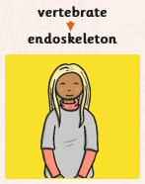
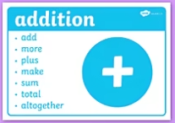
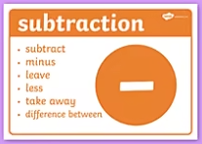
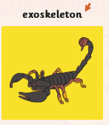
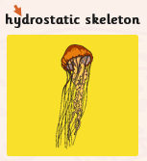
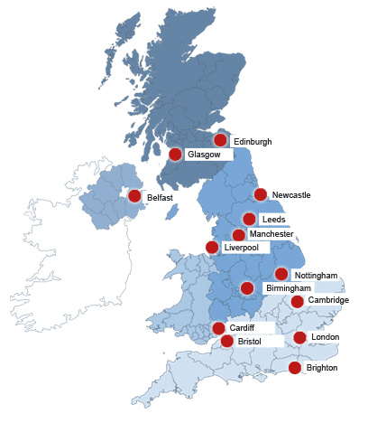
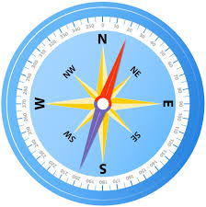
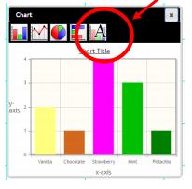
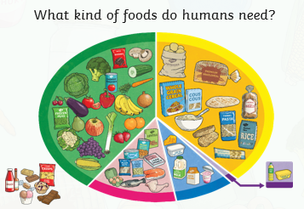
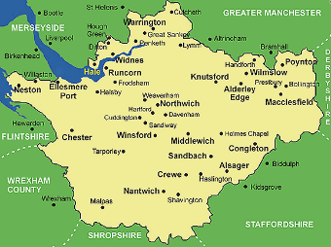
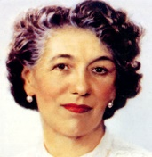

Year 3 Knowledge Organiser Spring 1 2021
English
Science
Maths
Adjective
Describing words used for characters and settings.
Paragraph
Ideas grouped together to organise writing.
Working with 2 and 3 digit numbers, crossing 10 and 100.
Computing
DT
Making a balanced meal
Geography
Life Skill
Riding a bike without stabilisers
UK counties
and cities
Naughty Elephants Squirt Water
Cardinal Points
Intercardinal points
Author
Enid Blyton
Representing info.
in spreadsheets and bar charts.
Vocabulary Dozen:
vertebrate invertebrate endoskeleton
exoskeleton hydrostatic skeleton adjective
paragraph clause prophet digit
county boundary
PSHE & RHE
Belonging to a community – laws and rules of society.
RE
The Islamic Prophet Muhammad (PBUH)

