Slide 1


Safeguarding

Slide 2

Keeping safe
ufiur4
Keeping safe is extremely important!
How can you keep yourself safe?

Slide 3

On the roads!
20% of all injuries happen on the school journey and increases for secondary school age children

Slide 4

Green Cross Code !
To be safe on the road you need to use the Green Cross Code.
1.Think
2.Stop
3.Look
4.Listen
5.Wait
6.Look and listen again
7.Arrive alive

Slide 5
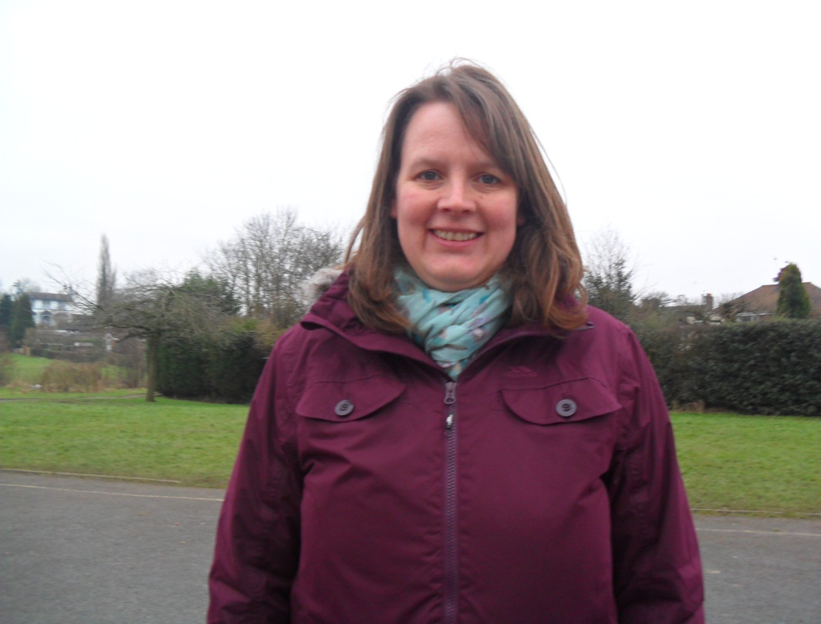
Dinner ladies keep you safe by keeping an eye on us and making sure we don’t hurt ourselves!
Dinner ladies

Slide 6


The green button
Children must not press the green button they might not be very nice.
Fire exits
Around school there are fire exits and signs to show the way if there is a fire alarm.
Around School

Slide 7

Be careful when sharing personal information online. Only use websites you trust. Personal information includes:
Full Name
Date of birth
Address
E-safety
• Always ask permission before using the Internet.
• Only send e-mails to your friends.
• Only go to Internet sites that you know are safe.
• Be careful what you type into a search engine.
• Never tell anyone your name, address or telephone number over the Internet.
• Always tell your parents or teacher if you are upset by something you see on the Internet.

Slide 8
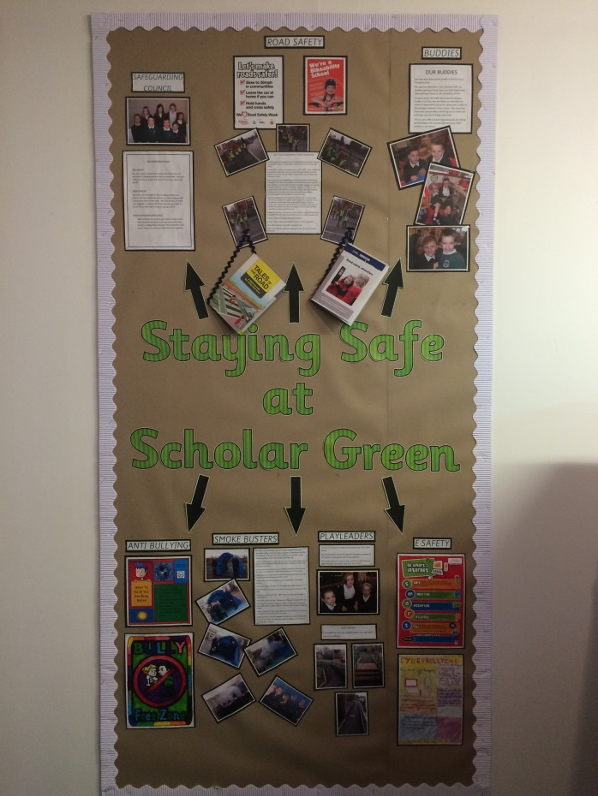

On our school safeguarding display in the entrance hall there is lots of information about safeguarding and how to keep safe!
Display/website

Slide 9

Thank you for listening!
Hope you enjoyed our assembly !

