Slide 1


Parent information meeting
Mrs Anna Whitehurst
Year 3 class teacher
awhitehurst@scholargreen.cheshire.sch.uk

Slide 2
Curriculum Coverage
Year 3 is the start of the KS2 journey.
Work taught now will be built upon in preparation for their Y6 SATS.
Maths and English is taught every day:
        Daily differentiated phonics/spelling lessons
        Weekly comprehension work using the Comprehension Express scheme
        3x weekly fluency lessons to teach reading skills and support the foundation subjects
        Weekly vocabulary lesson to link with foundation subjects
        Daily handwriting and spelling lessons
        Weekly reasoning and problem solving lessons
        Weekly TTRS practise
Science is taught twice a week in KS2.
PSHE, RE and PE are compulsory each week. PE is 2 hours.
All other subjects are 1 hour a week.
Junior Jam staff teach Music and Computing.
Mrs Stevenson will teach French.

Slide 3
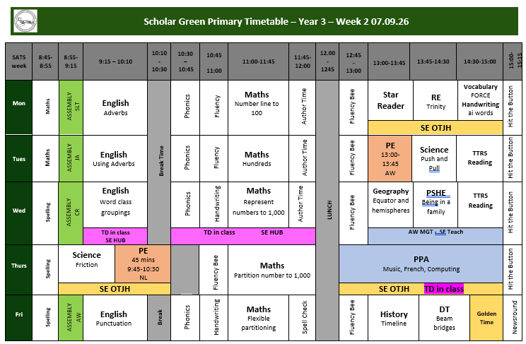

Slide 4
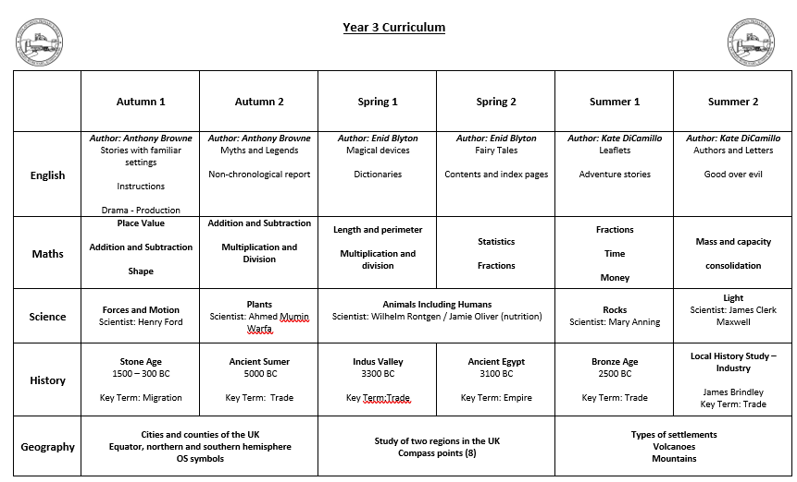

Slide 5
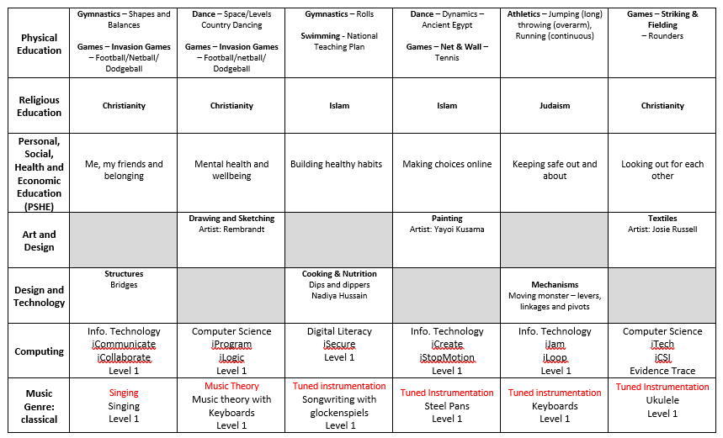

Slide 6
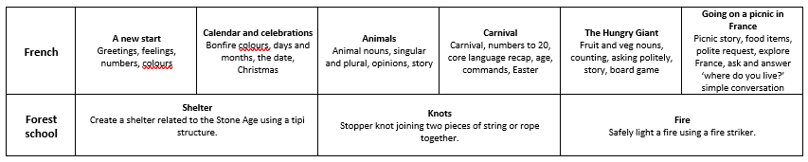

Slide 7

All our lessons across the school follow the same pictures and slide sequences for continuity.
Every lesson has:
the knowledge, skills and vocabulary to be covered
prior learning through ‘Flash Back 4s’ to help with sticky knowledge
an enquiry question, theme or significant individual
future learning and end-point expectation

Slide 8

National Curriculum Expectations
We assess formally 3 times a year in English and Maths using Testbase. This helps to see if your child is working towards expectations, age related or working at greater depth. (WT, ARE, GD) It also helps us to see where interventions are required to fill any gaps in learning.

Slide 9
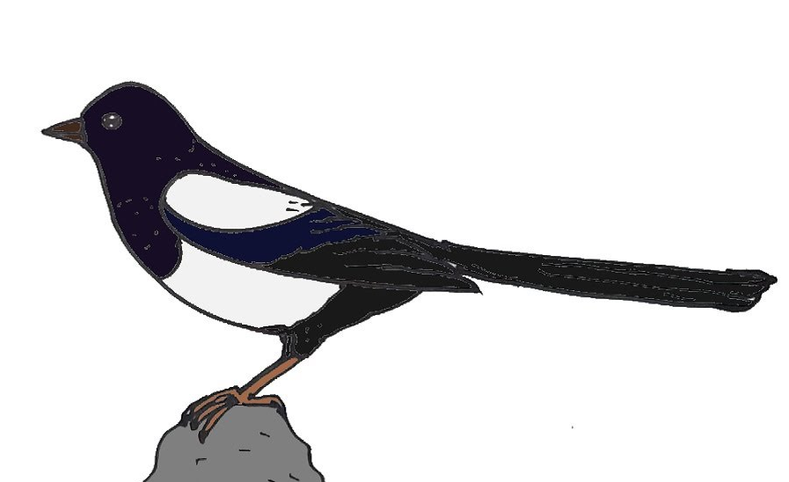
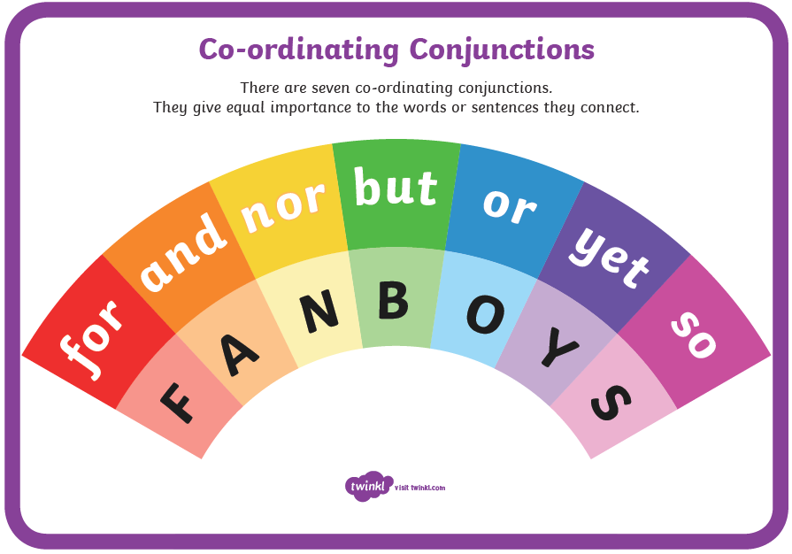
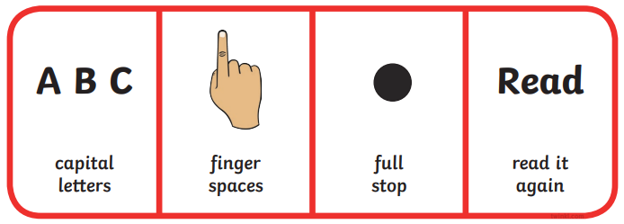



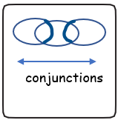

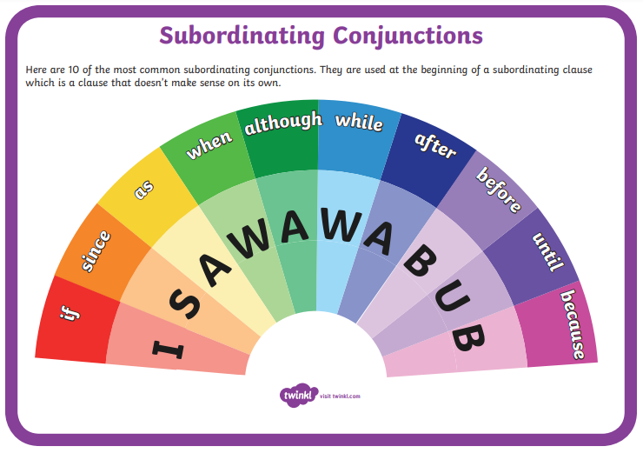
Writing is assessed continually through all subject areas. Skills are taught in English and applied in Science, History, Geography, RE, PSHE etc.
Y3 ARE writing needs:
legible handwriting of consistent size and spacing and evidence of joins
accurate spelling of Y3/4 words, and use of prefixes and suffixes
coherent sentences with accurate punctuation and consistent tenses
a clear beginning, middle and end to stories
paragraphs to show group related ideas
heading and subheadings to aid presentation
description of characters and settings – using adjectives and adverbs
joining of ideas through a range of conjunctions
punctuation of direct speech with inverted commas
nouns

Slide 10
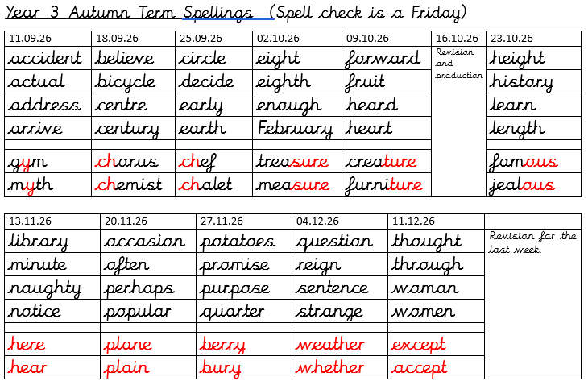
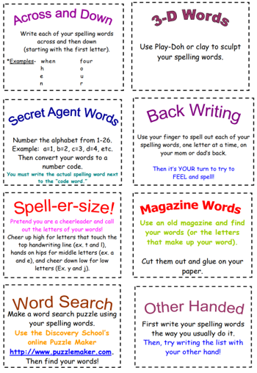

The ARE for spelling are the words from the Y3/4 list – we have broken them down into the two year groups.
We also cover prefix and suffixes, homophones and spelling patterns. These are the bottom 2 spellings on the weekly list.

Slide 11

The ARE in maths is to know their 2s, 3s, 4s, 5s, 8s and 10 times tables.
All four ways need to fluent, e.g.
4 x 8 = 32
8 x 4 = 32
32 ÷ 4 = 8
32 ÷ 8 = 4
Regular practise on TTRS is needed and tables will be set based on ability. There is a national screen of tables in Y4 where the children answer questions on an ipad in under 6 seconds.

Slide 12
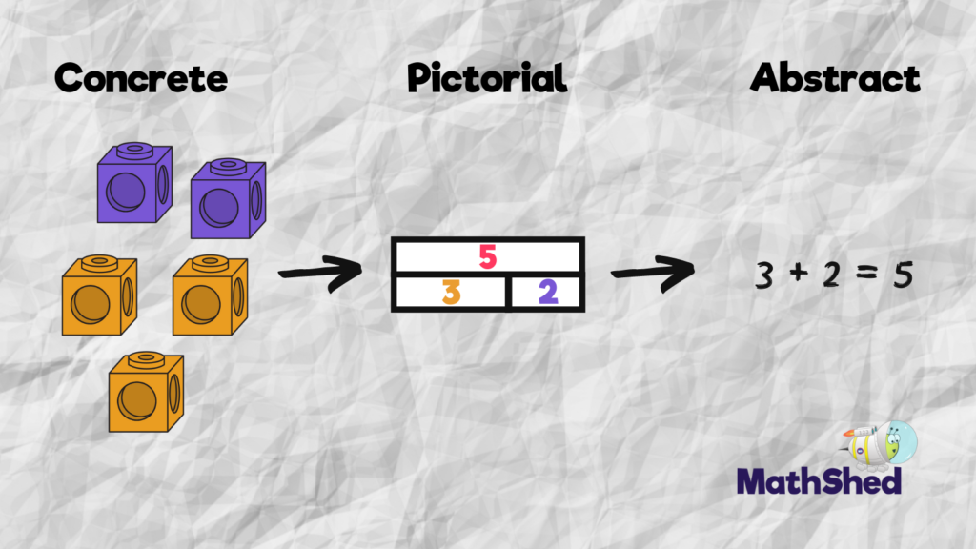
At Scholar Green all classes teach maths based on the concrete, visual and abstract approach.
1. Pupils are first introduced to an idea or skill by acting it out with real objects (a hands-on approach).
2. Pupils then are moved onto the visual stage, where pupils are encouraged to relate the concrete understanding to pictorial representations.
3. The final abstract stage is a chance for pupils to represent problems by mathematical notion.
The three stages feature in each year group

Slide 13
Key maths skills and vocabulary in Year 3
Addition Add numbers with 3 digits: +, add, more, addition plus, make, sum, total , altogether, double, near double, one more…, two more… ten more…, 100 more…greater, more, units, ones, tens, count, count (up) to count on (from, to) how many…? Hundreds boundary. | Subtraction Subtract numbers with 3 digits: -, subtract, take (away), minus leave, how many are left/left over? ten less… one hundred less , how many fewer is… than …? how much less is…? difference between, half, halve , =, equals, sign, is the same as , tens boundary, hundreds boundary, inverse
Multiplication Multiply 2-digits by a single digit number and solve problems for multiplication within the multiplication tables (3, 4 & 8 – ensure rapid recall): lots of, groups of , x, times, multiplication, multiply, multiplied by, multiple of, product, once, twice, three times, four, times, five times… ten times… , times as (big, long, wide and so on) , repeated addition, array, row, column | Division Divide 2-digit numbers by a single digit (where there is no remainder in the final answer): double, halve , share, share equally , one each, two each, three each… group in pairs, threes… tens , equal groups of , ÷, divide, division, divided by, divided into, left, left over, remainder

Slide 14

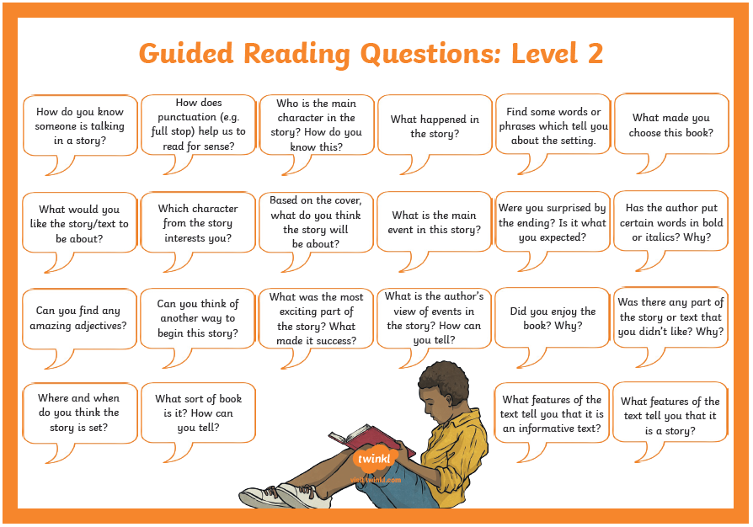
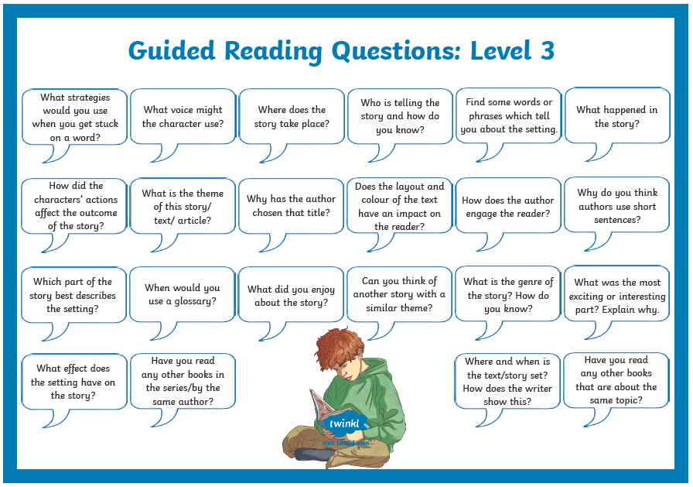
The ARE in reading is to have a ZPD level of 3.0-4.0.
The first number is the year group, the decimal is the months.
So, a ZPD of 3.4 means a reading level of year 3 and 4 months.
The most important thing is for your child to understand and talk about what they are reading, so ask plenty of questions to help them process the text.

Slide 15
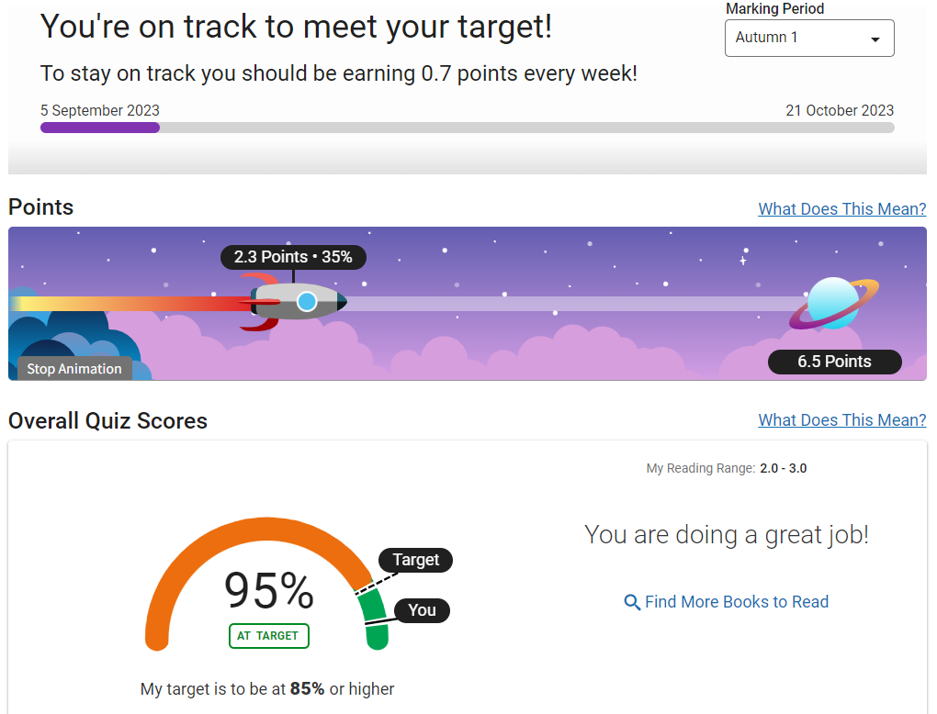
Reading Targets and Treat
We expect all children to read at least 4 times each week for 20 minutes.
In KS2 the children can write in their yellow diaries themselves, but you still need to hear them read and discuss/ ask questions.
I check their diaries on a Monday morning for the 4 reads and record with a sticker if it’s achieved.
All children on Accelerated Reader are given a reading target each half term which is recorded in their diaries. Each time they quiz and score enough to pass they earn points towards their target. They also see a rocket moving across the sky!

Slide 16
Reading Targets and Treat
When they reach their target, they achieve the reading treat.
  Using their reading target encourages consistent quizzing
  The children decide what they want to do for the treat, so they know
  what to aim for.
I keep a record of reading points each week to make sure each child is on track to make their target.
A text will be sent home if they are not on track and need more support.
As they reach 15 points, they get to place their photograph on the whole school display board in the library and Mrs Colman celebrates with a gold sticker. This continues in increments of 15 points.
If a child isn’t on AR they will need to read 4x a week for half the number of weeks in the half term as done previously.

Slide 17
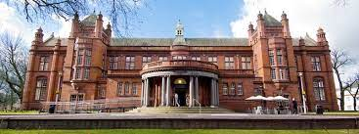
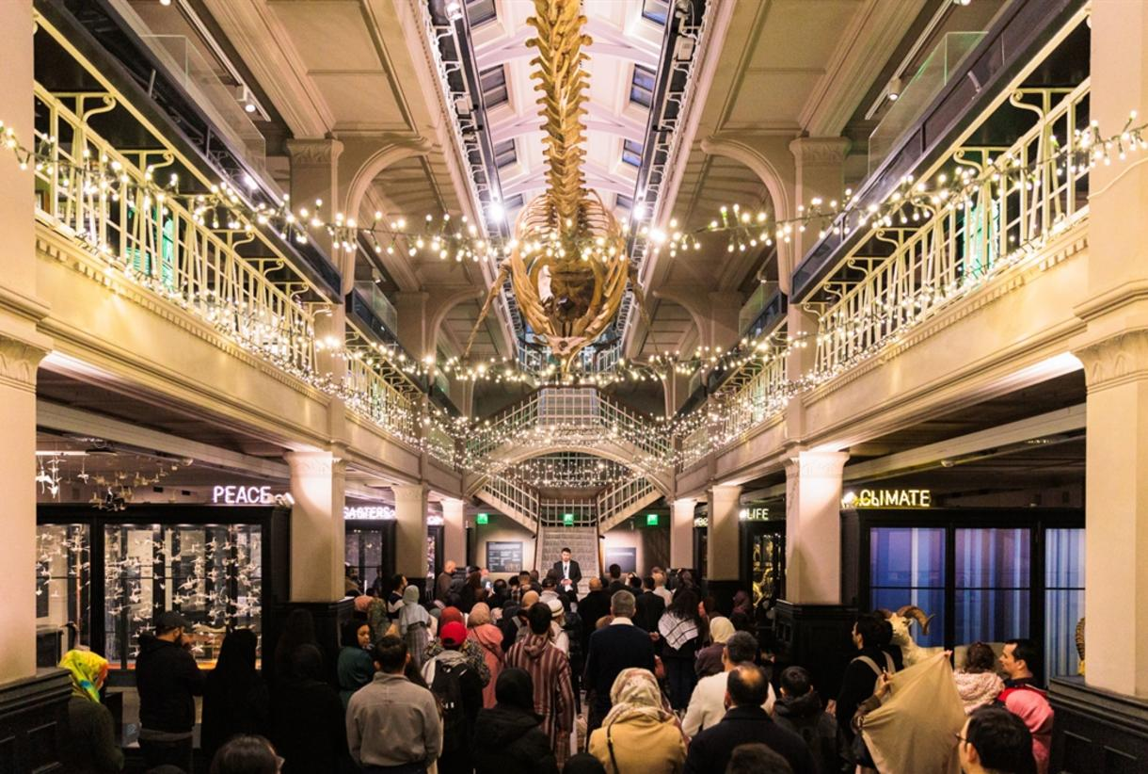

Autumn Term
Whitworth Art Gallery
Workshop with an artist focusing on portrait drawing and time in the galleries
https://www.whitworth.manchester.ac.uk/getinvolved/schoolscollegesanduniversities/primary/artschool/
Spring Term
Manchester Museum:Ancient Egypt Workshop and gallery tour https://www.visitmanchester.com/listing/manchester-museum/8571101/
Summer Term
Catalyst Discovery Centre
Workshops on volcanoes and rocks
https://www.catalyst.org.uk/

Slide 18

Volunteer & Support
We are always looking for adults to hear children read, or to help with the gardening/ school grounds maintenance. If anyone can spare a few hours each week or each half term, then please talk to me or see Sharon in the office.
I have an open-door policy and am available most days after school to talk to. Alternatively, email and I will respond as soon as possible.
awhitehurst@scholargreen.cheshire.sch.uk

