Slide 1

Welcome to year 1
Miss Hancock
Mrs Bailey

Slide 2
AGENDA
Expectations of Year 1
Phonics Screening Assessment
Changes to reading
Education Visits / Enrichment
Dates for the Diary
Any Questions

Slide 3

Year 1
This is the first time children learn from the National Curriculum, this involves specific subjects rather than areas of learning in the Early Years Framework.
English
Maths
Science
History
Geography
Art
DT
RE
PHSE (Personal, Health, Social and Economic Education)
Computing
Music
MFL
PE

Slide 4
Get Busy Time
Year 1 is a transition from the Early Years Framework to the National Curriculum.
This will be done gradually.
The children will still have access to the continuous provision which is known as “Get Busy Time.”
This includes practical activities to further their learning as well as play activities to develop their personal skills.
There will be some whole class lessons each week and this will build up after Christmas.

Slide 5
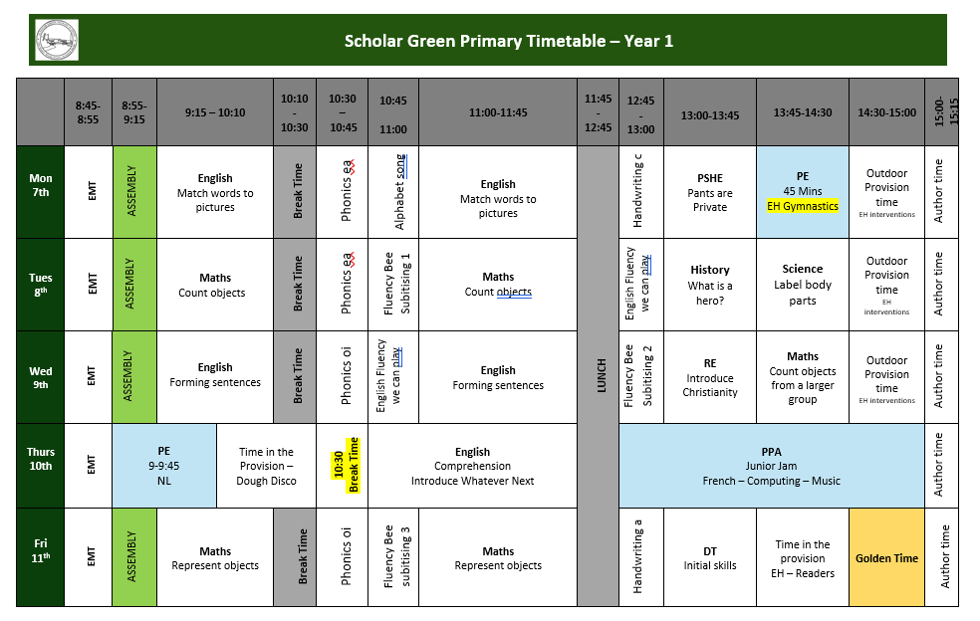
TIMETABLE

Slide 6
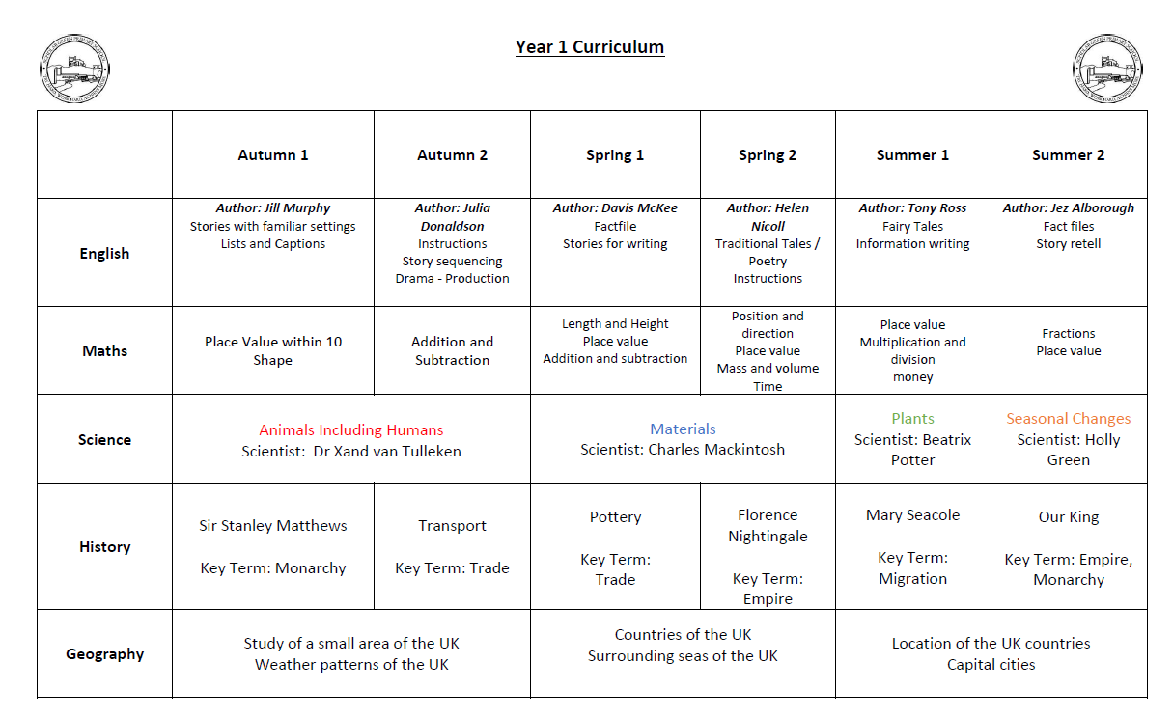
Year 1 overview

Slide 7
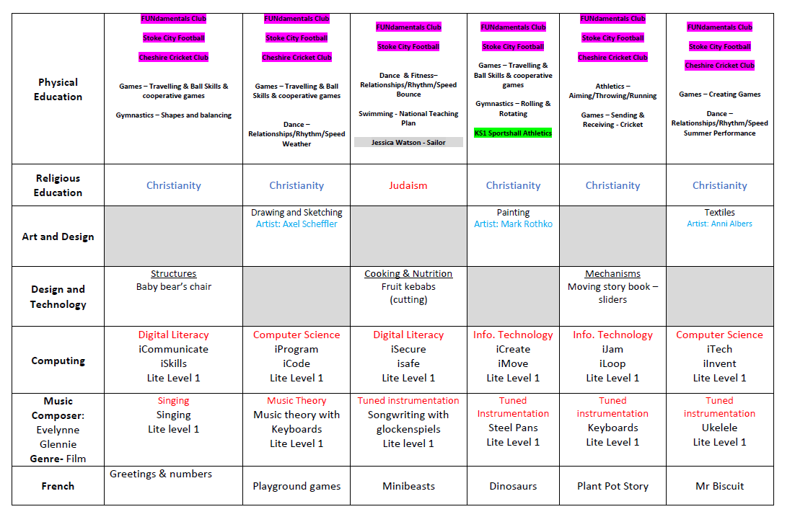
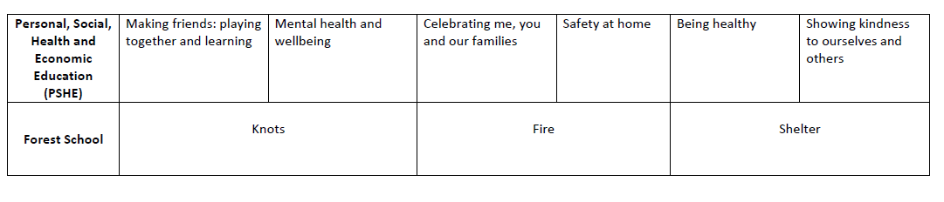

Slide 8

Pe Days
During this half term our PE days are:
Monday
Thursday
Children to come to school in PE kit on those days and any other days when they attend a sports club. Don’t wear any jewellery, earrings must be removed not just covered and hair needs to be tied up if it is longer than shoulder length.
PE may be inside or outside so please ensure your child will be warm enough.

Slide 9
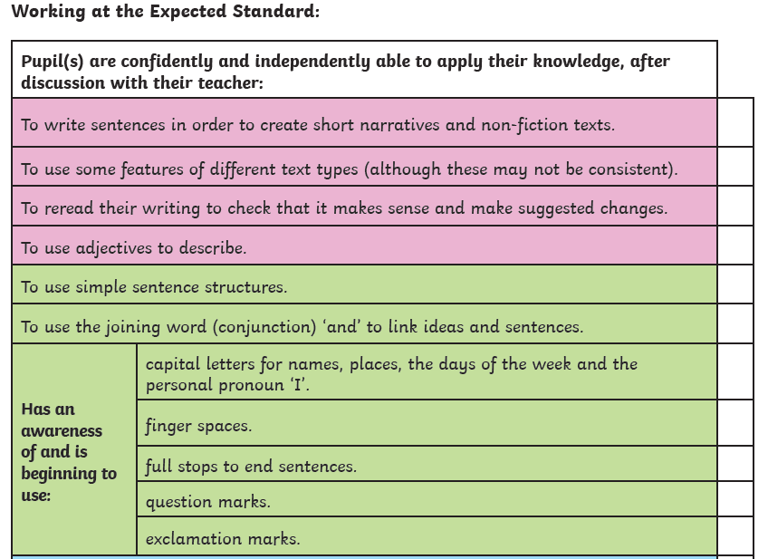
Writing expectations

Slide 10
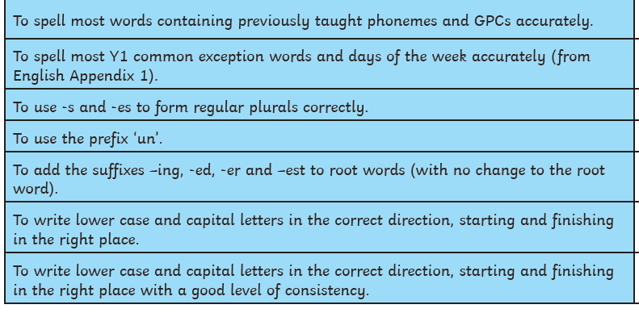
Writing expectations

Slide 11
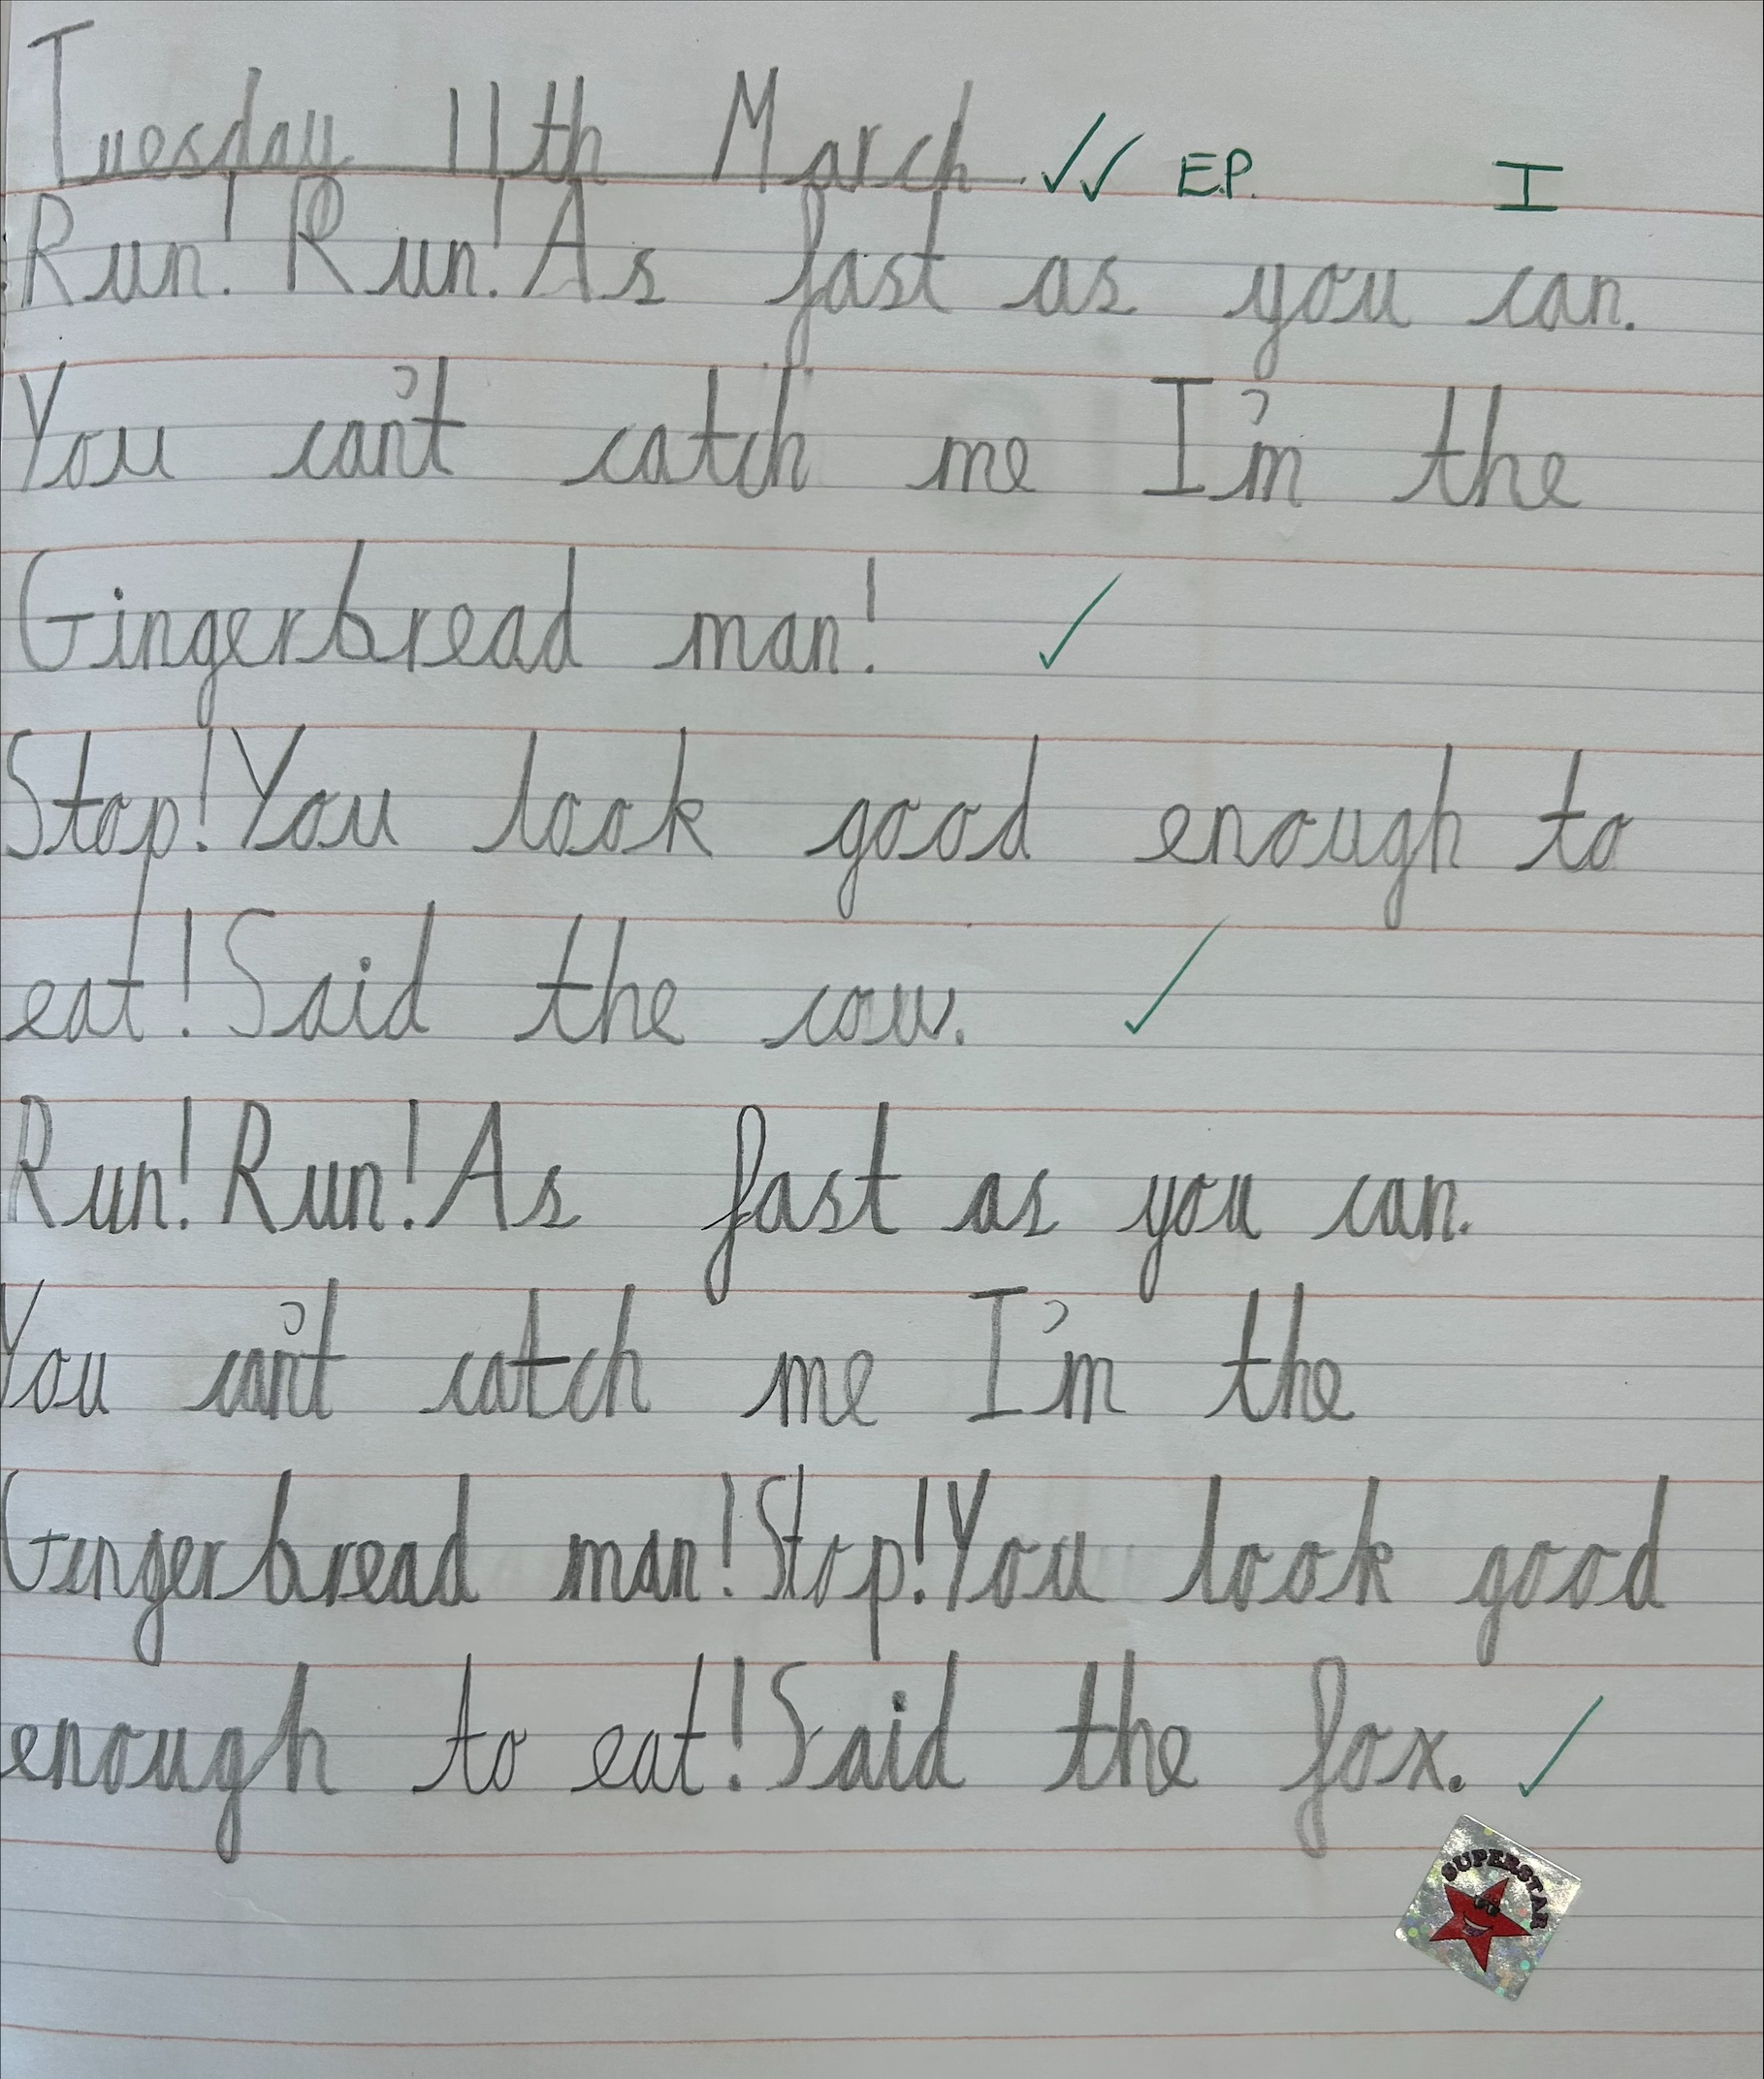
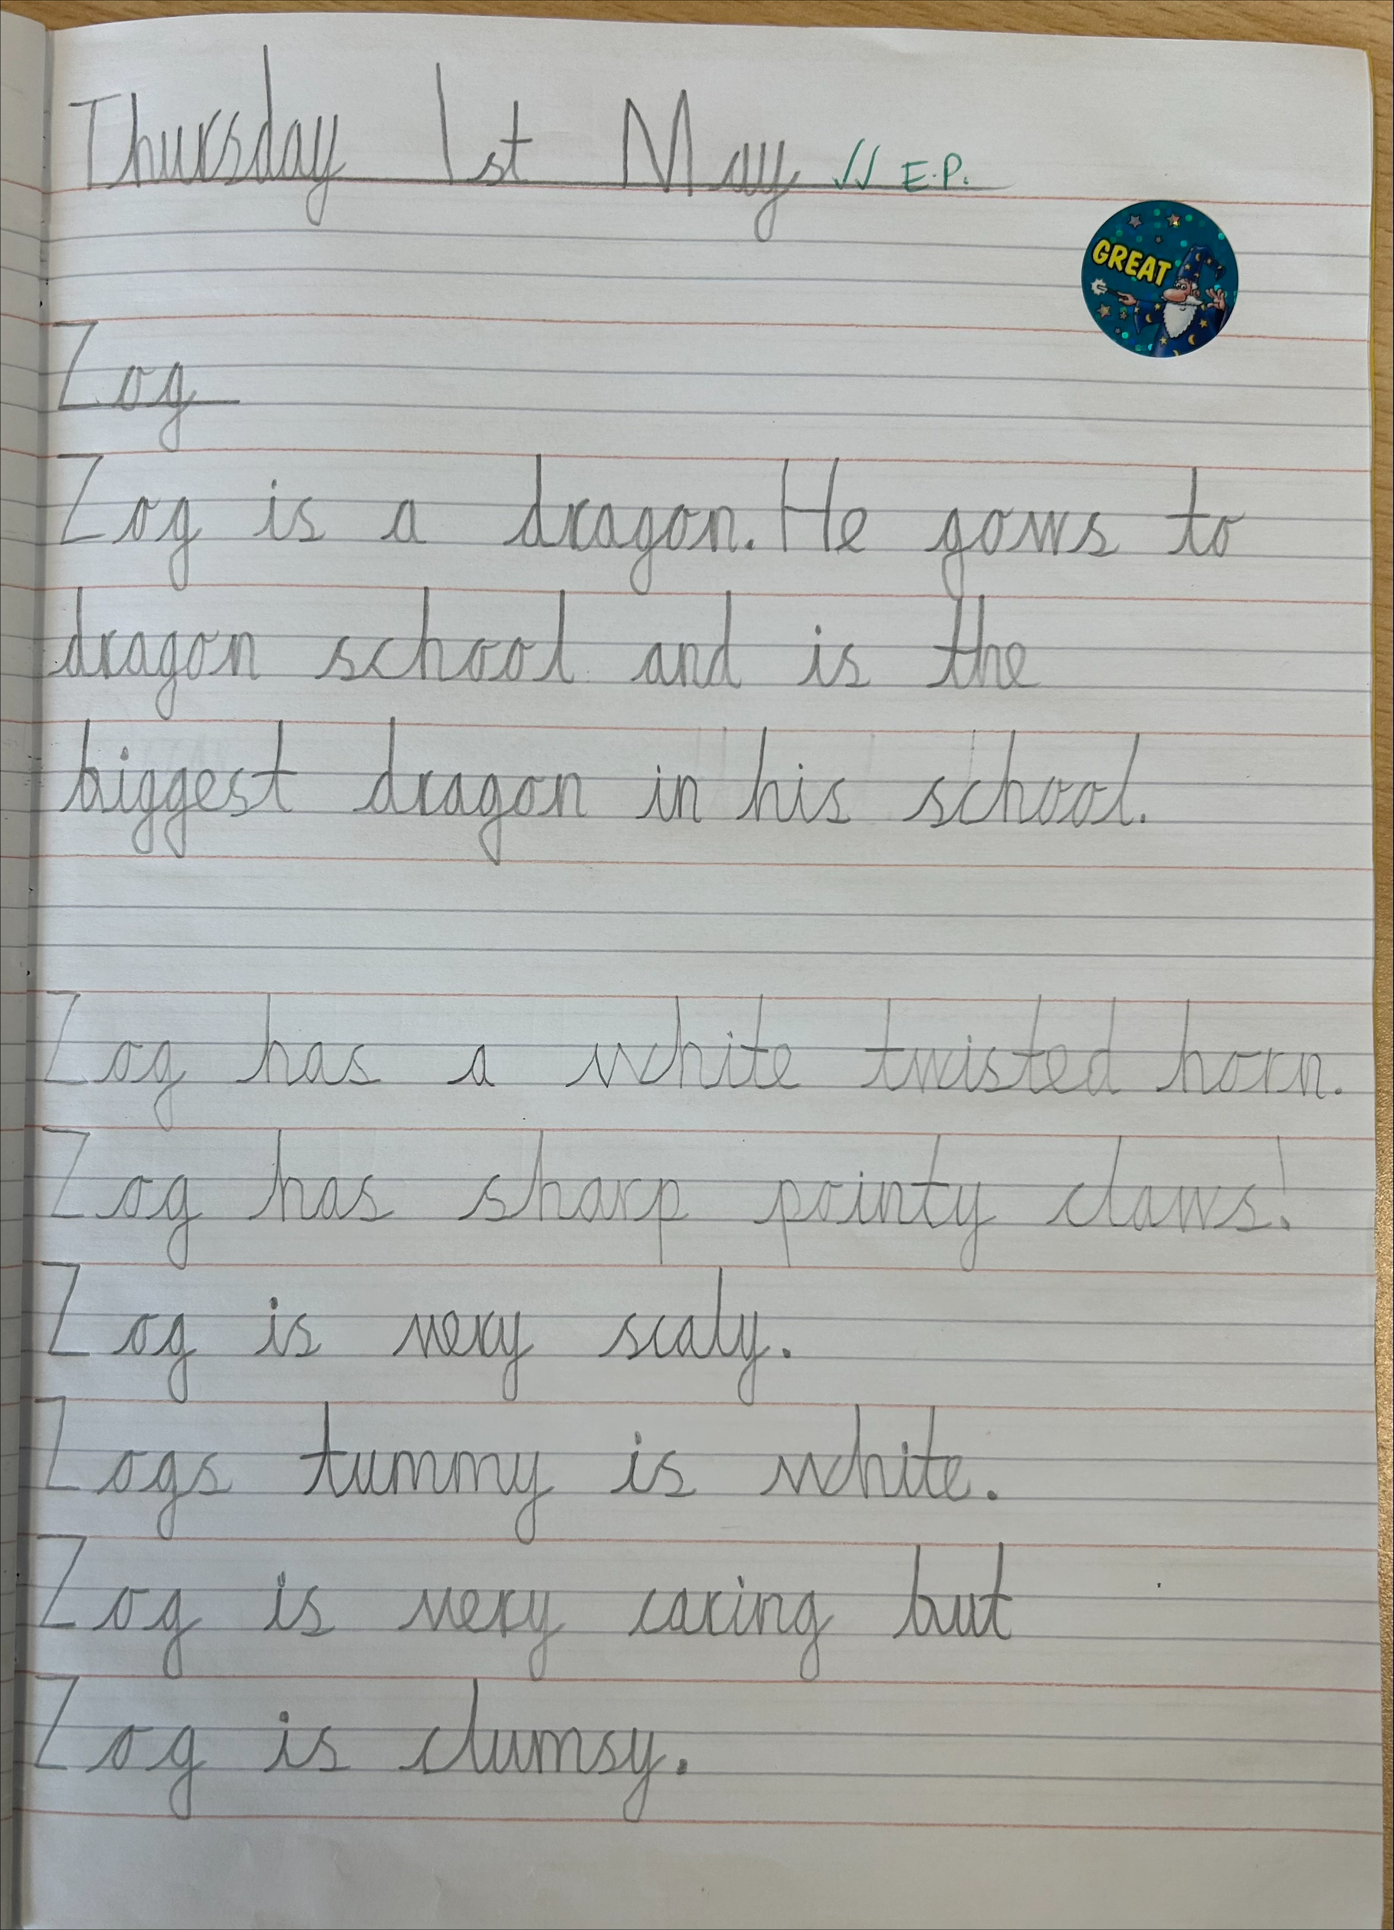
Writing expectations
This is an example piece of writing for a child working at the age related expectations in May.

Slide 12
Things to help at home
Practice letter formation, lower and upper case letters – shown on the next slide.
– some children find it hard to recognise the capital version of letters when it looks very different such as R and Q.
- It is usual at this point in the year to still have some reversals with letters but if your child is doing this, please practice with them at home and encourage them to check to see if they can spot the mistake for themselves.
Practice writing their full name including surname using a capital letters.

Slide 13
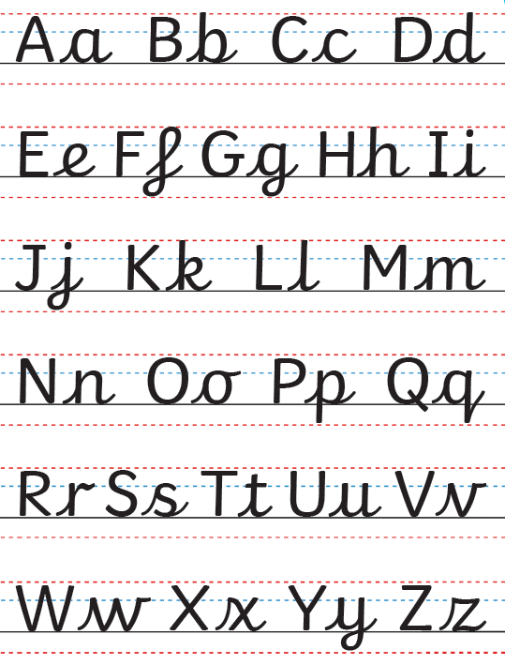

Slide 14
Continued…
Practice spelling “red” words these are the common exception words. (These are in your child’s reading diary)
Read regularly to your child for enjoyment. Outside of the school reading time, read for pleasure the books your child enjoys e.g. bed time story.
Practice saying the days of the week and months of the year. There are lots of songs to support this.
Practice writing the names of friends and family using capital letters.

Slide 15
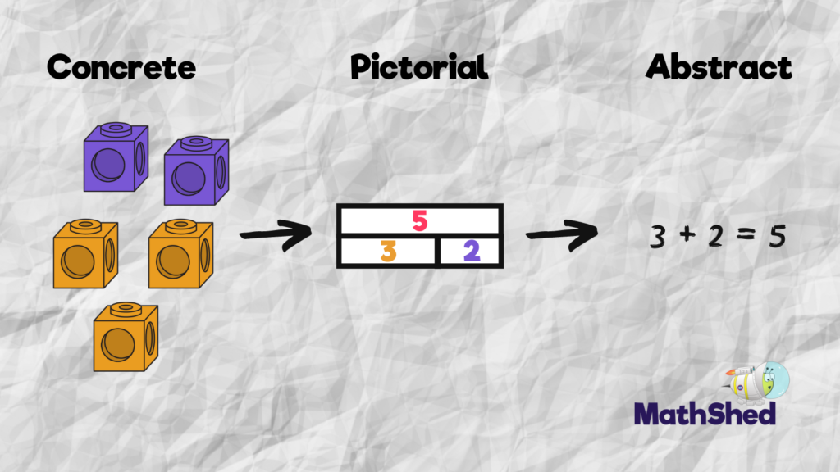
At Scholar Green all classes teach maths based on the concrete, visual and abstract approach.
1. Pupils are first introduced to an idea or skill by acting it out with real objects (a hands-on approach).
2. Pupils then are moved onto the visual stage, where pupils are encouraged to relate the concrete understanding to pictorial representations.
3. The final abstract stage is a chance for pupils to represent problems by mathematical notion.
The three stages feature in each year group.

Slide 16
Key maths skills and vocabulary in Year 1
Addition Add one-digit and two-digit numbers to 20, including zero: +, add, more, plus, make, sum, total, altogether, double, near double, one more, two more… ten more, greater, more, units, ones, tens, count, count (up) to count on (from, to) how many…? | Subtraction Subtract one-digit and two-digit numbers to 20, including zero: -, subtract, take (away), minus, leave , how many are left/left over? how many are gone? one less, two less, ten less… , how many fewer is… than…? how much less is…? difference between , half, halve , =, equals, sign, is the same as
Multiplication Solve one-step problems involving multiplication by calculating the answer using concrete objects, pictorial representations and arrays: Lots of, groups of, multiply, times, add, steps of, jumps of, double | Division Solve one-step problems involving division by calculating the answer using concrete objects, pictorial representations and arrays: share, share equally, groups of, divide, how many groups? half

Slide 17
Things to help at home
Practice number formation
- It is usual at this point in the year to still have some reversals with numbers but if your child is doing this, please practice with them at home and encourage them to check to see if they can spot the mistake for themselves.
Count forwards and backwards to 100, starting at different numbers.
Practice number bonds to 10. Hit the button is a great game for this. https://www.topmarks.co.uk/maths-games/hit-the-button
Talk about time so they have some awareness of what time they get up, go to school etc.

Slide 18
Continued…
Counting in 2s, 5s and 10s – both forwards and backwards
Identify coins and the value of each one – toast trolley.
Number hunts when out and about getting children used to recognising numbers in a range of contexts

Slide 19
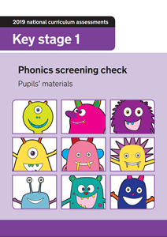
Phonics Screening check
Week commencing Monday 14th June 2027
NO HOLIDAYS PLEASE

Slide 20
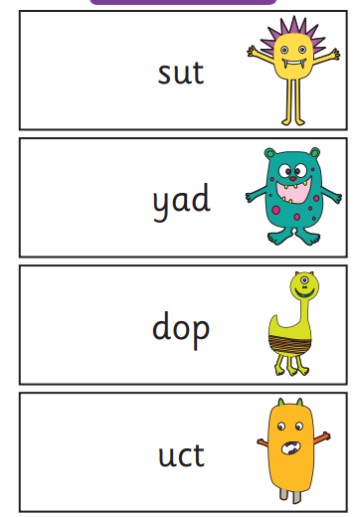
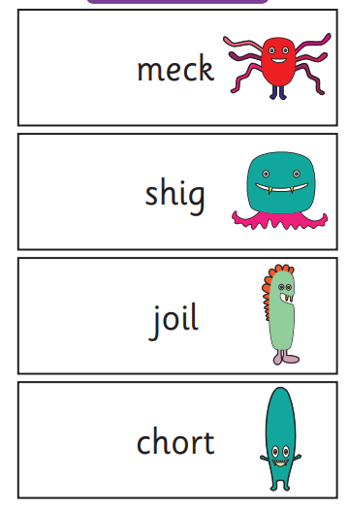
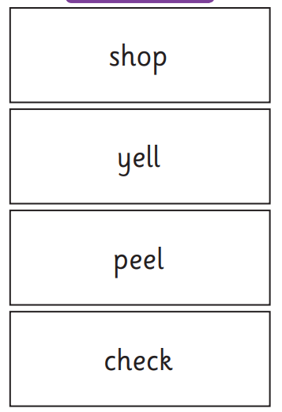
What the check looks like

Slide 21
Phonics screening check
Statutory assessment –in Year 1 Summer term.
Children have to read 20 real words and 20 nonsense (alien) words.
Nonsense words can be identified as they are always accompanied by a picture (usually an alien)
Children will complete the check on a 1:1 basis.
There will be a meeting at 3:30 on Tuesday 19th April to give out further information.

Slide 22
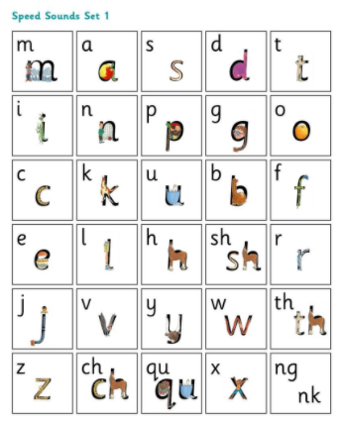
Set 1 sounds

Slide 23
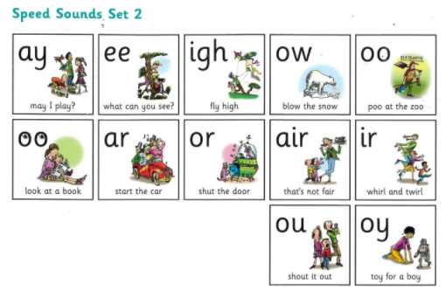
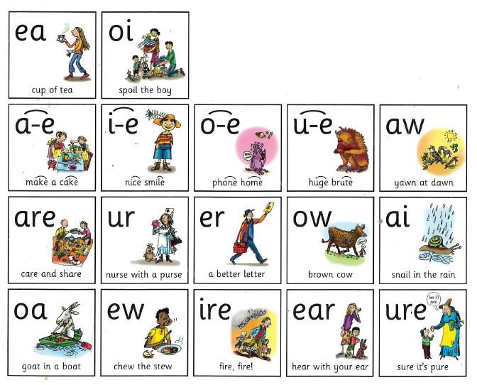
Set 2 and set 3 sounds
When they are secure with these sounds then they need to learn to recognise them in words.

Slide 24

Segmenting and blending
AN EXAMPLE OF A SPEED SOUND LESSON CAN BE SEEN HERE:
Parent video: Reading the Set 3 sounds and words with your child – YouTube

Slide 25
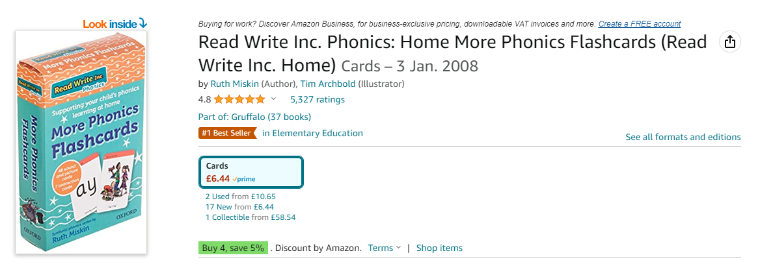
Resources to help you at home
You can buy all of the RWI resources on Amazon to support your child’s learning.
https://www.amazon.co.uk/Read-Write-Inc-Phonics-Flashcards/dp/0198386818/ref=asc_df_0198386818/?tag=googshopuk-21&linkCode=df0&hvadid=310903220820&hvpos=&hvnetw=g&hvrand=15705829238538563798&hvpone=&hvptwo=&hvqmt=&hvdev=c&hvdvcmdl=&hvlocint=&hvlocphy=9073591&hvtargid=pla-551312072804&psc=1&th=1&psc=1

Slide 26
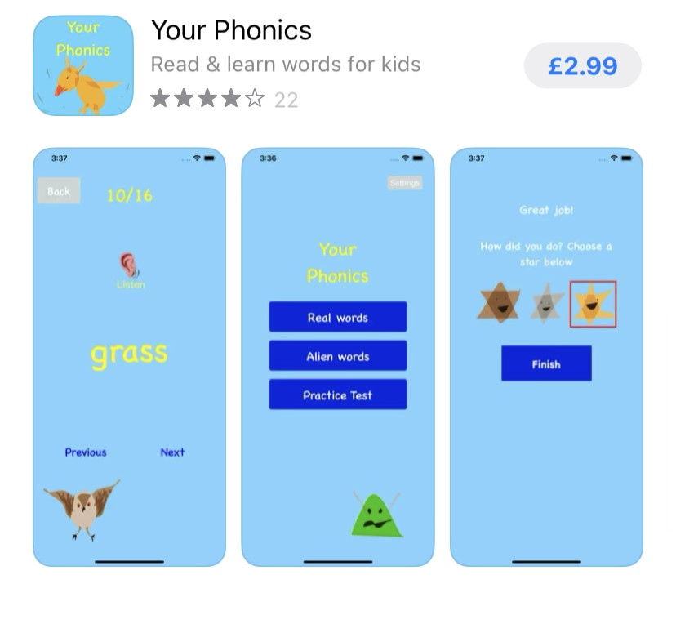
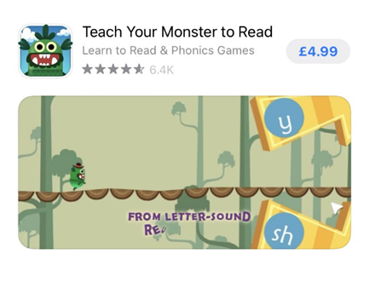
Making it fun at home
Apps and games can help

Slide 27
READING AT HOME
Fluency is the key. I know it can be frustrating and children can become bored reading the same book but I really can’t emphasise enough how important it is to become fluent.
If children are on orange, yellow, blue or grey books they need to be spotting cvc words such as cat, dog, had without needing to sound them out. Please try and encourage this at home. It is fine if they need to sound out initially but then try and encourage to re-read again so they do not sound out. Keep reading until they can do it without sounding out.
Reading 1 or 2 pages well is much better than trying to read a whole book. 15 mins a day is enough.

Slide 28
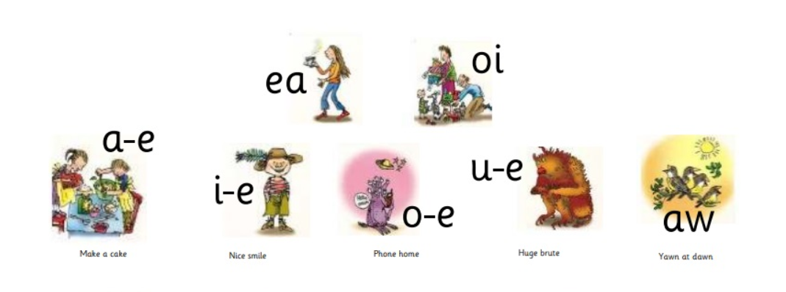
READING AT HOME
The jump from Yellow to Blue is the biggest and the hardest jump.
These are the hardest sounds to learn. Please can you support with this at home using the yellow flip books. Practicing sounds / red words can count as one of your readings.
Split Digraphs – best friends on the end

Slide 29
Reading treat
The children are expected to read at least 4 times per week. The children will need to have read at least half the weeks per half-term to receive their reading treat. For example, if the half term is 6 weeks, the children will need to have read 4 times per week for at least 3 of those weeks to receive their reading treat. Ideally, they should read 4 times a week, every week.
Occasionally it can include none school books, however where possible this should be their school book.
Practicing red words / spellings can count towards one of your reading times.
Children MUST become fluent when reading, this means rereading the same book many times until they do not need to sound out any of the words. We will only change the books when we think your child is fluent with it. It may seem like they have the book for a long time but fluency is really important.

Slide 30

Reading treat
The reading treat will be the last week before every half term.
This is something we decide on as a class, and this half term the children have chosen…
Toy from home

Slide 31

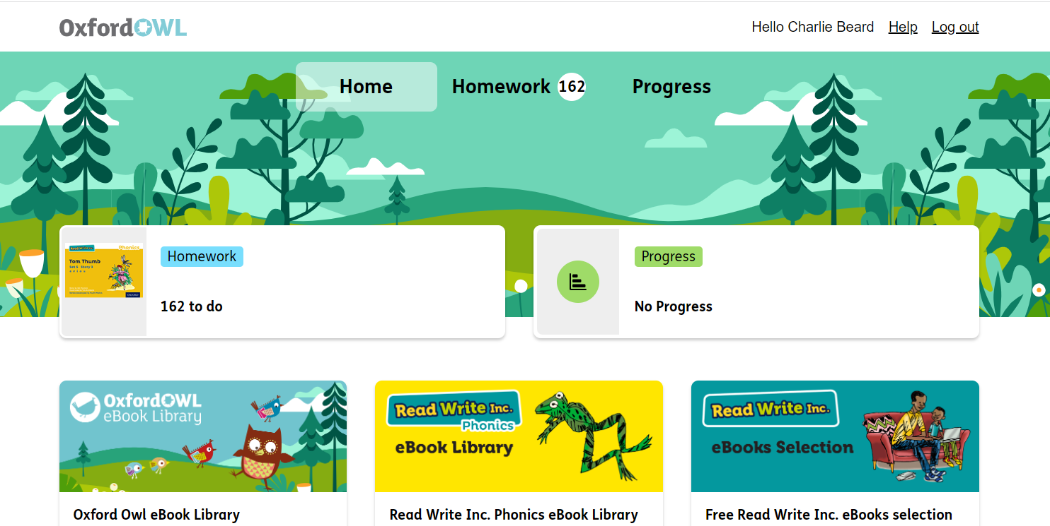
Oxford owl reading
This is a subscription provided by the school that has a lot of resources on it.
Logins can be found in the back of reading diaries.

Slide 32
Educational visits
23rd November 2026 - Stoke City Stadium Tour and multi-skills session. Letter to be given out.
8th January 2027 – Chester Zoo educational Visit.
Summer trip – TBC

Slide 33
Trips
Once letters have been given out, please return as soon as possible.
Payment can be made online using School Spider.
On this day, children will need to come in normal uniform and bring a coat.
If your child would like to order a sandwich lunch from the Chef, please tick the form, otherwise they will need a packed lunch /water bottle.
Normal pick up and drop off times.

Slide 34
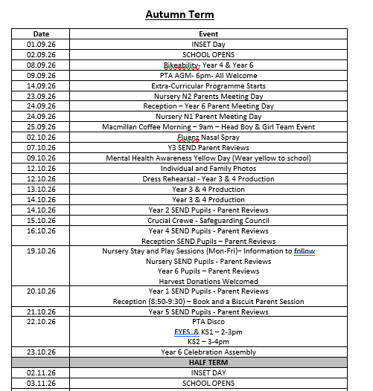
Dates for the diary

Slide 35

Any questions?
ehancock@scholargreen.cheshire.sch.uk

