Slide 1


Miss Worthington lworthington@scholargreen.cheshire.sch.uk
Year 5

Slide 2
The following subjects are taught to the children:
English (Daily)
Maths (Daily)
Spelling / Phonics (Daily)
Science (Weekly)
RE (Weekly)
PHSE (Personal, Health, Social and Economic Education) (Weekly)
PE (Twice a week)
History
Geography
Art
DT
Computing
Music
French (MFL)
Forest School

Slide 3

Curriculum Overview
Additionally, children also receive:
Fluency lessons to teach reading skills
Weekly vocabulary lessons
Handwriting sessions
Weekly reasoning and problem-solving lessons
TTRS practise
Every lesson has:
the knowledge, skills and vocabulary to be covered
prior learning through ‘Flash Back 4s’ to help with sticky knowledge
an enquiry question, theme or significant individual
future learning and end-point expectation

Slide 4
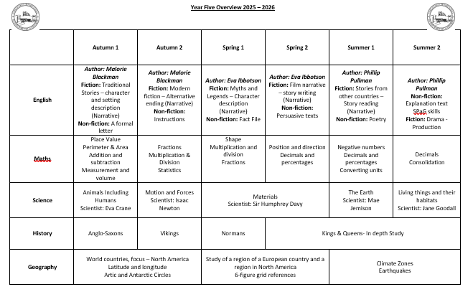
Curriculum Overview

Slide 5
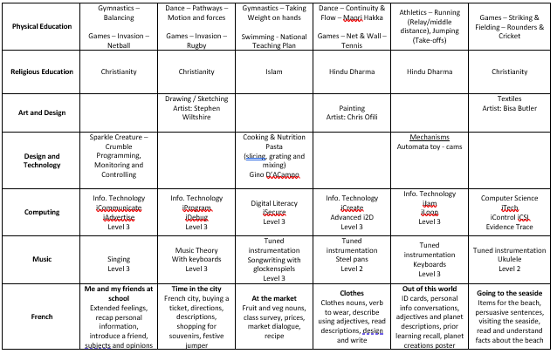

Slide 6
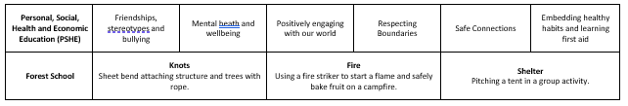

Slide 7
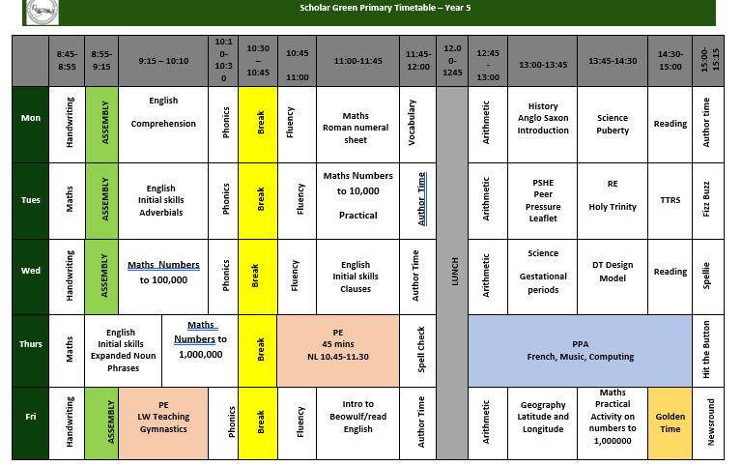
Timetable Example

Slide 8

We will continue to have the Junior Jam team on a Thursdays
They will be teaching Computing and Music and Mrs Stevenson will be teaching French (MFL).

Slide 9
Dates for the diary
Date | Event
01.09.26 | INSET DAY
02.09.26 | SCHOOL OPENS
08.09.26 | Bikeability - Year 4 & Year 6
23.09.26 | Nursery N2 Parent Meeting Day
24.09.26 | Parent Meeting Day – ADVANCE NOTICE
24.09.26 | Nursery N1 Parent Meeting Day
25.09.26 | Macmillan Coffee Morning
29.09.26 | Year 2 Nantwich Educational Visit
02.10.26 | Fluenz Nasal Spray
09.10.26 | Mental Health Awareness Yellow Day (Wear yellow to school)
12.10.26 | Individual and Family Photos
13.10.26 | Year 3 & 4 Production – 1pm
14.10.26 | Year 3 & 4 Production – 1pm & 6pm
15.10.26 | Crucial Crewe- Safeguarding Council
23.10.26 | Year 6 Celebration Assembly 9am

Slide 10
02.11.26 | INSET DAY
03.11.26 | SCHOOL OPENS
06.11.26 | Year 3 & 4 Whitworth Trip TBC
09.11.26 | Year 1-5 Assessment Week
09.11.26 | Anti-Bullying Week EYFS Nursery Rhyme Week
11.11.26 | Armistice Day Odd Sock Day- Pupils can wear Odd Socks to school on this day
20.11.26 | Children in Need
23.11.26 | Year 6 Assessment Week
30.11.26- 02.12.26 | Year 6 Robinwood
08.12.26 | Year 1 & Year 2 Production 1pm
09.12.26 | Year 1 & Year 2 Production 1pm & 6pm
14.12.26 | PTA Panto Church Carol Service
16.12.26 | EYFS Production
17.12.26 | Christmas Dinner & Christmas Jumper Day
18.12.26 | Year 5 Celebration Assembly END OF TERM
Dates for the diary

Slide 11
YEAR 5 ASSESSMENTS
Throughout the year, we will have three assessment weeks and the data gained from the assessments will gauge where support will be needed with children.
Towards the end of the year, SATs tests will be taken to give a scaled score and to see what children may need extra support next year.

Slide 12

English
English is taught every day.
Includes :
Writing – Transcription and Composition
Vocabulary
SPaG (Spelling, Punctuation and Grammar)
Reading – Word Reading, Comprehension and Fluency
Spoken Language / Oracy

Slide 13

Writing/sequence
Writing is assessed continually through all subject areas. Skills are taught in English and applied in Science, History, Geography, RE, PSHE etc.
Children are always aware of the reason for writing and the audience.
Read and evaluate a WAGOLL / pick out key features
Plan, draft using jotter books, write, improve and up-level
We encourage the children to use adventurous vocabulary in their writing.
Children should be able to self-check and improve their writing by reading it back to themselves, ensuring it is clear and cohesive and identifying ways to make it even better.
Children are encouraged to use dictionaries and thesauruses during lessons.

Slide 14
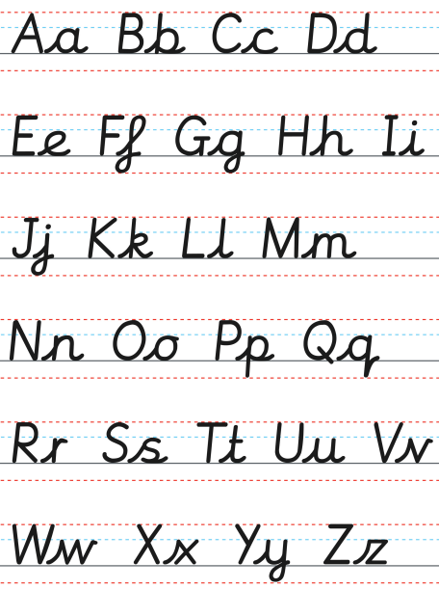
What does Age Related Expectation Mean?
Accurate punctuation – MUST have capital letters.
Accurate sentence structure
Adventurous vocabulary.
Be able to self check and correct own errors.
Suitable for purpose and audience.
Drawing all punctuation marks correctly.

Slide 15
Spelling Groups “phonics”
Children are grouped according to their spelling ability and can be with children of different ages.
Working on specific spellings patterns and completing a range of activities based on that spelling pattern.
Some children are being accelerated and some are plugging gaps.
Most children will work on Year 5 spelling list words as part of their Early Morning Task.

Slide 16
How to help at home
Practising dictionary skills – getting familiar with how to use it.
Practising spellings off the Year 5 spelling list and ensuring children are confident with the meaning of the words and can use them accurately.
Reading a wide range of genres including stories.
Writing if children want to – even things like football reports.

Slide 17


Reading Treat
Average for Year 5 5.0 - 6.0
The first number is the year group, the decimal is the months.
Linked to AR point targets.
AR point targets will be stuck into your child’ reading diary at the beginning of each half term.
Children will need to achieve their reading point target to receive their reading treat.
Still aim to read at home at least 4 times a week for 20 minutes.
Reading diaries will still be checked by myself on a Monday morning.
Notes:
See next slides to explain reading strands

Slide 18
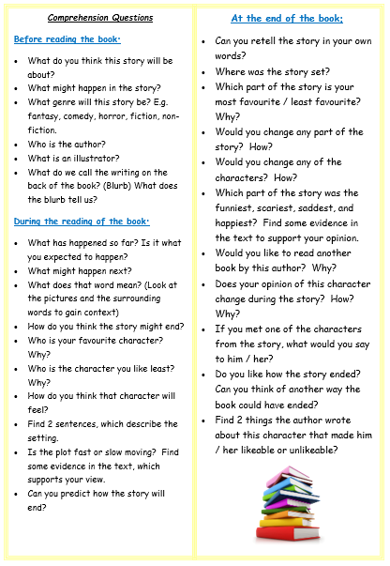
How to help at home
Make sure children are reading 4 times a week – they can read to themselves and record themselves.
Enjoy reading share stories together – they are not too old to be read to.
Read a range of texts, as reading impacts upon writing and lots of other topics e.g the understanding of a maths question.
Look up new / unknown vocabulary together.
Ask questions when you do read together – see questions.

Slide 19





Recommended Quality Texts
https://www.booksfortopics.com/booklists/recommended-reads/year-5/
www.thereaderteacher.com/
Notes:
See next slides to explain reading strands

Slide 20
Useful Websites to support English
https://www.spellzone.com/games/index.cfm
http://www.topmarks.co.uk/english-games/7-11-years/spelling-and-grammar
http://www.bbc.co.uk/education/levels/zbr9wmn
http://www.topmarks.co.uk/Interactive.aspx?cat=47

Slide 21
Mathematics
Daily counting usually times tables
Always starts with 0
Daily Practice
Mastery Curriculum – fluency, reasoning and problem solving.

Slide 22
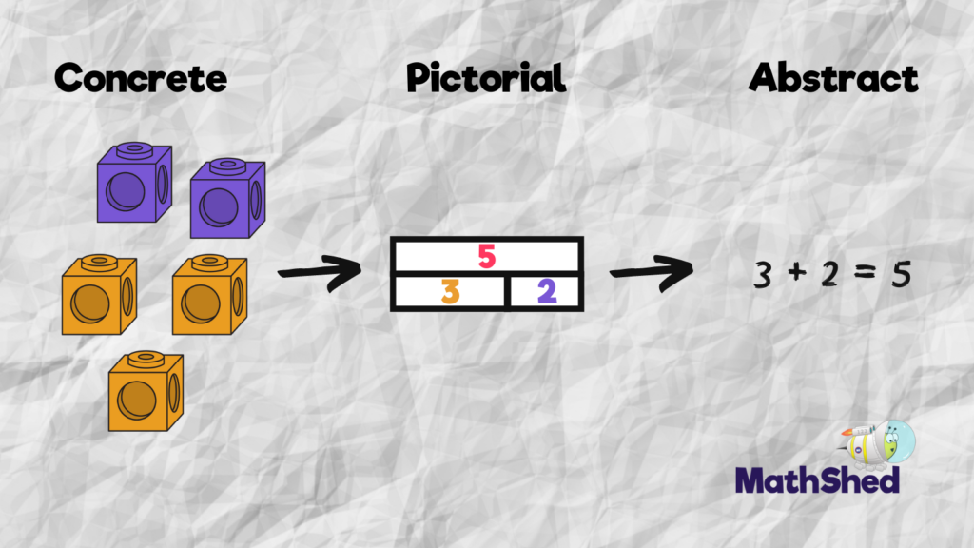
At Scholar Green all classes teach maths based on the concrete, visual and abstract approach.
1. Pupils are first introduced to an idea or skill by acting it out with real objects (a hands-on approach).
2. Pupils then are moved onto the visual stage, where pupils are encouraged to relate the concrete understanding to pictorial representations.
3. The final abstract stage is a chance for pupils to represent problems by mathematical notion.
The three stages feature in each year group.

Slide 23
Key maths skills and vocabulary in Year 5
Addition Add numbers with more than 4 digits: +, add, more, addition, increase, plus, make, sum, total, altogether, double, near double, one more…, two more… ten, more…, 100 more…greater, more, units, ones, tens, count, count (up) to count on (from, to) how many…?tens boundary , hundreds boundary, inverse, units boundary, tenths boundary | Subtraction Subtract numbers with more than 4 digits: subtract, subtraction, take (away), minus, decrease, leave, how many are left/left over? difference between , half, halve , how many, more/ fewer is... than...? , how much more/less is...? , equals, sign, is the same as , tens boundary, hundreds boundary , units boundary, tenths boundary, inverse, rounding to estimate and check
Multiplication Multiply numbers up to 4 digits by a one- or two-digit number: lots of, groups of, times, multiplication, multiply, multiplied by , multiple of, product , once, twice, three times, four times, five times… ten times , times as (big, long, wide, and so on) , repeated addition , array, row, column | Division Divide at least 4 digits by single-digit numbers: double, halve , share, share equally , one each, two each, three each… , group in pairs, threes… tens , equal groups of , divide, division, divided by, divided into, divisible by , remainder , factor, quotient , inverse

Slide 24
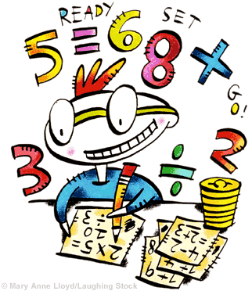
Multiplication
3 x 6 = 18
3 x 60 = 180
3 x 600 = 1800
0.3 x 6 = 1.8
Notes:
Link to methods shown at Parents’ meeting

Slide 25
How to help at home
Times Table Rock Stars - Times tables are essential – children MUST know them all without having to work them all out.
Number bonds to 10 and 100 and application
Telling the time and reading timetables .
Real life maths – weighing for baking / money.

Slide 26

Homework
Set on a Thursday
Hand in on a Tuesday
An English & a maths activity each week
Homework will consolidate work they have completed in class.
In addition, every week, children should read at least 4 times, practise spellings and regularly access Times Table Rock Stars.

Slide 27
Useful Websites to support Maths
https://ttrockstars.com/login
http://www.topmarks.co.uk/maths-games/7-11-years/problem-solving
http://www.bbc.co.uk/education/levels/zbr9wmn

Slide 28
OTHER INFORMATION

Slide 29

Year 5 trips
Autumn Term
Congleton Library
Spring Term
History Workshop in school
Summer Term
Catalyst Discovery Centre

Slide 30

Finally, WE NEED YOU!
We are looking for a bank of volunteers…
Can you spare any time to read with
our children?
Are you available to come on trips
with us?
Do you have any time to support us with fieldwork in the local area?

Slide 31
Thank you!
Thank you, if you have any questions or would like further information, please do not hesitate to contact me.
lworthington@scholargreen.cheshire.sch.uk

