Slide 1


Nursery Parents Curriculum Information
Nursery Year 2025/2026

Slide 2


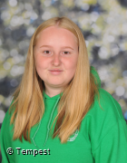




Meet the Team

Slide 3
Daily Routine
Our routines are very similar across both the 2’s and N2 rooms.
Welcome, self registration and wellbeing check in.
‘Getting Busy’ time- learning through play and child initiated play, adult supported.
Circle time and small group deployment – activities informed by curriculum, children’s interests, current topics.
Free flow indoor outdoor play, teacher interventions.
‘Snack and chat’, nappies.
Lunchtime
Circle time, afternoon greeting and registration, small group deployment.
Free flow indoor outdoor play, afternoon snack.
Large group activity, home time preparation.
The children are offered a range of healthy snacks including:
crumpets, toast, pancakes and fruit and vegetables and milk and water.
We encourage independence and social skills in this time.
Notes:
This is a brief overview of the routine in both rooms in our nursery. Flexible to change within the room including PE, assemblies, whole school experiences including enterprise week, pantomime’s etc.

Slide 4
Early Years Foundation Stage
Lays the Foundations for children’s journey and sets them up as life long learners
Outstanding curriculum that links all 7 areas of the Early Years Foundation Stage to the national framework, children’s interests and our local community.
- communication and language
-personal, social and emotional development
-literacy
-numeracy
-expressive arts and design
-understanding the world
-physical development
Learning through play and using the outdoor environment to support independence, risky play and learning with natural resources.
Notes:
Overview of the early years foundation stage and what its all about. All activities and interventions we do in nursery are informed by our curriculum and it encompasses everything the children need to learn and support them to meet their ELG’s at the end of reception.

Slide 5
Characteristics of Effective Learning
The characteristics are as follows:
Play and exploring
Finding out and exploring
Using what they know in their play
Being willing to have a go
Active Learning
Being involved and concentrating
Keeping on trying
Enjoying achieving what they set out to do
Creating and critically thinking
Having their own ideas
Using what they already know to learn new things
Choosing ways to do things and finding new ways
Notes:
We use the COEL to inform our planning and activities in nursery. The 2 year olds in nursery begin by playing and exploring and this supports them in the development of their active learning. The children are working towards the areas of active learning and c&c during their time in nursery and are creative and critical thinkers in preparation for reception. We use character books including

Slide 6
Curriculum
Awe and wonder
Enrichment
Life Skills
Self-Help
Emotionally healthy
Promote confidence and resilience
It’s ok to make mistakes
Exploring and curiosity
Problem solvers
Language development
Notes:
Our early years framework is all about nurturing children’s curiosity, independence and confidence. These attributes underpin the curriculum and how we deliver it what the children get. We aim to foster awe and wonder in the mundane experiences like thunderstorms or the sounds of nature, these above qualities encompass our framework and the experiences the children have at nursery at scholar green.

Slide 7
Baseline Assessment
Completing baseline assessments as children first enter Nursery
Informing the beginning of their learning journey
Getting to know key workers
If you are new to Nursery this time, children’s red books are really useful for us to look at.
National Statutory assessment between the age of 2 and 3.
review a child’s development and progress in the 3 prime areas of learning and development in the EYFS framework
identify any areas of concern or additional development needs
work with parents and other professionals to put in place appropriate support and interventions.
Notes:
Children are informally assessed when they are new to our nursery, and we have working assessments throughout the year for the staff to consistently update and monitor based on your child’s development. We often carry out a child’s 2 year check if they haven’t had one already and this is a review for a child aged 2-3 in the three prime areas – physical development, communication and language and personal social and emotional development.
Other assessments we do include Wellcomm, this is specific to a child’s speech, language and understanding but is often used for all children in different situations.

Slide 8
Physical Development
A prime area to support all-round development
Help them peruse happy, healthy and active lives
Gross motor skills provide the foundation for developing healthy bodies and social and emotional well-being.
Fine motor control and precision helps with hand-eye co-ordination which is later linked to early literacy.
PE with Mrs Kirk
Notes:
Spatial awareness, love for sports and exercise, promoting a healthy lifestyle, part of the wider school community.

Slide 9
Gross and Fine Motor Skills
Children develop gross motor skills using their whole body. You can see this from a baby’s earliest efforts to move and travel, to young children coordinating whole body movements. By using their whole bodies children become increasingly confident, agile and flexible.
This looks like large scale movements including painting on easels, chalking the floors outside, reaching up to get resources, brushing up in big movements etc. A lot of these activities are done in the outdoor area.
Fine motor skills involve small muscles working with the brain and nervous system to control movements in areas such as the hands, fingers, lips, tongue and eyes. Developing fine motor skills helps children do things like eating, writing, manipulating objects and getting dressed.
Mark making is an important experience for children because over time they can attribute meaning to their marks. Combined with a child’s developing dexterity, these marks become refined and deliberate, until the point at which the young child labels their marks, either as pictures or writing. Activities including dough disco and squiggle whilst you wiggle.
Notes:
Within our nursery this year we are having a strong focus on fine motor We love to see the children’s mark making progress during their time in nursery as they begin to or continue to make meaningful and detailed creations.

Slide 10


Formal Phonics
Early Phonics/ Language
Our early phonics sessions focus on developing children's speaking and listening skills.
Aim to get children attuned to the sounds around them and ready to begin oral segmenting and blending.
Environmental sounds- Listening walks, drumming outdoors, making shakers etc.
Rhythm & Rhyme
Nursery Rhymes.
When the children are ready- small groups, play based
Read, Write, Inc programme
Each sound is introduced- ensuring correct pronunciation
https://www.youtube.com/watch?v=5J2Ddf_0Om8&feature=player_detailpage
Children learn rhymes to help them write the sounds
Fred talk to segment and blend
Notes:
First autumn term and sunbeams activities – as the children turning 3 this year come up.
Fred the frog is a puppet who helps the children blend sounds into words, this is something the N2 children begin to learn in the Summer term of nursery once their understanding of the set 1 sounds is solid. This is called Fred Talk ‘ C a t- cat’

Slide 11
Reading
Reading at home is incredibly important.
We want to promote a love of reading.
Library books will be chosen by the children for them to share with you at home and recorded in their reading diary.
When children are ready they may receive a picture reading book. It is encouraged that children look at their books on more than one occasion.
Lots of experiences of singing nursery rhymes, reading a favourite story, pointing to signs whilst out shopping; it is not just limited to books. These are vital in your child’s development.
Please encourage them to look after the books and really enjoy them and please make notes in the diary to let us know how you’re getting on.
Mystery Reader- we need your help!
Story sacks for traditional tales.

Slide 12
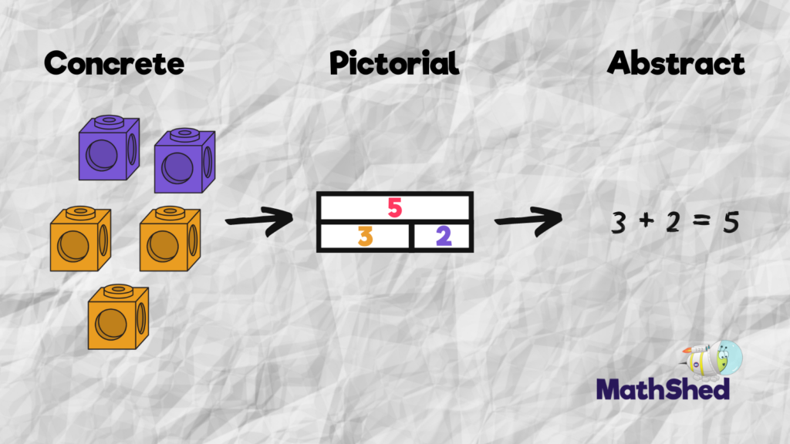
Early number
Maths is everywhere!
Rhymes
Actions
Objects
Being creative!
Having fun!
At Scholar Green all classes teach maths based on the concrete, visual and abstract approach.
Notes:
Our maths activities in nursery mainly start with concrete example including counting beads, using counters, creating shapes with building blocks. We move on to pictorial and abstract once our children have a good understanding of number recognition, counting and composition of numbers.

Slide 13
Key maths skills and vocabulary in Nursery
Addition Recite numbers up to 10 and compare group sizes: one, two, three, four, five, six, seven, eight, nine, ten more, bigger, how many, count, same, total | Subtraction Separate a group of three or four objects in different ways, beginning to recognise that the total is still the same: one, two, three, four, five, six, seven, eight, nine, ten less, smaller, how many, count, same, total
Multiplication Know that numbers identify how many objects are in a set, shows an interest in number problems: pair, how many altogether, lots of, groups of | Division Know that numbers identify how many objects are in a set, shows an interest in number problems: pair, lots of, groups of, share

Slide 14
How to help your child at home
Developing independence-helping to dress themselves, putting coats on, zipping up coats and helping with buttons, toileting, helping to tidy, special jobs, using a knife and fork, carrying their own bags/belongings
Practise counting concrete objects and objects when out e.g. lampposts, flowers, things in the shopping trolley.
Games to develop listening & attention and sharing and turn taking
Name recognition & recognising familiar signs and logos
Large scale mark making in a range of contexts, e.g. chalking, using shaving foam, play dough
Model writing in a range of contexts, e.g. invitations, cards etc
Activities to develop fine motor skills and hand-eye co-ordination, e.g. threading, zips, puzzles, weaving, tweezer activities

Slide 15

Tapestry
Used to document key milestones your child has reached
Moments taken during continuous and enhanced provision
Collect a range of evidence
Match against Development Matters standards
Observe and record Characteristics of effective learning
Information added to the tapestry care diary regarding nappies, mealtimes and other care information.
Please leave comments and likes where possible so staff know that you are contributing to our school-home relationship.
Recording of information is no longer statutory in the EYFS frame work, there is a big emphasis on the practitioners being with the children but we do aim to put on WOW moments and key learning for you to see at home.

Slide 16

Our Golden Rules
Good Listening
Good Looking
Good Sitting
Kind Words
Kind Hands and Feet
Our Outdoor Rules
Listen to your teachers
Keep yourself and others safe
Look after our toys
Choose it, use it, put it away!
Kind Hands and Feet
Notes:
Warnings and time out
Traffic light system and bells
123 eyes on me.

Slide 17

Dummies and speech
Prolonged use of a dummy can damage the teeth and affect speech development.
It reduces the amount of babbling, a vital stage needed before a child can talk. Children need to practice this at all times.
Children learn words by listening to & copying adults. A dummy prevents a child from copying words & sounds back correctly.
Many speech sounds are made at the front of the mouth (p, b, t , d, s) Regular dummy/ bottle users will struggle to develop these sounds and may then need speech therapy.
The more a child talks with a dummy the higher the risk of needing long term speech therapy.
A child is much less likely to talk if they have an object in their mouth.
Recent studies show that over half of all dummy users are referred for speech therapy

Slide 18
Punctuality and Attendance
Absences need to be reported via the school office- the telephone number is 01782 651099
Good attendance is essential to ensure your child is happy and settled in Nursery and is getting the best opportunity to grow and develop alongside their peers and their teachers.
Children should aim to achieve 97% attendance at least throughout the year.
Nursery doors open at 8.50 and ready for a prompt 9am start to session.
After this time, the Nursery gate will be shut and children will need to enter through the main entrance and you sign them in.
We encourage you to minimise any reason why your child may not attend Nursery during term time e.g. holidays.

Slide 19

Any other business
It would be great if the children could have wellies and a waterproof coat in school at all times. (They can leave them on their pegs)
Spare clothes can be left on their pegs. Staff will inform when nappies and supplies need replenishing.
Please label all items of clothing.
Thank you for you support and attending the meeting.

Slide 20
Important Dates for the Diary
Date | Event
15.09.25 | Parent Information Workshop Online
26.09.25 | Macmillan Coffee Morning – 9:00-10:30
03.10.25 | Athlete In School
06.10.25 | Nursery Stay and Play Week 9:00-9:45 – Parents Invited (more info to follow)
10.10.25 | World Mental Health Day – Yellow Day (Wear yellow to school)
13.10.25 | Individual & family Photos Arts Week
17.10.25 | Big Draw Parent Gallery – 2:30pm
WC 20.20.25 | Harvest Donations
22.10.25 | PTA Disco
24.10.25 | END OF TERM

Slide 21
Website
Please check for regular updates and notifications
Facebook is another avenue to keep up to date and can accessed through our website
www.scholargreen.cheshire.sch.uk
Your comments are valued
We are always here to answer your questions

Slide 22

Thank you for listening! Any questions?
mhadfield@scholargreen.cheshire.sch.uk

