Slide 1

Parents’ meeting with Miss Worthington
Year 6

Slide 2
Curriculum Overview
The following subjects are taught to the children:
English (Daily)
Maths (Daily)
Science (Weekly)
RE (Weekly)
PHSE (Personal, Health, Social and Economic Education) (Weekly)
History
Geography
Art
DT
Computing
Music
MFL

Slide 3

Curriculum Overview
Additionally, children also receive:
Fluency lessons to teach reading skills and support the foundation subjects
Weekly vocabulary lesson
Handwriting sessions
Weekly reasoning and problem-solving lessons
TTRS practise
Every lesson has:
the knowledge, skills and vocabulary to be covered
prior learning through ‘Flash Back 4s’ to help with sticky knowledge
an enquiry question, theme or significant individual
future learning and end-point expectation

Slide 4
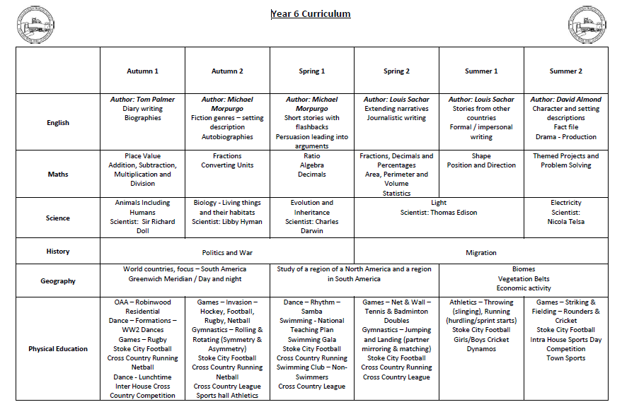
Curriculum Overview

Slide 5
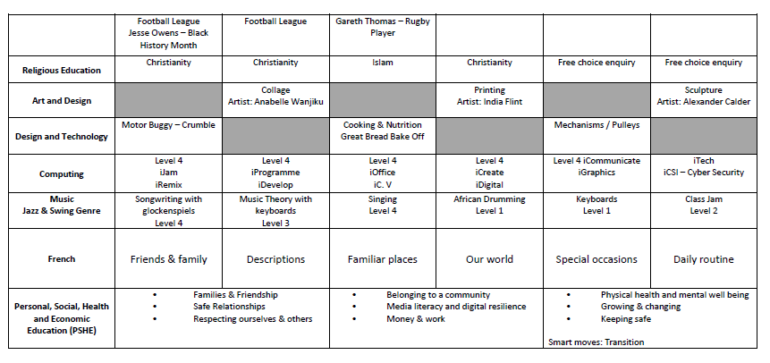
Curriculum Overview cont.

Slide 6
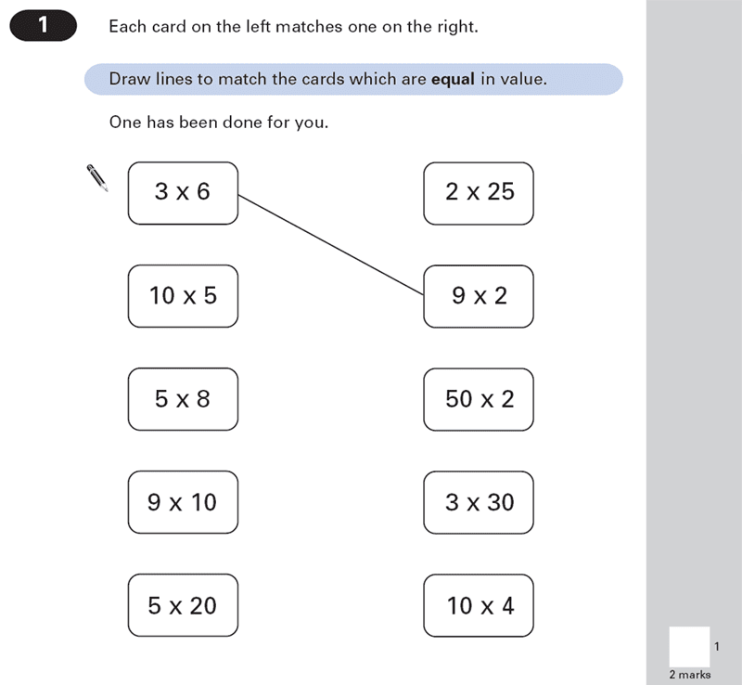

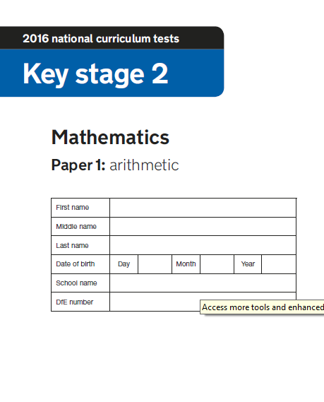
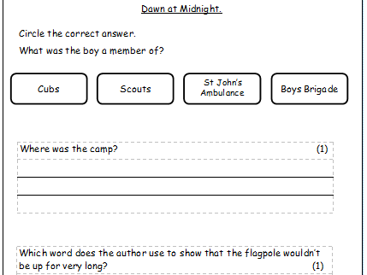
Week beginning 11th May 2026
A SATs meeting will be held on 20th January at 3.30pm in the Year 6 classroom. A representative for each child must attend.
Please DO NOT take holidays in this time.

Slide 7

English
Taught every day
Includes :
Writing
SPaG (Spelling, Punctuation and Grammar)
Reading

Slide 8

Sequence of Writing
Read and evaluate / identify key features
Plan
Draft
Proofreading / editing
Publish

Slide 9
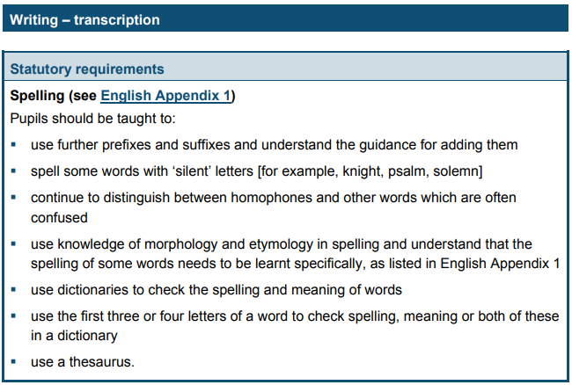
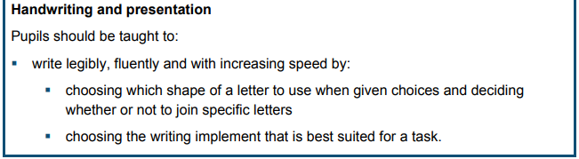
Writing Expectations

Slide 10
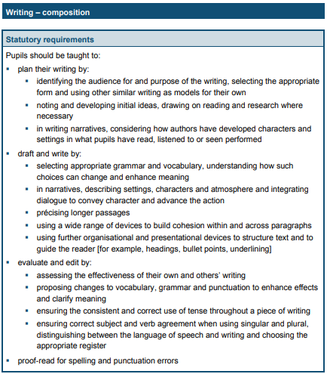
Writing Expectations

Slide 11
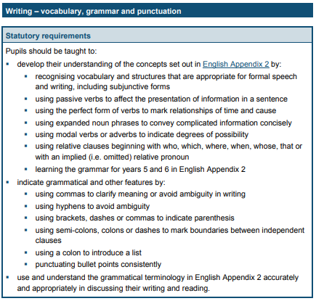
Writing Expectations

Slide 12
What does Age Related Expectation Mean?
Accurate punctuation – MUST have capital letters.
Accurate sentence structure.
High level of adventurous vocabulary.
Be able to self check and correct own errors.
Suitable for purpose and audience.
Drawing all punctuation marks correctly.
Must be joined

Slide 13

SPaG
It comes in 2 parts Grammar, Punctuation, Vocabulary and Spelling.
By Y5 most of the content has been taught.
Spellings are practised in daily handwriting.

Slide 14
Spelling
Spelling MUST be accurate to be at Age Related Expectation.
However, children can self check using a dictionary, word bank or by asking a peer or adult for the spelling.
Dictionaries/ thesauruses are a great tool and we encourage children to use them in lessons.

Slide 15
Phonics
Working on specific spellings patterns and completing a range of activities based on that spelling pattern.
Some children are being accelerated and some are plugging gaps.
Children will work on the Year 6 spelling list words as some of our Early Morning Tasks.

Slide 16
How to help at home
Practising dictionary skills – getting familiar with how to use it.
Practising spellings off the Year 5&6 spelling list and ensuring children are confident with the meaning of the words and can use them accurately.
Reading a wide range of genres including stories.
Writing if children want to – even things like football reports.

Slide 17
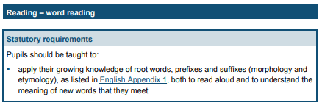
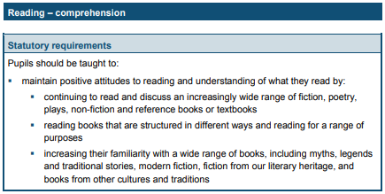
Reading Expectations

Slide 18
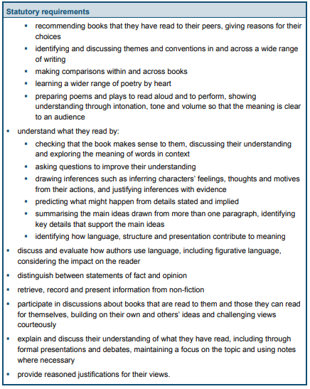
Reading
Expectations continued

Slide 19


Reading Treat
Linked to AR targets.
AR targets will be stuck into your child’s reading diary at the beginning of each half term.
Children will need to achieve their reading target to receive their reading treat.
Aim to read at home at least 4 times a week.
Reading diaries will still be checked on a Monday morning.
Reading for sustained periods is an expectation in Year 6.

Slide 20
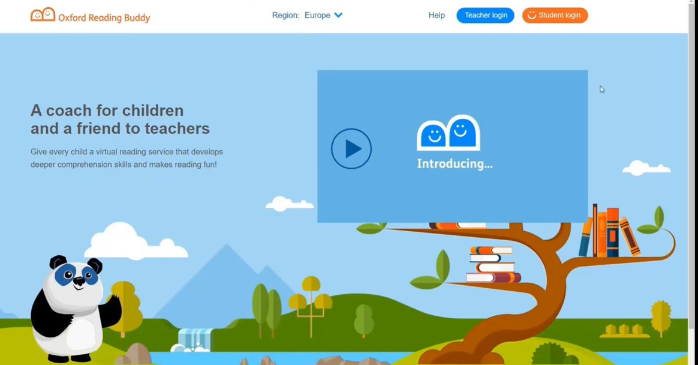

Reading
The average ZPD for a Y6 child is between 6.0 - 7.0.
https://ukhosted101.renlearn.co.uk/2248193/
https://www.oxfordowl.co.uk/login?active-tab=students
https://www.oxfordreadingbuddy.com/uk

Slide 21




Recommended Quality Texts
www.booksfortopics.com/year-6 www.thereaderteacher.com/

Slide 22
Reading Strands – KS2
National Curriculum Reference | No. of marks | % of total mark
2a give / explain the meaning of words in context | 5 – 10 | 10 – 20%
2b retrieve and record information / identify key details from fiction and non-fiction | 8 – 25 | 16 – 50%
2c summarise main ideas from more than one paragraph | 1 – 6 | 2 – 12%
2d make inferences from the text / explain and justify inferences with evidence from the text | 8 – 25 | 16 – 50%
2e predict what might happen from details stated and implied | 0 – 3 | 0 – 6%
2f identify / explain how information / narrative content is related and contributes to meaning as a whole | 0 – 3 | 0 – 6%
2g identify / explain how meaning is enhanced through choice of words and phrases | 0 – 3 | 0 – 6%
2h make comparisons within the text | 0 – 3 | 0 – 6%

Slide 23
How to help at home
Make sure children are reading 4 times a week – they can read to themselves and record themselves.
Enjoy reading share stories together – they are not too old to be read to.
Ensure children are reading for sustained periods.
Read a range of texts as reading impacts upon writing.
Look up new / unknown vocabulary together. (2A link)
Ask questions when you do read together – see questions.

Slide 24
Useful Websites to support English
https://www.spellzone.com/curriculum/national-curriculum/years-5-6.cfm
http://www.topmarks.co.uk/english-games/7-11-years/spelling-and-grammar
http://www.bbc.co.uk/education/levels/zbr9wmn
http://www.topmarks.co.uk/Interactive.aspx?cat=47

Slide 25
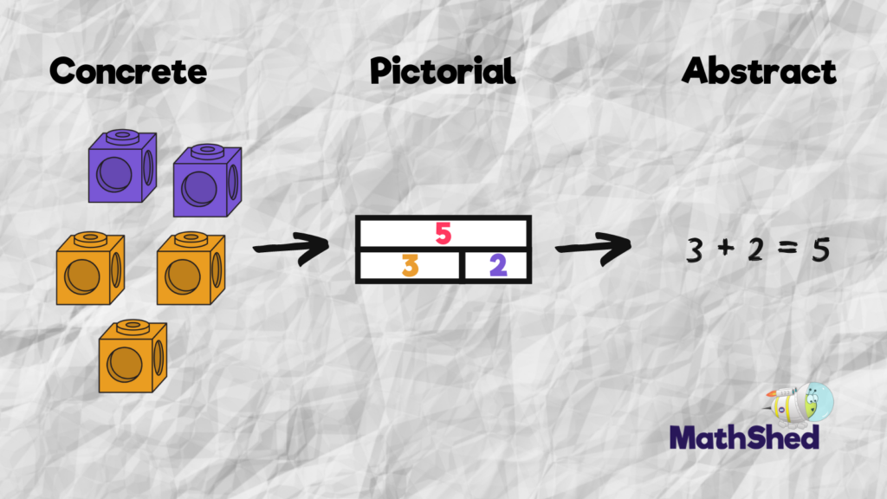
At Scholar Green all classes teach maths based on the concrete, visual and abstract approach.
1. Pupils are first introduced to an idea or skill by acting it out with real objects (a hands-on approach).
2. Pupils then are moved onto the visual stage, where pupils are encouraged to relate the concrete understanding to pictorial representations.
3. The final abstract stage is a chance for pupils to represent problems by mathematical notion.
The three stages feature in each year group.

Slide 26
Key maths skills and vocabulary in Year 6
Addition Add numbers with more than 4 digits +, add, more, addition, increase, plus, make, sum, total, altogether, double, near double, one more…, two more… ten, more…, 100 more…greater, more, units, ones, tens, count, count (up) to count on (from, to) how many…?tens boundary , hundreds boundary, inverse, units boundary, tenths boundary | Subtraction Subtract numbers with more than 4 digits: subtract, subtraction, take (away), minus, decrease, leave, how many are left/left over? difference between , half, halve , how many, more/ fewer is... than...? , how much more/less is...? , equals, sign, is the same as , tens boundary, hundreds boundary , units boundary, tenths boundary, inverse
Multiplication Multiply multi-digit numbers up to 4 digits by a two-digit whole number: lots of, groups of, times, multiplication, multiply, multiplied by , multiple of, product , once, twice, three times, four times, five times… ten times , times as (big, long, wide, and so on) , repeated addition , array, row, column | Division Divide up to 4 digits by a two-digit: double, halve , share, share equally , one each, two each, three each… , group in pairs, threes… tens , equal groups of , divide, division, divided by, divided into, divisible by , remainder , factor, quotient , inverse

Slide 27

Maths
Arithmetic Paper
2 Reasoning Papers

Slide 28
Mathematics
Daily counting
Always starts with 0
Commutative law 3x4 = 12 4x3 = 12
Daily Practise
Mastery Curriculum – fluency, reasoning and problem solving.
Concrete, Pictorial and Abstract

Slide 29
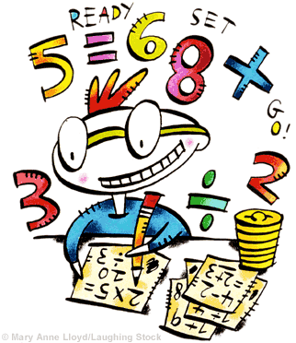
Multiplication
3 x 6 = 18
3 x 60 = 180
3 x 600 = 1800

Slide 30
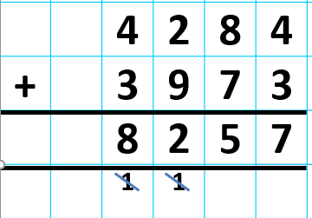
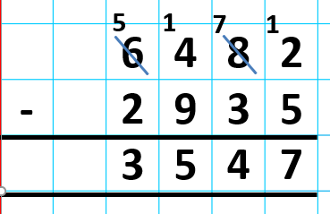
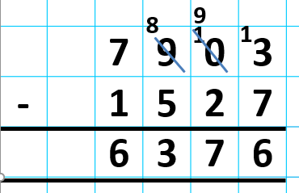
Calculation Methods
Vertical Addition
Vertical Subtraction

Slide 31
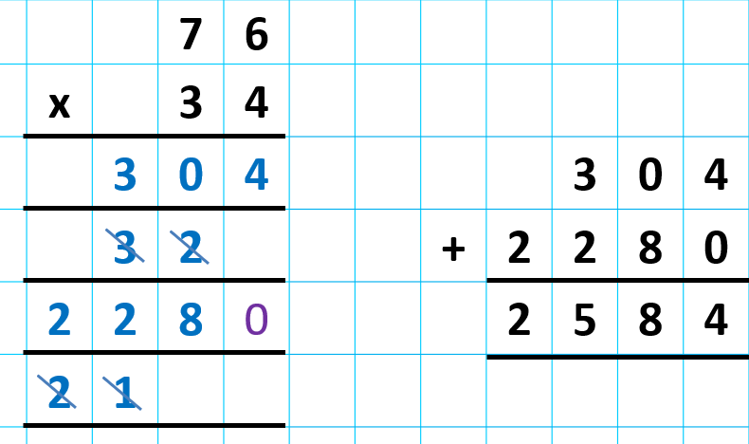
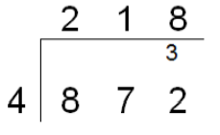

Calculation Methods
Multiplication
Division

Slide 32
How to help at home
Times Table Rock Stars - Times tables are essential – children MUST know them all without having to work them all out.
Number bonds to 10 and 100 and application e.g. 24 + 36 = 60
Telling the time and reading timetables .
Real life maths – weighing for baking / money.

Slide 33
Useful Websites to support Maths
https://ttrockstars.com/login
http://www.topmarks.co.uk/maths-games/hit-the-button
http://www.topmarks.co.uk/maths-games/7-11-years/problem-solving
http://www.crickweb.co.uk/ks2numeracy.html
http://www.bbc.co.uk/education/levels/zbr9wmn

Slide 34

Homework
Set on a Thursday
Hand in on a Tuesday
Linked to current learning taking place

Slide 35
Educational Visits:
Autumn term – Residential to Robinwood Educational Centre
Spring term – History workshop on World War 2
Summer term – Leaver’s trip

Slide 36

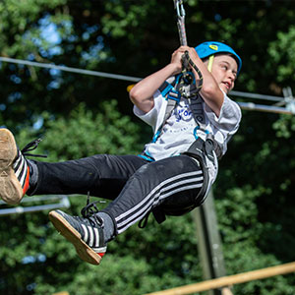
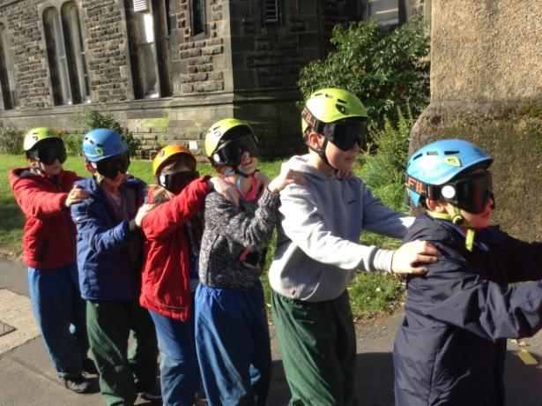
Robinwood
1st – 3rd
December 2025

Slide 37

Finally, WE NEED YOU!
We are looking for a bank of volunteers…
Can you spare any time to read with
our children?
Are you available to come on trips
with us?
Do you have any time to support us with fieldwork in the local area?

Slide 38

Thank you!
If you have any queries or questions please don’t hesitate to email me on lworthington@scholargreen.cheshire.sch.uk

