Slide 1


Mrs Kapp & Miss Vaughan
akapp@scholargreen.cheshire.sch.uk
evaughan@scholargreen.cheshire.sch.uk

Slide 2
Curriculum Overview
The following subjects are taught to the children:
English (Daily)
Maths (Daily)
Spelling / Phonics (Daily)
Science (Weekly)
RE (Weekly)
PHSE (Personal, Health, Social and Economic Education) (Weekly)
PE (Twice a week)
History
Geography
Art
DT
Computing
Music
French
Forest School

Slide 3

Curriculum Overview
Additionally, children also receive:
Fluency lessons to teach reading skills
Weekly vocabulary lessons
Handwriting sessions
Weekly reasoning and problem-solving lessons
TTRS practise
Every lesson has:
the knowledge, skills and vocabulary to be covered
prior learning through ‘Flash Back 4s’ to help with sticky knowledge
an enquiry question, theme or significant individual
future learning and end-point expectation

Slide 4
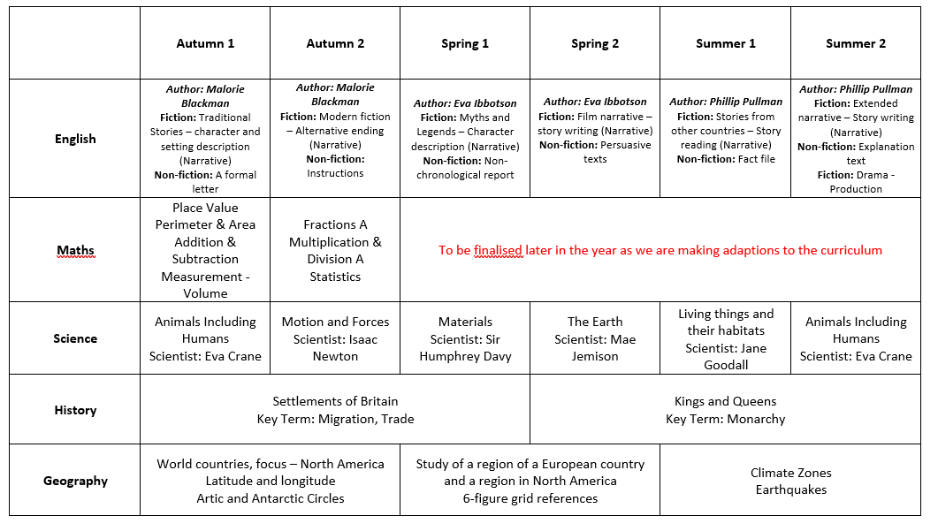
Year 5 Overview

Slide 5
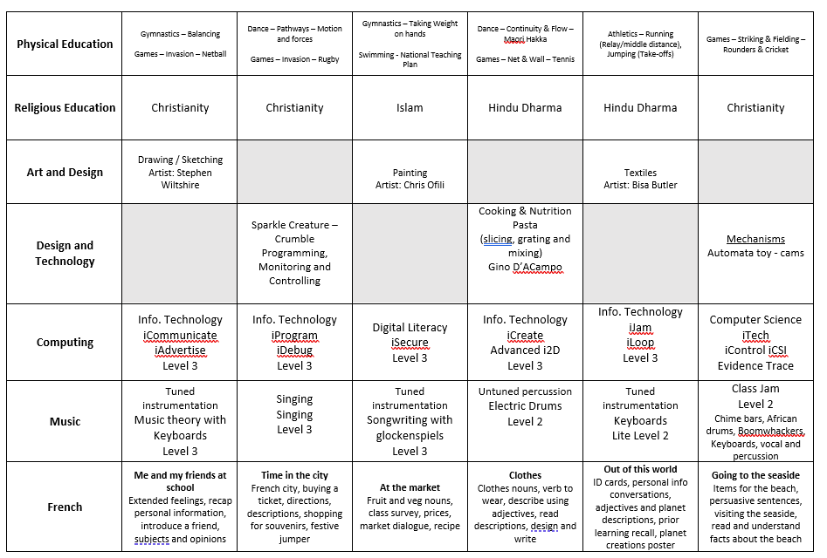

Slide 6
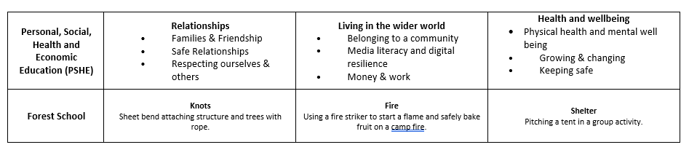

Slide 7
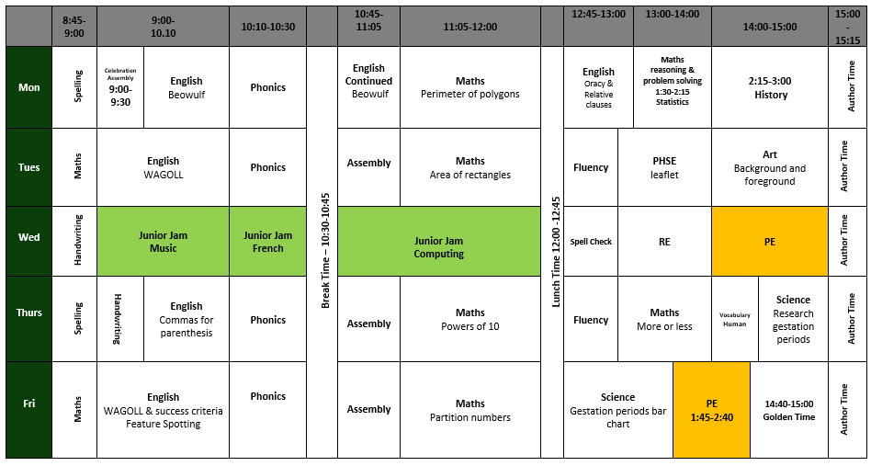
Example Timetable

Slide 8

We will continue to have the Junior Jam team on a Wednesday.
They will be teaching Computing and Music. Mrs Stevenson will also teach French on a Wednesday.

Slide 9
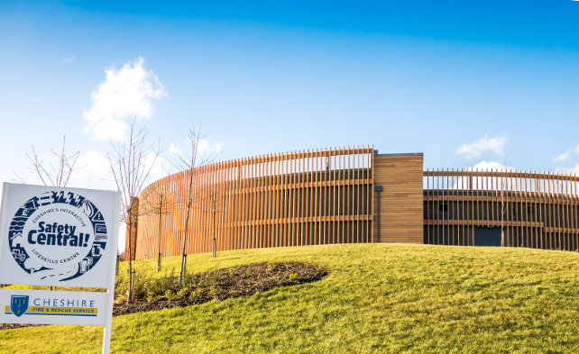
Dates for the diary
Date | Event
15.09.25 | Parent Information Workshop Information Online
15.09.25 | After School Clubs Start
26.09.25 | Macmillan Coffee Morning – 9:00-10:30am – Head Boy & Girl Team Event
03.10.25 | Athlete in School
10.10.25 | World Mental Health Day – Yellow Day (Wear yellow to school)
13.10.25 | Individual & family Photos
13.10.25 | Arts Week
14.10.25 | Crucial Crewe – Safeguarding Council
17.10.25 | Big Draw Parent Gallery – 2:30pm
W/C 20.10.25 | Harvest Donations are welcomed into School
22.10.25 | PTA Disco
24.10.25 | END OF TERM
Advanced notice: our first educational visit for Y5 will take place on Tuesday 18th November. We are visiting Safety Central which is a life skills centre and more information will be sent out nearer the time.
Autumn Parent Consultation Meetings – Wednesday 26th November

Slide 10

Year 5 Assessments
Throughout the year, we will have three assessment weeks. We use this data, alongside teacher judgement, to see if your child is working towards expectations, at age related expectations or working at a greater depth. This data also helps us to see what support or interventions may be required.
Please avoid holidays during these weeks
Assessment week 1: 17.11.25 – 21.11.25
Assessment week 2: 02.03.26 – 06.03.26
Assessment week 3: 18.05.26 – 22.05.26
Towards the end of year 5, SATs tests will be taken to give a scaled score and to see what children may need extra support with next year.

Slide 11


English
English is taught every day.
Includes :
Writing – Transcription and Composition
Vocabulary
SPaG (Spelling, Punctuation and Grammar)
Reading – Word Reading, Comprehension and Fluency
Spoken Language / Oracy

Slide 12

Writing and our writing sequence
Writing is assessed continually through all subject areas. Skills are taught in English and applied in Science, History, Geography, RE, PSHE etc.
Children are always aware of the reason for writing and the audience.
Read and evaluate a WAGOLL / pick out key features
Plan, draft using jotter books, write, improve and up-level
We encourage the children to use adventurous vocabulary in their writing.
Children should be able to self-check and improve their writing by reading it back to themselves, ensuring it is clear and cohesive and identifying ways to make it even better.
Children are encouraged to use dictionaries and thesauruses during lessons.

Slide 13
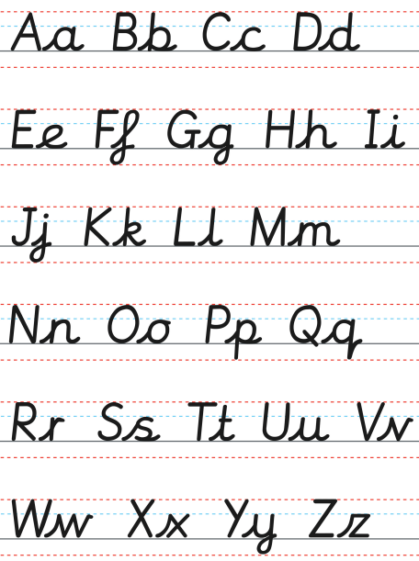
What does Age Related Expectation Mean?
Accurate punctuation – MUST have capital letters, full stops and a range of punctuation. Children must draw their punctuation marks correctly.
Be able to self check and correct own errors – cohesive and ensuring writing makes sense.
Suitable for purpose and audience.
If children don’t correctly join their writing by the end of Key Stage Two, they will not be able to achieve Age Related Expectations.
Spelling MUST be mostly accurate to achieve the Age Related Expectation. However, children can self check using a dictionary, word bank or by asking an adult for the spelling.

Slide 14
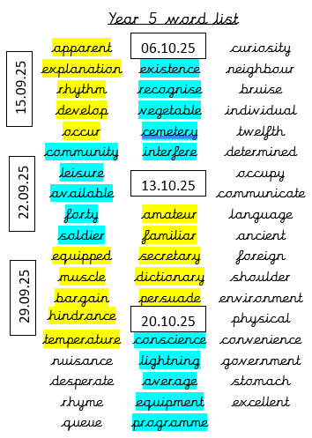
Spelling groups ‘phonics’
Year 5 word list
Children are grouped according to their spelling ability and can be with children of different ages.
Working on specific spellings patterns and completing a range of activities based on that spelling pattern.
Some children are being accelerated and some are plugging gaps.
Most children will work on Year 5 spelling list words as an Early Morning Task.

Slide 15
How to help at home
Practising dictionary skills – getting familiar with how to use it.
Practising spellings off the Year 5 word list and ensuring children are confident with the meaning of the words and can use them accurately.
Writing if children want to – even things like football reports.
Ensuring their homework makes sense and handwriting is joined. Encouraging them to self-check for spellings and cohesion.

Slide 16
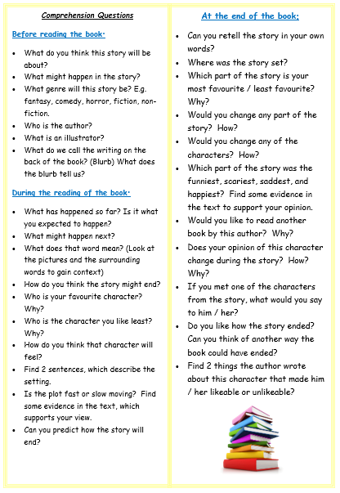
Reading
Children should be aiming to read at home at least 4 times a week.
Now your child is in Upper Key Stage 2, they should be starting to read for sustained periods.
Your child should try to read a wide variety of books: fiction, non-fiction, poetry, play scripts etc.
Children can record their reading in their diaries themselves, but please question your child on their reading a few times a week to check their comprehension.
It is your child’s responsibility to change their reading book.
Notes:
See next slides to explain reading strands

Slide 17

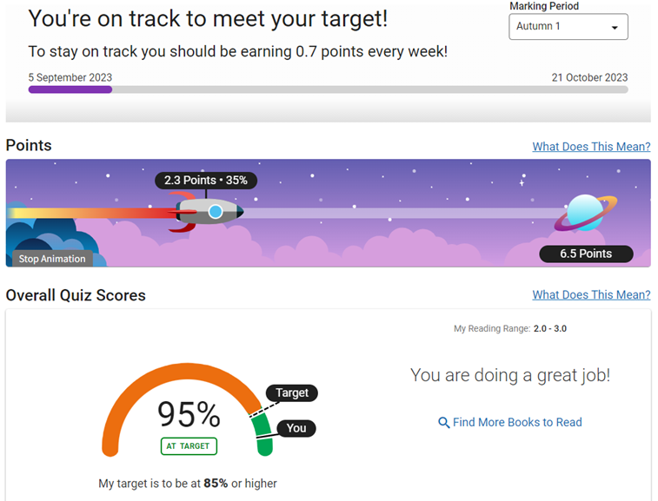
Accelerated Reader
Average for Year 5 5.0 - 6.0
The first number is the year group; the decimal is the months. So, a ZPD of 5.4 means a reading level of year 5 and 4 months.
An Accelerated Reader points target will be stuck into your child’s reading diary at the beginning of each half term.
Children will need to achieve their points target to receive their reading treat.
Reading diaries are checked on a Monday morning.
Notes:
See next slides to explain reading strands

Slide 18





Recommended Quality Texts
https://www.booksfortopics.com/booklists/recommended-reads/year-5/
www.thereaderteacher.com/
Notes:
See next slides to explain reading strands

Slide 19

How to help at home
Make sure children are reading at least 4 times a week – they can read to themselves and record their reading in their reading diary.
Enjoy reading and share stories together – they are not too old to be read to. The most important thing is for your child to understand and talk about what they are reading, so ask plenty of questions to help them process the text.
Reading a wide range of genres as reading impacts upon writing.
Look up new / unknown vocabulary together.

Slide 20

Mathematics
Daily counting
Always starts with 0
Daily Practice
Mastery Curriculum – fluency, reasoning and problem solving.
Concrete, Pictorial and Abstract

Slide 21
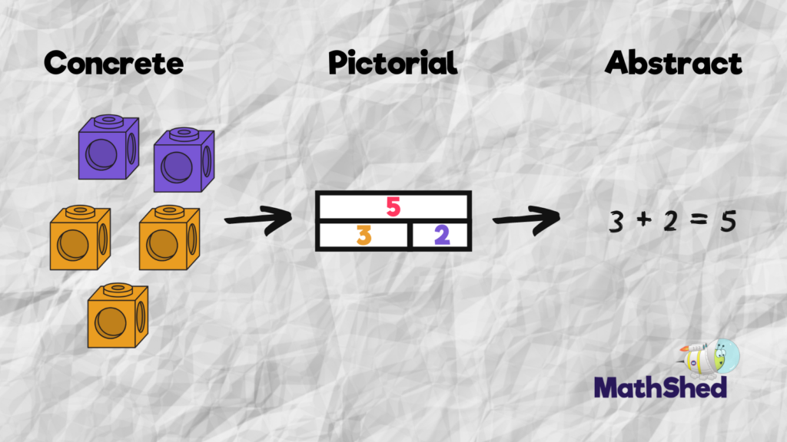
At Scholar Green all classes teach maths based on the concrete, visual and abstract approach.
1. Pupils are first introduced to an idea or skill by acting it out with real objects (a hands-on approach).
2. Pupils then are moved onto the visual stage, where pupils are encouraged to relate the concrete understanding to pictorial representations.
3. The final abstract stage is a chance for pupils to represent problems by mathematical notion.
The three stages feature in each year group.

Slide 22
Key maths skills and vocabulary in Year 5
Addition Add numbers with more than 4 digits: +, add, more, addition, increase, plus, make, sum, total, altogether, double, near double, one more…, two more… ten, more…, 100 more…greater, more, units, ones, tens, count, count (up) to count on (from, to) how many…?tens boundary , hundreds boundary, inverse, units boundary, tenths boundary | Subtraction Subtract numbers with more than 4 digits: subtract, subtraction, take (away), minus, decrease, leave, how many are left/left over? difference between , half, halve , how many, more/ fewer is... than...? , how much more/less is...? , equals, sign, is the same as , tens boundary, hundreds boundary , units boundary, tenths boundary, inverse, rounding to estimate and check
Multiplication Multiply numbers up to 4 digits by a one- or two-digit number: lots of, groups of, times, multiplication, multiply, multiplied by , multiple of, product , once, twice, three times, four times, five times… ten times , times as (big, long, wide, and so on) , repeated addition , array, row, column | Division Divide at least 4 digits by single-digit numbers: double, halve , share, share equally , one each, two each, three each… , group in pairs, threes… tens , equal groups of , divide, division, divided by, divided into, divisible by , remainder , factor, quotient , inverse

Slide 23
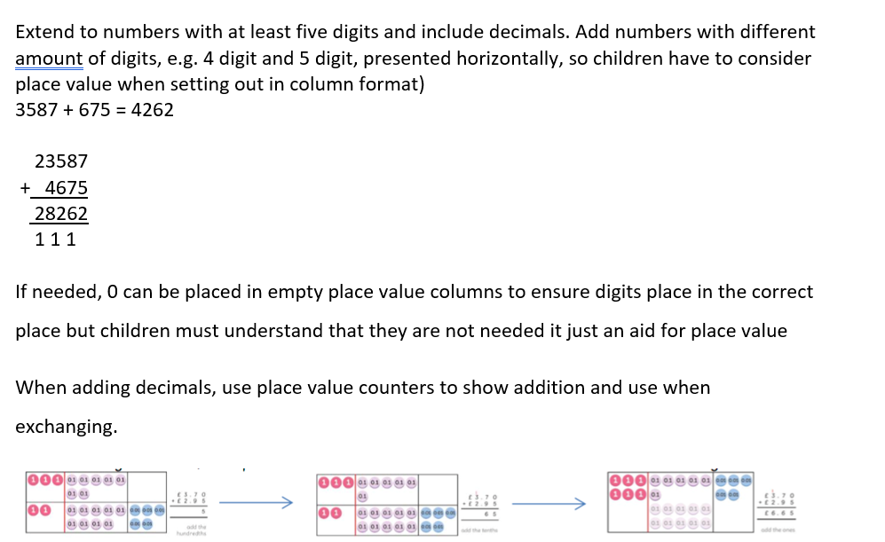
Calculation Policy

Slide 24
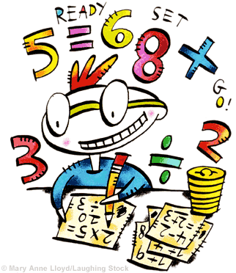
Multiplication
3 x 6 = 18
3 x 60 = 180
3 x 600 = 1800
0.3 x 6 = 1.8
Notes:
Link to methods shown at Parents’ meeting

Slide 25

How to help at home
Times Table Rock Stars - Times tables are essential – children MUST know them all without having to work them all out.
Number bonds to 10 and 100 and application
Telling the time and reading timetables
Real life maths – weighing for baking / money

Slide 26

Homework
Set on a Thursday
Hand in on a Tuesday
An English & a maths activity each week
Homework will consolidate work they have completed in class.
In addition, every week, children should read at least 4 times, practise spellings and regularly access Times Table Rock Stars.

Slide 27

Finally, WE NEED YOU! We are looking for a bank of volunteers…
Can you spare any time to read with our children?
Are you available to come on trips with us?
Do you have any time to support us with fieldwork in the local area?

Slide 28
Thank you, if you have any questions or would like further information, please do not hesitate to contact us. akapp@scholargreen.cheshire.sch.uk evaughan@scholargreen.cheshire.sch.uk

