Slide 1



Slide 2
Curriculum Overview
The following subjects are taught to the children:
English (Daily)
Maths (Daily)
Phonics
Science (Weekly)
RE (Weekly)
PHSE (Personal, Health, Social and Economic Education) (Weekly)
History
Geography
Art
DT
Computing
Music
MFL

Slide 3

Every lesson has:
the knowledge, skills and vocabulary to be covered
prior learning through ‘Flash Back 4s’ to help with sticky knowledge
an enquiry question, theme or significant individual
future learning and end-point expectation

Slide 4
Curriculum Coverage
English
Writing for a wide range of purposes.
Reading - fiction, nonfiction and poetry plus comprehension
Writing a non-chronological report
Recount writing
Poetry
Writing stories based in imaginary worlds
Writing instructions
Writing an explanation text, a dilemma text
Writing stories linked to adventure and mystery
Writing an information leaflet
Writing a fairy tale
Writing a letter

Slide 5
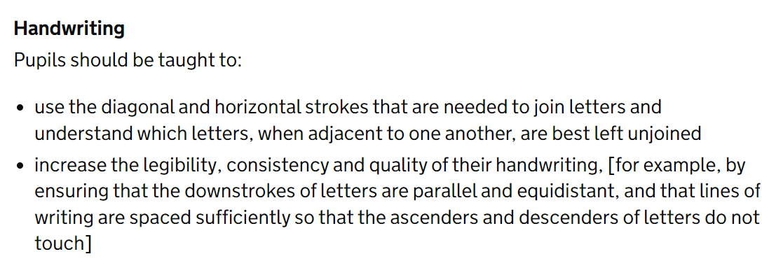
Statutory Guidance

Slide 6



Reading
Our authors in YR4 are –
Anthony Horowitz
Andy Stanton
Jenny McLachlan

Slide 7

At home
Reading should still be done 4x per week.
TTRS 4x per week.
Children can sign their own diaries; these will be checked every week.
Reading treat will be linked to their points target NOT how many times they’ve read!
ZPD for YR4 should be between 4.0 – 5.0.

Slide 8

Curriculum Coverage
Maths
Place Value
Addition & Subtraction
Area
Multiplication & Division
Length & Perimetre
Fractions
Decimals
Money
Time
Shape
Statistics
Position & Direction (clockwise & anti clockwise)

Slide 9
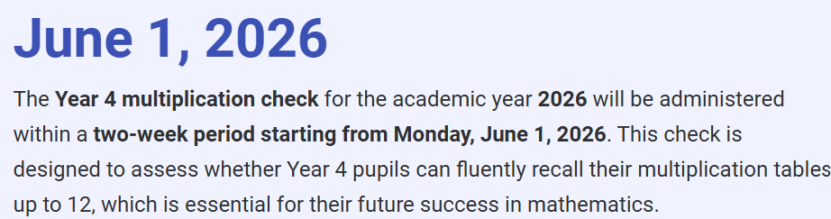
Multiplication Check
Statutory
Completed within this 2 week window
6 seconds per question
25 questions per check
Up to 12x tables
Completed on an iPad
Please avoid holidays during this time
Average national score in the UK in 24/25 was 20.
Last year 40% scored 25/25 74% scored 22 or above.

Slide 10

Very similar format to the actual check if they play on Soundcheck.
Weekly X4
practice at home
Copies of the website addresses are available.
https://mathsframe.co.uk/en/resources/resource/477/Multiplication-Tables-Check
https://www.mathshed.com/en-us/mtc
https://www.timestables.co.uk/multiplication-tables-check/

Slide 11



Curriculum Coverage
Foundation Subjects
History: Shang Dynasty, Iron Age, Ancient Rome, Ancient Greeks & The Golden Age of Early Islam.
Geography: Focus on Oceania, Tropics of Cancer & Capricorn, Major cities of Europe, 4 grid map references, a study comparing Rome with Chester, Rivers and the water cycle and different land uses.
Art: Maurits Escher, William Morris and Leo Sewell.

Slide 12
Curriculum Coverage
Foundation Subjects
D&T: Aldo van Eyck – playgrounds
Joe Wicks – healthy food (making fruit or veg tarts)
Pneumatics – making a monster that moves by using a
pneumatic mechanism.
RE: Christianity, Judaism & Islam
PE: Dance, invasion games, swimming, cross country running, net & wall tennis, gymnastics, athletics, rounders & cricket.
Our OAA targets (outdoor & adventurous activities) are covered whilst we are at Petty Pool.

Slide 13
Curriculum Coverage
Foundation Subjects
PSHE:
Relationships - Families & Friendship, Safe Relationships, Respecting ourselves & others.
Living in the wider world - Belonging to a community, Media literacy and digital resilience, Money & work.
Health & Well Being -Physical Health and mental well being, Growing & Changing, Keeping Safe

Slide 14

Computing, Music & French with Mrs Stevenson .

Slide 15
National Curriculum Expectations
We assess formally 3 times a year in English, Maths and reading using Testbase. This helps to see if your child is working towards expectations, age related or working at greater depth. (WT, ARE, GD) It also helps us to see where interventions are required to fill any gaps in learning.
If you would like to see the format of any past papers please get in contact.

Slide 16

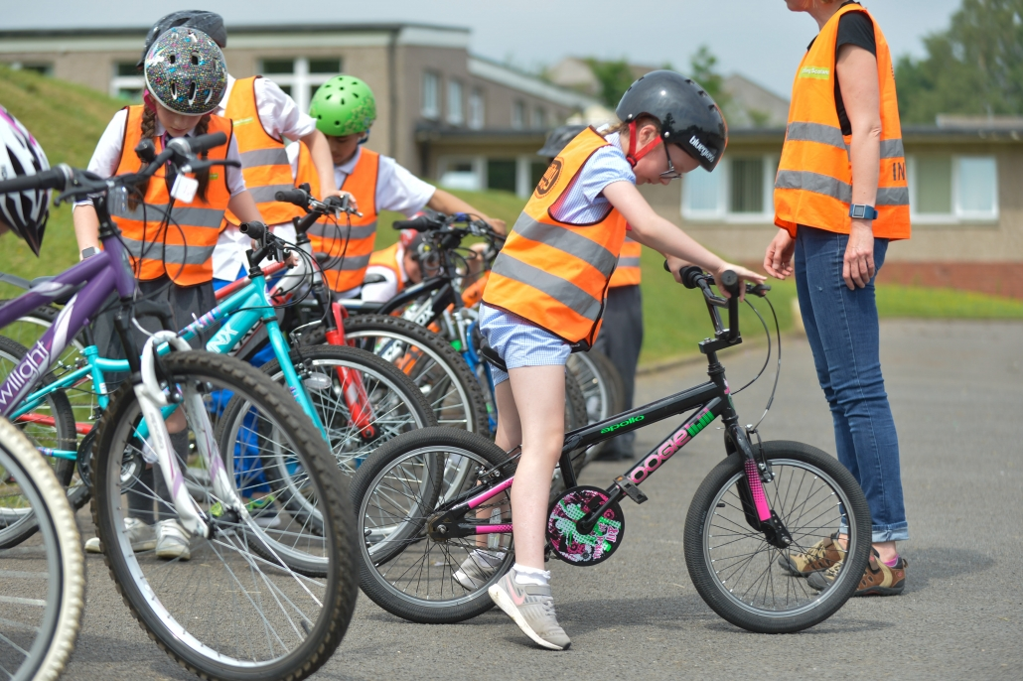
Need safe & working bike
Must be able to safely ride their bike
Must have a helmet
Monday 29th September + Tuesday 30th September

Slide 17
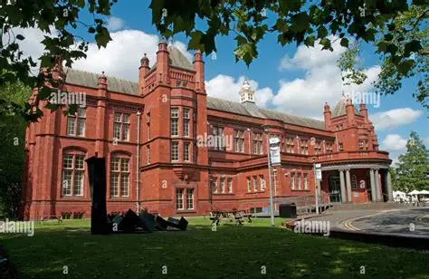
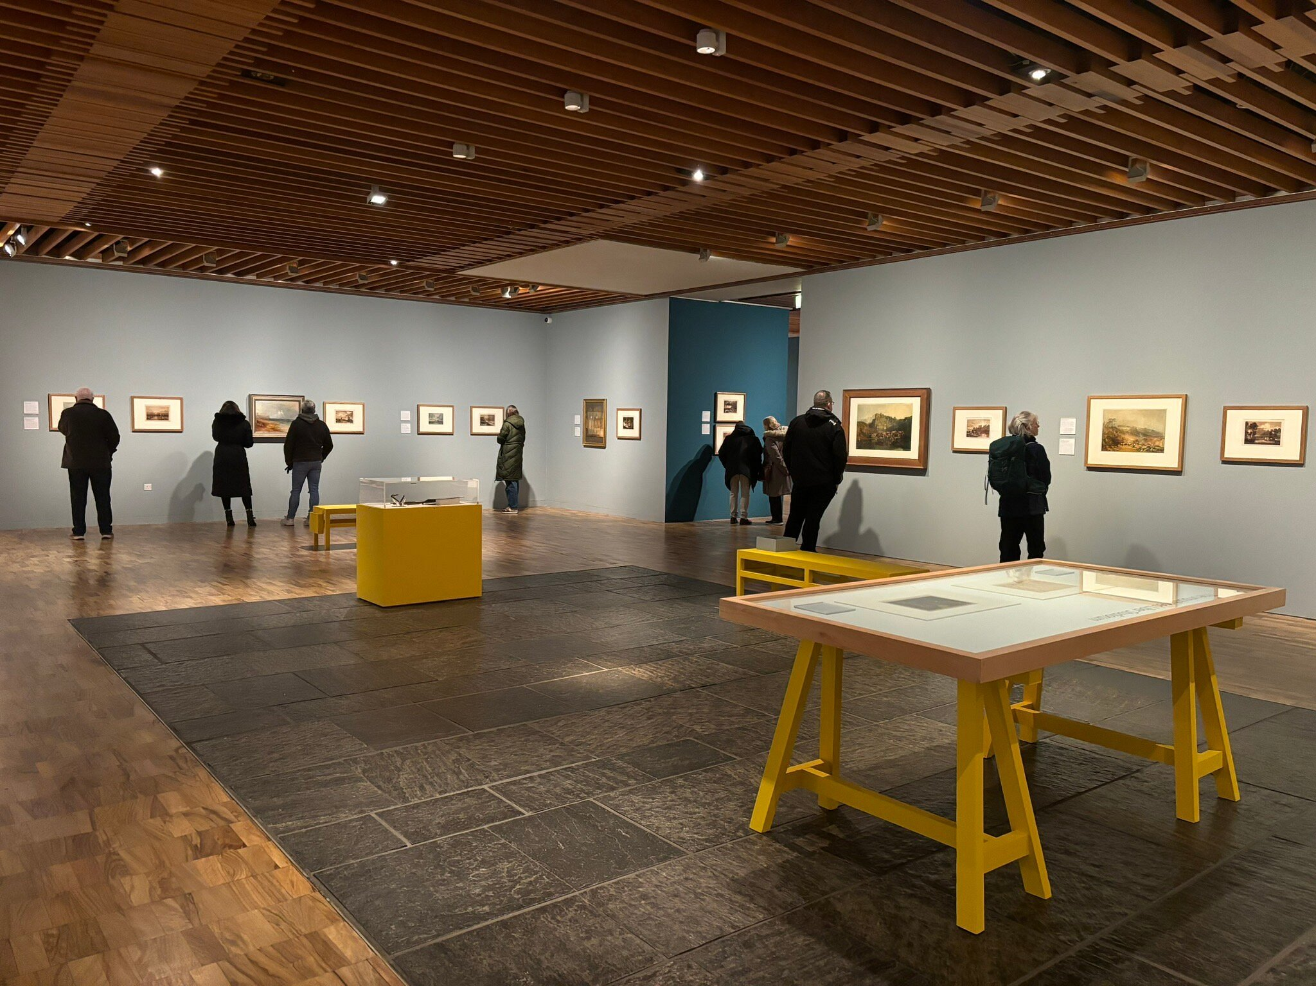
Trip to Whitworth ART gallery with YR3.
Tuesday 21st October.
The children will complete a collage based workshop.
The price for the trip is TBC but information will be out within the next couple of weeks.

Slide 18

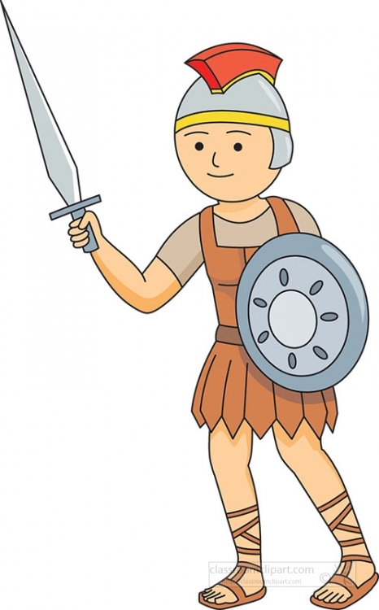
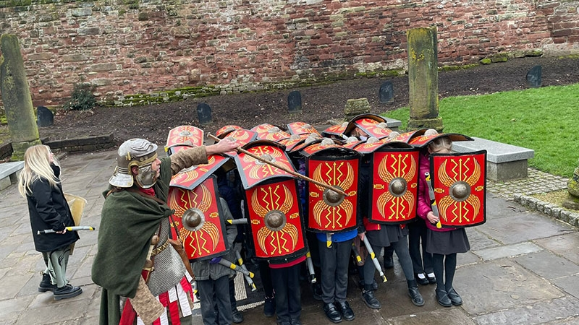
Roman Britain:
A Time Travel Tour through
Chester

Slide 19
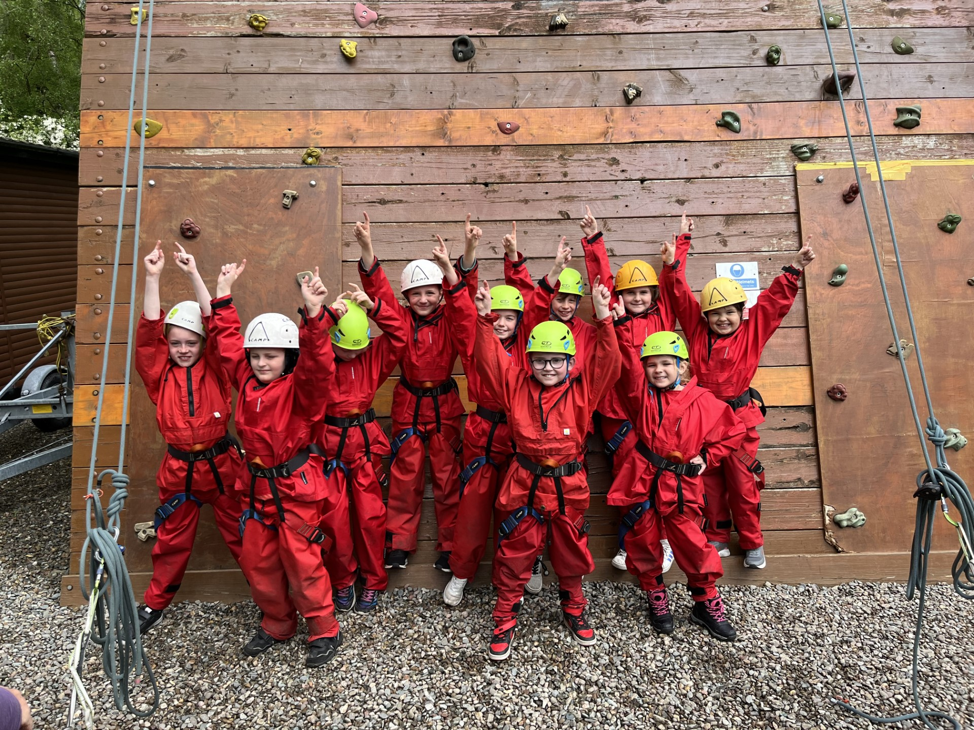
Petty Pool
Zip wire
Leap of faith
River walking
Canoeing
Den building
2026 cost –
TBC last years was around £185.
Coach, food, accommodation and activities.

Slide 20
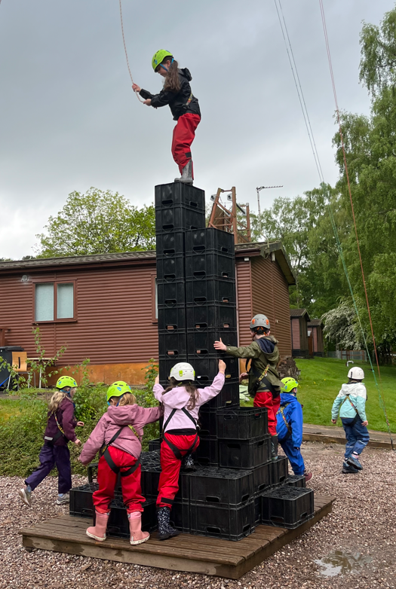
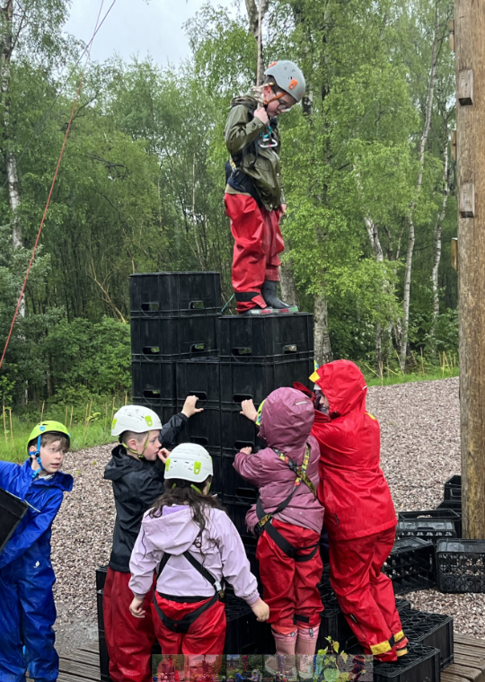
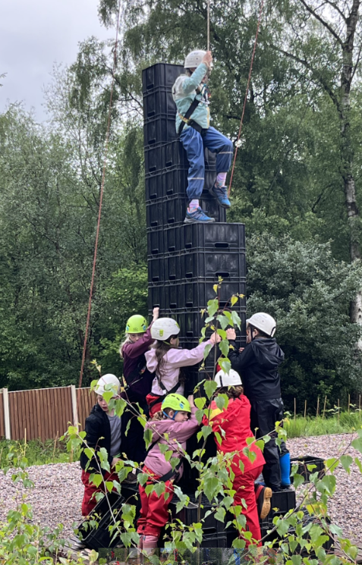
Petty Pool
22nd-24th June 2026

Slide 21
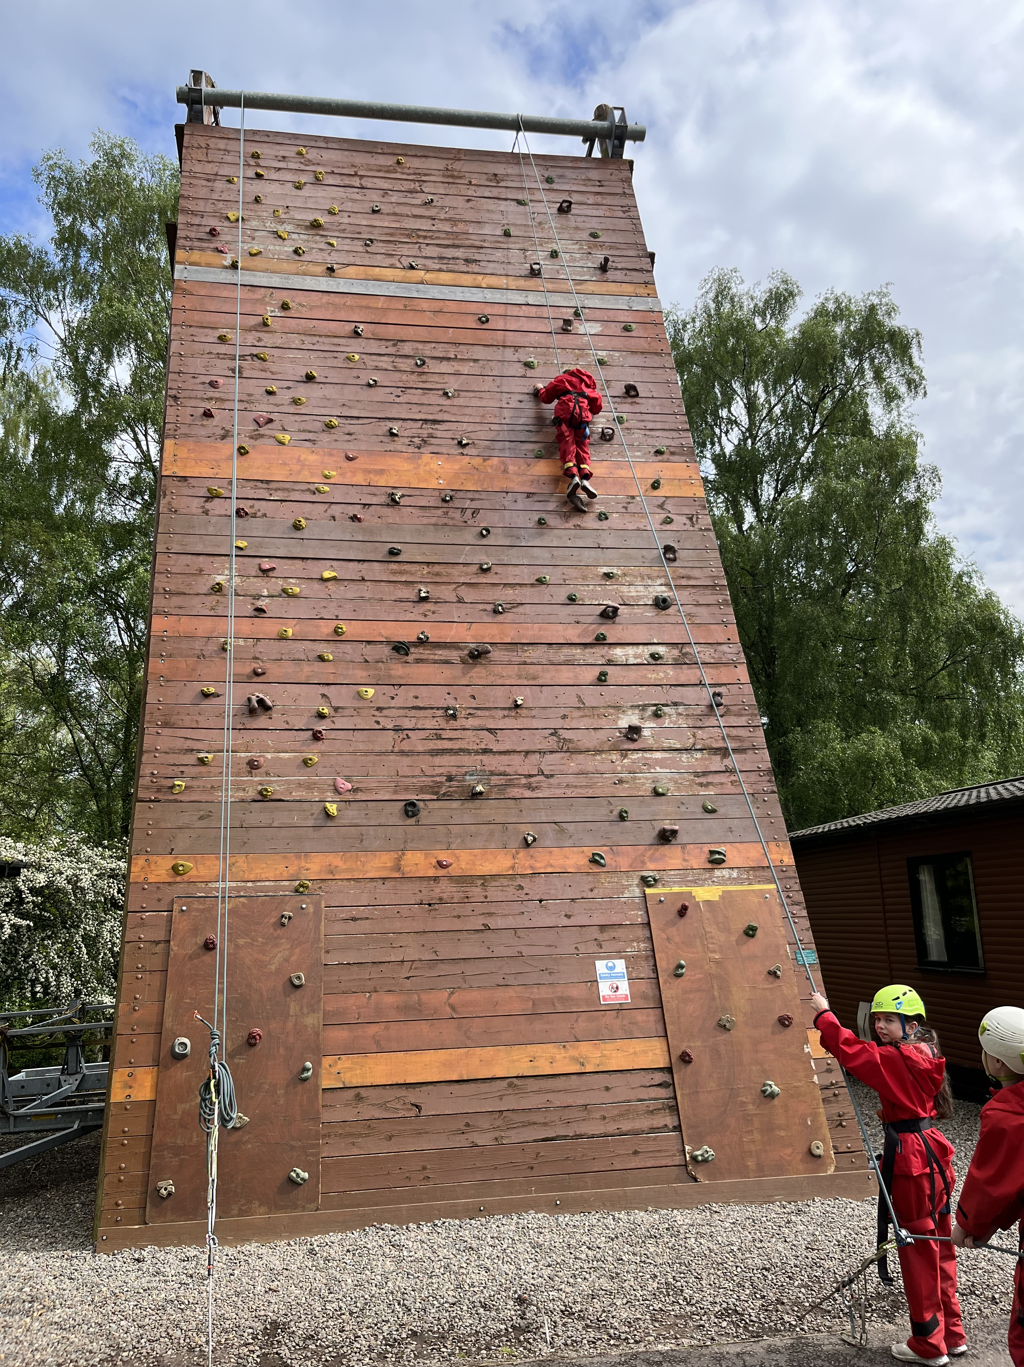
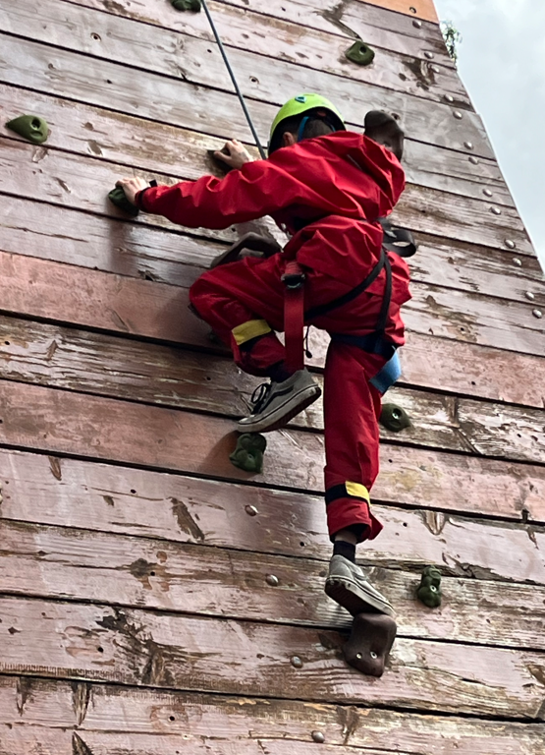
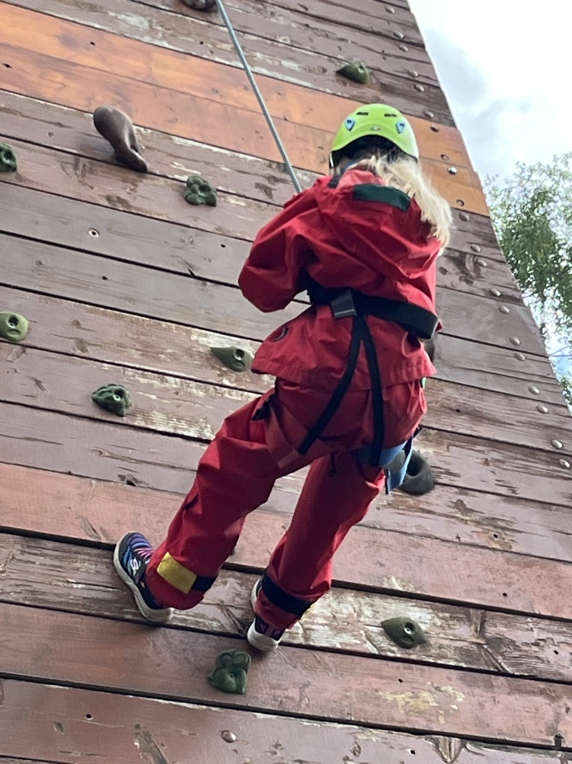
Petty Pool
22nd-24th June 2026

Slide 22
Volunteer & Support
We are always looking for adults to hear children read, or to help with the gardening/ school grounds maintenance. If anyone can spare a few hours each week or each half term, then please talk to me or see Sharon in the office.
I have an open-door policy and am available most days after school to talk to. Alternatively, email and I will respond as soon as possible.
nlewis@scholargreen.cheshire.sch.uk

