Slide 1


Welcome to Year 2
Miss Rigby
crigby@scholargreen.cheshire.sch.uk

Slide 2
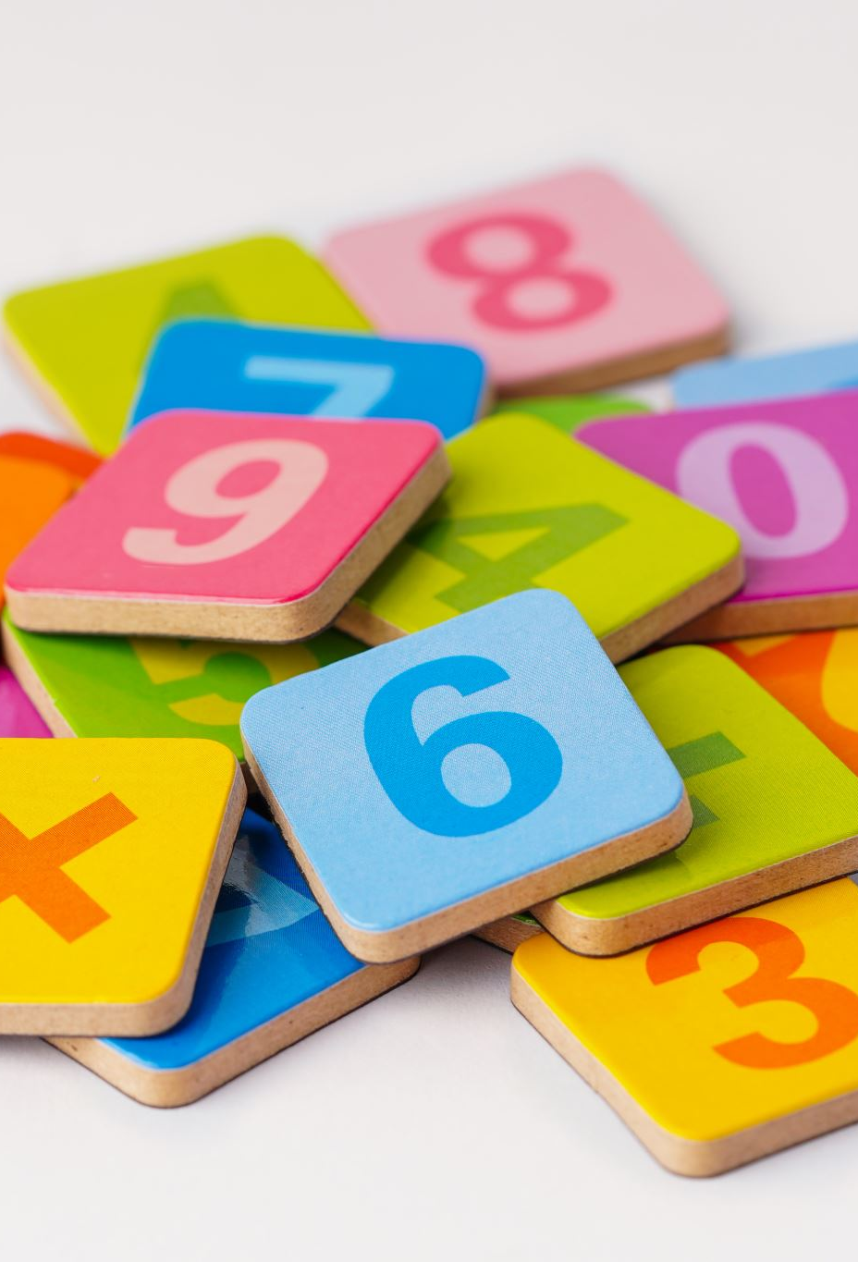
What will my child learn in Y2?
Maths and English is taught every day.
Daily differentiated phonics lessons focusing on the spelling rules
Weekly comprehension work using the RWI scheme
3x weekly fluency lessons to teach reading skills
Weekly vocabulary lesson to link with foundation subjects
Science is taught weekly
Spell Check every Wednesday based on the Y2 word list- the words of the week are recorded on the sheet sent home at the start of every half term
Weekly reasoning and problem-solving lessons
PSHE, RE and PE are compulsory each week.
PE is 2 hours with Mrs Kirk.
All other subjects are 1 hour a week
Junior Jam staff teach Music and Computing.
Mrs Stevenson will teach French.

Slide 3
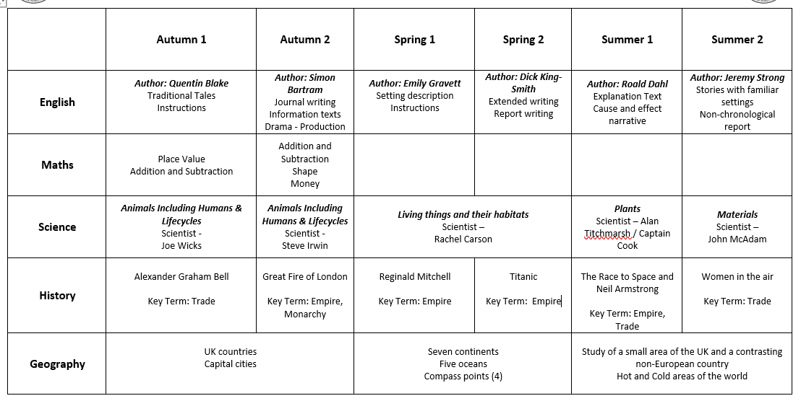
Year 2 Overview

Slide 4
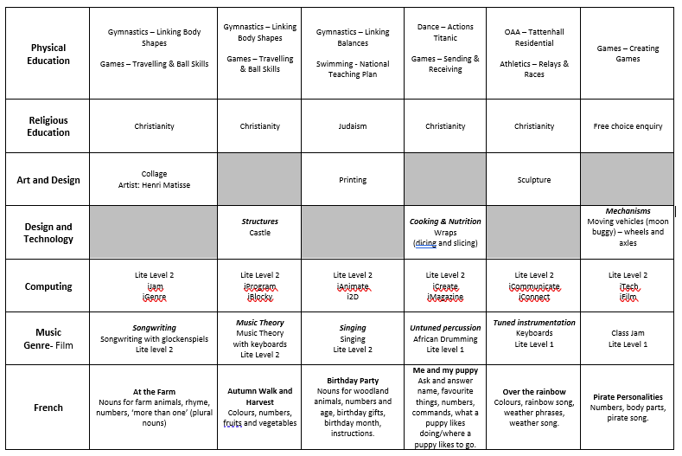
Year 2 Overview continued…

Slide 5
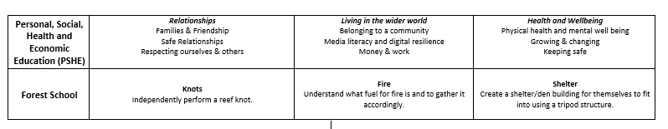
Year 2 Overview continued…

Slide 6

YEAR 2 ASSESSMENTS
Throughout the year, we will have three formal assessment weeks. There will be on in the Autumn term, Spring term and Summer term. Assessments help us to see if your child is working towards expectations, age related or working at greater depth. (WT, ARE, GD) It also helps us to see where interventions are required to fill any gaps in learning.
It is important that holidays are not booked during this time.

Slide 7
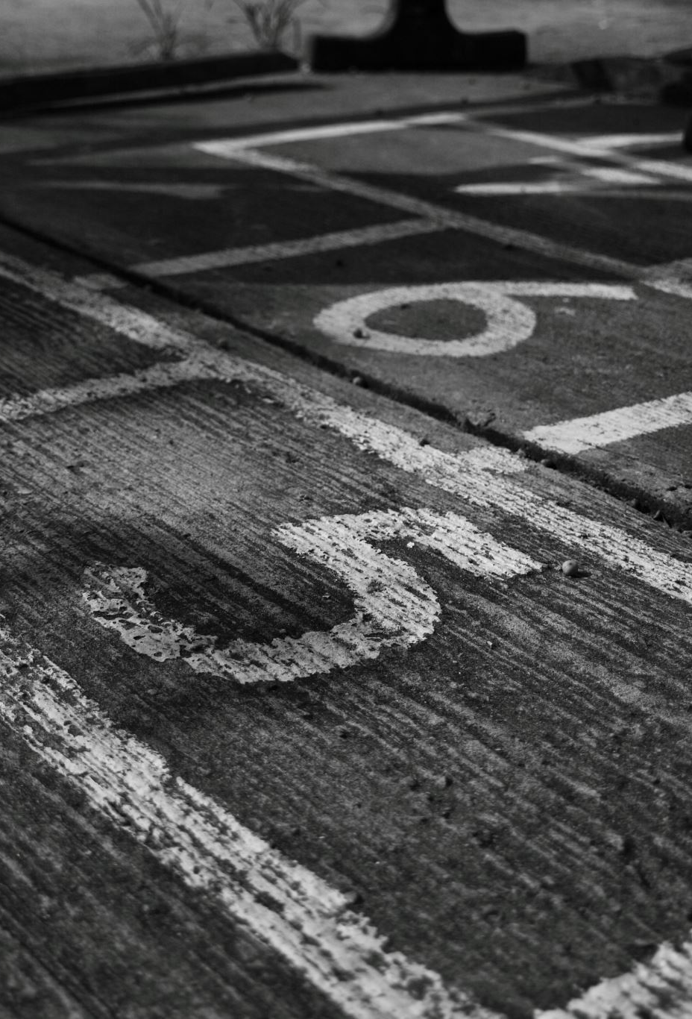
Age Related Expectations in Year 2

Slide 8
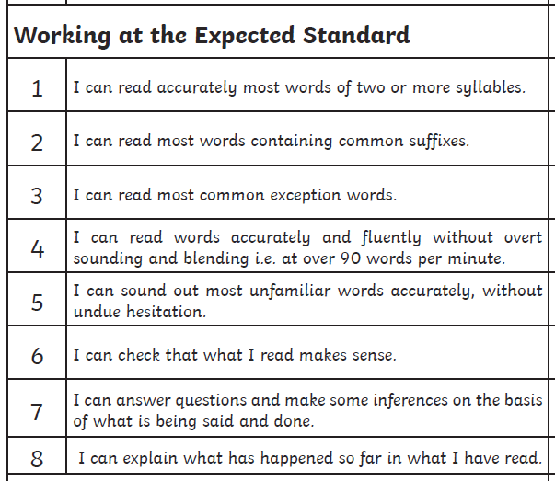
Reading

Slide 9
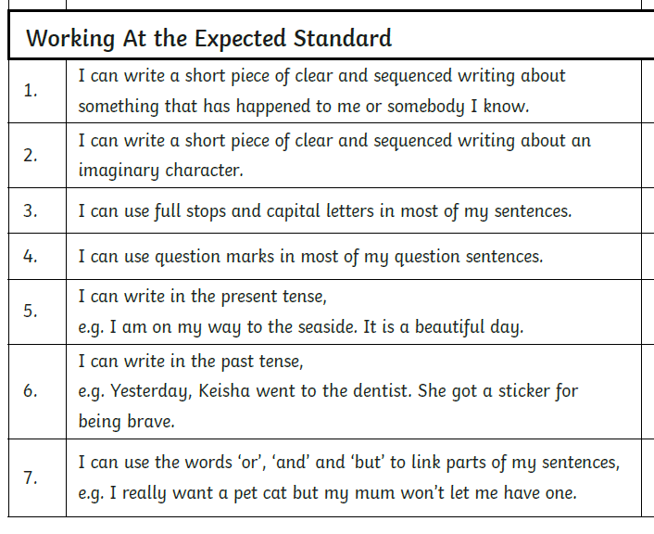
Writing

Slide 10
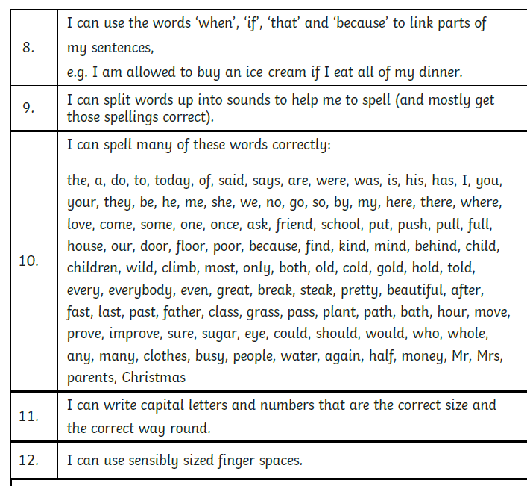
Writing continued…

Slide 11
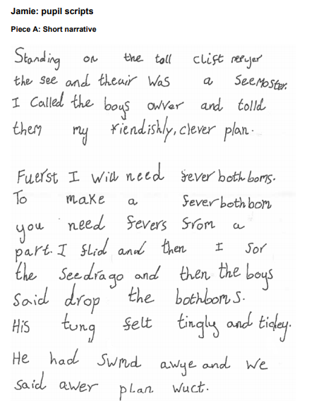
Working towards expected level.

Slide 12
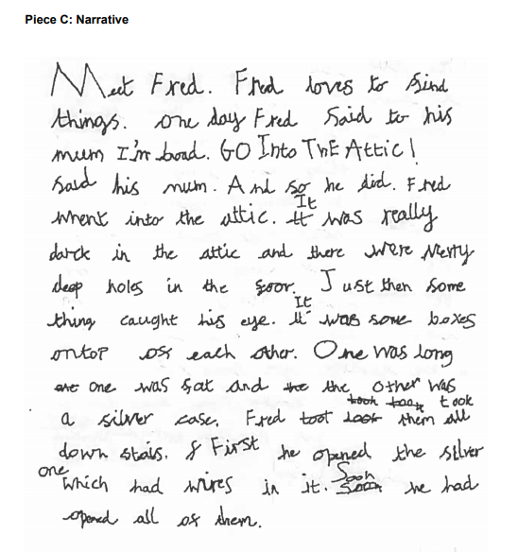
Working at expected level.

Slide 13
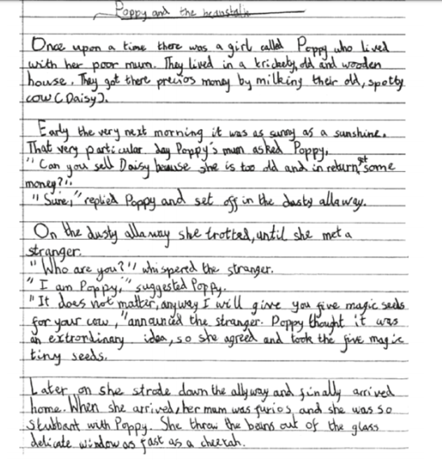
Working at greater depth.

Slide 14
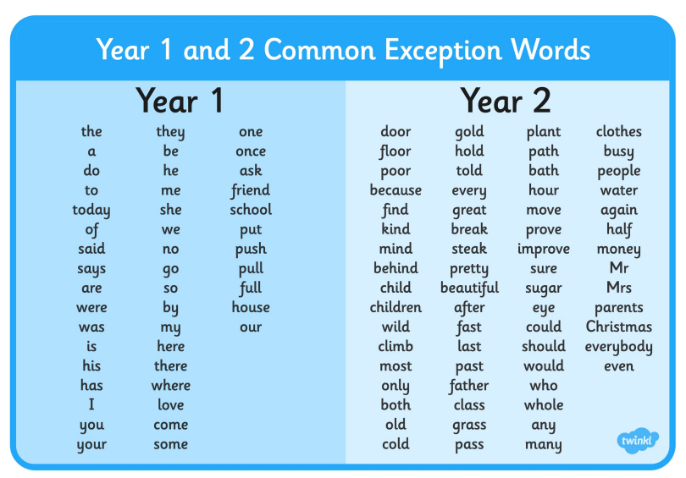
The Y2 age related words are in your child’s reading diary.

Slide 15

Reading Treat
Children are expected to read for at least 20 minutes per day, at least 4 times a week.
Children who read four times a week for half the amount of weeks in a half term will receive their reading treat. They will have a sticker in their reading diary.
Reading must be recorded in their reading diary.
It is really important that children are reading their school reading scheme books at home with an adult to ensure that they are practising the skills taught in phonics.
Reading diaries will still be checked on a Monday morning.
Logins are in the back of the children’s diaries.
Notes:
See next slides to explain reading strands

Slide 16
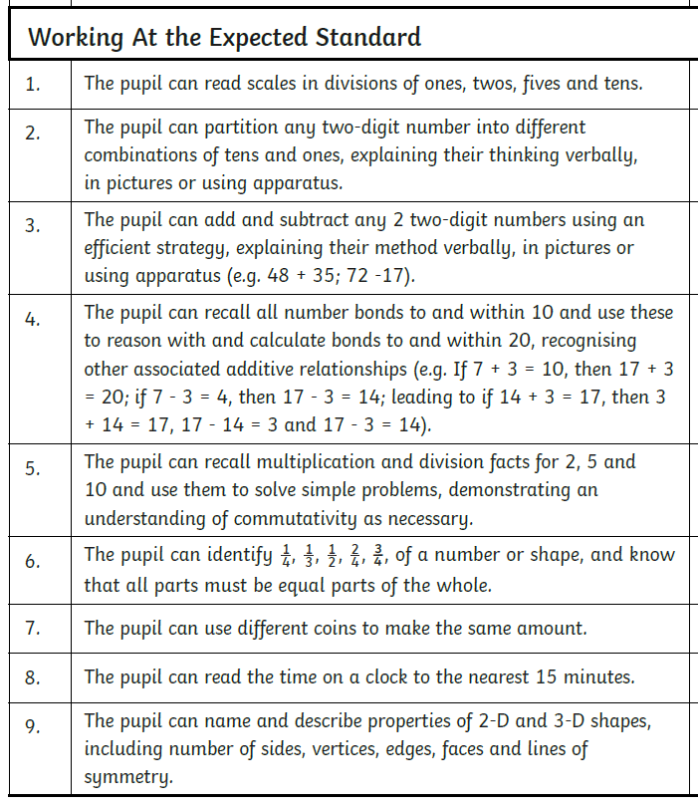
Maths

Slide 17

Times Tables
Times tables rocks (TTRS)
Year Two
2x 5x 10x 3x
https://itunes.apple.com/gb/app/times-tables-rock-stars/id973811326?mt=8

Slide 18

Useful Websites to support Maths
https://ttrockstars.com/login
https://www.topmarks.co.uk/
https://www.bbc.co.uk/bitesize/subjects/zjxhfg8/year/z7s22sg
https://numbots.com/

Slide 19
OTHER INFORMATION

Slide 20

Homework
Set on a Thursday
Checked on a Tuesday
At least 20 minutes on NumBots – this is checked online
Spellings- three words a week that are checked in the weekly spell check on a Wednesday
Reading at least 4x a week

Slide 21
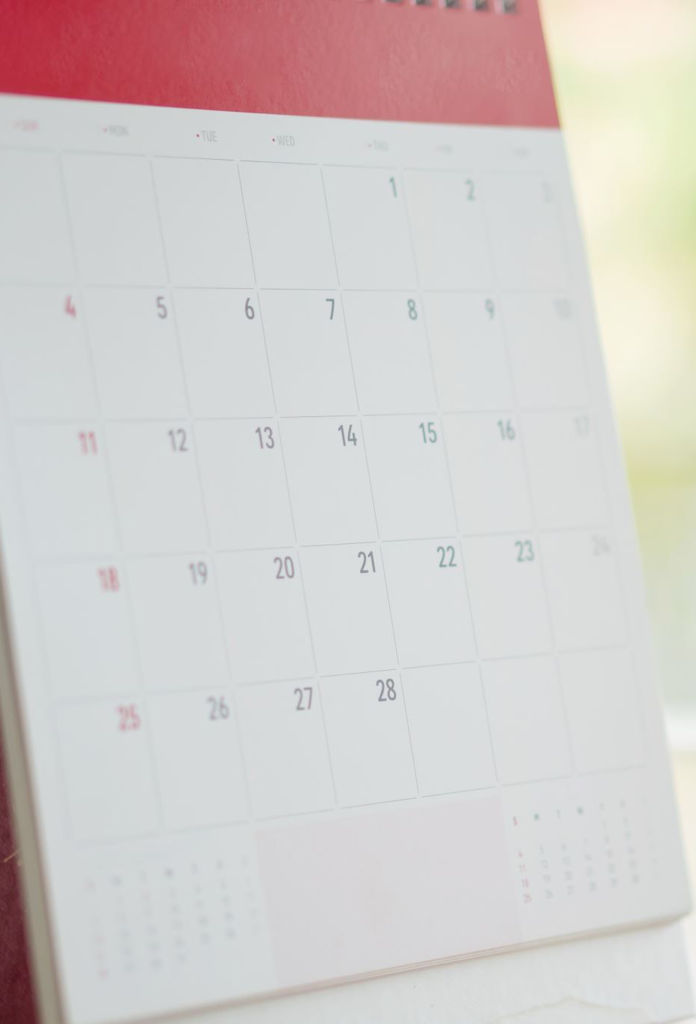
Dates for the diary- Trips
Autumn Term
Blue Planet– 16th October
Spring Term
Manchester Museum- TBC
Summer Term
Tattenhall Residential - Overnight 04/06/25

Slide 22

Finally, WE NEED YOU!
We are looking for a bank of volunteers…
Can you spare any time to read with
our children?
Are you available to come on trips
with us?
Do you have any time to support us with fieldwork in the local area?

Slide 23

Thank you for listening!
We have an open-door policy. Alternatively, email and I will respond as soon as possible.
crigby@scholargreen.cheshire.sch.uk

