Slide 1


Welcome to Reception!
Reception Curriculum Meeting.

Slide 2
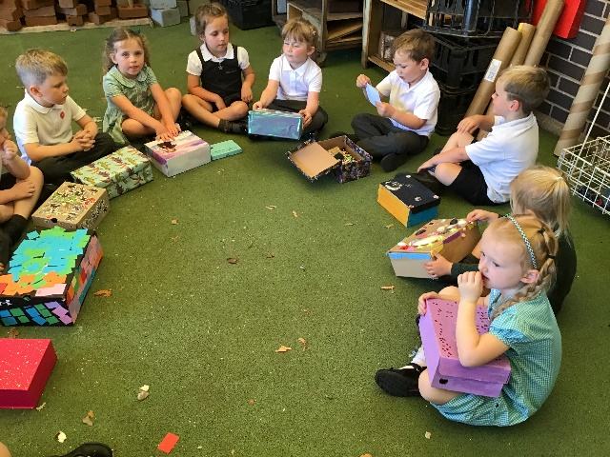
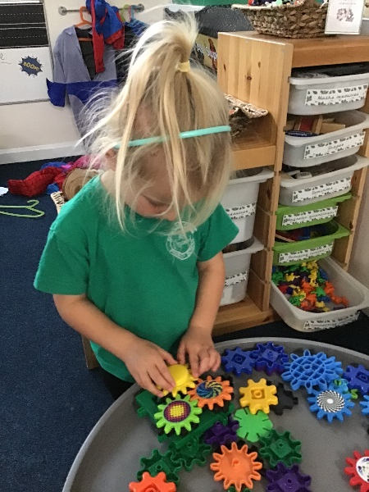
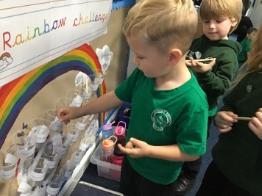

Welcome to Reception Class
The main points in Reception are:
EYFS curriculum planned by us incorporating themes and children’s interests
The amount of adult-led activities will gradually increase from September, it is slowly made more formal .
After baselining the children they will receive a daily phonic session following the Read Write Inc scheme.
Daily counting sessions
We have a big focus on fine motor development and this is incorporated into our curriculum and classroom environment.
Reading is also a big focus and we like to teach the children to read but also to read for pleasure.

Slide 3

Early Years Foundation Stage (EYFS)
Lays the Foundations for children’s journey and sets them up as life long learners
The EYFS Curriculum consists of…
Communication & Language
Personal, Social & Emotional Development
Physical Development
Mathematics
Literacy Inc. Phonics
Understanding the World
Expressive Arts & Design
Within all of these areas, we implement the Characteristic of Effective Learning which demonstrate what type of learner your child is and therefore, how they learn best

Slide 4
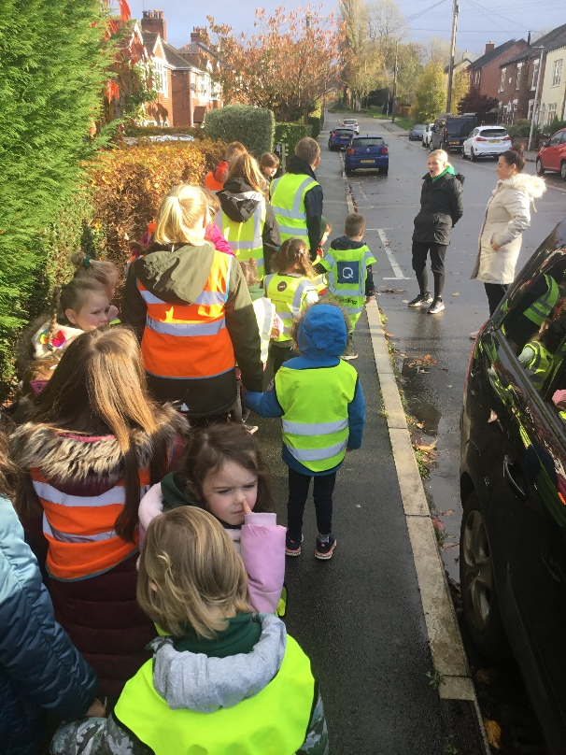
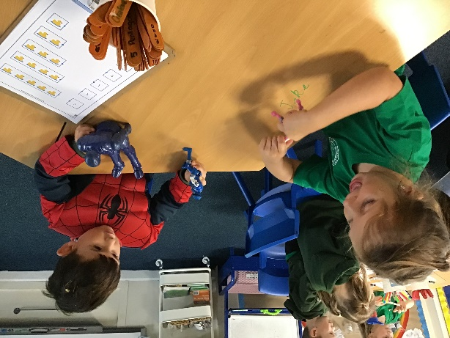
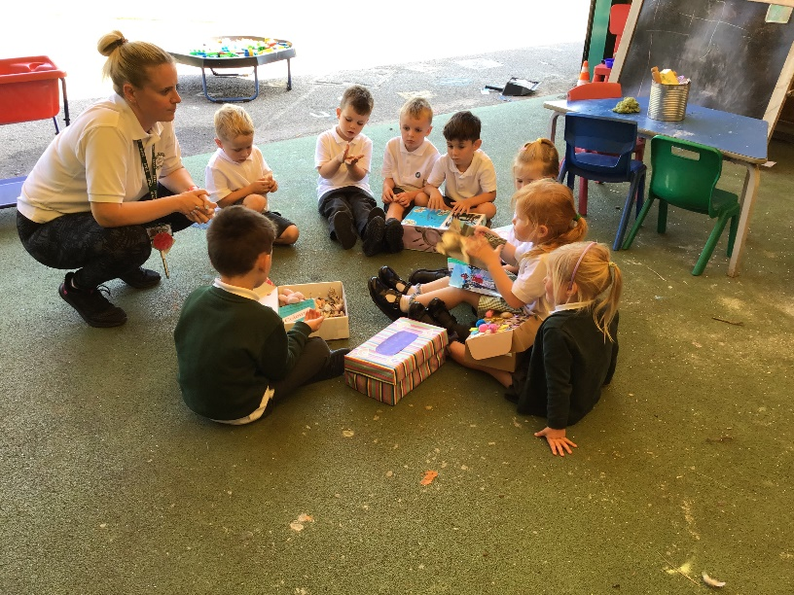
Curriculum
What to expect in Reception class and how you can help at home.

Slide 5
Reception Baseline
In the first few weeks, your child will be settling into the provision and as staff begin to get to know your child we will be baselining them to know their starting points.
The baseline completed is a statutory government baseline which tests maths and literacy skills and gives statements at later date.
We also conduct our own baselining of other skills, in areas such as Understanding the World, Personal Social and Emotional Development, Fine motor Skills, Gross Motor Skills etc.
These all come together to form the next steps for your child.

Slide 6
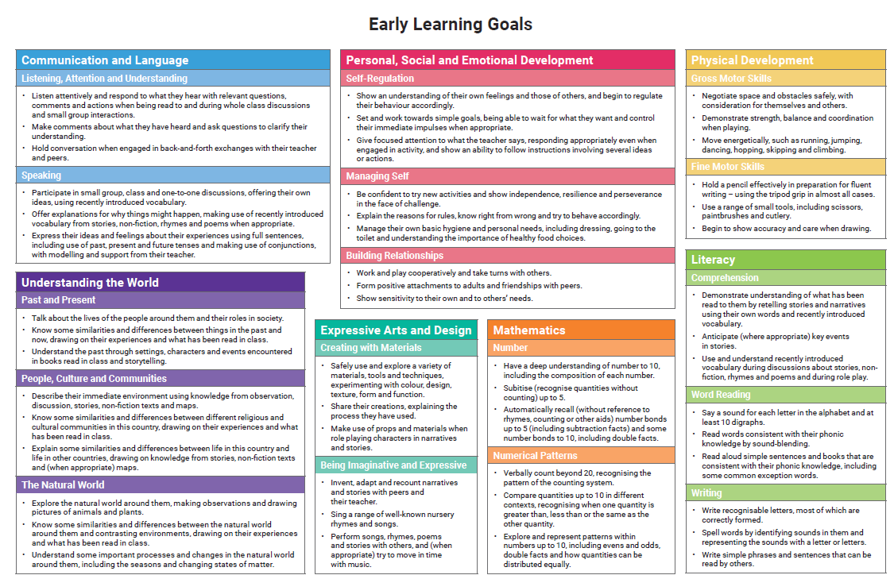
By the end of Reception, children will be assessed by the teacher against these goals.
Our curriculum is designed to give children the best opportunity to reach these goals at the end of Reception.
There was a hand out of this at the welcome meeting back in July, however if you would like another one please contact Mrs Moran.

Slide 7
The Good Level of Development
Once children are assessed against the early learning goals. They may have reached what we call the ‘GLD’ which is the Good Level of Development. To gain this, children must reach the early learning goals in the following areas:
Communication and Language
Physical Development
Personal, Social and Emotional Development
Maths (number and numerical pattern)
Literacy (reading, writing and comprehension)
What if my child does not reach the GLD?
At the end of Reception if your child does not reach the GLD, individual targets will be transferred to their Year 1 teacher so they can begin to bridge the gaps and support your child in the areas needed.

Slide 8
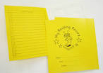
Reading
The children are expected to ‘read’ at least 4 times per week, to gain a reading treat at the end of the half-term.
Initially, they may have pre-textbooks and then books with simple words in. Children will also have red and green words to practise each week. Practising these will contribute towards their reading treat.
They will also have a library book for you to enjoy together.
The reading scheme books are matched to their phonic knowledge
Reading is vital and underpins the skills for writing.
All reading will need to be recorded in their reading diary. This includes reading scheme books, red and green words, you reading to them for pleasure.

Slide 9
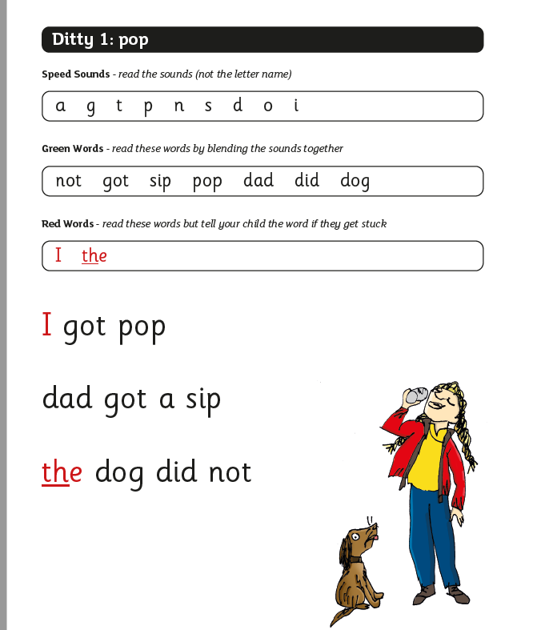

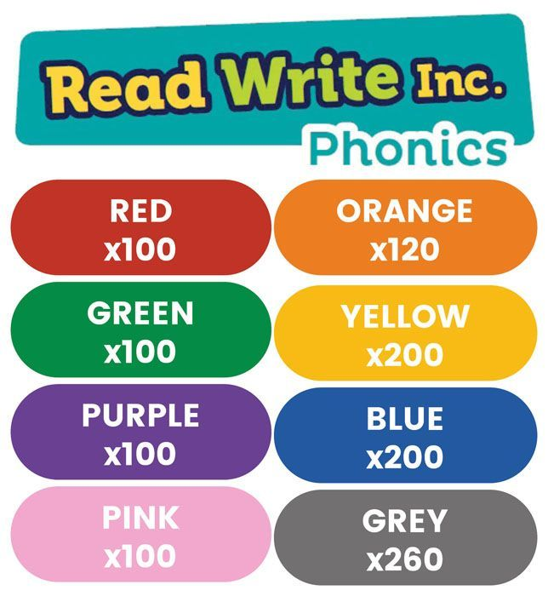
Sound blending books – support segmenting and blending words back together
Ditty Example
Coloured book bands

Slide 10

Reading- Read. Write. Inc. Scheme
Set 1 sounds
Ditties- will come home on cards
Red Group
Green
Purple
Pink
Orange
Yellow
This is where we would expect the children to be by the end of Reception
To get onto Orange, children will need to know all of the Set 2 sounds and be able to blend them in words.

Slide 11


Red/ Green words
Read, Write, Inc. phonics programme.
Green words- words you can ‘sound out’ e.g. c-a-t is cat.
Green words are featured in the dittys or books that your child will bring home. We may send extra home if they need some more support.
Red words (tricky words)- flash cards will be sent home in a pack for you to practise daily with your child. We send them out in sets. We aim to check these weekly or fortnightly, once your child knows the ones that have been sent home, a new set will be sent.
Red words are words which can’t always be sounded out to read or spell, for example: I, the, you, said etc. The motto that we use for these words in school is that ‘we just have to know them’.

Slide 12
Oxford Owl Reading Buddy
Logins in reading diary.
A chance for a different way of reading.
Children can quiz on what they have read to support their comprehension.

Slide 13

Writing
By the end of the Reception year children should:
Write recognisable letters, most of which are correctly formed;
Spell words by identifying sounds in them and representing the sounds with a letter;
Write simple phrases and sentences that can be read by others.
For children to be able to do this, practising red words at home alongside what they do in school is essential.

Slide 14
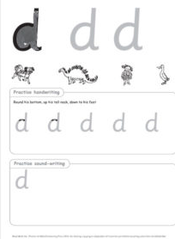
Handwriting
In the Autumn term, we focus on lots of pre-handwriting skills.
We engage the children in activities such as fine motor challenges and gross motor challenges.
When we think the children are ready, we begin to teach each letter of the alphabet. We focus on a letter a week so children can practise throughout the week.
In our policy, we use a precursive style of writing in Reception. This is to support children in their future learning where they will be expected to join their letters as they get older.
RWI is not cursive- therefore we say- ‘This is how read it, this is how we write it.’

Slide 15
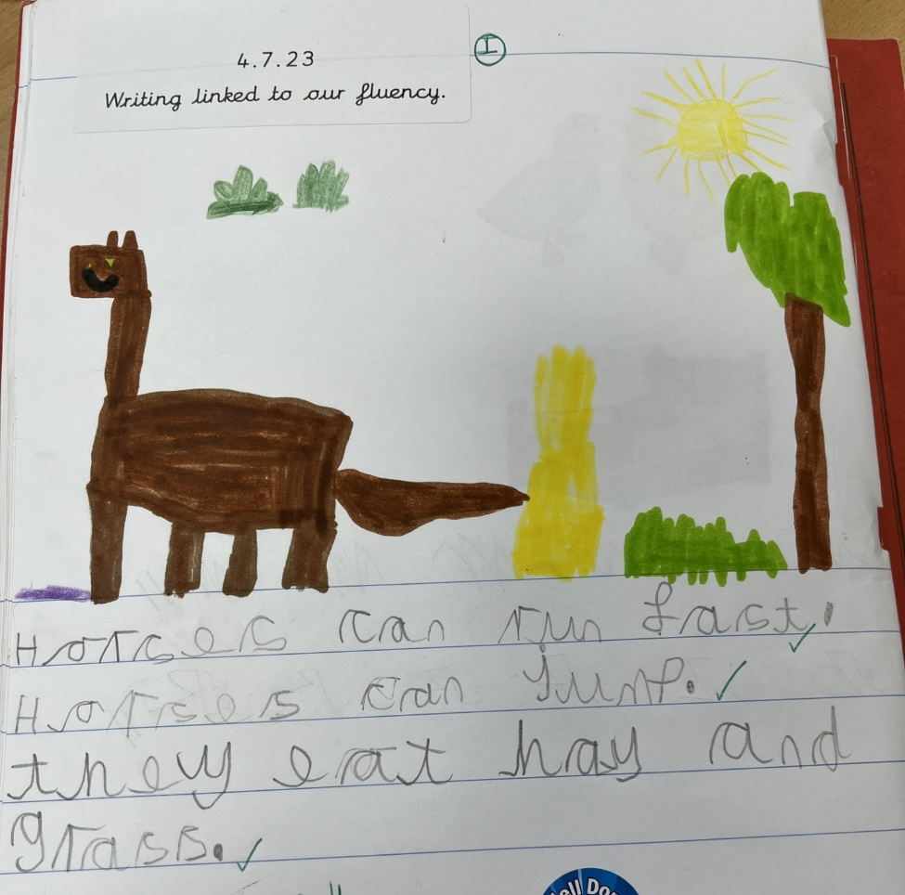
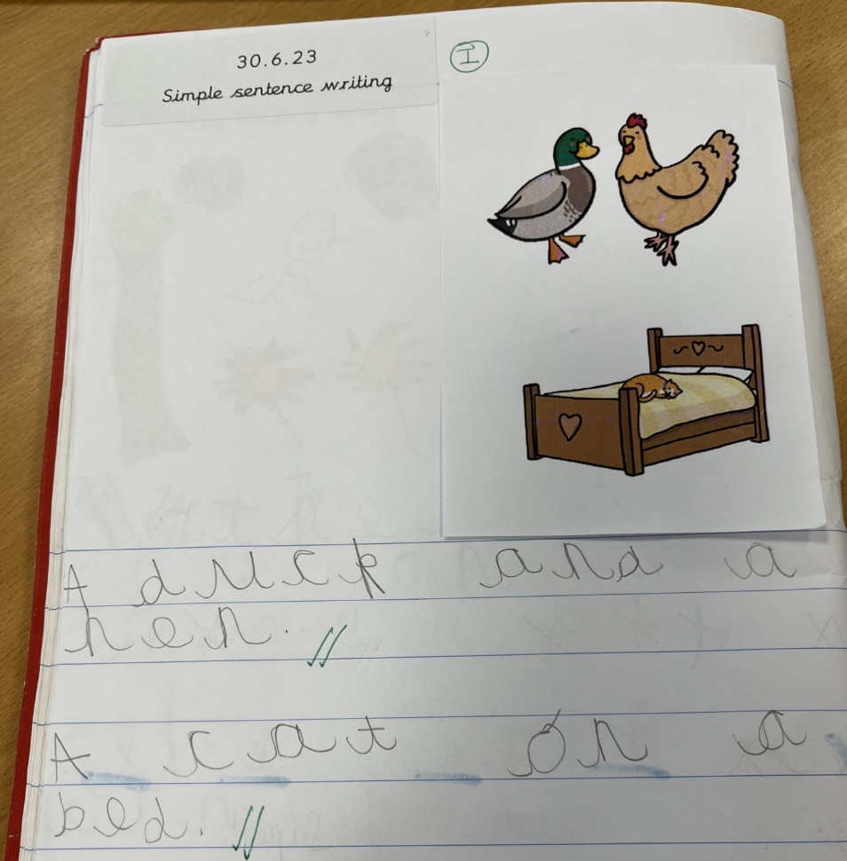
Examples of writing by the end of the EYFS (Reception)

Slide 16

Maths
Our curriculum is designed to dig deep within numbers to 10 and practising core skills such as counting, using concrete materials, problem solving with numbers to 10 when they are ready.
Instead of going wider and moving onto bigger numbers, our key focus is to ensure that children understand the number bonds, adding, subtracting really well. Which will enable to hopefully apply these skills to the Year 1 Curriculum.
We incorporate maths into the outside area, role play area, so that they are experiencing it in a range of different situations.
A lot of our maths in the first few months is very practical, this gets recorded in our photo evidence book. WOW moments may be recorded on Tapestry but we aim to make sure our practitioners are with the children and communicating at all times to ensure the best learning is taking place.

Slide 17
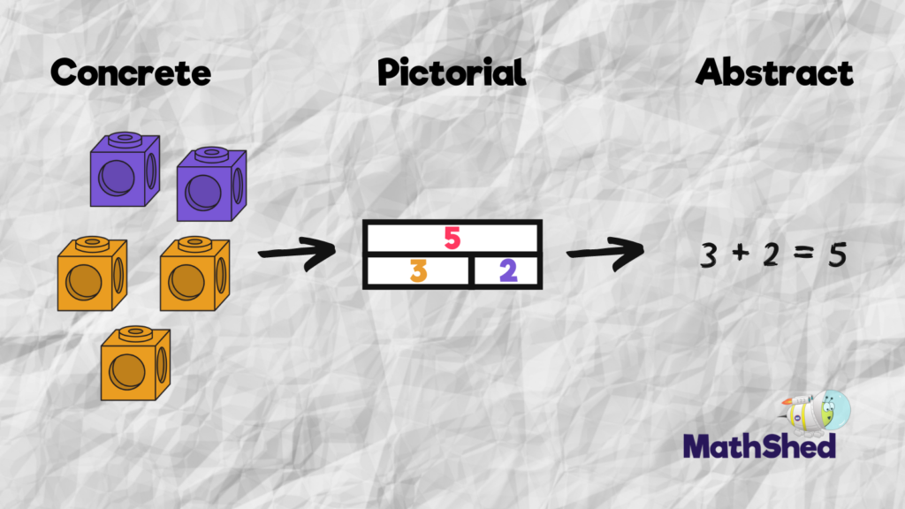
At Scholar Green all classes teach maths based on the concrete, visual and abstract approach.
1. Pupils are first introduced to an idea or skill by acting it out with real objects (a hands-on approach).
2. Pupils then are moved onto the visual stage, where pupils are encouraged to relate the concrete understanding to pictorial representations.
3. The final abstract stage is a chance for pupils to represent problems by mathematical notion.
The three stages feature in each year group.

Slide 18
Key maths skills and vocabulary in Reception
Addition Count accurately up to 20, add two single digit numbers up to 10, counting on to find the answer and find one more than a certain number: add, more, make, sum, total, altogether, more, sum, one more, ten more | Subtraction Using quantities and objects, subtract two single-digit numbers and count back to find the answer and find one less than a certain number: take (away), leave, how many are left/left over? how many have gone? one less, two less… ten less… how many fewer is… than…? difference between, is the same as
Multiplication Solve problems, including doubling: ‘lots of’, ‘doubling’ | Division Solve problems, including halving and sharing: share, share equally, sharing, groups of, how many groups? halving

Slide 19
Numbots
Logins in reading diary.
A chance for a different way of exploring numbers and maths problems.
This is part of reception homework.

Slide 20
Communication and Language, Physical Development, Personal Social and Emotional Skills
Children will participate in sessions of P.E with Mrs Kirk which focus on gross motor skills. Your child will take part in dance, gymnastics and team sports.
It is important to note, that even though they do have P.E sessions, in our outdoor area we have lots of physical development apparatus where they can consolidate their skills.
Communication and language under pins our curriculum, this is happening every day and staff will be aware of next steps for children and these will be targeted through conversations, modelling to children and being engaged with them.
Talking is key!
Personal, social and emotional skills. We do have a PSED carpet session we aim to do this every week, but again the skills that children will need to practice will happen every day. Practitioners will be modelling to children, sharing, showing resilience by being with the children in their play.

Slide 21
Expressive Arts and Design and Understanding the World
We focus on a different artist every term.
We practise a range of art skills and then pop these into the provision for children to use their own imagination and practice skills.
We have different topics for Understanding the World, that link with our literacy sessions and Traditional Tales that we learn.
We use the outdoor area, forest school and local area to support our learning.
We try to link child interest to the topics to get the most out of the learning for the children.
The classroom environment reflects both topic and child interest throughout the year and will change accordingly.

Slide 22
Homework
Numbots
Oxford Owl
Reading
Red and green words
The key piece of homework is talking! Talking is key.

Slide 23

Tapestry
We use a secure online learning journey to collect information about your child.
We use this as a form of communication such as memos, activities to complete at home and any other useful information
You will be able to see photos and captions about your child’s learning and will also be able to comment too.
It is a great way of celebrating children’s learning.
If your child is in Nursery, we will continue to use the same account.
You will be sent a password if you don't already have one.
Recording of information is no longer statutory in the EYFS frame work, there is a big emphasis on the practitioners being with the children but we do aim to put on WOW moments and key learning for you to see at home.

Slide 24
Reception Trips
The dates for the Reception trips are yet to be confirmed but as it stands we are hoping to go to Congleton Library in the Autumn term.
We have a workshop planned for January.
We also have a trip to Trentham Gardens planned for June 2026.
You will be updated in due course about each trip.

Slide 25
Dates for the Diary
10.10.25 – Book & Brioche. A chance to look at what we have done so far and have a look around the classroom.
26.11.25 - Parent’s Meetings Day
Trip dates are yet to be confirmed, but these happen in Autumn term, Spring term and Summer term.

Slide 26
PTA
The Parent Teacher association provides fun and enjoyable events for the whole school and their families to enjoy. The money they raise helps to fund many of the invaluable extras we like to offer our children.
Please ask if you would like any more information about joining the PTA. We warmly welcome new members and fresh ideas.

Slide 27
Volunteers
We are on the hunt for volunteers for the following
Trips
Individual reading with children
Completing red word check with children
Many more activities
Fieldwork around the local area
Except for class trips out, we ask if you would like to be a volunteer to go in a different class than where your child is based.
Please let me know if you would like to be a volunteer.

Slide 28

Communication
Email is the best form of communication. If you have any questions then please do not hesitate to contact us.
Mrs Moran
cmoran@scholargreen.chehsire.sch.uk
Mrs Yarwood
deputy@scholargreen.cheshire.sch.uk
We use School Spider app for messages, bookings and payments
Facebook
Tapestry- memos and activities

