Slide 1

Bringing up a child in the 21st century

Slide 2
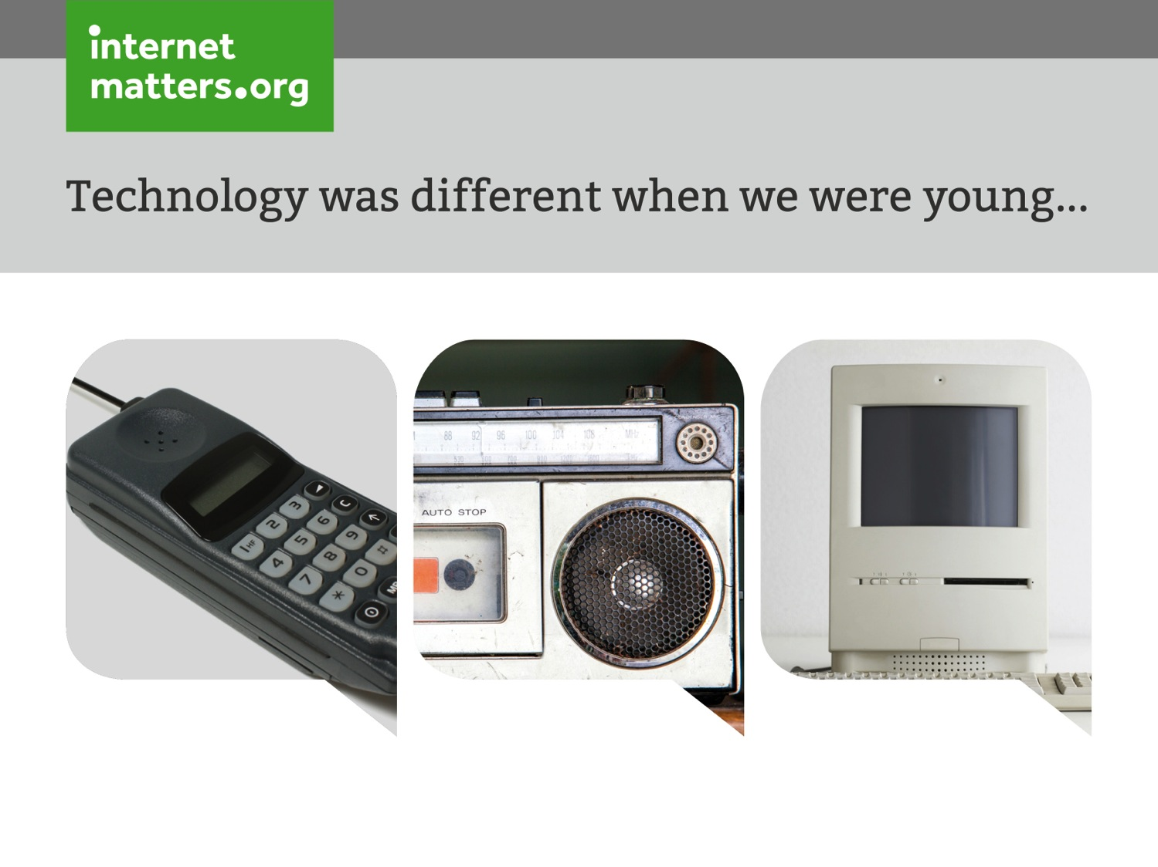

Slide 3
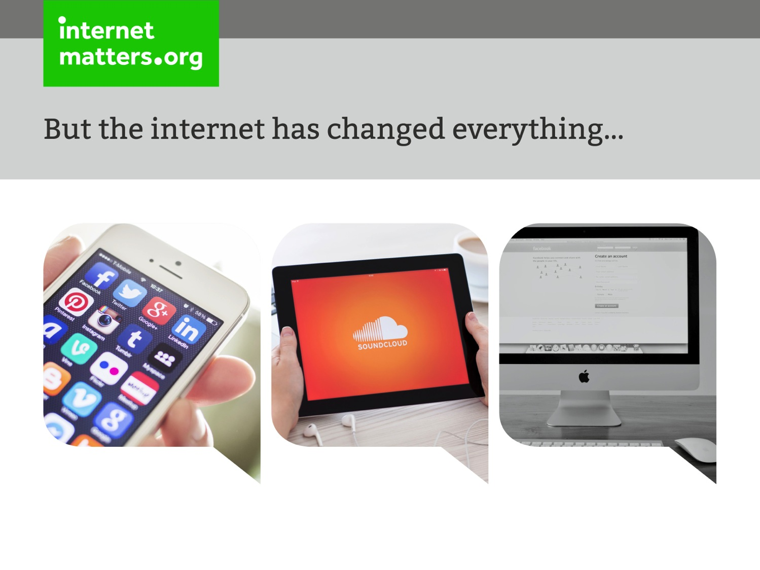

Slide 4
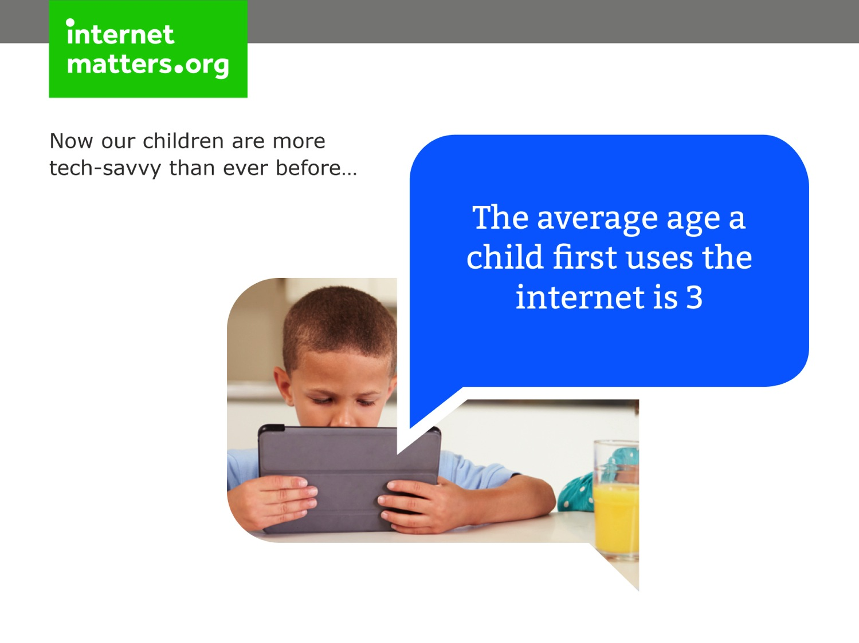

Slide 5
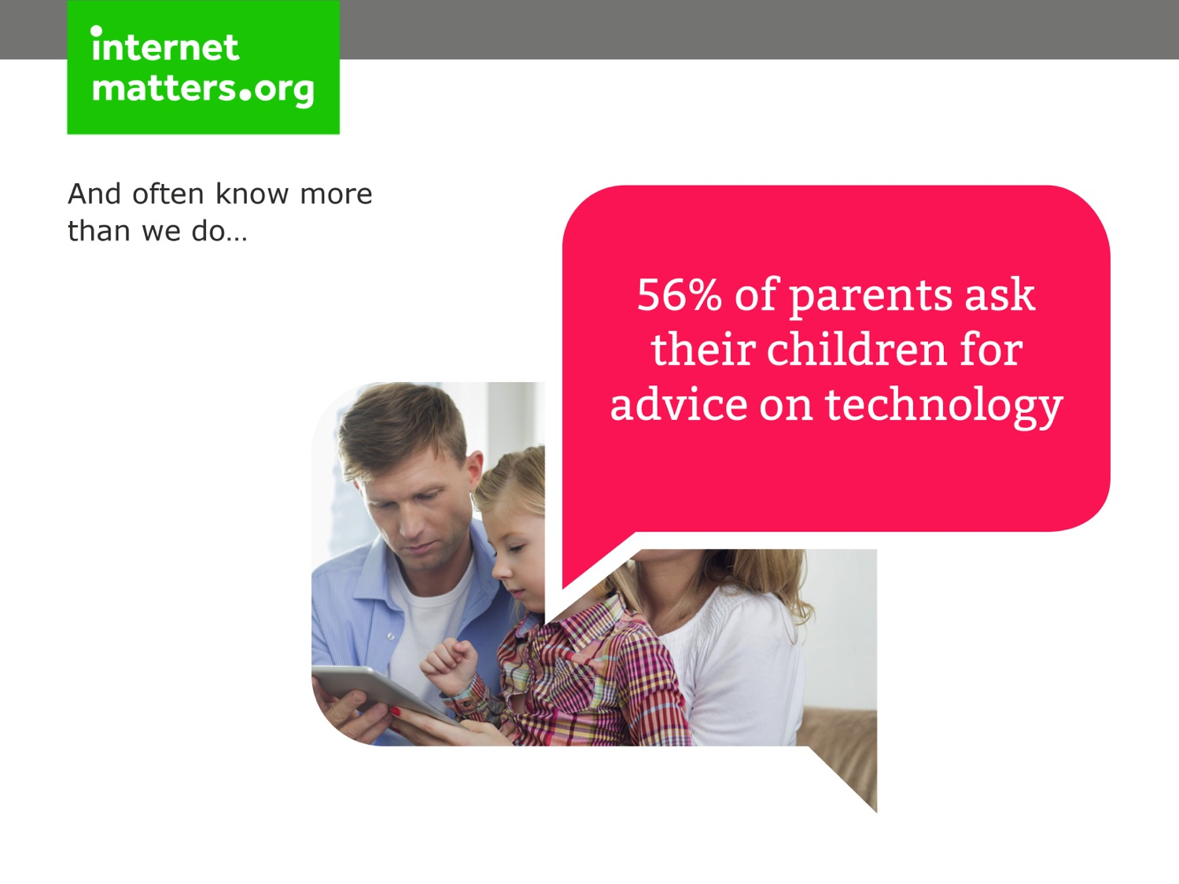

Slide 6
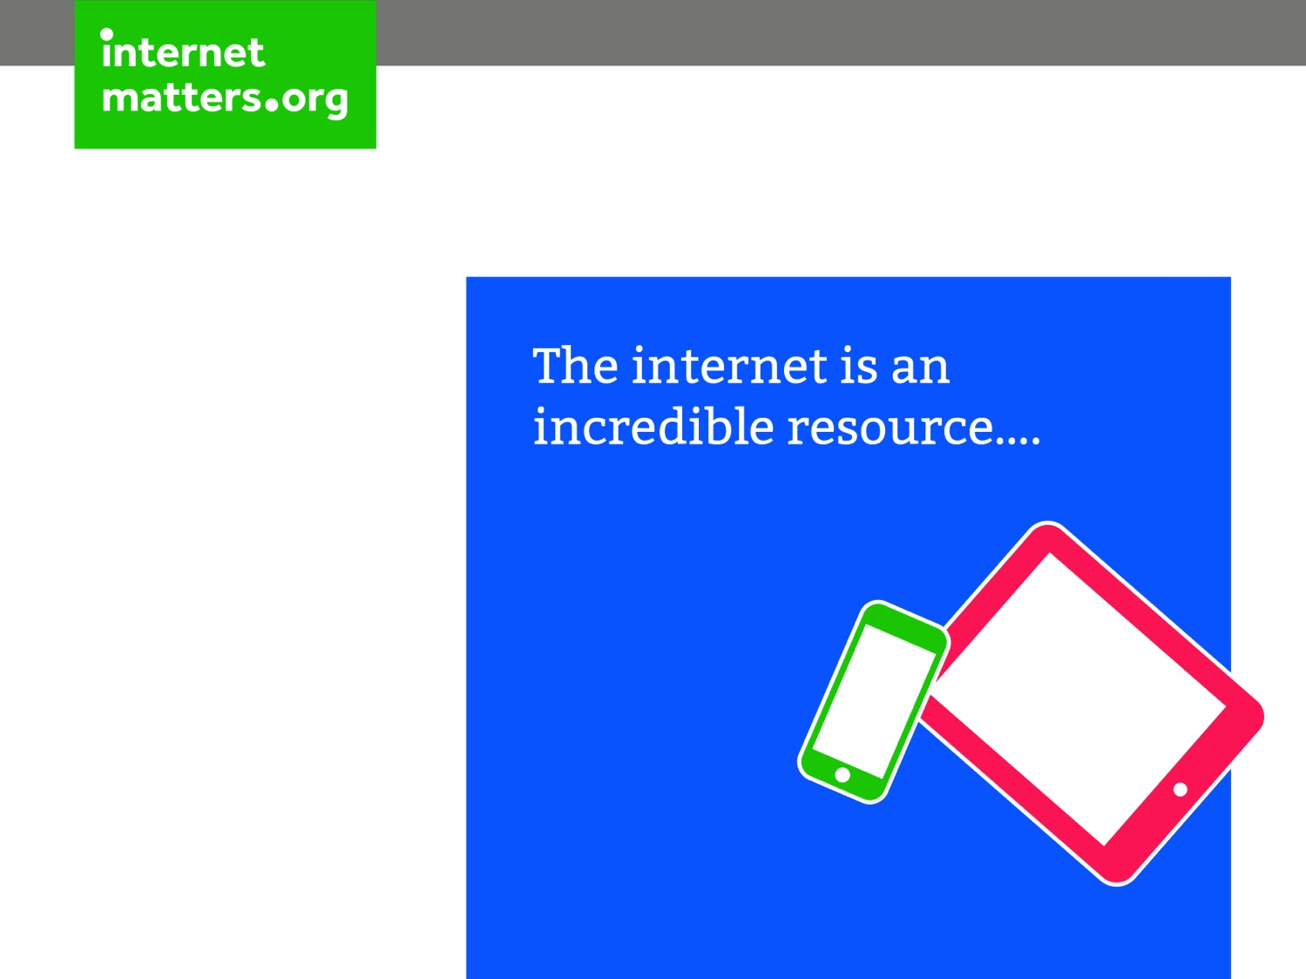

Slide 7
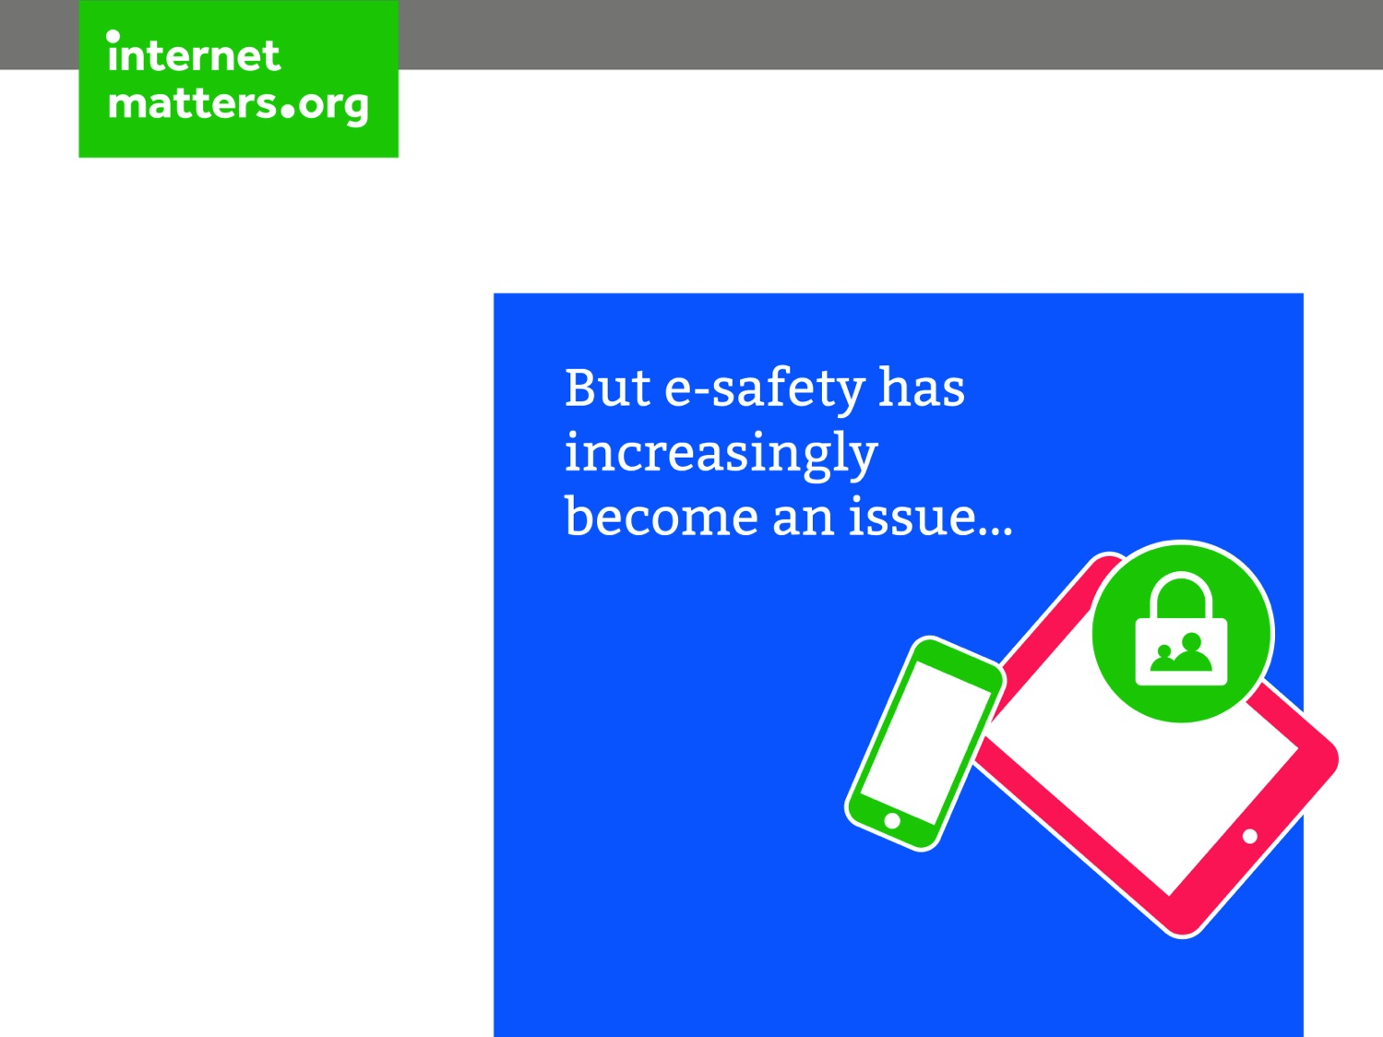

Slide 8
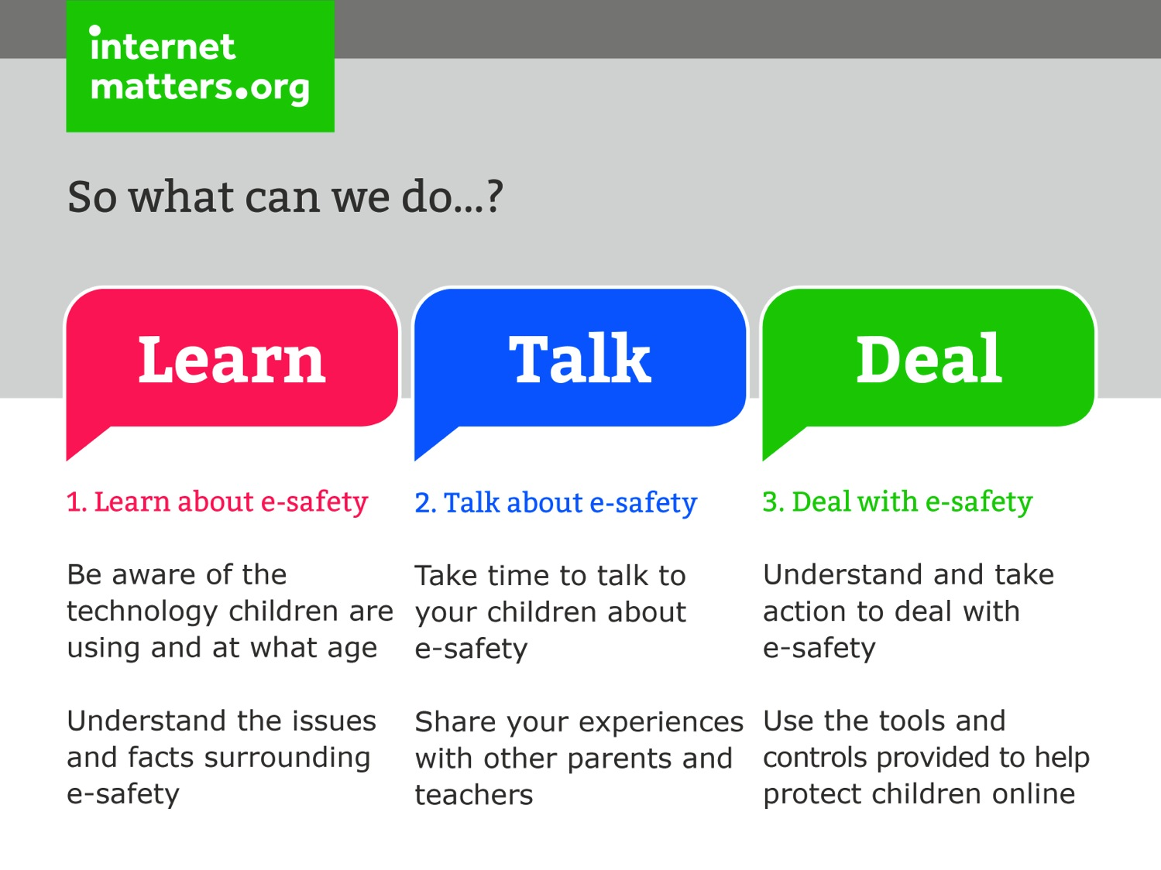

Slide 9
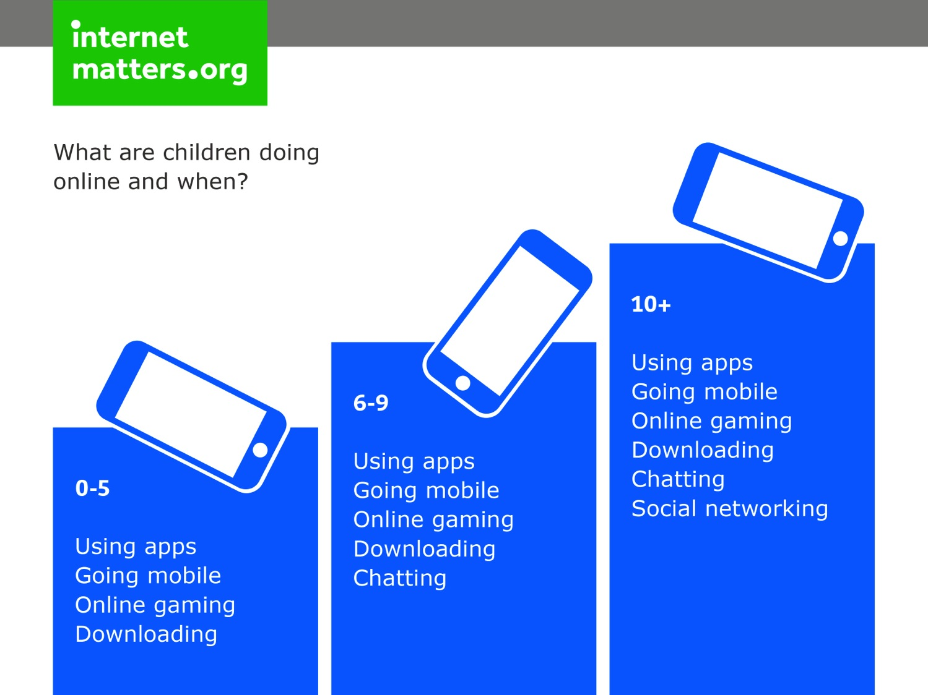

Slide 10
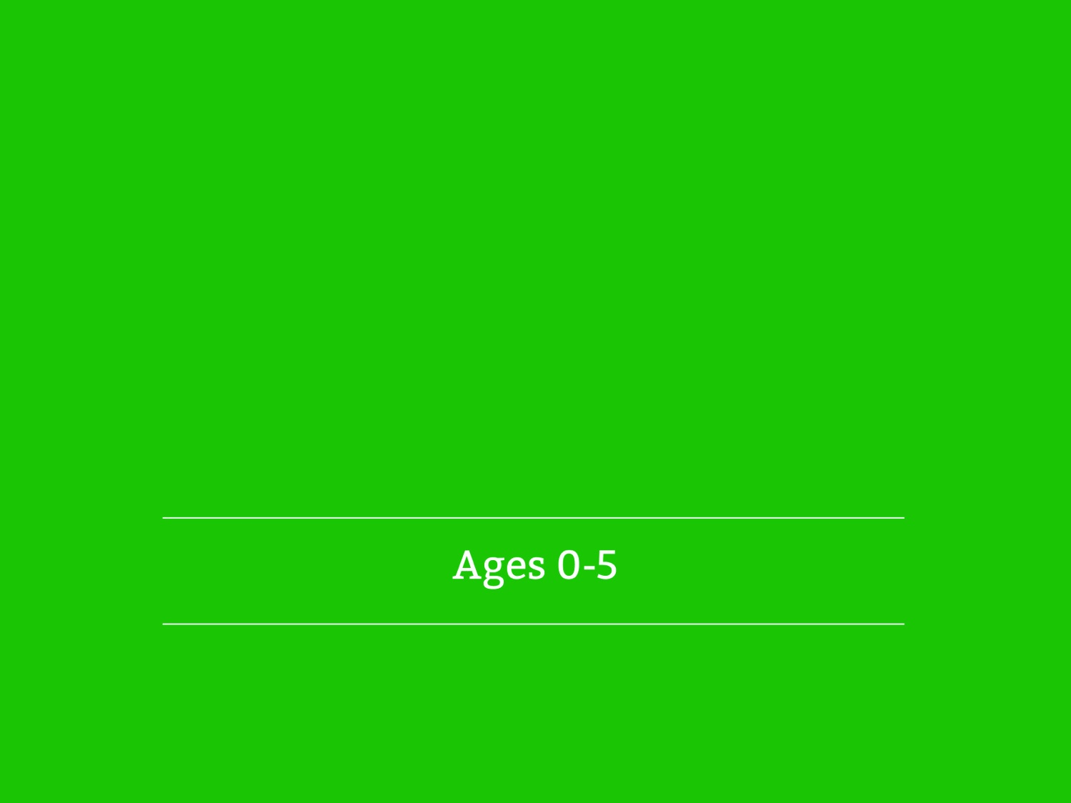
Notes:
Please note, slides 11-17 are optional if you feel you want to cover this age group as well

Slide 11
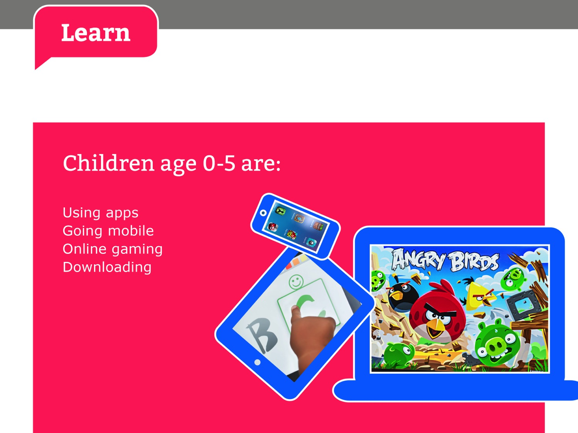
Notes:
Please note, slides 11-17 are optional if you feel you want to cover this age group as well

Slide 12
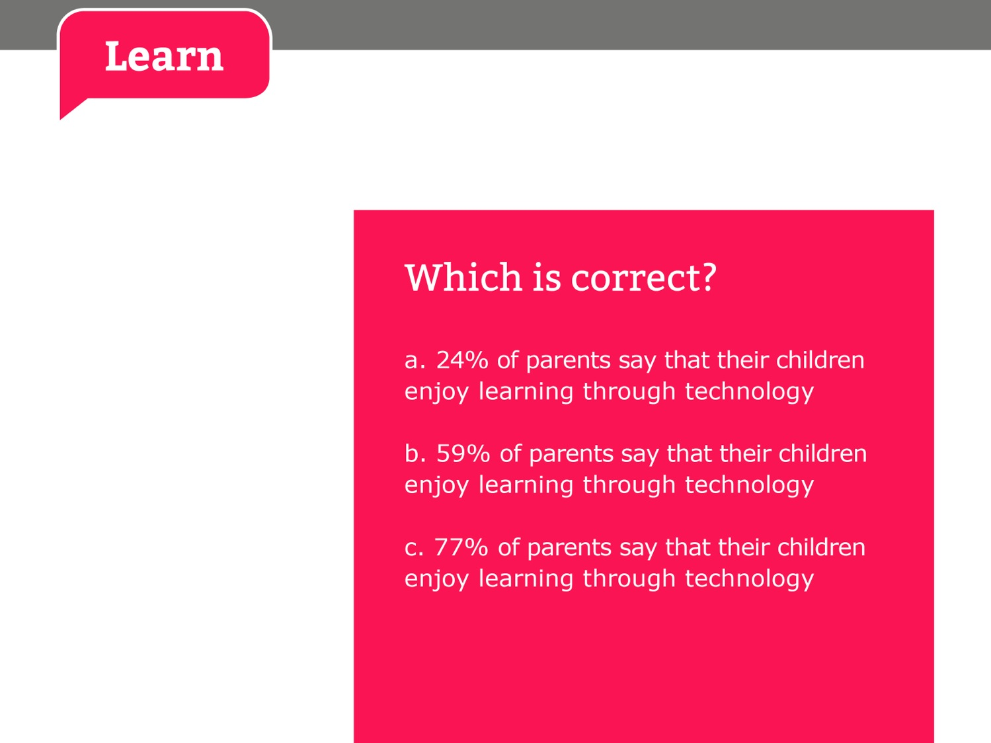
Notes:
Please note, slides 11-17 are optional if you feel you want to cover this age group as well

Slide 13
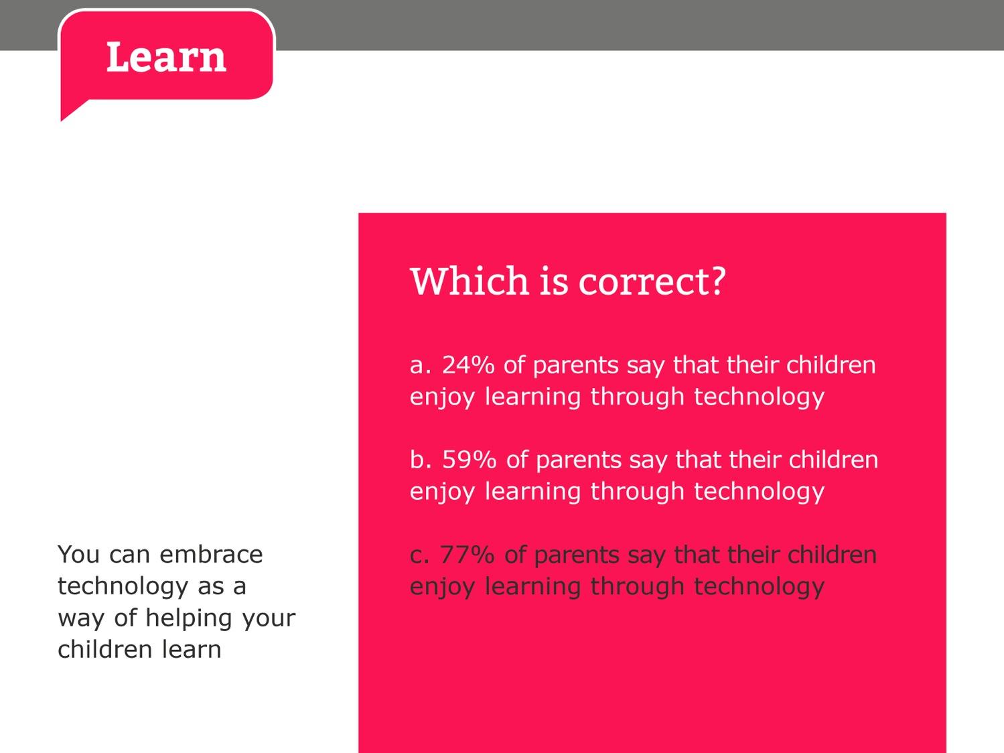
Notes:
Please note, slides 11-17 are optional if you feel you want to cover this age group as well

Slide 14
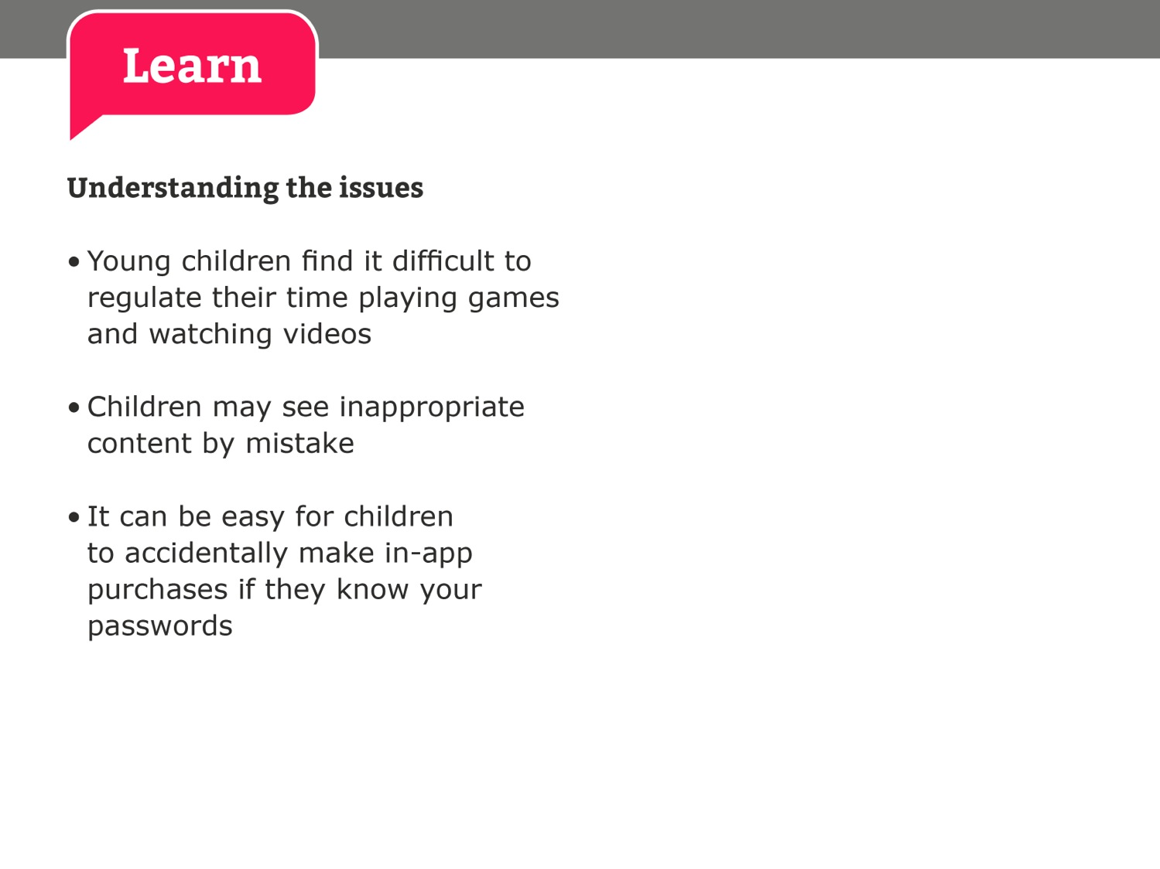
Notes:
Please note, slides 11-17 are optional if you feel you want to cover this age group as well

Slide 15
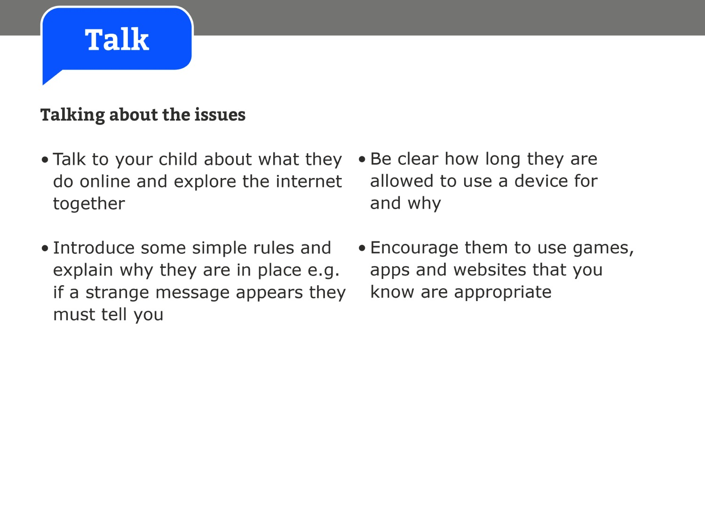
Notes:
Please note, slides 11-17 are optional if you feel you want to cover this age group as well

Slide 16
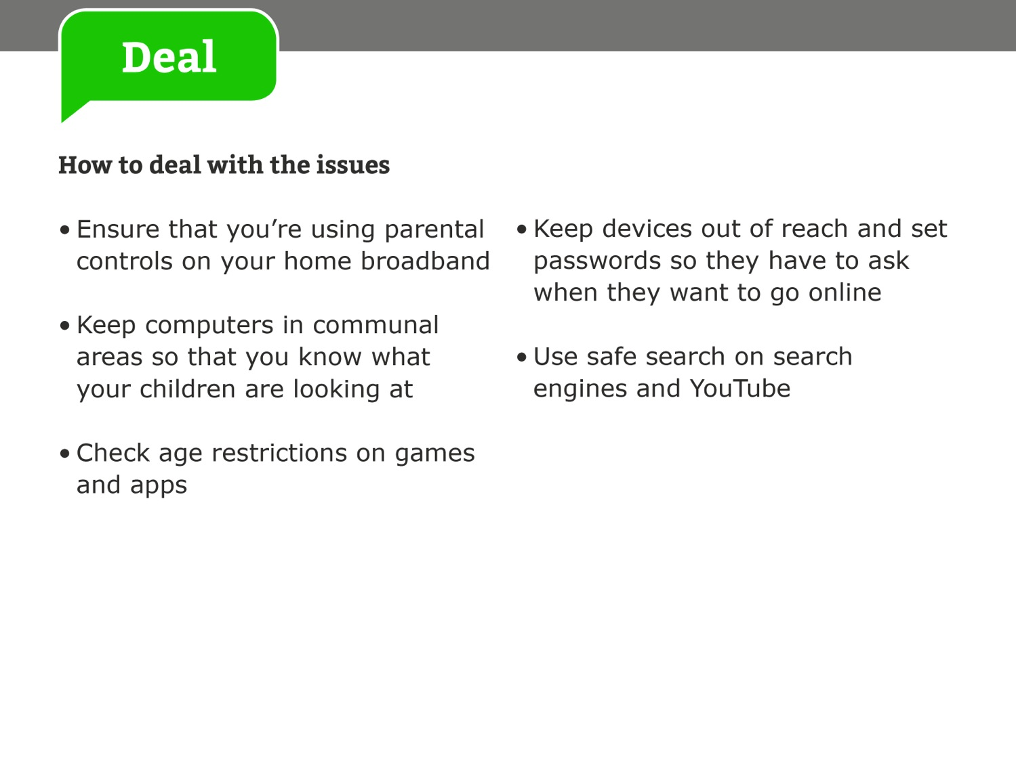
Notes:
Please note, slides 11-17 are optional if you feel you want to cover this age group as well

Slide 17


Slide 18
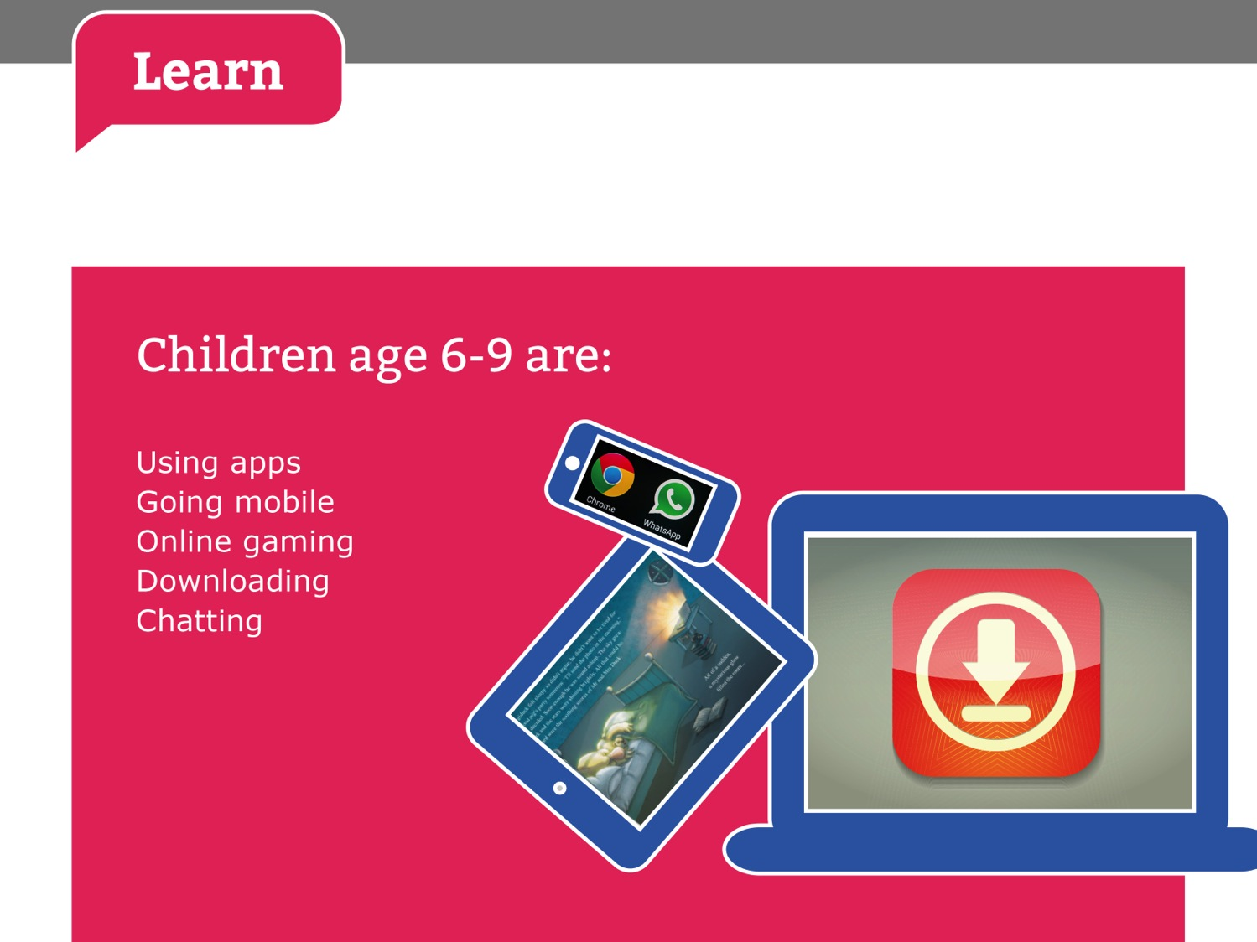

Slide 19


Slide 20
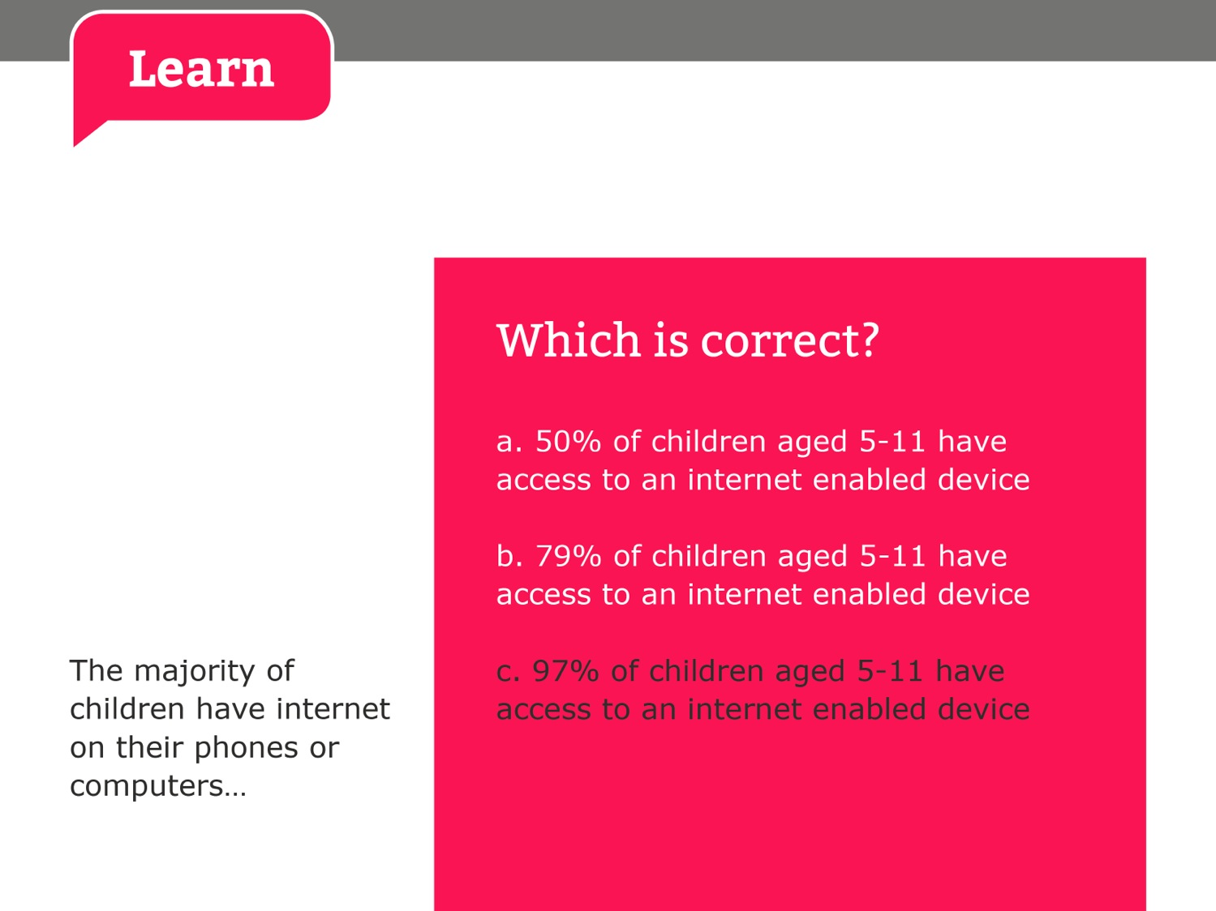

Slide 21
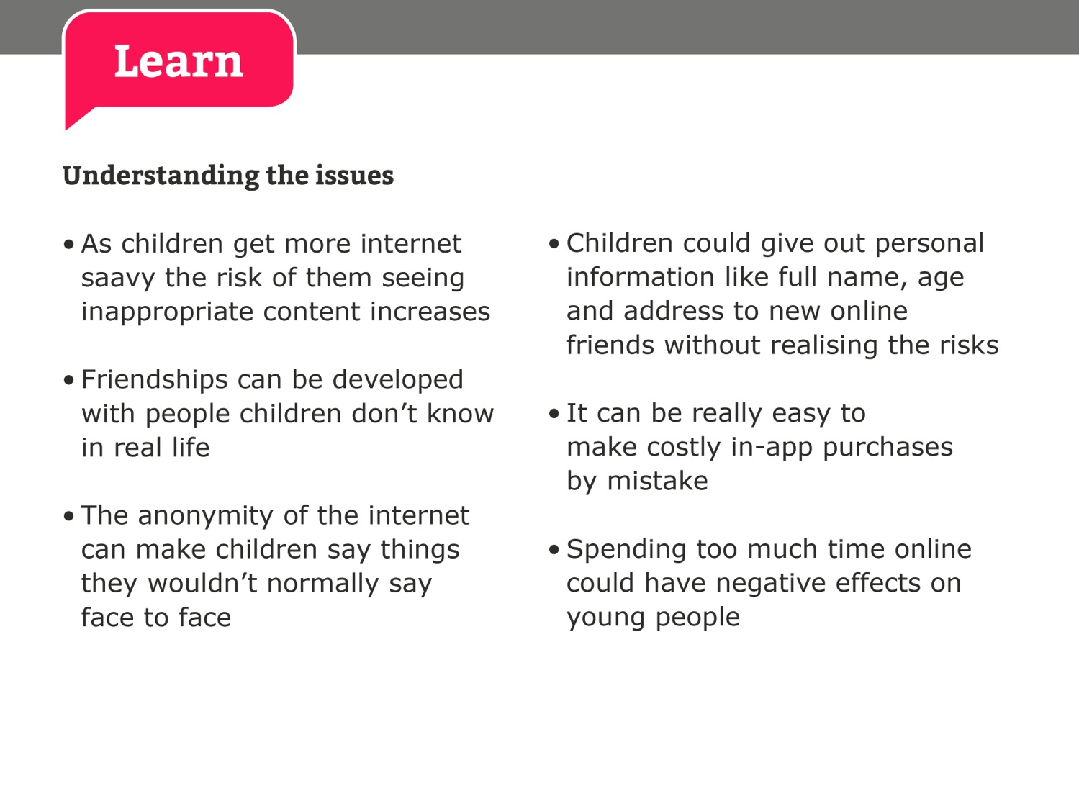
savvy

Slide 22
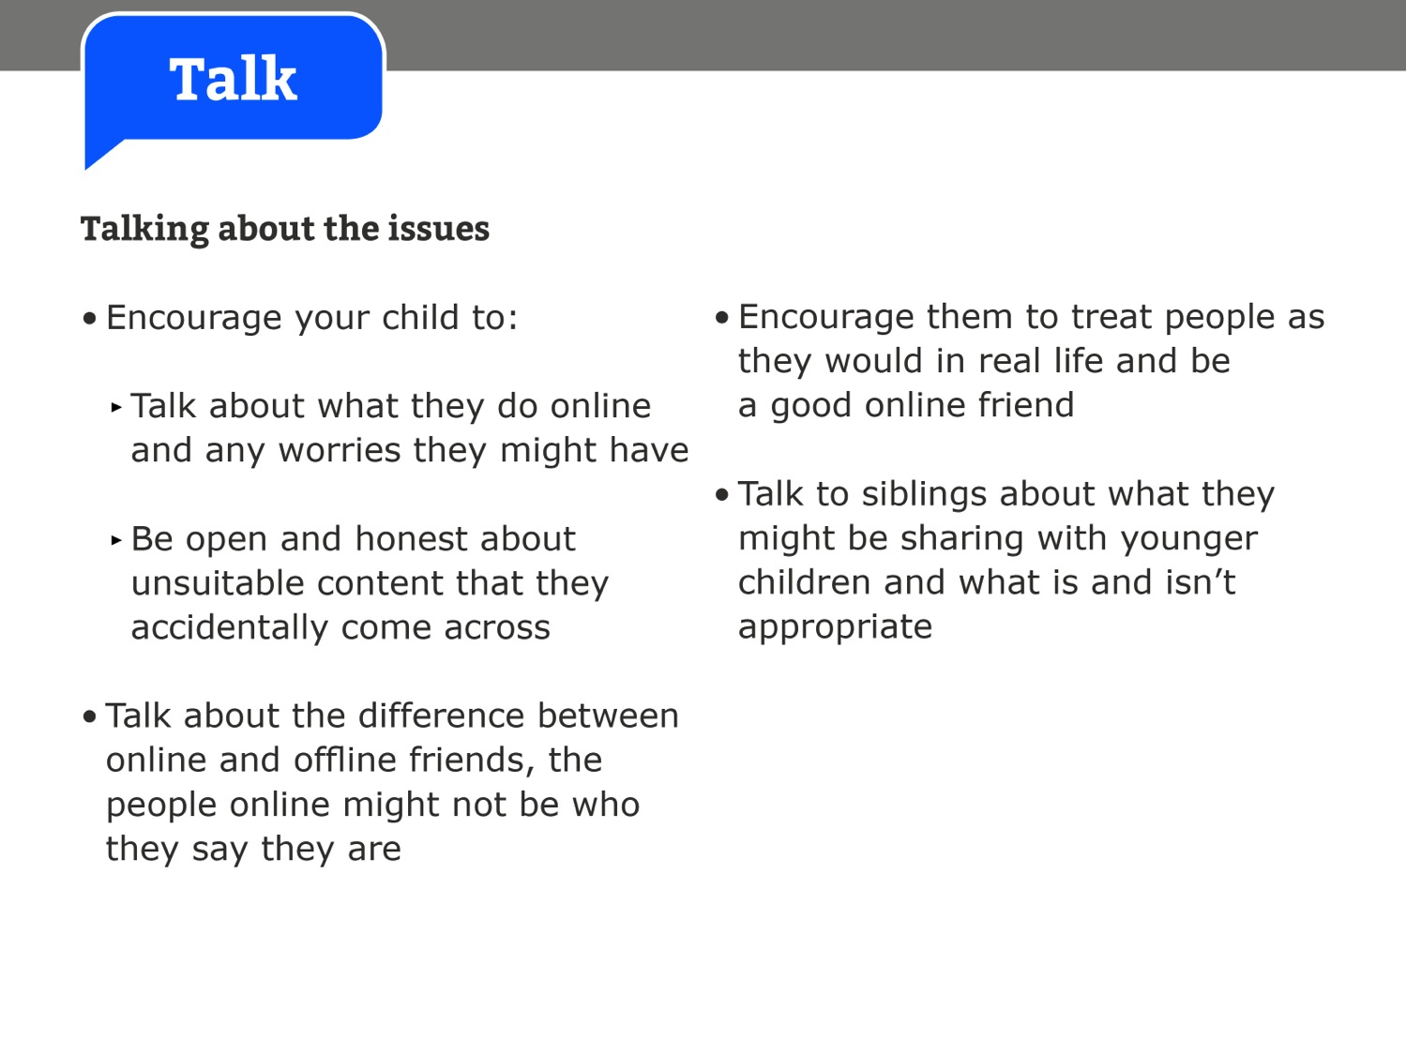

Slide 23
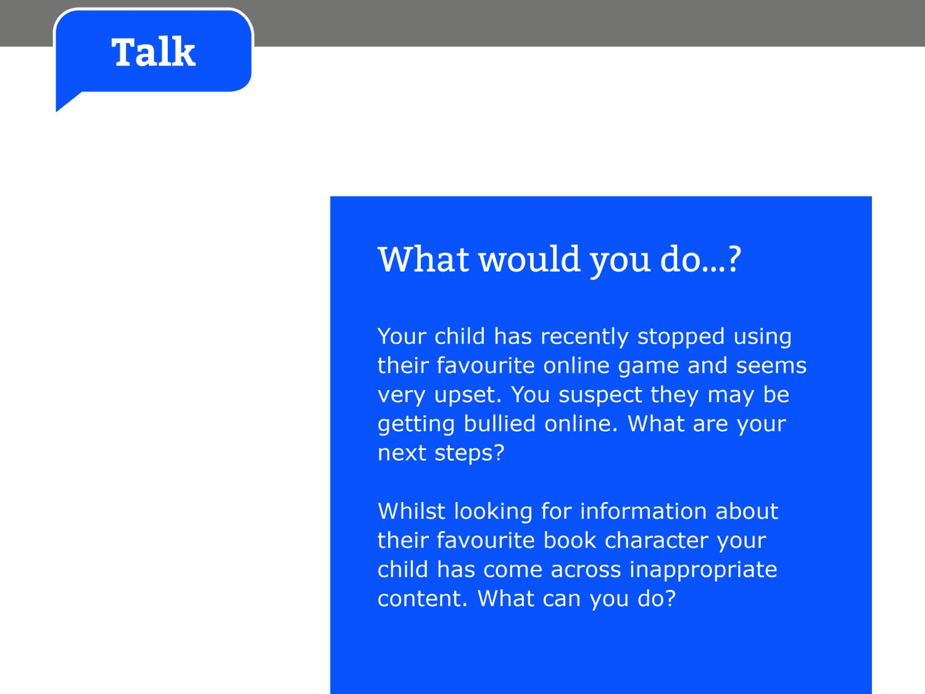

Slide 24
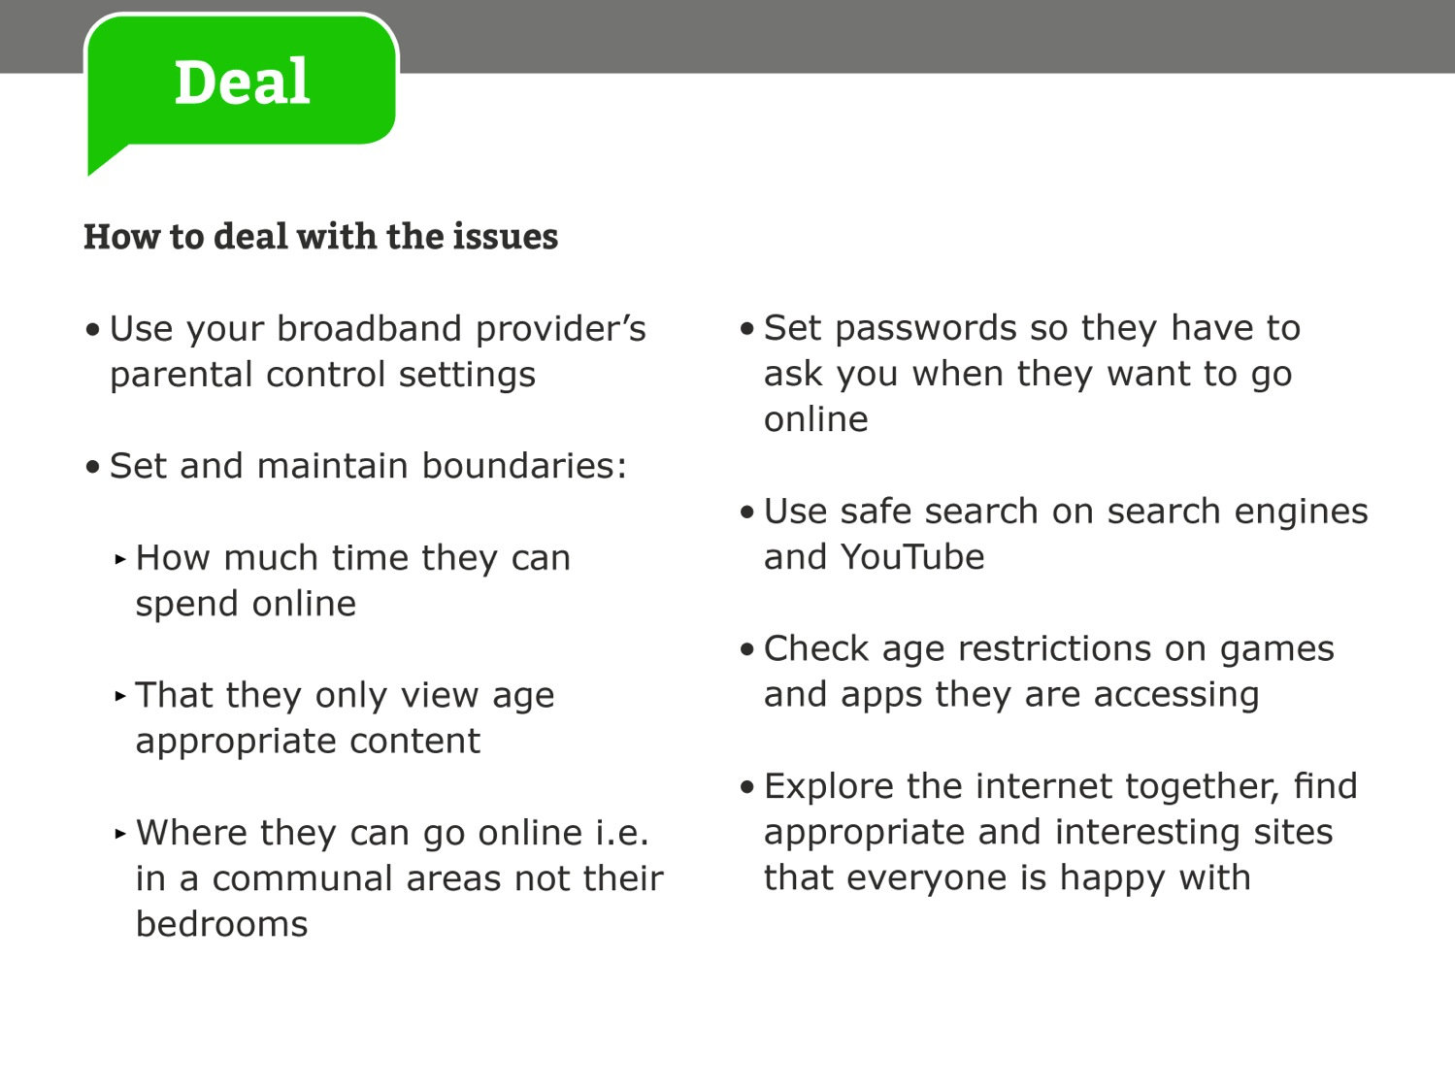

Slide 25
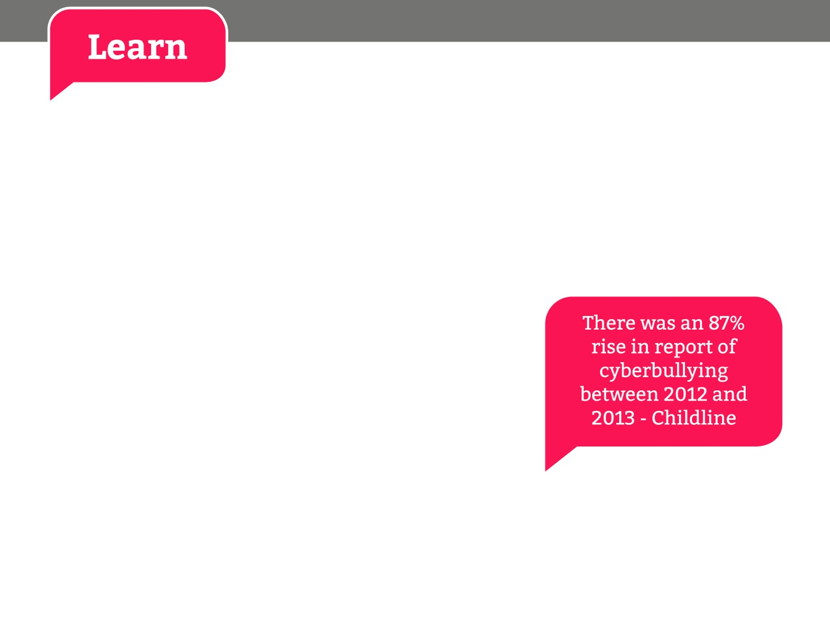
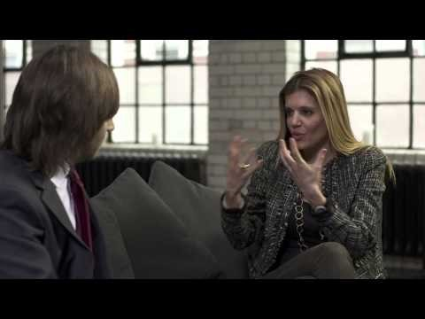
Click here to open hyperlink to video
Notes:
Risks children face online: Cyberbullying (Primary) - http://www.youtube.com/watch?v=5yVE0XszE3A
http://www.internetmatters.org/issues/cyberbullying.html

Slide 26
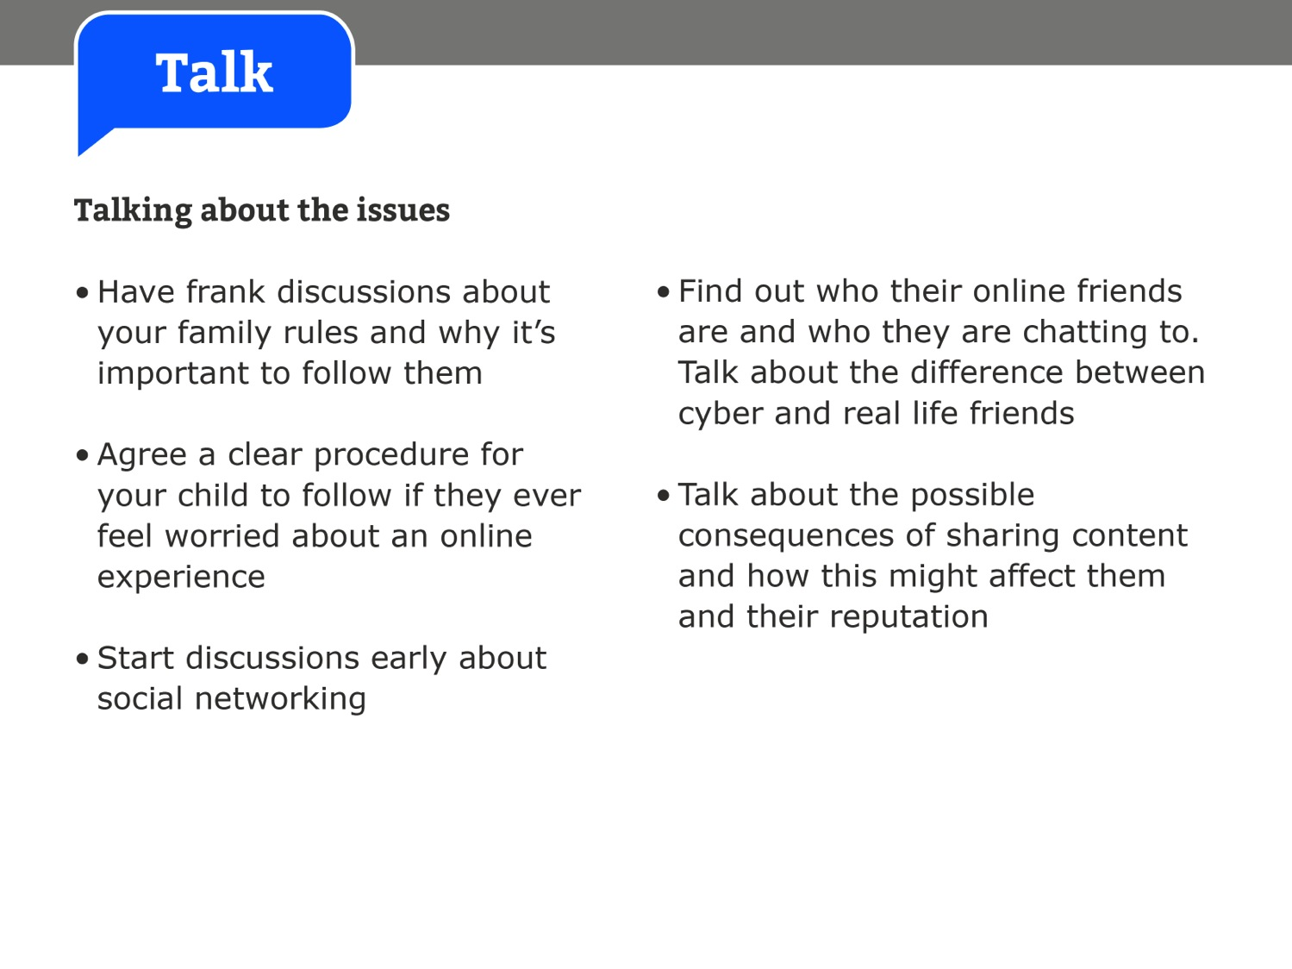

Slide 27


Slide 28
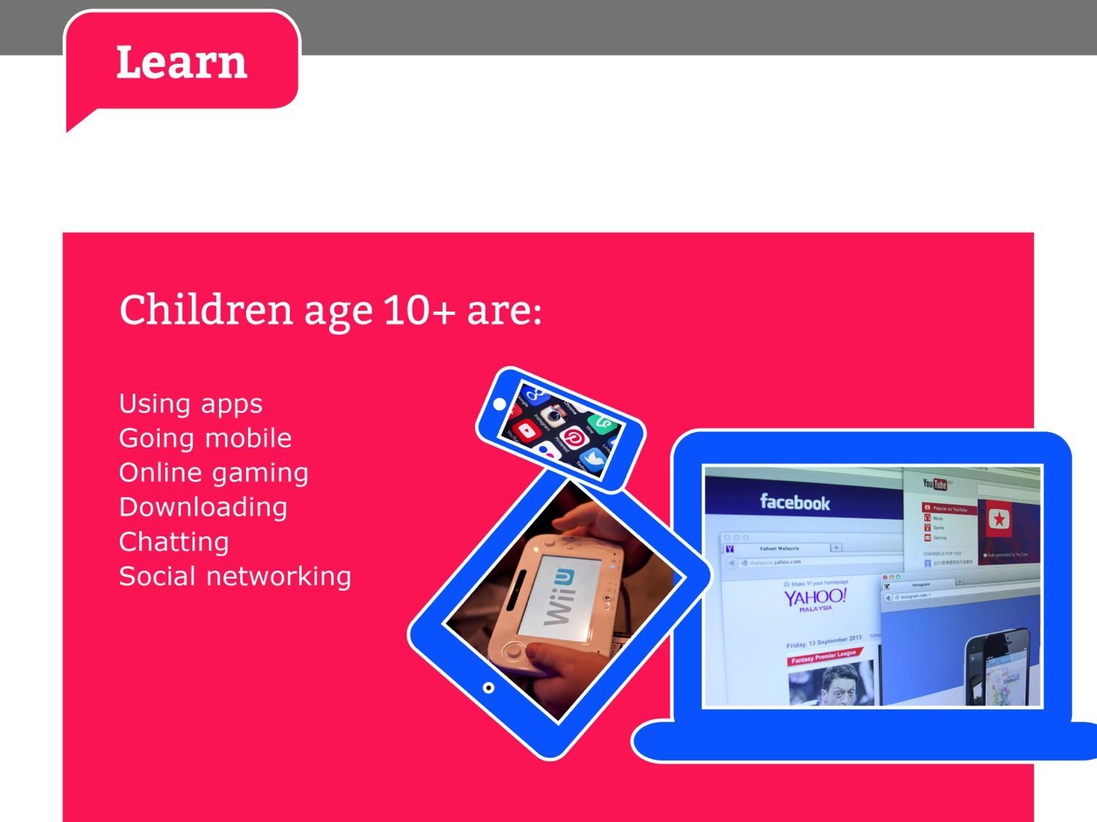

Slide 29
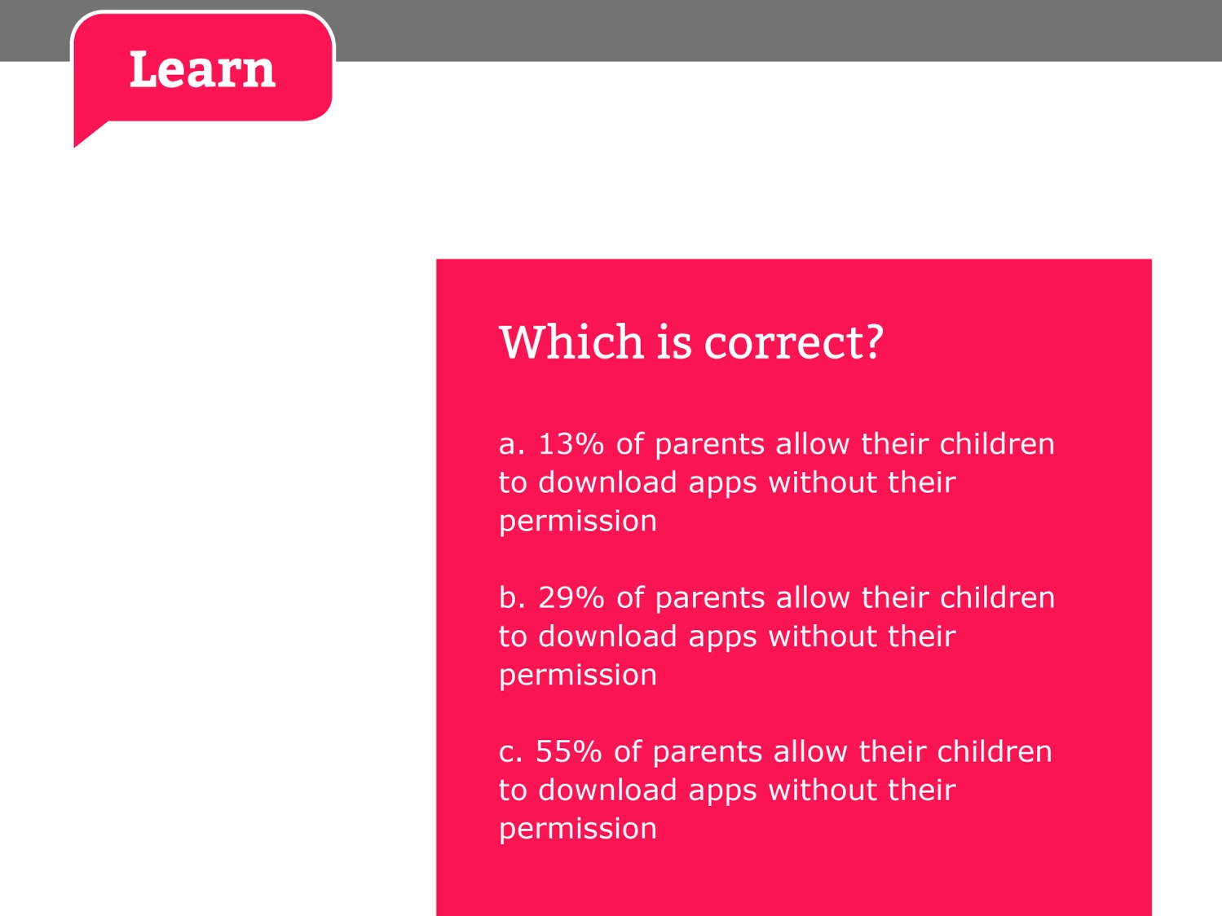

Slide 30
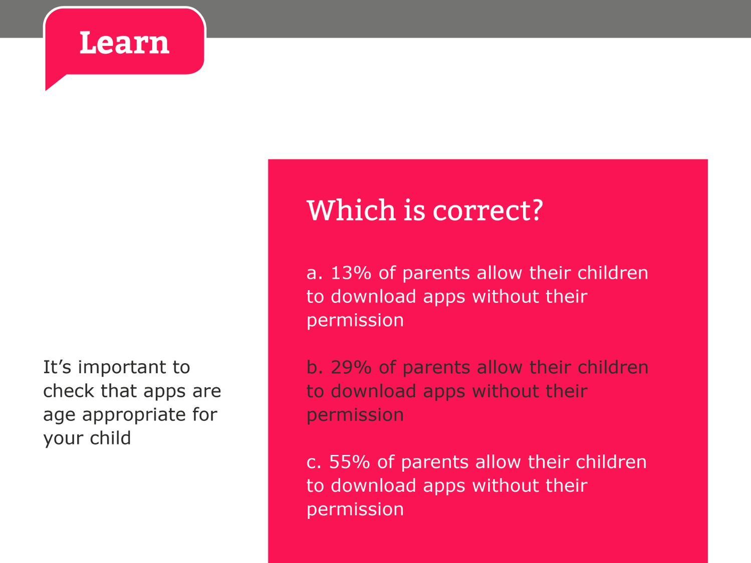

Slide 31
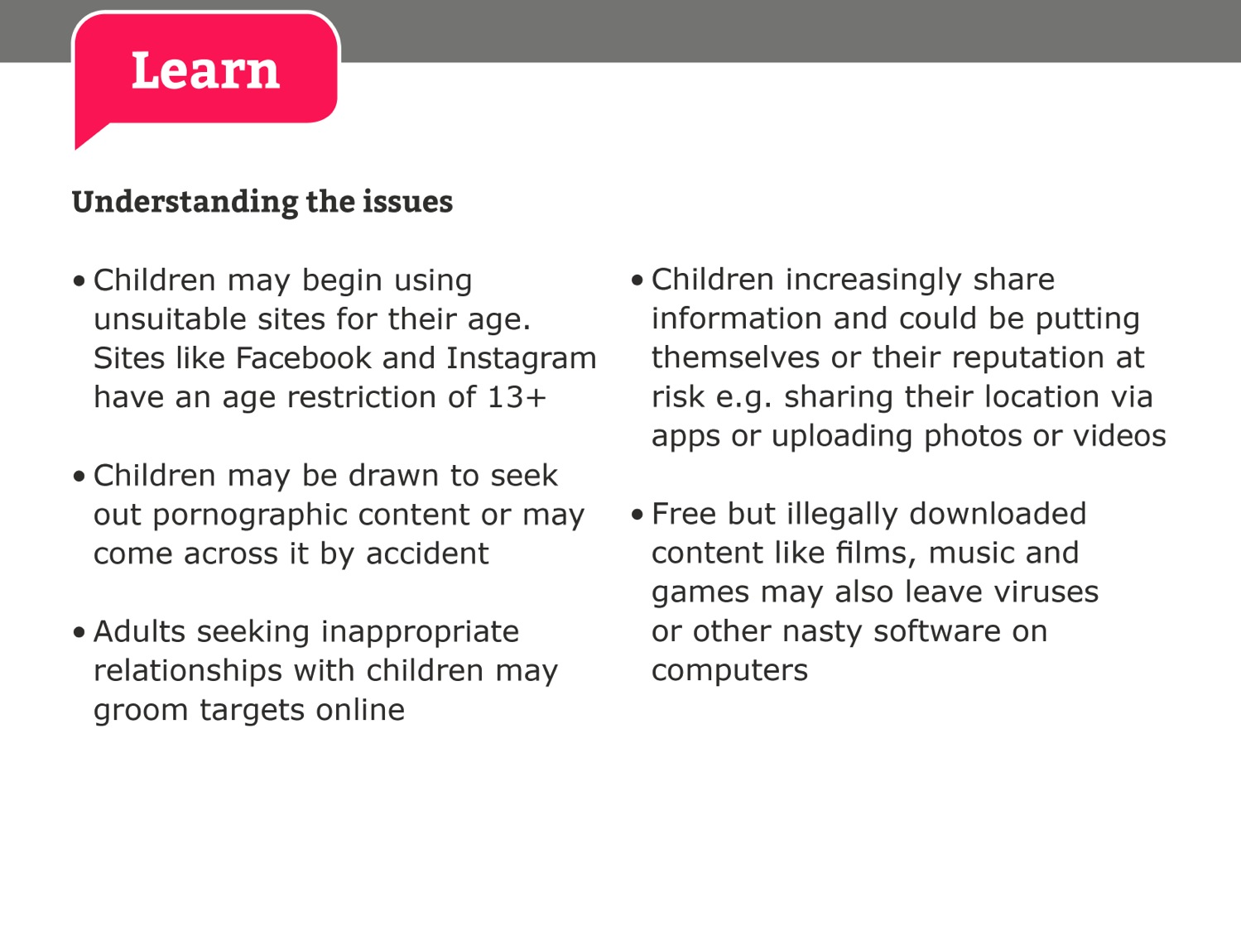

Slide 32
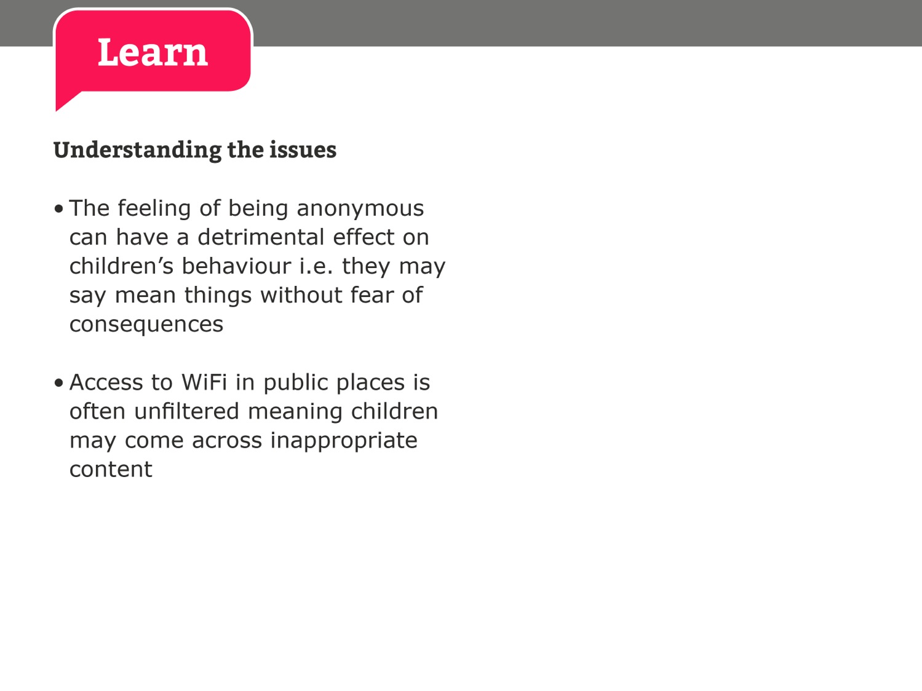

Slide 33


Slide 34
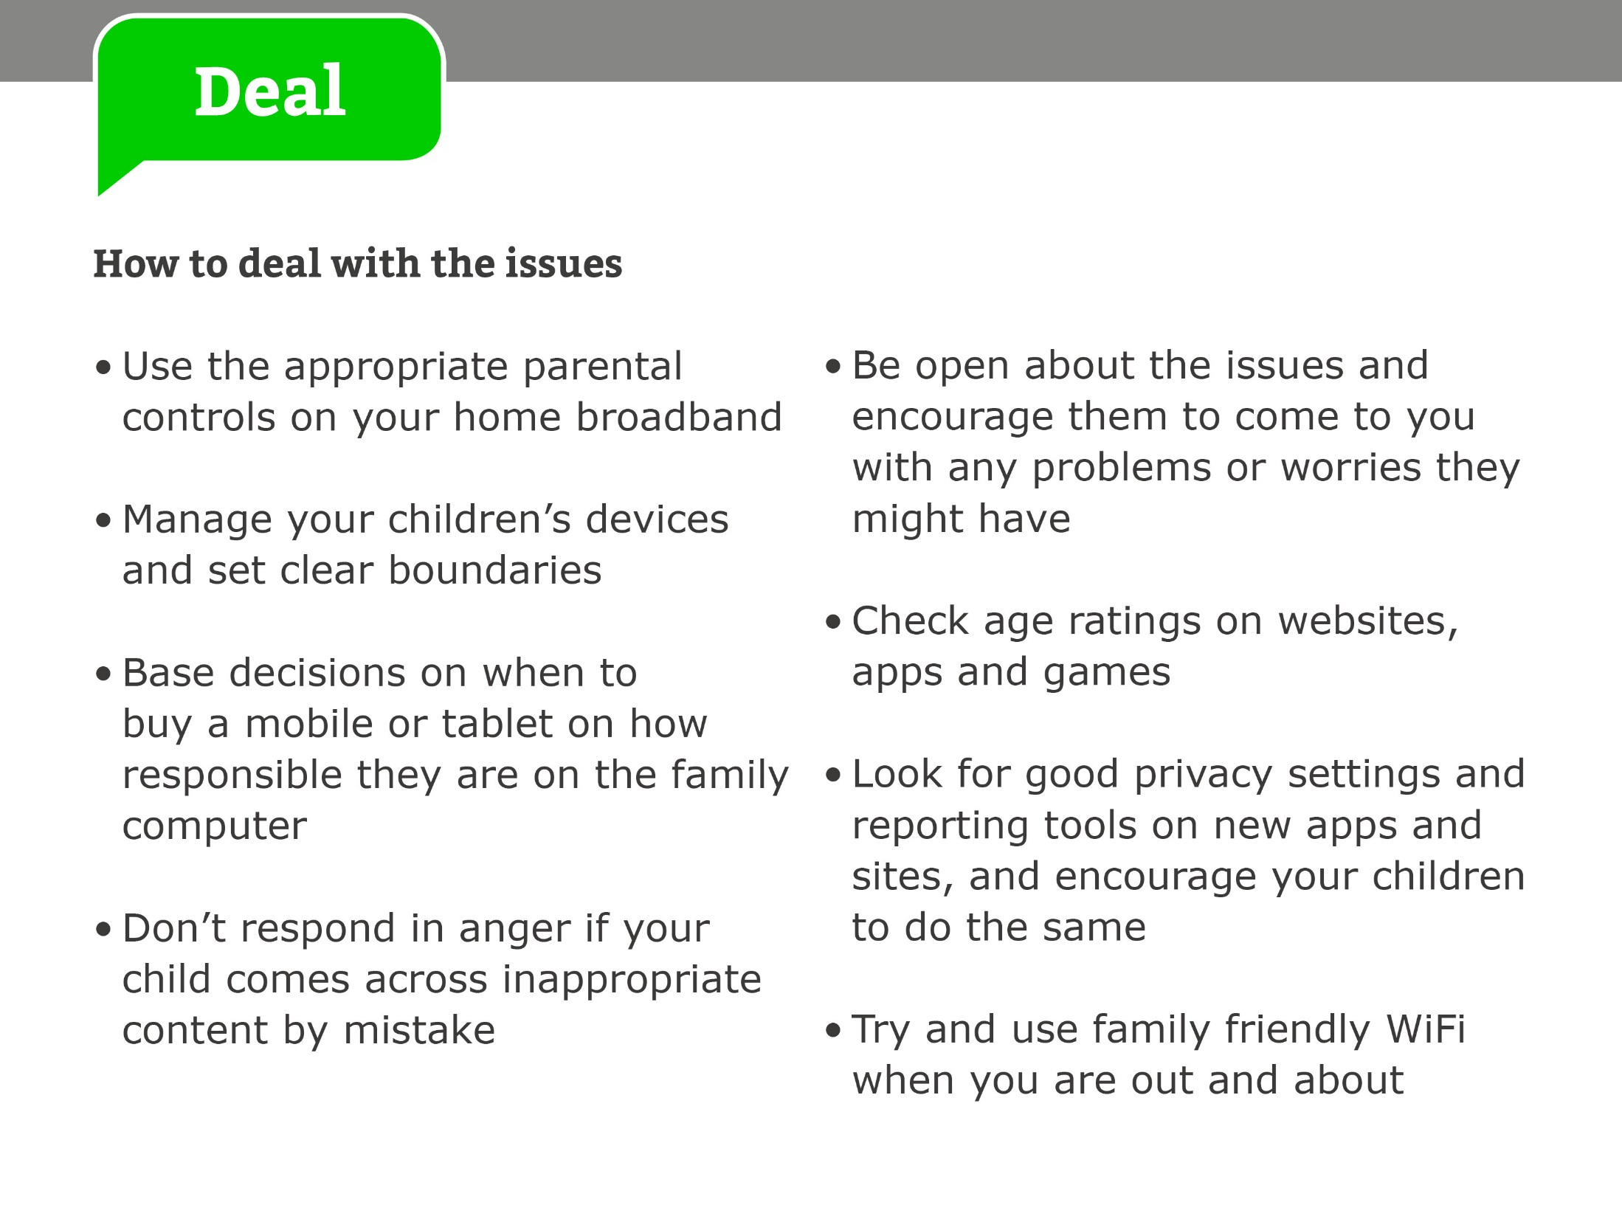

Slide 35
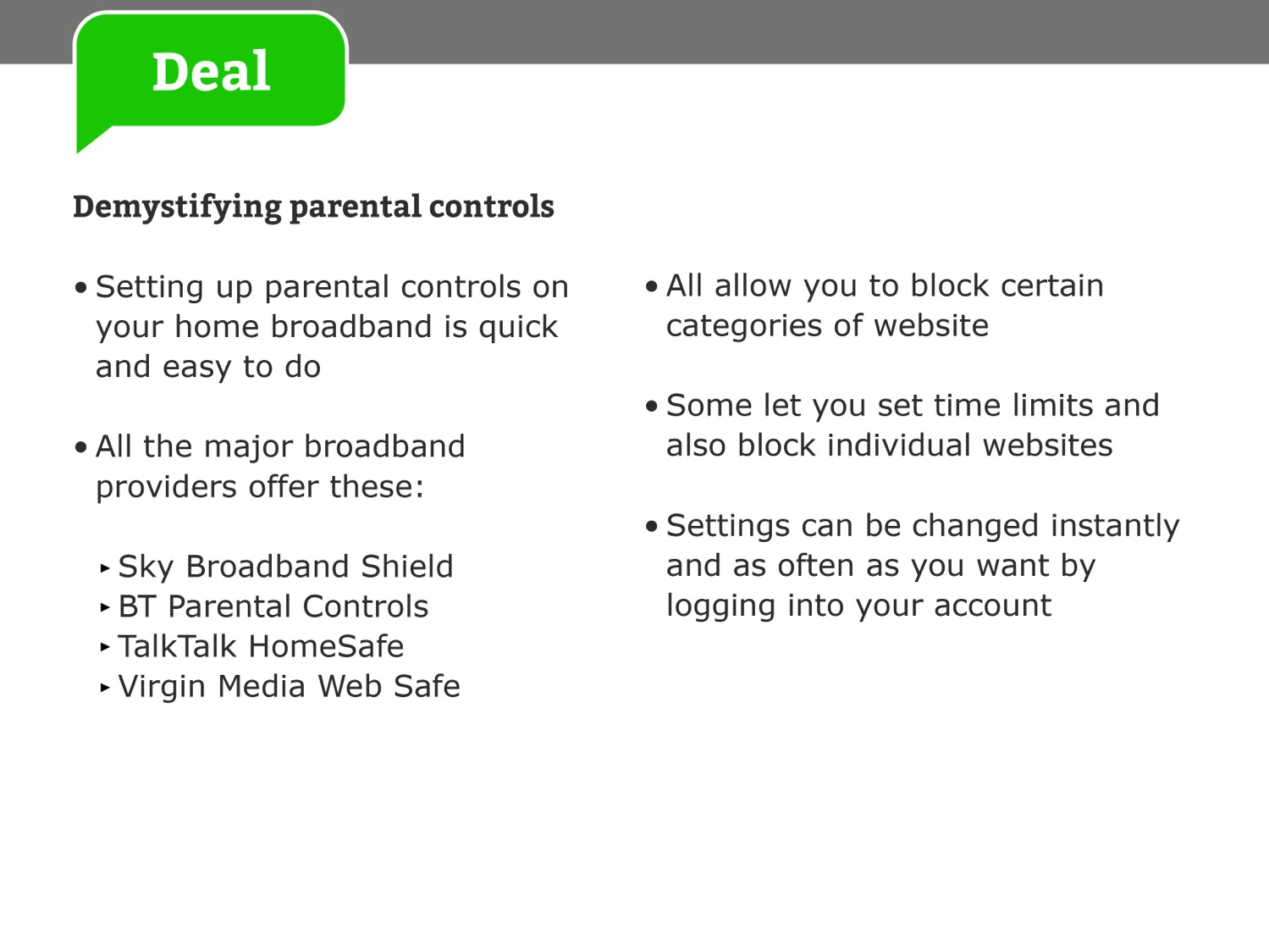

Slide 36
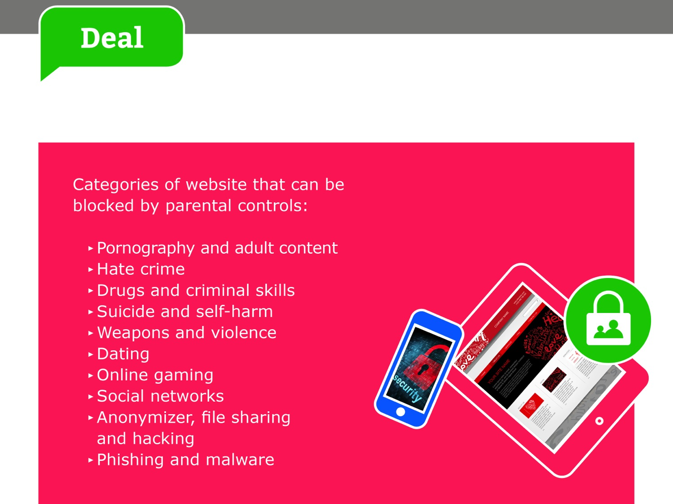

Slide 37

E-safety is an integral part of all our teaching at Brookburn, whenever technology is being used.
There is a clear progression throughout the school, allowing staff to teach children about the appropriate risks and how to handle themselves online.
In addition to this, we have regular assemblies, special days and visual prompts around the school, reminding children about how to stay safe online.

Slide 38

We are committed to keeping up-to-date with technological developments and ensuring that we are aware of the risks and dangers which the online world presents.
All staff receive annual training on e-safety and our policy is regularly updated and is available to view via our school website.

Slide 39
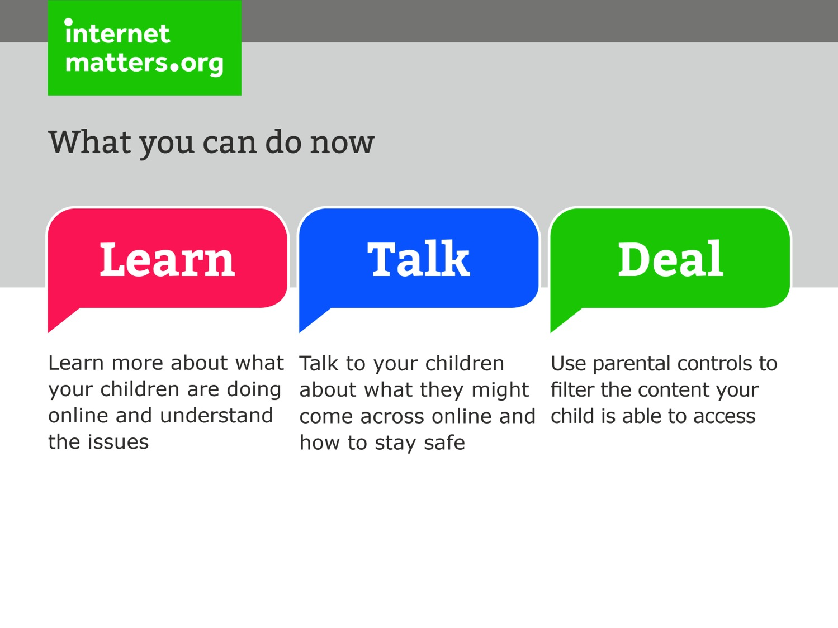

Slide 40


