Slide 1

Robinwood 2025
Staff: Mrs MacDonald, Mrs Ash, Mr Astle
Monday 23rd-Wednesday 25th June
Monday-arrive normal time
Wednesday-should be back by 3.30pm but will send updates.

Slide 2
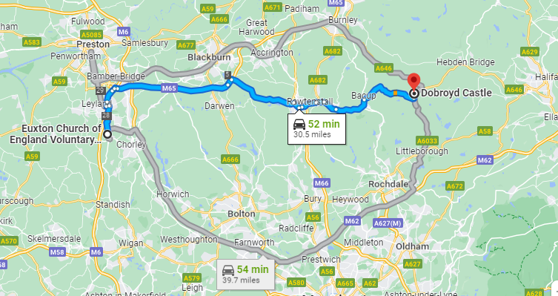
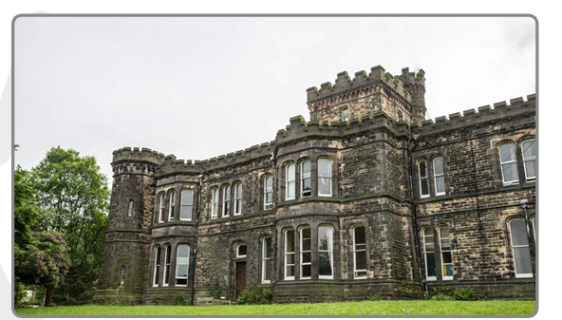

Slide 3
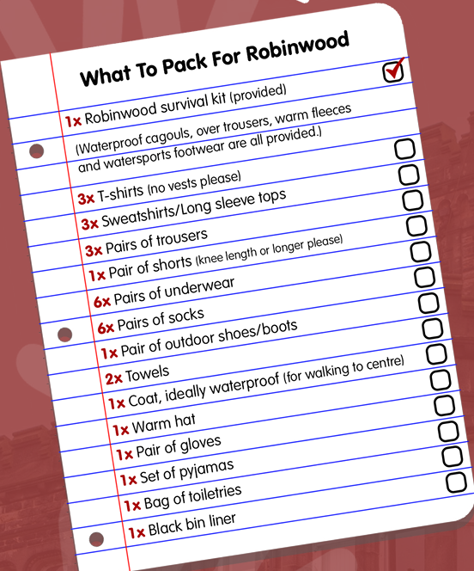
KIT LIST

Slide 4
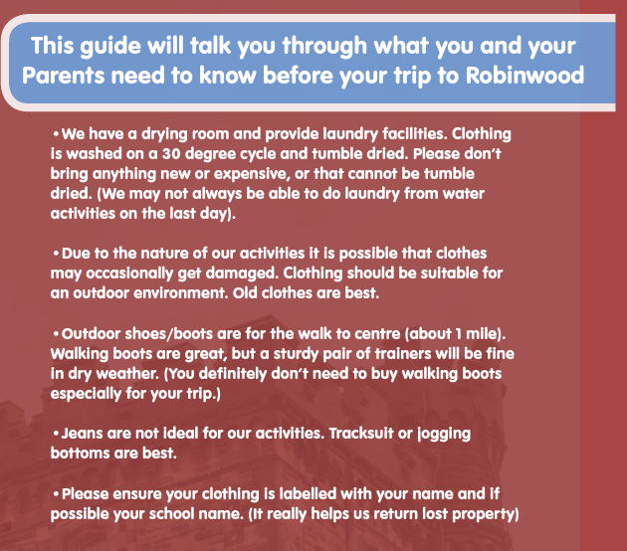

Slide 5
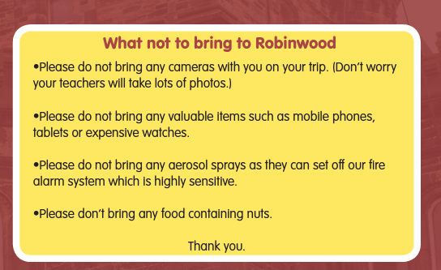

Slide 6
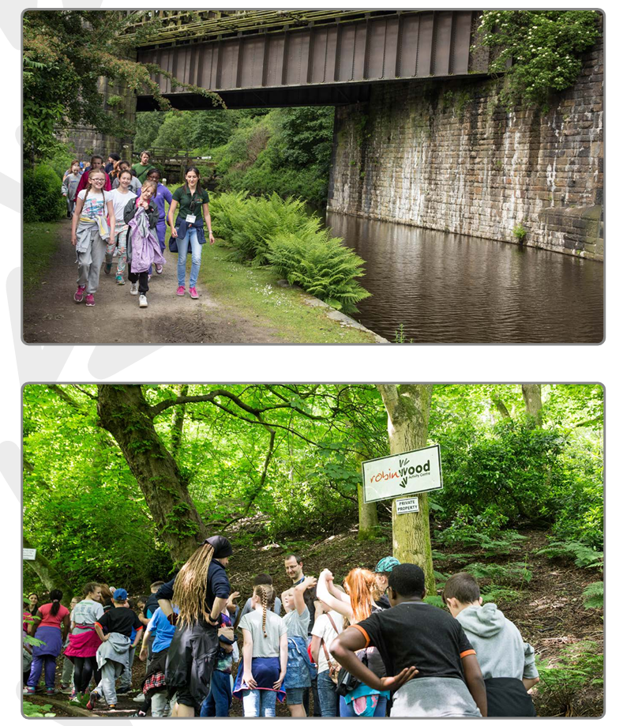
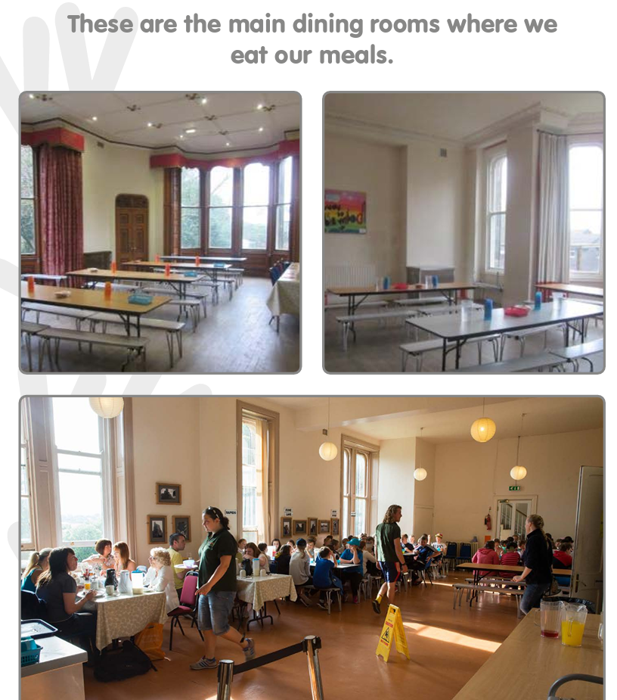

Slide 7


Slide 8
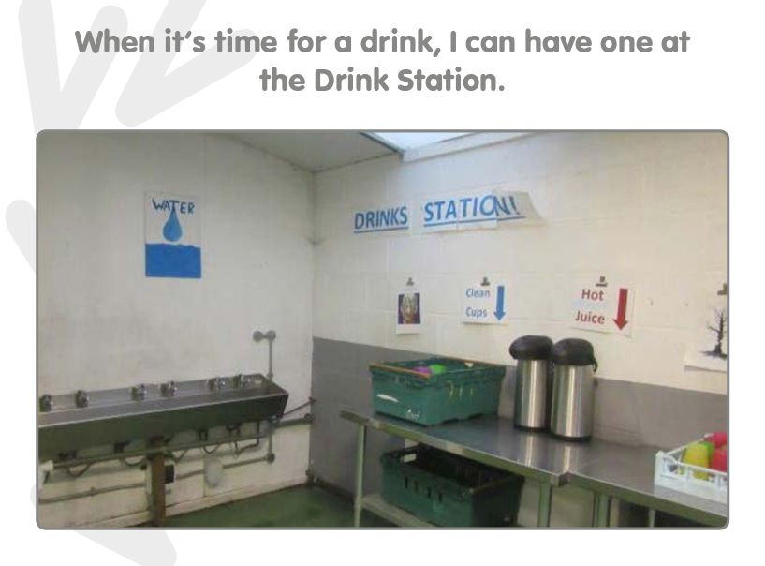

Slide 9
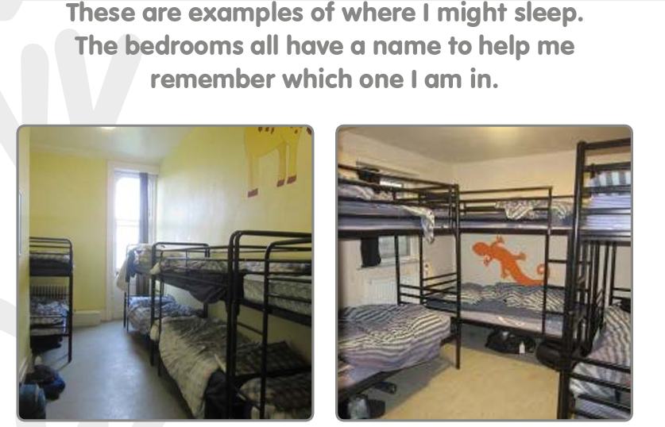
Sleep arrangements
We will allocate rooms based on how well we know your children.

Slide 10
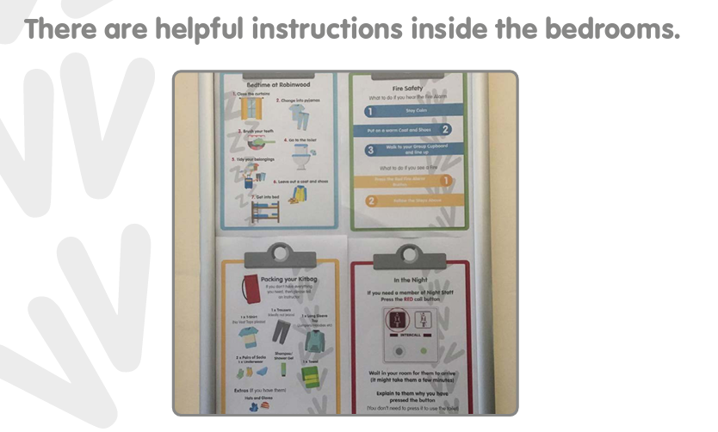

Slide 11
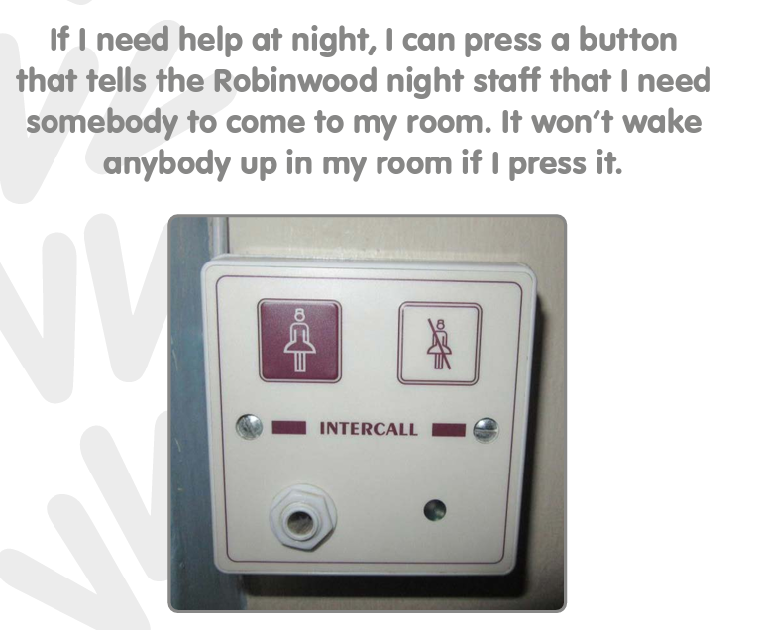

Slide 12


Slide 13
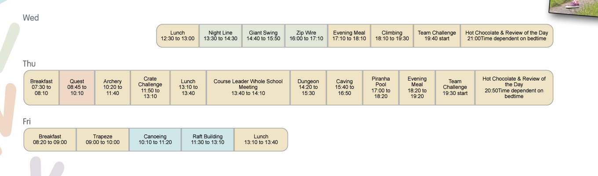

Slide 14


Slide 15
To do list:
Medical forms: please complete and return to school as soon as possible.
Medicine: please ensure it is clearly labelled, in date, and in a bag or tub. These can then be carried by the member of staff who is with your child’s group. If you wish us to take the inhaler or medicine we hold in school, please state so on the medical form.
Souvenir list: information to follow.
Please keep your mobile phone on loud, in case we need to contact you (not sleep mode).

