Slide 1
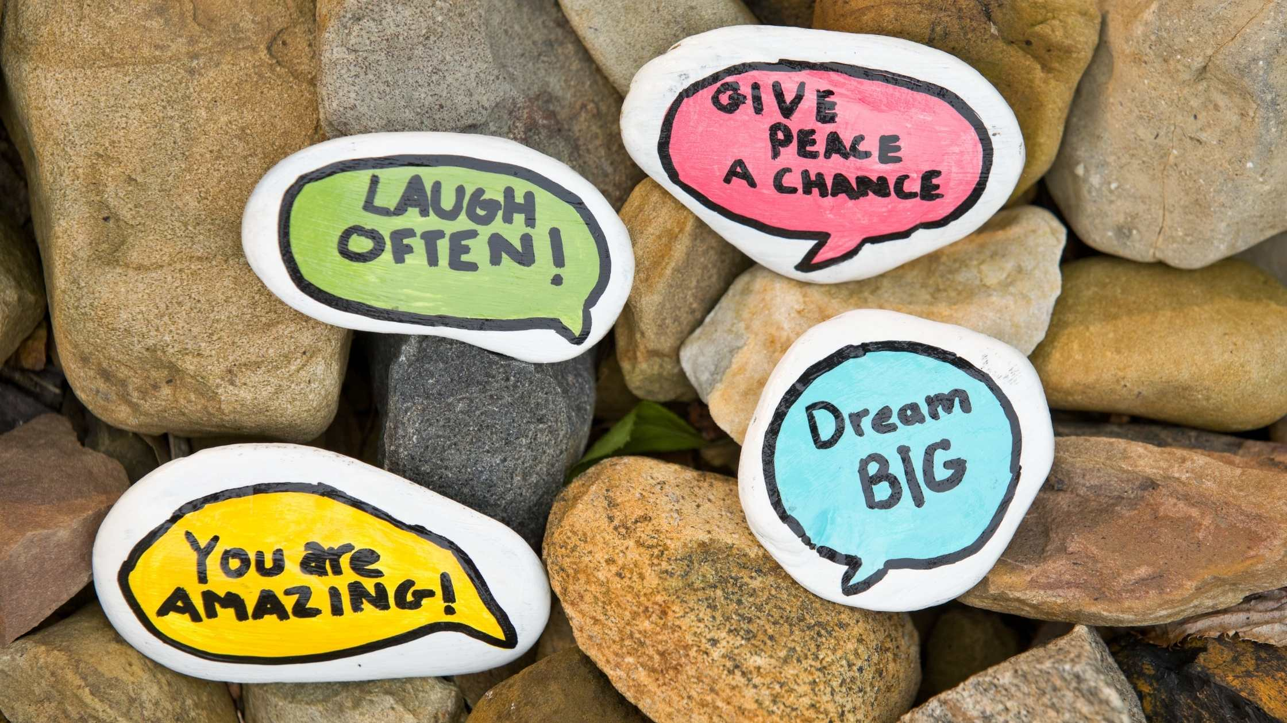
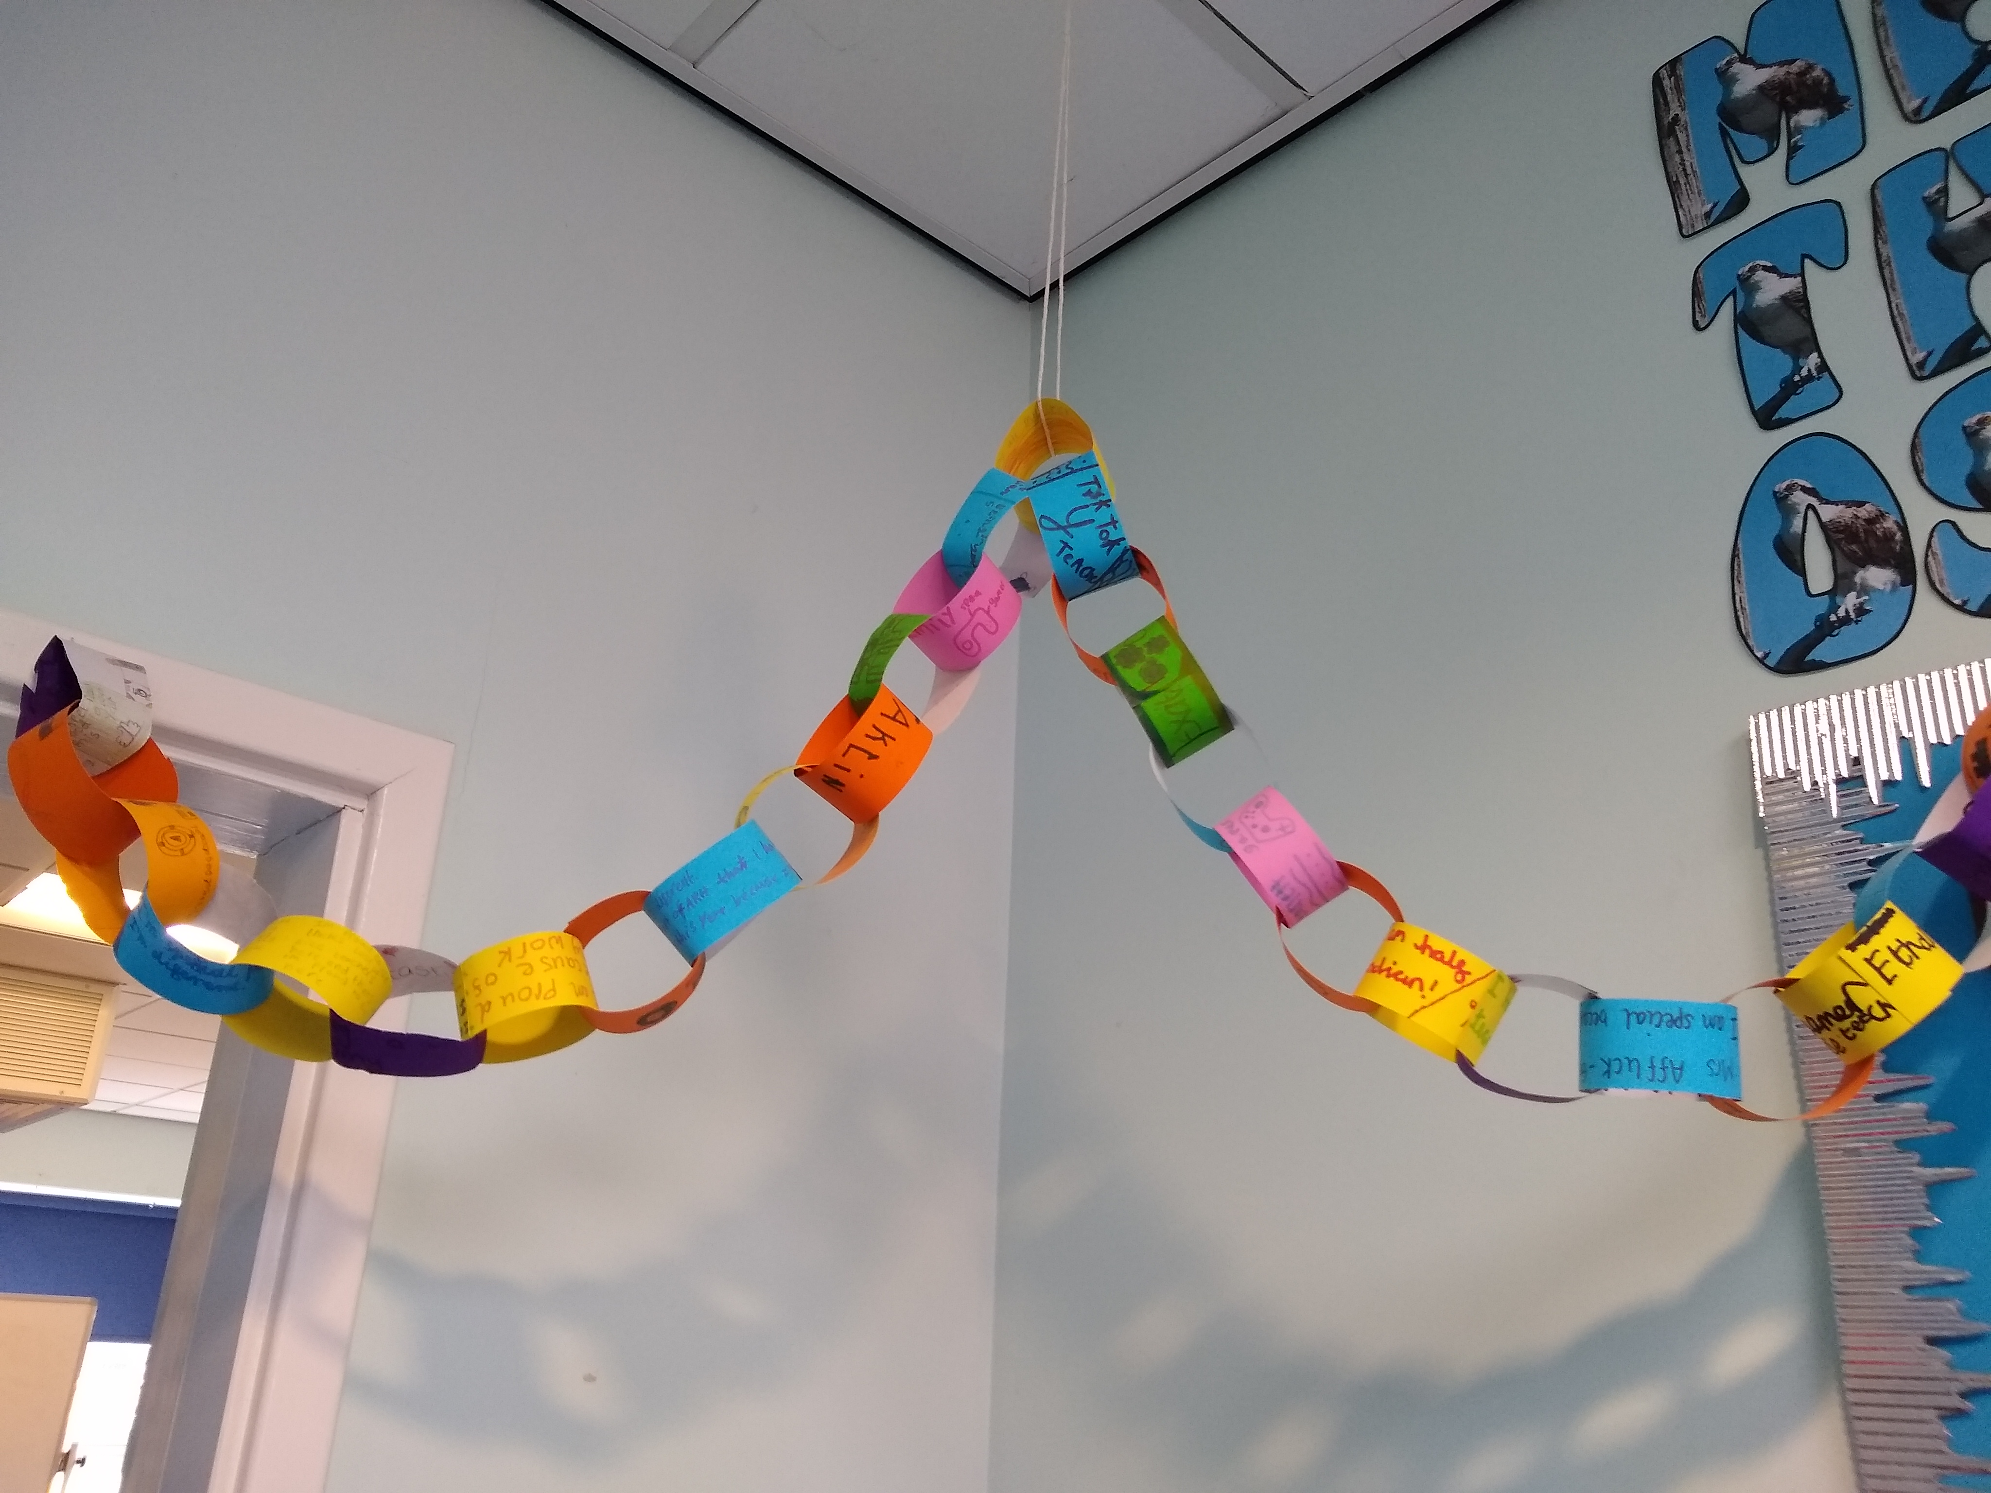
Wellbeing Homework - Campaign of Kindness
Kindness has an impact on wellbeing by making you feel happier and more connected to others. Try one of the following activities at home.
Paint rocks with a positive message. This is a great way to spread some cheer.
Write or draw something you are thankful for on a paper chain link. You could add links to the chain throughout the week. Ask family members and friends if they would like to add to your chain.

