Slide 1

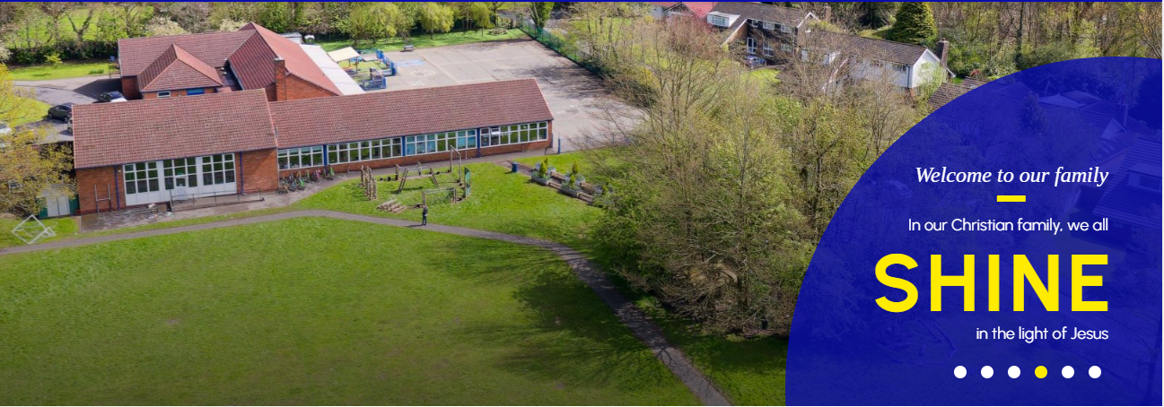

Slide 2

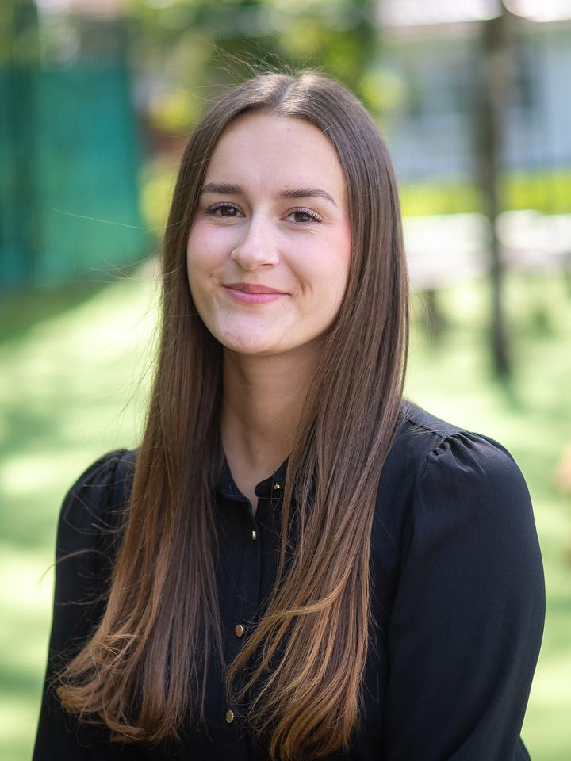
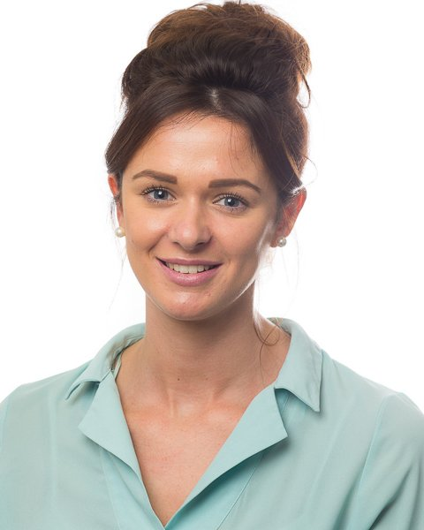

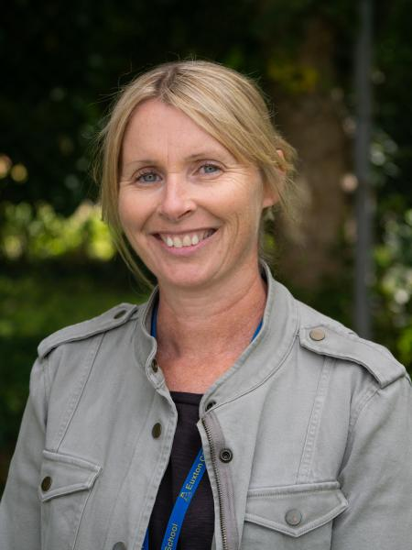
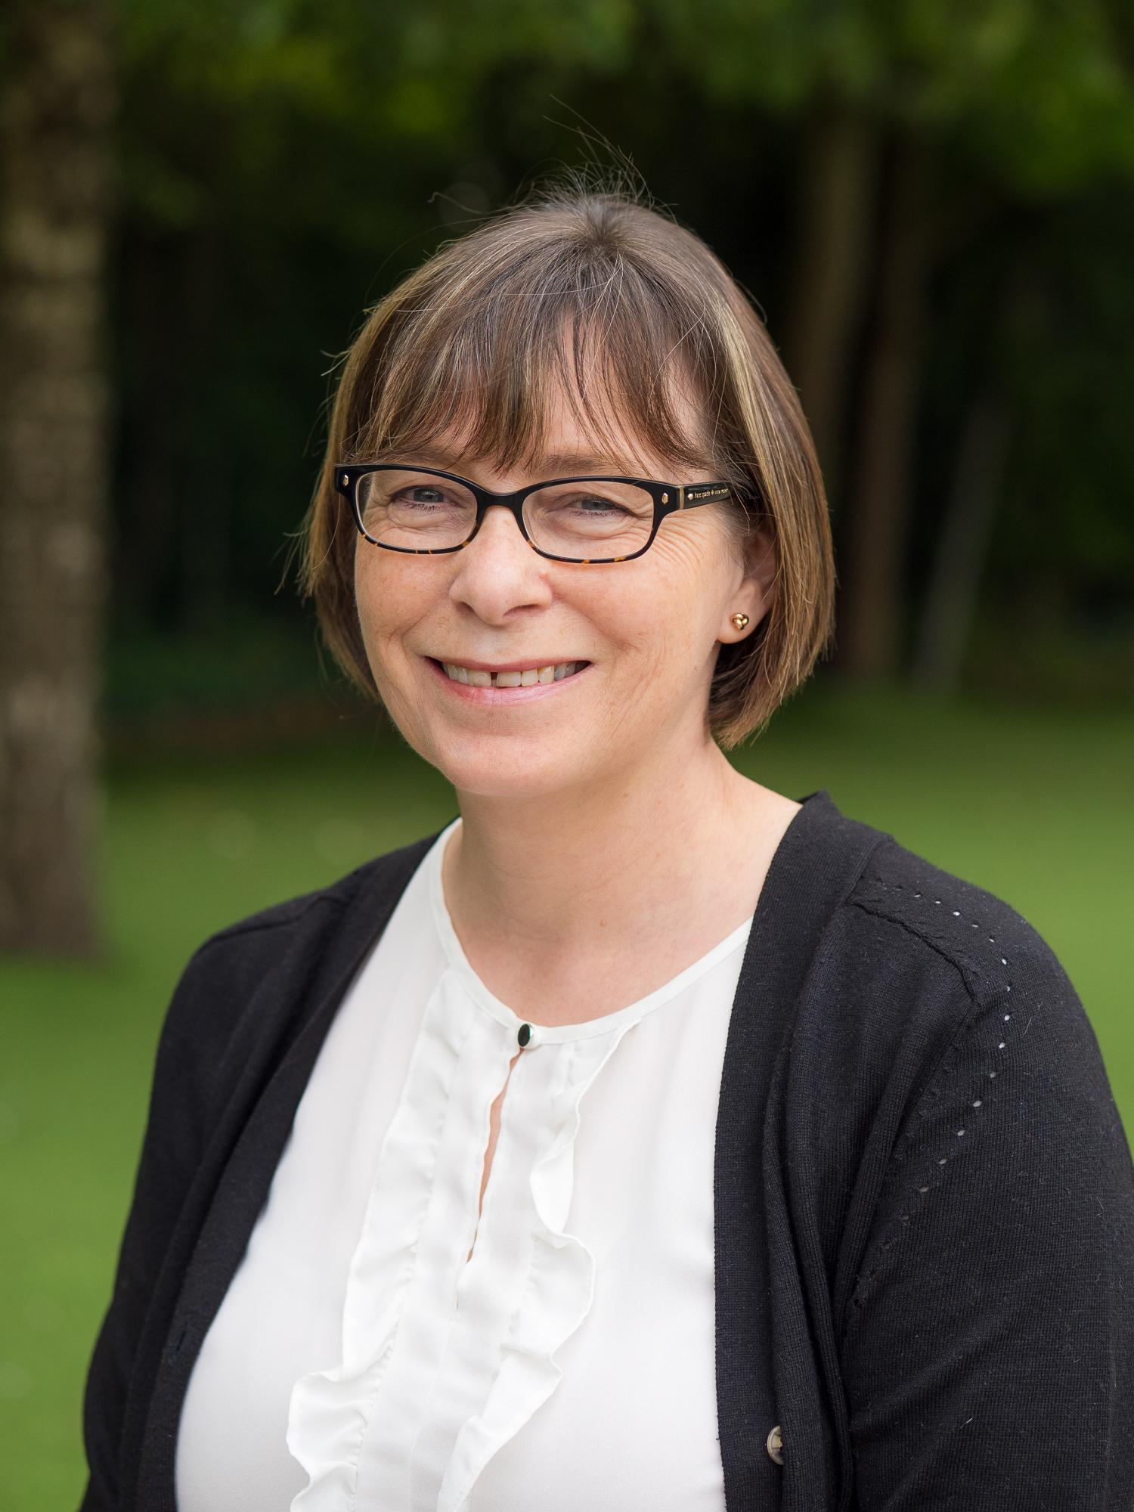
Mrs Wiles &
Miss Haydock
Class Teachers
Mrs Tattersall
Mrs Kelly

Slide 3


What you need to know:
Homework will focus on reading, spellings and times tables. It will be set on a Friday via the class blog on the school website. Spelling and times tables quizzes will be given to the children in class on a Thursday.
Reading books can be changed as soon as the children have finished their books. There are no set days. Please send your child with their book each day as we will always try and read with them where possible.
MTC check. This will take place in the Summer term. Children have 25 different multiplication questions and are given 6 seconds to answer each one.

Slide 4
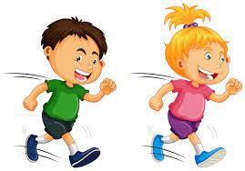
PE
PE kits are to be kept in school. PE days will be a Monday & Wednesday with a different focus on each day.
Children will need to be able to remove their own earrings as they are not permitted for PE lessons.

Slide 5

REMINDERS:
Water bottles can be kept in the classroom and refilled at school when required.
Children can use a backpack for school. Please ensure backpacks are a reasonable size to be able to fit on school pegs in the corridors as space is limited.
All equipment for learning is provided by school. There is no need to bring any pencil cases or pens from home.
Please send your child with a healthy snack should they wish to have one at playtimes. We are a nut free school so please ensure they aren’t bringing snacks with nuts in as we have several allergies.
Please send any medication in your child needs keeping in school.

Slide 6
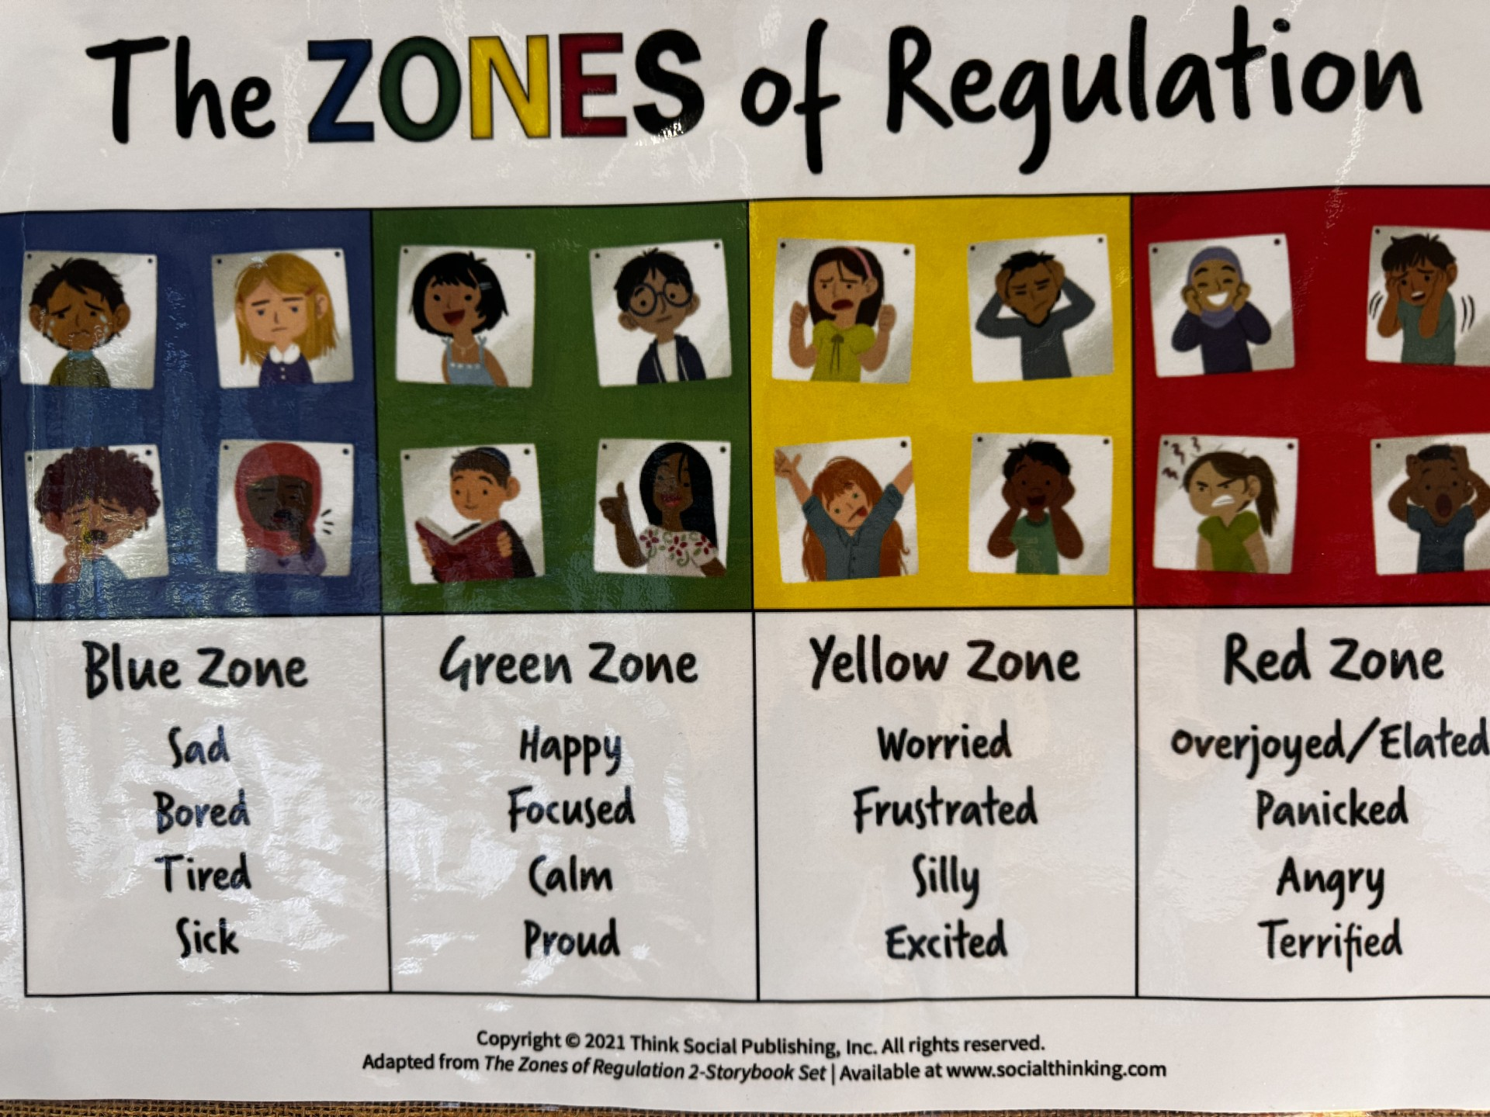
Behaviour policy

Slide 7
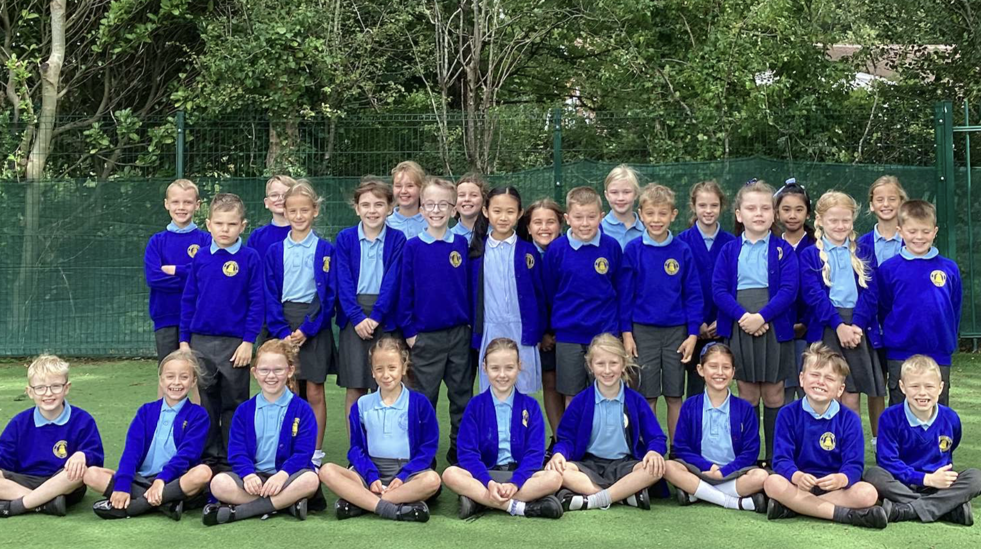
Class Blog

Slide 8
End of the day
Children will be seen out by a member of staff at the end of each day.
children will only allowed home with adults on the safeguarding list on the forms that have been returned to school unless school has been contacted.
ASC: If your child goes to afterschool club, please make them aware of any changes to collections.

Slide 9


