Slide 1

St Austin’s Catholic Primary and Nursery School
‘Welcome to St. Austin's !’
Reception parents meeting
September 2026

Slide 2
Reception Class 2026-27
Headteacher: Mrs. Colette Hickey
Deputy Headteacher: Mrs. Jane Doyle
Assistant Headteacher: Mrs. Alison Kelly

Slide 3
Aims
To welcome you all into our school community
To inform you of key dates
To share essential information to support your child’s transition
To meet some of our key staff members and children

Slide 4
Key People
EYFS Department
Miss McCallion EYFS lead & Reception teacher, Phonics lead and Deputy Safeguarding lead
Mr Hughes Reception class teacher, I.T and computing lead, Forest school lead, Instagram lead.

Slide 5
Mrs. Doyle: Deputy headteacher, Deputy safeguarding lead, Teaching and Learning lead, Assessment lead, KS2 English lead and KS2 teacher.
Mrs. Kelly: Assistant headteacher, deputy safeguarding lead, KS1 lead, Curriculum Lead, Prayer and Liturgy, KS1 English lead, Year 2 teacher.
Mrs. Hughes: Inclusion lead – SEND, Medical , Attendance, Line Manager to Learning Support Staff and KS2 teacher
Office: Miss Waldron, Mrs. Doran & Mrs. Melia
Parish: Fr David Potter
Governors: Mrs. Anna Hosey-Davies, Chair of Governors

Slide 6
Chair of Governors Mrs Anna Hosey-Davies
Vice Chair Mr Ged Gibbons
Head teacher Mrs. Colette Hickey
LA Governor Mr Terry Jones
Safeguarding Governor Mrs. Jaime Dunn
Staff Governor Mrs. Hughes
Foundation Governors Fr David Potter
Mr Pealing
Mrs Keegan
Mrs Culley
Parent Governor Mr Tallant
Parent Governor Mrs. Bouffard- Roupe

Slide 7
St Austin’s Parent Teacher Association
SAPTA
Mrs. Bouffard- Roupe
All new parents/carers are welcome to join!
Please enquire via the office staff

Slide 8
RELIGIOUS EDUCATION
“To know you more clearly”
As we are a Catholic school we follow the Catholic syllabus.

Slide 9
MISSION STATEMENT
‘In our school, where everyone is special, we will love and serve as Jesus taught.’

Slide 10
St Francis of Assisi Church
  Spiritual Development
  Parish priest: Father David Potter
  Children’s Mass: 9.30am –all welcome.

Slide 11
Mrs. Hughes – Inclusion Lead
Senior management team
KS2 class teacher
Special educational needs coordinator
Line manager to learning support staff
Medical and the administration of medicines
Attendance and welfare of children
Early help assessment lead / Team around the family

Slide 12
First day response – School will contact the parent/carer if no message has been left at the office. If still no response we will continue to contact three other contacts provided by the parent.
48-hour sickness rule - If your child has a vomiting or diarrhoea bug please ensure they stay at home, and not return until they have completed 48 clear hours. This is NHS England school guidance.
Attendance and Punctuality – We have excellent attendance
Holidays in term time - are not permitted, as Headteacher I can not authorise this. I have no power to do so!
We have incentives ! These are ……

Slide 13
Special educational needs
Early intervention
Transition- Nurseries
SEN register- SSPs
Support agencies
Trained staff
Meetings with stakeholders
COMMUNICATION

Slide 14
Medical Needs
Any allergies or medical need- care plan
School Nurse - Jenny Doyle
Contact number - 295 9700 Call centre

Slide 15
Key Stage 2 – Year 6 Achievements in 2025
EXP GD
Reading 89% 35%
Writing 73% 13%
Maths 76% 24%
Spelling & Grammar 80% 36%

Slide 16
Reception Information 2026-2027
Please welcome
Miss McCallion and our reception children!

Slide 17
Dates for the diary
Tuesday 1st Sept – INSET training day
Wednesday 2nd Sept – School opens for years 1 – 6
Thursday 3rd Sept – School opens for Reception

Slide 18
First Day At School
Thursday 3rd September 2026
School siblings - 8.45am - 3.10pm
Miss McCallion - 9.00 am - 3.10pm
Mr. Hughes - 9.15 am - 3.10pm
(The above times apply to the first day only, all children will attend school from 8.45am – 3.10pm going forward)
*Please do not bring older siblings on to the key stage one playground with reception children

Slide 19
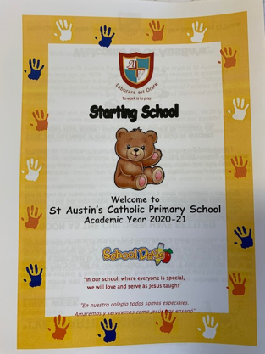
St Austin’s EYFS Curriculum
Parents/carers will receive a booklet
“Starting School.” Please talk to your child over the summer holidays about their class teacher and the items they will need to begin their educational journey.

Slide 20
AT ST AUSTIN’S, WE PRIDE OURSELVES ON HOW SMART OUR CHILDREN LOOK IN THEIR UNIFORM.
Our Winter Uniform
Grey long trousers/shorts/skirts/pinafores
White shirt
Maroon V-neck jumper/cardigan ( no logos)
Maroon/Gold tie
Grey or maroon socks/tights (no white socks – summer uniform only)
Black plain school shoes
Maroon blazer (optional)
School waterproof coat (optional )

Slide 21
Our Summer Uniform
Pink & white checked dress
Maroon cardigan
White socks
Black shoes
Open neck white short sleeved shirt
Maroon jumper
No tie
Black shoes

Slide 22
P.E. Kit
Black shorts (not cycling shorts and no logos)
Plain white top (no logos)
Pumps
In Key Stage 2 the children can wear school tracksuits on PE days.

Slide 23
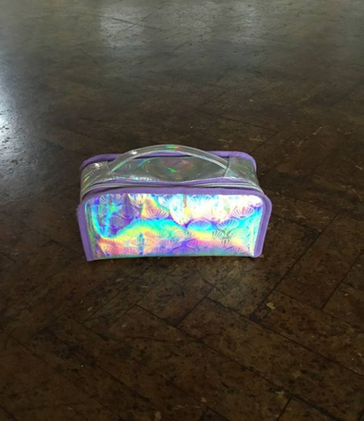
LUNCHTIMES
For lunchtime we ask that your child’s lunchbox is easy to open as children are encouraged to be independent in their self-care. A zip fastened lunchbox is fine.

Slide 24
UNIFORM : Earth Uniform
Parents/ carers can purchase school bags, reading book protector bags, ties, book bags, water bottles, coats and P.E bags through the school office every day up until our last day which is 23rd July 2026.
We are open on the INSET day – 1st September

Slide 25
Health School Award
Milk – all Liverpool schools use a private company which parents/carers must apply directly to if they wish their children to have milk each day. The payment is made directly to the dairy. School receive a register.
Parents only pay once their child turns 5. Under 5s still need to be registered or they won’t receive milk.
www.dairylink-uk.com
Fruit – this is free for all EYFS and KS1 children. A healthy snack can be brought to school if your child wishes.

Slide 26
READING
Reading is one of our school priorities.
Mrs Kelly: KS1 English Lead

Slide 27


Slide 28


Slide 29
ESSENTIAL FORMS
WE WILL NEED …
Pupil medical information
Reception information and consent for short notice visits to our local area
Photographic Images and Digital consent for website/ Instagram
Electronic communication via parents emails
Equal opportunities monitoring for the LA
Emergency Contact numbers (we need 3 contact names)
(If you have not yet completed your forms please see the school office as you leave )

Slide 30
Breakfast & After School Club
Breakfast Club Times: 7.45am – 8.45am
Cost £4 per session
After School Club Times: 3.15- 5.45pm
Cost £12.50 per session

Slide 31
Universal School Meals
All children who start reception class will be eligible for a free school meal. Once in Key Stage 2, parents/carers will need to pay for a hot dinner.
However, all children have the option to bring a packed lunch.
Pupil premium eligibility and expanded FSM
Parents who are in receipt of Government benefits may be eligible for free school meals beyond Year 3. In addition to your child receiving a free school meal school will also receive extra funding. For our school. This allows free school meals to continue whilst at St Austin's school. Please check with our office staff if you think you are eligible and need assistance to complete out the necessary forms.

Slide 32
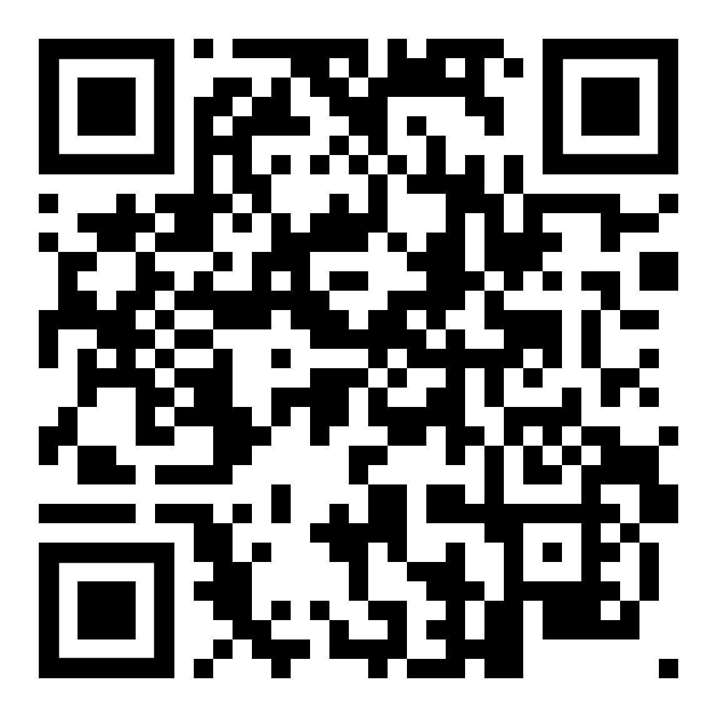
Universal School Meals
Liverpool.gov.uk

Slide 33
“The extent to which pupils contribute to and benefit from the Catholic life and mission of the school is outstanding. Pupils and staff clearly embrace the distinctive Catholic identity and mission of their school. They are proud of it! Their outstanding sense of belonging is tangible. Pupils recognise their uniqueness and are committed to following the teachings and examples of Jesus. They have respect for themselves and for each other. They are active participants in school events and do so with purpose and conviction, feeling it is their duty to seek opportunities to serve others.”
Catholic Inspection Report - January 2023

Slide 34
“This is a friendly and welcoming school. Pupils, including children in the early years, arrive each morning smiling and ready to learn. Parents and carers appreciate that their children benefit from the school’s nurturing environment. Pupils have positive relationships with each other and with staff.”
Ofsted Inspection Report - October 2023

Slide 35
If you have any questions, please email school
enquiries@st-austins.co.uk
F.A.O of the EYFS team
Mrs. Kelly – KS1 Lead
Mrs. Hughes – SENCO
Please check our website and your emails continuously.

Slide 36
CommunicatioN
Staff communicate with all parents/carers through the following sources:
School Website
www.st-austins.co.uk
School ParentAPP is moving to ArborapP
Newsletters
Instagram @staustinsschool

Slide 37
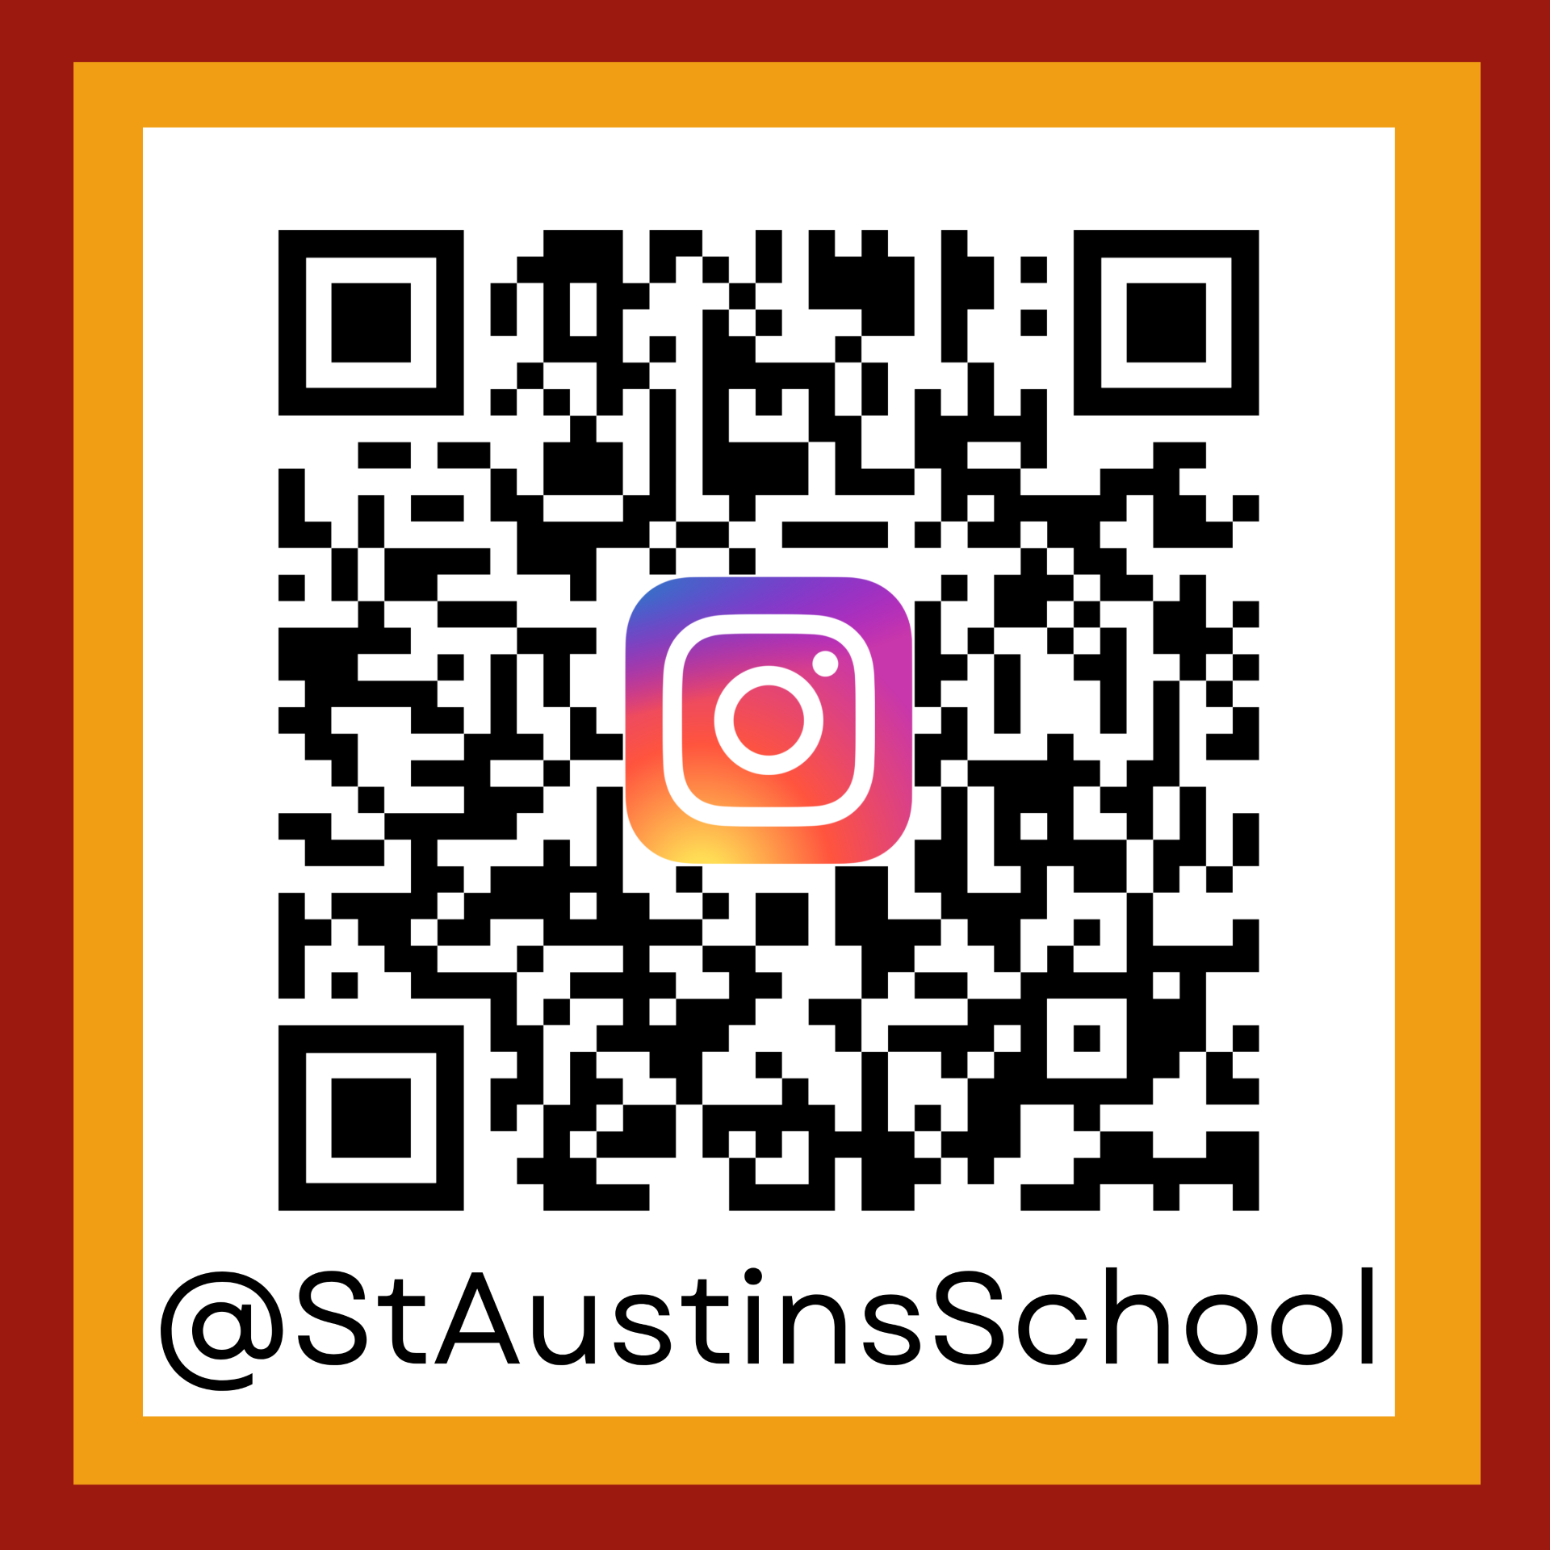

Slide 38
Reception Class 2026 - 27
Any Questions ?

Slide 39
Thank You!
Mrs Colette Hickey
Headteacher

