Slide 1
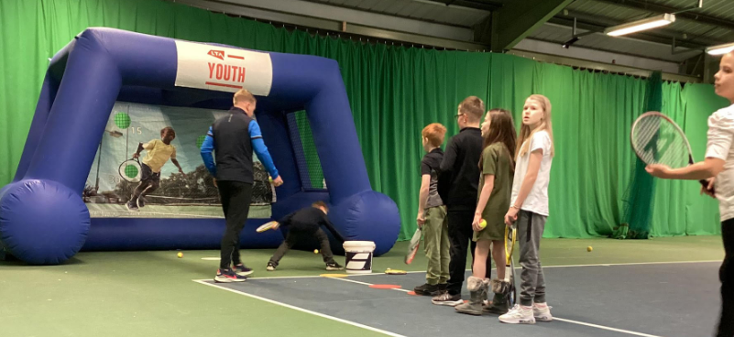
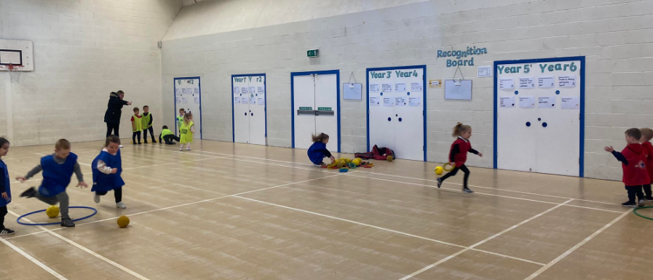
PE at Rock Ferry

Slide 2

Last Years Positives of PE
HMI Inspector
  “Physical education has a high profile at Rock Ferry. Pupils regularly take part in inter-school sporting competitions. The range of sports on offer provide ample opportunities for pupils to develop their interests and talents. I saw enough evidence during this visit to support leaders’ views that the teaching of physical education at this school is a particular strength.”
Wirral School Games - Platinum Award
  This is the highest award you can gain, and we are the first school in our cluster to gain this award.
High level of attendance at clubs/fixtures and events
All KS2 children went on an outdoor adventurous activity trip
We won 4 different competitions; Tag Rugby at Birkenhead Park, Basketball at The Hive with Liverpool Foundation, Dodgeball Finals with Wirral School Games and Boccia with Wirral School Games. We also represented Wirral at the Merseyside Finals for Dodgeball and Boccia.

Slide 3
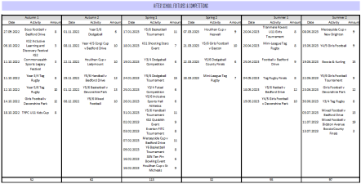
Last Years After School Clubs & Fixtures
Last year, we had 57% of children on our additional needs register attending extra curriculum competitions and events, not just clubs, which is an amazing achievement for our school, as so many of these children come under our targeted groups of girls, pupil premium, SEND and behavioural issues.

Slide 4
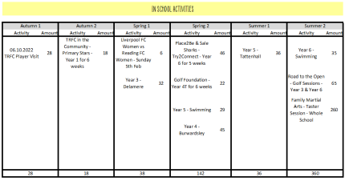
Last Years In School Activities
During this school year, we have had external agencies including The Hive, Tranmere Rovers FC in the Community, Liverpool FC Foundation, Everton FC in the Community, Sale Sharks Foundation, Birkenhead Rugby Club, Golf Foundation, Panathalon and Family Martial Arts. These external agencies have helped improve the participation of pupils through sessions and competitions to improve the children's physical literacy and skills.

Slide 5
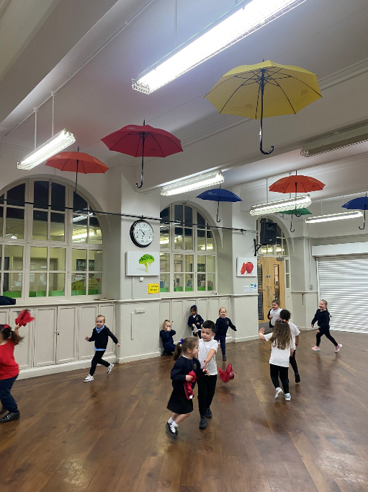

PE Curriculum
Beyond the Physical
Intent
Beyond the Physical Scheme of Learning forms an integral part of the our school Curriculum that is inclusive and engages all pupils, in a supportive and challenging environment. The holistic Scheme of Learning aspires for all children to acquire, develop and master their fundamental movement skills; to further their knowledge and understanding of Physical Education concepts and principles and develop their overall competence, to enjoy, and excel in, a broad range of physical activities.
The holistic nature of the Scheme of Learning not only allows for children to succeed and master the physical skills associated with Physical Activity but will teach children through cognitive and social domains allowing them many opportunities to cooperate and collaborate effectively as part of a team and compete appropriately against others, adhering to the principles of fairness, sportsmanship and respect.

Slide 6
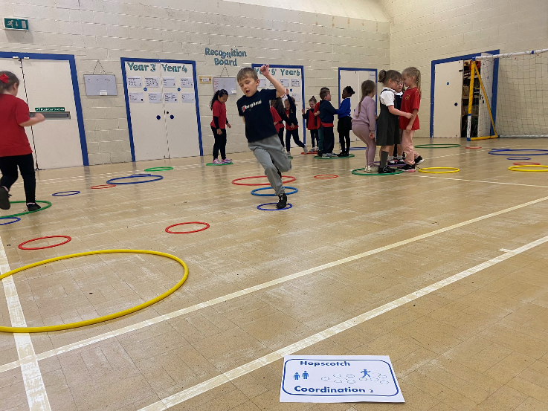
PE Curriculum
Beyond the Physical
Implementation:
Through the high-quality delivery of our Scheme of Learning in a P.E. lesson you will see:
High-Quality activities that engage all children to have success and master fundamental skills
Opportunities to work independently and collaboratively, sharing ideas, strategies and feedback
Opportunities for children to progress their learning at their own level through STEP principle
Effective use of AfL strategies including high-quality questioning to assess learning
Developing Cognitive and Social domains – going Beyond the Physical skills and attributes
Knowledge of the journey that the lesson will take the children on within future P.E. lessons.

Slide 7
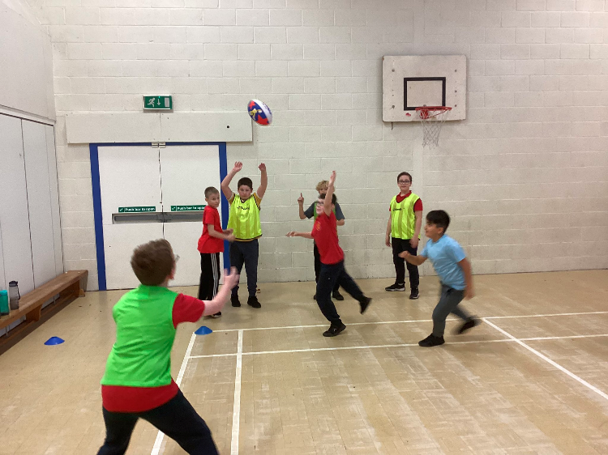
PE Curriculum
Beyond the Physical
Impact:
Our scheme of learning ensures that the PE curriculum is inclusive and progressive and allows all children the opportunity to acquire, develop and master fundamental skills, gain knowledge and understanding of key concepts and provide opportunities that will foster a life-long love and participation in Physical Activity and Sport. All children will show a higher engagement within curriculum PE and wider Physical Activity and School Sport.

Slide 8
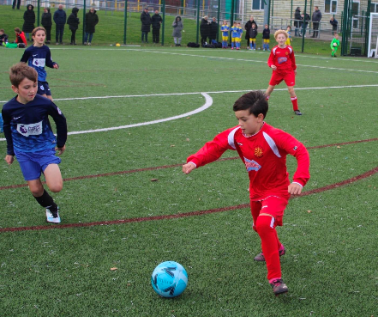
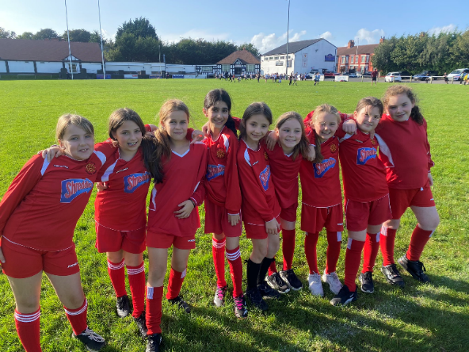
After School Clubs & Fixtures
So far in the Autumn term, we have ran several extra curriculum clubs, they have included:
  Yoga every morning
  UKS2 Girls Football
  UKS2 Boys Football
  Year 1 Multi Skills
  Year 2 Football
  Junior Duke Award
We have also been to several fixtures this term too. Which include:
  Girls and Boys Football
  Dodgeball
  Basketball
  Futsal
So far this year, we have had 45% of children on the additional needs register participate in sporting clubs, fixtures and events and around 48% of the pupil premium children.

Slide 9
Extra Curricular Events
As well as the children attending clubs and fixtures we have also attended events to support children’s learning, well being and social communication with others.
This term we have attended an Inclusive Tennis session at Bidston Tennis Centre, we have worked with Wirral School Games to provide year 2 and a select group of children a Christmas Fun Fest yesterday, our annual Santa Dash will be ran on Friday and next week 6ML will be going to a SEN ten pin bowling session to work on communication and confidence.

Slide 10

Junior Duke Award
To encourage independence, confidence, resilience and self-motivation, we are now running our own Junior Duke club after school, for 20 select children. We will be learning valuable life skills that will support our children's lives.
The children have loved this so far and all completed their cooking badge and will now continue to complete all 10 activities set for us. This includes, first aid and calling for emergency help, learning British sign language, mopping floors, taking electricity meter readings and even walking to our local shop to buy things we may need.

Slide 11
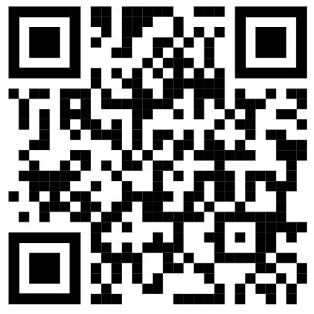
Plans for The Year
Gain our AfPE Quality Mark Award for the strength and quality of Physical Education, School Sport and Physical Activity in our school
Have a greater uptake of clubs, fixtures and events for all of our children, including targeted groups (SEN & PP)
All KS2 children to have the opportunity to go on another outdoor adventurous activity trip again.
Follow our school PE Twitter for regular updates, if you don’t already!

