Slide 1
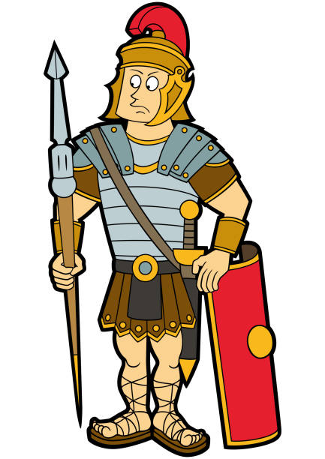


Year 4 – Learning From Home
Writing
Tasks will be put up on LbQ that are relevant to this term’s topic, go to lbq.org/login and put in the code that will be on Class Dojo in the morning.
Escape From Pompeii – narrative about the eruption of Mount Vesuvius and escaping Pompeii
Music
teamtutti.org
Start your music lessons at home from week 1!
PSHE
Calm box homework. Check Class Dojo for the instructions.
PE
Go on to Youtube and search for activities from,
Cosmic Kids Yoga
Go Noodle
#This is PE
Art
Roman Shields and mosaics
Spanish
Duolingo.com
Quizizz.com
Spring – Romans
Here is some guidance for learning from home should your child need to isolate for any reason. You can upload any work the children have done onto their portfolio on Class Dojo. This learning all links to what your child would be doing in class.
Reading
Tasks will be put up on LbQ that are relevant to this term’s topic, go to lbq.org/login and put in the code that will be on Class Dojo in the morning.
Adventures in Ancient Greece Home Learning Unit of work
Maths
Tasks will be put up on LbQ that are relevant to this term’s topic, go to lbq.org/login and put in the code that will be on Class Dojo in the morning.
White Rose Lessons
As always, children can access TTRS to keep their tables up to date. Just get in touch if your child has forgotten their log in details. Head to ttrockstars.com
History
Romans
Sequence timeline
Roman Gods
British Resistance – Boudicca
Roman Myths
Computing
If you have a laptop, search for dance mat typing on BBC Bitesize.
Alternatively, head to
code.org/
Complete the course we have subscribed to.
Science
Tasks will be put up on LbQ that are relevant to this term’s topic, go to lbq.org/login and put in the code that will be on Class Dojo in the morning.
Create volcano looking at chemical reactions and reversible and irreversible changes

