Slide 1

What makes a healthy mind and why does it matter?
Half of how we feel comes from our genes- what we are born with.
10% comes from what is happening in our lives
The rest -40% we can learn to control. Which is great news!
Feeling happy makes us feel good. It helps to keep our immune system strong. This helps to keep us from getting ill.
This Photo by Unknown Author is licensed under CC BY-NC

Slide 2

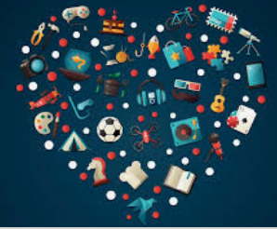

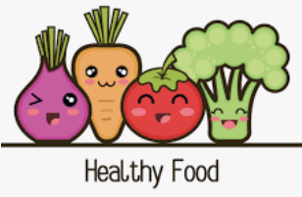
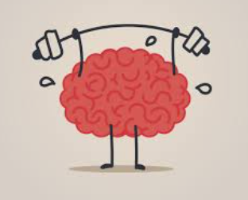

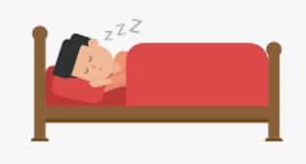
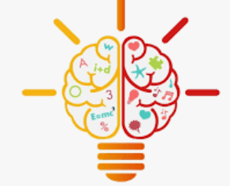
Brain Breaks
Staying Active
Connecting with people
Quality Sleep
Learning something everyday

Slide 3
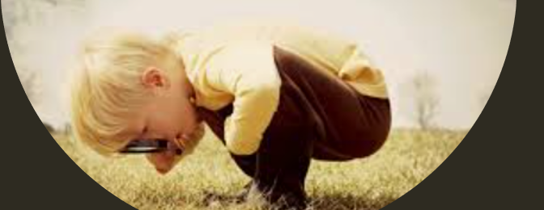
Brain breaks –Starts with noticing your breathing. Taking longer slower breaths.
Brain breaks or mindfulness is about being in the present, not worrying about things that have happened or might in the future.
Be curious.
Let yourself think about what you are doing right now. Noticing your thoughts and feelings about what is in front of you.
You can imagine your safe place or see what is happening around you.
Spending time on our hobbies is a really good way of giving ourselves chance to feel peaceful, calm and happier.
Sorry but computer games don’t work so well for brain breaks. Fun though they are! They tend to help you escape from the moment rather than live it.
What do you enjoy?
Brain Breaks

Slide 4
Increased blood flow in the brain means that your mood is lifted. A chemical called serotonin is released which helps us with our feelings of wellbeing and makes us feel happier. It also helps with sleeping and digesting our food.
Exercise helps to increase your blood flow throughout your body, it helps to take away chemicals the brain doesn’t need.
Exercise helps to build our brains by increasing levels of a protein (BDNF). It helps our brains to grow!
Try to get moving an hour a day or more! This can be broken down into shorter chunks through the day.
Do something you love such as running, football, gymnastics, dancing.
Staying Active

Slide 5
Our brains are the hungriest part of our body!
It needs lots of healthy food to help with memory and concentration. Healthy food contains important nutrients such as vitamins. These include eggs, fish such as salmon and mackerel; and vegetables (especially green ones).
High fibre food such as wholegrain/brown rice, pasta and bread help with brain skills such as developing thinking and reasoning. So we can use things we have learnt to solve problems.

Slide 6
It’s fun to stay up and bedtime comes round far too quickly but unfortunately getting enough sleep is SO important for our brains.
When we are asleep our brains keep busy, it’s a chance for all your new memories and things you have learnt to be stored for when you need them.
Your brain is busy organising your thoughts, making sense of new experiences so when you repeat them you know what to do!
Experts tend to agree you need about 10 hours at least per night. When we don’t get enough sleep we find it hard to concentrate, learn and get along with others.
Sleep repairs and re-energises our brains and our bodies.
Quality Sleep

Slide 7
We all deserve to be listened to and understood, this makes us feel wanted and cared for. Research shows relationships and having people who care about us is one of the most important things in making us happy. When you feel alone talk to people who care about you.
Have you ever tried to talk to someone who wasn’t really listening- how did it make you feel?
It is important to remember we all belong, we are all important, we must take talking and listening in turns, and encourage each other.
Listening to a friend or family member with our ears, eyes and full attention makes them feel good. These might seem like small things but they have a powerful effect.
Listening and looking out for each other is one of the loudest forms of kindness.
Connecting with people

Slide 8
Challenges, making mistakes may not seem to be good for our brains at first but mistakes make our brains grow.
The more things we learn the more connections (neural pathways) are made. Scientists have looked at the activity in our brains and found that when we stick with things, our brain can stretch and grow so hold more ideas and information.
Learning something everyday

