Slide 1

Phonics Meeting for Parents
​​

Slide 2
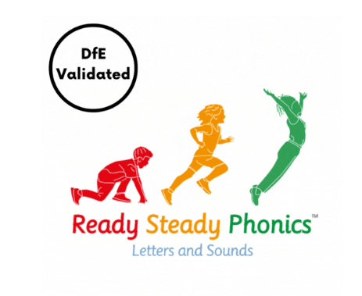
Why teach phonics?
Phonics helps children to develop good reading and spelling skills.
The ability to read and write is a vital skill for all children, paving the way for an enjoyable and successful school experience.
We use a systematic synthetic phonics approach
called “Ready Steady Phonics”.

Slide 3
What is synthetic phonics?
Synthetic Phonics is a way of teaching reading. It focuses on the use of pure sounds.
Children are taught to read letters or groups of letters by saying the sound(s) they represent – so, they are taught that the letter s sounds like s when we say it.
Children can then start to read words by blending the sounds together to make a word.

Slide 4

Some Definitions
Phoneme
This is the smallest unit of sound in a word. A phoneme can be 1, 2, 3, or 4 letters long
How many phonemes can you hear in play?

Slide 5

Grapheme
This is a letter or group of letter that represents a sound. A grapheme can be 1, 2, 3, or 4 letters long, such as 'i', 'sh', 'igh', or 'eigh'.

Slide 6
A phoneme you hear
A grapheme you see
One sound can have alternative spellings eg 'c' (cat), 'k' (kit), 'ck' (pick), or 'ch' (chemist)
One spelling can have alternative sounds eg 'o' can represent words like "odd," "no," and "to"

Slide 7
Graph (1 letter): Most common, such as 'c', 'a', and 't' in the word cat.
Digraph (2 letters): Two letters representing one sound, like 'sh' in ship, 'ch' in chip, or 'oa' in boat.
Trigraph (3 letters): Three letters for one sound, such as 'igh' in light or 'ear' in hear.
Quadgraph (4 letters): Four letters representing a single sound, like 'eigh' in eight (sounding like /ai/) or 'ough' in though (sounding like /oa/).

Slide 8
Extended Code
Once the children are competent with the initial code they begin the extended code, this is the point at which the alphabet code becomes more complex.

Slide 9
Extended Code
Through the extended code, the children learn that –
Some sound symbols (graphemes) represent more than one sound ( ‘ea’ in steak, bread, sea)
Many sounds (phonemes) can be represented by more than one grapheme (ie spelled in more than one way
for example ay, ea, a-e, ai)

Slide 10
Phonics Assessment: Year 1
In June (w.c. 8th June 2026) majority of Year 1 pupils across the country will take a ‘phonics screening check’.
The aim of this check is to ensure that children have confidently learnt to recognise all 40+ phonemes, and that they are able to blend and segment appropriately. These are vital reading skills.
Y2 children who did not pass in Y1 will also re-sit the check during the same week.

Slide 11
What does the screening check look like?
The screening check takes approximately 10 minutes to administer per child and is done 1:1 with their teacher in a quiet room. It is very similar to the tasks that the children already complete during their daily phonic lessons.

Slide 12
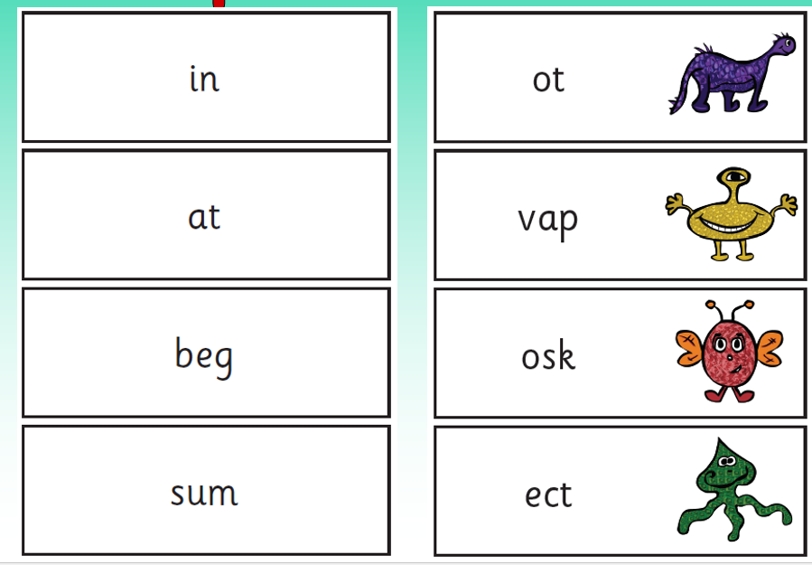
Children are presented with a range of ‘real words’ and ‘pseudo words’ to sound out and read e.g.
To prevent confusion/’normalising’ the word, the pseudo words are introduced as alien names. The children are asked to read the names of the aliens, and the pictures of the aliens are on the card.

Slide 13
The children are given a practice set of 4 real words and 4 pseudo words to read before the check starts, so that they understand what they need to do.
The children are told whether the word is a real word or an ‘alien name’ (also highlighted by the presence of alien pictures!) before they attempt them.
The words start off easier (e.g. CVC structure) so that most children can access them. This makes it stress-free for the pupils.
They are encouraged to sound aloud and blend the word in order to read it. Children may write sound buttons under the words. If they do not blend the sounds (phonemes) together, they cannot be awarded the mark.

Slide 14
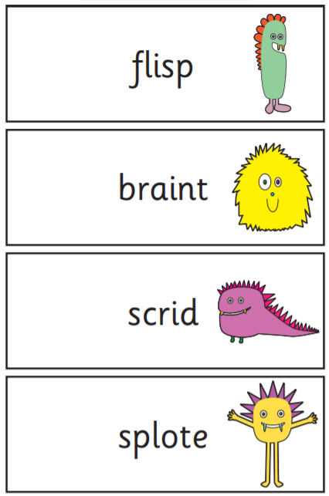
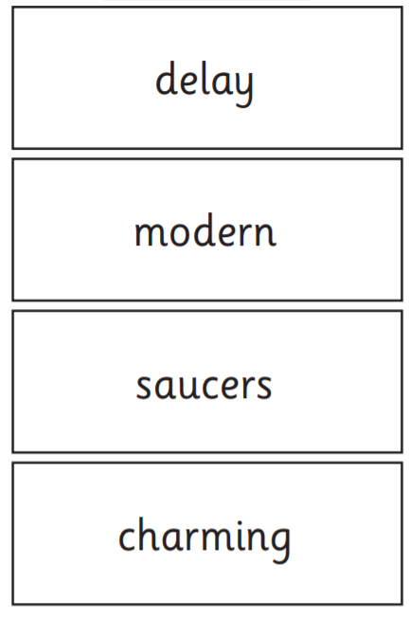
Some examples from previous years

Slide 15
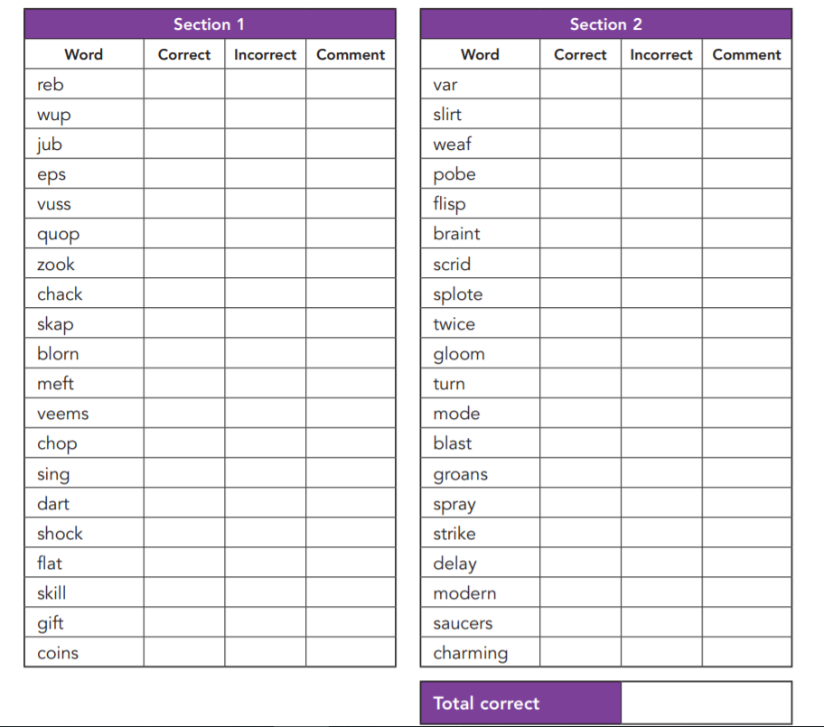
The pupil’s final answer is the answer which is recorded. Accents are considered as the teacher will know your child and how they pronounce each sound, so do not worry!
Your child’s teacher will record their answers on a sheet which looks like this:
We note down your child’s attempt and analyse any common mistakes, so that we can fill any gaps in your child’s understanding in future phonic lessons.

Slide 16
The check is there to help us recognise any gaps in your child’s phonic knowledge, and to show their fluency when reading and decoding words. We like to see it as a useful tool!!
Will I know if my child passed?
Parents will be informed as to whether their child passed the screening check in our end of year reports. We will not know a pass mark until it is released nationally in the summer, so cannot tell you before then.

Slide 17
How do we get ready for the phonics check?
The children are taught phonics daily.
The children read in a group or 1:1 with a teacher or a teaching assistant.
We do some practice papers with the children, so they are familiar with the check.
Children who have gaps in their phonics have a daily intervention called precision teaching.

Slide 18
How can you help at home?
Use the sound mats and say the sounds daily.
Read daily, encouraging your child to sound out unknown words, ask is it a digraph? Is it a split digraph?
Use the phonics play game, play with your child ensuring they are sounding and blending. Target sounds they struggle with.
PhonicsPlay - Phase 5 Resources
Use ict games.com
Poop Deck Pirates
Mr T’s Phonics on youtube has short videos
Mr T's Phonics – YouTube
Twinkl have some free resources
Precision teaching
John Taylor's Freebies

Slide 19
Any questions?

