Slide 1
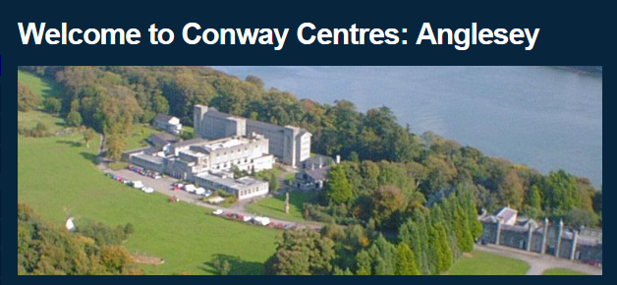
Wednesday May 20th – Friday 22nd May 2026

Slide 2
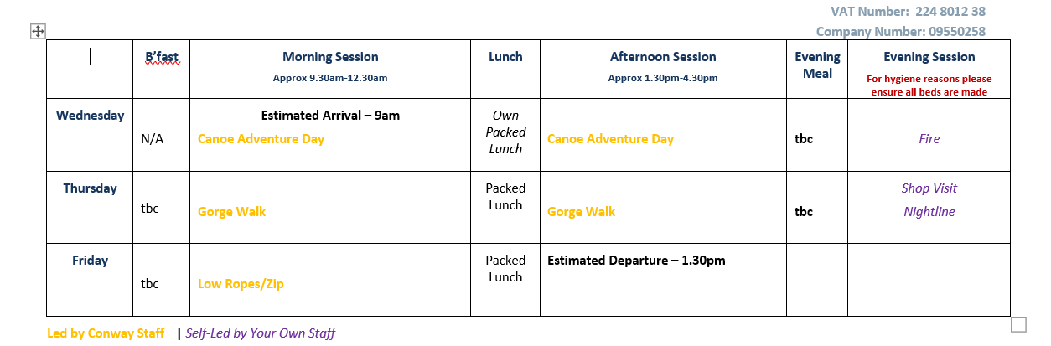

Slide 3
In the summer term children in Year 6 will take SATs papers. Year 6 SATs will take place the week beginning Monday 11th May. These tests in English and maths will reflect the national curriculum not just from year 6, but test what has been taught in Key Stage 2. They are externally marked.

Slide 4
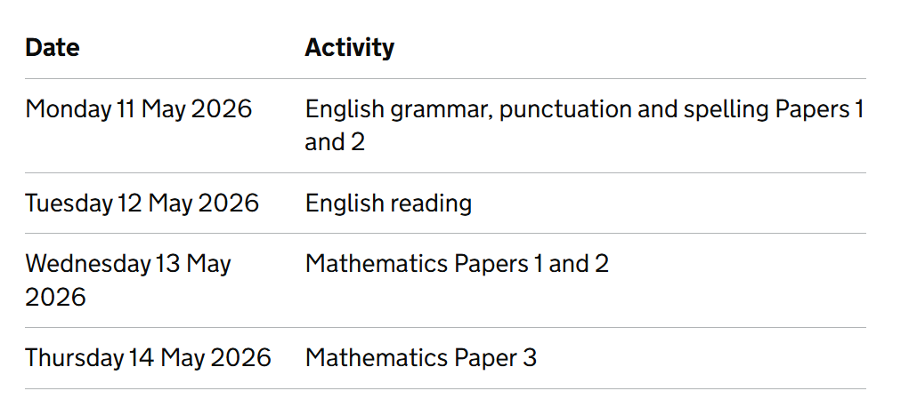
Key Stage 2 SATs.

Slide 5
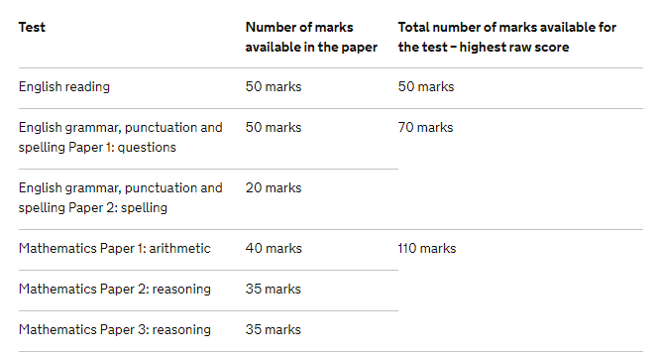

Slide 6
You will be given your child’s raw score (the actual number of marks they get), alongside their scaled score and whether they have reached the national average.
The scaled score ranges from 80 – 120
The average score is 100, if a child doesn’t meet 100 they will be recorded as HNM (has not met the end of Key Stage Standard).

Slide 7
Grammar, Punctuation and Spelling
The grammar, punctuation and spelling test will consist of two parts: a grammar and punctuation paper requiring short answers, lasting 45 minutes and a spelling test of 20 words, lasting around 15 minutes.
The grammar and punctuation test will include two sub-types of questions:
Selected response, e.g. ‘Identify the adjectives in the sentence below’
Constructed response, e.g. ‘Correct/complete/rewrite the sentence below,’ or, ‘The sentence below has an apostrophe missing. Explain why it needs an apostrophe.’

Slide 8
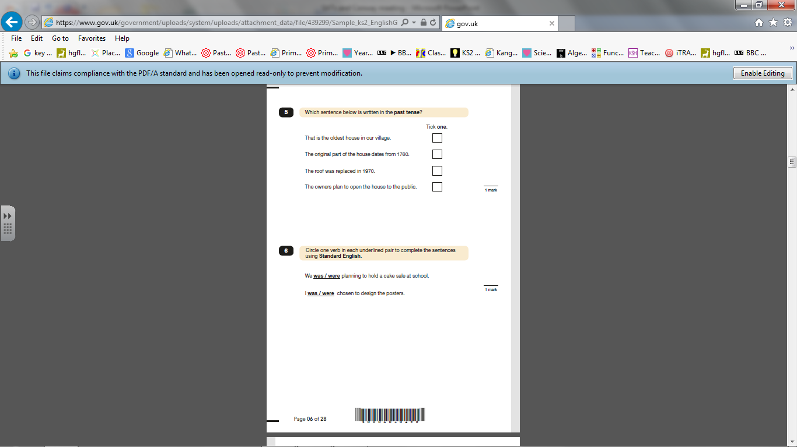
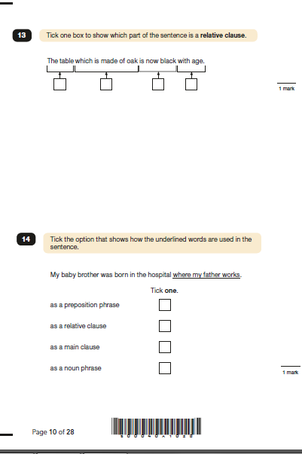

Slide 9
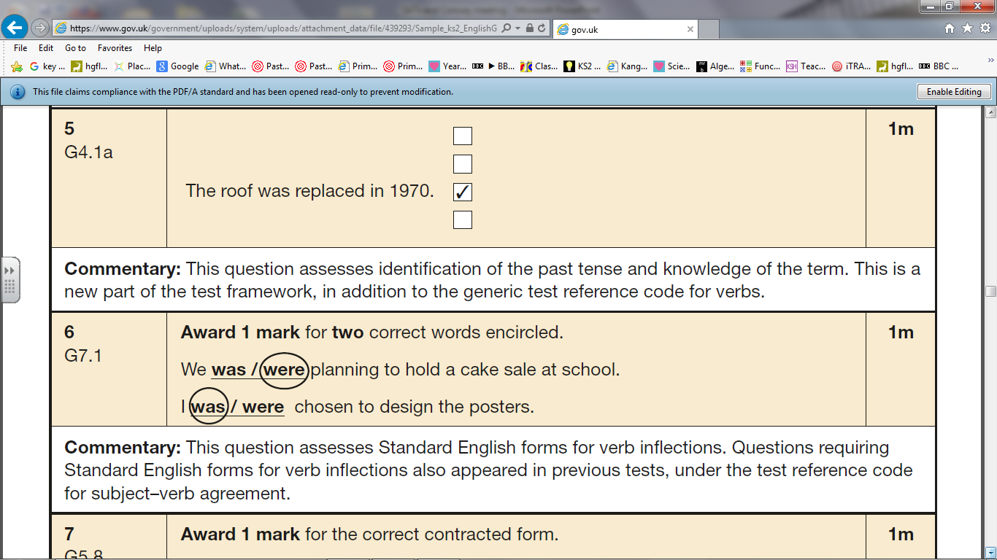
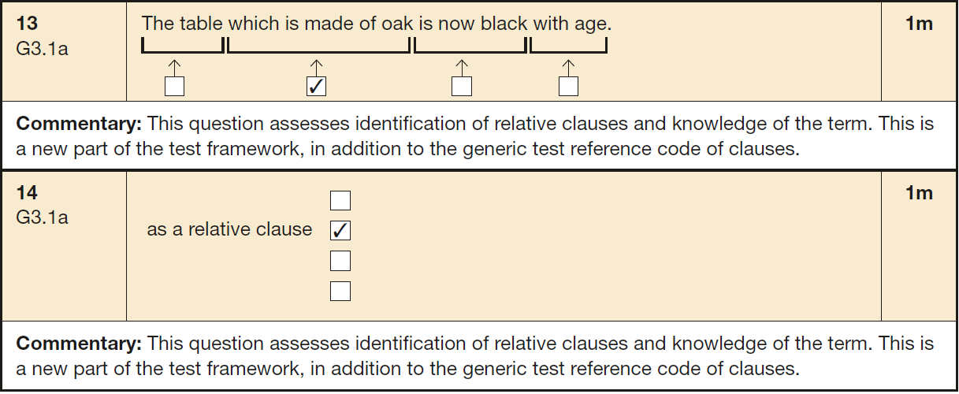

Slide 10
Reading Test
The reading test will be a single paper with questions based on three passages of text. Your child will have one hour, including reading time, to complete the test.
There will be a selection of question types, including:
Ranking/ordering, e.g. ‘Number the events below to show the order in which they happen in the story’
Labelling, e.g. ‘Label the text to show the title of the story’
Find and copy, e.g. ‘Find and copy one word that suggests what the weather is like in the story’
Short constructed response, e.g. ‘What does the bear eat?’
Open-ended response, e.g. ‘Look at the sentence that begins Once upon a time. How does the writer increase the tension throughout this paragraph? Explain fully, referring to the text in your answer.’

Slide 11
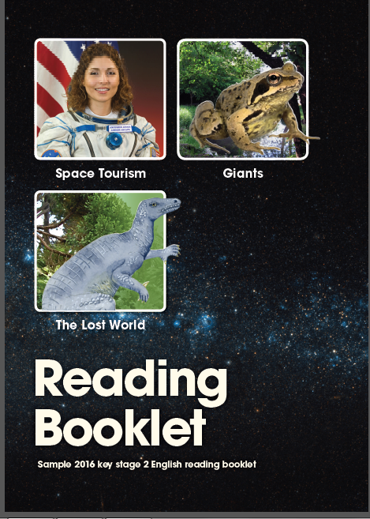

Slide 12
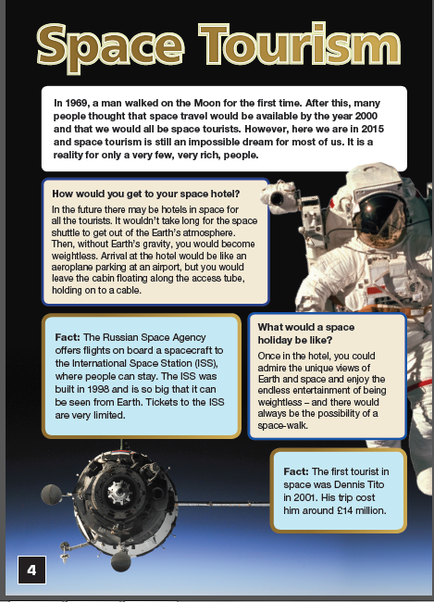
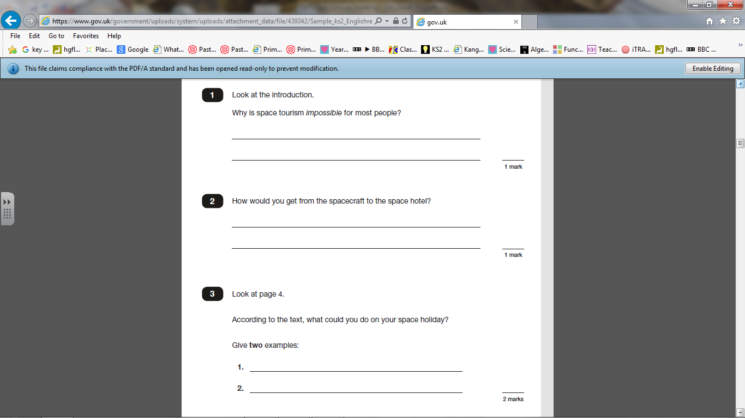

Slide 13
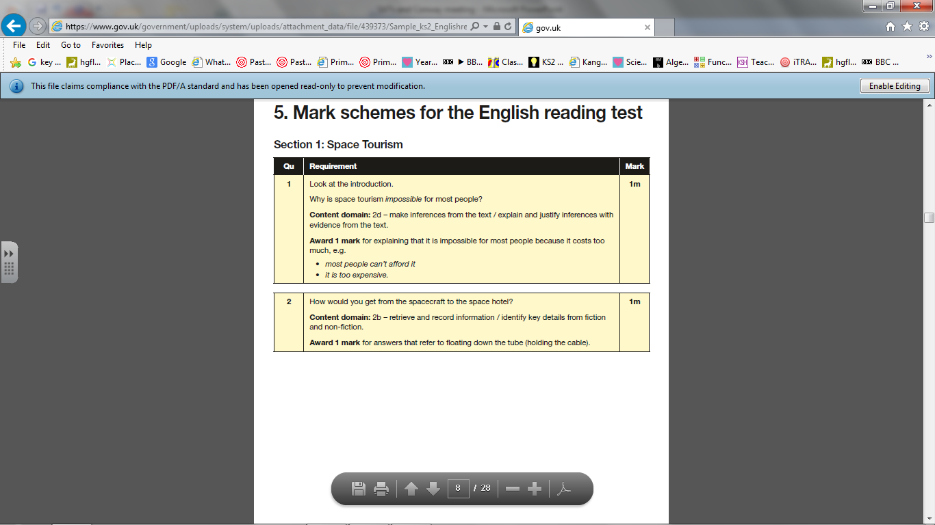
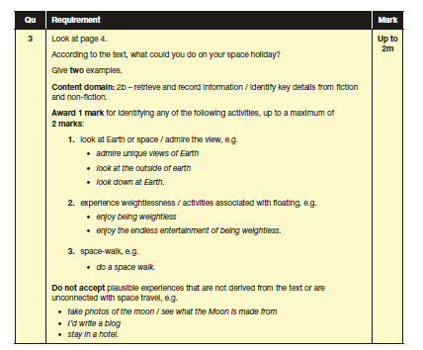

Slide 14
Writing
There is no test for writing, teacher assessments are made from writing in all subject areas, they have to consistently be achieving each objective.
Moderation takes place throughout the year between schools and some schools are moderated in May.
All the children have writing targets so they know how to improve their writing. Feedback and marking also shows them how to improve.

Slide 15
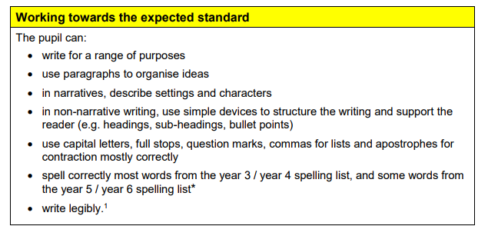

Slide 16
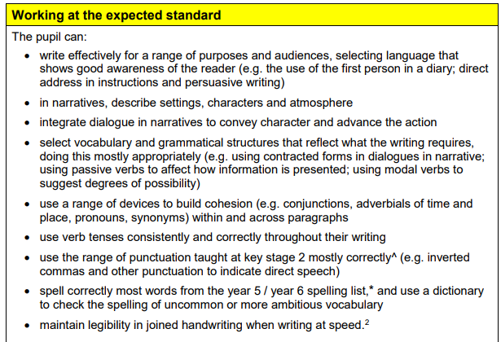

Slide 17
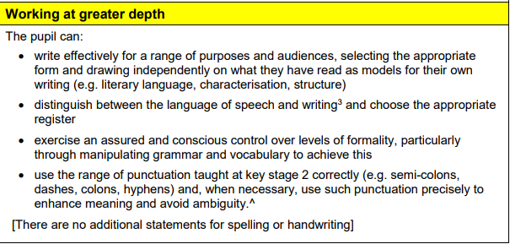

Slide 18
Maths Test
Children will sit three papers in maths:
Paper 1: arithmetic, 30 minutes
Papers 2 and 3: reasoning, 40 minutes per paper
Paper 1 will consist of fixed response questions, where children have to give the correct answer to calculations, including long multiplication and division.
Papers 2 and 3 will involve a number of question types, including:
multiple choice, true or false, giving the answer to a calculation, drawing a shape or completing a table or chart.
The children will have to explain their approach for solving a problem and in some cases explain how they know.

Slide 19
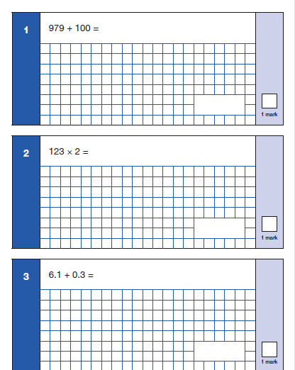
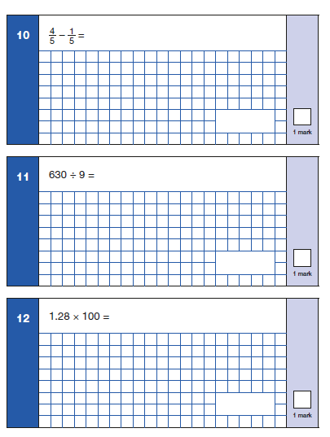
Because this is a timed test, knowing times tables will help.

Slide 20
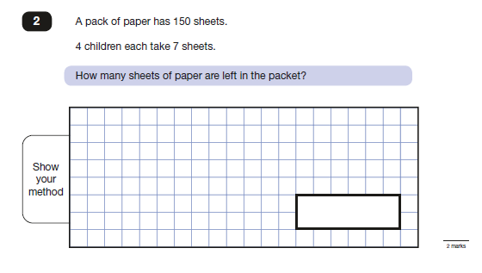
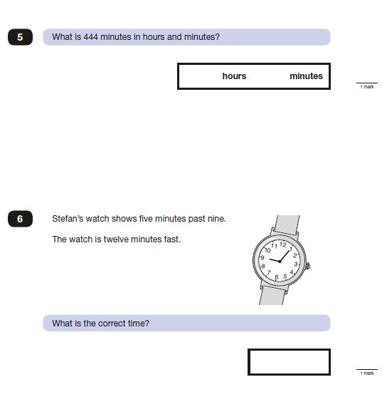
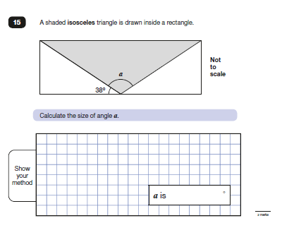

Slide 21
How can you help?
Support with homework.
Talk to the children about their learning.
As we get closer to May doing extra work at home.
Revision books £7.90 for 3 revision books.
Order open now, closes next Wednesday.

Slide 22
