Slide 2

Review of the last academic year (2024/2025)
Question | Stats: | Further context Relative to local challenges
What percentage of your current Year 6 cohort can swim competently, confidently and proficiently over a distance of at least 25 metres? | 90% | Many of our children are complete non-swimmers and only swim when they go with school.
What percentage of your current Year 6 cohort can use a range of strokes effectively [for example, front crawl, backstroke, and breaststroke]? | 60% | As above
What percentage of your current Year 6 cohort are able to perform safe self-rescue in different water-based situations? | 69% | Use this text box to give further context behind the percentage.
If your schools swimming data is below national expectation, you can choose to use the Primary PE and sport premium to provide additional top-up sessions for those pupils that did not meet National Curriculum requirements after the completion of core lessons. Have you done this? | Yes/No | The data improved by 5.5%
Have you provided CPD to improve the knowledge and confidence of staff to be able to teach swimming and water safety? | Yes/No

Slide 3
Review of the last academic year (2024/2025)

Slide 4
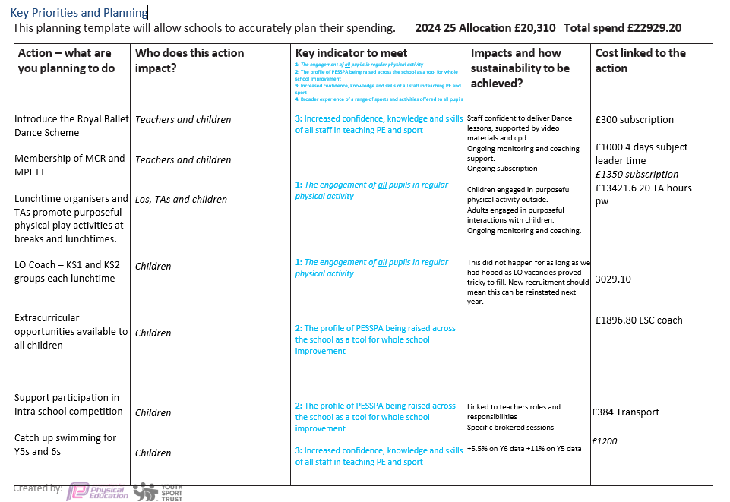

Slide 5
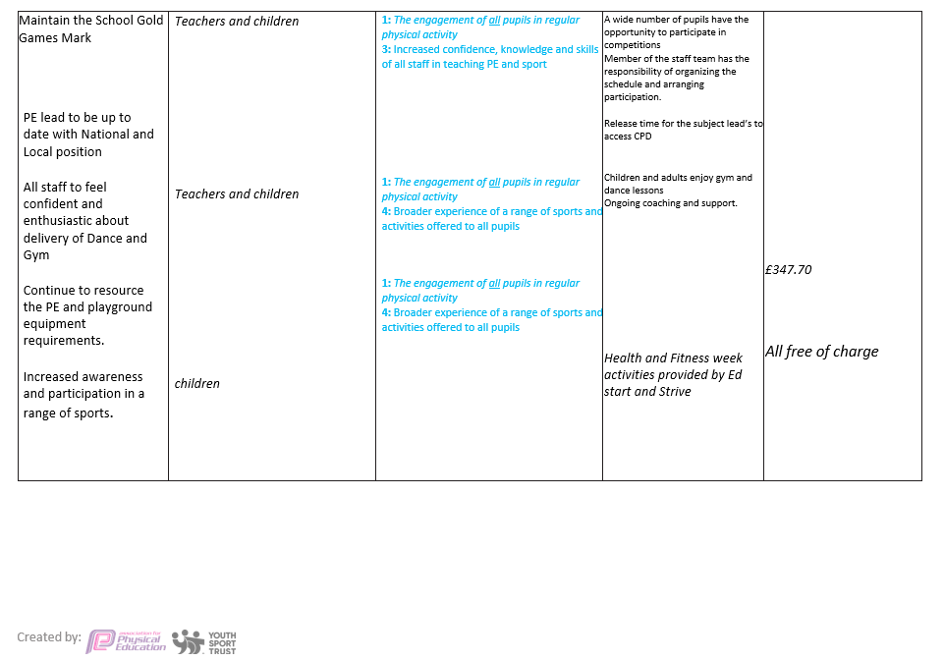

Slide 6
Aims for the next academic year (2025/2026)
Using your whole school priorities, school development plan and previous PE, school sport and physical activity data, set out your aims for the year ahead.
Think about specific areas of need such as inactive girls, SEND and disadvantaged pupils
Remember to also input your swimming data and reflections in the table located at the bottom of this page.
Consider which of the 5 key areas improvements will be focusing on:
Increasing confidence, knowledge and skills of all staff in teaching PE and sporting activities prioritising CPD and training where needed.
Increasing engagement of all pupils in regular physical activity and sporting activities
Raising the profile of PE and sport across the school, to support whole school improvement
Offer a broader and more equal experience of a range of sports and physical activities to all pupils and ensure equal access to sport for boys and girls
Increasing participation in competitive sport
Swimming and Water Safety | What went well? Supporting evidence? | What didn't go well? Supporting evidence?
1. Swim competently, confidently and proficiently over a distance of at least 25m
2. Use a range of strokes effectively (for example, front crawl, backstroke and breaststroke)
3. Perform safe self-rescue in different water-based situations

Slide 7
Allocation 2025-2026: £20,310
Aim | Why? | Key Area | Cost | Supporting evidence
Further develop a Whole-School Structured Active-Play (Break & Lunch) | Increase physical and mental wellbeing of all pupils. Increase participation of SEND and Pupil Premium pupils. Improve staff skills and knowledge. | 1.Increasing confidence, knowledge and skills of all staff in teaching PE and sporting activities. 2. Increasing engagement of all pupils in regular physical activity and sporting activities |  | Staff confidence surveys, pupils attainment data, playtime observations, pupil voice.
Lunchtime Coach – KS1 and KS2 groups each lunchtime. | Increase physical and mental wellbeing of all pupils. Increase participation of SEND and Pupil Premium pupils. | 2: The engagement of all pupils in regular physical activity 4. Offer a broader and more equal experience of a range of sports and physical activities to all pupils and ensure equal access to sport for boys and girls |  | Playtime incident data, playtime observations, pupil voice.
Extracurricular opportunities available to all children | Increase participation of SEND and Pupil Premium pupils. | 2: The engagement of all pupils in regular physical activity |  | Pupil participation data.
Update & Future-Proof PE and Playground Equipment | Safe and engaging equipment; sustained through pupil sports leaders and annual audit. | 2. Increasing engagement of all pupils in regular physical activity and sporting activities |  | Annual audit, pupil voice activities.
Provide regular inter and intra school competition, as well as all pupils accessing inter competitions against other schools. Competition formats to reflect needs of pupils. | To ensure all pupils can access competition in school and outside of school, to encourage all pupils to participate and enjoy these valuable experiences. | 3. Raising the profile of PE and sport across the school, to support whole school improvement 5. Increasing participation in competitive sport |  | Competition formats and planning for all intra lesson level competitions, all inter and intra school competitions hosted at our school and sports day. Competition results, calendar and register of participants.
Strive to ensure all pupils meet the minimum requirement in swimming. | To increase the number of children achieving curriculum requirements by the end of the summer term. | Increasing engagement of all pupils in regular physical activity and sporting activities. |  | Swimming assessment reports and data.

