Slide 1

Hartford Manor Primary School
Supporting Your Child’s Reading at Home

Slide 2
Hints on Pronunciation
3. A moth is not a moth in mother,
nor both in bother, broth in brother,
And here is not a match for there
Nor dear and fear for bear and pear,
And then there’s dose and rose and lose -
Just look them up - and goose and choose.
4. And cord and work and card and ward,
And font and front and word and sword,
And do and go and thwart and cart -
Come come, I’ve hardly made a start!
A dreadful language? Man alive,
I’d mastered it when I was five!
By TSW
1. I take it you already know
Of tough and bough and cough and dough?
Others may stumble, but not you
On hiccough, thorough, laugh and through?
Well done! And now you wish perhaps
To learn of less familiar traps?
2.Beware of heard, a dreadful word
That looks like beard and sounds like bird;
And dead: it’s said like bed, not bead -
For goodness sake don’t call it ‘deed’.
Watch out for meat and great and threat.
They rhyme with suite and straight and debt.

Slide 3
Fluent, independent readers who enjoy reading
Notes:
We are aiming for fluent, independent readers who enjoy reading not endure it. Our teaching approach at Hartford Manor aims to achieve these in a number of ways. The early stages of reading begin with lots of talk, making clear speech sounds and having 2 way conversation. We also model holding a book and reading in a story voice. We encourage them to notice things around them and look for things that are familiar.

Slide 4
When They Start School
The significance of direction
The significance of position
The phonetic code
We learn helpful words such as I, they, the
How to problem-solve by combining the meaning, structure and vocabulary
It feels a bit like this...
Notes:
They have to learn these things. There’s so much to think about and this is how they might feel.

Slide 5
Reading as problem solvers
Fi uoy nac daer siht ylkciuq, neht
uoy era ylbaborp gnileef erom tnedifnoc naht na ylrae redaer. Siht si ylniam esuaceb uoy evah eht egatnavda fo gnisingocer yreve rettel no eht egap.
Notes:
How did they feel. What helped? We approach teaching in the following ways.

Slide 6
How do we teach reading?
Phonics
Guided reading in a small group or whole class
Shared reading as a class
Individual reading

Slide 7
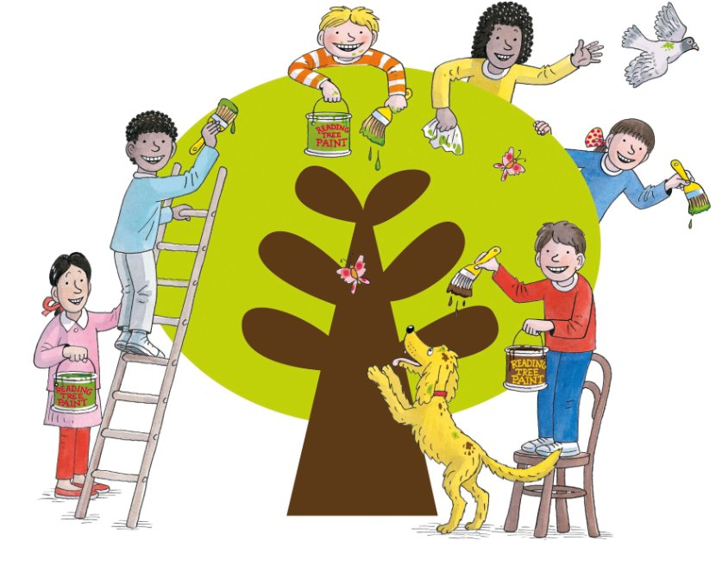
Hartford Manor uses the
Oxford Reading Tree
Floppy’s Phonics programme
By Oxford University Press
and Debbie Hepplewhite
Notes:
How phonics starts in Nursery. Environmental sounds, rhythm, rhyme, singing, chanting, percussion, music, discussion, oral blending and segmenting. At home you can help to train children in their awareness of sounds of speech. Make up games where you are training your child’s ‘ear’ to ‘hear’ the words from the separate sounds – and to break up the words into their constituent sounds. I spy with my little eye something that sounds like c-oa-t, p-e-n

Slide 8
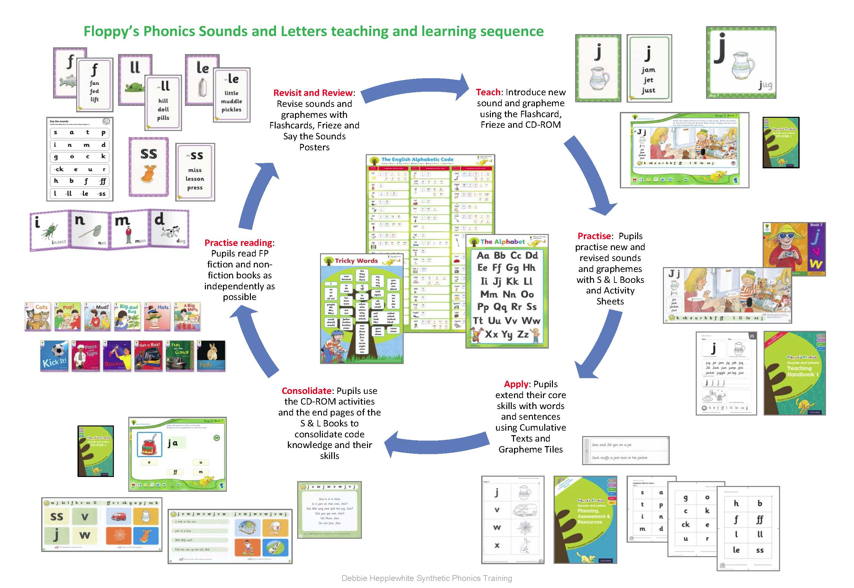
Phonics in Reception and KS1
https://www.oxfordowl.co.uk/api/interactives/32214.html
Notes:
Phonics provision is based on introducing and revising the alphabetic code and the phonics skills through the structure of a teaching and learning cycle or sequence.

Slide 9
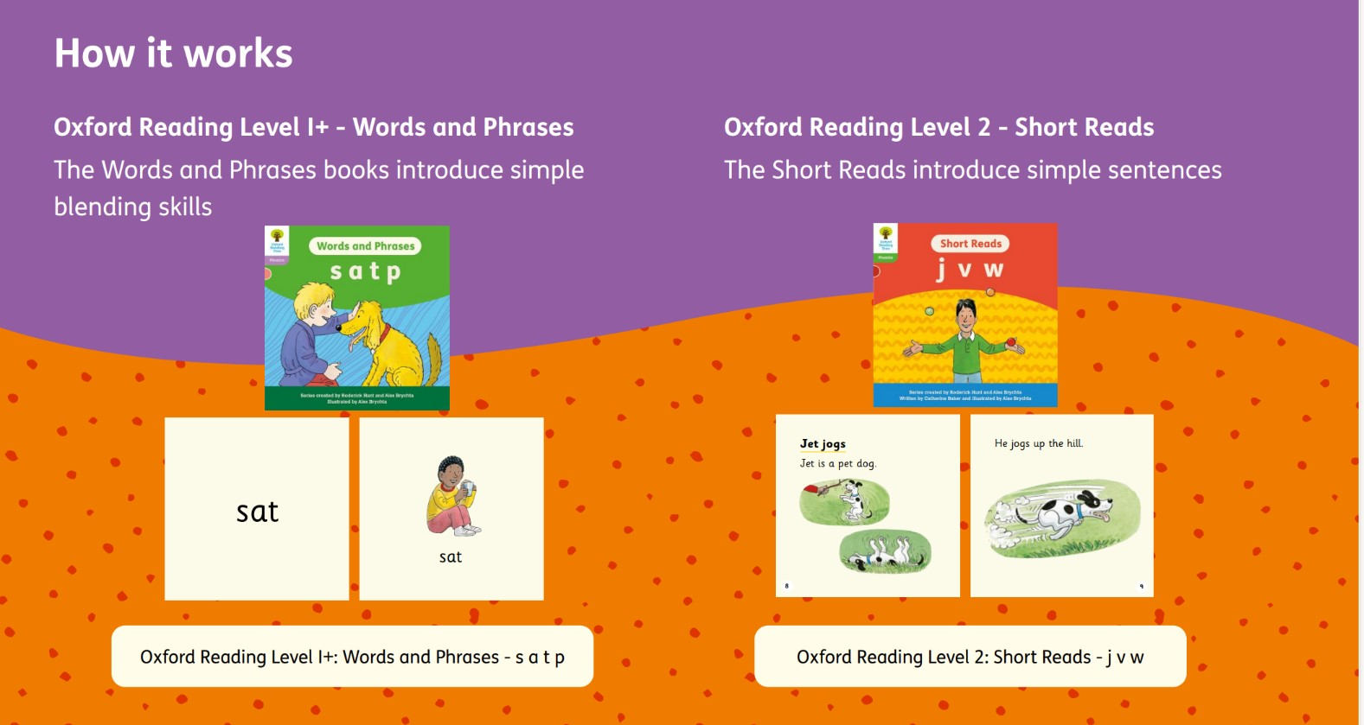
Floppy’s Phonics Reading Books
Cumulative, decodable reading books are read in school then sent home for extra practice. Keep for the week to reread for fluency and comprehension.
Behind the sequence
Notes:
There is also a complete range of cumulative, decodable Floppy’s Phonics fiction and non-fiction reading books to support the Floppy’s Phonics programme.
When these are sent home as children’s ‘reading books’, ensure they lag behind the code being taught in school. Children are tired at the end of the day and home-reading must not be stressful in any way whatsoever.

Slide 10
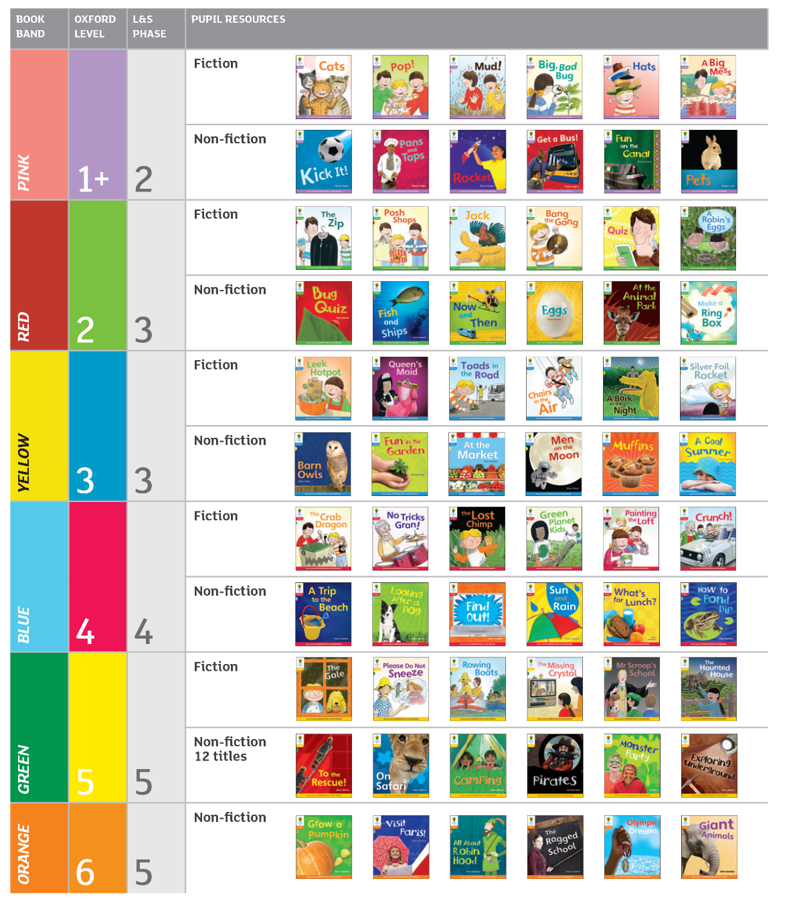
Floppy’s Phonics Fiction and Non-fiction
Notes:
There is also a complete range of cumulative, decodable Floppy’s Phonics fiction and non-fiction reading books to support the Floppy’s Phonics programme.
When these are sent home as children’s ‘reading books’, ensure they lag behind the code being taught in school. Children are tired at the end of the day and home-reading must not be stressful in any way whatsoever.
SHARE PHONICS MATS

Slide 11
Phonetic Code
c oa t
p i c ture
sh ar k
Notes:
Phonemes are taught alongside picture cues. Refer to sound mats on table.

Slide 12
Pronunciation alternatives
We teach the children to be flexible when reading. Graphemes sometimes have pronunciation alternatives:
e.g. Letter ‘a’ can be pronounced:
/a/ as in apple /ai/ as in angel
/ar/ as in father /o/ as in want
Notes:
Refer to Alphabetic Code Chart.

Slide 13
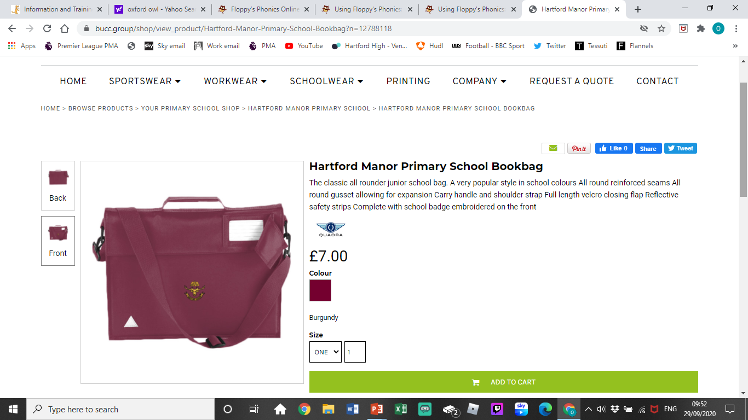
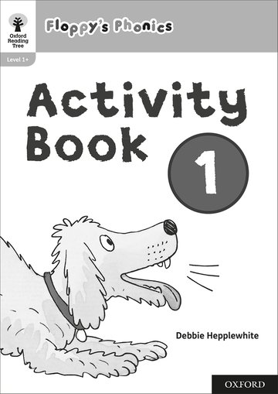
Our bookbag routine
The paper-based resources
are added to your child’s phonics
folder for the bookbag routine.
You can then see and
support some of the phonics
work that takes place in school.
Please return the file/book each
week.
Notes:
Please take an interest in your child’s phonics work. It may be helpful to practise some of it again at home as ‘little and often’ learning helps children to remember.
Give your child plenty of praise for his or her work whatever the level of the knowledge and skill of the child.
If you have any worries about the phonics work, or any questions, please don’t hesitate to contact your child’s teacher.
You can always communicate through your child’s READING RECORD BOOK which is also kept in the bookbag.

Slide 14
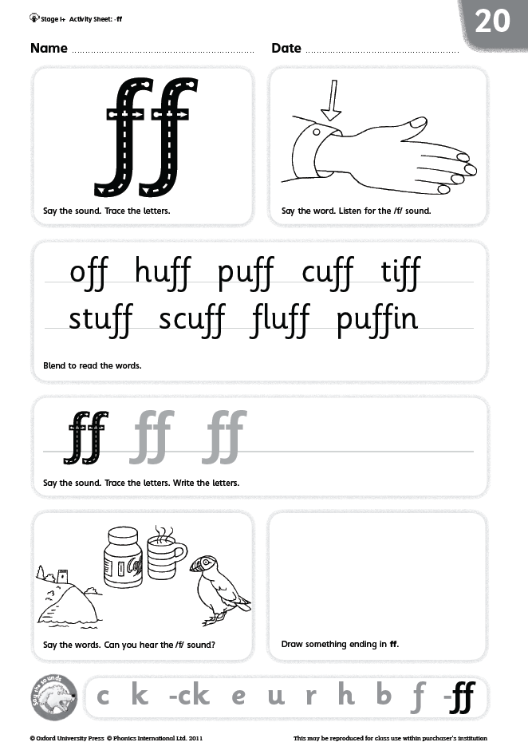
Revisit the Activity Sheets
Notes:
Children are fully trained in the routines they will show you how the sheets work.
Practice reading the bank of words, tracing over the letters, listening for the focus sound.
Please do not complete any sounds not taught yet.

Slide 15
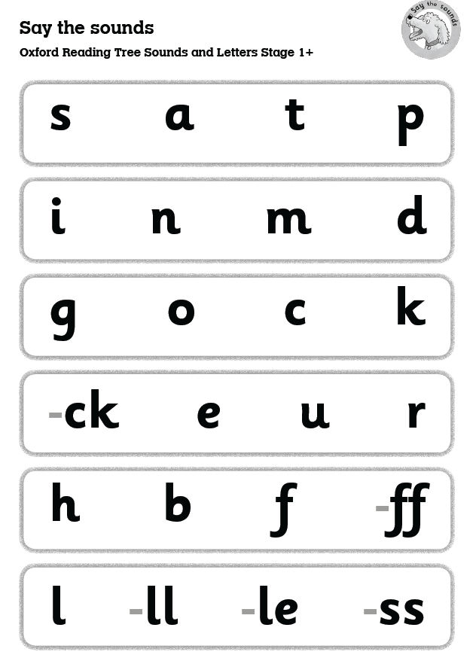
Hear the Sounds
Parent says the sound and
child points to the grapheme
(this is a sub-skill of spelling)
“Which /k/?”
“The /k/ as in cat, the /k/ as
in duck...”
Practice air writing
“Air-write /d/, /h/, /k/.”
Notes:
We can use the Say the Sounds Posters for the sub-skill of spelling too. The adult says the sounds, and the pupils point to the graphemes, or air-write the letters and letter groups.

Slide 16
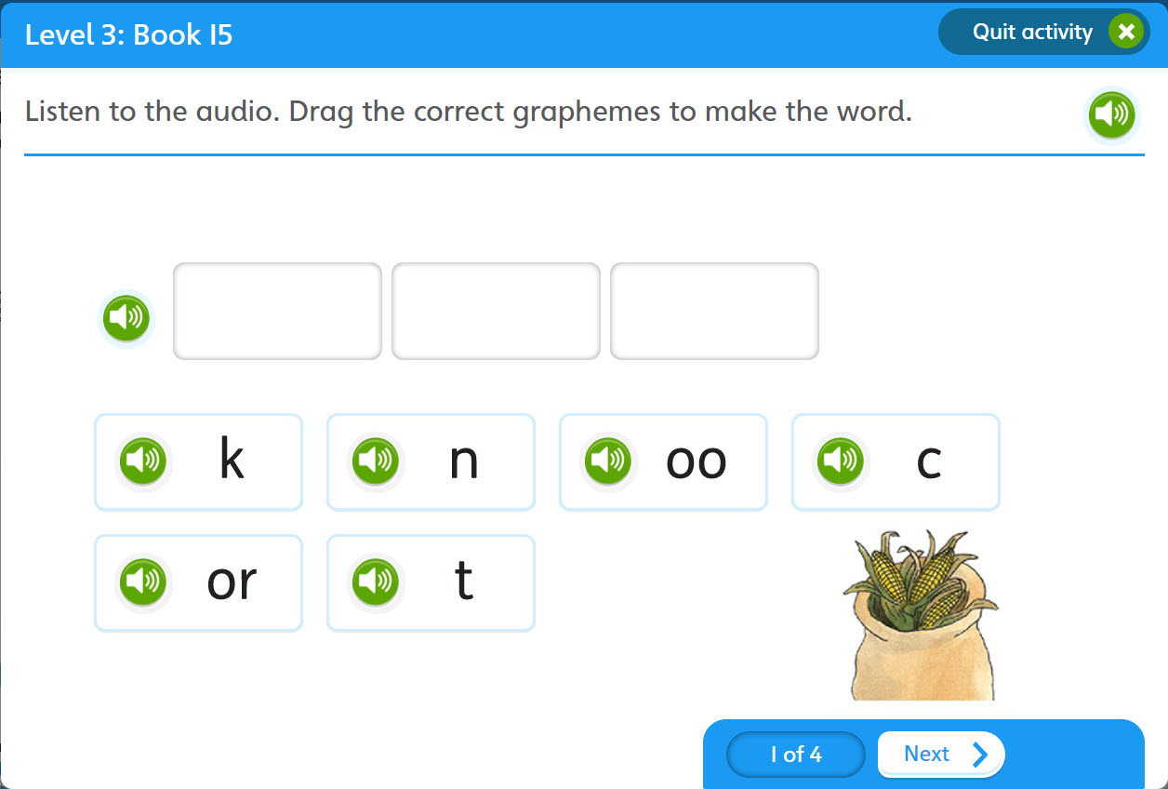
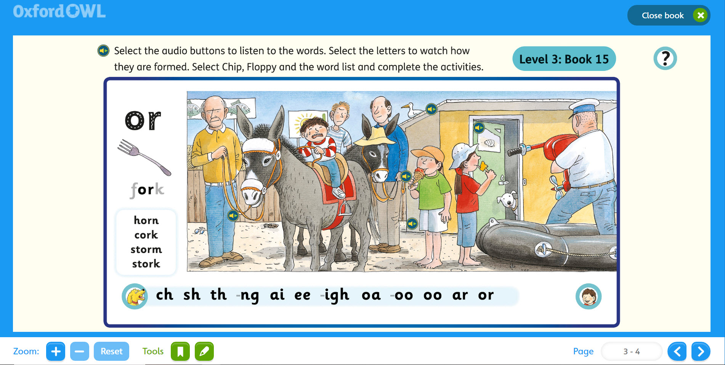
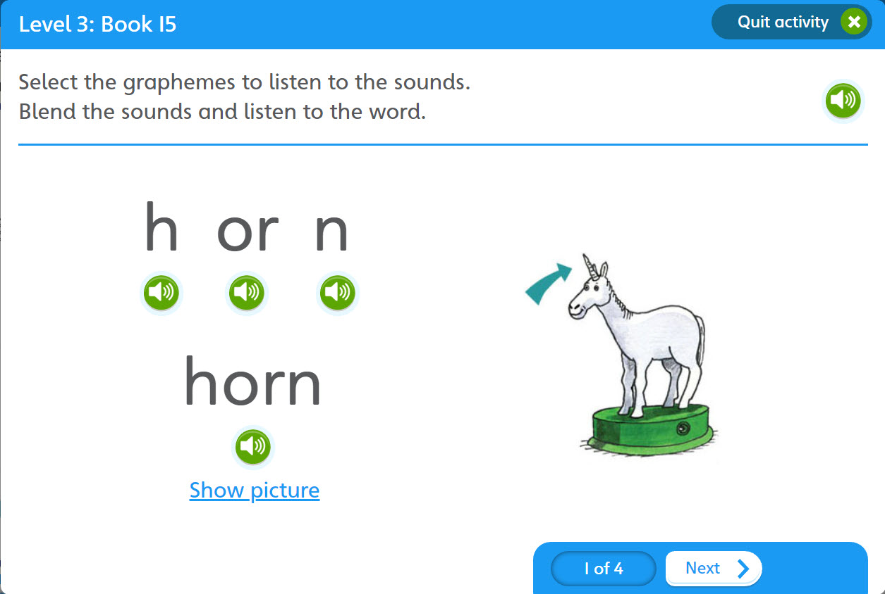
Visit Oxford Owl
Select the letters to watch
letter formation
Drag and drop
for spelling
See the letter/s,
say the sounds
Hear the sounds,
point to the graphemes
Blend and reveal
for reading
Class teachers will provide you with the login details
Notes:
Your child’s teacher will have given you a password to get onto the Extra Practice Zone.
The web-based platform matches the Sounds Books with core phonics skills and their sub-skills.

Slide 17
How To Be a Great Reader
Good letter and word knowledge (phonic knowledge and helpful words by sight)
Pay close attention to punctuation- helps with phrasing
Reading sounds like talking- fluent
Point underneath a word if needed- helps us to focus
Problem-solve independently by using meaning, structure and visual information in combination.

Slide 18
Parent Power!
Model reading
Expect phrasing and fluency
Tap into their thinking- what might they already know
Pen and paper at the ready
Hand responsibility to your child- they hold the book
Keep messages clear and simple eg say the first sound
Familiar reading- allows us to feel good at what we do

Slide 19
Something Familiar
Fi uoy nac daer siht ylkciuq, neht
uoy era ylbaborp gnileef erom tnedifnoc naht na ylrae redaer. Siht si ylniam esuaceb uoy evah eht egatnavda fo gnisingocer yreve rettel no eht egap.

Slide 20
You could try...
Allowing them to point
Quality rather than quantity
Putting your feet up with a good book!
A free eye test
Noticing how well they solve for themselves
Closing your eyes and listening- do they sound like a good reader? Model the reading
Asking questions about the story/information
Reading to them

