Slide 1
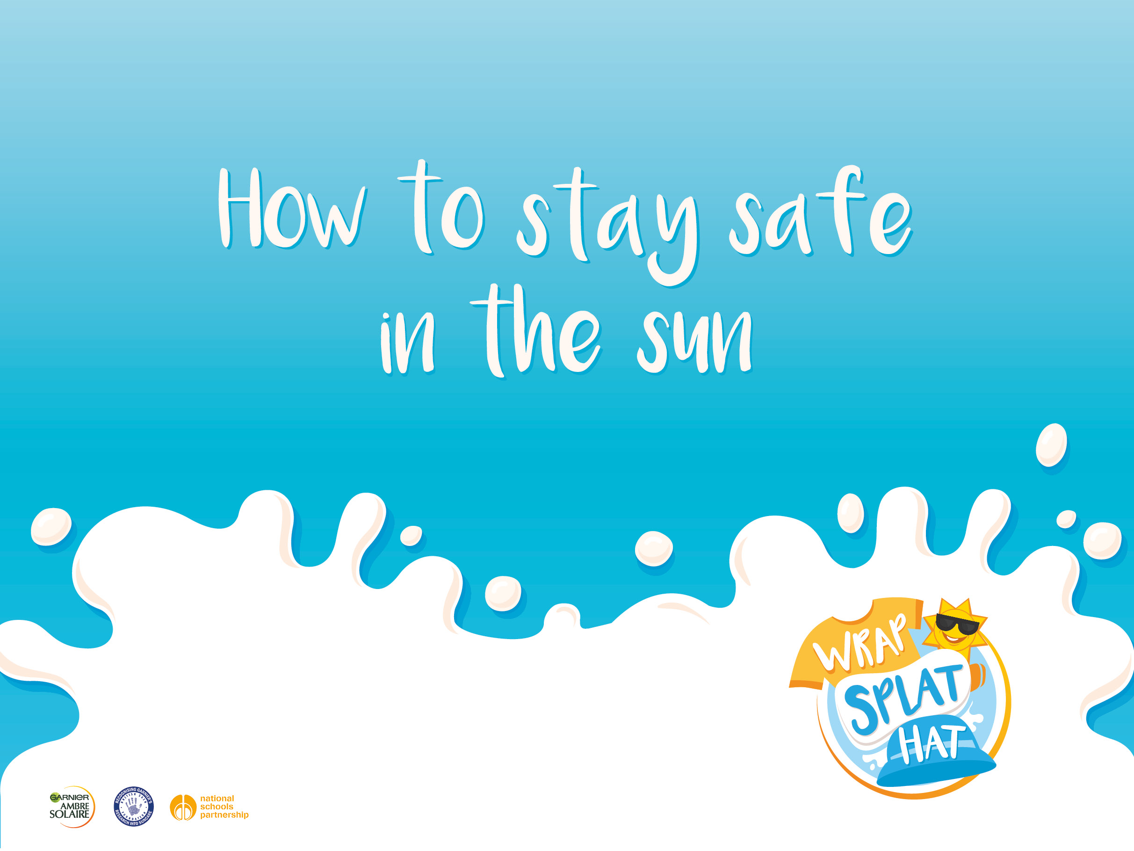
Notes:
This slide can be displayed as the children are waiting for the class or assembly to start, to get them thinking about how they would stay safe in the sun.

Slide 2
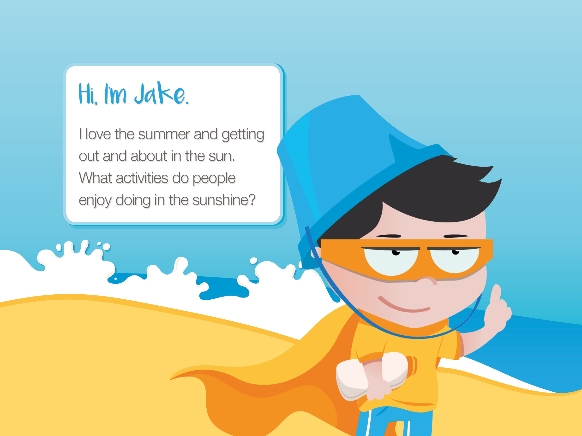
Notes:
This slide introduces pupils to Jake who features throughout the Wrap, Splat, Hat education programme. Ask several pupils to share ideas about outdoor activities.

Slide 3
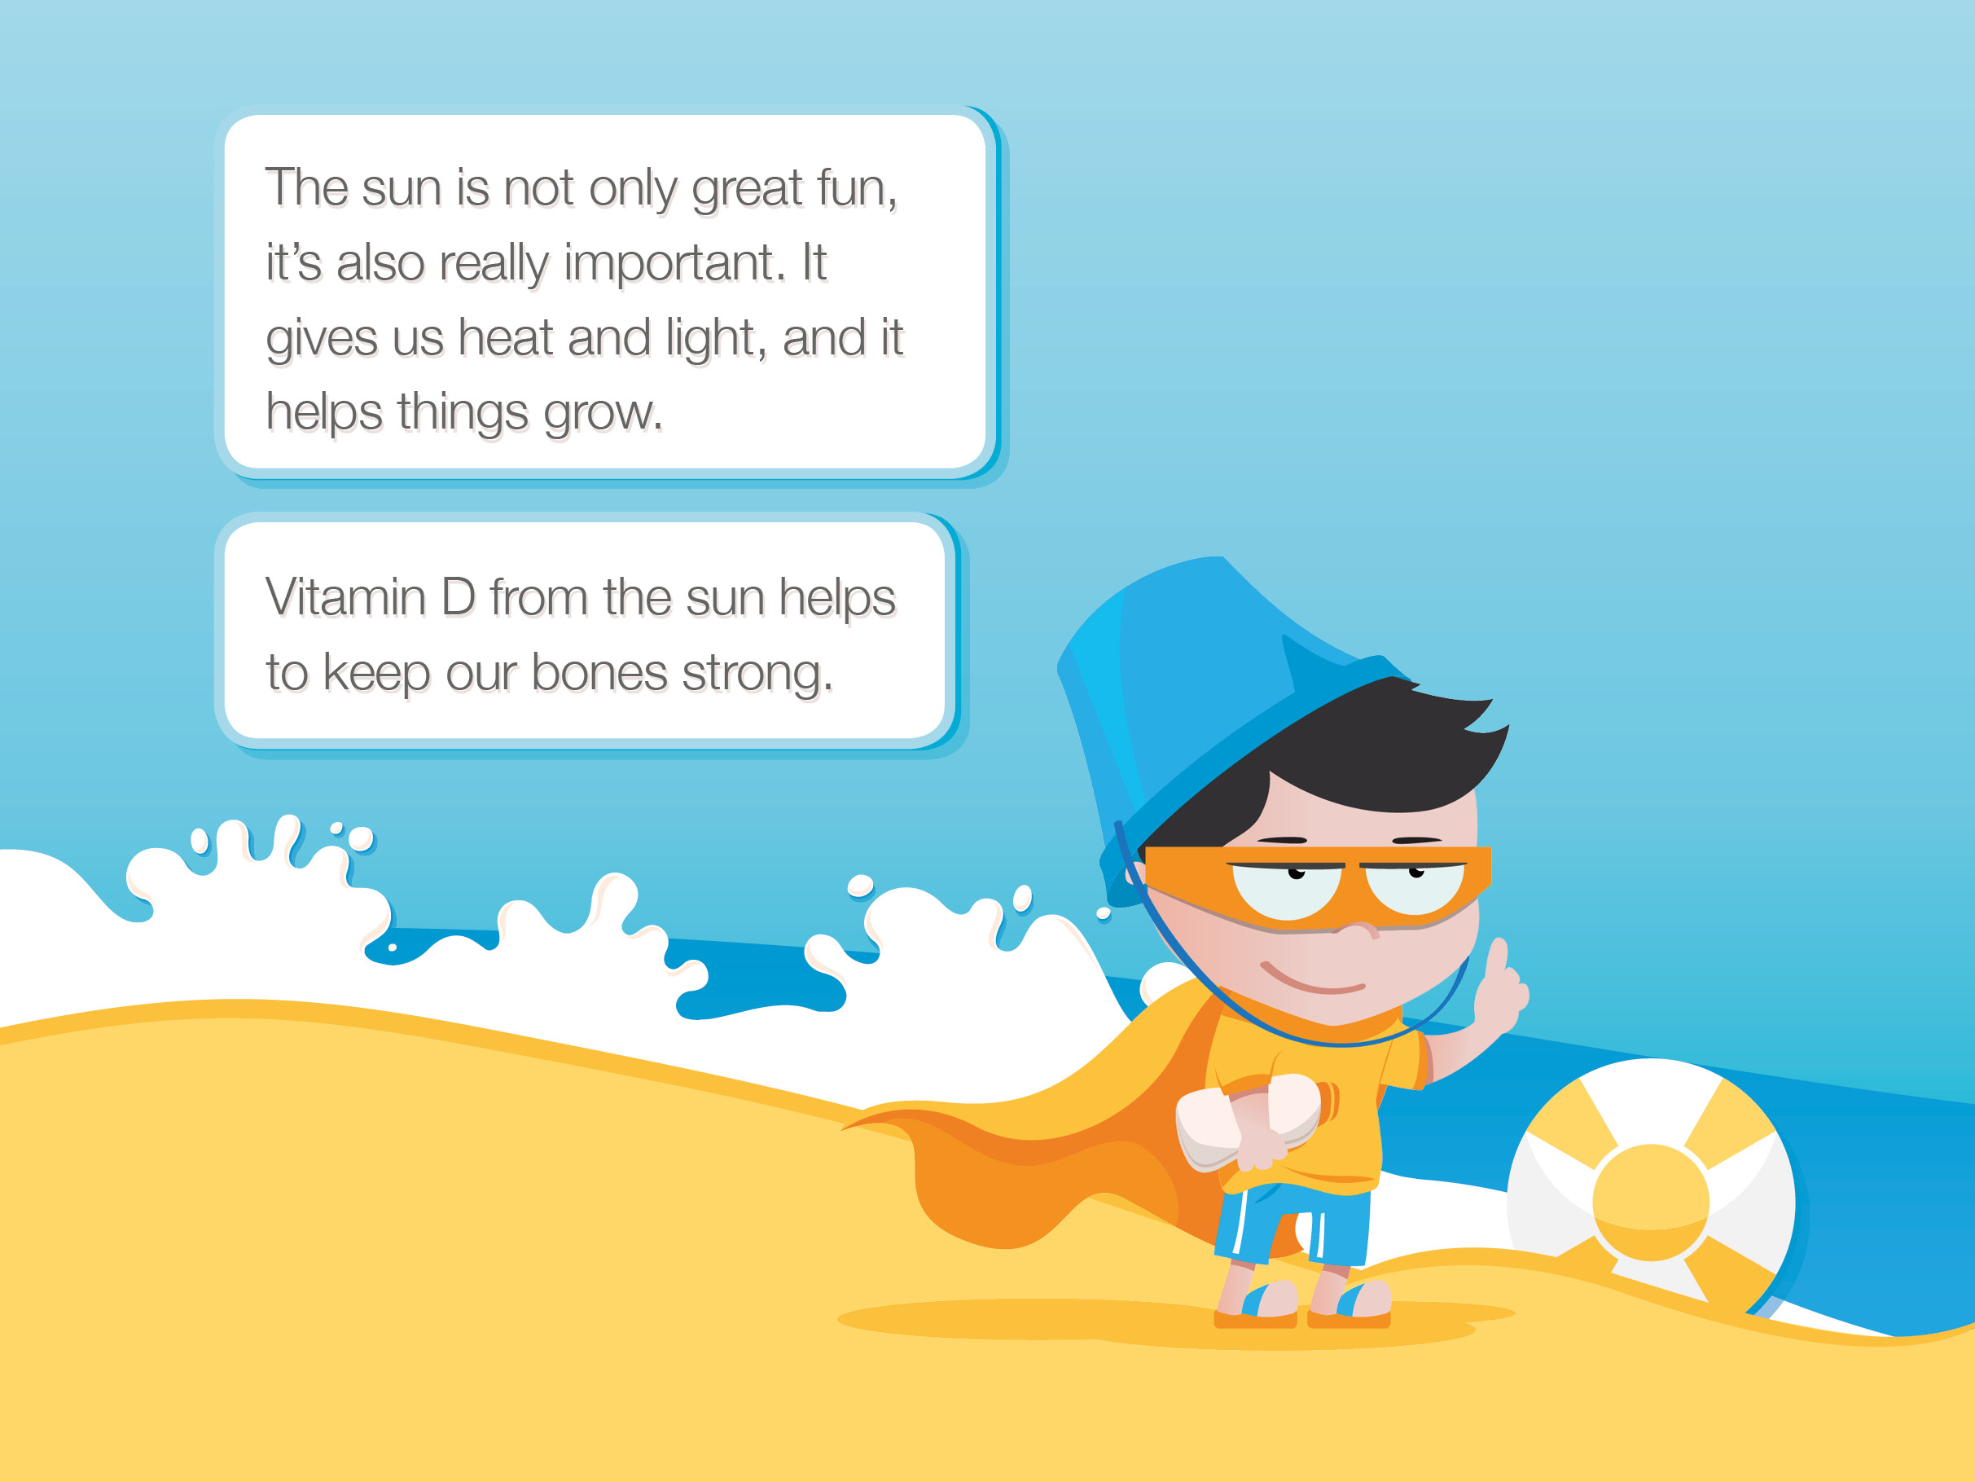
Notes:
Emphasise that it is good to play outside in the sun and that the sun is very important to us.

Slide 4
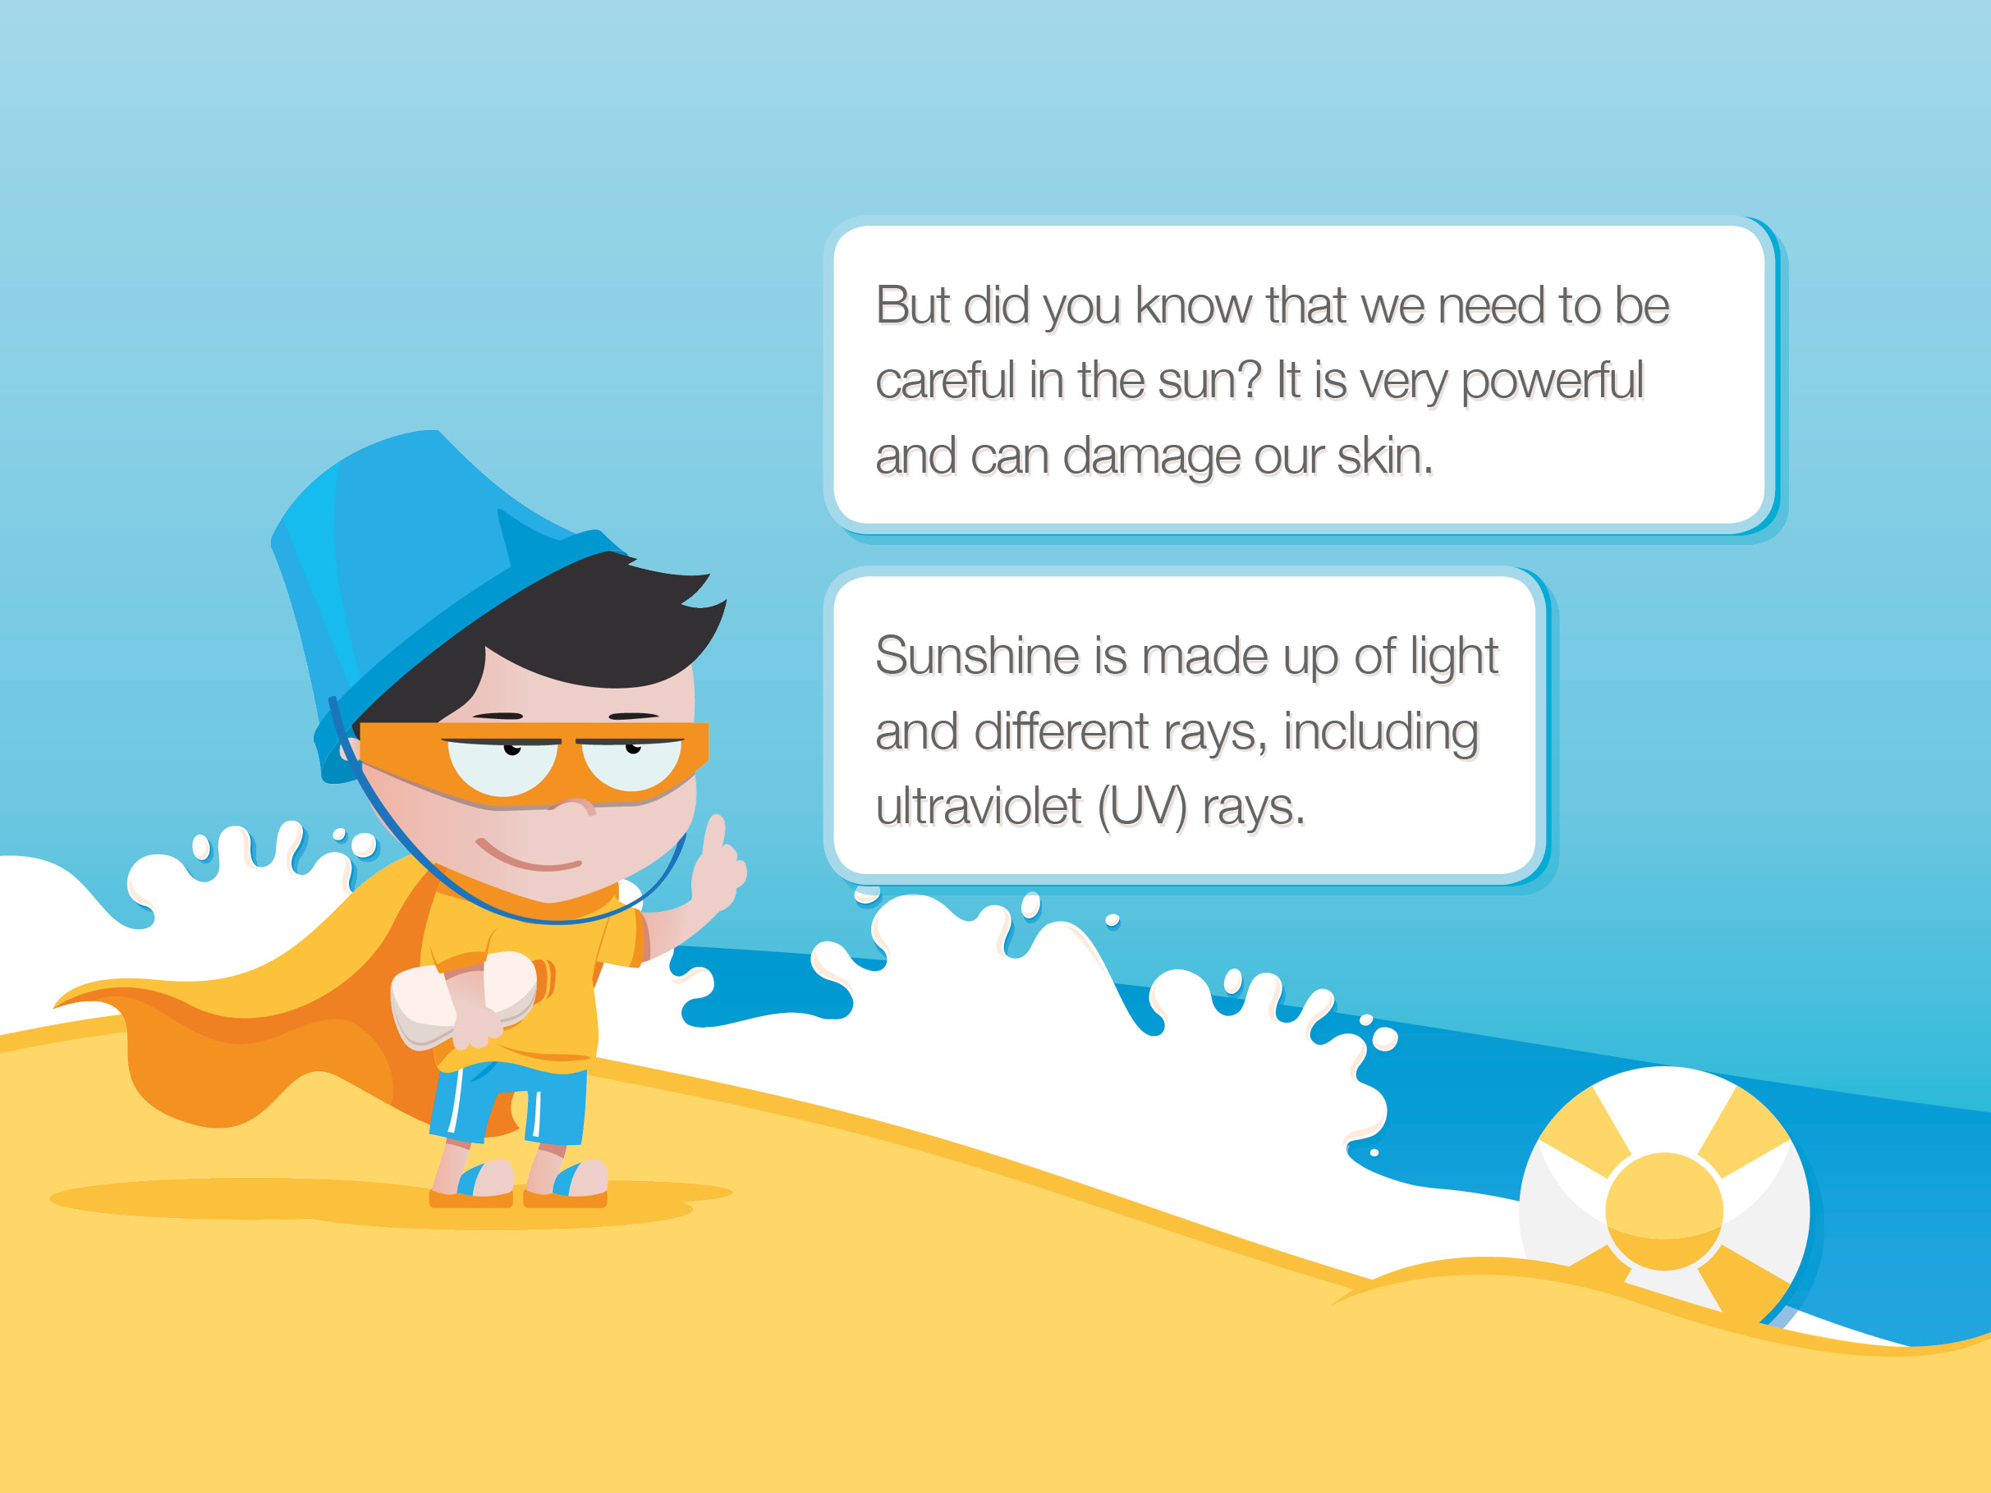
Notes:
This highlights that we need to be careful when out in the sun. It starts to explain some of the science behind the damage the sun can do.

Slide 5
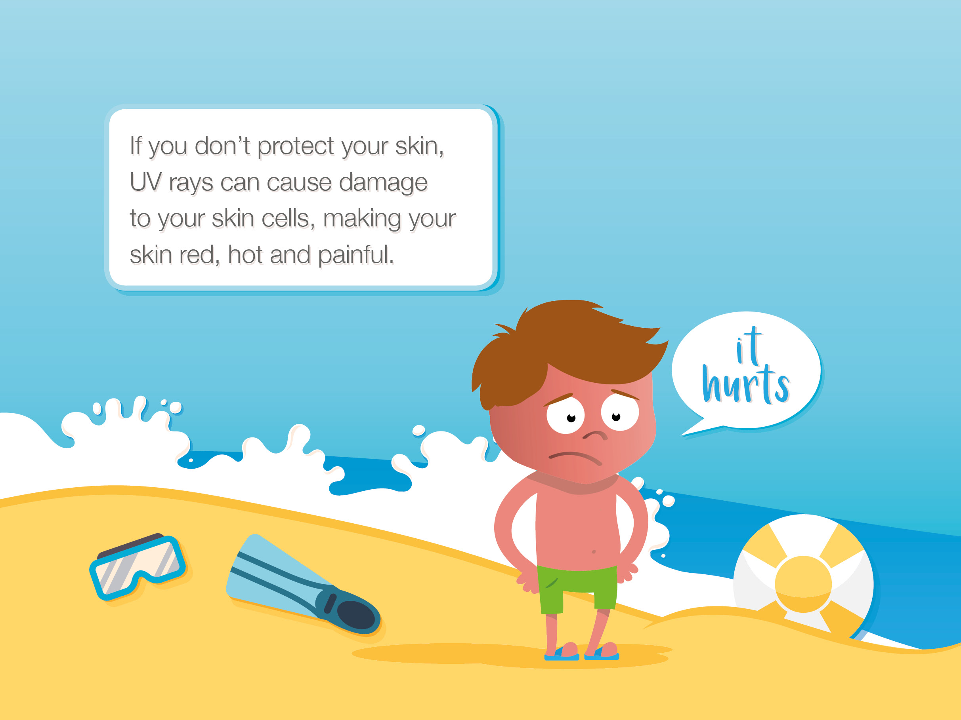
Notes:
Emphasise the need to protect our skin from the sun. The image shows a boy (not Jake) who hasn’t been sun safe, to reinforce the message.

Slide 6
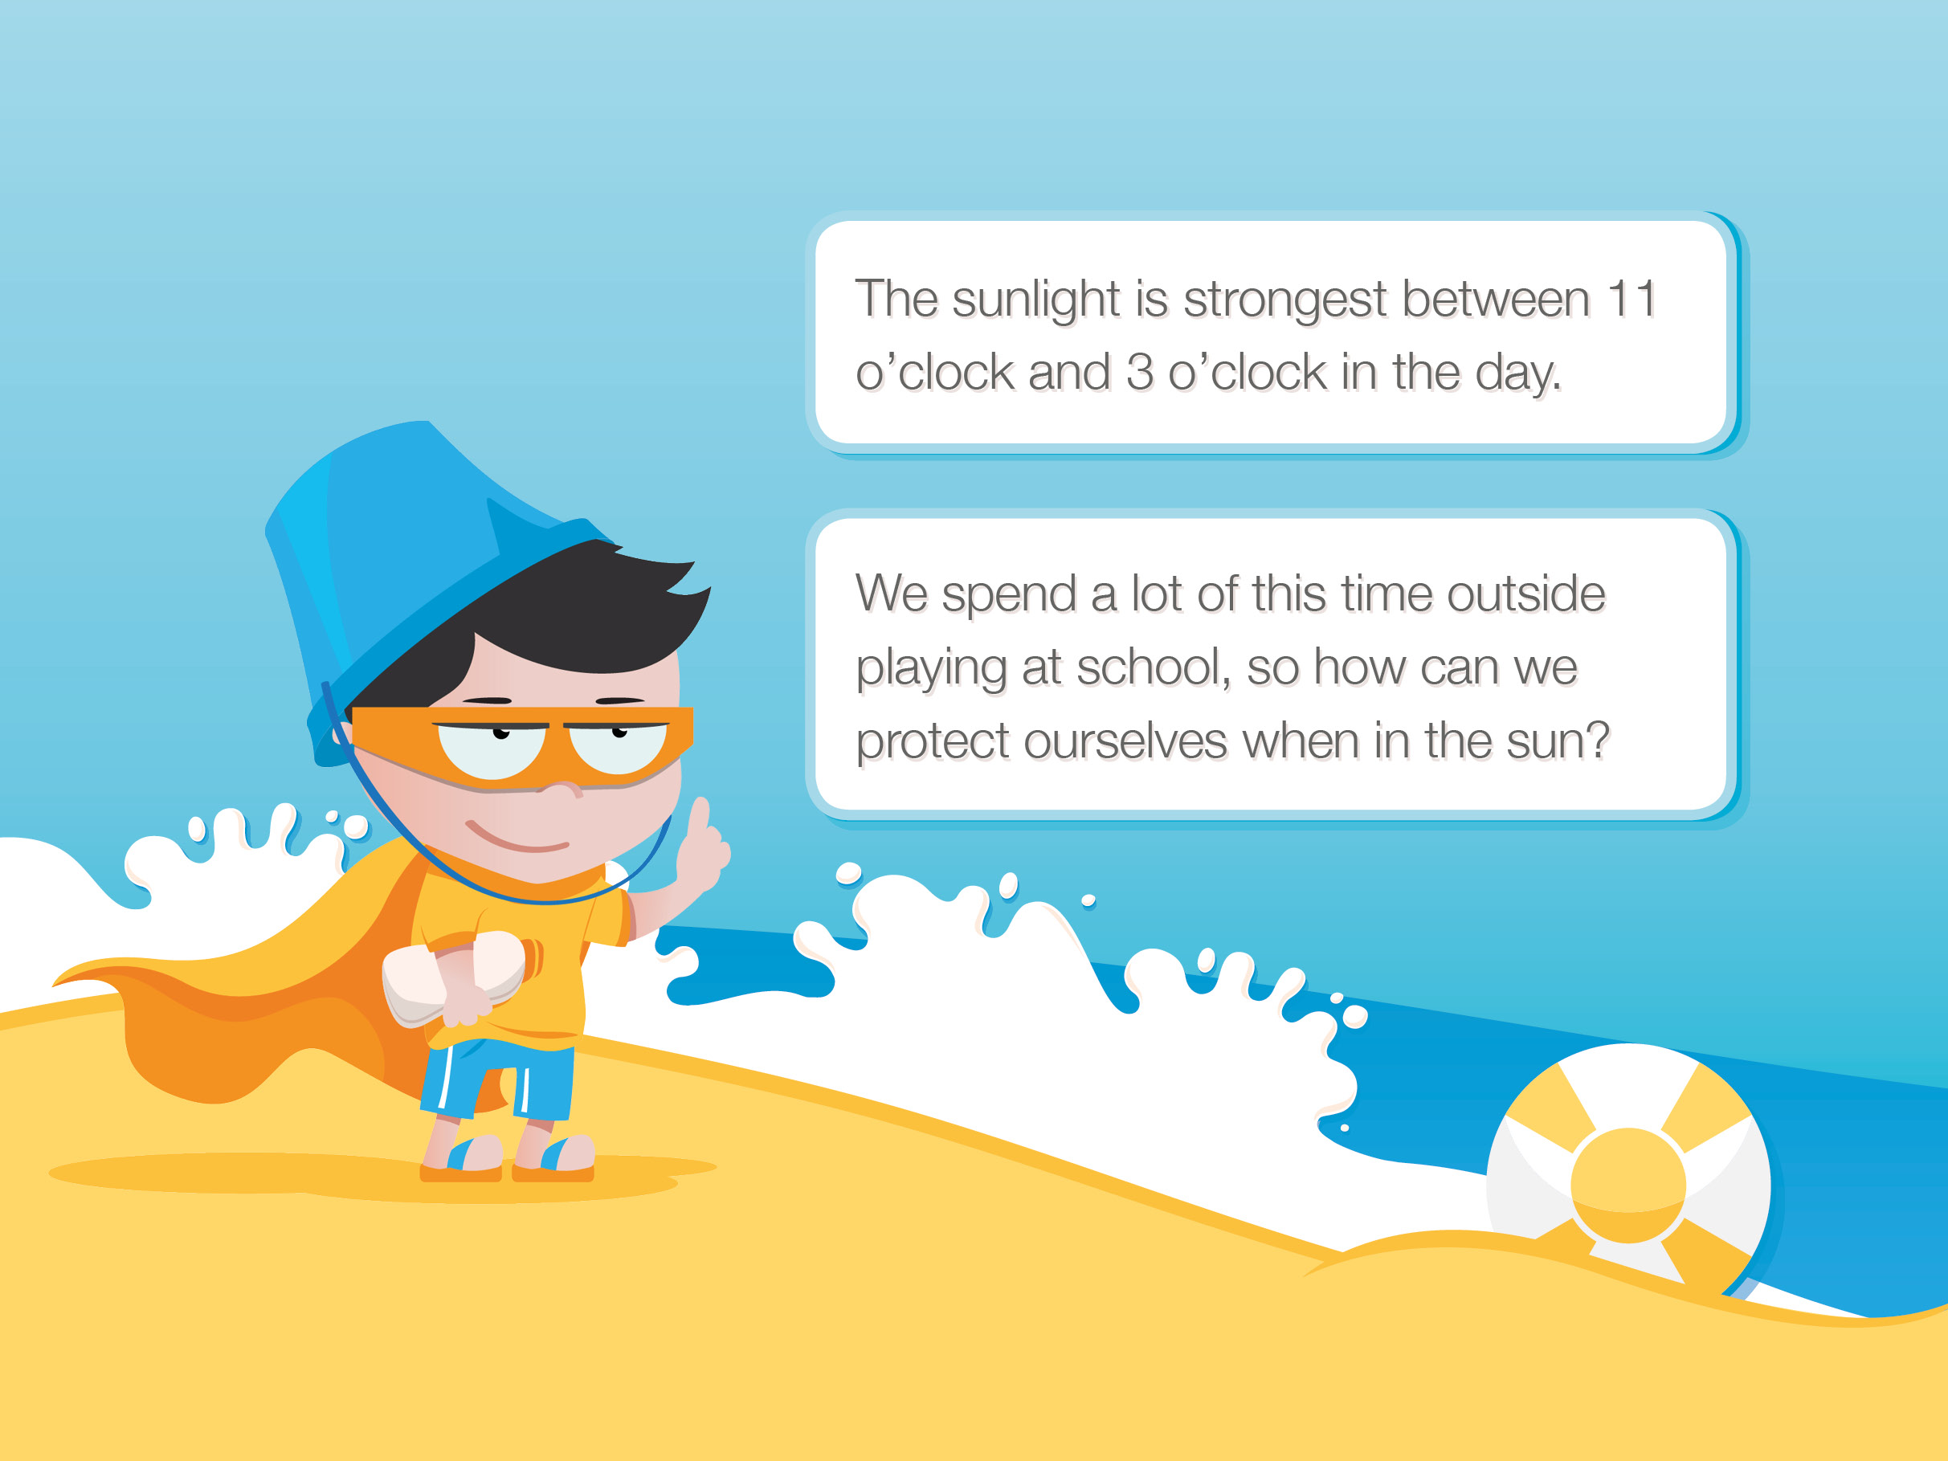
Notes:
Ensure children know that for a large part of the time they are playing in the playground or your outdoor area the sun is at its strongest, but that there are ways we can still have fun safely. Ask children to suggest some ideas and learn from each other.

Slide 7
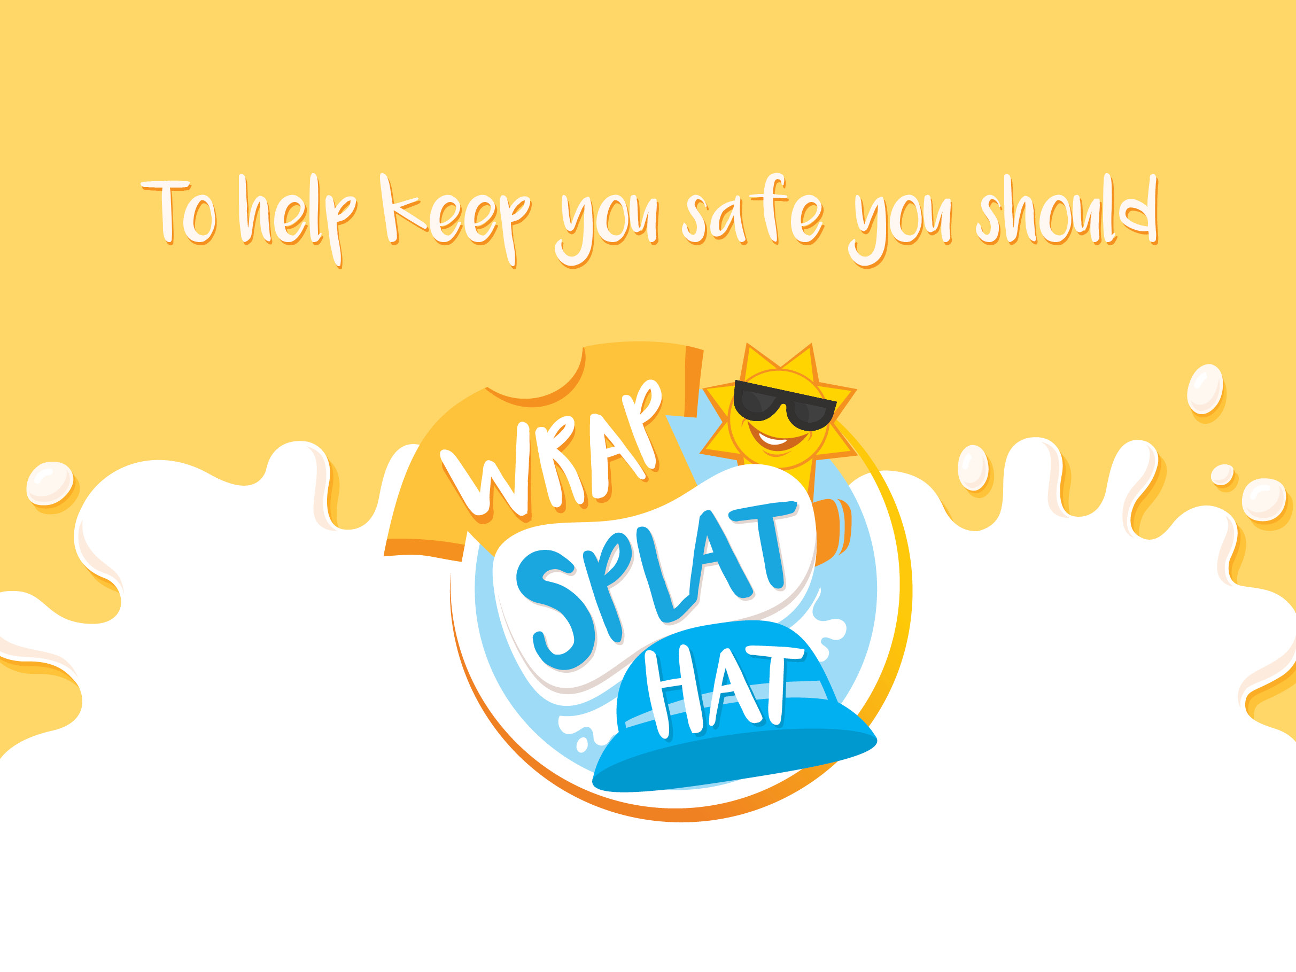
Notes:
‘Wrap, Splat, Hat’ provides an easy way to help children remember three of the most important ways to stay safe in the sun.

Slide 8
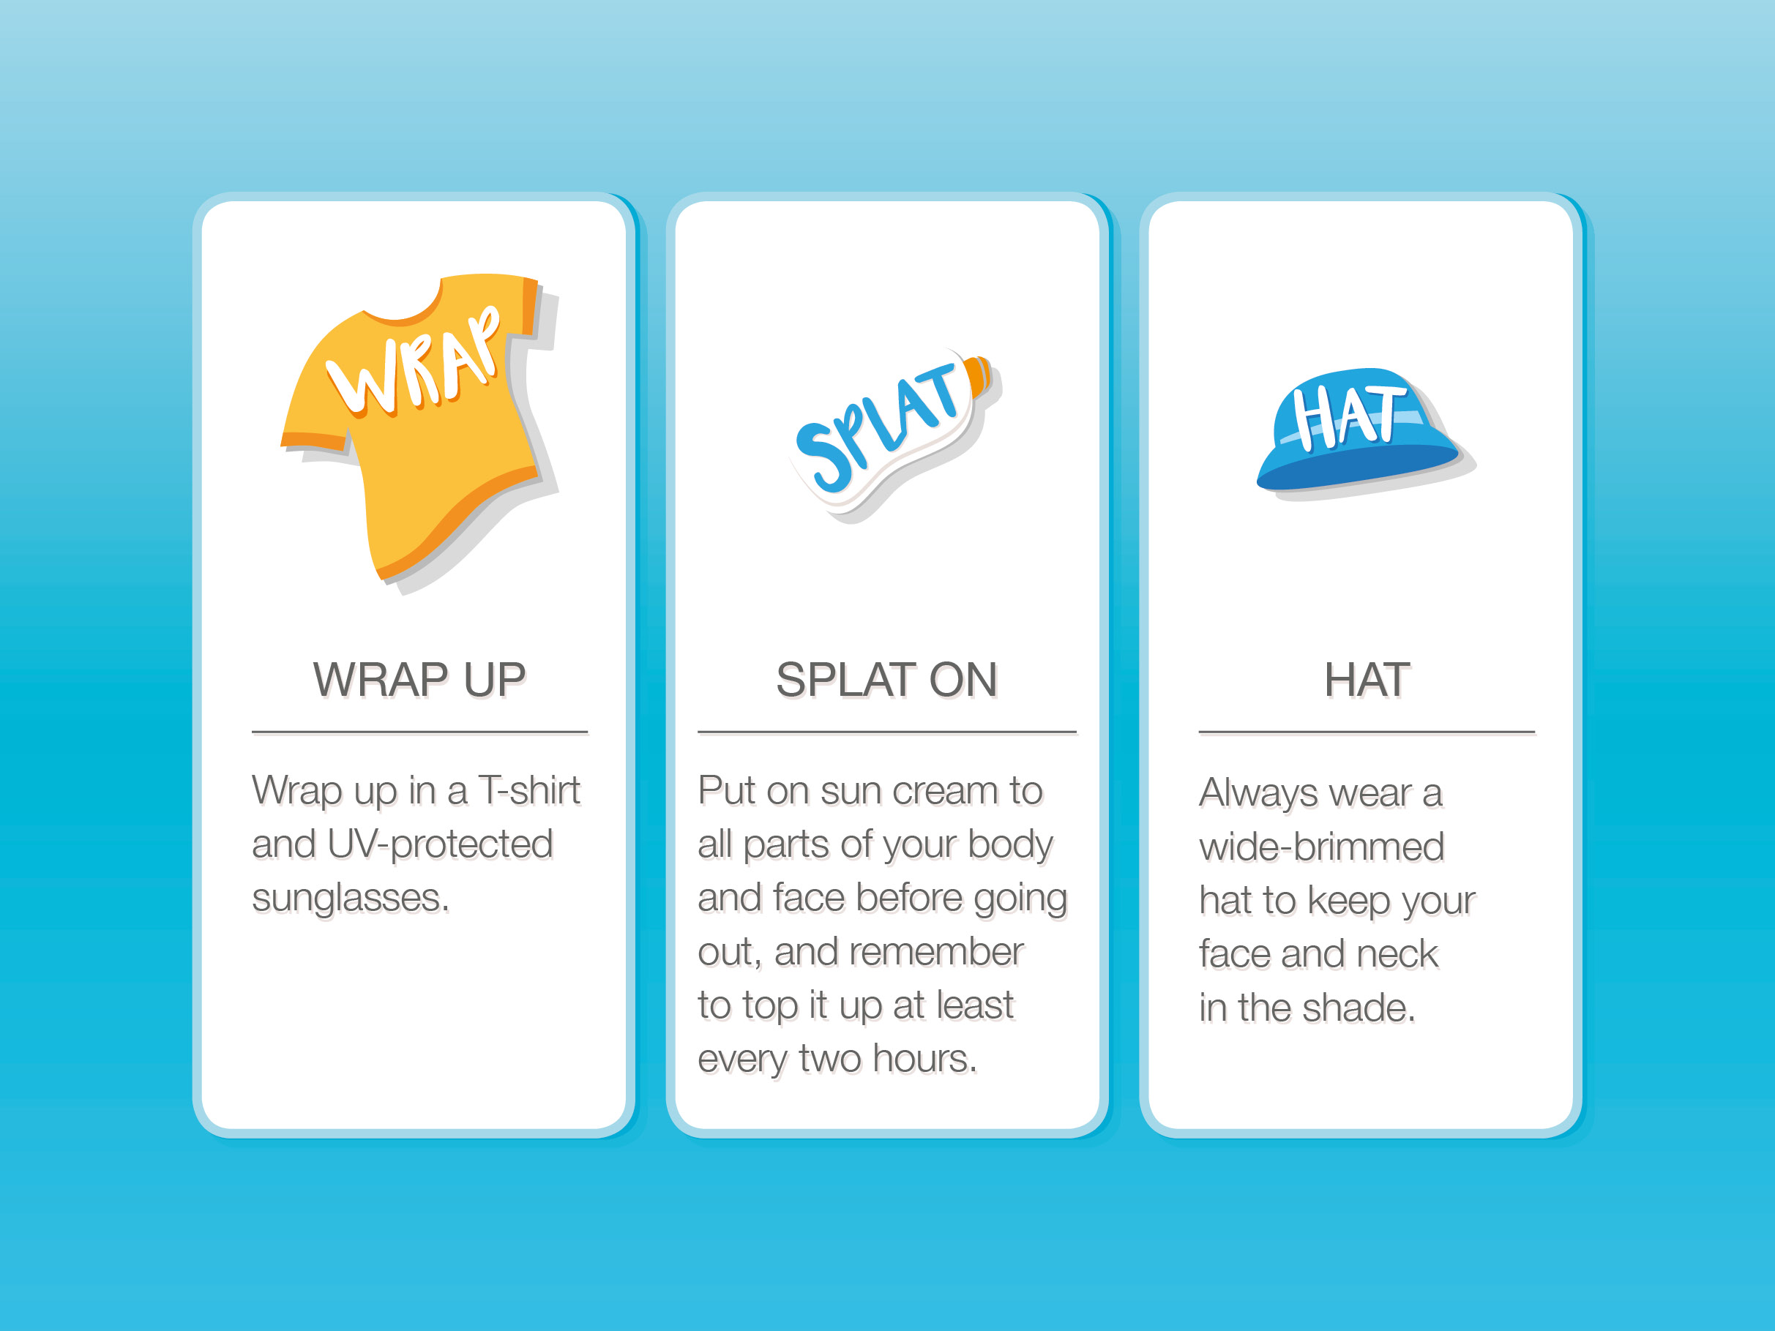
Notes:
You might like to get the children to add movements to this message (e.g. mime pulling on a t-shirt, rubbing sun cream on their face or arms, putting on a hat).

Slide 9
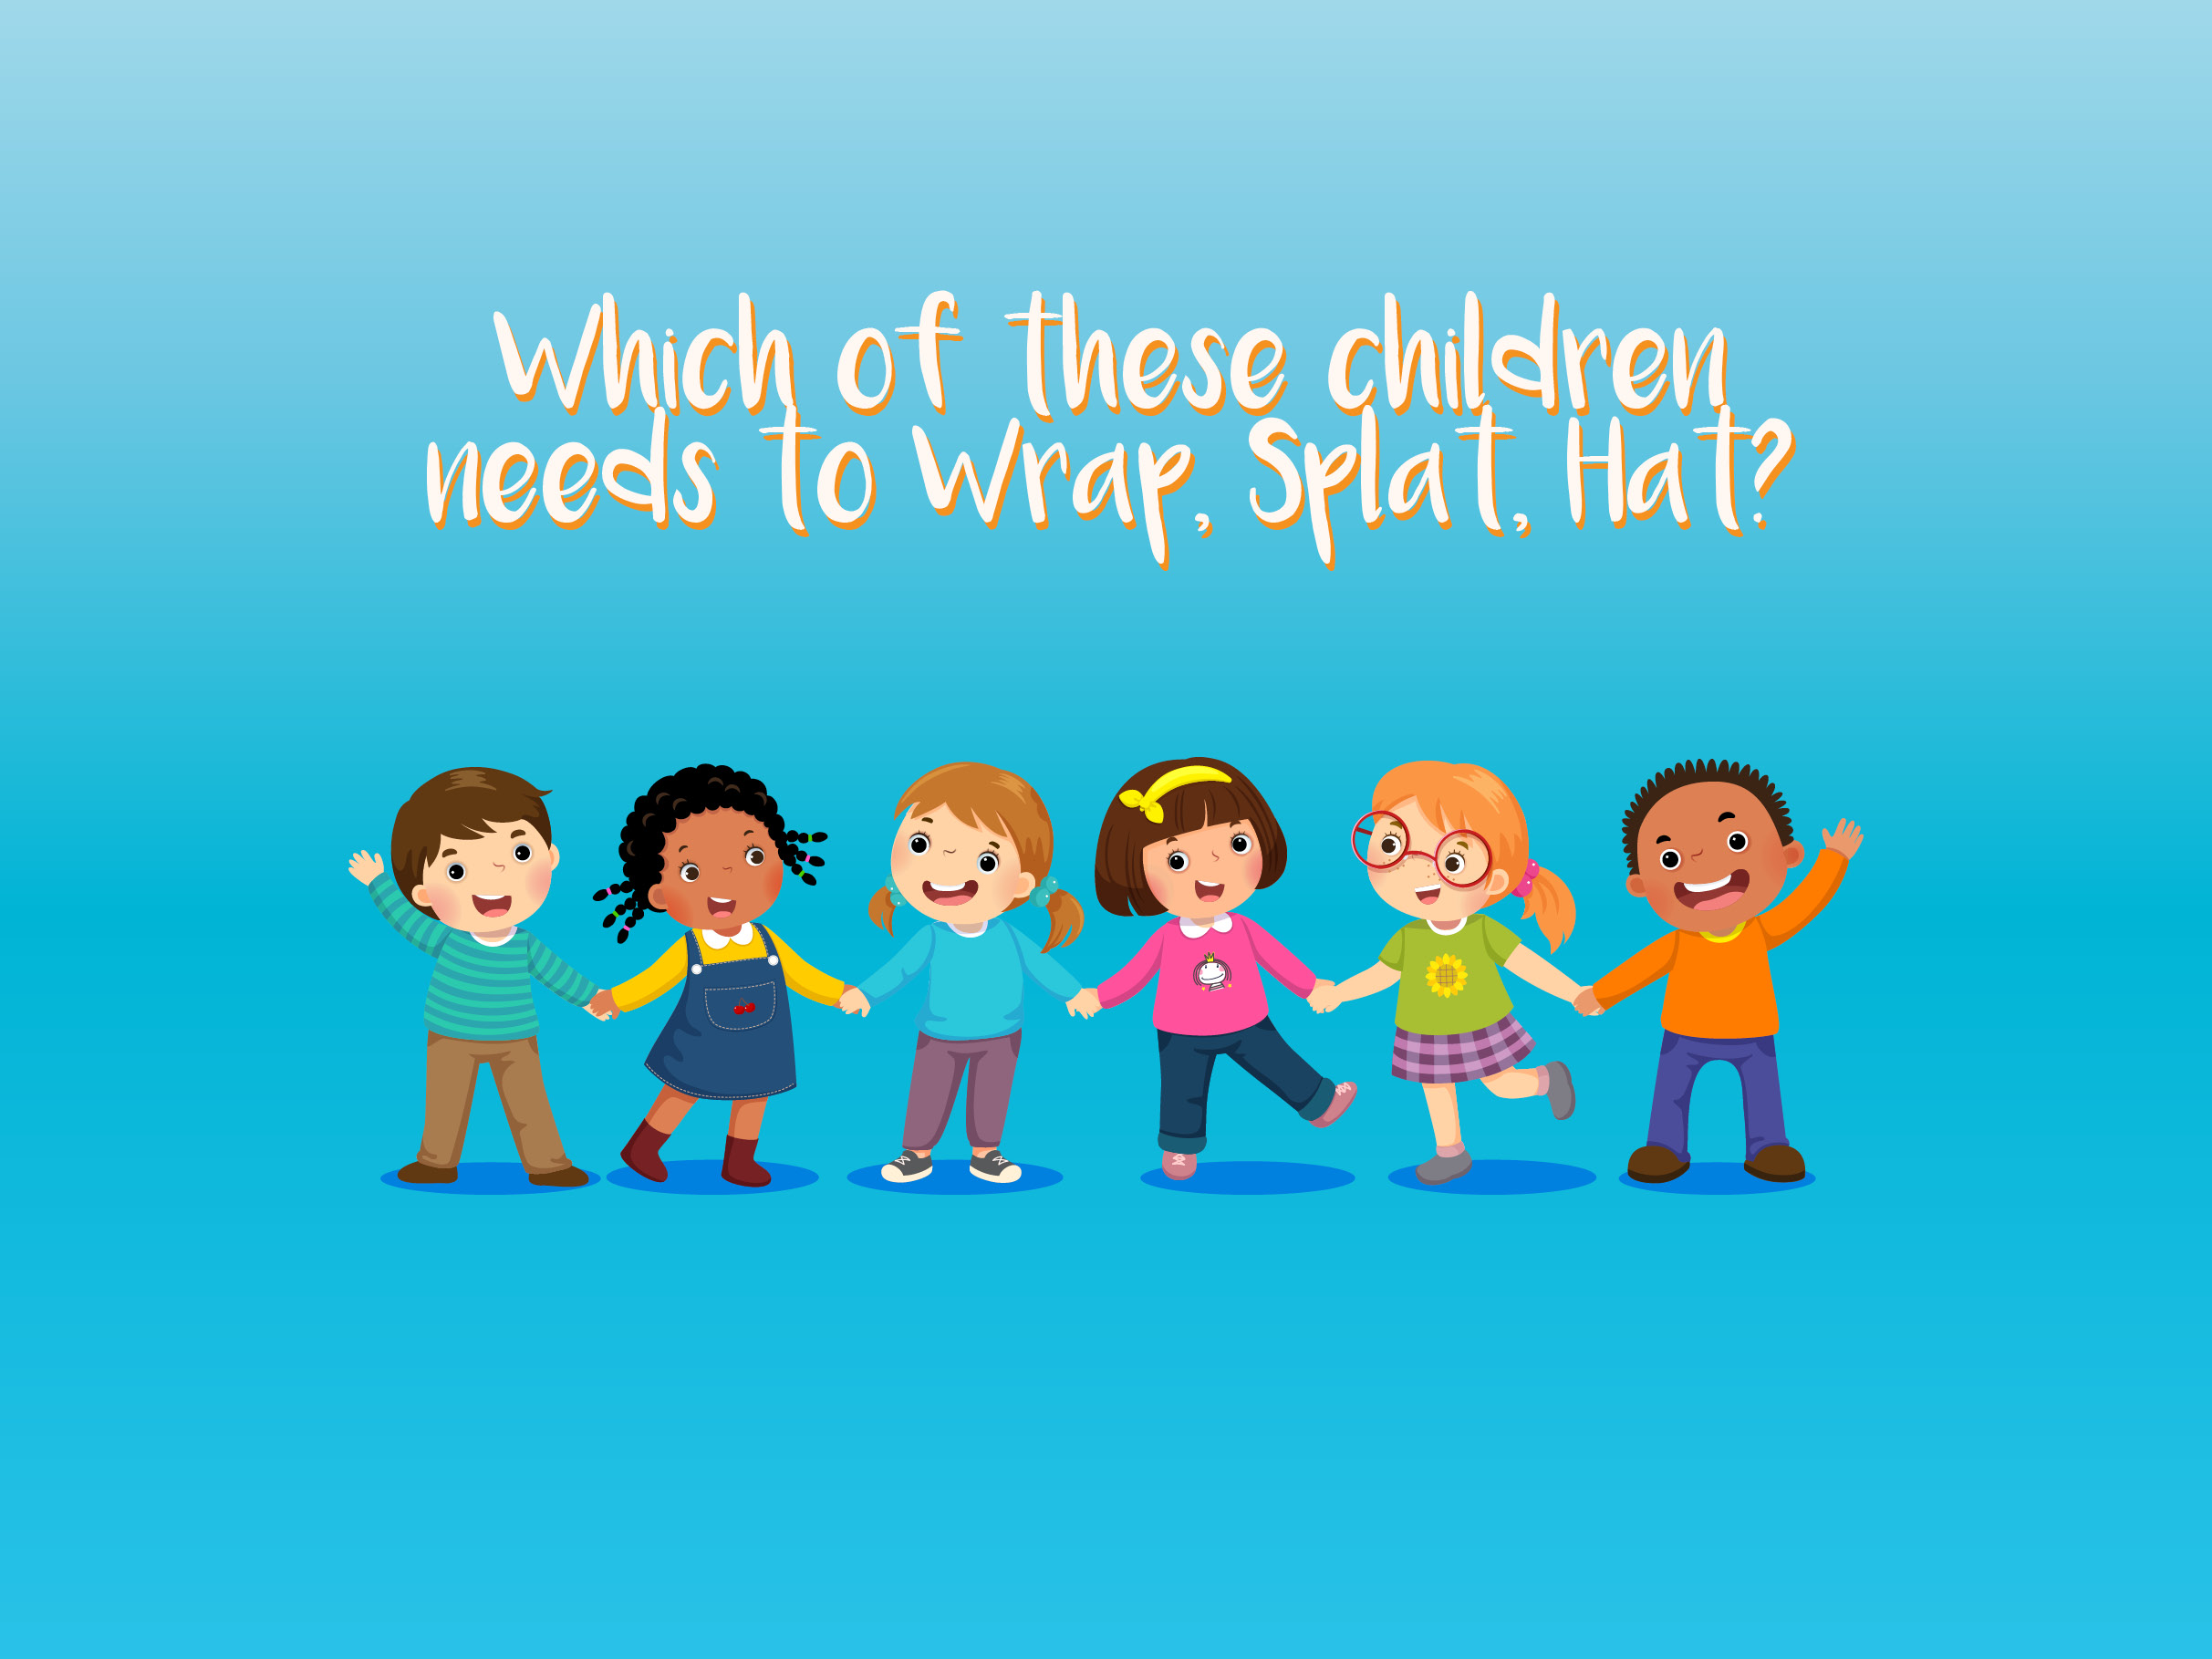
Notes:
Ask which of these children need to Wrap Splat Hat in the sun and take feedback. Explain that everyone needs to protect themselves from the sun. Some children are more at risk, but the sun’s powerful rays can cause damage to everyone, so we all need to stay sun safe.

Slide 10
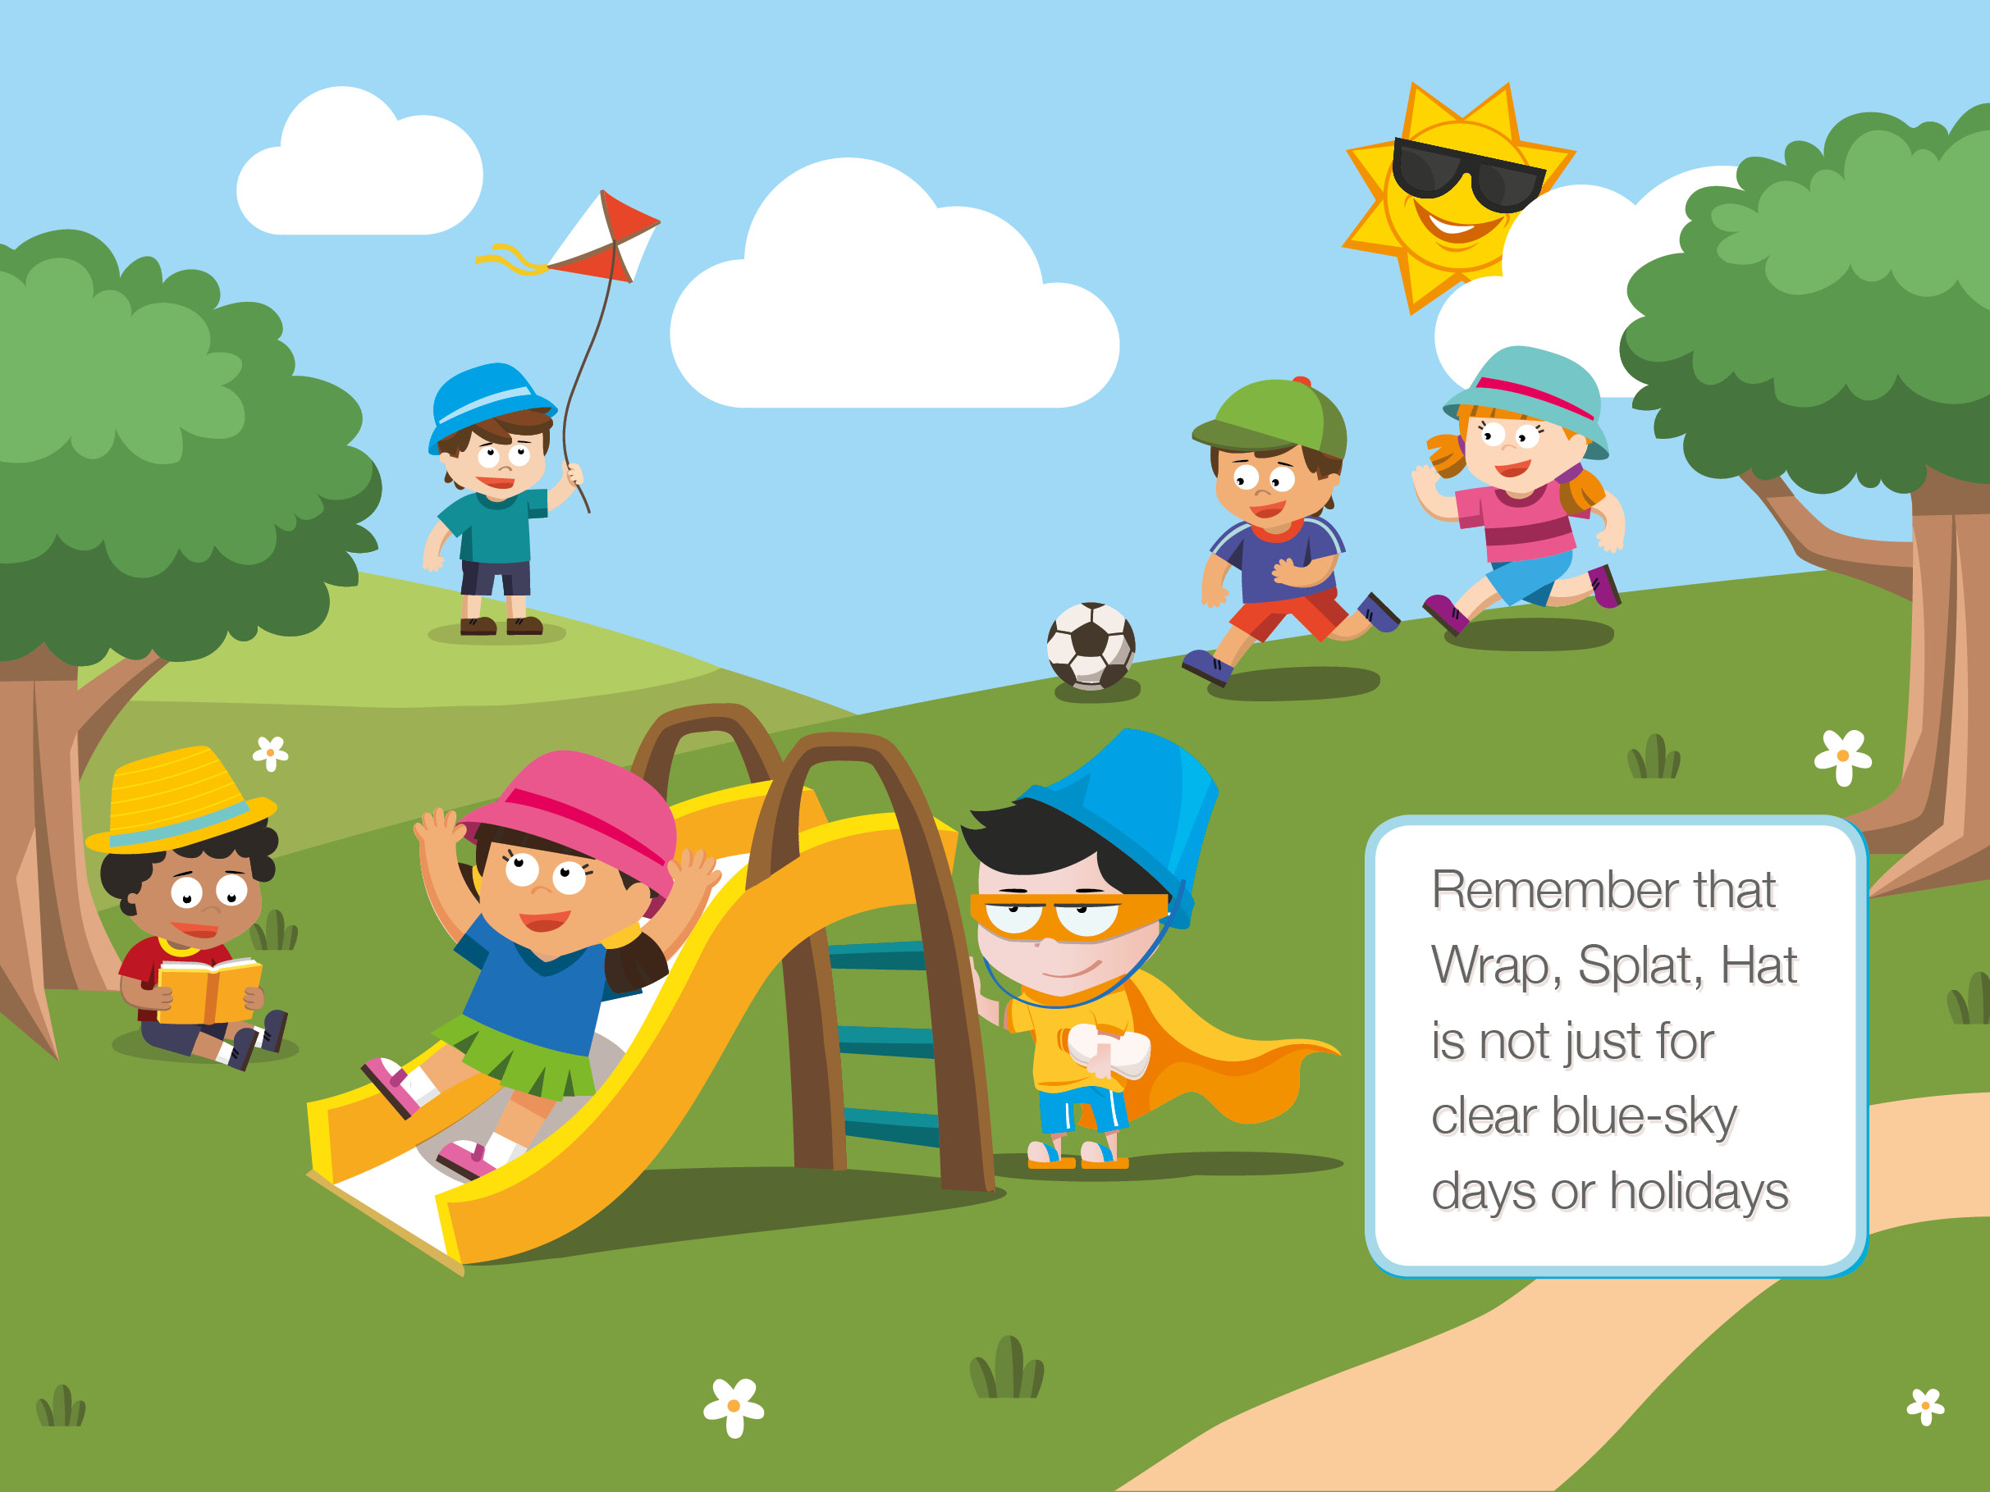
Notes:
Remind children that we need to protect ourselves from the damaging sun’s rays on a daily basis, not just when we are on holiday in a hot place or on a beach. Explain that dangerous rays can get through clouds and can still hurt your skin. Water molecules and small particles found in clouds scatter UV rays, so even if the skies are not clear, we still need to Wrap, Splat, Hat. So even if the skies are not clear, we still need to Wrap, Splat, Hat.

Slide 11
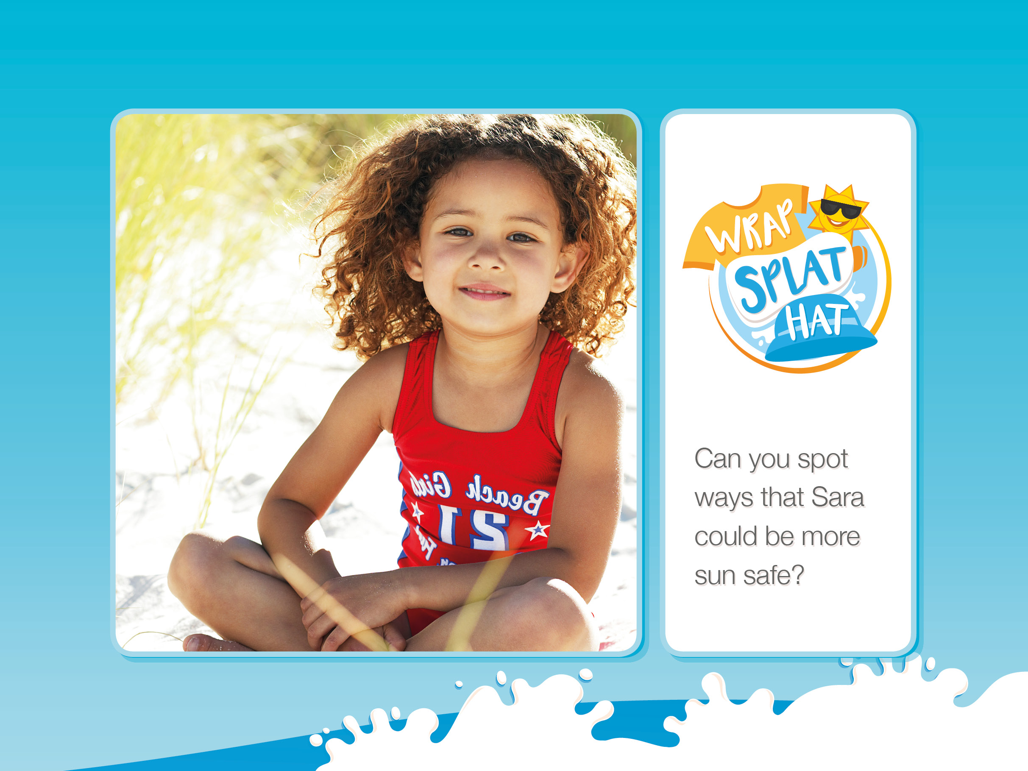
Notes:
This slide is to be used to test the pupils’ understanding of the Wrap, Splat, Hat message. Explain that Sara is playing on the beach with Jake, but that she needs to be a bit more sun safe. Can pupils suggest some things that she could do? (putting on sun cream, wearing a hat, wearing sunglasses, finding shade, having a water bottle handy)

Slide 12
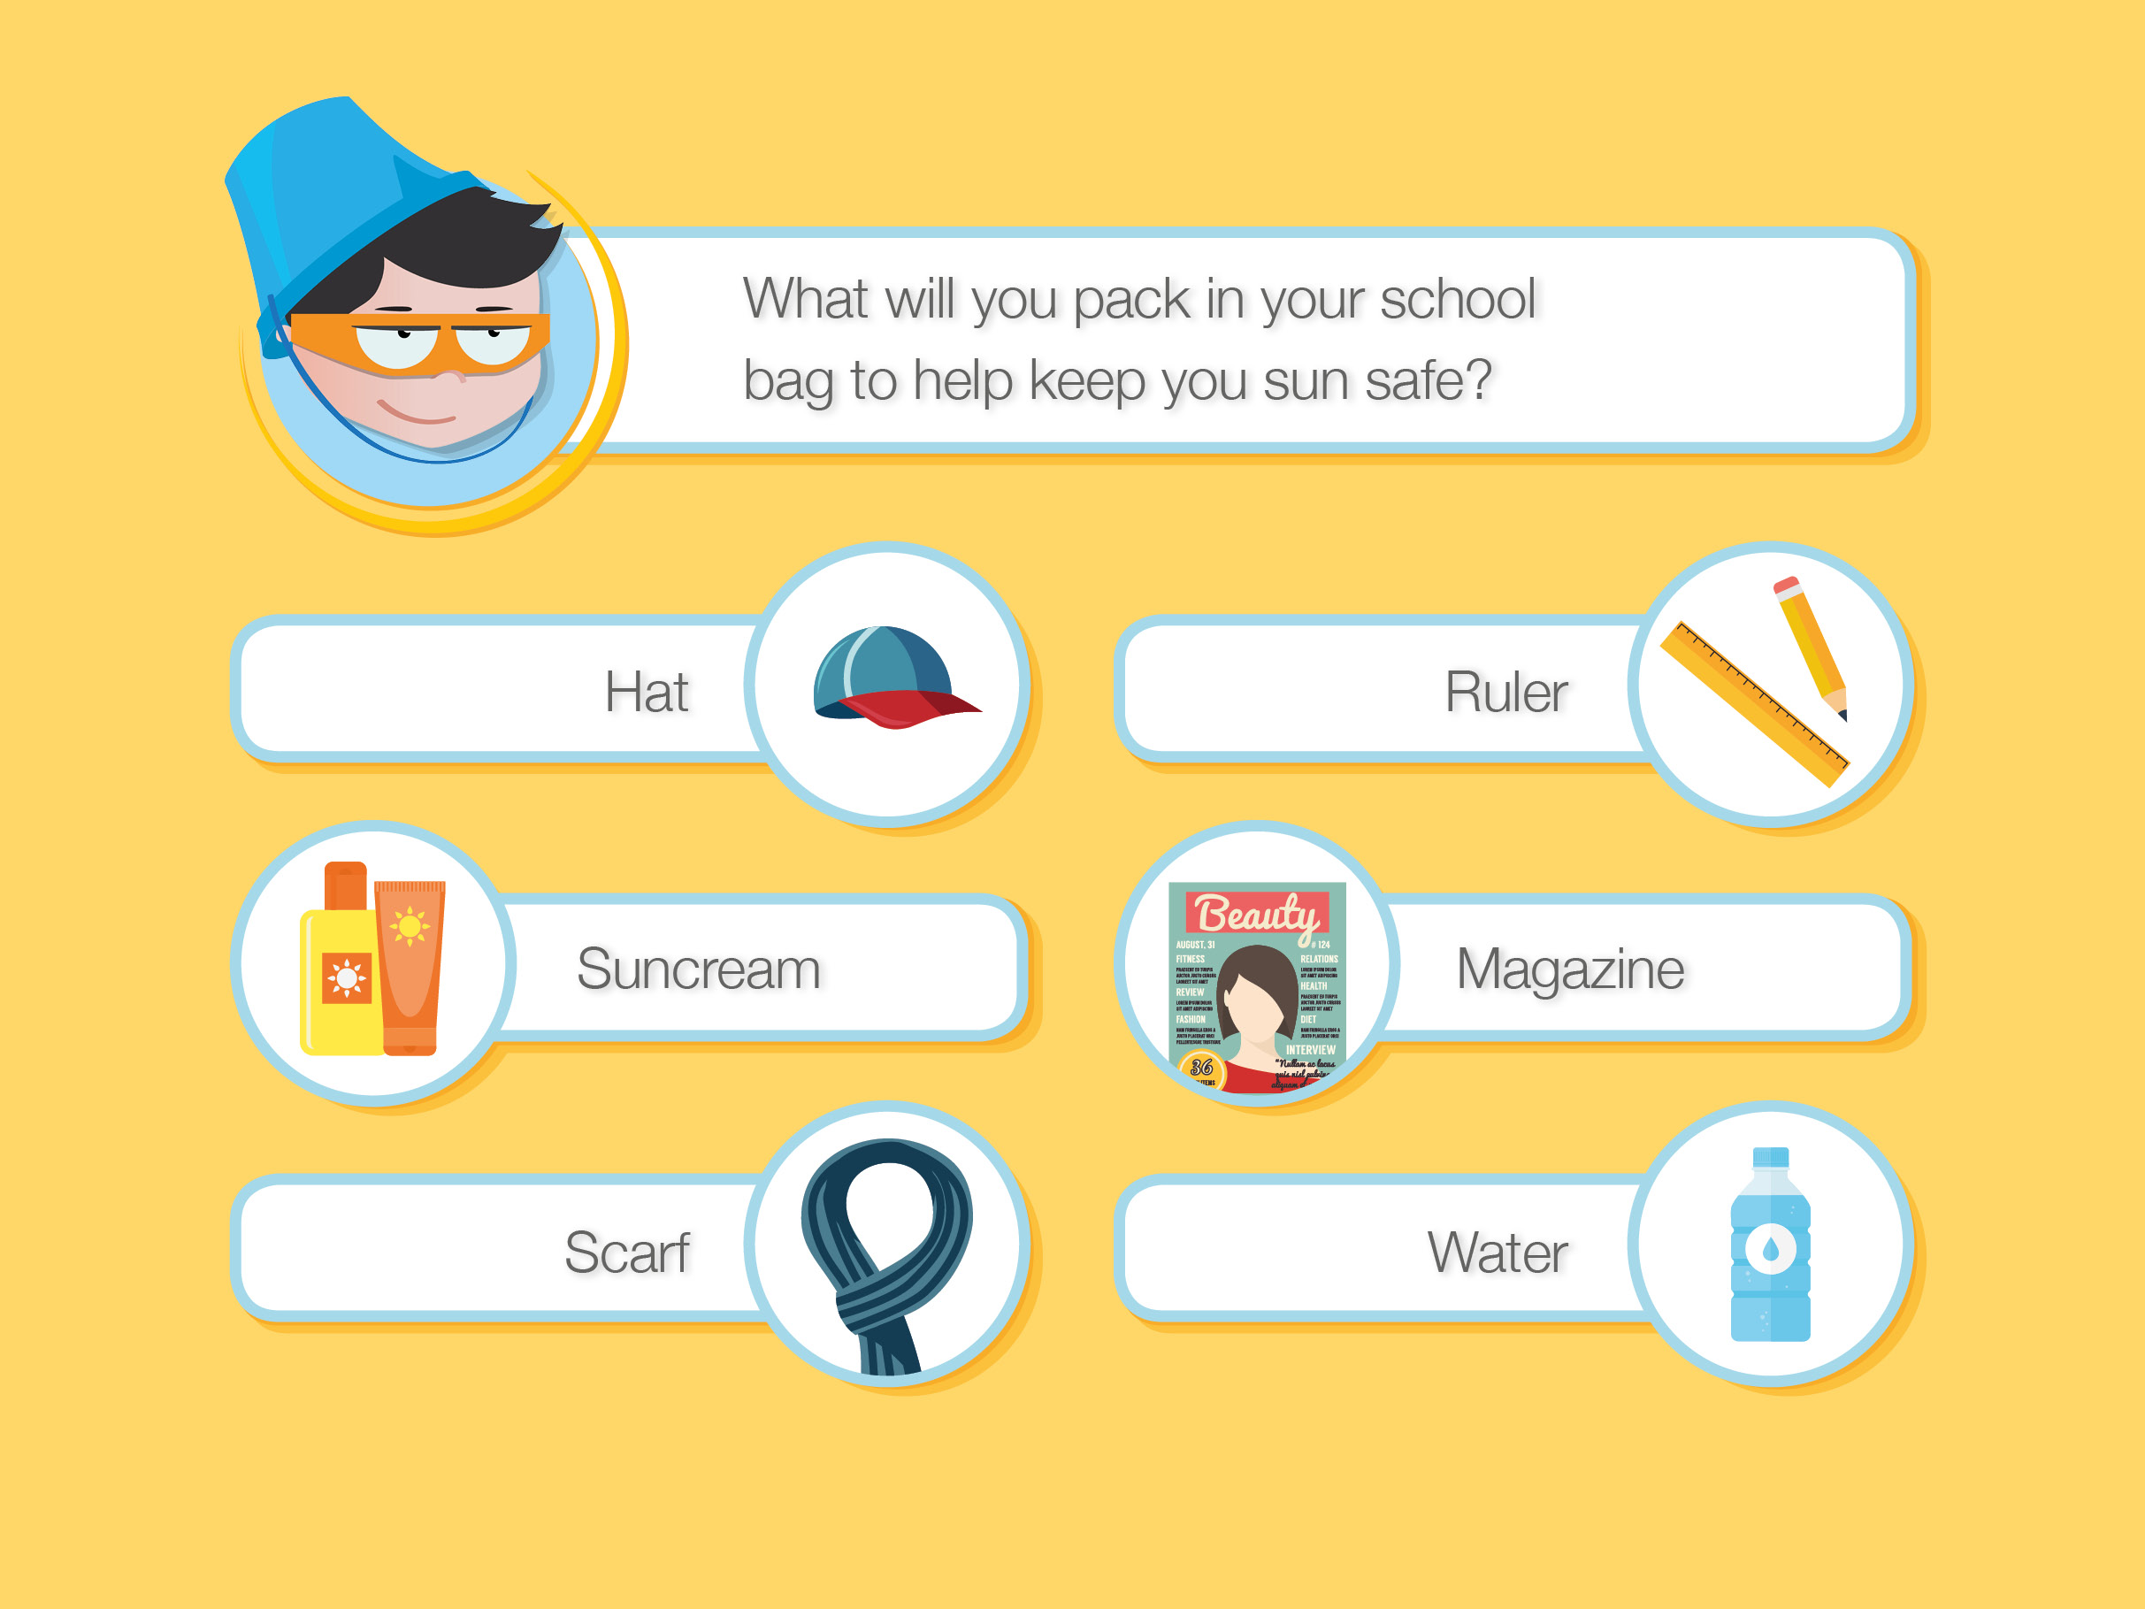
Notes:
Correct: Hat, Sun cream, Water
Incorrect: Ruler, Magazine, Scarf
This slide helps to encourage pupils to begin to take some responsibility for their sun safety.

Slide 13
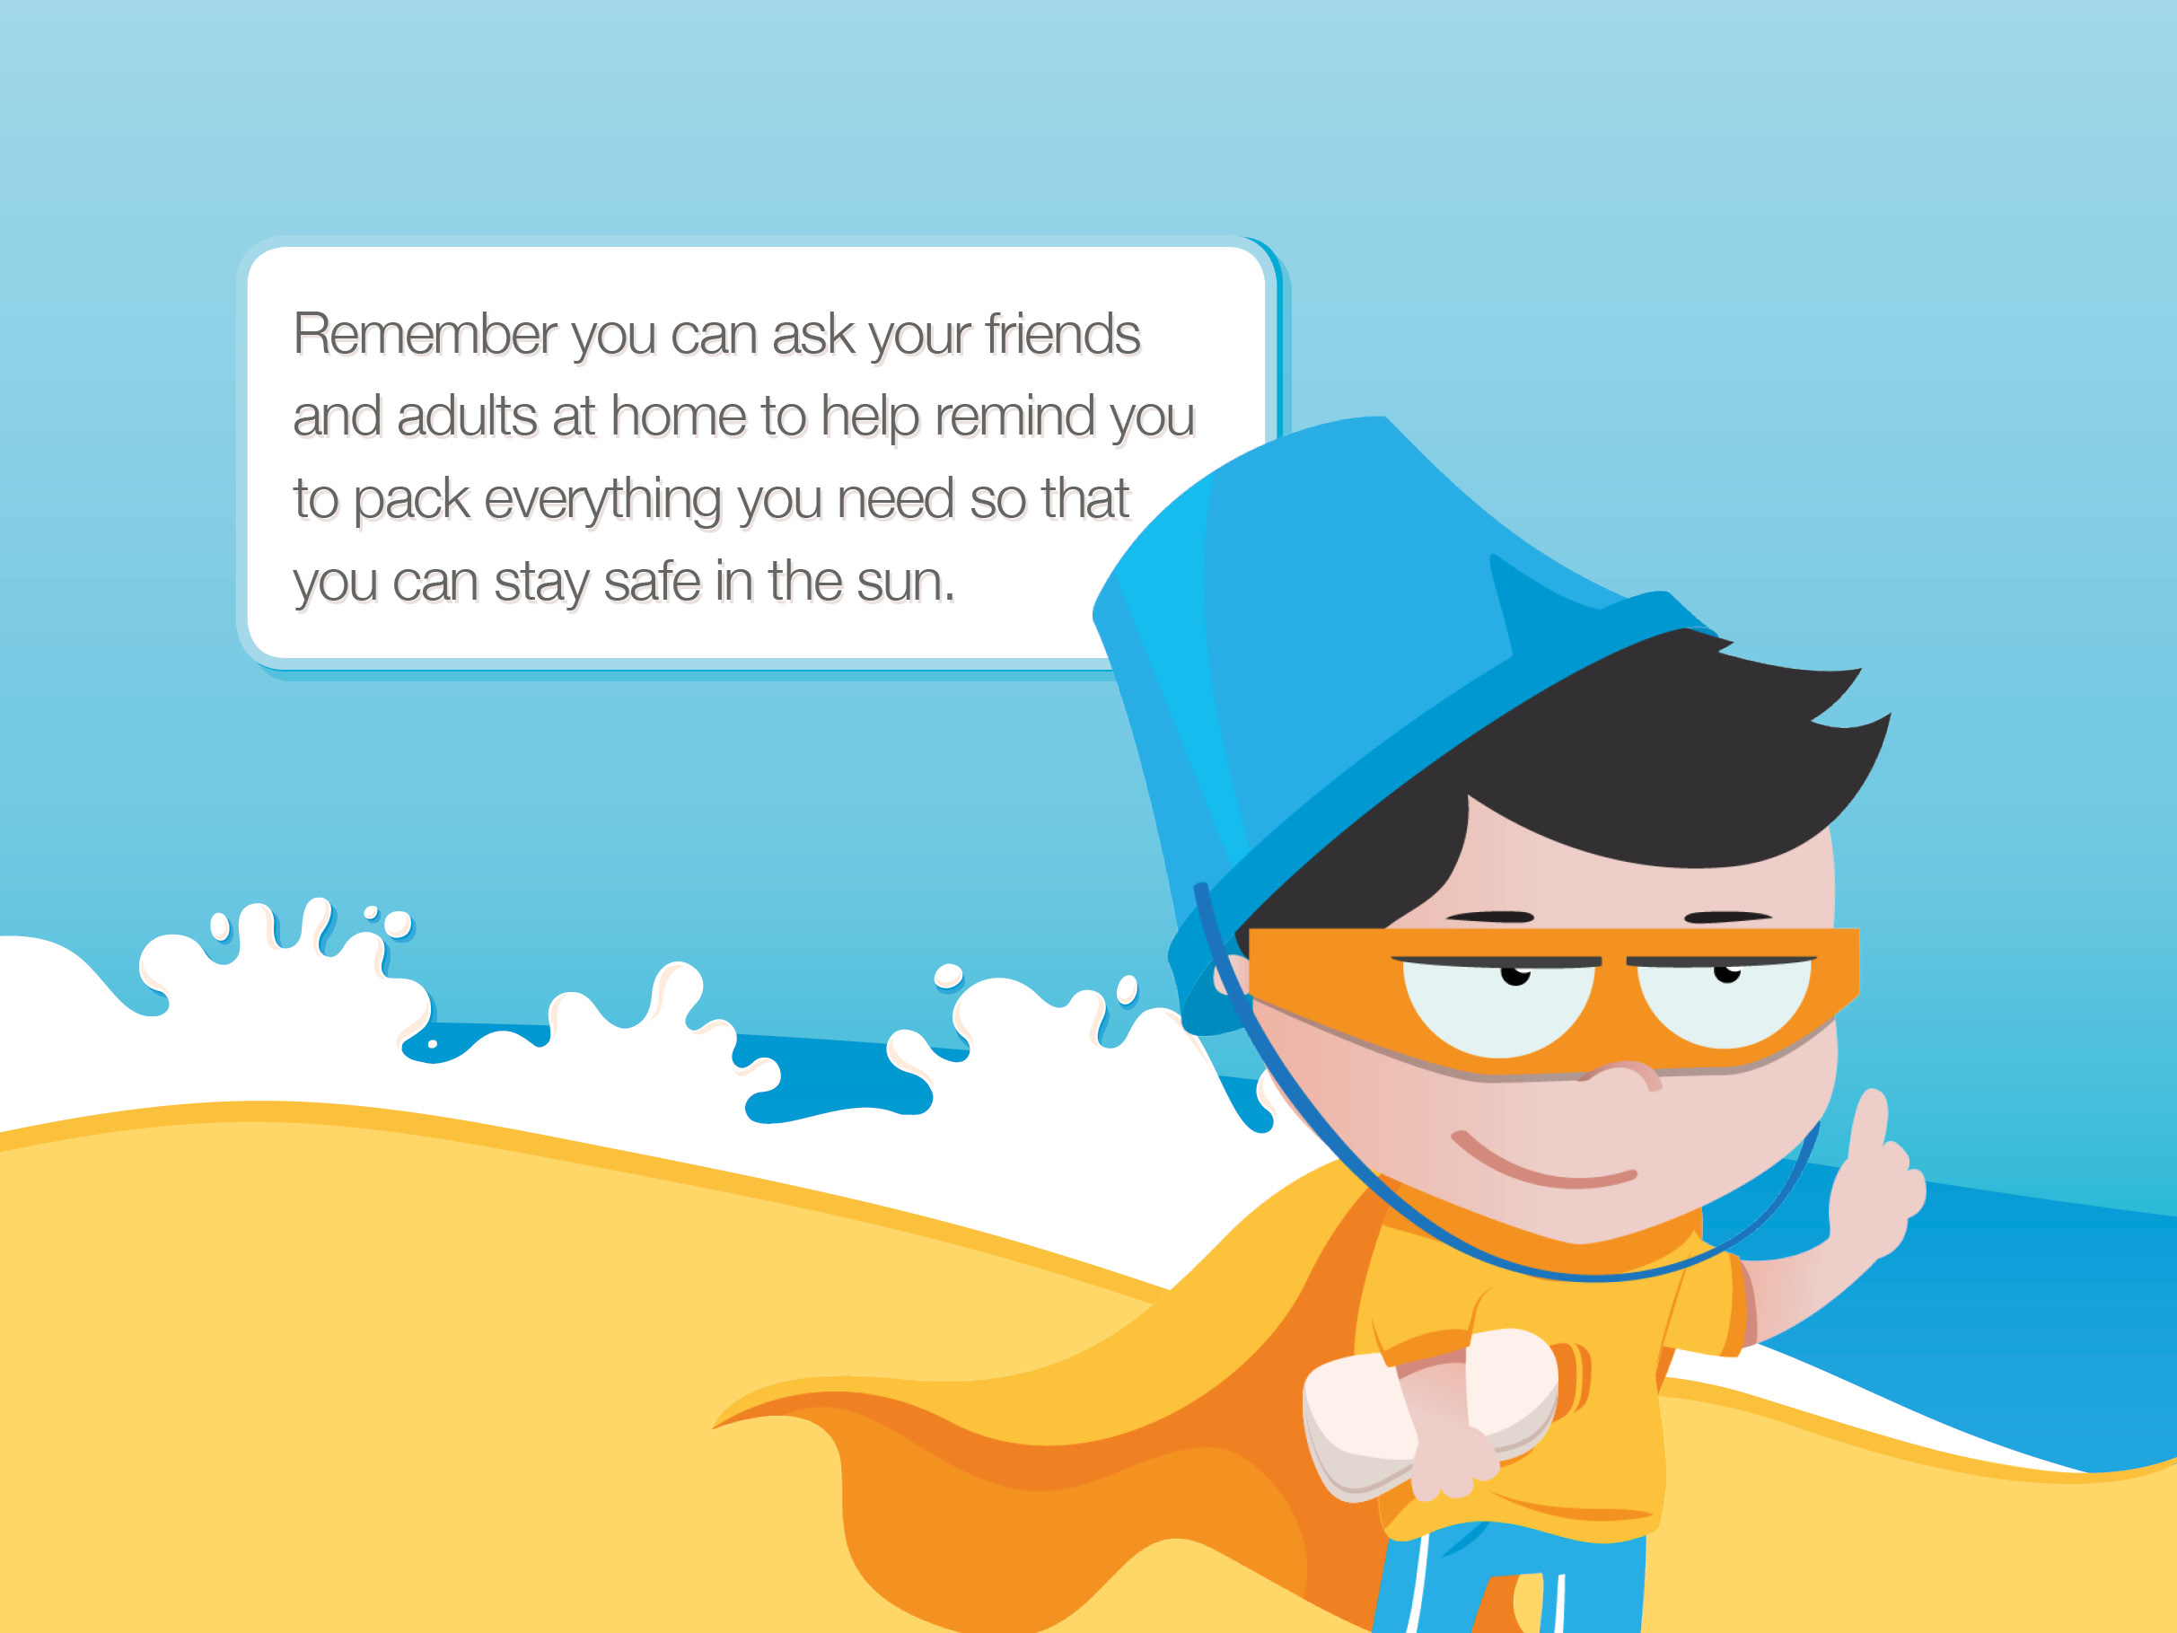
Notes:
Re-emphasise that pupils can start to take some responsibility for their sun safety (and perhaps help protect their siblings as well), but also reassure them that it is not only up to them and that people such as parents, teachers or friends will help them to remember to stay sun safe. And they can remind grown-ups too!

Slide 14
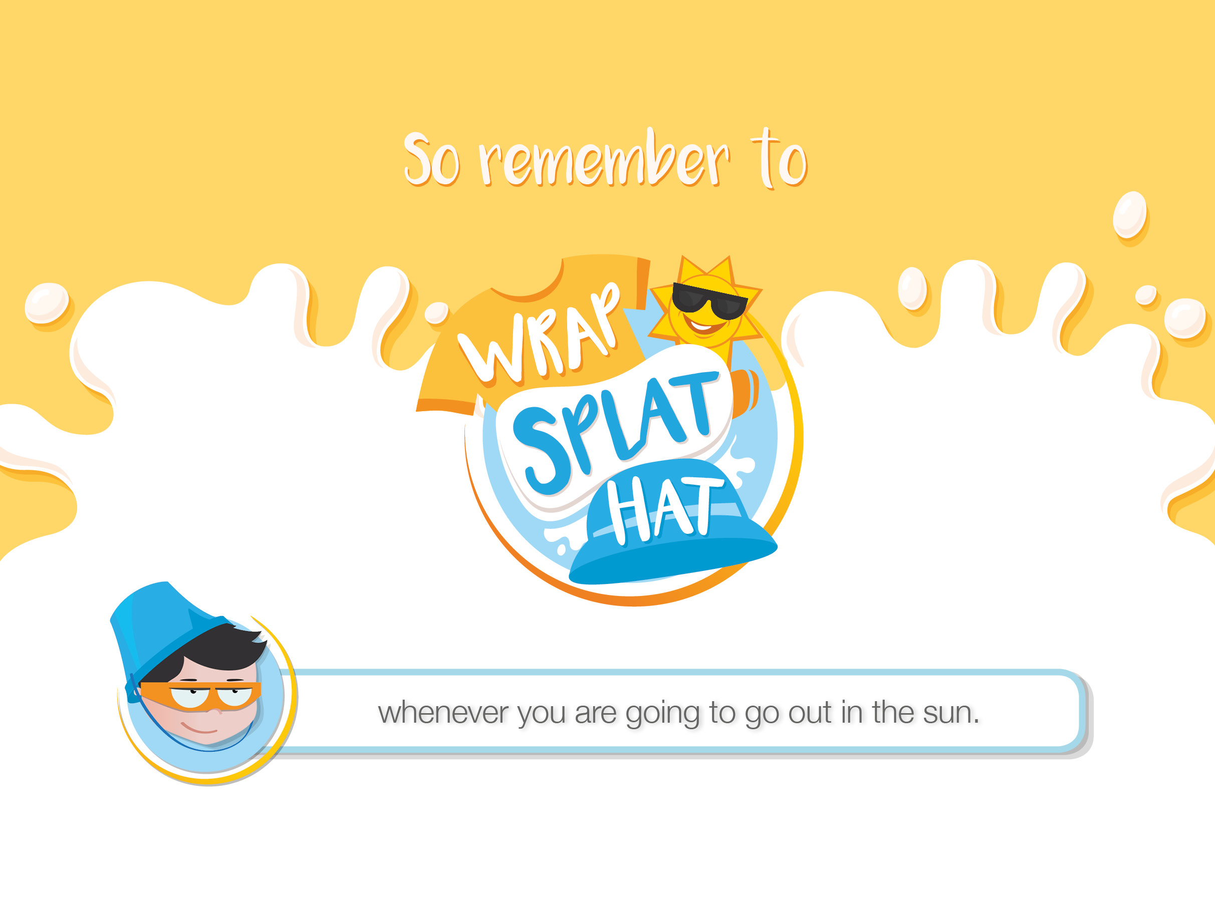
Notes:
You could ask children to shout out the message as loudly as they can.

