Slide 1

Welcome To
Year 1
Information Evening
September 2025
With
Mrs Moloney & Mrs Morris

Slide 2
Class Teachers
Mrs Moloney
Monday/Tuesday/Wednesday
Mrs Morris
Thursday/Friday
(and alternate Wednesday pm)
Teaching Assistants
Mrs Balden – Tues, Wed, Thurs all day.
Miss Davidson - Monday all day and Friday am

Slide 3
Routines
8.45 am: Line up whistle
Coats/planners/water bottle/book bags away
9am: Worship
9:20 am Lesson 1 Maths
10:15am: Break time – Fruit and milk
10:30am: Lesson 2 – Phonics and English
12:00pm: Prayers then Lunch time
1:00pm: Lesson 3 - Foundation subjects
2:00pm: Breaktime – small healthy snack from home
2:10pm: Lesson 4 – Foundation subjects
3:00pm: Story time
3:15pm: Prayers then Home Time
Foundation subjects are:
Science, History, Geography, DT, Art, PSHE, PE, Music, My Happy Mind
*One to one and guided reading activities for small group reading take place across the school day and week.

Slide 4
Key messages
Please put any messages or letters in planners, as book bags are not checked daily.
Name all clothing
Milk – Contact the office if you would like to pay for your child to have milk each day.
Class dojo
Star of the day (badge)

Slide 5
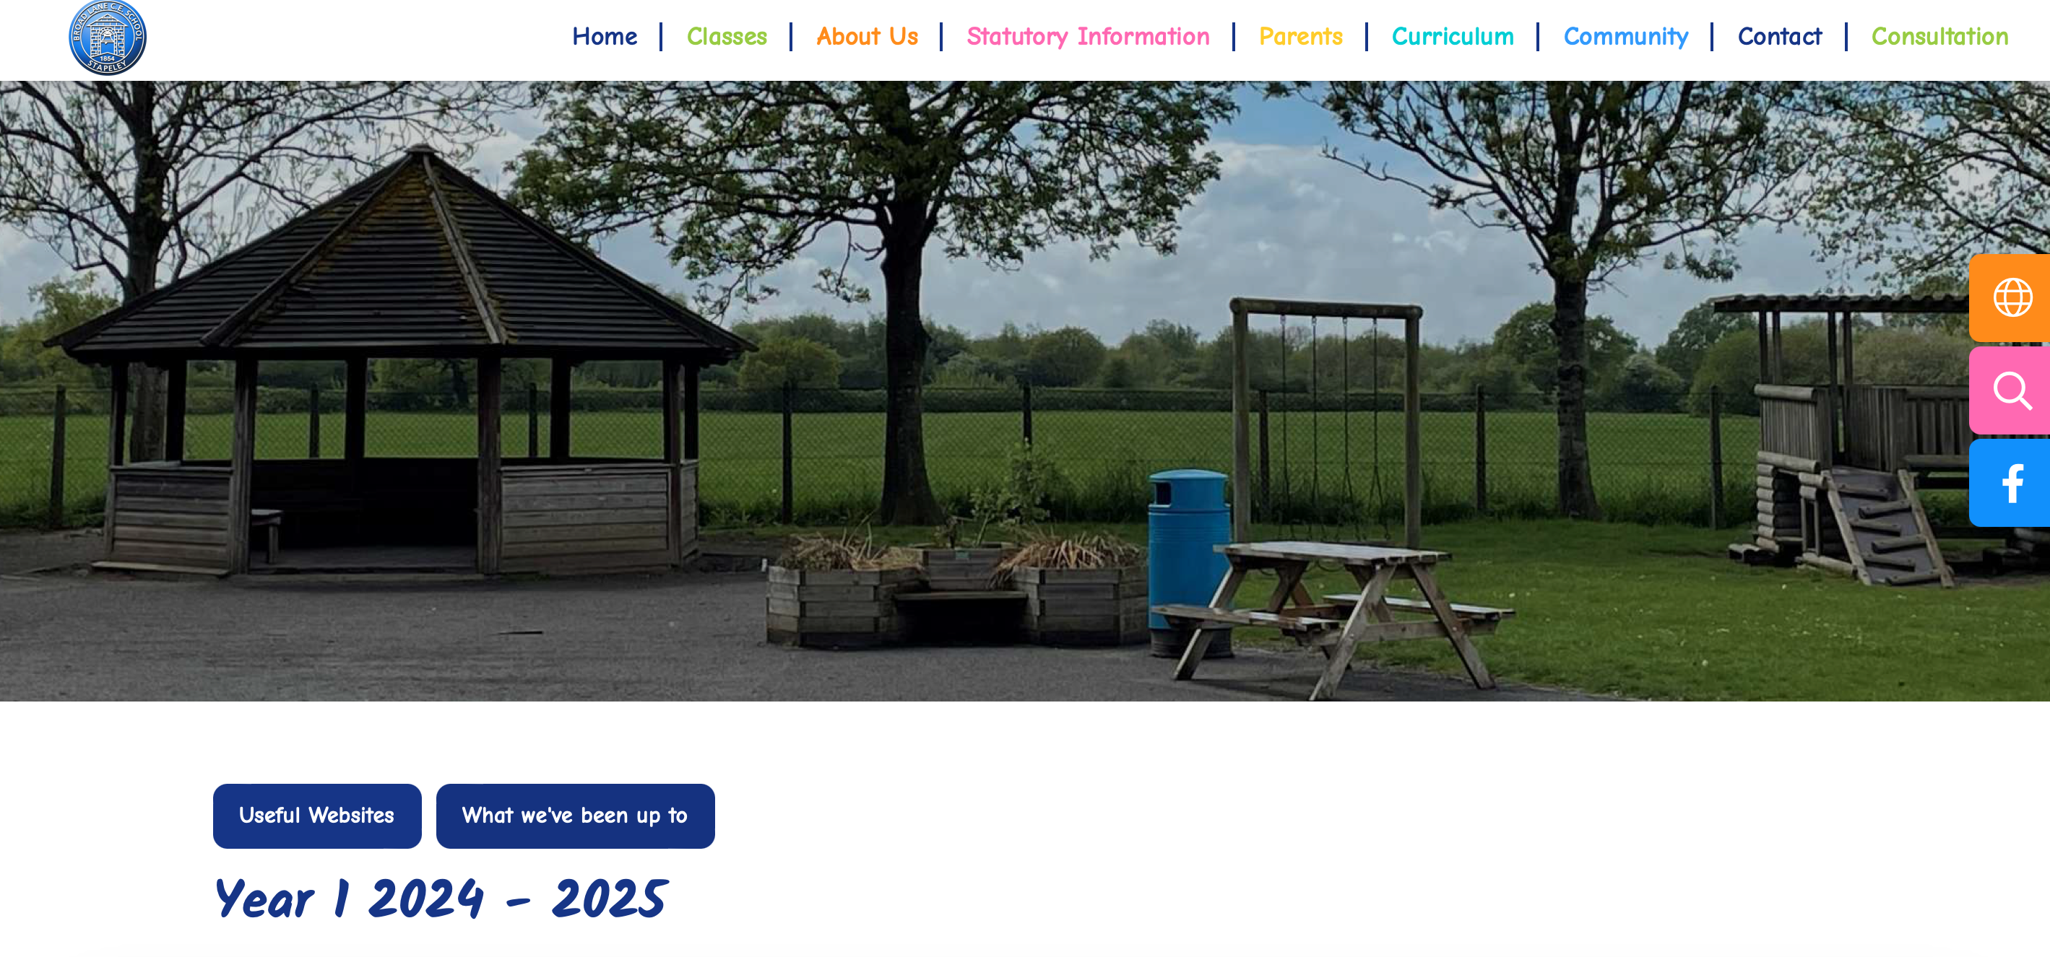
Curriculum
Coverage for the Autumn term can be found on the class page of the website.

Slide 6
Seating
Children have table places where they sit for the majority of the time. These change every so often, usually half-termly.
Table places may be different for Maths and English.

Slide 7

Reading in Year 1
Children continue to engage in the school’s phonics programme Little Wandle.
Children will have a 30 minute phonics lesson each day and are encouraged to use the strategies taught when reading and writing in other lessons and at home.
Children are now expected to read with a degree of automaticity, as this will allow them to progress onto the next level in their reading ability.
Assessments continue to happen each half term
How does phonics look in Year 1?

Slide 8
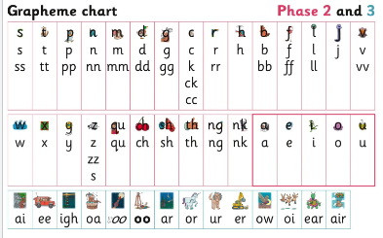
Reception – Phase 2 and 3
Find me on the phonics page of the school website.

Slide 9
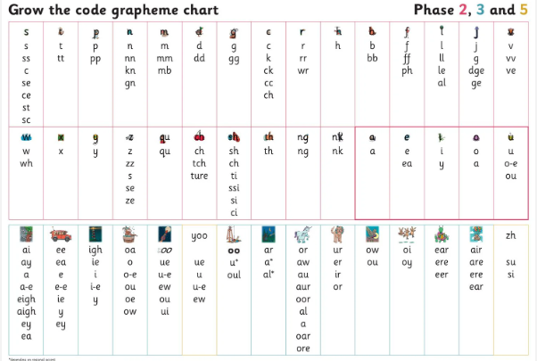
Year 1 – Phase 2, 3 and 5
Find me on the phonics page of the school website.

Slide 10


Let’s take a look…
ai – tail in the rain
play
paper
shake
eight
straight
grey
break
Can you think of any other examples?

Slide 11
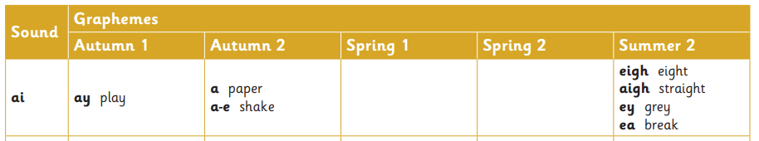
An example of the progression
Find me on the phonics page of the school website.

Slide 12



Spellings and Tricky Words
Each lesson has a spelling element to it.
Say it – Segment it – Count the sounds
Model writing the word
Hide the word
Have a go
Check it together
Tricky words are taught by see it, say it and we always identify and model the tricky part.

Slide 13
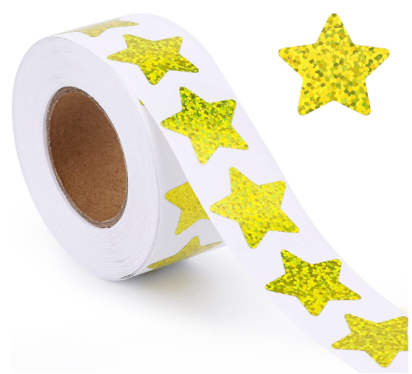
Reading at home and eBooks
2 levelled reading books (changed weekly)
1 eBook to match the reading practice text, child engagement to be celebrated each half term.
Details of how to access the eBooks was emailed last week.
Login details for each child are in their planners.
Reading for pleasure book (Star books)

Slide 14
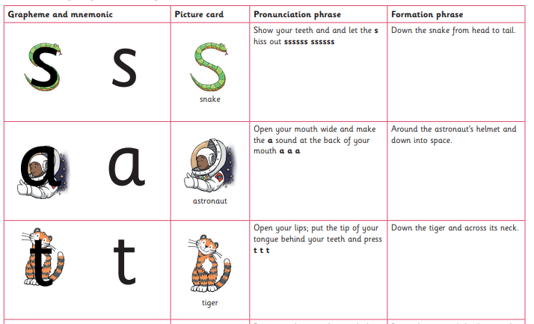
Handwriting
We continue to use the grapheme and mnemonics taught in Reception to help remind children of the letter formation.
Formation of capital letters is also taught.
Year 1 will have regular handwriting practice sessions throughout the week to support their progress in handwriting.
Find me on the phonics page of the school website.

Slide 15
Writing in Year 1
We encourage the children to develop a positive attitude towards writing by writing in a range of genres – narrative, poetry, reports, instructions, recounts etc.
We encourage the children to think it, say it, write it , read it!
Children are asked to ‘read back’ their work and correct mistakes.
We focus on the main punctuation: Capital letters, finger spaces, full stops, question marks and exclamation marks.

Slide 16

Literacy Tree
We teach writing by following the Literacy Curriculum - Literacy Tree alongside our phonic programme.
This is a complete, thematic approach to the teaching of primary English.
It places children’s literature at its core.
Using high quality texts to engage the children in their learning.

Slide 17

The Phonic Screening Check
Every Year 1 child in the country will be taking the phonics screening check in the same week in June.
The aim of the check is to ensure that all children are able to decode any word that they come across. For this reason, the word is made up of real and non-sense words.
This ‘midpoint check’ will ensure that we have a clear understanding of what the children need to learn in year 2. If needed, the children will resit the test in Year 2.

Slide 18


What will the children
be expected to do?
The check is very similar to tasks the children already complete during phonics lessons.
Children will be asked to ‘sound talk and blend’ the sounds together.eg d-o-g - dog
The focus of the check is to see which sounds the children know and therefore the children will be asked to read pseudo ‘nonsense’ words.

Slide 19
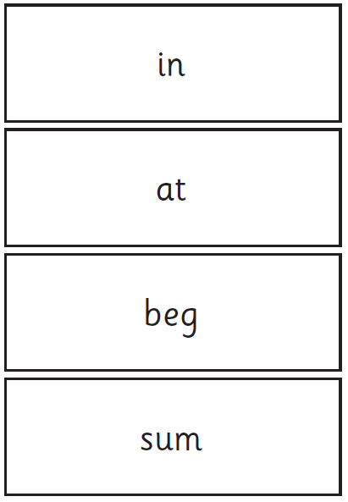
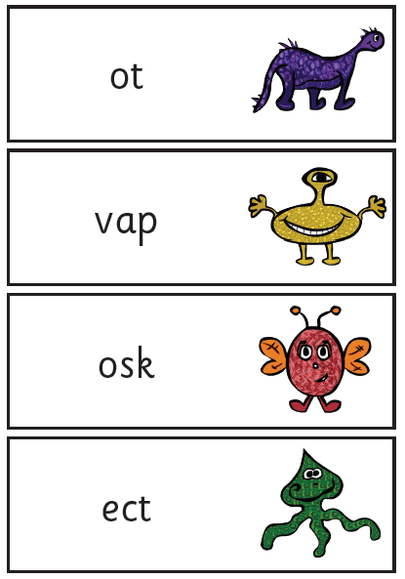
Examples of words:

Slide 20

When will the
screening take place?
The screening will take place throughout the week beginning Monday 9th June 2025. The children cannot retake the test at any other time so it is very important your child is in school during this week.
The check has been designed so that children of all abilities will be able to take part.
Results will be published in your child’s school report at the end of the year.

Slide 21

Who will complete the check?
The children will complete the check one at a time in a quiet area of the school.
The class teachers will conduct all of the screening checks with the children.
The screening will take around 10 minutes.

Slide 22
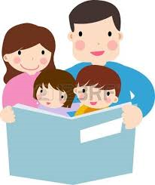
How can you help?
Please continue to read with your child each night and encourage them to:
Sound out
Re-read to check it makes sense.
Use pictures for clues.
Ask questions about the book.
Discuss words they don’t understand.
And most importantly ENJOY READING!

Slide 23
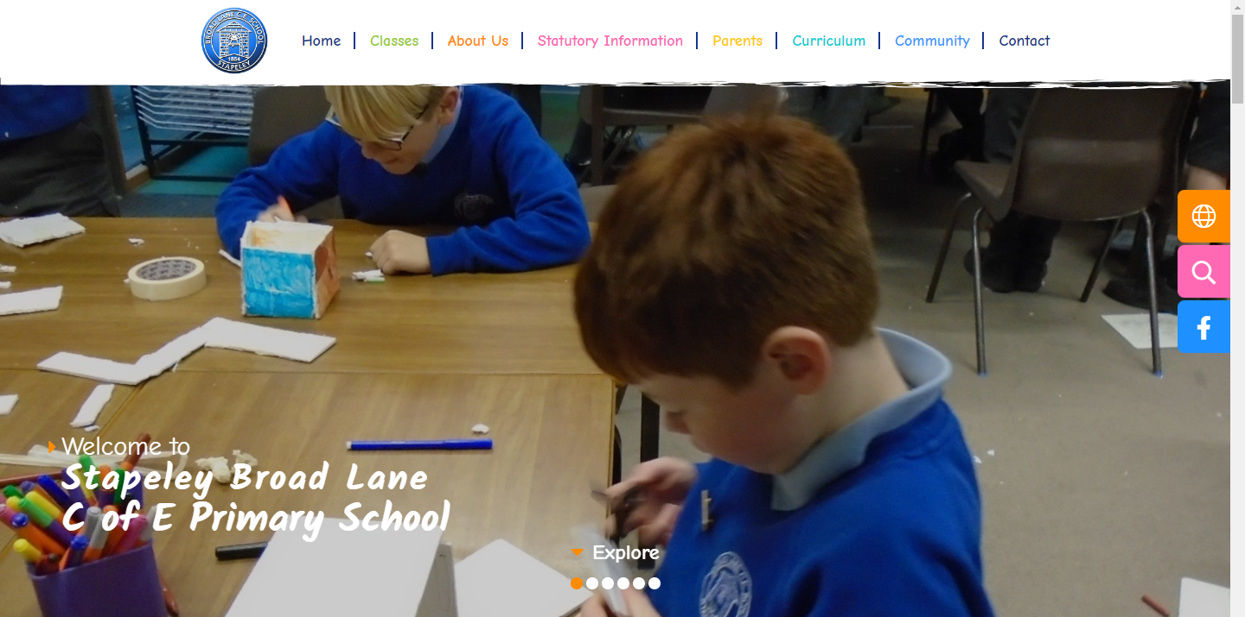
Phonics support and resources on the school website

Slide 24
Mathematics
We follow Oak Academy maths framework at Stapeley Broad Lane.
The children will engage in an interactive whole class input and then work practically to master mathematical skills before recording their knowledge through written activities.
A number formation sheet has been added to the homework book to support this topic also.

Slide 25
Homework Learning Tasks
Your child has a homework book to use at home.
A grid has been added to the front of your child’s homework book (grey cover) explaining what to do and giving a variety of tasks for your child to complete over the course of the half term.
The due date will be written at the bottom of the grid each half term.
This is when we will share all the amazing work your child has done at home ☺

Slide 26
Favourite reads book
We have started to create a ‘Class 1’s favourite reads’ book!
Each week we will choose a new child to take the book home and add their favourite story to the collection. This will act like a recommendation to others in the class, so make sure you enjoy reading back what other children have added to the book before you.
It will come home on a THURSDAY and needs returning by WEDNESDAY so that we can share it and pass it on.

Slide 27
Class Author
We are looking for book donations for each of our class authors. If you have any unwanted or duplicate copies written by the following authors, please send them in for us to add to our class library.
Nick Butterworth
Oliver Jeffers
Rachel Bright

Slide 28
Any Questions?
Please email both of us together
cmorris@stapeleybl.cheshire.sch.uk
smoloney@stapeleybl.cheshire.sch.uk
Thank you for attending
☺

