Slide 1
Aims of the meeting
A few questions answered:
How does ‘the phonic scheme’ work?
What and how are you teaching my child in school?
What should be in my child’s reading folder?
How can I help my child at home?
Notes:
DA – run through aims.

Slide 2
How does the phonic scheme work?
The phonic scheme follows the progression of ‘Phonemes’, Grapheme Phoneme Correspondence (GPCs) and tricky words.
It’s organised so that children are taught from the simple to more complex GPCs.
The scheme takes into account the frequency of their occurrence in the most commonly encountered words.
Graphemes taught are practiced in words, sentences and fully decodable books.
Children review and revise GPCs and words, daily, weekly and across terms and years.
Notes:
DA

Slide 3
What is a phoneme?
Phoneme – A single unit of sound
c
t
r
Notes:
CM - orally
Ask parents do they know the phonemes?

Slide 4



What is a grapheme?
Grapheme – How a sound/letter is formed.
Notes:
CM – Use Grapheme cards ‘s h p’ to demonstrate how we teach the Mnemonic and formation.
Resources – Gr cards s h p
grapheme information sheet

Slide 5

How children learn to pronounce these phonemes is extremely important.
This short clip demonstrates how we pronounce each sound clearly.
From the video you can see how purely each sound is made.
There is no schwaring (uh) to the sounds being made.
Notes:
Video – From our phonic scheme platform.
Parent section is very useful.
Include videos on pronunciation.
(Links will be added to class page after meeting)

Slide 6
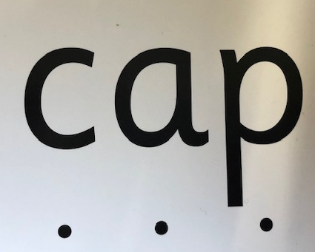
Segmenting and Blending
Segmenting –
Breaking the word down into each phoneme
Blending –
Putting the word back together to hear the word
Notes:
CM
Selection of blending cards to demonstrate sound buttons.

Slide 7
Reading books
Reading levels in Reception and Year 1
We have begun the reading scheme in school already
Phonic assessments are carried out half termly to check ability and ensure children are on the correct level.
Levels are matched to child's phonic knowledge wherever possible but will also challenge their other reading skills at the same time.
Notes:
CM
Resources – example book from each level

Slide 8
Reading bookmark
To be used as guidance to focus the reading time at home
Ensures all aspects of reading are practiced
Follows the same format as our in school reading sessions

Slide 9
Phonic Keyrings
Aimed at helping children to practice the phonemes they may be struggling to remember or need to practice
Added to book bag if and when needed
Regular practice is key!
Let’s take a look at one.
Notes:
CM – Use example to demonstrate.
Role play

Slide 10
Word boxes – sound it out!
Aimed at helping children to practice the art of segmenting and blending.
Not to be rushed. Can be repeated several times as it’s like learning to ride a bike.
Used as a tool to practice at the child’s level, this is either oral blending with adult support or segmenting and blending independently.
Let’s take a look at one.
Notes:
CM – Use example to demonstrate.
Role play

Slide 11
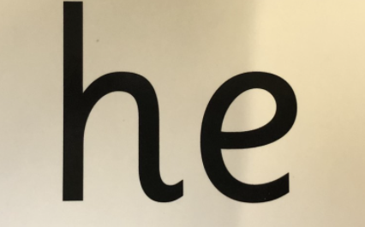

Tricky words – See it, say it!
High frequency words
Cannot be decoded using the
phonemes that have been
taught up to that point
These will be added after they have been taught for your child to practice at home
Notes:
DA –
Resources – Tricky word cards

Slide 12
What should be in my child’s book bag?
Reading diary/planner
Reading books
Phonic keyring/Word boxes/Tricky words (Please don’t write on these resources as we reuse them.)
Reading for pleasure book (star books)
Please ensure all of this comes into school each day so we can use it during learning times.
Notes:
DA –
Resources
Planner
Books
Word box
Tricky words

Slide 13





Reading for pleasure
Enjoy a good bedtime story
These help children to learn to love a story, follow the patterns of a story and build on their knowledge of vocabulary and the world around them.
This experience feeds into their own reading and writing development in the future.
Notes:
DA -

Slide 14

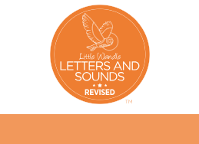
https://www.littlewandlelettersandsounds.org.uk/resources/for-parents/
Little Wandle Parent Support

