Slide 1

Reception Class

Slide 2
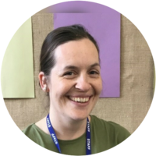
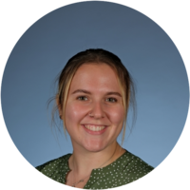
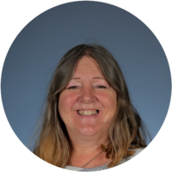
Meet the Staff
Mrs Lawton- class teacher
Miss Fitton- Teaching assistant
Mrs Herbert Jackson- PPA cover (Tuesday afternoons)

Slide 3
Times of the day
8:50 register, lunch choices
9:00 Worship/School worship
9:15 phonics and maths
10:00 playtime
10:15 Literacy then busy time
11:40 story, hand wash and toilet
12:00 lunch
1:00 registration and afternoon session (learning focus, PE, RE, French etc)
2:00 playtime
2:10 afternoon input (dough disco, oral story telling, music etc.)
2:50 story and getting ready for home
3:15 home time

Slide 4
Daily routines
Phonics- Each morning we do phonics sessions and literacy.
Reading- Through the week all children will complete 2 shared read sessions in a small group and will then read with a teacher. This 1:1 read will either be reading a book or reading tricky words. This will alternate weekly.
Assemblies- We will join assemblies next week so these will be built into the children’s day. We didn’t join straight away so that we can build up the timetable for them. Children may enjoy talking about assemblies at home.
Busy time- during the school day after learning times have finished children go to ‘busy time’. This is their choose time to learn and complete activities and challenges set out. They can choose inside or out to get busy and are encouraged to go in different areas for example, not always in the block area or construction.

Slide 5
Topics
Autumn 1- All about me and Friendships
Autumn 2- Diwali and Celebrations
Spring 1- Winter, Chinese New Year and Superheroes
Spring 2- Weather, Springtime and Easter
Summer 1-Under the Sea and Life cycles (caterpillars)
Summer 2-Pirates and Transition
Parent overviews will be sent out at the start of each half term and shared on school website.

Slide 6
Trips
We will go to the panto in December with the whole school! Lovely first school trip.
Aquarium visit either end of spring term or start of summer.
Hands on bug workshop. It was great this year so would like to book that again.

Slide 7
Expectations from parents
Homework
Children will have a homework grid. These can be completed once a week or a few in one go. The homework will be due in the Monday of the last week of half term. Pictures can be shared on Tapestry if you like- not everything needs to be recorded in book. Homework books can stay at home until they are due in- not in book bags as will get scruffy.
Reading
Children will be bringing home a book each week which they choose from our ‘books we love’ that they can share with parents. Reading with your child really helps their phonics and comprehension.
Children will be reading wordless books in school during shared read. We have recently bought into e-books so we will be giving you access to these weekly.
Planners
We would ask that you write any messages or notes in the children’s planners. These get checked each morning so we can read it and respond if needed. Tapestry isn’t always checked daily so planners or emails are better.

Slide 8

Tapestry
Tapestry is a great way of sharing learning so please ensure you check each week. We will post observations and share pictures of things the children have been busy doing.
Remember not to share pictures on social media or anywhere else as these pictures are of your own children and others.
Parents are able to upload observations. We may not have time to always show things each week, but if your child does anything exciting they want to share, then please post. We share as often as possible.
If you struggle with access to Tapestry please contact myself or the school office.

Slide 9
Reminders
Lunches- Children can have hot or cold lunch. This can change each day if needed based on the lunch choices that week. Children tell us in the morning what they are having so it is no problem to swap and change.
Snack- Children are given fruit in the morning but can bring their own snack for the afternoon playtime. Healthy snack please. No nuts.
PE- each Thursday. Children to come in wearing their PE for now.
Book bags and not large bags. During the school day children put pictures in their bookbags and get out their snack for afternoon break. We don’t need bags for anything else. Spare clothes can be left on pegs if needed.
Names please! Still many jumpers and cardigans with no names. It is impossible for them to be returned with no name if they have been left outside or around school.

Slide 10

Contacting us
If you need to contact school or teacher you can do this by:
Phoning or contacting the school office
Email me directly on mlawton@stapeleybl.cheshire.sch.uk
- Write a note in planners
Talk to us on the gate to arrange the best time to talk.

Slide 11
Please feel free to catch me at the end if you have any questions.
Thank you

