Slide 1
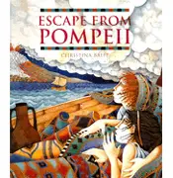
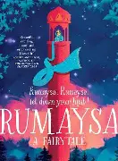
Spring
Mulberry Class
Maths
We are covering a variety of topics this term including bar charts, area, estimates, problem solving, and using coordinates.
Please encourage your child to access Times Tables Rock Stars at home.
Writing
Our writing book is Escape from Pompeii
We will be learning about direct speech, grouping paragraphs, fronted adverbials and expanding our vocabulary.
Reading
Our class novel is Rumaysa: A Fairytale by Radiya Hafiza.
We will also do a Whole Class Reading lesson every day, usually about our other subjects.
How To Help
Read often with your child and talk to them about what they have read.
Science
States of Matter
Exploring gases, liquids and solids including the Water Cycle.
How To Help
Discuss different states of matter you may see at home.
Geography
Volcanoes
How To Help
Use Google Earth to look at world volcanoes. You could also watch videos of volcanoes erupting.
Computing
We will be learning about how to compose an email
How To Help
Watch videos about communication online
RE
Hinduism and Manir
How To Help
Research religious symbols and places.
Art
Pointillism
How to help
Research the artist Suerat.
PE is on a Thursday afternoon. It will be handball, and throwing and jumping
Year 4 also have forest school on a Tuesday.

