Slide 1
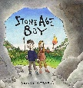
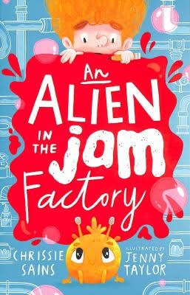
Spring1
Juniper Class
Maths
We will be working on topics including:
X and ÷ problems
Finding fractions of an amount
Rounding to the nearest 10 and 100
How To Help
Practise times tables, including related division (e.g. – 3x5=15 so 15÷3=5)
Writing
Our writing book is
Stone Age Boy
Build a rich and varied
vocabulary, use the correct tense in writing and punctuate speech.
How To Help
Practise picking out interesting words when reading and seeing if they can use it correctly.
Reading
Our class novel is Alien in the Jam Factory.
We will also do a Reading lesson every day, usually about our other subjects.
How To Help
Read often with your child and talk to them about what they have read.
Science
Rocks and Soils
We will compare and group together different kinds of rocks. Learn how fossils are formed and recognise that soils are made from rocks and organic matter.
How To Help
Look out for different rocks and what their purpose is.
History
We will be learning about Stone Age .
How To Help
Talk to your child about what they have learnt – can they quiz you?
Watch videos together about Stone Age.
Computing
We will be working on designing a web page about the Stone Age.
How To Help
Give your child chance to type on a keyboard.
RE
Christianity
What is the Bible?
How To Help
Talk about special books they have. What makes the special?
DT
British Inventors
Exploring different inventors and inventions that have made a difference to our lives.
How To Help
Research how an everyday object was invented.
PE is on a Monday afternoon.
PSHE is Safety and the Changing Body.
Music is Latin percussion.

