Slide 1
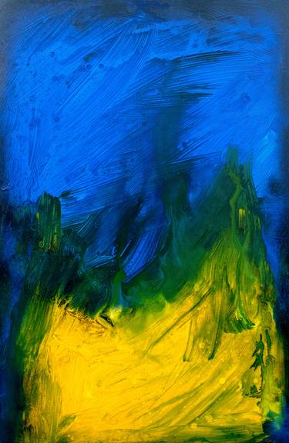

Welcome to Year 3

Slide 2
Juniper Class

Slide 3

Daily Timetable:
8:35 – 8.45 | Skills check and reading
8.45 – 10.00 | Maths
10.00-10.15 | Break
10.15-11.00 | Whole Class Reading / Fluency/ Handwriting
11.00-12.00 | English
12.00-1.00 | Lunch
1.00-1.15 1.15-1.30 1.30-3.15 | Class Novel Spelling Afternoon lessons

Slide 4
Weekly timetable:
PE day is Friday for this half term. Children are to come into school in PE kits and wear them for whole day.
PE Uniform
Dark bottoms (joggers, shorts, leggings – but not gym pants!)
White t-shirt
Blue school hoodie
Trainers or pumps

Slide 5
Staffing:
Mrs Clements will be in class Monday, Tuesday, Wednesday and Thursday morning.
Mrs Coneboy will be in class Thursday afternoon and Friday afternoon.
Miss Bennett is the Year 3 Teaching Assistant.
We also have a number of other adults who support with individual and groups of children: Mrs Jones, Mrs Jones, Mrs Buswell and Mr Etty.

Slide 6
Introducing OPAL (Outdoor Play and Learning)
This year we will be starting the OPAL programme at our school. OPAL is all about improving playtimes so that children have more fun, more freedom and more chances to learn. We want to make play as important a part of the school day as maths and English.
Children will have the chance to use a wider range of play equipment and materials.
Playtimes will become more active, creative and social.
Research shows that better play helps children’s happiness, confidence, attendance and learning in class.
The big idea is simple: if we improve play, we improve the whole school experience for every child.

Slide 7
Changes:
Children all have play at the same time, and there are no set areas where children can go. The whole yard is for every child to access.
Play is led by the children and adults monitor and make sure everyone is safe.
Children have access to many materials such as dressing up costumes, kitchen equipment, sports equipment and small world items.
As we move through the programme more, things such as tyres and scooters will begin to be introduced. Forest school will eventually always be open.
Football has been reduced to give all the children more opportunities to play in smaller boosts. At lunchtimes this is refereed by a sports coach.
Play will take place in all weathers, and the field is always open, so it would be useful if all children could have wellies in school all the time.
We will be asking for small donations of used items throughout the year from small businesses, parents, and other members of the local community and any help is greatly appreciated. Please see the class teacher if you feel you have something that could be donated.

Slide 8
Trips and Visits:
During the year there will be a trip to Beeston Castle.

Slide 9
Reading:
We would encourage all children to read at home. It has a huge impact on all subjects across the curriculum.
Children will have a reading book that suits their needs.
We will show children when and where to change their books so they become as independent as possible when doing this!
Children will also have access to the school library and can bring a book home.

Slide 10
Year 3 will all have times table rock stars login – please download app and allow children time to play.
Spelling lists will also be sent home.

Slide 11


Identity:
Our new topic for the half term which will underpin all our learning is Be yourself: everybody else is already taken.

Slide 12
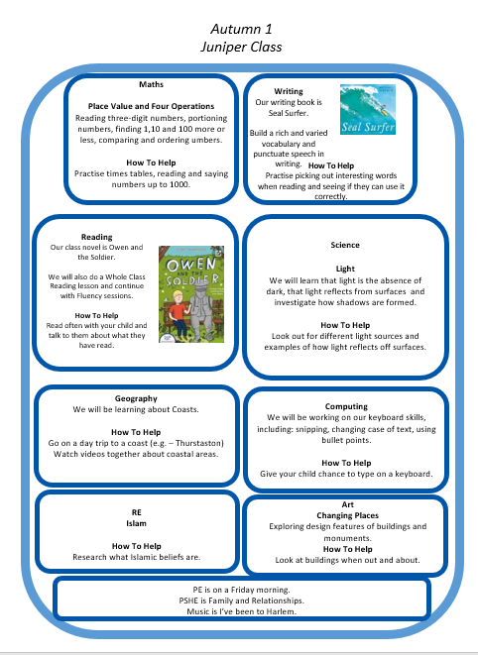

Slide 13
Keeping in touch:
If you need to speak to us, you just need to call the school office to arrange this before hand. Alternatively, you can catch us once all the children have left at 3.15 (either in person or by phone).
Some children walk to the gate – if you want your child to do this I can add them to my list!
FREE BREAKFAST CLUB starts at 8.15

