Slide 1
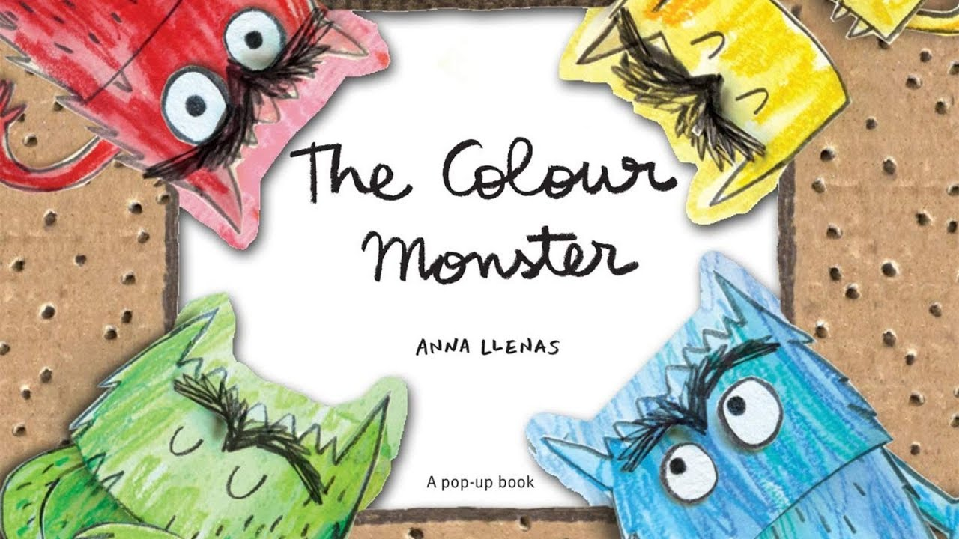
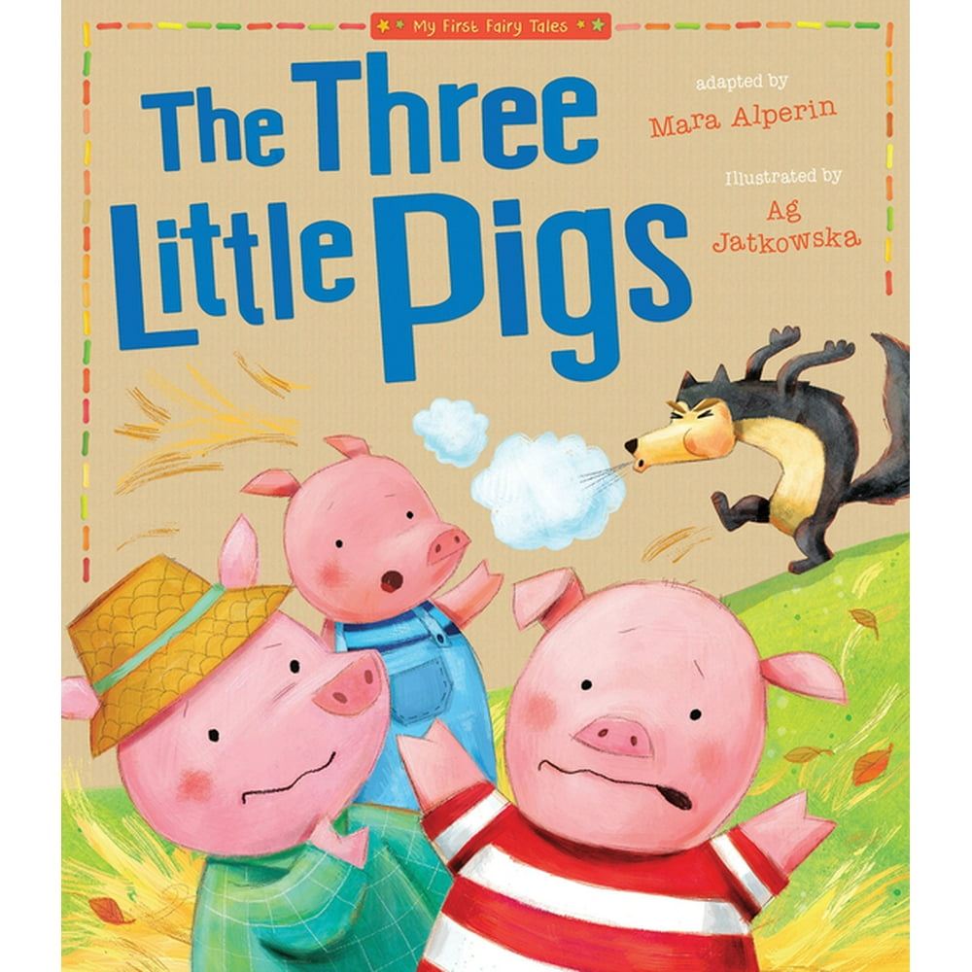
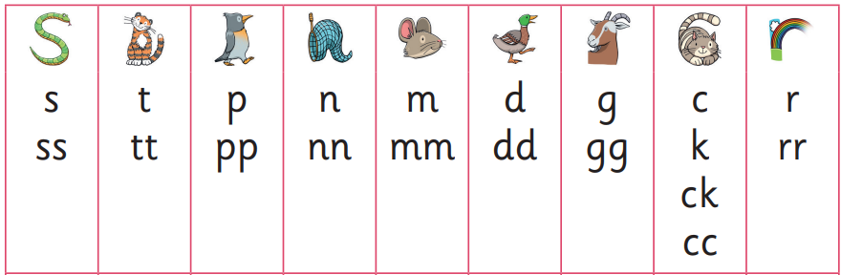
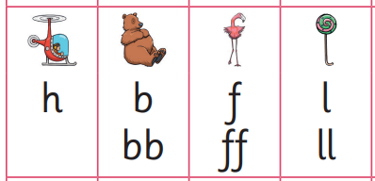
Autumn 1
Sycamore Class
Maths
Number
Counting sets of up to 5. recognizing numerals to 5
How To Help
Practice counting objects around the home.
English
Our writing books are Colour Monster and The Three Little Pigs.
How To Help
Practice forming letters from our phonics list.
Phonics
We will be learning Phase 2 sounds.
How To Help
Encourage your child to read their reading book to you.
Understanding the World
We will explore seasonal changes of autumn and learn about Diwali.
How To Help
Go on a walk around your local area and search for signs of autumn
Expressive Art and Design
We will be mixing autumnal colours and creating Rangoli patterns.
How To Help
Make pictures with autumn treasures such as acorns, leaves, twigs.

