Slide 1
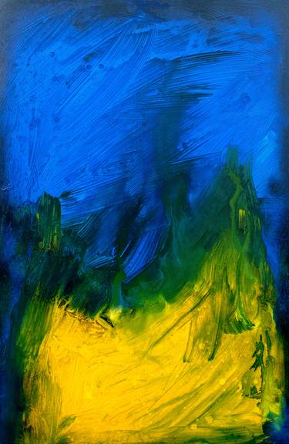

Welcome to Year 3

Slide 2
Juniper Class

Slide 3
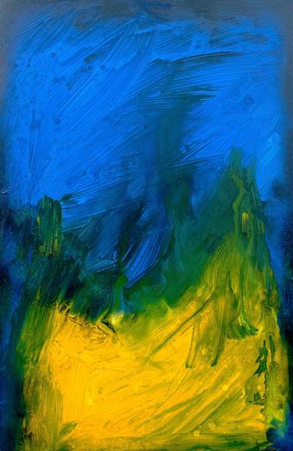
Daily Timetable:
8:35 – 8.45 | Skills check and reading
8.45 – 10.00 | Maths
10.00-10.15 | Break
10.15-11.00 | Whole Class Reading / Fluency/ Handwriting
11.00-12.00 | English
12.00-1.00 | Lunch
1.00-1.15 1.15-1.30 1.30-3.15 | Class Novel Spelling Afternoon lessons

Slide 4
Weekly timetable:
PE day is Friday for this half term. Children are to come into school in PE kits and wear them for whole day.
PE Uniform
Dark bottoms (joggers, shorts, leggings – but not gym pants!)
White t-shirt
Blue school hoodie
Trainers or pumps

Slide 5
Staffing:
Mrs Clements will be in class Monday, Tuesday, Wednesday and Thursday morning.
Mrs Coneboy will be in class Thursday afternoon and Friday afternoon.
Miss Bennett is the Year 3 Teaching Assistant.
We also have a number of other adults who support with individual and groups of children: Mrs Jones, Mrs Jones, Mrs Buswell and Mr Etty.

Slide 6
Trips and Visits:
During the year there will be a trip to Beeston Castle.

Slide 7
Reading:
We would encourage all children to read at home. It has a huge impact on all subjects across the curriculum.
Children will have a reading book that suits their needs.
We will show children when and where to change their books so they become as independent as possible when doing this!
Children will also have access to the school library and can bring a book home.

Slide 8
Year 3 will all have times table rock stars login – please download app and allow children time to play.
Spelling lists have also been sent home.

Slide 9

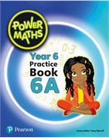
Identity:
Our new topic for the half term which will underpin all our learning is Be yourself: everybody else is already taken.

Slide 10


Autumn 1
Juniper Class
Maths
Place Value and Four Operations
Reading three-digit numbers, portioning numbers, finding 1,10 and 100 more or less, comparing and ordering umbers.
How To Help
Practise times tables, reading and saying numbers up to 1000.
Writing
Our writing book is
Seal Surfer.
Build a rich and varied vocabulary and punctuate speech in writing.
How To Help
Practise picking out interesting words when reading and seeing if they can use it correctly.
Reading
Our class novel is Planet Omar.
We will also do a Whole Class Reading lesson every day, usually about our other subjects.
How To Help
Read often with your child and talk to them about what they have read.
Science
Light
We will learnt hat light is the absence of dark, that light reflects from surfaces and investigate how shadows are formed.
How To Help
Look out for different light sources and examples of how light reflects off surfaces.
Geography
We will be learning about Coasts.
How To Help
Go on a day trip to a coast (e.g. – Thurstaston)
Watch videos together about coastal areas.
Computing
We will be working on our keyboard skills, including: snipping, changing case of text, using bullet points.
How To Help
Give your child chance to type on a keyboard.
RE
Islam
How To Help
Research what Islamic beliefs are.
Art
At the pantomime
Exploring design features of a pantomime.
How To Help
Look at images of a pantomime.
PE is on a Friday afternoon.
PSHE is Family and Relationships.
Music is I’ve been to Harlem.

Slide 11
Keeping in touch:
If you need to speak to me, you just need to call the school office to arrange this before hand. Alternatively, you can catch us once all the children have left at 3.15 (either in person or by phone).
Some children walk to the gate – if you want your child to do this I can add them to my list!

