Slide 1

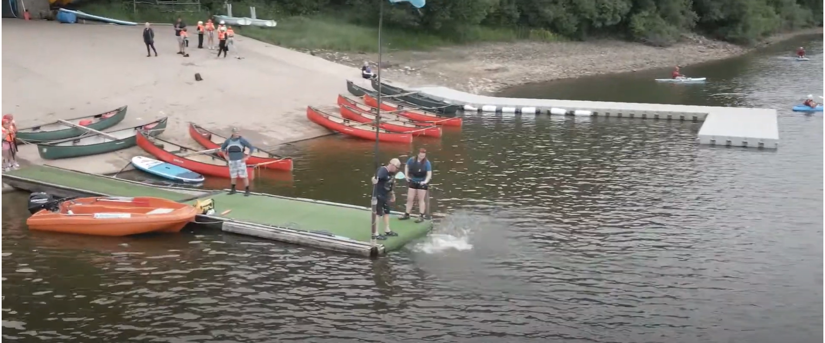

Slide 2
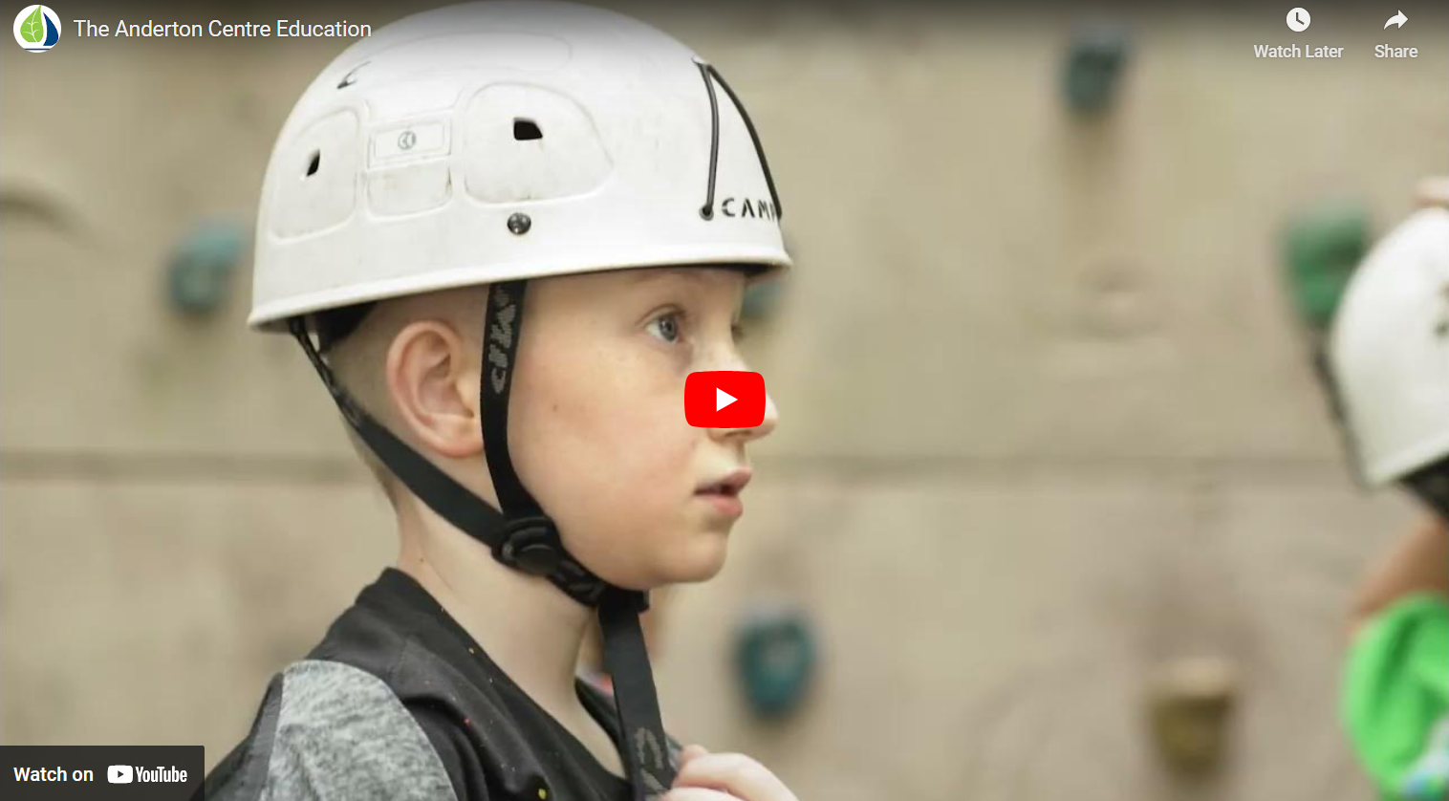
Notes:
Explore website

Slide 3
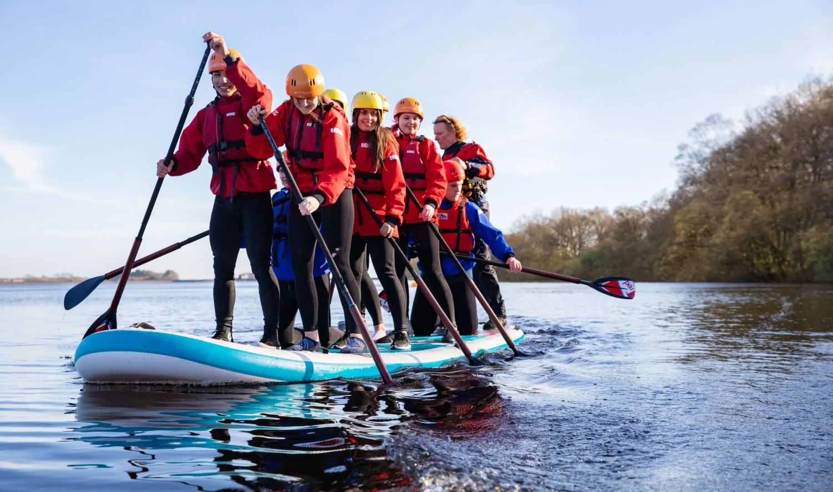
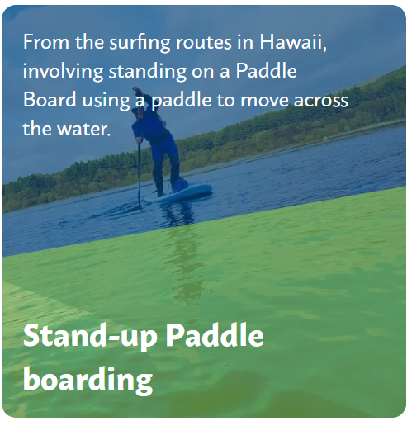

 | Itinerary – Day 1
1pm | Arrive & Sitewalk
1.30pm | XL Stand-up Paddleboards
4pm | Check In
5pm | Evening Meal
6pm – 8pm | Bushcraft
Notes:
Packed lunch (disposable) Arrive at school non-uniform. Coach will leave school at 12pm

Slide 4


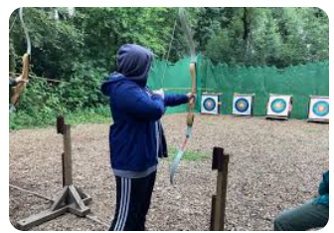
 | Itinerary – Day 2
8.30am | Breakfast
9.30am | Archery / High All Aboard / Tree Climb
12.30pm | Lunch
1 – 4pm | Rafted Open Canoes
5pm | Evening Meal
6-8pm | Forest Craft
Notes:
Message on school spider to say when we will be on our way

Slide 5
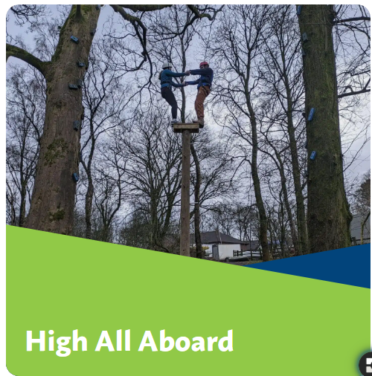
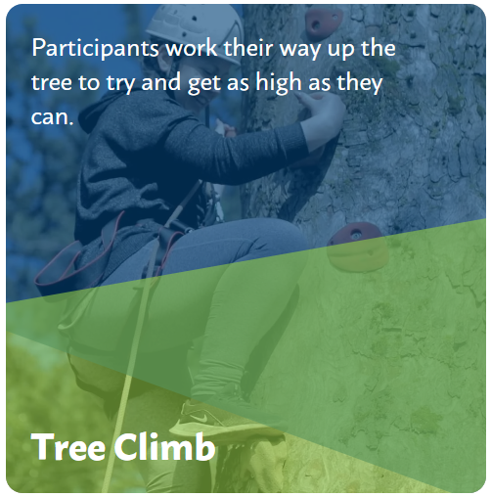
 | Itinerary – Day 3
1pm | Breakfast
9.30pm | Archery / High All Aboard / Tree Climb
12.30pm | Lunch
1pm | Return to School

Slide 6
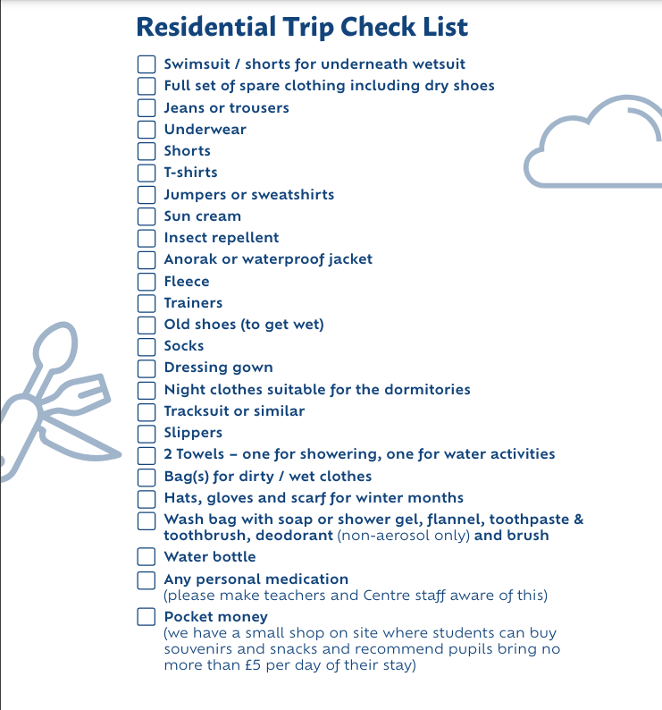
Notes:
Medical form

Slide 7


