Slide 1

Welcome to Year 4!
Meet the Teacher Meeting
September 2025
We Can Do It!

Slide 2
Meet the Team
Year 4G
Teacher- Mrs Glover
Teaching Assistant- Miss Copoc

Slide 3
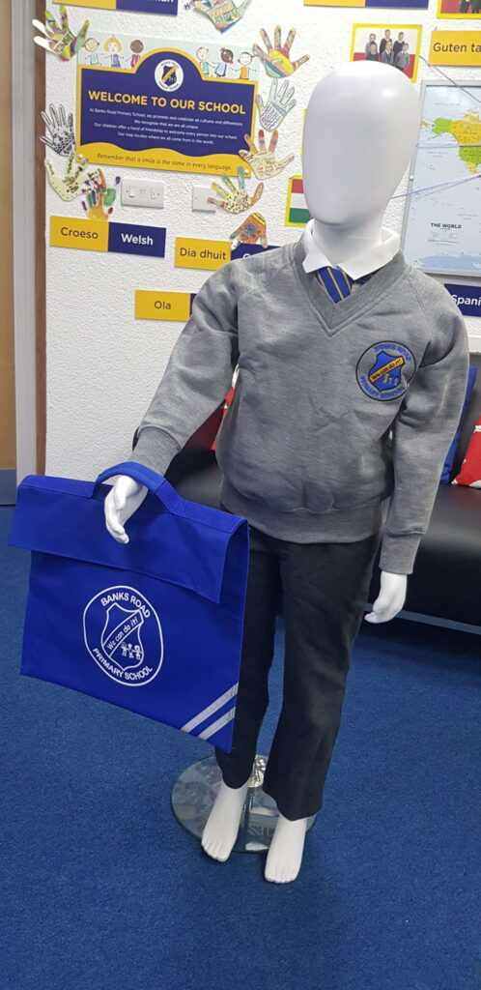
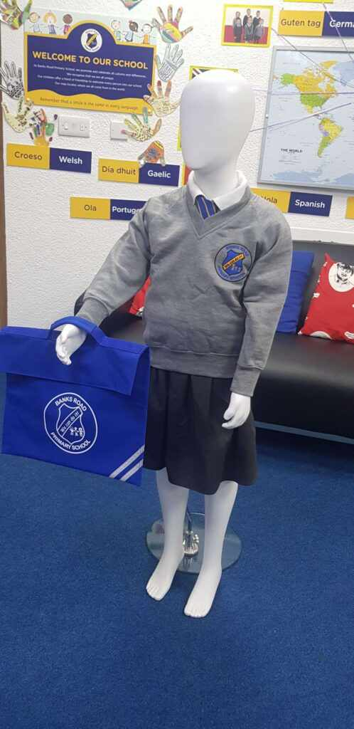
Uniform
Dark grey skirt/trousers
Polo shirt/shirt and tie – white
Grey sweatshirt/cardigan
White, black or grey socks
No false nails or nail varnish
No jewellery other than stud earrings
Long hair should be tied back

Slide 4
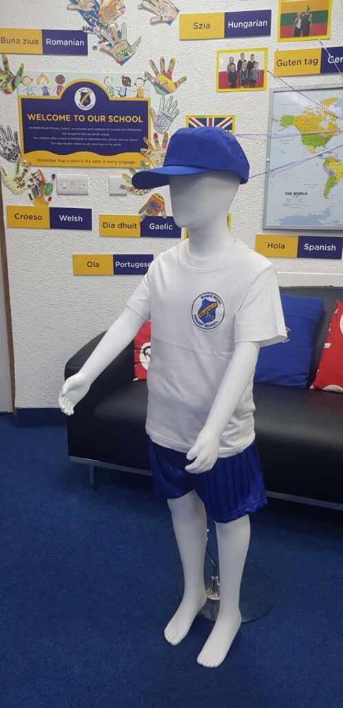
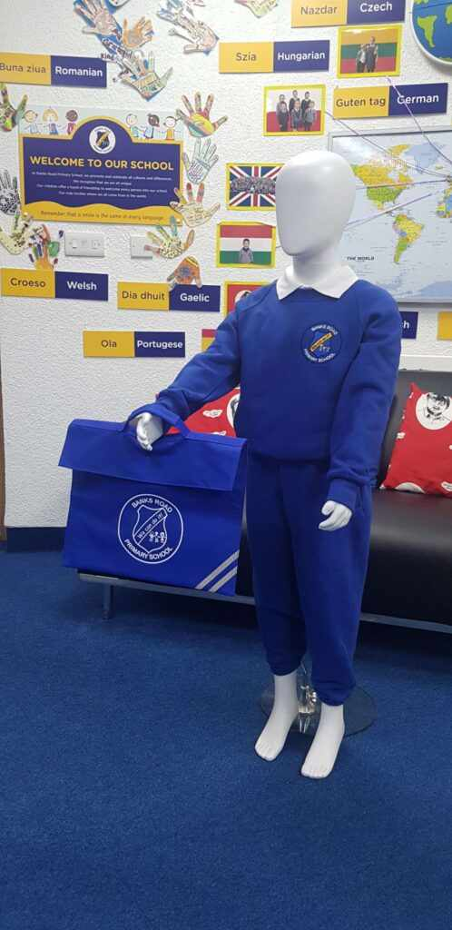
Uniform
On the day that your child has PE, they can come to school in their Banks Road jog suit and remain in this all day.
Alternatively, they can change into their PE kit before the lesson.
Our PE day is Thursday.

Slide 5

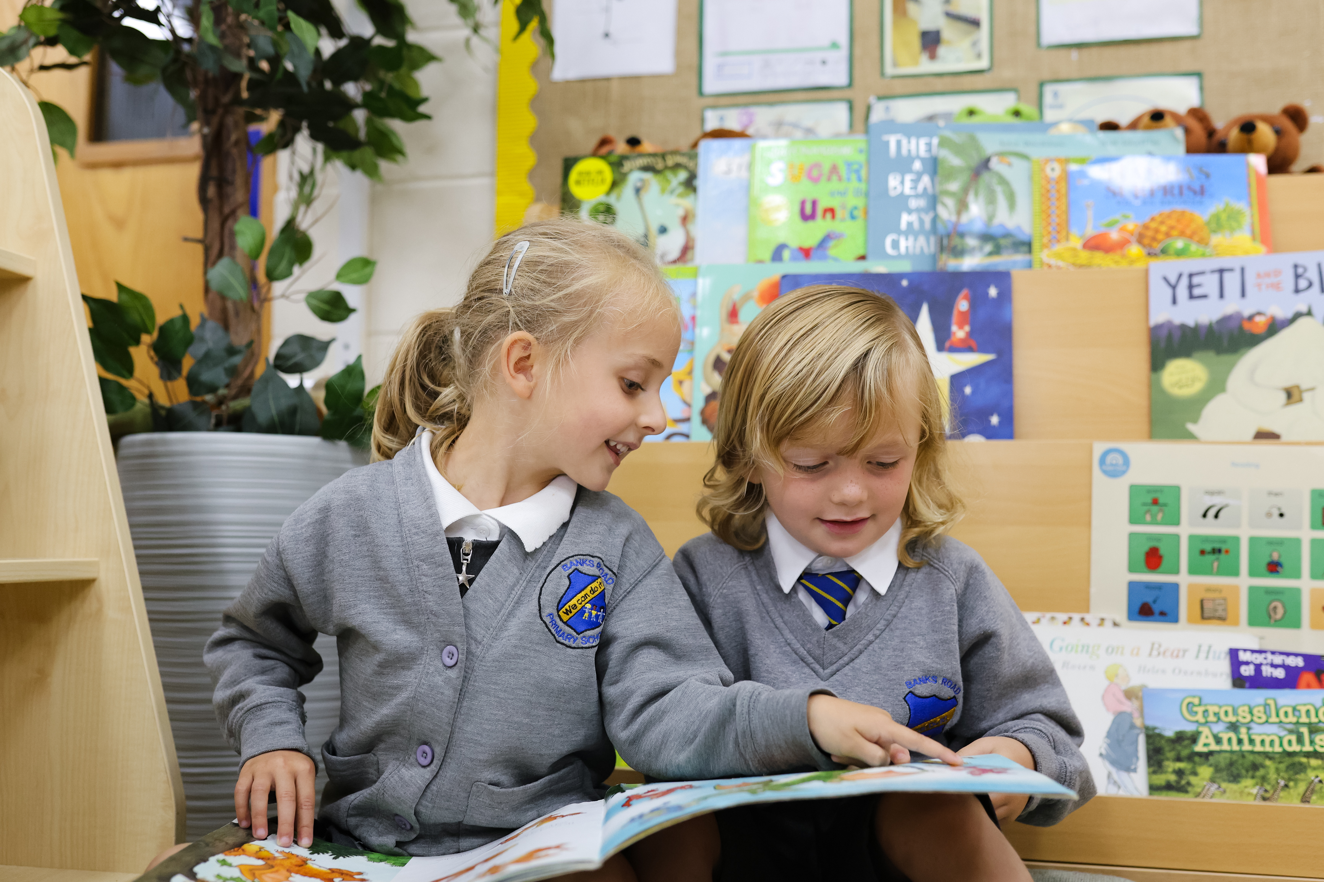
Uniform
Black shoes (no black trainers)
If your child comes in wearing footwear that is not school uniform they will be given a pair of black pumps to wear.
They will be asked to wear the black pumps all day in school and then return them to the school office at the end of the day.
School uniform can still be purchased from the school office.

Slide 6

Behaviour
All children’s behaviour is tracked on the ‘tracking sheet’. This is age-appropriate.
  Different behaviours have different consequences.
  This could result in either a break time detention for children who display a Stage 4 behaviour.
  Additionally, this could result in a lunchtime detention for children who receive a ‘Stage 5’ behaviour.
The Banks Road behaviour scale and behaviour policy is available on the school website under the ‘School Policies’ tab.

Slide 7
Attendance and Punctuality
The government, Liverpool City Council and Banks Road expect children to attend at least 97% of the time.
If your child is not able to attend school, it is essential you contact school as soon as possible in the morning.
A genuine absence is called an authorised absence.
An absence for no good reason or which cannot be explained to the school is called an unauthorised absence. This appears as truancy on your child’s record.
Holidays in term time cannot be authorised. A fine will be issued if you take your children out of school for a holiday.

Slide 8

Attendance and Punctuality
Illnesses that can be managed in school:
Coughs
Colds
Headaches
Sore legs/arms
Tired legs/arms
Conjunctivitis
Cold sores
If you keep your child off school for any of these illnesses, the absence will be marked as unauthorised.
Hand, foot and mouth disease
Slapped cheek syndrome
Sore throat
Worms

Slide 9
Attendance and Punctuality
If your child has five absences in a term, as parents you will be placed on a 20-day monitoring period and your child’s attendance will be monitored by the Education Welfare Service.
If there are further absences you will be issued with a fixed-penalty notice of up to £160. This increases if it not paid on time.
Fines are issued per parent and per child. So if you have two children, parents will receive four separate notices.
Further absences may result in legal action being taken by the local authority.

Slide 10
Attendance and Punctuality
Attendance below 90% is called Persistent Absentism.
Children will fall into Persistent Absentism if they miss the equivalent of one afternoon or morning each week.
10% of missed schooling is the equivalent of an entire month of school each year.
If a child missed 10% of school every year at primary school (Y1 – Y6), they will have missed over half a year of school – 24 weeks!!

Slide 11
Reporting your child’s absence
The following absences will be unauthorised:
  Staying off for birthdays
  Poor weather
  Extra days at the caravan
  Feeling tired
  Uniform not dry
  Headache
  School trip
  Illness, without medical proof
  Staying with grandparents
  Sleeping in
  Sibling off school
  Nobody to bring them to school
  ‘Mental health’ days
  Child ‘not feeling up to it’
  Nobody to collect child at the end of the day
  Worried about a test
  Parents attending a wedding/funeral
  Vaccinations taking place in school
  Parent ‘babysitting’ somebody else’s children
  Car not working
  Parent is waiting for a meeting with someone from school

Slide 12
Reporting your child’s absence
If your child is going to be absent you can contact school by either:
    Telephoning the school office from 8am on 0151 427 4360
    Leaving a message on the school answer machine before 8am. Please note: We will then call you back to see how we can support you in getting your child back into school.
    Contacting Ms Barnes on Class Dojo
If you do not contact school to let us know why your child is absent then we will make a home visit to your home. It is our legal duty to account for every child each morning.
Please do not send class teachers or members of the school’s leadership team messages on Class Dojo about children’s absence. It is unlikely that this message will be read until later on in the school day and the absence may be recorded as unauthorised.

Slide 13
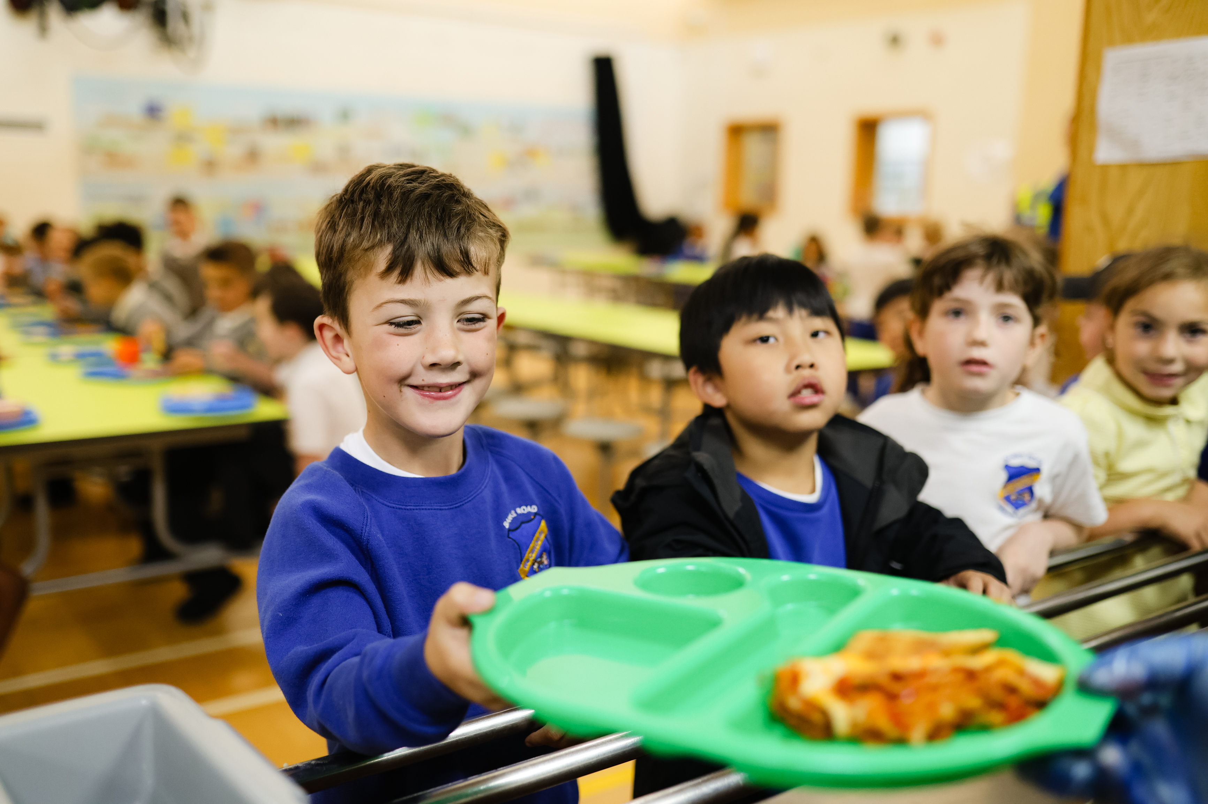

A Day in the Life of Year 4
Calculations
Maths
Shared reading
Break
English
Spellings/Handwriting
Lunch
Break
Foundation subjects/PE/Music/Art
Story of the Day
MTC- Multiplications tables check to be completed May/June
TTRS log-ins needed

Slide 14
P.E.
Children must wear their PE kit every Thursday. Only 1 day a week.
All P.E. kit and uniform must be labelled with your child’s name.
This half term, your child’s P.E. lessons will be with LFC coaching.

Slide 15
Communication with Parents/Carers
If you would like to contact your child’s class teacher, you can:
  Contact them via Class Dojo;
  Speak to them at the end of the school day after you have collected your child;
  Contact the school office to make an appointment.
If you have not yet signed up to Class Dojo please speak with your child’s class teacher directly and they will be able to give you your child’s login details.
ClassDojo is our main method of communication with all parents/carers.

Slide 16
Communication with Parents/Carers
We will communicate with you through a variety of means, including:
  School telephone
  Letter – although we do try to reduce the amount of letters we send out (saving the environment)
  Email
  The school website
  Class Dojo – Most parents/carers are already signed up. If you still need to sign up, please speak to your child’s class teacher.
It is very important that we have up-to-date contact details, including parents’ mobiles.

Slide 17
Reminders
Each day your child must bring:
Their reading bag with their reading book and reading record inside
A bottle of water, which is clearly labelled. There are cups to access tap water in each classroom.
*Children may bring a healthy snack to school. Please do not send in:
    Chocolate
    Jelly sweets
    Chewing gum
    Fizzy drinks
    Sports drinks / Energy drinks

Slide 18
Dropping off and collecting your child from school
School gates open at 8:30am
Classroom doors open at 8:40am
All children must be in school for morning registration by 8:50am
School gates will close at 8:50am
School finishes at 3:15pm for all children, except those in Nursery and Reception who finish at 3:05pm
Attendance and lateness are monitored on a daily basis

Slide 19

Late collection at the end of the school day
We understand that occasionally parents/carers can be late collecting their children from school
However, where this is persistent, this leads to challenges in supervising children who have not been collected after the school day.
Where parents are persistently late collecting their children (after 3:30pm), school will place their children in Kidz Place after school provision. This will incur a charge of £10 per child, payable to Kidz Place.

Slide 20
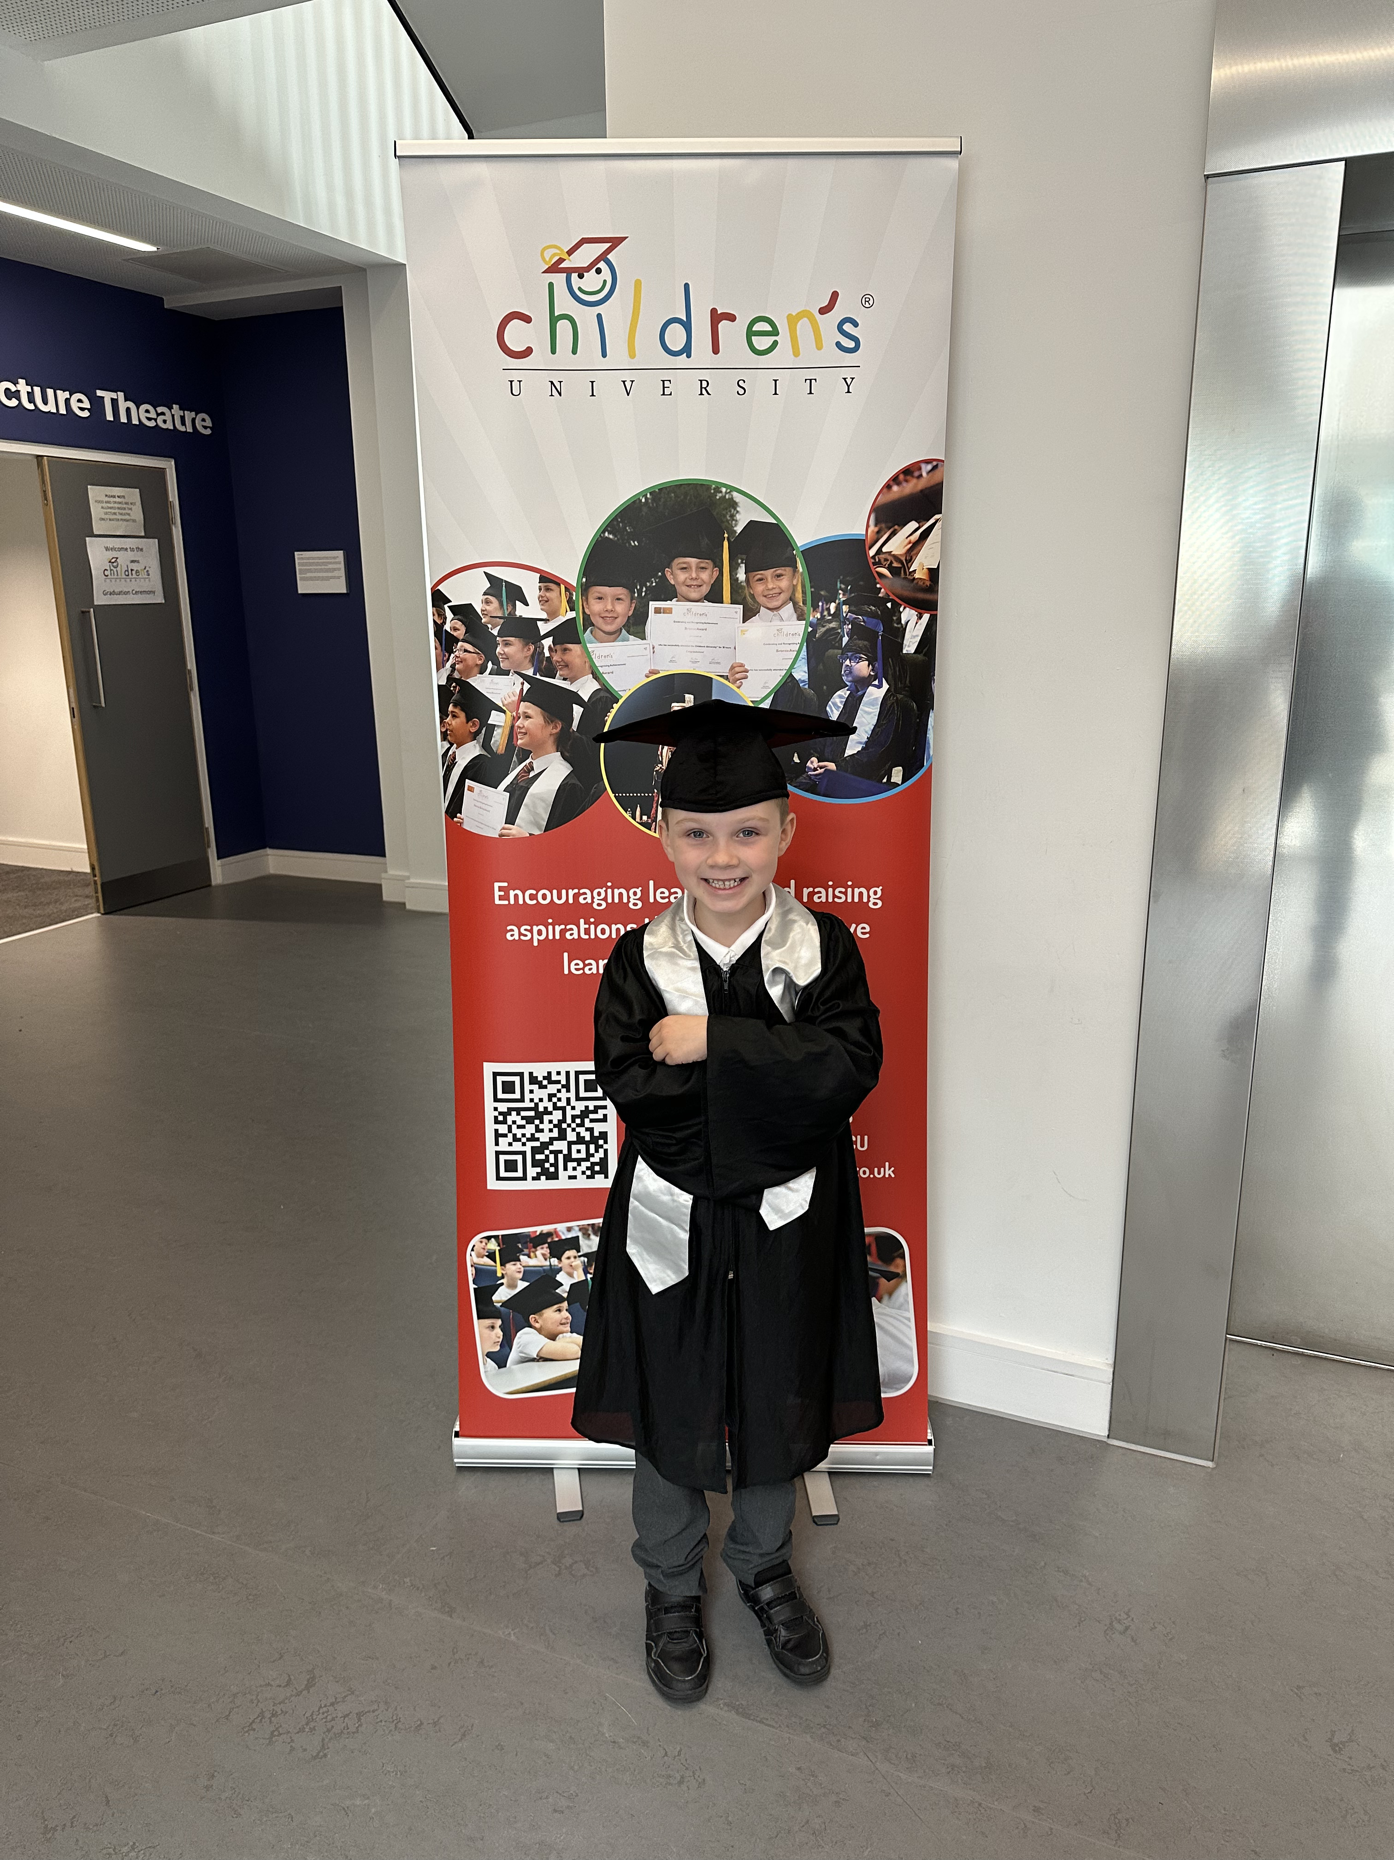
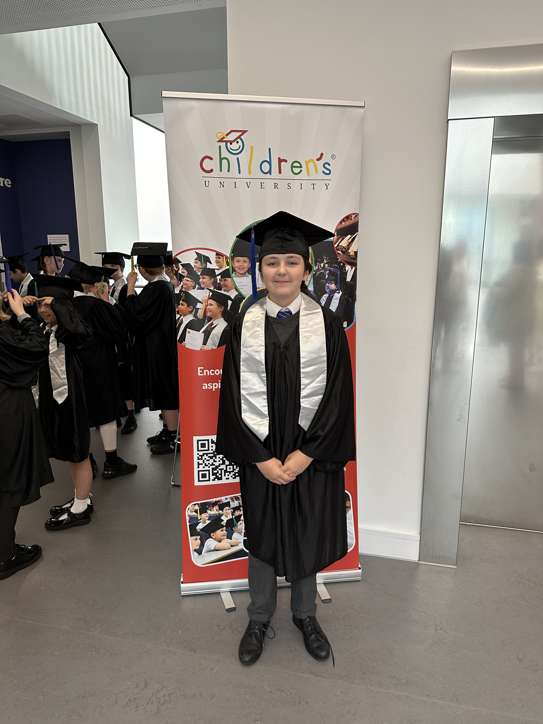
After School Clubs – Children’s University
We offer a range of free after school clubs for all children from Year 1-Year 6. We begin after school clubs for Reception children from January onwards.
Staff at Banks Road give up their own time to put on the after school clubs.
Letters will be handed out this week.
Children can collect credits for attending after school clubs, which can lead to them graduating from Children’s University at the end of Year 2 and Year 6.

Slide 21

Kidz Place at Banks Road
Full wraparound childcare available now:
Breakfast Club
Available from 7:45am
£5.00 per child per session
Afterschool Club
Available until 6:00pm
£10.00 per child per session
Holiday Clubs
Available from 7:45am until 6:00pm
£24.00 per child per day
The staff at Kidz Place can help you work out what support you can access to help pay for childcare.
Contact information
E: banksroad@kidz-place.org T: 0151 338 5454 or 07719 601 001

Slide 22
Relationships, Sex and Health Education
It is statutory for schools to teach the RSHE curriculum and to make parents/carers aware of what we are covering.
At Banks Road, we use a carefully chosen curriculum resource called ‘Jigsaw’.
The Relationships and Health Education elements of RSHE are covered in our ‘Jigsaw’ lessons, in the Summer 2 unit ‘Changing Me’.
The ‘Sex’ element of RSHE is taught within Science lessons as part of reproduction in mammals. It is age-appropriate and is the same content that is taught in all schools throughout England and Wales.
A full overview of what is taught is available on our website under the PSHE tab.

Slide 23
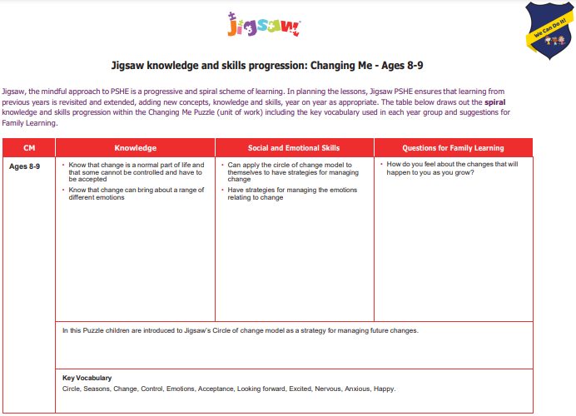
Year 4 RSHE Curriculum

Slide 24






Relationships, Sex and Health Education
Children in Key Stage 2 (Years 3 – 6) also have additional PSHE lessons covering:
  Black History Month
  NSPCC Speak Out. Stay Safe.
  Pride Month (June)
  Anti-Bullying Week
  Our PSHE curriculum is statutory. Parents/carers do not have the legal right to withdraw their children from PSHE lessons, including Relationships, Sex and Health Education.

