Slide 1
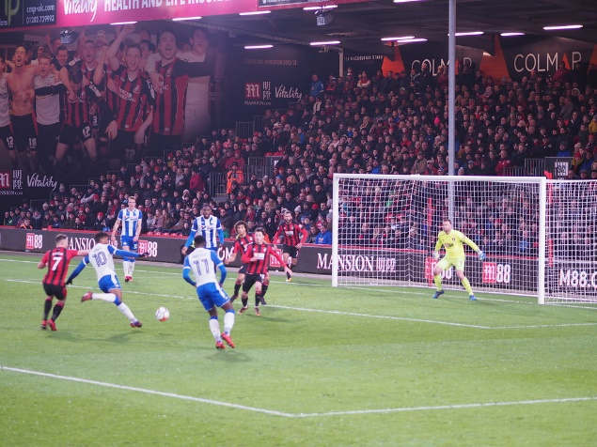

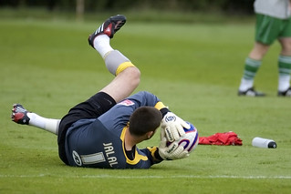


How AFC Bournemouth got to the Premier League
By
James Jalal

Slide 2

THE GREAT ESCAPE 2008-2009

Slide 3
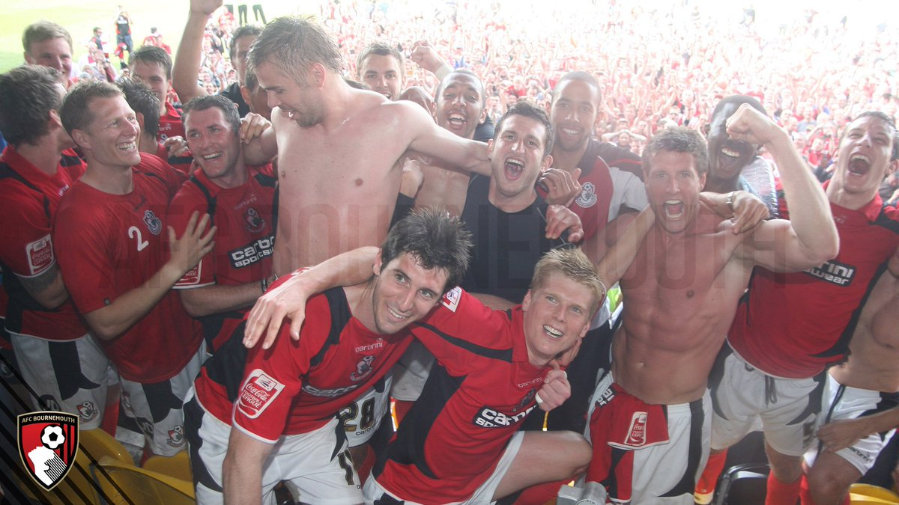

PROMOTION TO LEAGUE 1 2009-2010

Slide 4
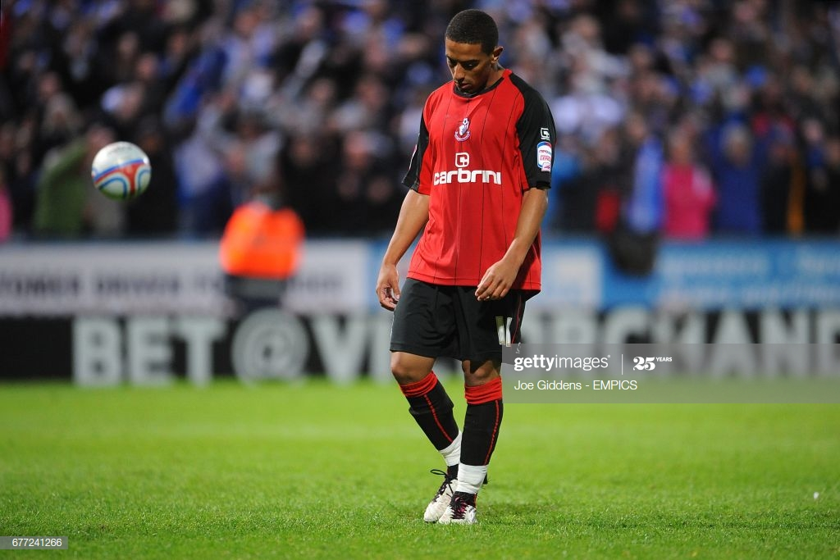
PLAYOFF DISAPPOINTMENT 2010-2011
https://www.youtube.com/watch?v=RdNmQG2yUh0

Slide 5


PROMOTION TO CHAMPIONSHIP 2012-2013

Slide 6
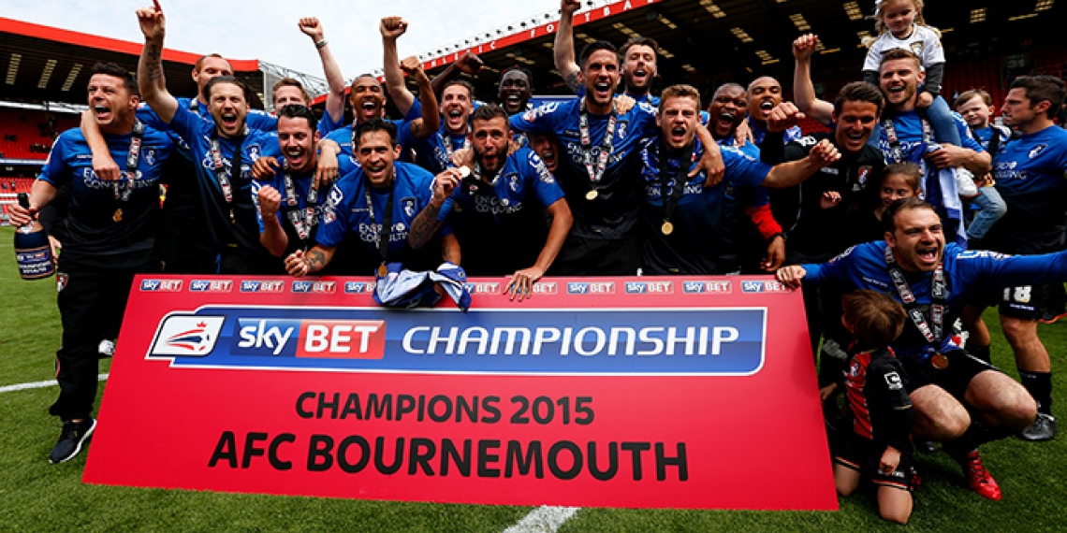
PROMOTION TO THE PREMIER LEAGUE

Slide 7



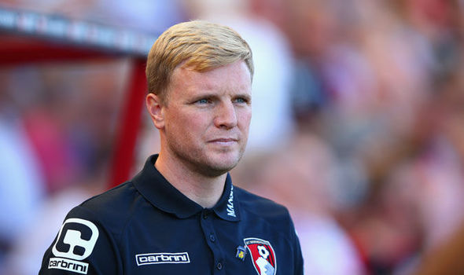
I HOPE YOU ENJOYED MY POWERPOINT

