Slide 1
Meet the Teacher
Miss Smith and Mrs Yates
Maple Class

Slide 2
Staff
Teachers:
Miss Smith – Monday to Wednesday
Mrs Yates – Thursday and Friday
csmith@stannesfulshaw.net
myates@stannesfulshaw.net
TA support:
Mrs Bradley, Miss Cibuls, Mrs Freeman, Mr Dipnall, Miss Lee.

Slide 3
Reminders
Book bag keychains - please just one.
Healthy snack
Water bottle every day
PE kit will be sent home at the end of every half term (unless wet or dirty)

Slide 4
Class Reward Systems
Minions – stars
Team points

Slide 5
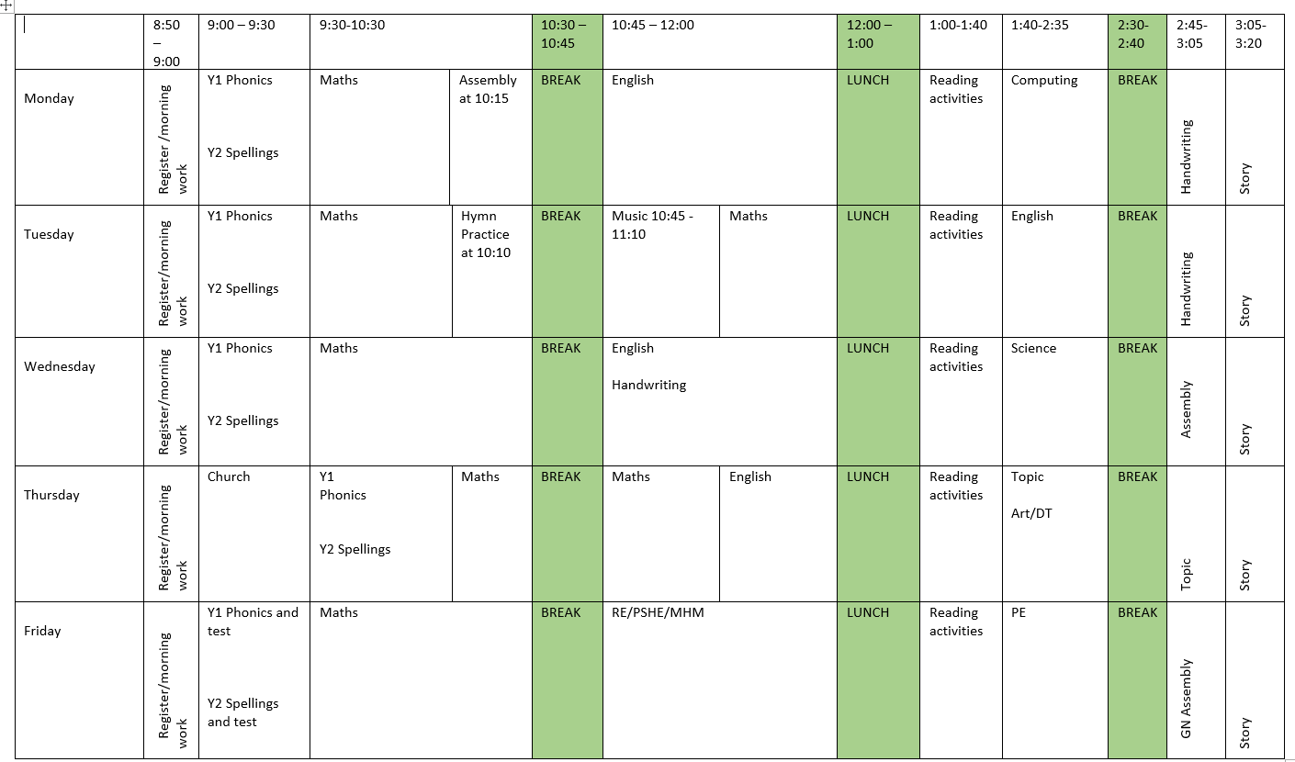
A typical day
We have both Year 1 and Year 2 children in here and we run the classroom as continuous provision. Sometimes your child will be listening to inputs, completing a focus activity with an adult or ‘learning around the room’.

Slide 6
Our curriculum - Topics covered this term (check class page for updates)
Maths White Rose, Concrete and Pictorial
English 2 pieces of writing each half term, fiction and non-fiction based on one quality text.
Reading and phonics, Little Wandle (see phonic overview) https://www.littlewandlelettersandsounds.org.uk/resources/for-parents/#tabnametabSupportForPhonics

Slide 7
Homework
- Maths journal which aligns to the weekly learning that we do in school. It is around 3 pages each week to complete.
- Spellings, written,oral, spelling shed.
- Reading - LW in folder, shared book in reading diary.
Additional - links on class page
Handed out on a Thursday – due back in the following Wednesday.

Slide 8
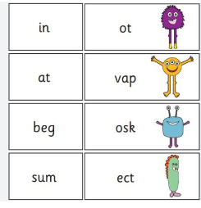
Phonics Screening
All children in Year 1 will take part in the PSC in June 2027. Some children in Year 2 may complete this if they did not pass last year.
It is 40 words (20 real and 20 alien) completed with an adult one to one to check progress in phonics.

Slide 9
How to help at home
Reading - 15 minutes everyday. Please record reading in diaries. A mixture of independent and shared. Lots of familiar stories to build up fluency and expression.
Spelling - help to learn the spelling patterns and strings. Spelling Shed.
Maths - rapid recall of number facts, bonds to 10/20/100. Times tables. https://whiteroseeducation.com/parent-pupil-resources/maths/maths-with-michael Parent guides

Slide 10
Any questions?

