Slide 1


United Curriculum
Primary Art & Design

Slide 2
United Curriculum Principles: Art & Design
The United Curriculum for Art provides all children, regardless of their background, with:
Entitlement
  Regardless of their starting point, the curriculum allows pupils to produce creative work, to explore ideas and develop the confidence to excel in a broad range of artistic techniques. All pupils will learn about artists and cultures from across history and across the world.
Coherence
  Taking the National Curriculum as its starting point, the curriculum is sequenced from Early Years to Key Stage 3 and beyond so that pupils gradually develop and build their practical knowledge, including the formal elements, the use of a range of materials in two and three dimensions, and the techniques required to produce artwork. Theoretical and disciplinary knowledge is sequenced so that pupils build a deeper understanding across key stages.
Mastery
  All pupils will be explicitly taught about the formal elements – colour, form, line, pattern, shape, texture and tone – and other aspects of art knowledge in small steps. Pupils will revisit, develop and apply their skills with increasing technical proficiency.
Adaptability
  Our art curriculum is designed to give teachers flexibility, allowing them to select and adapt resources for their specific context. Schools are encouraged to bring it to life for their pupils by supplementing it with artists from their local area. In Key Stage 3, schools should select outcomes, materials and skills focus for units based on local context and teacher expertise.
Representation
  The Art curriculum provides children with the opportunity to explore historical and contemporary artists and artworks, who represent their own and others’ cultures, values and beliefs. We will explore the context in which the art was produced, and consider the full breadth of human experience and expression through art.
Education with Character
  We aim to build and maintain pupils’ confidence in their ability as artists to create. The curriculum will develop aspects of character such as resilience, confidence and risk taking. Through the curriculum, pupils are given opportunities to share, reflect and learn about each other’s experiences whilst recognising the things we have in common.

Slide 3
United Curriculum: Art & Design
Science Detectives
Pattern & Pumpkins
Where We live
Year
1
Year
4
Watercolour Tropical Rainforest
Spring in
Our Step
I am an Artist
Mythology
Drawing My Favourite Things
N 3/4
My Heroes
Paper Sculpture
Clay Fairy Tales
Year 5
Key Stage 3
Marvellous Me /
Look at Me
Me & My World
The Natural World
Why Do We Make Art?
Illustrations & Narrative Art
Art & Identity
It’s Getting Cold / Bears
R
Year 2
Year 3
Journeys
Displacement / Challenges
Polar Express / Special Days
All Creatures Great & Small
1/2
Our School
Painting Water
Pattern & Sculpture
Recycled Materials Installation
Once Upon a Time
1/2
Year
6
Colour
& Tone

Slide 4
United Curriculum: Art & Design
 | Year 1-2 | Year 2 | Year 3-4 | Year 4 | Year 5-6 | Year 6
 | Cycle A | Cycle B | Cycle A | Cycle B | Cycle A | Cycle B
Autumn | I Am An Artist Introducing sketchbooks, experimenting with mark-making and learning about primary colours. Paul Klee Piet Mondrian Wassily Kandinsky | Our School Looking at architecture and urban landscapes through photography and recording surface textures. Producing a collaborative outcome with printmaking. Zaha Hadid The Boyle Family | Why Do We Make Art? Exploring the purpose of art through the study of cave paintings from Lascaux. Using continuous line and considering the use of perspective. Satoshi Kitamura Pablo Picasso | Pattern & Pumpkins Making 3D pumpkins from clay. Exploring texture and pattern by printmaking using bubble wrap. Yayoi Kusama | Illustration & Narrative Art Developing a visual response to a text, creating digital art. Marjane Satrapi, Mel Tregonning | Recycled Materials Installation Using plastic waste to create an installation. Ifeoma Anyaeji Serge Attukwei Clottey Veronika Richterová Katharine Harvey
Spring | Paper Sculpture Further exploration of mark making. Creating a sculpture by folding and twisting paper and gluing onto a base. Photography of shadow and light. Charles McGee | Colour and Tone Looking at tints, tones and shades in The King Who Banned the Dark and Picasso’s paintings from his Blue Period. Emily Haworth-Booth Pablo Picasso | Clay Fairy Tales Using clay to produce a collaborative visual representation of a fairy tale crime. Anthony Browne Quentin Blake | Watercolour Tropical Rainforest Exploring use of watercolours to create a collaged response to the work of artists studied. Abel Rodriguez Henri Rousseau Henri Matisse | Journeys Looking at Shackleton’s Journey and how artists have portrayed journeys. Collage, printmaking and mixed-media outcomes. Richard Long, Frida Kahlo, Lubaina Himid | Displacement / Challenges Looking at the work of artists who have been refugees or have produced art in different circumstances. Pissarro, Wiltshire, Schwitters, Kerr
Summer | The Natural World Drawing from observation, printmaking using leaves and introducing secondary colours. Leonardo Da Vinci Frances Hatch | Painting Water Using wax resist and watercolour to create water textures. Exploring collage to create an outcome using suspended fish paintings. Katsushika Hokusai David Hockney Claude Monet | Mythology Representations of myths by artists from different eras. Introduction of key terms: traditional, modern, contemporary. Claude Monet David Hockney Edward Burne-Jones | My Favourite Things Looking at objects from the British Museum using This or That by Goodhart. Drawing a still life based on personal possessions. Pippa Goodhart Joseph Cornell | Pattern & Sculpture Using origami to create bird sculptures out of printed designs exploring pattern and the natural world. Mark Hearld Jackie Morris | Art & Identity Considering the impact of the British Empire on art and how our art can reflect our identity. Drawing the face and creating a shared exhibition. Yinka Shonibare Sonia Boyce

Slide 5
Art & Design in Our Local Context
Art is taught in 6-lesson units, once a term (Art alternates with D&T).
The United Curriculum is sequenced so that meaningful links are made between subjects, and the order of units allows these connections to be made. For example, in Year 3 Spring pupils have the opportunity to create individual clay tiles which form part of collaborative storyboard illustrating a fairy tale. This unit links explicitly with the English curriculum unit Fairy Tale Crimes, in which pupils consider alternative readings of fairy tale characters and their intentions.
The United Curriculum for Art & Design has been adapted for Royles Brook by considering the context of our pupils and the community.
For example:
Pupils learn about local artists and their work, both past and present e.g Lubaina Himid who is from Preston
In Y1 Summer, pupils have the opportunity to explore the natural environment around their school building, including our many different trees, and record their findings using art techniques.
In Y2 Autumn, pupils explore their school environment and consider the work of designers and architects in relation to their own built environment.
In Y4 Summer and Y6 Summer, pupils are encouraged to explore and celebrate their identity through artwork.
In Y5 Spring, pupils have the opportunity to record a journey they have made, during which they explore the local area through the study of maps.

Slide 6
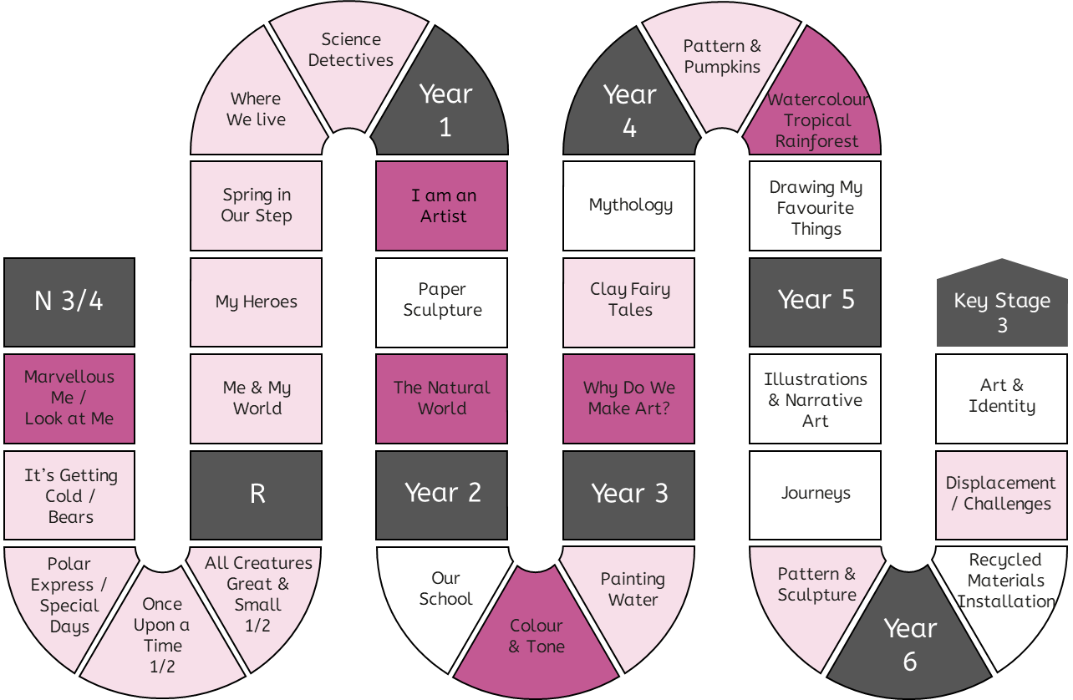
Progression in Practical Knowledge
Formal Elements
Primary colours are red, blue and yellow. They cannot be mixed from other colours.
Secondary colours are green, orange and purple. They are mixed from primary colours.
The appearance of secondary colours can vary according to the amount of each primary colour used to mix it.
Colour
Earthy colours are reds, browns, oranges (colours of earth).
Tone
Line
Tertiary colours are red-orange, yellow-orange, yellow-green, blue-green, blue-purple, red-purple. They are mixed from one primary and one secondary colour.
Form
Use colours that are representative of real objects and how I feel.
Space
Shape
Pattern
Texture
Control of Materials
Prior knowledge of colour is explicitly reviewed in units across EYFS-KS2.
Mark Making
Painting
Drawing
Printing
Sculpture
Digital
Artists can change the way a colour looks by making tints (adding white), tones (adding grey) and shades (adding black).
Warm colours are red, orange and yellow. Cool colours are blue, purple and green.
Colours can be used to represent emotions. For example, red can represent anger and blue can represent sadness.
Mixed Media

Slide 7
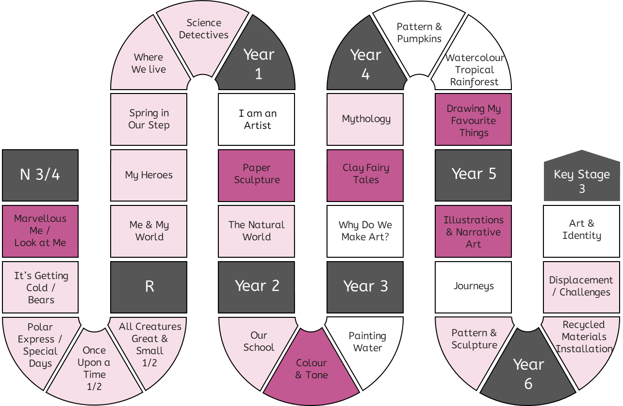
Progression in Practical Knowledge
Tone is about light and dark in an artwork. A strong tone means there is a big difference (contrast) between the light and the dark areas.
Doing the same thing with different materials - like pencil, fineliner, biro, felt tip - can create a different tone.
Shadows are an area of darkness that can be created by a sculpture or other 3D object.
Formal Elements
Colour
Tone
Tone can be created using the same pencil by pressing harder or lighter.
Line
Explore mark making with different materials and using different pressure to create lighter and darker marks.
Form
Tone can be created using different grades of pencil.
Space
Shape
Pattern
Texture
Control of Materials
Mark Making
Prior knowledge of tone is explicitly reviewed in units across EYFS-KS2.
Painting
Drawing
Printing
Sculpture
Tone can be created using white pens and pencils, which highlight areas of the artwork.
Linear shading is a method of creating tone, often with a pen.
Examples of linear shading include hatching, cross hatching and contoured hatching.
Digital
Manipulate shadows using torches to create a different tone.
Mixed Media

Slide 8
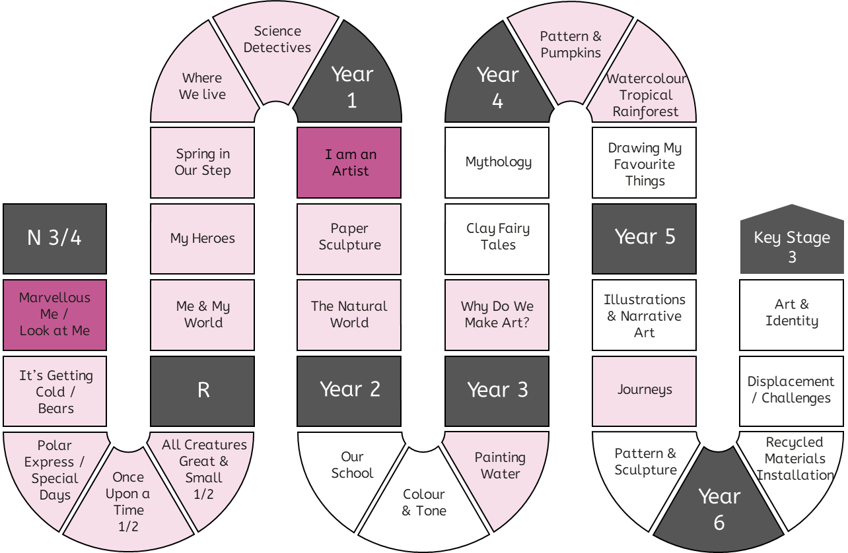
Progression in Practical Knowledge
A line is a mark made on a surface that joins different points.
Lines can vary in length, width, direction and shape.
A continuous line drawing is one where the pencil does not leave the page.
Doing the same thing with different materials - like pencil, crayon, pens, charcoal - can create different lines.
Formal Elements
Colour
Tone
Line
Prior knowledge of line is explicitly reviewed in units across EYFS-KS2.
Form
Make marks including lines and closed shapes.
Space
Shape
Pattern
Texture
Control of Materials
Mark Making
Painting
Drawing
Printing
Sculpture
Digital
Mixed Media

Slide 9
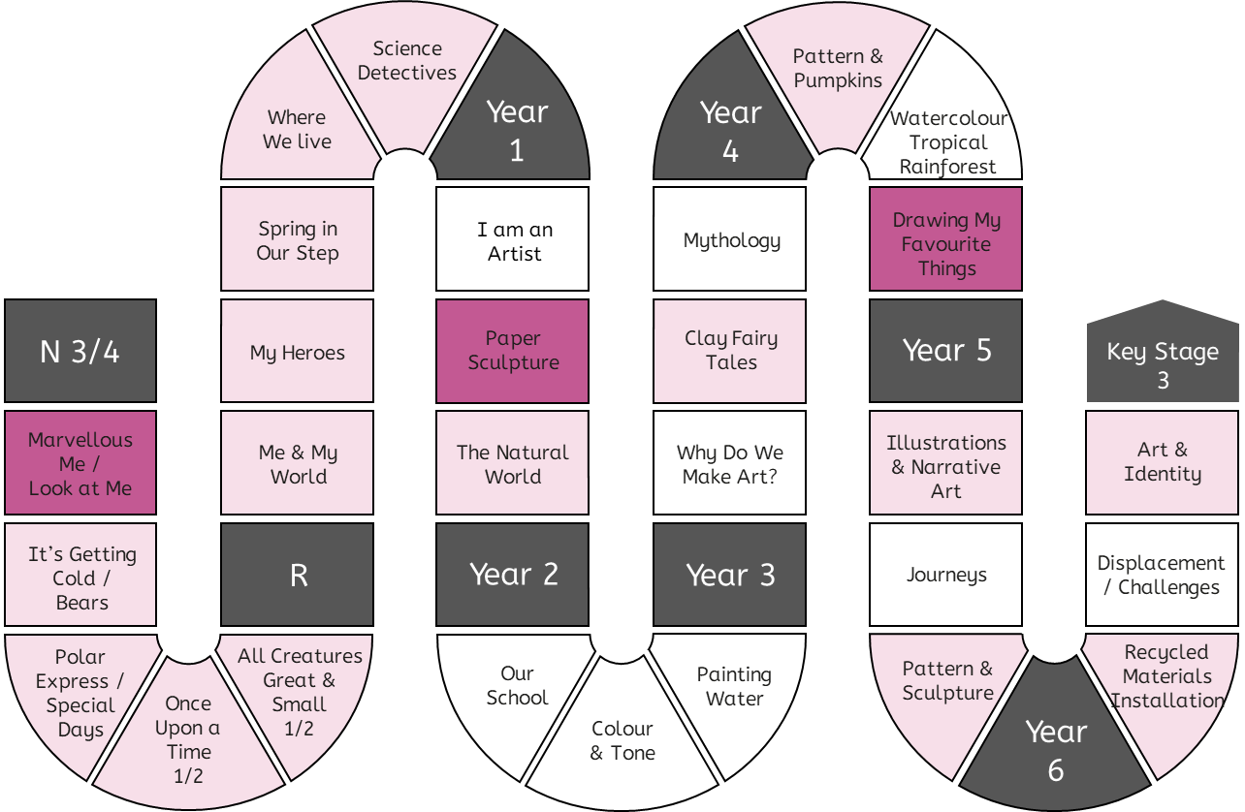
Progression in Practical Knowledge
A form is something that you can view from all sides [it is 3D].
A form can be created as a sculpture.
Formal Elements
Colour
Tone
Line
A form can be represented using tone in a 2D artwork.
Form
Space
Make 3D sculptures in junk modelling.
Shape
Pattern
Texture
Control of Materials
Mark Making
Painting
Drawing
Printing
Sculpture
Digital
Prior knowledge of form is explicitly reviewed in units across EYFS-KS2.
Mixed Media

Slide 10
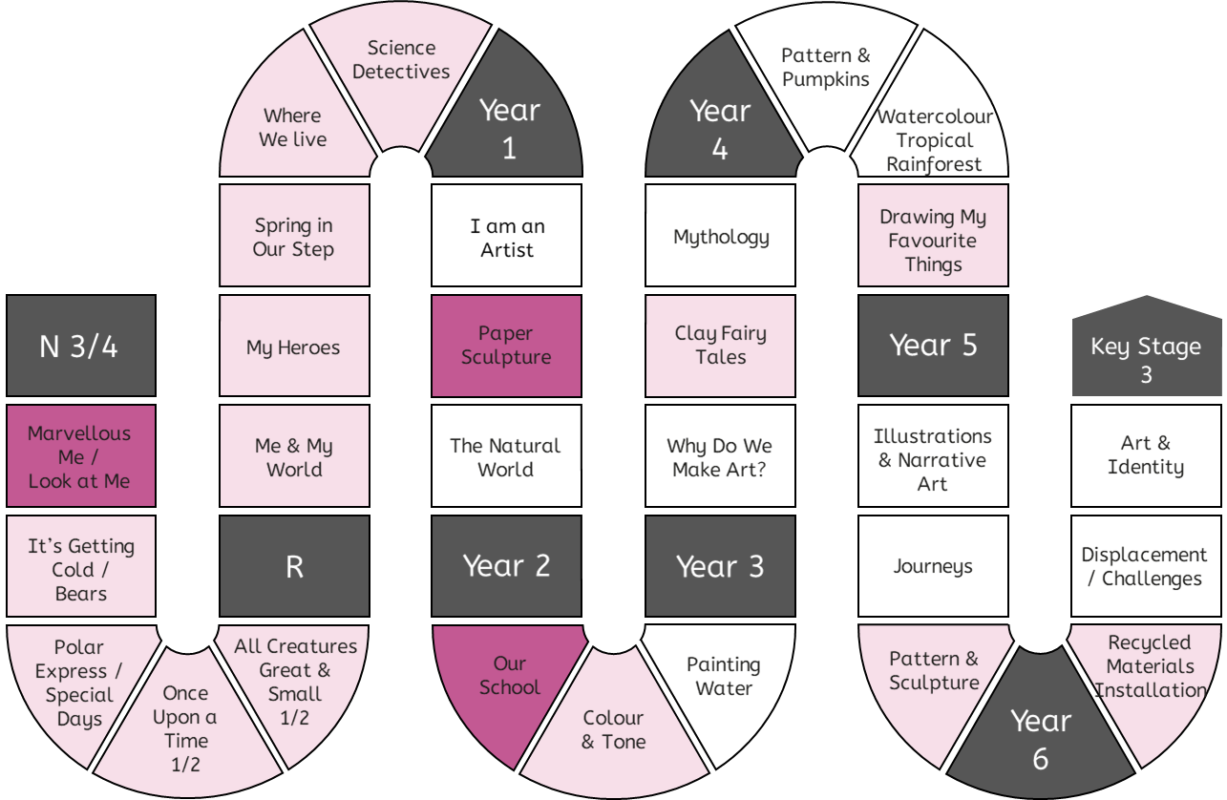
Progression in Practical Knowledge
Formal Elements
Space is an area around an object. Space is created when you make a 3D sculpture (e.g. the gap between two parts of the sculpture).
Colour
Tone
Line
Form
Space
Implicitly create space when junk modelling.
Shape
Pattern
Texture
Control of Materials
Mark Making
Painting
Drawing
Printing
Sculpture
Digital
Space can be found around existing objects and used to create art.
Prior knowledge of space is explicitly reviewed in units across EYFS-KS2.
Mixed Media

Slide 11
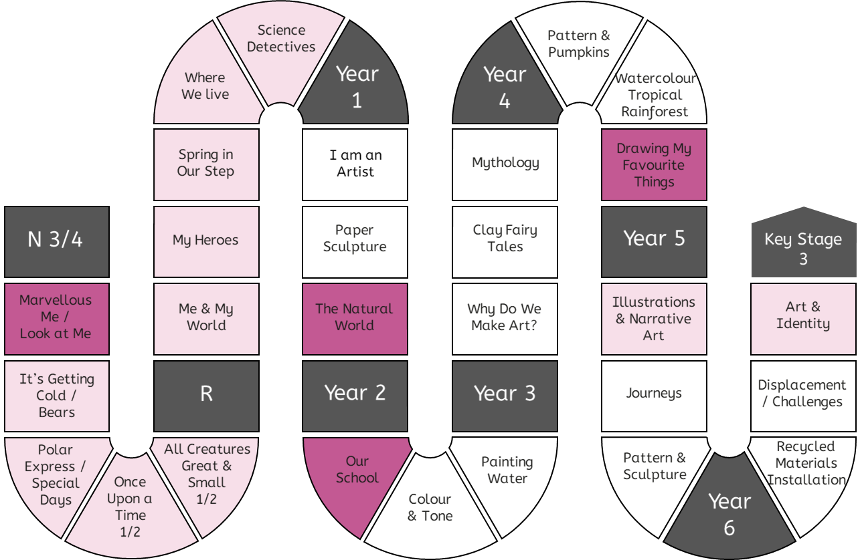
Progression in Practical Knowledge
Formal Elements
Drawing can be about representing flat [2D] objects using [2D] shapes on paper.
Colour
Tone
Drawing can be about representing 3D forms with 2D shapes on paper (a 2D surface).
Line
Form
Select items in junk modelling based on their shape.
Space
Shape
Pattern
Texture
Control of Materials
Mark Making
Painting
Drawing
Printing
Sculpture
Digital
Shapes can be found in existing objects and used to create art.
Prior knowledge of shape is explicitly reviewed in units across EYFS-KS2.
Mixed Media

Slide 12
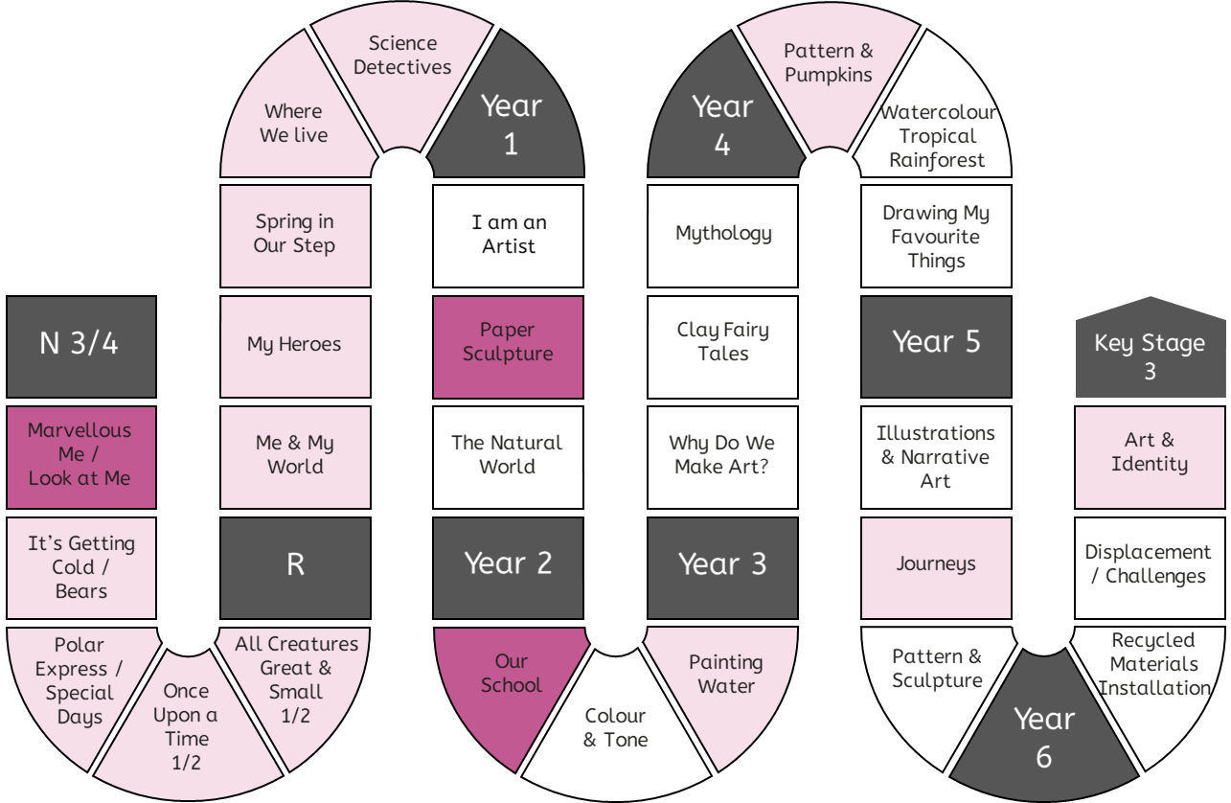
Progression in Practical Knowledge
Formal Elements
Patterns can be created with a series of repeated marks like dots and lines.
Colour
Tone
Line
Prior knowledge of pattern is explicitly reviewed in units across EYFS-KS2.
Form
Space
Create patterns when making marks. Describe patterns.
Shape
Pattern
Texture
Control of Materials
Mark Making
Painting
Drawing
Printing
Sculpture
Identify patterns in the world around us.
Digital
Mixed Media

Slide 13
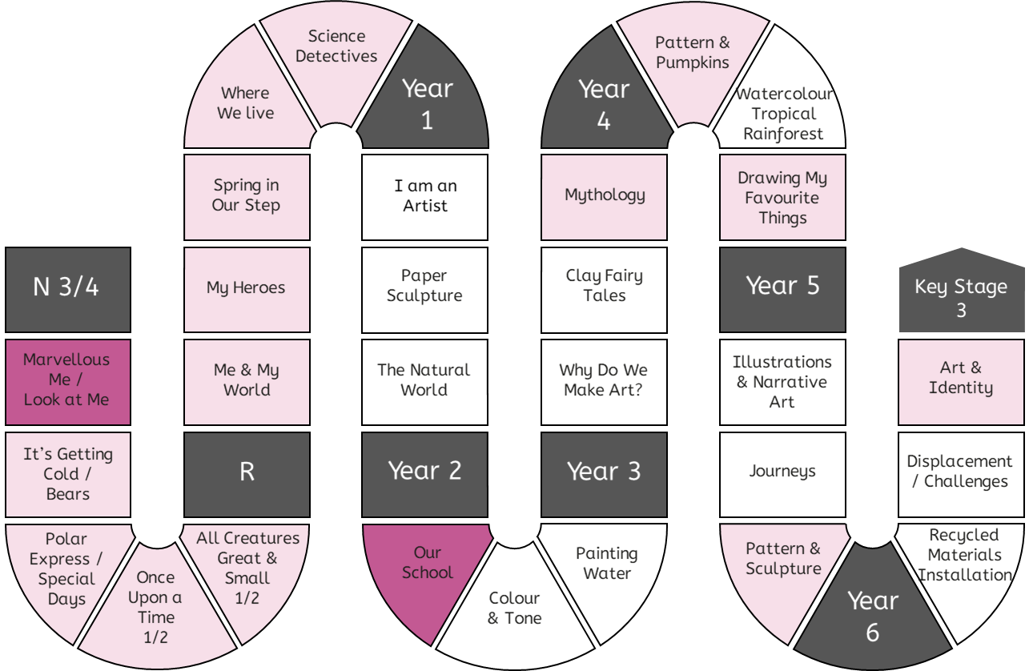
Progression in Practical Knowledge
Formal Elements
Colour
Tone
Line
Prior knowledge of texture is explicitly reviewed in units across EYFS-KS2.
Form
Describe how materials feel using words like rough and smooth.
Space
Shape
Pattern
Texture
Control of Materials
Mark Making
Painting
Drawing
Printing
Sculpture
Digital
Texture is how something feels. Artists can make art that tells us how something might feel, without us having to touch it.
Mixed Media

Slide 14
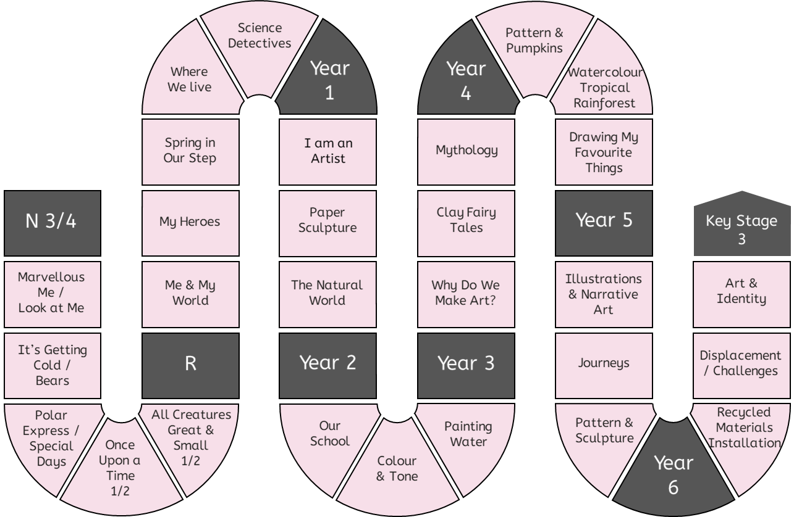
Progression in Practical Knowledge
Formal Elements
Focus on pencils and paintbrushes.
Focus on wax crayons.
Focus on pens and pencils.
Colour
Tone
Line
Use mark-making tools with a palmer grasp or digital pronate grasp.
Use mark-making tools with a static tripod grip.
Form
Space
Focus on pens.
Shape
Pattern
Texture
Control of Materials
Mark Making
Painting
Drawing
Printing
Sculpture
Digital
Use mark-making tools with a dynamic tripod grip.
Focus on using crayons on their side to create rubbings.
Focus on chalk pastels.
Mark making tools are used in every unit. Examples have been included to show the range of mark-making tools that are used EYFS-KS2.
Mixed Media

Slide 15
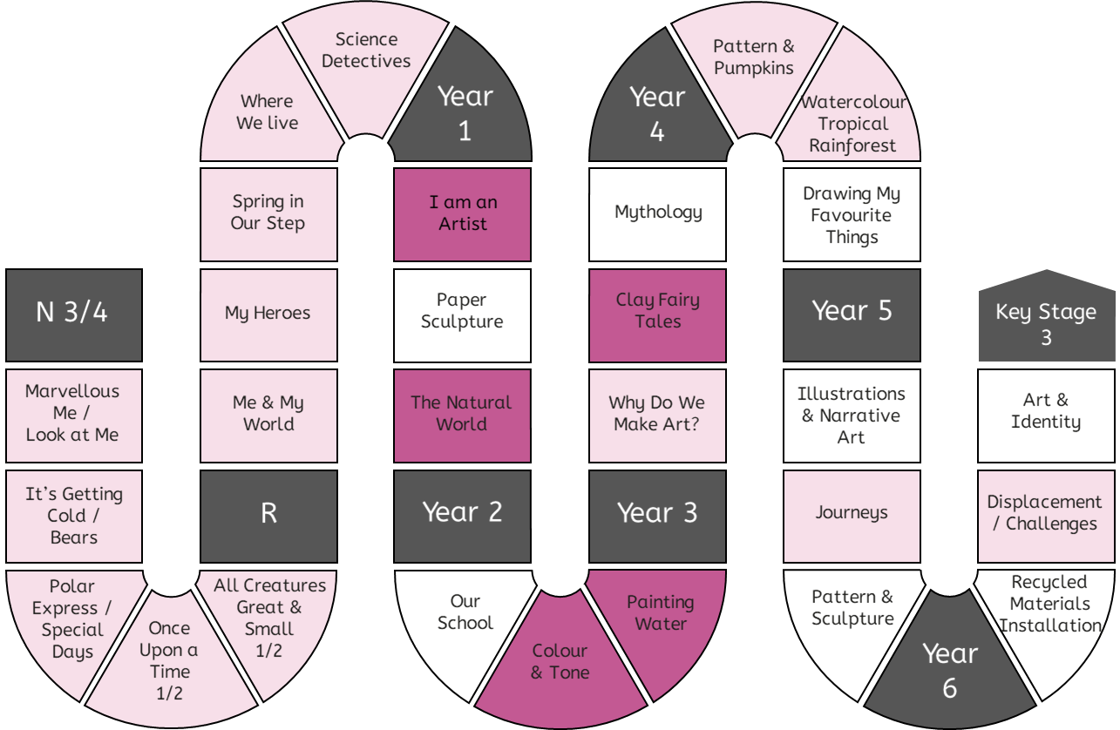
Progression in Practical Knowledge
Formal Elements
Use poster paints.
Use wax resist technique with watercolour paints.
Mix colours using watercolour paints on the page (not in a palette).
Use a flat wash brushstroke with watercolour paint.
Colour
Tone
Prior knowledge of painting is explicitly reviewed in units across EYFS-KS2.
Line
Explore mark making with paints with increasing confidence and skill.
Form
Mix colours using acrylics paints in a palette.
Space
Shape
Pattern
Texture
Control of Materials
Mark Making
Painting
Drawing
Printing
Sculpture
Mix colours using poster paints in a palette.
Use stippling, tapered and dry brushstrokes with watercolour paint.
Use wet on wet and 'less to more see through' [opaque to translucent] techniques.
Use different amounts of water to create stronger [more opaque] and weaker [more translucent] colours.
Different paintbrushes are suited to different brush strokes and techniques.
Digital
Mixed Media

Slide 16
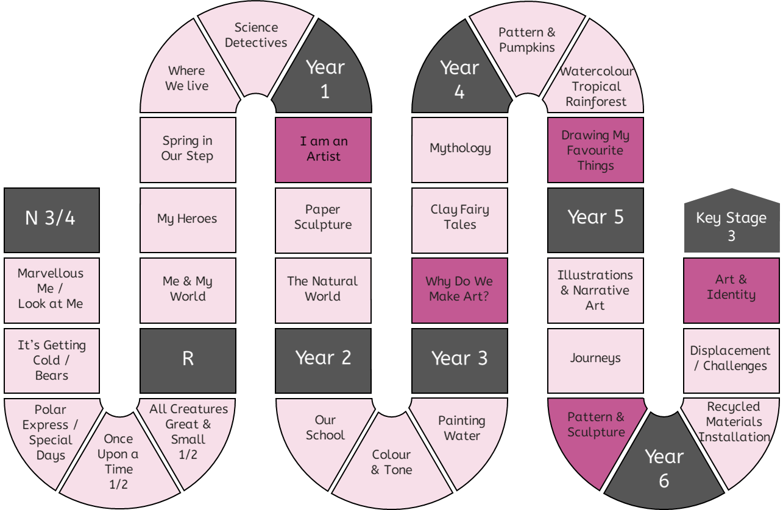
Progression in Practical Knowledge
Formal Elements
Making simple line drawings, including continuous line drawings.
Drawing is a key skill in Art & Design and reviewed in some way in every unit.
Colour
Tone
Line
Form
Make a tonal drawing using pencil.
Space
Make marks to draw familiar things.
Shape
Pattern
Texture
Control of Materials
Draw the human face and its features in proportion using pencil.
Mark Making
Painting
Drawing
Printing
Sculpture
When drawing from observation artists must look often and very carefully and at the object they're drawing from.
When drawing from primary observation, artists look at the object they're drawing from. When drawing from secondary observation, artists look at a drawing or a copy of object.
Digital
Mixed Media

Slide 17
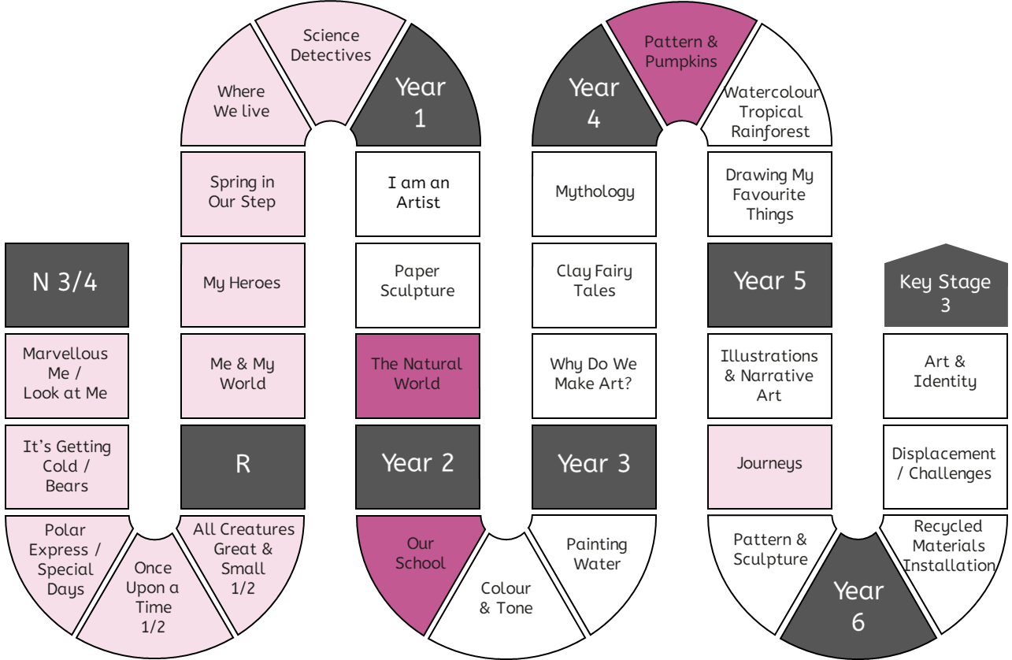
Progression in Practical Knowledge
Formal Elements
Press print onto paper or fabric using the natural colour of the leaves.
Collagraphic printmaking is a process in which materials are built up on a plate to be printed from.
Colour
Tone
Line
Form
Make simple prints using poster paints.
Space
Prior knowledge of printing is explicitly reviewed.
Shape
Pattern
Texture
Control of Materials
Mark Making
Painting
Drawing
Printing
Sculpture
Digital
Using crayons to transfer texture and pattern from existing surfaces.
Monoprint onto paper.
Create a plate to make a press print. Apply ink (or paint) with a roller. Press print onto paper or fabric using a plate.
Mixed Media

Slide 18
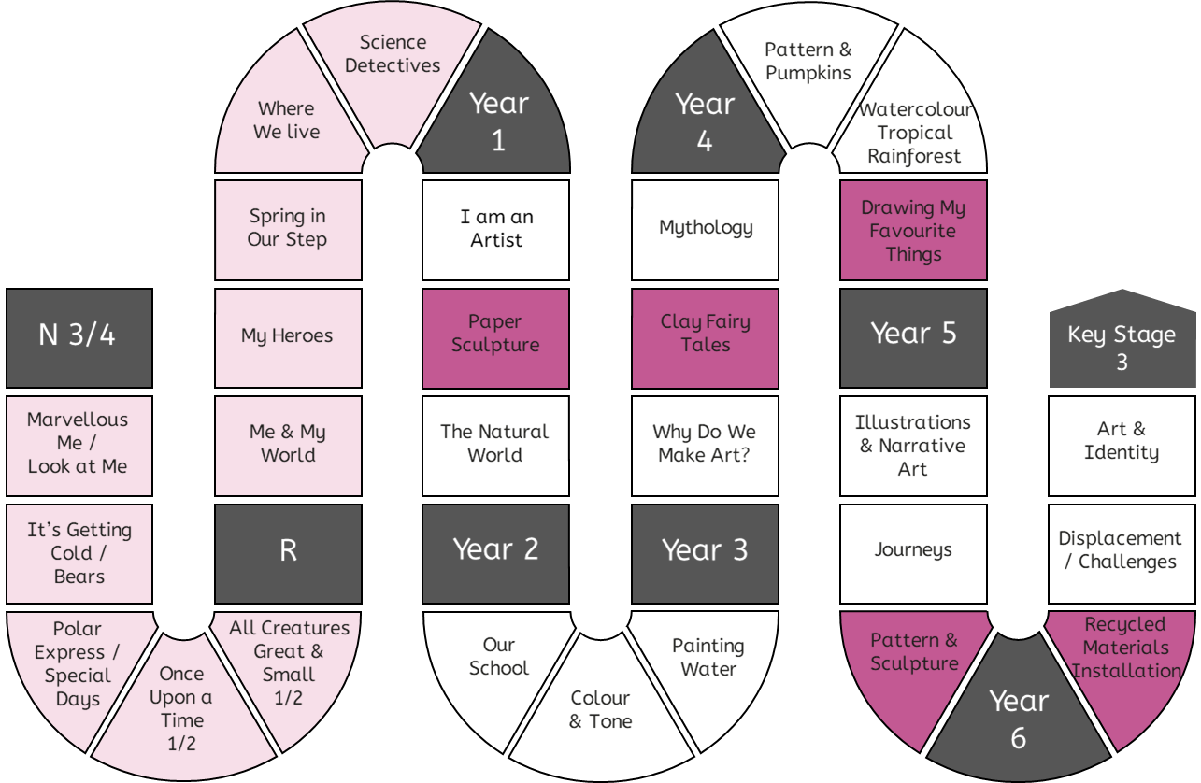
Progression in Practical Knowledge
Formal Elements
Create a paper sculpture by folding and twisting and gluing it together.
Arrange a 3D composition by considering size, shape, texture and space between objects.
Colour
Tone
Line
Form
Explore making sculptures using a range of materials and junk modelling.
Origami is a Japanese artform of creating 3D models by folding a piece of paper.
Space
Shape
Pattern
Texture
Control of Materials
Mark Making
Painting
Drawing
Printing
Cut, shape and manipulate existing objects to create a sculpture.
Sculpture
Make a tile using clay.
Make a raised relief by adding layers of clay.
Use slip (a mixture of clay and water) as a glue in ceramics.
Score surfaces before adding slip to help the pieces attach more reliably.
Digital
Mixed Media

Slide 19
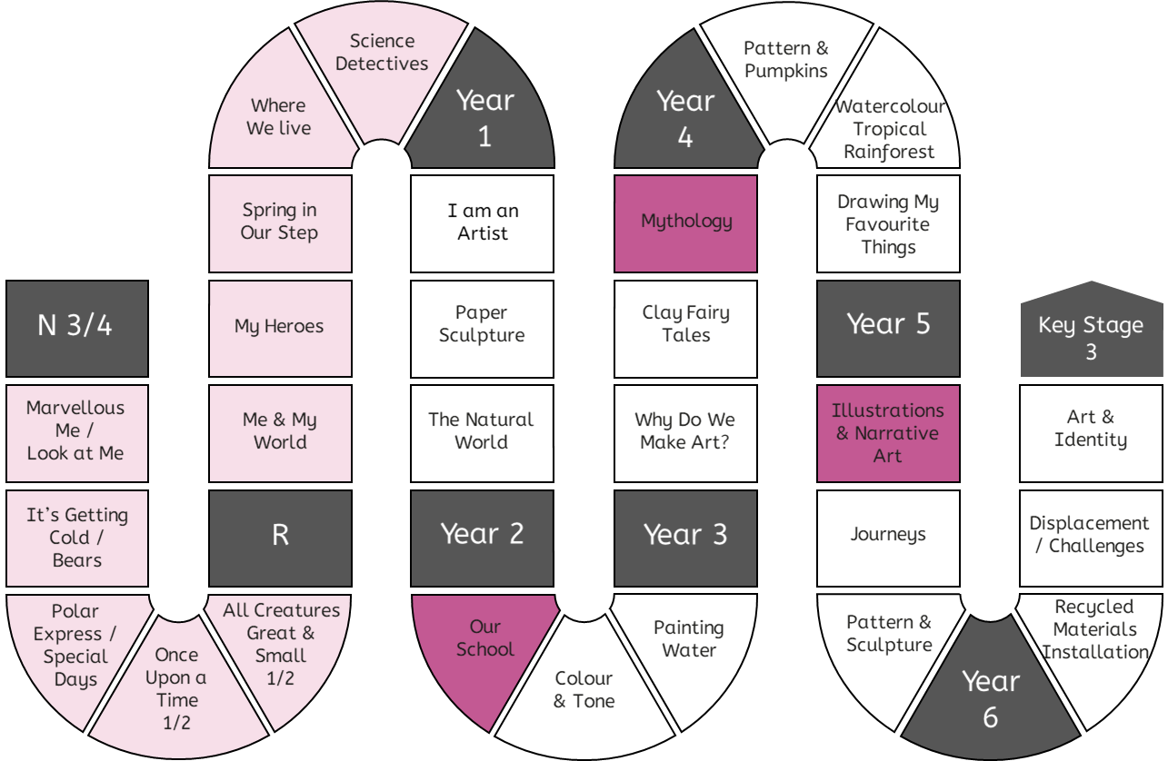
Progression in Practical Knowledge
Formal Elements
Take photographs of tableau vivant, which is made by standing still to represent the figures in a story.
Colour
Tone
Line
Form
Design figures and characters in software programmes (e.g. PowerPoint).
Space
Shape
Pattern
Texture
Control of Materials
Mark Making
Painting
Drawing
Printing
Sculpture
Digital
Take photographs of objects and surfaces using cameras or tablets.
Mixed Media

Slide 20
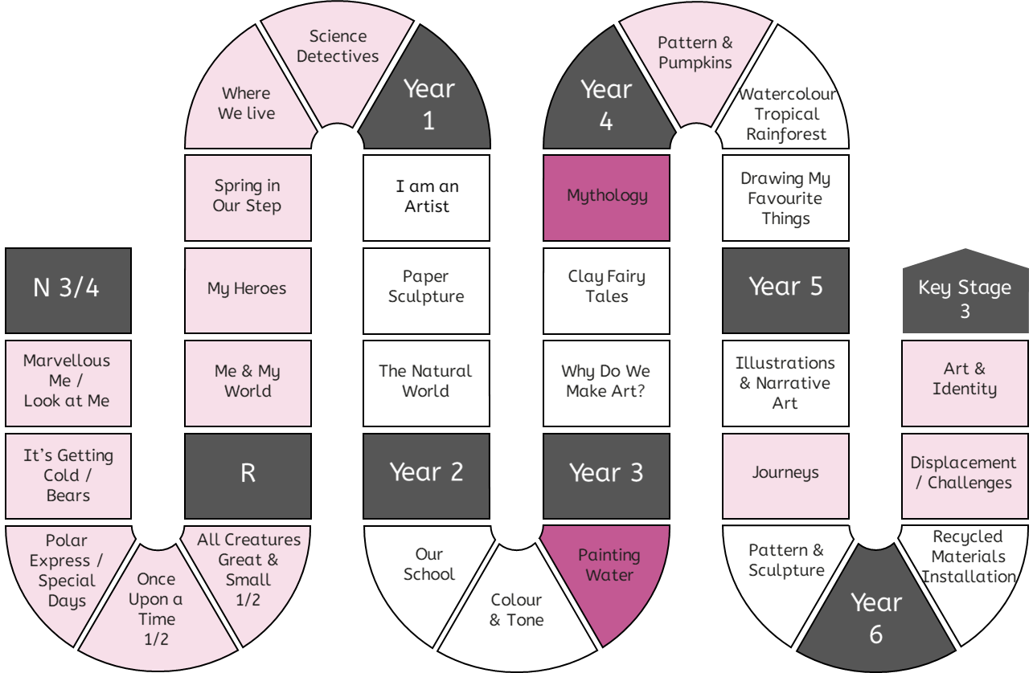
Progression in Practical Knowledge
Formal Elements
Create a montage.
Colour
Tone
Line
Prior knowledge of mixed media is explicitly reviewed in units across EYFS-KS2.
Form
Space
Shape
Pattern
Texture
Control of Materials
Mark Making
Painting
Drawing
Printing
Sculpture
Digital
Create a collage.
Mixed Media

Slide 21
Progression in Theoretical Knowledge
Different Artworks
EYFS | Illustrations are the pictures in a book that tell a story. Different artists make art in different ways.
Y1 | Abstract art is art that does not try to look like things in the real world. Instead, it is made up of shapes, colors, and lines that might not look like anything you recognize. Representational art tries to look like things in the real world, such as people, animals, or objects. When you look at representational art, you can usually tell what it is supposed to be. Art can be flat [2D] or something that you look around [3D]. A sculpture is an artwork can be viewed from all sides [it is 3D]. A sculptor is an artist who makes sculptures.
Y2 | Illustrations help to tell a story. Artists who make illustrations are called illustrators. A collage is an artwork made by sticking pieces of paper or other materials onto a background.
Y3 | Mixed-media is artwork that uses more than one art material e.g., paint and pens. Ceramics is the process of making art from clay. A montage is a mixed-media artwork including collaged photographs. Traditional art describes everything from early Christian art to the 1850s and is usually representational. Modern art describes art made from around the 1850s to the 1970s. Modern artists wanted their art to show how they felt. It was more abstract than representational. Contemporary art describes artwork being made by living artists, or art that has been made recently (e.g., 1980s onwards). Contemporary art can be anything and artists create work using traditional, modern and other techniques. Traditional, modern and contemporary art definitions can only be applied to western art. Artists can arrange objects or images in a composition. Traditional composition is often made up of foreground, midground and background. Perspective is the way a flat (2D) image looks deep (3D). Illustrations help to tell a story. Narrative art tells a story on its own.
Y4 | A viewfinder can be used to identify an interesting section within a composition. An assemblage is a 3D artwork usually made of found objects. A still life is a genre of artwork that shows a collection of objects.
Y5 | Artwork does not have to be abstract or representational. It is a spectrum. Some artworks are representational (so you can recognise the objects from the real world), but they don't look realistic. Expressive art conveys emotions and feelings. There are more examples of expressive art in modern and contemporary than traditional art. Expressive art can be representational or abstract.
Y6 | Installation art is designed to fill a specific space, often for a particular length of time. An exhibition is a display of artwork. It is curated by a curator.

Slide 22
Progression in Theoretical Knowledge
Traditional, Modern and Contemporary Artists
Klee
(1910-40s) – Y1
Mondrian
(1910-40s) – Y1
Kandinsky
(1910s-20s) – Y1
Hockney
(1960-2020s) – Y2
Auerbach
(1960-2020s) – Y3
Long
(1960-2020s) – Y5
Rousseau
(1750-1780s) – Y4
Hokusai*
(1820-30s) – Y2
Van Gogh
(1880-90s) – Y3
Matisse
(1940-50s) – Y4
Himid
(1980-2020s) – Y5
1490
1500
1520
1520
1750
1760
1770
1780
1790
1800
1810
1820
1830
1840
1850
1860
1870
1880
1890
1900
1910
1920
1930
1940
1950
1960
1970
1980
1990
2000
2010
2020
2030
Leonardo (1470s-1500s) – Y1
Raphael (1500s-1520) – Y3
Michelangelo (1500s-40s) – Y5
Monet
(1860-1900s) – Y1
McGee
(1950-2020s) – Y1
Kusuma
(1950-2020s) – Y1
Hadid
(1990-2010s) – Y2
Ofili
(1990-2020s) – Y3
Boyce
(1990-2020s) – Y6
Shonibare
(1990-2020s) – Y6
Picasso
(1900-50s) – Y2
Kahlo
(1930-40s) – Y5
*The art history terms traditional, modern and contemporary art can only be applied to western art.

Slide 23
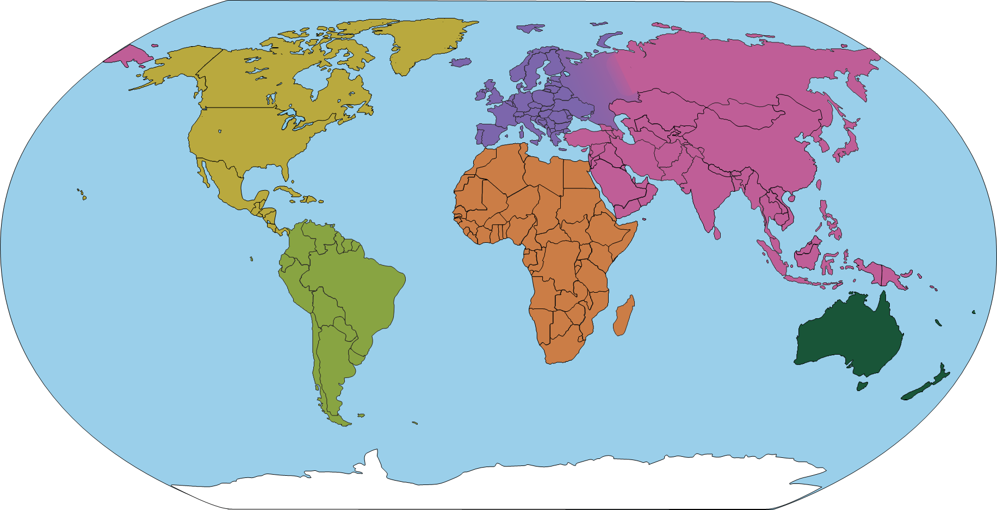
Progression in Theoretical Knowledge
Artists from around the world
UK
Hockney (Y2)
Ofili (Y3)
Long (Y5)
Himid (Y5)
Boyce (Y6)
France
Monet (Y1)
Rousseau (Y4)
Matisse (Y4)
Netherlands
Mondrian (Y1)
Van Gogh (Y3)
Italy
Raphael, Michelangelo, Leonardo (Y1, Y3)
Russia
Kandinsky (Y1)
Germany
Klee (Y1)
Auerbach (German-British) (Y3)
USA
McGee (Y1)
Spain
Picasso (Y2)
Japan
Hokusai (Y2)
Kusama (Y4)
Mexico
Kahlo (Y5)
Iraq
Hadid (British-Iraqi) (Y2)
Colombia
Rodriguez (Y4)
Nigeria
Shonibare (British-Nigerian) (Y6)

Slide 24
Progression in Disciplinary Knowledge
 | What do artists do? | What inspires artists? | Understanding Artworks
EYFS | Artists explore and play. | Artists can be inspired by the stories they read. | Make statements about my artwork.
Y1 | Artists experiment, explore and play. A sketchbook is a special book that artists use. | Artists can be inspired by the natural world. | Review the above. Discuss the work of artists, including our own.
Y2 | Review the above. Artists often create art for its own sake. Designers create things that are useful and have a purpose. Sometimes artists are designers who create art for a specific purpose. Architects are artists and designers who design buildings. Art can be made by individual artists, or by a group of artists who collaborate. | Review the above. Artists can be inspired by hidden details in seemingly ordinary objects. Artists can be inspired by the artificial (man-made) world. | Review the above. Label the features of different artworks with key words.
Y3 | Review the above. Creating art is something humans have done from the very beginnings of their existence. Artists make choices about materials that are appropriate for their composition. | Review the above. Artists can be inspired by each other, and we can make connections between our artworks and theirs. | Review the above. Annotate the features of different artworks and the effects they have on the viewer.
Y4 | Review the above. | Review the above. Artists can be inspired by their own experiences and stories. | Review the above. Annotate my artwork with connections to another artist's work.
Y5 | Review the above. Artists can make mood boards to help them collect and shape ideas. | Review the above. | Review the above. Compare the artwork of two artists. Curate an exhibition, deciding how the artwork will be displayed.
Y6 | Review the above. | Review the above. Artists can be inspired to bring difficult or contentious issues to light and provoke debate and discussion. | Review the above. Write as an art historian to analyse artists and their artworks.

Slide 25
Alignment to the National Curriculum
The below tables outlines where the statutory content from the National Curriculum is first taught across KS1 or KS2. The curriculum has been sequenced so that much of the content is reviewed in subsequent units.
In KS1, pupils should be taught:
To use a range of materials creatively to design and make products | Y1 Aut, Y1 Spr, Y1 Sum, Y2 Aut
To use drawing, painting and sculpture to develop and share their ideas, experiences and imagination | Y1 Aut, Y1 Spr, Y1 Sum, Y2 Sum
To develop a wide range of art and design techniques in using colour, pattern, texture, line, shape, form and space | Y1 Aut, Y1 Spr, Y2 Aut, Y2 Sum
About the work of a range of artists, craft makers and designers, describing the differences and similarities between different practices and disciplines, and making links to their own work. | Y1 Aut, Y1 Spr, Y1 Sum, Y2 Aut, Y2 Sum
In KS2, pupils should be taught:
To develop their techniques, including their control and their use of materials, with creativity, experimentation and an increasing awareness of different kinds of art, craft and design. | Y3 Aut, Y4 Aut, Y4 Sum
To create sketch books to record their observations and use them to review and revisit ideas | (Y1) Y3 Aut, Y4 Aut, Y4 Spr, Y4 Sum, Y5 Aut, Y6 Sum
To improve their mastery of art and design techniques, including drawing, painting and sculpture with a range of materials [for example, pencil, charcoal, paint, clay] | Y3 Aut, Y3 Spr, Y4 Aut, Y4 Spr, Y4 Sum
About great artists, architects and designers in history. | Y3 Aut, Y3 Sum, Y4 Aut, Y4 Spr, Y5 Aut

Slide 26
Implementation
The implementation of the United Curriculum for Art & Design reflects our broader teaching and learning principles:
For Art & Design in particular:
Content is always carefully situated within existing schemas. Every unit considers the prior knowledge that is prerequisite for that unit and builds on that knowledge to develop a deeper understanding of that concept. For example, pupils are not expected to be able to produce a representational drawing until after they have explored a range of drawing materials and have had the opportunity to experiment and create using a range of materials, techniques and processes.
Vertical concepts are used within lessons to connect aspects of learning. In Art and Design, this is most clearly evidenced in the progression of knowledge and skills linked through the formal elements (line, tone, space, shape, form, colour, pattern and texture). These building blocks of the subject offer opportunities for pupils to develop their knowledge and understanding as well as their practical skills.
Disciplinary knowledge is explicitly taught to pupils and carefully sequenced to ensure pupils are provided with opportunities to practice these skills throughout the curriculum. Pupils are encouraged to engage with big questions about the meaning and purpose of art, as well as exploring the concept of creativity in both a theoretical and very practical way. Our purpose is to allow our pupils to see themselves as artists by developing their innate creativity through building their confidence in knowledge, understanding and skill.

Slide 27
Impact
The careful sequencing of the curriculum – and how concepts are gradually built over time – is the progression model. If pupils are keeping up with the curriculum, they are making progress. Formative assessment is prioritised and is focused on whether pupils are keeping up with the curriculum.
In general, this is done through:
Use of sketchbooks and pupil-conferencing
Unless it is unavoidable, pupils use the same sketchbook over multiple years, until it is complete. Sketchbooks contain a record of pupils’ progress over a significant period of time. Talking to pupils about their sketchbooks allows us to assess how much of the curriculum content is secure. These conversations are used to determine whether pupils have a good understanding of the vertical concepts (practical knowledge), and if they can link recently taught content to learning from previous units.
Formative assessment in lessons
There are opportunities for formative assessment in the lessons, and teachers continually adapt their lesson delivery to address misconceptions and ensure that pupils are keeping up with the content.
Low-stakes summative assessment
We also use low-stakes quizzes at the end of the unit to assess whether pupils have learned the core knowledge for that unit. These are also used formatively, and teachers plan to fill gaps and address misconceptions before moving on.

